Slide 1
RNNs for Multivariate Time Series and Sentimentally Analysis
報告人：陳昭維、林禹陞
日期: 04/22/22

Slide 2
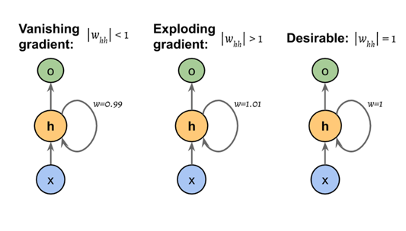
RNN difficulties in training

Slide 3
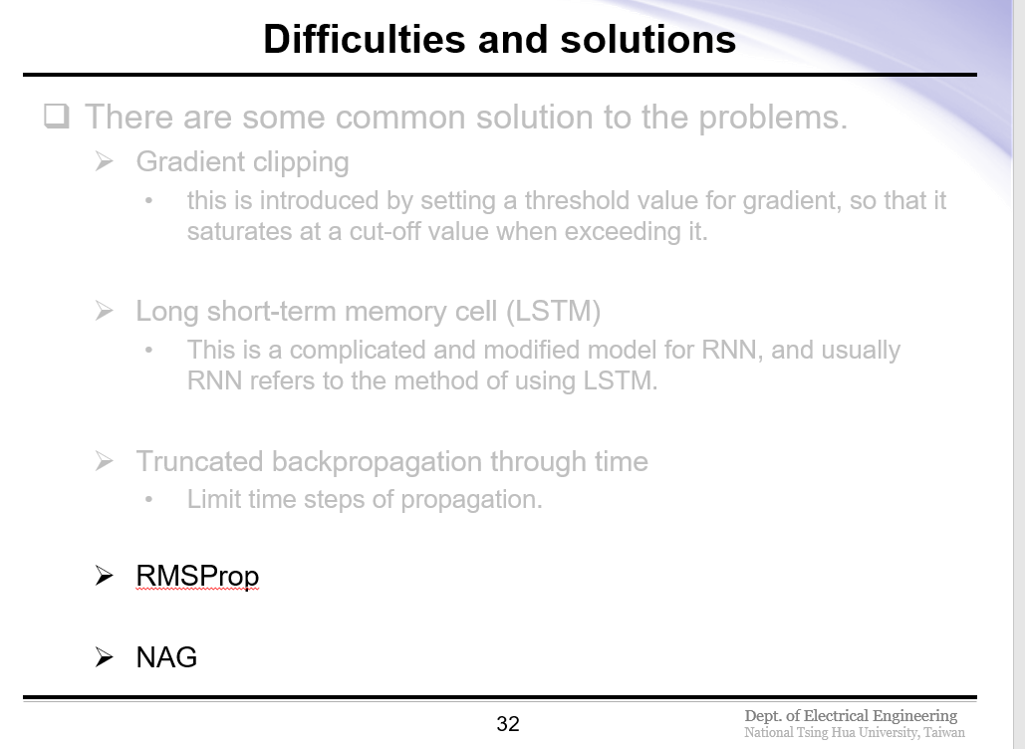

Slide 4
Outline
RMSProp
Momentum and Nag
Echo state networks

Slide 5
Outline
RMSProp
Momentum and Nag
Echo state networks

Slide 6
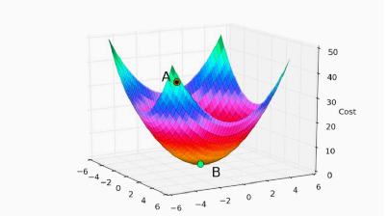
RMSProp
RMSProp(Root Mean Square propagation) is one of a optimizer to generate better result by updating the weights and bias.
The goal is to reach B from A iteratively until converge

Slide 7
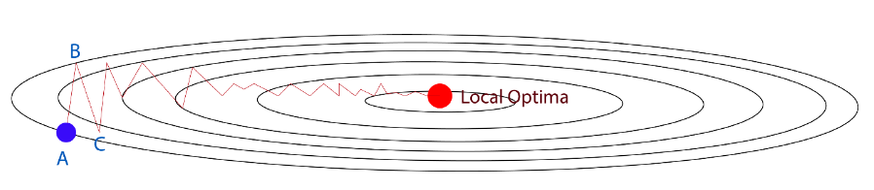
RMSProp
Consider the contour of gradient descent
The motions of moving extremely among from dimensions (A to B / B to C) slows down the Gradient Descent.
We want a slower leaning in vertical direction and faster learning in horizontal direction.

Slide 8
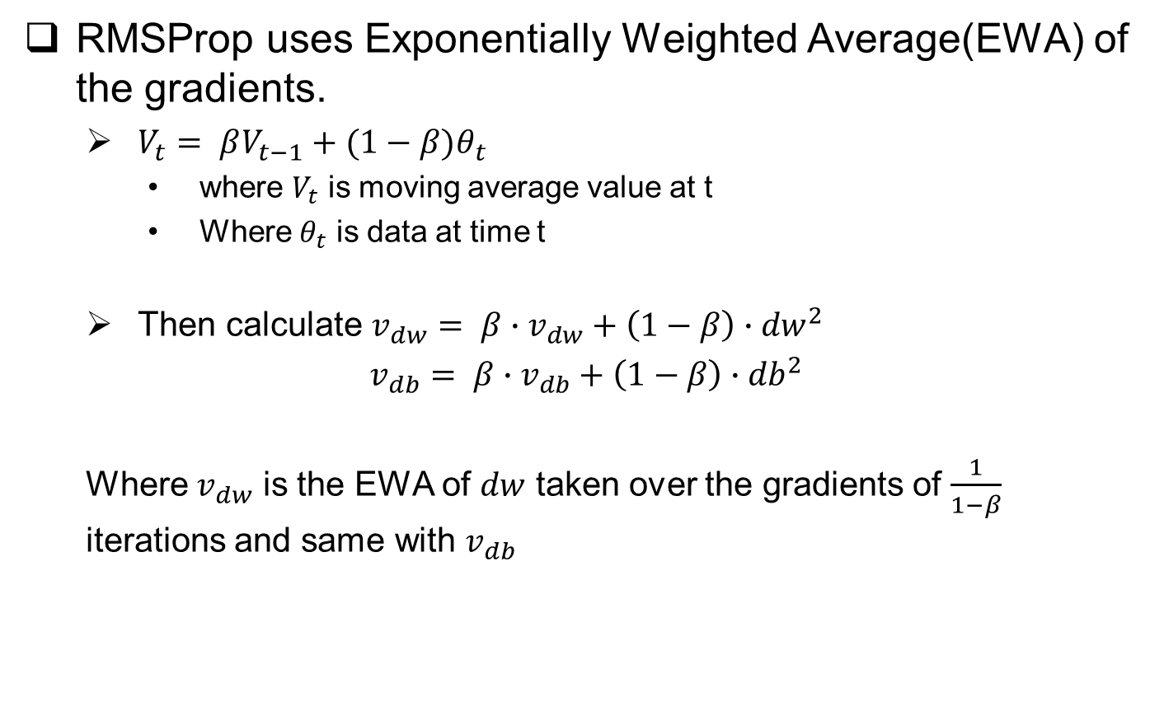
RMSProp
RMSProp uses Exponentially Weighted Average(EWA) of the gradients.
$V_{t}= βV_{t−1}+(1−β)θ_{t}$
where $V_{t}$ is moving average value at t
Where $θ_{t}$ is data at time t
Then calculate $v_{dw}= β∙v_{dw}+\left(1−β\right)∙{dw}^{2}$
$v_{db}= β∙v_{db}+\left(1−β\right)∙{db}^{2}$
Where $v_{dw}$ is the EWA of $dw$ taken over the gradients of $\frac{1}{1−β}$ iterations and same with $v_{db}$

Slide 9
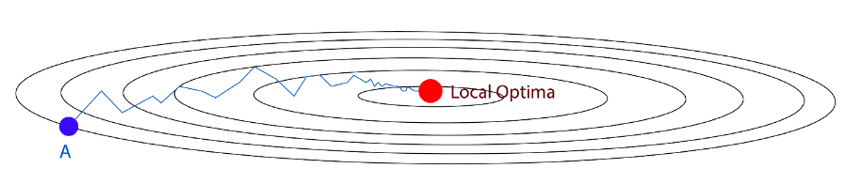

RMSProp
Then update weight and bias using the following:
$W=W − α∙\frac{dw}{\sqrt{v_{dw}}+ε}$
$b=b − α∙\frac{db}{\sqrt{v_{db}}+ε}$
Now the learning vertical direction has been slow down and learning of the horizontal direction has been boost throughout the averaging.

Slide 10
Outline
RMSProp
Momentum and Nag
Echo state networks

Slide 11
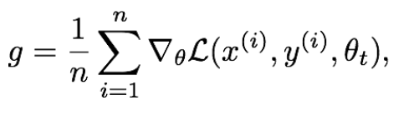
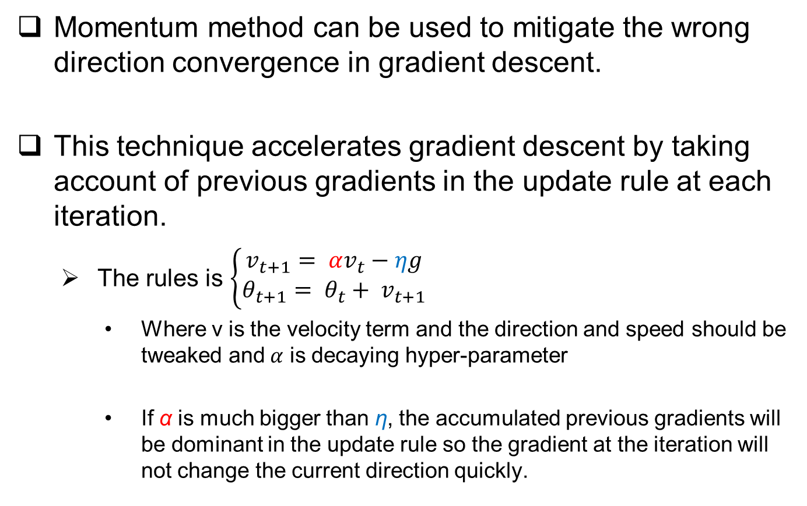
Momentum
Momentum method can be used to mitigate the wrong direction convergence in gradient descent.
This technique accelerates gradient descent by taking account of previous gradients in the update rule at each iteration.
The rules is $\left\{\begin{aligned}v_{t+1}= αv_{t}−ηg \\ θ_{t+1}= θ_{t}+ v_{t+1}\end{aligned}\right.$
Where v is the velocity term and the direction and speed should be tweaked and$α$ is decaying hyper-parameter
If α is much bigger than η, the accumulated previous gradients will be dominant in the update rule so the gradient at the iteration will not change the current direction quickly.

Slide 12
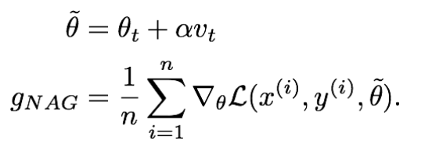
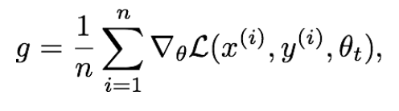
Nesterov Accelerated Gradient
NAG uses similar approaches with some addition step.
After we get the gradients we update the velocity with the same way as Momentum method.

Slide 13
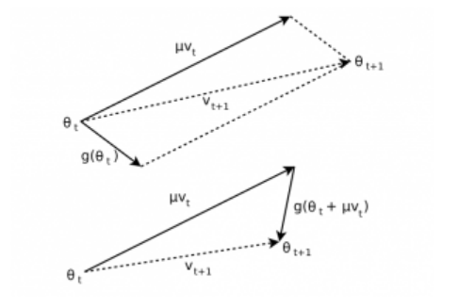
Nesterov Accelerated Gradient
We can view NAG as the correction factor for momentum method.
consider when the velocity added to the parameters gives immediate unwanted loss, if NAG being applied the gradients will direct the update backward to avoid big loss.

Slide 14
Outline
RMSProp
Momentum and Nag
Echo state networks
Introduction to ESN
Offline training
Online training
Stock prediction with ESN

Slide 15
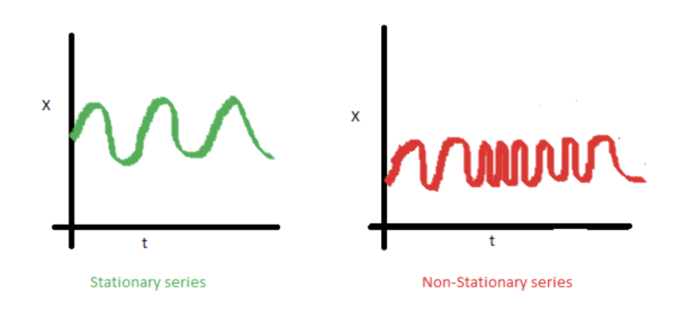
Echo state networks
Stock market is often viewed as a chaotic time series, advanced stochastic methods are often applied.
But trying to predict chaotic time series in a reliable manner is somehow counterintuitive to chaos.
Most model build on the basis of data being “stationary”

Slide 16
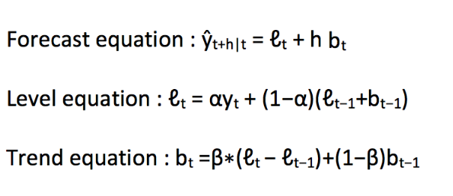
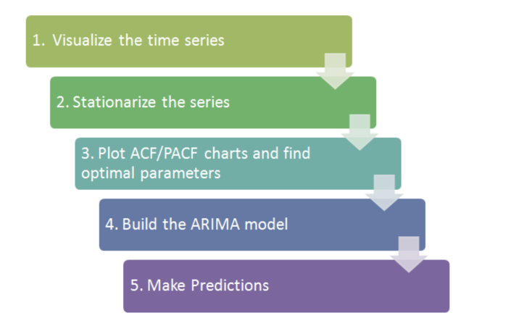
Echo State Network
Some practical method dealing with time series data
Good old fashion – moving average
Holtz linear model- extends simple exponential smoothing
ARIMA

Slide 17
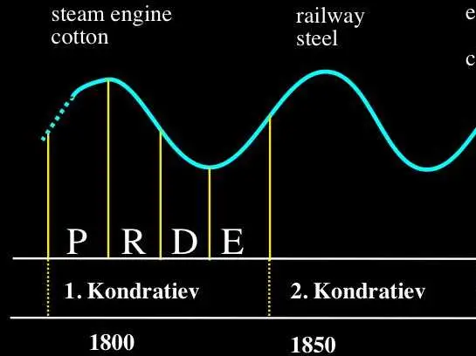
Echo State Network
All the method mentioned in some degree relied on data having some kinds of autocorrelation and periodicity.
Which is not present in stock markets, since there exists oscillation such as Kitchin cycle (3~5 years) , Juglar cycle (7~11 years periodicity), Kuznets swing(15~25 years) , Kondratiev wave(45-60 years

Slide 18
Echo State Network
People then move their attentions to neural networks
Clipping gradients method
Easy build-up but lose information throughout time.
LSTM & GRU
Popular but slow
Echo states RNNS
Echo state networks are a relatively new invention, it is essentially a recurrent neural network with a loosely connected hidden layer, called a ‘reservoir’ which works surprisingly well in the presence of chaotic time series.
In an ESN, we only have to train output weights of the network, which speeds up the training of the model.

Slide 19
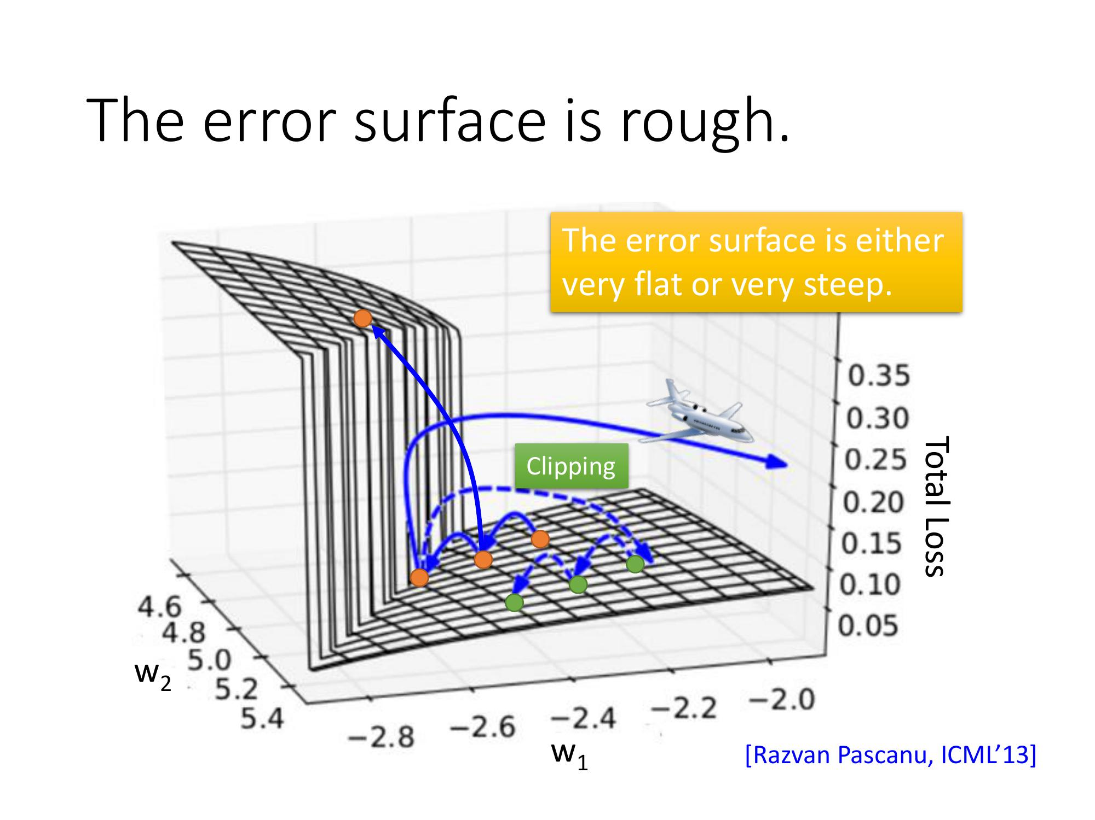
Gradient clipping

Slide 20
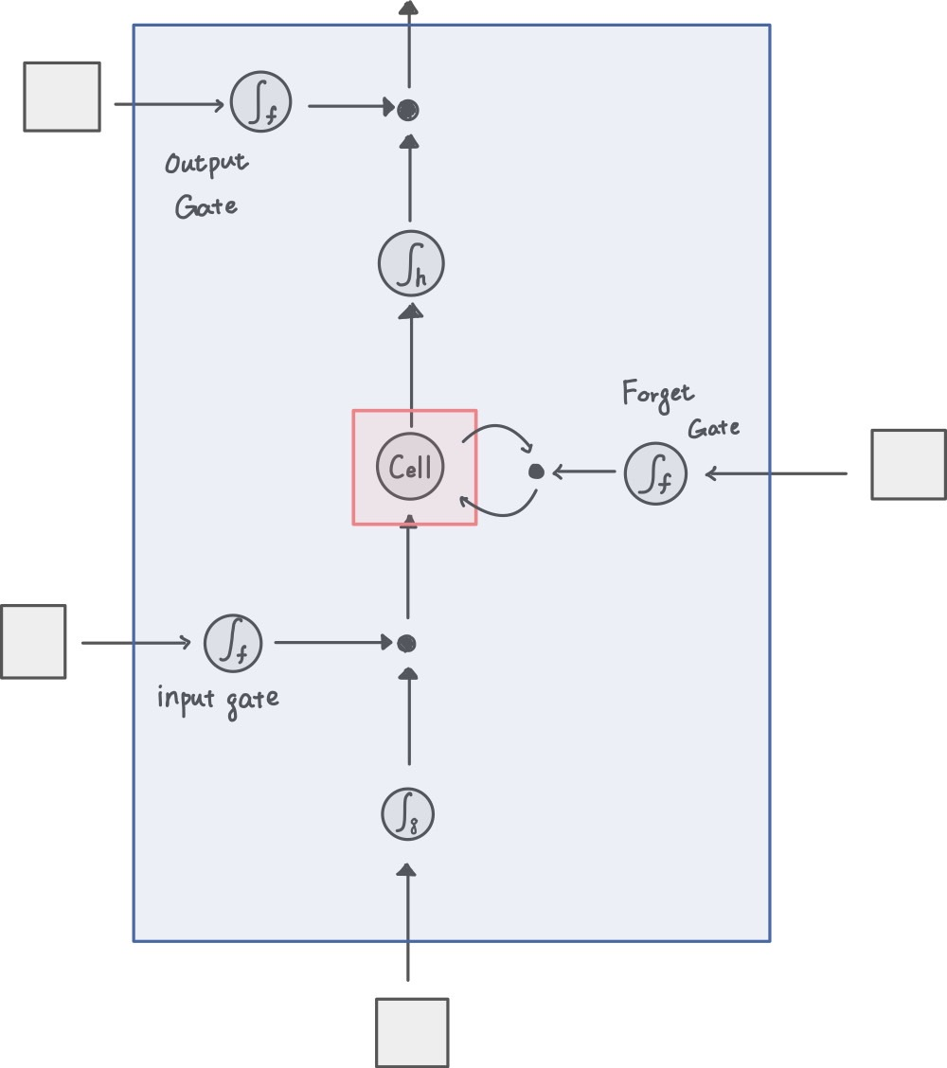
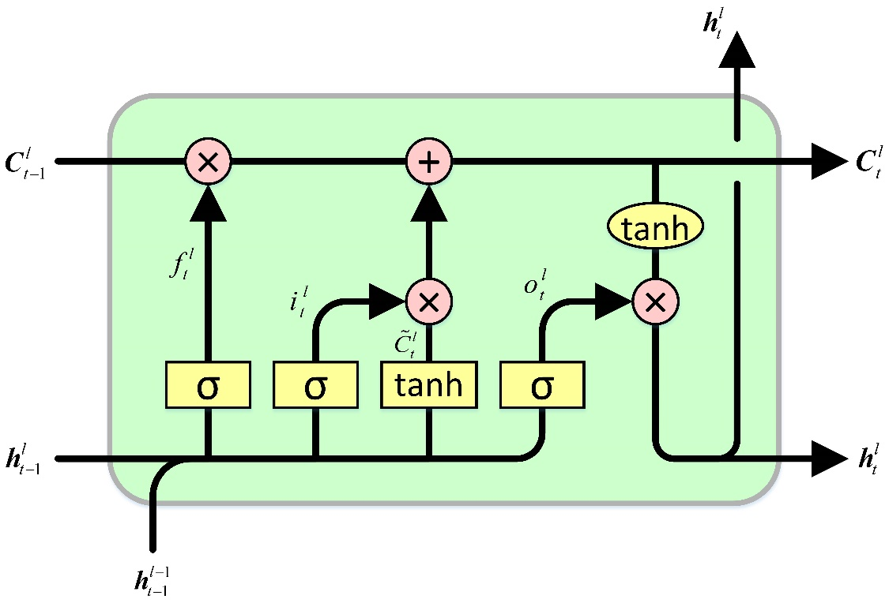
LSTM model and configuration

Slide 21
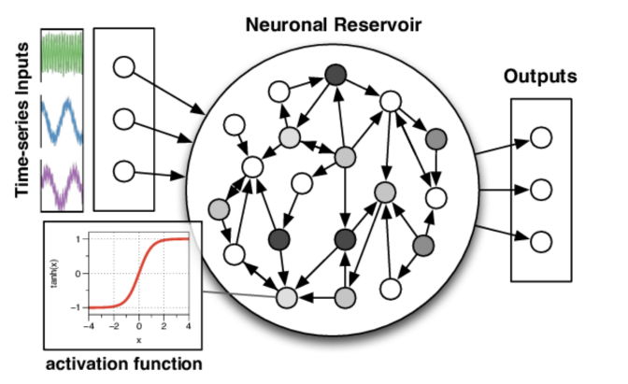
Echo State Network
The reservoir should have “echo state property”

Slide 22
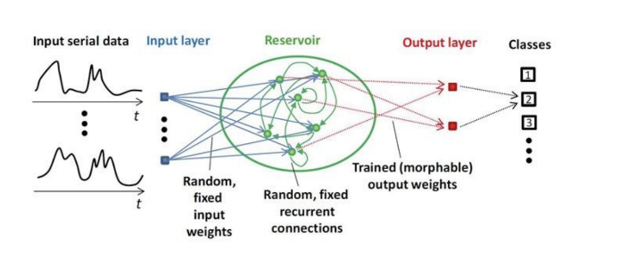
Echo State Network
Since value for input and recurrent weights are initialized randomly and then are mixed through out prediction.
How to optimize?
No systematics method exists to optimize hyperparameters, usually uses validation set.

Slide 23
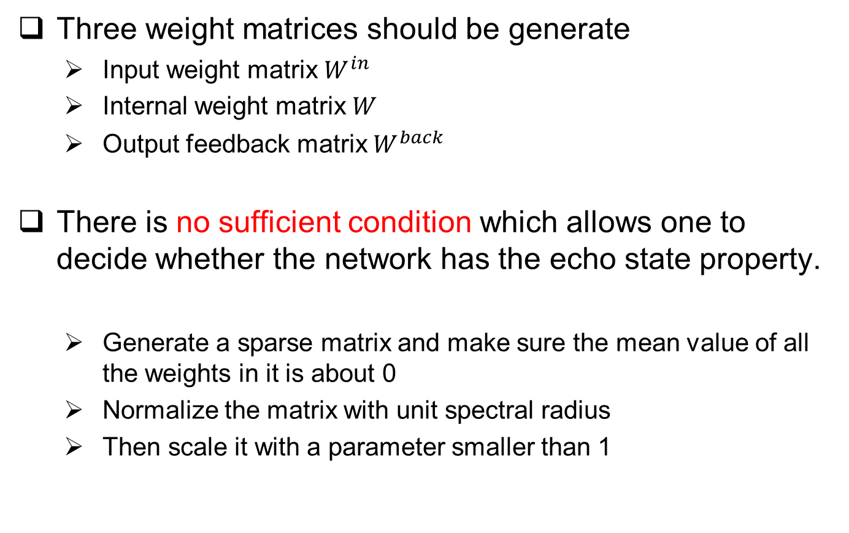
Offline training
Three weight matrices should be generate
Input weight matrix $W^{in}$
Internal weight matrix $W$
Output feedback matrix $W^{back}$
There is no sufficient condition which allows one to decide whether the network has the echo state property.
Generate a sparse matrix and make sure the mean value of all the weights in it is about 0
Normalize the matrix with unit spectral radius
Then scale it with a parameter smaller than 1

Slide 24
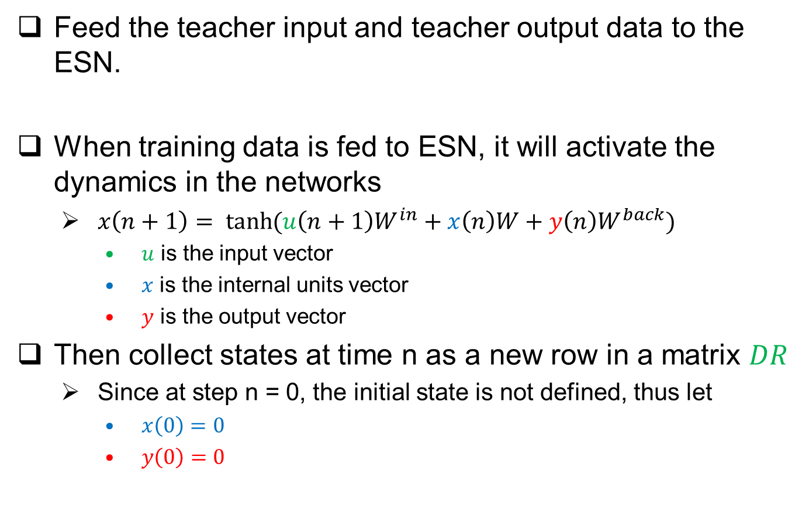
Offline training
Feed the teacher input and teacher output data to the ESN.
When training data is fed to ESN, it will activate the dynamics in the networks
$x\left(n+1\right)= \tanh{(u\left(n+1\right)W^{in}+x\left(n\right)W+y\left(n\right)W^{back})}$
$u$ is the input vector
$x$ is the internal units vector
$y$ is the output vector
Then collect states at time n as a new row in a matrix $DR$
Since at step n = 0, the initial state is not defined, thus let
$x\left(0\right)=0$
$y\left(0\right)=0$

Slide 25
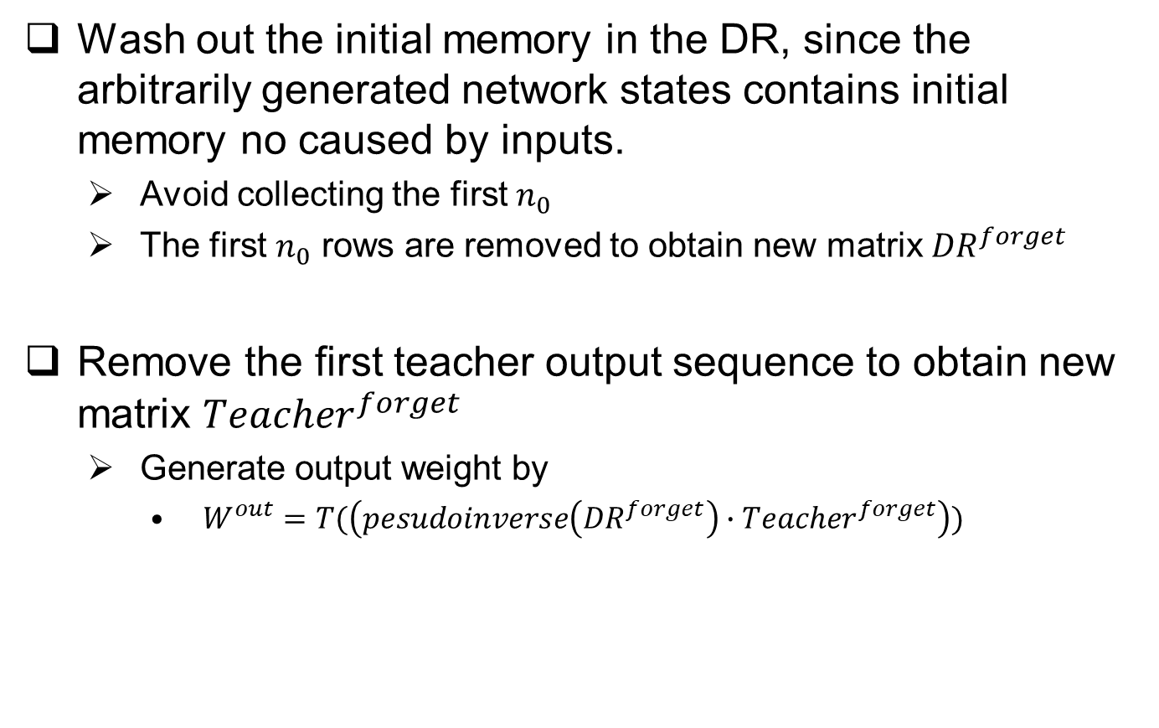
Offline training
Wash out the initial memory in the DR, since the arbitrarily generated network states contains initial memory no caused by inputs.
Avoid collecting the first $n_{0}$
The first $n_{0}$ rows are removed to obtain new matrix ${DR}^{forget}$
Remove the first teacher output sequence to obtain new matrix ${Teacher}^{forget}$
Generate output weight by
$W^{out}=T(\left(pesudoinverse\left({DR}^{forget}\right)∙{Teacher}^{forget}\right))$

Slide 26
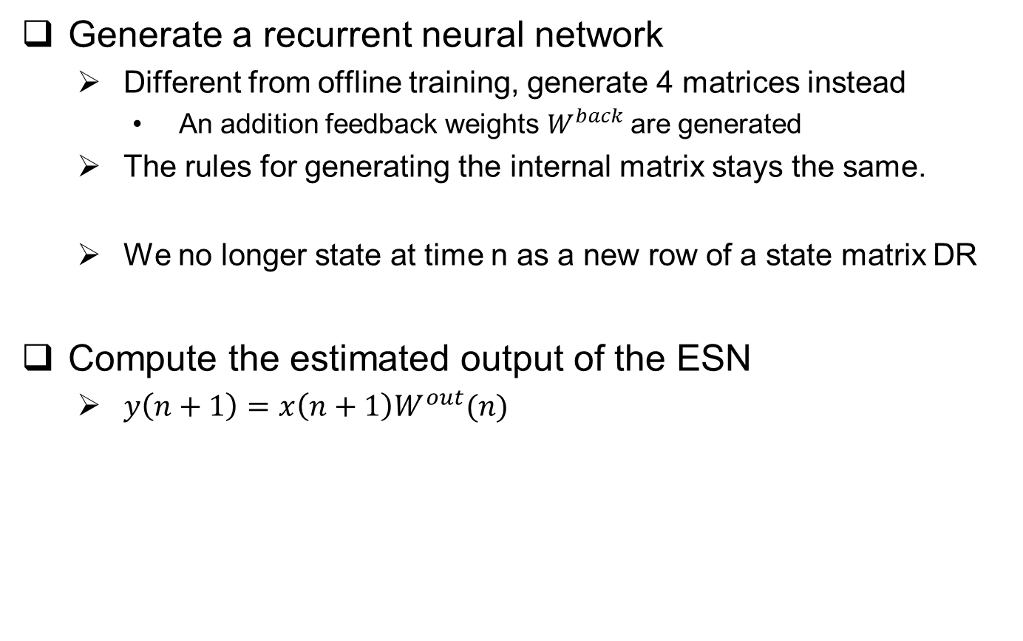
Online training
Generate a recurrent neural network
Different from offline training, generate 4 matrices instead
An addition feedback weights $W^{back}$are generated
The rules for generating the internal matrix stays the same.
We no longer state at time n as a new row of a state matrix DR
Compute the estimated output of the ESN
$y\left(n+1\right)=x\left(n+1\right)W^{out}(n)$

Slide 27
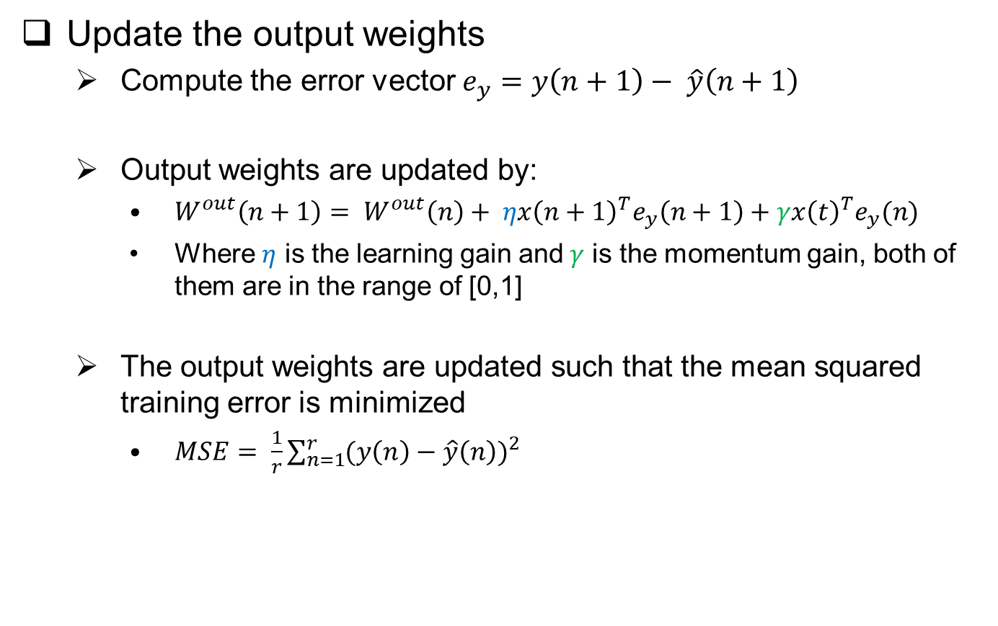
Online training
Update the output weights
Compute the error vector $e_{y}=y\left(n+1\right)− \hat{y}\left(n+1\right)$
Output weights are updated by:
$W^{out}\left(n+1\right)= W^{out}\left(n\right)+ ηx{\left(n+1\right)}^{T}e_{y}\left(n+1\right)+γx{\left(t\right)}^{T}e_{y}(n)$
Where $η$ is the learning gain and$γ$ is the momentum gain, both of them are in the range of [0,1]
The output weights are updated such that the mean squared training error is minimized
$MSE= \frac{1}{r}\sum_{n=1}^{r}{{(y\left(n\right)−\hat{y}\left(n\right))}^{2}}$

Slide 28
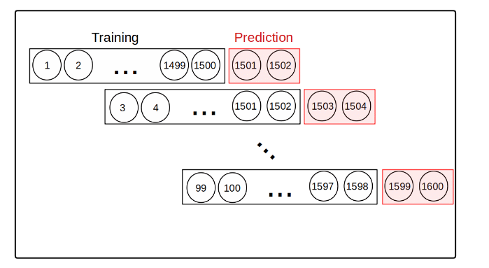
Echo State Network
Predicting Amazon Stock Prices
Predict two days ahead by using the previous 1500 points and do that for 100 future points.

Slide 29
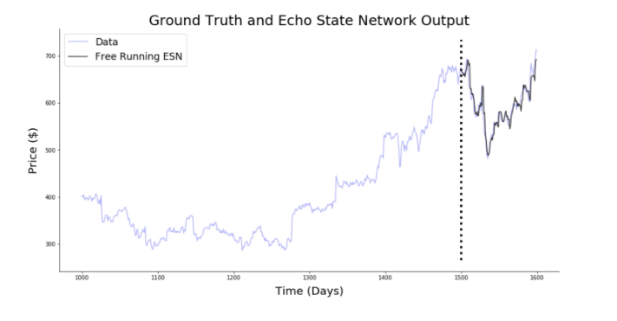
Echo State Network
Prediction of using windows of 2 days
Very good approximation, but only ever prediction 2 days into the future at any given time

Slide 30
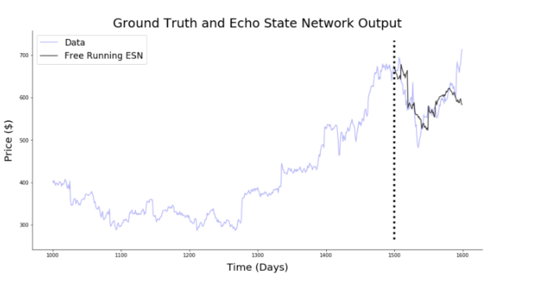
Echo State Network
Prediction of using windows of 10 days
Drop of prediction performance

Slide 31
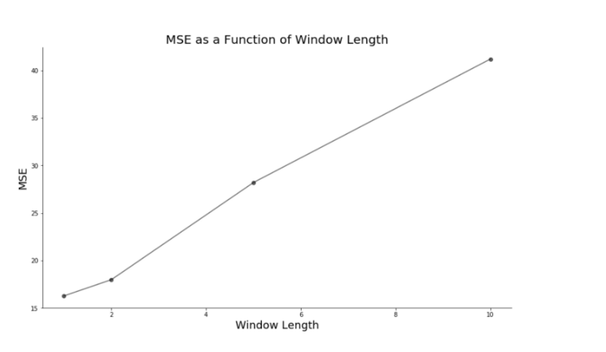
Echo State Network
The ability of the echo state network to analyze chaotic time series makes it an interesting tool for financial forecasting, but for short term, since MSE increases as window lengths increases.
Useful implementation
Weather forecast
Dynamic system control
Pattern recognition
Short term day trading prediction

Slide 32
Reference
[1] Jing Dai, Ganesh K. Venayagamoorthy, Ronald G. Harley1
An Introduction to the Echo State Network and its Applications In Power System
[2] Herbert Jaeger
Adaptive Nonlinear System Identification with Echo State Networks
[3] https://towardsdatascience.com/predicting-stock-prices-with-echo-state-networks-f910809d23d4

Slide 33
END

