Slide 1
Normalization Methods on CNN
報告人：林禹陞、陳昭維
日期: 12/16/22

Slide 2
Outline
Batch Normalization
Other normalization methods
Implementation on our model

Slide 3
Outline
Batch Normalization
Pros and cons
Other normalization methods
Implementation on our model

Slide 4
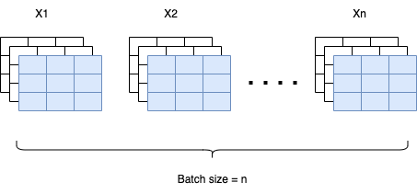
Batch Normalization
Batch normalization is successful on MLP and CNN, though not effective on RNN.
Improving convergence of training a model; also increasing learning rate for convenience.
Including random noise in one mini-batch to help regularize model.

Slide 5
Batch Normalization
Strongly depends on the inputs of one mini-batch.
Performs good at image classification tasks, but not so well on pixel-level image generating tasks (ex. Image style transfer).
Doing normalization on many unrelated inputs in one mini-batch, losing specific information on a single input.
Using multiple inputs to train model, but doing inference just using one input.
No mini-batch information when doing inference, just using expectation value of mean and variance recorded when training the model.

Slide 6
Outline
Batch Normalization
Other normalization methods
Layer Normalization
Instance Normalization
Group Normalization
Implementation on our model

Slide 7
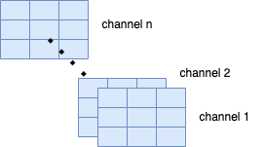
Other Normalization methods
Remove the dependence on one batch → do normalization in one single input.
1. Layer normalization:
Corresponding to doing normalization among all channels in one input.
Usually used in RNN model.

Slide 8
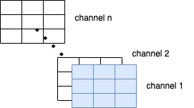
Other Normalization methods
2. Instance normalization:
Doing normalization for one channel in one single input.
Can only be used in CNN model, since in MLP or RNN there is only one single value for one hidden unit output.
Performs good at image style transfering tasks, but worse than BN on image classification tasks.

Slide 9
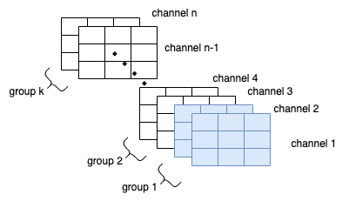
Other Normalization methods
3. Group normalization:
Doing normalization within one group, each group contains several channels.
A compromise between Layer Norm. & Instance Norm.
Have better performance than BN on object detecting, video classification…

Slide 10
Outline
Batch Normalization
Other normalization methods
Implementation on our model

Slide 11
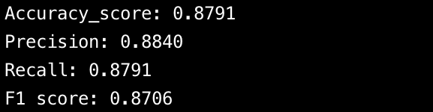
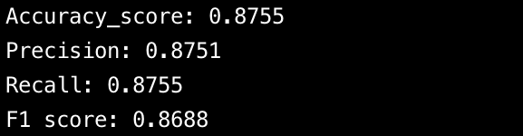
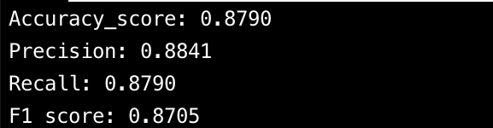
Model performance
Layer Norm. :
Instance Norm. :
Group Norm.(8 chnls/grp) :
F1 score from ~84.04% to ~87%
Reason: doing normalization on many unrelated inputs in one mini-batch, losing specific information on a single input.

Slide 12
END

