Slide 1
期末專題報告
De novo assembly of the Aedes aegypti genome using Hi-C yields chromosome-length scaffolds
《基於Hi-C輔助從頭組裝-埃及斑蚊基因體組裝生成染色體尺度之長片段》
/ Paper Reproduction
/論文覆現實驗
NCCUCS 楊明翰 108753203
NCCUCS 曾偉綱 108753122
NCCUCS 王神鐸 107753048
█ https://github.com/1081-Bioinformatics/finalproject-3ddna_108

Slide 2
期末專題報告
Part 1 /
Introduction

Slide 3
NGS 次世代 定序
基本概念介紹
read
把原本的DNA打成小段的碎片之後利用重複的頭尾關係，從較短的片段組合回長序列。而所謂的從頭組裝，是指不依靠既有的參考基因組(Reference Genome) 直接從短片段組合出定序結果。
因為快速和便宜，雖然單一樣本的準確率不如第一代測序Sanger Method，但依靠大量的數據可以更方便的投入疫區有更多醫療和商業價值。
contig
Sorting
scaffold

Slide 4
Hi-C 染色體結構捕獲
基本概念介紹
HiC Map
Ligation
主要是利用染色體之間存在實際上的折疊三維空間關係，利用交聯反應捕捉後，計算次數，最後得到能夠反應三維遠近關係的二維矩陣
額外多了3維的空間關係資訊除了去了解染色體的各種性質之外也可以利用較近的片段容易被交聯而數量較多，越遠則越少的關係，去輔助染色體定序的組裝排序。
Counts

Slide 5
基於Hi-C輔助從頭組裝
索引
參考基因組
.fa
常見索引
可以下載
基本概念介紹
索引工具
參考基因組& 索引 Index
Bowtie 2
BWA
…
視覺化手動糾錯
Hi-C 實驗定序原始數據
Juicer Box
.hic
R1
. fasta
R2
. fasta
本論文的主軸是在介紹他們新設計的從頭組裝軟體3D-DNA ，具有使用Hi-C數據輔助組裝的能力
整體分析流程如右圖，本次專案覆現實驗會從進入3D-DNA之後開始，
直接使用原論文提供的輸入前處理數據
Hi-C 互作矩陣
Hi-C 分析工具
Hi-C 組裝後長片段互作矩陣
Hi-C Pro
Juicer
…
一般NGS定序原始數據
FINAL. fasta
X. fasta
draft.fasta
組好後的定序結果
組裝染色體工具
依照重疊區域組成短片段
Hi-C輔助組裝染色體工具
w2rap contigger…
3D-DNA
ALLHIC
…

Slide 6
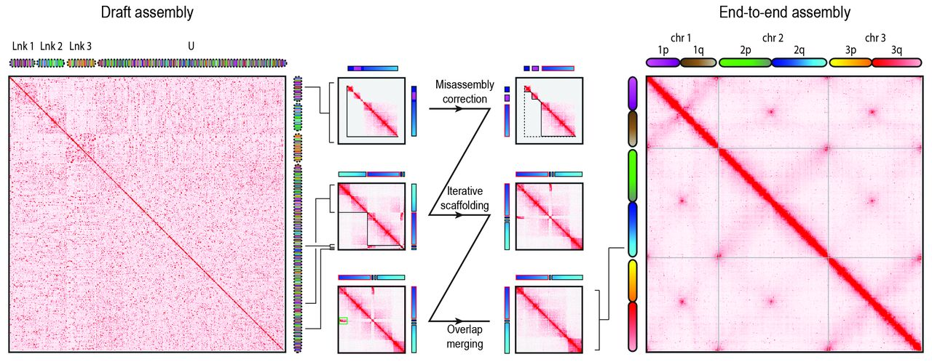
實驗目標設計
基本概念介紹
Fig. 1 Starting with a draft assembly, we used Hi-C data to correct misjoins, scaffold, and merge overlaps, thereby generating an assembly of the Ae. aegypti mosquito genome with chromosome-length scaffolds.
本論文利用組裝前，中，後的 Hi-C圖表，去展現出輔助組裝後長片段在互作圖的表現，會明顯清晰很多。利用這部分的現象，想要簡易的覆現這篇論文，可以把組裝前中後的圖表進行比較。

Slide 7
期末專題報告
Part 2 /
Environment Setup

Slide 8
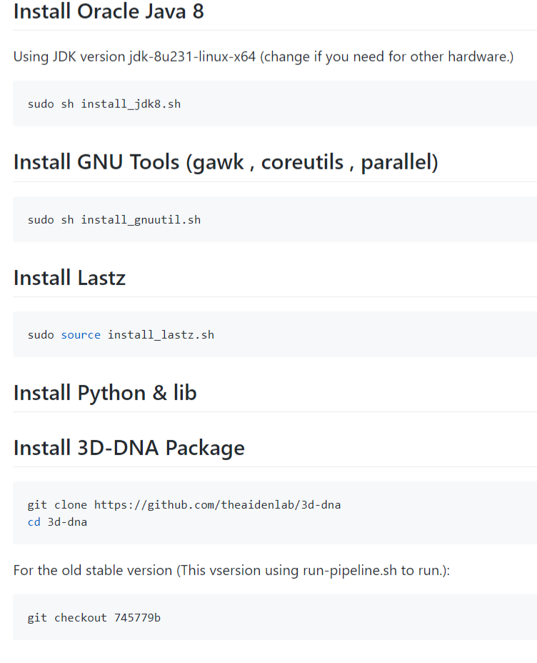
3D-DNA 環境需求與安裝
系統安裝方法
3D-DNA 需要的使用的程式包含了, Java Python , Shell 這三種語言。本專案安裝的部分是事先寫好每一步驟的安裝腳本，再逐一執行。
如果想要使用原始的3D-DNA進行實驗覆現，可以利用版控跳到第745779b 版本
< /Source Code >
https://github.com/1081-Bioinformatics/finalproject-3ddna_108/tree/master/code/install_3ddna_dependence

Slide 9
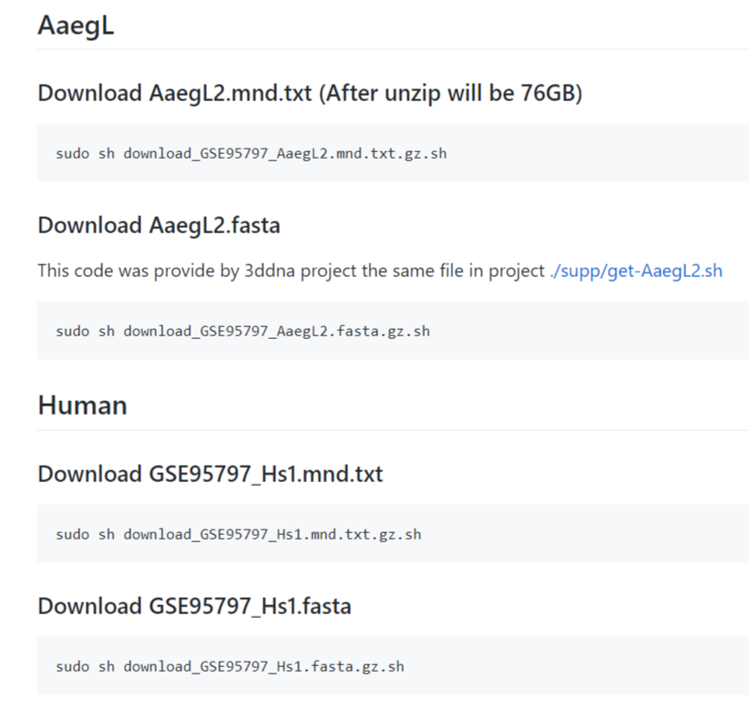
AaegL2 &Human 實驗數據準備
系統安裝方法
 | 組裝草稿 (待組序列) | Hi-C 合併的片段數量統計(輔助組裝 上游分析為Juicer)
AaegL2 埃及斑蚊 | GSE95797_AaegL2.fasta.gz | GSE95797_AaegL2.mnd.txt.gz
Human 人類 | GSE95797_Hs1.fasta | GSE95797_Hs1.mnd.txt
< /Source Code >
https://github.com/1081-Bioinformatics/finalproject-3ddna_108/tree/master/code/download_data
< /Tips to Speed up>
axel -n 30 ftp://...

Slide 10
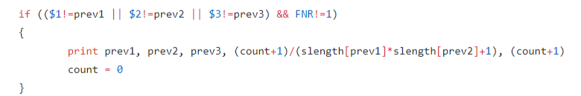


3D-DNA 程式除錯
系統安裝方法
$$\frac{y}{x}$$
$$\frac{(y+1)}{(x+1)}$$
執行舊版的時候有時候會遇到
fatal: division by zero attempted
為了順利進行分析，以拉普拉斯平滑修正了出錯的地方。
< /Source Code >
https://github.com/1081-Bioinformatics/finalproject-3ddna_108/tree/master/code/fixbug_code

Slide 11
期末專題報告
Part 3 /
Run Analysis

Slide 12
3D-DNA 執行
執行輸出結果
$ chmod +x run-asm-pipeline.sh
$ nohup ./run-asm-pipeline.sh GSE95797_Hs1.fasta GSE95797_Hs1.mnd.txt > run_GSE95797_Hs1.log 2>&1 &
(新版)
< /Source Code >
https://github.com/1081-Bioinformatics/finalproject-3ddna_108/tree/master/code/run_analysis

Slide 13
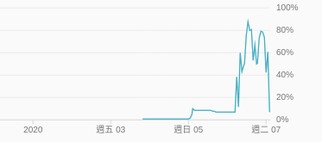
3D-DNA 運行情況
執行輸出結果
Google Cloud Platform
n1-standard-16 (16 vCPUs, 60 GB memory, 1TB HDD)
OS Version
Ubuntu 16.04.6 LTS (Xenial Xerus)
Run both AaegL2&Human
CPU Usage Plot ( The analysis process run 5 Days)

Slide 14
期末專題報告
Part 4 /
Output Result
Hi-C Figure
https://github.com/1081-Bioinformatics/finalproject-3ddna_108/tree/master/results
.hic File
https://github.com/1081-Bioinformatics/finalproject-3ddna_108/tree/master/data

Slide 15
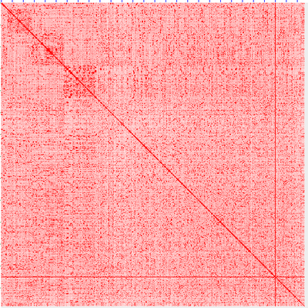
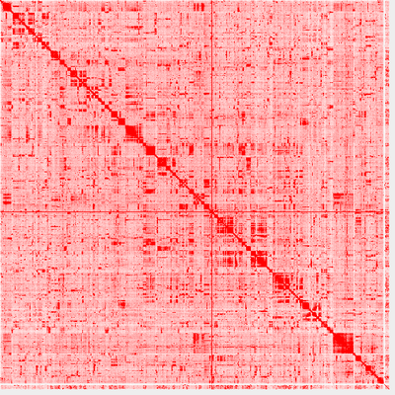
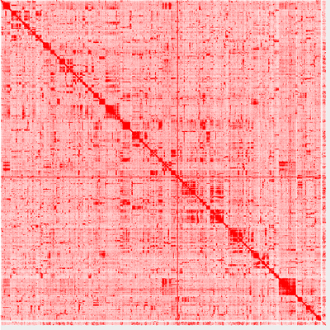
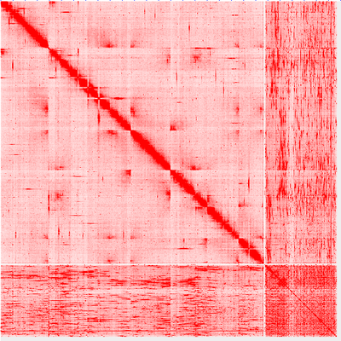
埃及斑蚊 Hi-C圖 變化
AaegL2.2.draft.hic
AaegL2.2.0.hic
實驗結果整理
從左上，右上，左下 ，右下依序是從草稿Hi-C是視覺化圖，一直到最後一輪迭代的Hi-C圖。視覺圖有由本次專案輸出的.hic檔經Juicer Box 視覺化。
可以明顯的比較出來，隨著3D-DNA正確的參照Hi-C的資訊進行長片段組裝迭代，Hi-C圖有越來越清晰的傾向，表示隨著組裝序列越長，越有回復到原本的序列。
AaegL2.2.1.hic
AaegL2.2.2.hic

Slide 16

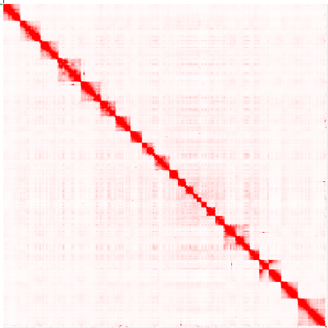
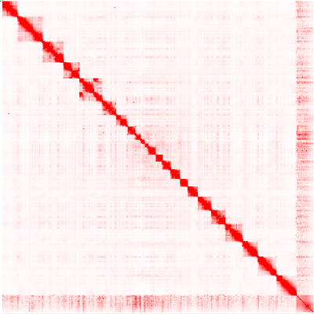
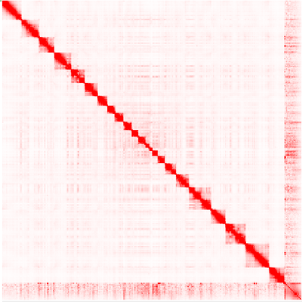
人類 Hi-C圖 變化
GSE95797_Hs1.draft.hic
GSE95797_Hs1.0.hic
實驗結果整理
與前面一樣，迭代次數增加，Hi-C圖有越來越清晰的傾向，恢復的資訊越多。從以上兩組Hi-C圖的視覺化，就能夠清楚知道其作用。
GSE95797_Hs1.1.hic
GSE95797_Hs1.2.hic

Slide 17
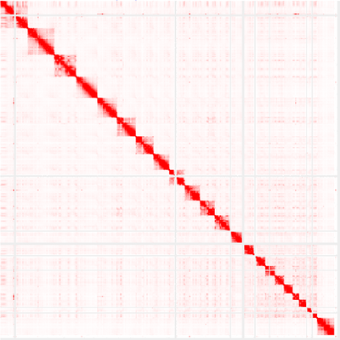
實驗結果整理
人類
Hi-C圖 比較
左邊是本論文的資料經過輔助組裝後的結果，右邊是2014年其他人實驗所繪製的Hi-C圖，兩者具有類似結構
GSE95797_Hs1.2.hic
GM12878_Cell_2014
(HIC001(148M) Cell. 2014 Dec 18;159(7):1665-80. doi: 10.1016/j.cell.2014.11.021. Epub 2014 Dec 11.)

Slide 18

GSE95797_Hs1.draft.hic
實驗結果整理
人類
Hi-C圖 疊圖比較
左下半較清晰的是組裝後的圖，右上半是尚未組裝的圖。
GSE95797_Hs1.2.hic

Slide 19
實驗結果整理
結論
01
Hi-C能夠有效協助序列組裝，
3D-DNA組裝效果佳。
本專案是部分
<De novo assembly of the Aedes aegypti genome using Hi-C yields chromosome-length scaffolds>論文再現實驗。
並且得到了由Hi-C輔助組裝的序列。其中，3D-DNA透過修正與排序疊代調整組裝得長片段，右邊列出最後三點總結。
02
3D-DNA 計算效能消耗大。如果需要在有限時間內完成，需要預留更多時間。
03
3D-DNA 部分程式碼應該可以更加完善

Slide 20
實驗結果整理
Supp
With the Zika virus spreading largely unchecked in Latin America and the Caribbean by way of a now-notorious insect, some of the nation’s leading mosquito researchers are striving to assemble a state-of-the-art DNA map that they say will help them fight the disease with the mosquito’s own genetic code.
Some want to hunt for genes that, if altered in mosquitoes released into the wild, could drive the species to extinction. Others are trying to identify genes that control how mosquitoes sense human prey so as to devise better repellents. Still others favor the idea of selectively breeding populations of mosquitoes, like corn or cattle, for desirable — or, at least, less undesirable — traits, such as a preference for biting animals other than humans.

Slide 21
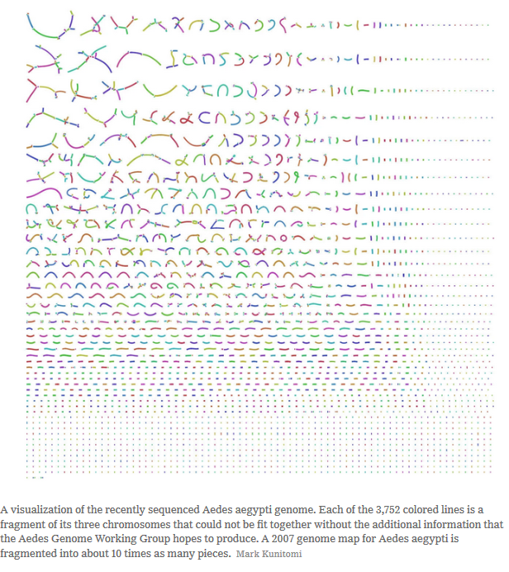
實驗結果整理
Supp
That a genome map for Aedes aegypti, however imperfect, was published in 2007 is a testament to the species’ longtime status as a potent human foe. (Its genus name, bestowed by 18th-century naturalists with a penchant for accuracy, means “unpleasant” in ancient Greek; “aegypti” refers to Egypt, where it was first believed to have been collected.)
Besides Zika and yellow fever, the insect carries dengue, which causes a severe and sometimes fatal flulike illness, and chikungunya, which can cause intense joint pain that lasts for years.

Slide 22
實驗結果整理
Supp
But the technology used for the 2007 Aedes map, and many others, could only read relatively short stretches of DNA at a time, which were then pieced together by matching up the sections where they overlapped in a process that often left some areas garbled and riddled with gaps. And since more than half of the Aedes genome consists of sequences that repeat again and again, it has proved more difficult than many genomes to make sense of.

Slide 23
實驗結果整理
Supp
“The Zika outbreak, spread by the Aedes aegypti mosquito, highlights the need to
create high-quality assemblies of large genomes in a rapid and cost-effective way. Here
we combine Hi-C data with existing draft assemblies to generate chromosome-length
scaffolds. We validate this method by assembling a human genome, de novo, from short
reads alone (67× coverage). We then combine our method with draft sequences to
create genome assemblies of the mosquito disease vectors Ae. aegypti and Culex
quinquefasciatus, each consisting of three scaffolds corresponding to the three
chromosomes in each species. These assemblies indicate that almost all genomic
rearrangements among these species occur within, rather than between, chromosome
arms. The genome assembly procedure we describe is fast, inexpensive, and accurate,
and can be applied to many species.”

Slide 24
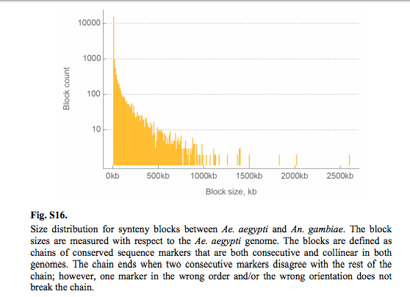
Supp2

Slide 25
Supp2
Notes:
Here each 100-kb locus in Ae. aegypti is assigned a color. For the other species, each 100-kb locus is assigned a combination of the colors of the corresponding DNA sequences in Ae. aegypti, weighted by length. MYA, million years ago.

Slide 26
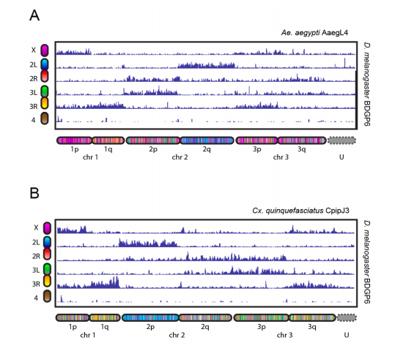
Supp2
Notes:
Fig. S19. Conservation of synteny across dipterans. Several chromosome arms, such as D. melanogaster 2L, Ae. aegypti 2q, and Cx. quinquefasciatus 2p, show strong conservation of content. Chromograms along the x- and y- axes indicate which portions of BDGP6 correspond to which positions in the other genomes and genome assemblies.

Slide 27
Supp2
provides a rapid, inexpensive methodology for generating highly accurate de novo assemblies with chromosome-length scaffolds.
the current approach is not perfect for local ordering of small adjacent contigs.
This might be circumvented by more sophisticated analysis of Hi-C data. Additional data (such as long or paired-end reads) could also improve the results.

Slide 28
實驗結果整理
參考資料
THE CENTER FOR GENOME ARCHITECTURE Baylor College of Medicine & Rice University http://aidenlab.org/assembly/manual_180322.pdf
De novo assembly of the Aedes aegypti genome using Hi-C yields chromosome-length scaffolds. https://www.ncbi.nlm.nih.gov/pubmed/28336562
Hi-C辅助基因组安装 https://www.jianshu.com/p/95792fbde9c3

Slide 29
THANKS
期末專題報告

