Slide 1
Diagnostic potential for a serum miRNA neural network for detection of ovarian cancer
Kevin M Elias, Wojciech Fendler, Konrad Stawiski, Stephen J Fiascone, Allison F Vitonis, Ross S Berkowitz, Gyorgy Frendl, Panagiotis Konstantinopoulos, Christopher P Crum, Magdalena Kedzierska,
Daniel W Cramer, Dipanjan Chowdhury
陳先灝、盧佳妤、段寶鈞
課程：生物資訊概論與實務
2020/1/7

Slide 2
Outline
01
Introduction
02
Data
03
Preprocess
04
Models
05
Results
06
Others

Slide 3
Introduction

Slide 4
Introduction & Data Format
Motivation
While recognizing epithelial ovarian cancer(EOC), protein (CA125) detection is not convenient enough, and have some shortcomings.
1. microRNA can detect more rare transcripts in the blood through PCR.
2. All microRNA are in the same unit measurement, which is easier to incorporate into multiplexed panels.
3. miRNAs play a critical role in ovarian cancer biology, whereas the function of CA125 is unknown.
Data Property & Format
microRNA with elements “A”, “T”, “C”, “G”.
Fastq format
We will use elements recorded in line 2, and maybe the quality values listed in line 4.
It can be read easily.

Slide 5
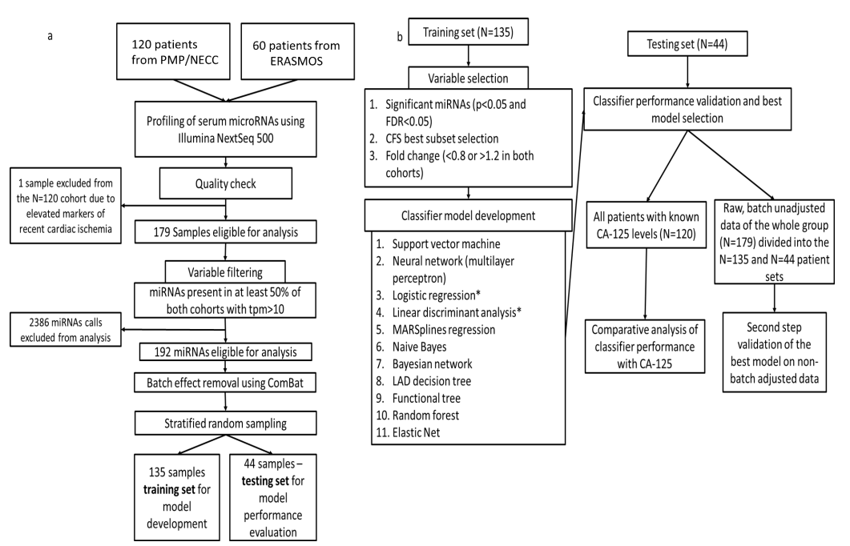
Flowchart of study design

Slide 6
Flowchart
Data Download
Construct
Models
Output Results
Feature Selection

Slide 7

Tool
Paper
STATISTICA Data Miner 12.5 (It’s not free.)
Weka 3.9.0
We want to use
python
Numpy
Keras
pytorch
scikit-learn

Slide 8
Data

Slide 9
Data Download
Where to download?
NCBI - GEO Accession viewer (GSE94533)
Run Selector (PRJNA371423)
EBI - ENA Broswer (PRJNA371423)
How big in terms of GB? in terms of reads?
sra - 48.78GB
fastq - 1.29GB * 204
xlsx - 4.89MB + 9.22MB

Slide 10
Preprocess

Slide 11
Preprocess
xlsx file - GSE94533_Processed_file_Cohort1.xlsx
GSE94533_Processed_file_Cohort2.xlsx
sample, 01_summary_all, mirna_rawcounts, mirna_tpm (Remap Name), smallrna_rawcounts, smallrna_tpm, putative_mirna
Run Selector - PRJNA371423
Run, BioSample, AvgSpotLen, Bases, Bytes, diagnosis, Experiment, GEO_Accession, Histology, MBases, MBytes, Sample Name, stage
GEO Accession viewer (GSE94533)
180 of Samples (Sample Name/Remap Name)

Slide 12
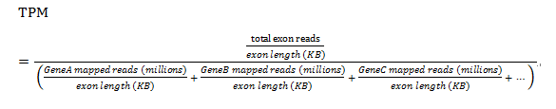
Preprocess - Why mirna_tpm
TPM (Transcript Per Million)
TPM is a unit used to measure expression in NGS experiments.
The number of reads for a particular miRNA is divided by the total number of mapped reads and multiplied by 1 million.

Slide 13
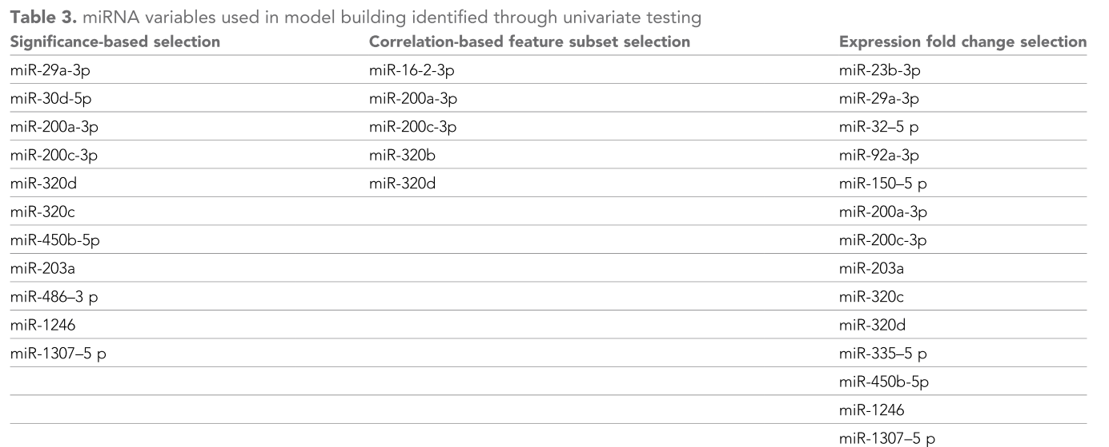
Feature Select
Significance
Correlation
Fold

Slide 14
Fold Change
Assumption
Genes that are important in classification will have a greater difference in the expression of the two classes.
However, considering only the absolute difference may be highly impacted by the mass of numeric value.
So let’s measure this by the difference of fold!

Slide 15
Results of Fold Change
Fold Change from Paper (with fold > 1.2 or fold < 0.8)
15 types of RNA from 2571 types.
Simple Fold Change from us (with fold > 1.2 or fold < 0.8)
646 types of RNA from 2571 types.

Slide 16
Split Training and Testing Set
1 data ignore, not mention in paper
→135 training set, 45 testing set

Slide 17
Models

Slide 18
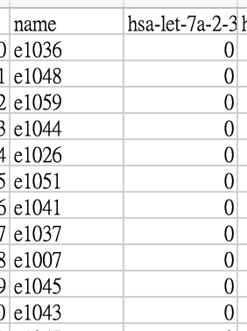
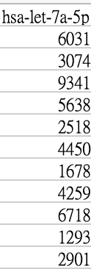
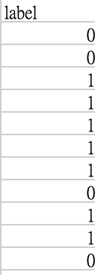
Input & Output
Input: A person with selected miRNA features.
Output: 1 for cancer and 0 for benign/borderline/control.
...

Slide 19
Reproduced Models
We reproduced several models in scikit-learn.
Linear discriminant analysis (LDA)
Logistic Regression (LR)
Support vector machine (SVM)
Random forest
Elastic net
We also reproduced the NN model using Keras.

Slide 20
Neural network
Input Features
Fully-Connected Layer
Fully-Connected Layer
Output

Slide 21
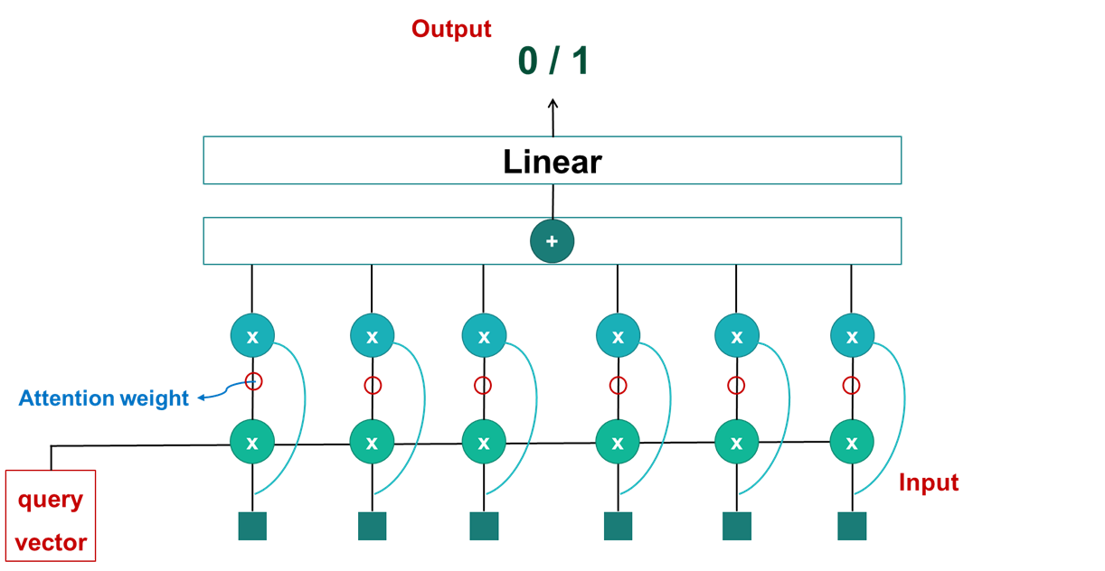
Another Model
Vaswani, Ashish, et al. "Attention is all you need." Advances in neural information processing systems. 2017.
Attention
proposed a attention-baed model using PyTorch

Slide 22
Results

Slide 23
Linear discriminant analysis
Paper
 | Significance | Correlation | Fold
AUC (95% CI) | 0.80 (0.66–0.93) | 0.76 (0.62–0.90) | 0.78 (0.64–0.92)
Ours
 | Significance | Correlation | Fold
AUC (95% CI) | 0.67 (0.54-0.79) | 0.63 (0.54-0.72) | 0.75 (0.64-0.85)

Slide 24
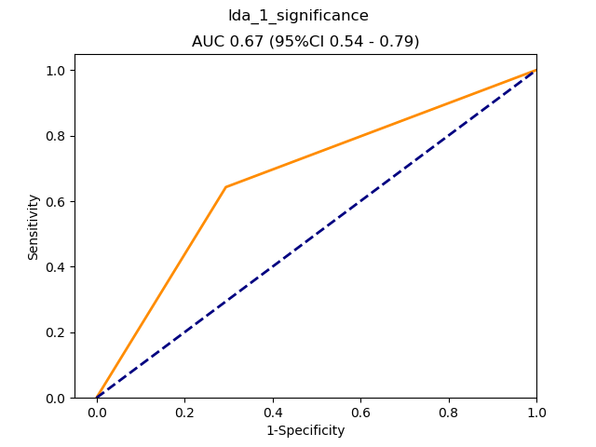
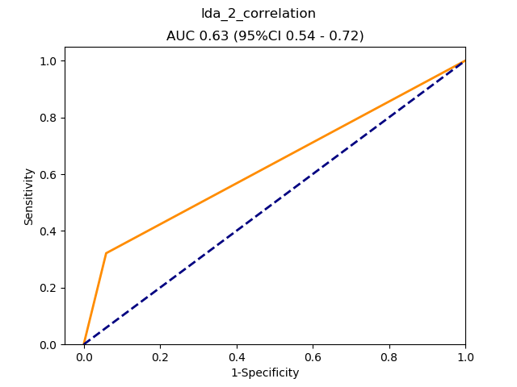
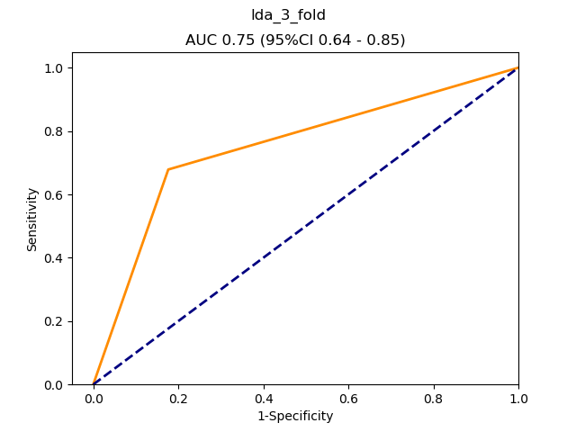
Linear discriminant analysis
Ours

Slide 25
Logistic regression
Paper
 | Significance | Correlation | Fold
AUC (95% CI) | 0.81 (0.68–0.94) | 0.75 (0.61–0.90) | 0.82 (0.70–0.94)
Ours
 | Significance | Correlation | Fold
AUC (95% CI) | 0.61 (0.48-0.73) | 0.71 (0.61-0.80) | 0.70 (0.57-0.81)

Slide 26
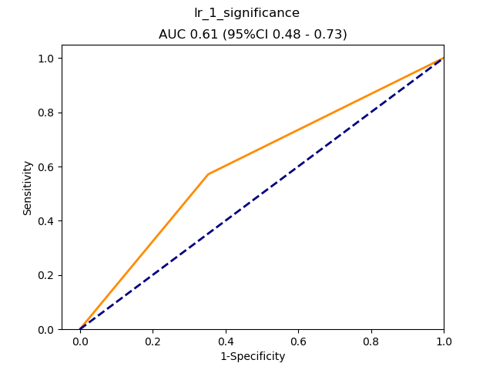
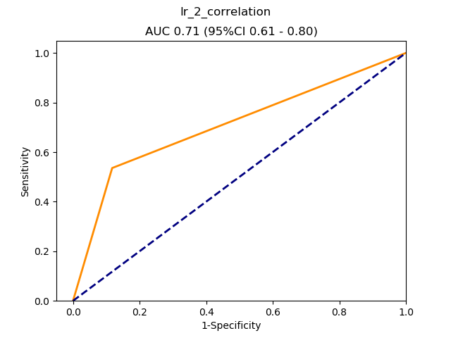
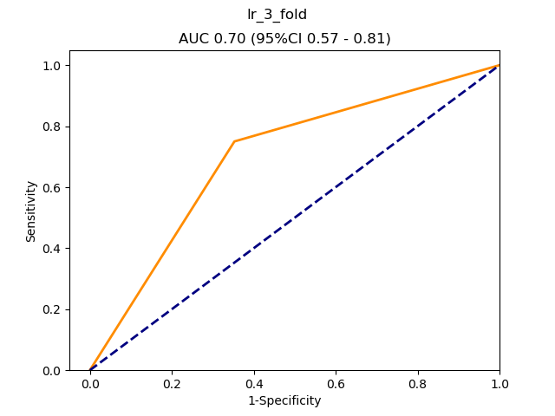
Logistic regression
Ours

Slide 27
Support vector machine
Paper
 | Significance | Correlation | Fold
AUC (95% CI) | 0.77 (0.63–0.91) | 0.73 (0.58–0.87) | 0.77 (0.63–0.91)
Ours
 | Significance | Correlation | Fold
AUC (95% CI) | 0.61 (0.48-0.74) | 0.71 (0.60-81) | 0.70 (0.59-0.81)

Slide 28
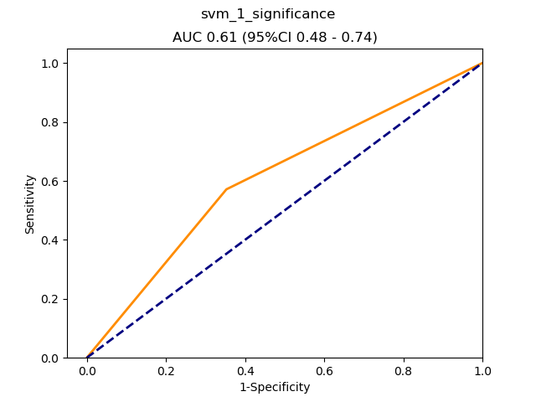

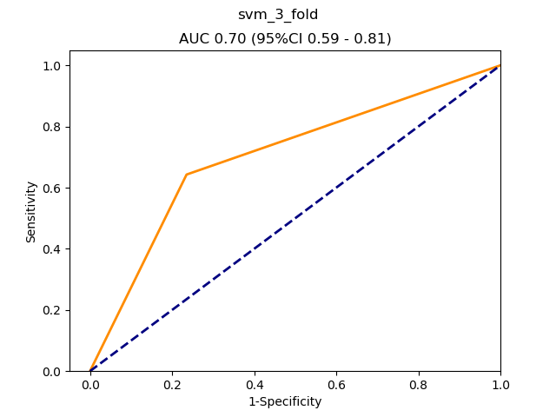
Support vector machine
Ours

Slide 29
Random forest
Paper
 | Significance | Correlation | Fold
AUC (95% CI) | 0.78 (0.64–0.91) | 0.71 (0.56–0.86) | 0.76 (0.62–0.90)
Ours
 | Significance | Correlation | Fold
AUC (95% CI) | 0.66 (0.53-0.77) | 0.69 (0.57-0.80) | 0.59 (0.47-0.71)

Slide 30
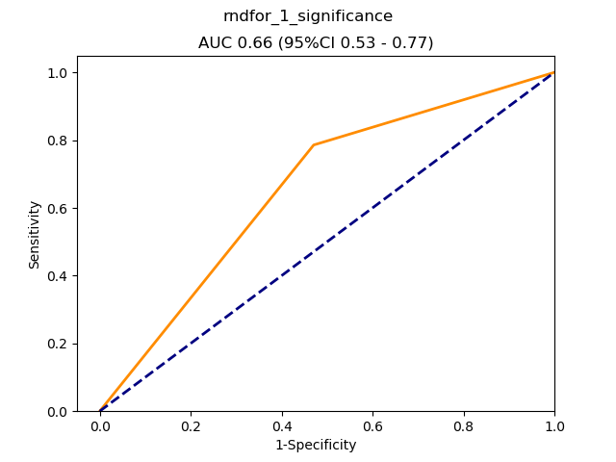
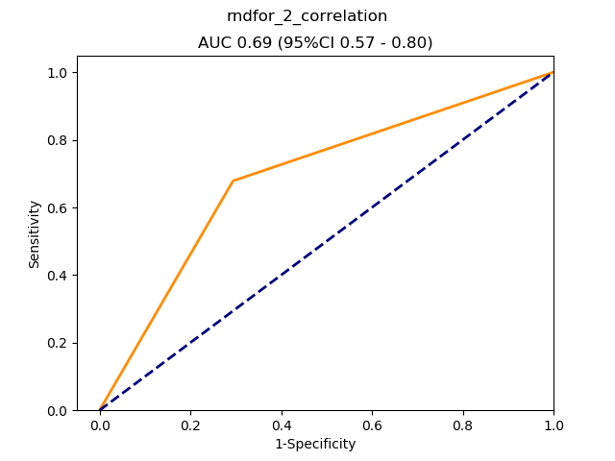
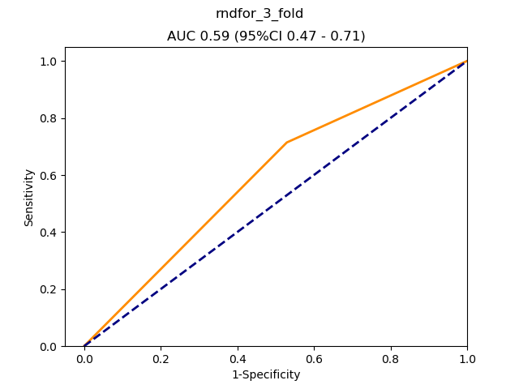
Random forest
Ours

Slide 31
Elastic net
Paper
 | Significance | Correlation | Fold
AUC (95% CI) | 0.80 (0.67–0.93) | 0.76 (0.62–0.90) | 0.79 (0.66–0.92)
Ours
 | Significance | Correlation | Fold
AUC (95% CI) | 0.71 (0.57-0.85) | 0.72 (0.58-0.84) | 0.72 (0.57-0.85)

Slide 32
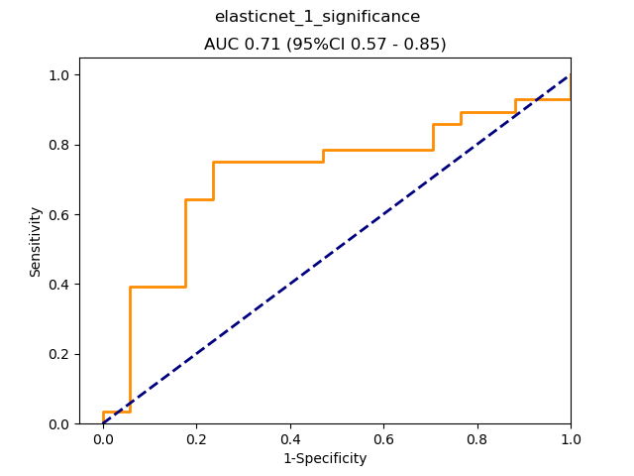
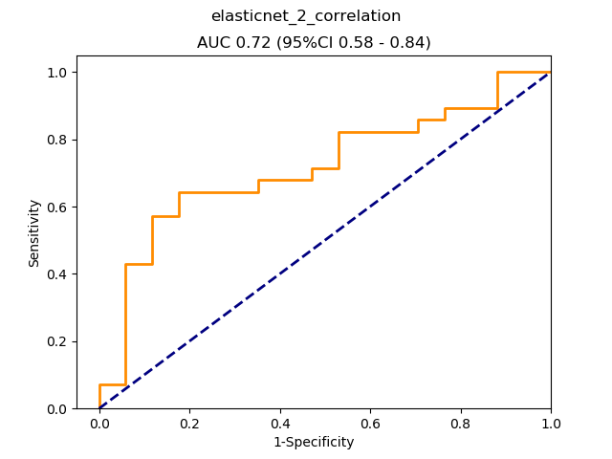
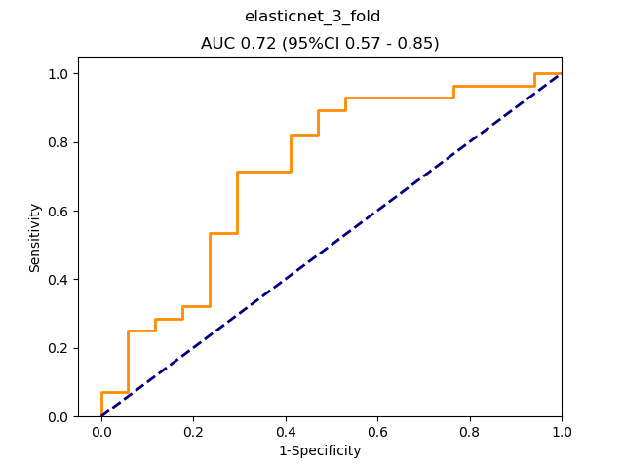
Elastic net
Ours

Slide 33
Neural network (3-layer)
Paper
 | Significance | Correlation | Fold
AUC (95% CI) | 0.84 (0.72–0.96) | 0.75 (0.60–0.89) | 0.90 (0.81–0.99)
Ours
 | Significance | Correlation | Fold
AUC (95% CI) | 0.65 (0.58-0.72) | 0.57 (0.45-0.69) | 0.63 (0.51-0.76)

Slide 34
Attention
ours
 | Significance | Correlation | Fold
AUC (95% CI) | 0.75 (0.62-0.87) | 0.59 (0.44-0.74) | 0.63 (0.48-0.77)

Slide 35
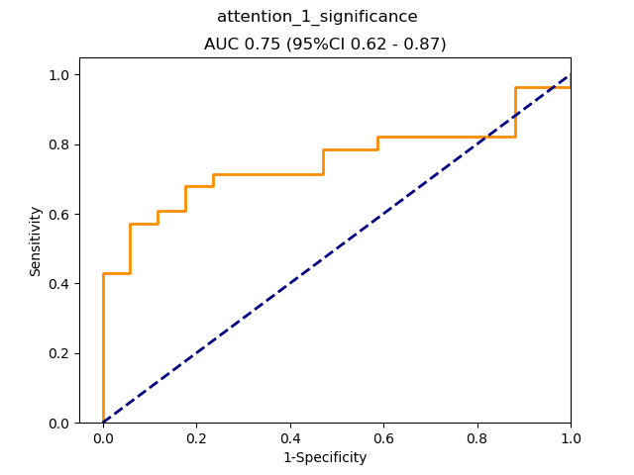
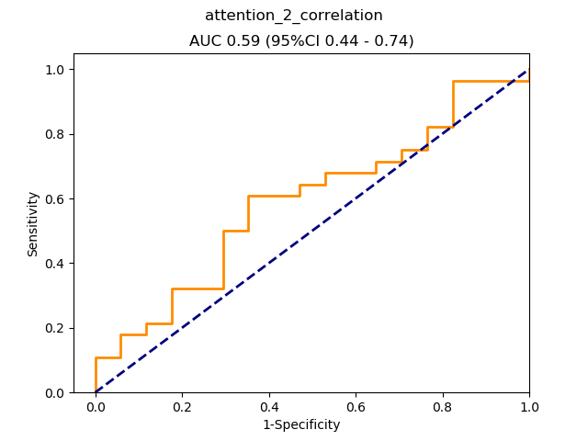
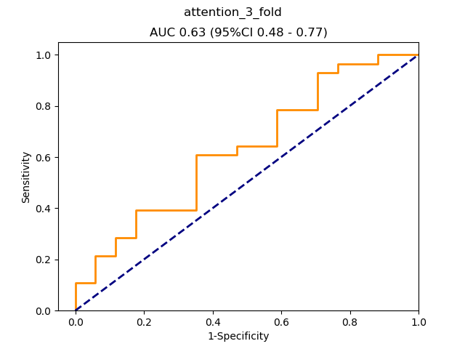
Attention
Ours

Slide 36
Conclusion
The original authors uses STATISTICA and Weka to produce their models. Since these programs either required commercial licenses or is hare to use, we chose to use python to reproduce the results. However, we are not able to reproduce the results since STATISTICA and Weka provides some fine-tuning that we don't know.
We proposed a attention-baed model using PyTorch, and gained a good enough results. However, the results are still worse than the best models proposed by the original authors, maybe because of the lack of data complexity, witch cause our model easily to overfit the training data.

Slide 37
Others

Slide 38

Corporate
資料下載及處理：段寶鈞、陳先灝、盧佳妤
模型重現：
挑特徵值：陳先灝
模型建構及結果：
LDA: 盧佳妤
LR: 段寶鈞
SVM: 盧佳妤
Random forest: 盧佳妤
Elastic net: 盧佳妤
NN: 陳先灝
其他模型實作(attention)：盧佳妤

Slide 39

References
* Paper
Elias, K. M. et al. Diagnostic potential for a serum miRNA neural network for detection of ovarian cancer. Elife 6, (2017)
Vaswani, Ashish, et al. "Attention is all you need." Advances in neural information processing systems. 2017.
* Packages we use
- numpy (matrix utilities)
- scikit-learn (statistics routines)
- pytorch (attention model framework)
- keras (NN model framework)
- matplotlib (figure drawing)
- absl-py (flag management)
- coloredlogs (beautiful logging)

Slide 40
Thank You

