Slide 1
資料科學期末報告
組員：
資科碩一 王柏仁108753204
資科碩一 蕭郁君109753203

Slide 2
大綱
簡介
資料輸入與輸出
實驗方法
資料前處理
模型
實驗結果
程式 Demo

Slide 3
簡介 比賽內容

Slide 4
簡介 分工
模型 - logistic regression : 蕭郁君

Slide 5
資料輸入與輸出

Slide 6
實驗方法 資料前處理

Slide 7

實驗方法 模型 – brief Intro
Modeling process:
perform evaluation by k –fold cross validation ( k $∈\left[5,10\right]$)
choose model by evaluating test fold’s accuracy
Method1:
Logistic regression
Method II:
xgboost

Slide 8
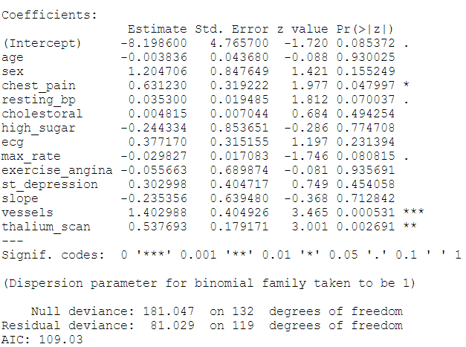
實驗方法 模型 – logistic regression
with all fearures:
p < 0.05
chest_pain
vessels
thalium_scan

Slide 9
實驗方法 模型 – logistic regression
baseline:
feature
chest_pain + vessels + thalium_scan + resting_bp + max_rate (without doing any thing
Public score: 0.86363
Private score: 0.75471

Slide 10
實驗方法 模型 – logistic regression
Process : (a small mistake, so only train fold one data within 5 fold)
feature
chest_pain + vessels + thalium_scan + resting_bp + max_rate (without doing any thing
Public score: 0.86363
Private score: 0.83018
Accuracy is not always the best choice to choose the test mode !!!!

Slide 11
實驗方法 模型 – logistic regression
Process : (tries)
One hot encoding
(chest_pain, ecg, slope, thalium_scan)
consider seperately
age
cut into bins => nonsignificant
linear combinations
examine p-value

Slide 12
實驗方法 模型 – logistic regression
Performance about ont - hot encoding:
features | private score | public score
resting_bp_without_label + slope_label + vessels + chest_pain + thalium_scan | 0.81132 | 0.90909
resting_bp_without_label + slope_label + vessels + chest_pain + thalium_scan_1 + thalium_scan_3 (column: thalium_scan) | 0.86792 | 0.90909
resting_bp_without_label + slope_label + vessels + chest_pain_2 + chest_pain_3 + chest_pain_4 + thalium_scan (column: chest_pain) | 0.77358 | 0.86363

Slide 13
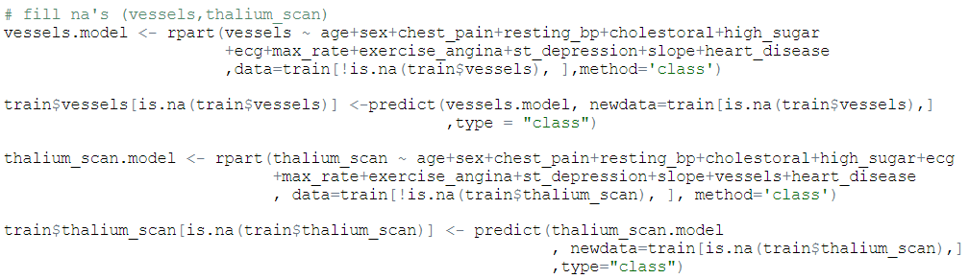
實驗方法 模型 – logistic regression (fINAL
Formula:
resting_bp_without_label + slope_label + chest_pain + vessels + thalium_scan_1 + thalium_scan_3
說明:
補了NA項
vessels
thalium_scan
以decision tree, 拿沒有NA的column項來預測遺失值

Slide 14
實驗方法 模型 – logistic regression (FINAL
resting_bp_without_label
用kmeans 跑區間
最後分出5個區間:
(93, 113, 133, 160, 192)
slope_label
origin category: 0,1,2
Since distribution like the table below
category = 0 => 0
category = 1,2 => 1
 | slope | Heart_disease
0 | 1 | 0.283
1 | 2 | 0.657
2 | 3 | 0.500

Slide 15
實驗方法 模型 – logistic regression (FINAL
thalium_scan
Origin: 3,6,7 => transform to 1,2,3
One – hot encoding
Important Concept
Since there are three categories, but we actually only need two categories to represent
So, we use thalium_scan_1 + thalium_scan_3 as feature

Slide 16
實驗方法 模型 – logistic regression (FINAL
Result:
Public score: 0.90909
Private score: 0.86792
other parameters: seed(4)

Slide 17
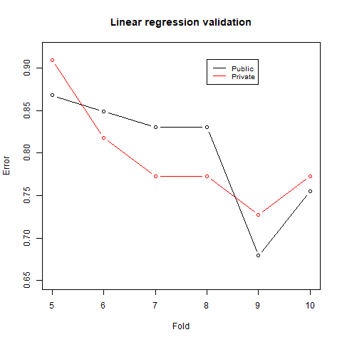
實驗方法 模型 – logistic regression (FINAL
Other interesting results:

Slide 18
實驗方法 模型 – logistic regression (FINAL
Other tries:
Change the seed used to shuffle the data order
The way we cut into fold is important, it can be improved if we make some tricks before cut
seed | public score | private score
4 | 0.86792 | 0.90909
10 | 0.83018 | 0.81818

Slide 19
程式 Demo

Slide 20
Any questions
END

