Slide 1
資料科學期末報告
組員：
資科碩一 王柏仁108753204
資科碩一 蕭郁君109753203

Slide 2
大綱
簡介
資料輸入與輸出
實驗方法
資料前處理
模型
實驗結果
程式 Demo

Slide 3
簡介 比賽內容

Slide 4
簡介 分工
模型 - logistic regression : 蕭郁君

Slide 5
資料輸入與輸出

Slide 6
實驗方法 資料前處理

Slide 7
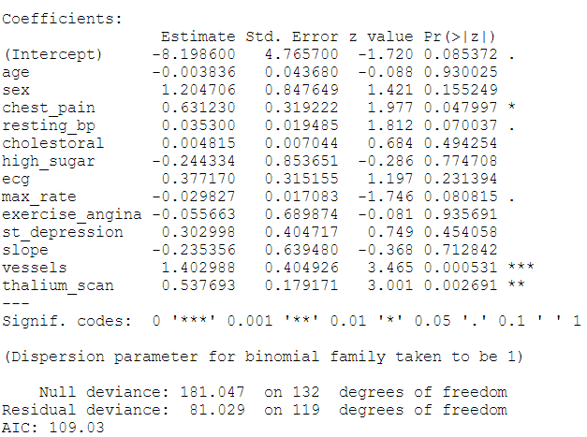
實驗方法 模型 – logistic regression
with all fearures:
p < 0.05
chest_pain
vessels
thalium_scan

Slide 8
實驗方法 模型 – logistic regression
baseline: (after some try)
feature => chest_pain+vessels+thalium_scan+resting_bp+max_rate (without doing any thing
Public score: 0.86363
Private score: 0.75471

Slide 9
實驗方法 模型 – logistic regression
Process : (a small mistake, so only train fold one data by 5 fold)
feature => chest_pain+vessels+thalium_scan+resting_bp+max_rate (without doing any thing
Public score: 0.86363
Private score: 0.83018

Slide 10
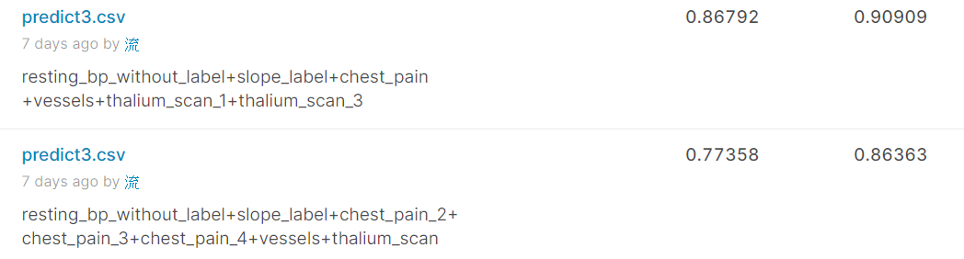
實驗方法 模型 – logistic regression
Process : (tries)
One hot encoding
(chest_pain, ecg, slope, thalium_scan)
age
cut into bins => nonsignificant
linear combinations
examine p-value

Slide 11
實驗方法 模型 – logistic regression (FINAL
resting_bp_without_label
用kmeans 跑區間
最後分出5個區間:
(93, 113, 133, 160, 192)
slope_label
origin category: 0,1,2
Since distribution like the table below
category = 0 => 0
category = 1,2 => 1
 | slope | Heart_disease
0 | 1 | 0.283
1 | 2 | 0.657
2 | 3 | 0.500

Slide 12
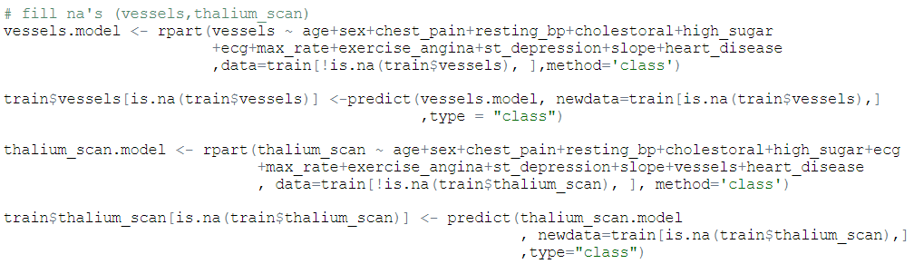
實驗方法 模型 – logistic regression (fINAL
Formula:
resting_bp_without_label + slope_label + chest_pain + vessels + thalium_scan_1 + thalium_scan_3
說明:
補了NA項
vessels
thalium_scan
以decision tree, 拿沒有NA的column項來預測遺失值

Slide 13
實驗方法 模型 – logistic regression (FINAL
resting_bp_without_label
用kmeans 跑區間
最後分出5個區間:
(93, 113, 133, 160, 192)
slope_label
origin category: 0,1,2
Since distribution like the table below
category = 0 => 0
category = 1,2 => 1
 | slope | Heart_disease
0 | 1 | 0.283
1 | 2 | 0.657
2 | 3 | 0.500

Slide 14
實驗方法 模型 – logistic regression (FINAL
thalium_scan
Origin: 3,6,7 => transform to 1,2,3
One – hot encoding
Important Concept
Since there are three categories, but we actually only need two categories to represent
So, we use thalium_scan_1 + thalium_scan_3 as feature

Slide 15
實驗方法 模型 – logistic regression (FINAL
choose model by 5- fold cross validation and evaluated by accuracy
Public score: 0.90909
Private score: 0.86792
other parameters: seed(4)

Slide 16
實驗方法 模型 – logistic regression (FINAL
Other interesting results:
Private Public
5: 0.86792 0.90909
6: 0.84905 0.81818
7: 0.83018 0.77272
8:
9:
10 …..
(麻煩圖片

Slide 17
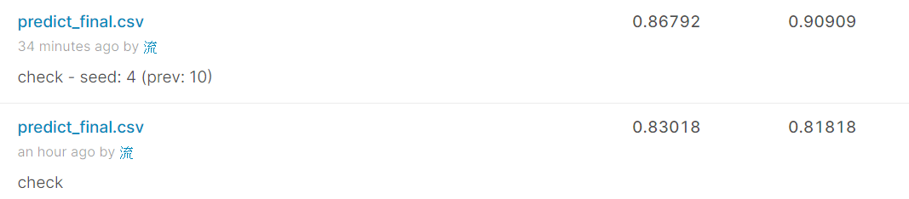
實驗方法 模型 – logistic regression (FINAL
Other tries:
Change the seed used to shuffle the data order
The way we cut into fold is important, it can be improved

Slide 18
實驗結果

Slide 19
程式 Demo

Slide 20
Any questions
END

