Slide 1


Slide 2
Data Science _ Final Project
California Housing Price Prediction
Group 6
107363015 郭育丞
108971017 劉書傳

Slide 3
About the Dataset
California Housing Prices dataset from 1990 on Kaggle
A modified version of the California Housing dataset available from Luís Torgo's page.
Appeared in a 1997 paper titled Sparse Spatial Autoregressions by Pace, R. Kelley and Ronald Barry
20, 640 observations
10 attributes (9 predictors and 1 response)

Slide 4
Features of the Dataset
longitude: A measure of how far west a house is
latitude: A measure of how far north a house is
housing_median_age: Median age of a house within a block
total_rooms: Total number of rooms within a block
total_bedrooms: Total number of bedrooms within a block
population: Total number of people residing within a block
households: Total number of households, a group of people residing within a home unit, for a block
median_income: Median income for households within a block of houses (measured in 10,000$)
ocean_proximity: Location of the house
median_house_value: Median house value for households within a block (measured in US Dollars)

Slide 5
End-to-End ML Project Steps [1]
1. Define business object
2. Make sense of the data from a high level
3. Create the training and test sets using proper sampling methods, e.g., random vs. stratified
4. Correlation analysis (pair-wise and attribute combinations)
5. Data cleaning (missing data, outliers, data errors)
6. Data transformation via pipelines (categorical text to number using one hot encoding, feature scaling via normalization/standardization, feature combinations)
Ref : California Housing Data (1990) on Kaggle

Slide 6
End-to-End ML Project Steps [2]
7. Train and cross validate different models and select the most promising one (Linear Regression, Decision Tree, and Random Forest were tried in this tutorial)
8. Fine tune the model using trying different combinations of hyperparameters
9. Evaluate the model with best estimators in the test set
10. Launch, monitor, and refresh the model and system
Ref : California Housing Data (1990) on Kaggle

Slide 7


Slide 8
Our Project Steps
Splitting dataset
Missing value implementation
EDA (Exploratory Data Analysis)
Feature Engineering
Standardization & Normalization
Building up models on train dataset
Test models on test_30 to get our public score
Test models on test_100 to get our final score

Slide 9
(1) Splitting dataset
1. Sampling 70% of the original dataset as our raw dataset.
2. Split the data into train dataset & test dataset.
3. Further split test dataset into test_30 & test_70 with 30% & 70% of the test dataset respectively.
4. train is what we have to train model.
5. test_30 is used to yield the public score on Kaggle.
6. test_70 is used to yield the private score on Kaggle.

Slide 10

(2) Missing value implementation
1. Implement the MVs by train data and test data respectively.
2. If we Implement the MVs by whole data, then “data leakage” happens and the result would be overfitting.
Ref : Ariga, M., Nakayama, S., Nishibayashi, T. (2018). Machine Learning at Work.

Slide 11
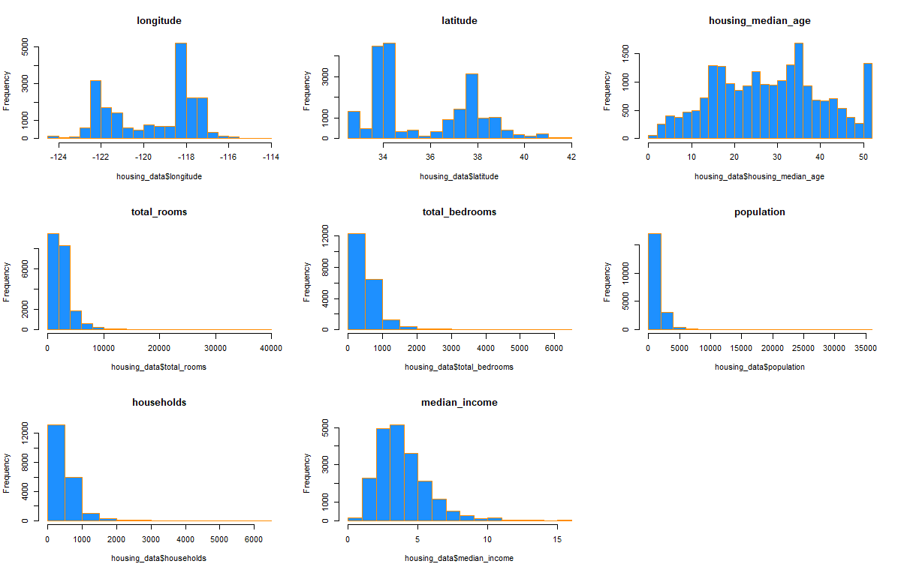
Variables distribution
(3) EDA (Exploratory Data Analysis) [1]
rBayesianOptimization

Slide 12
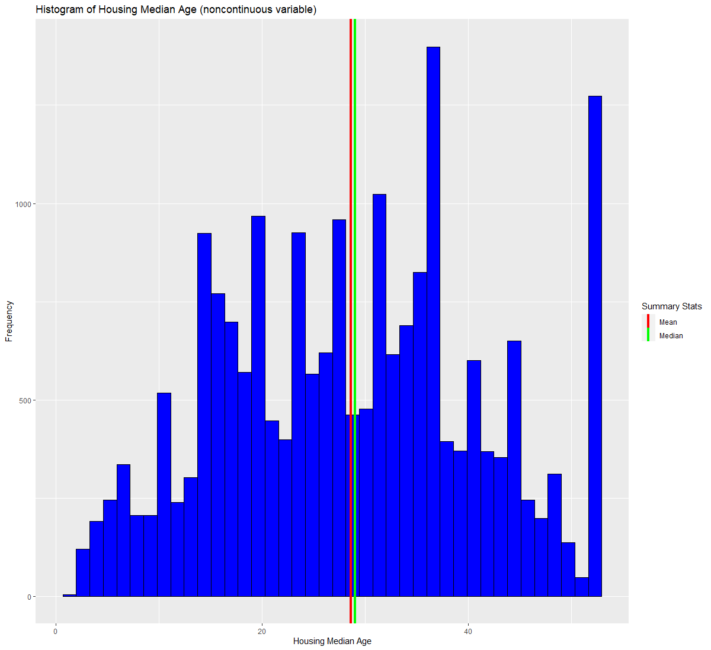
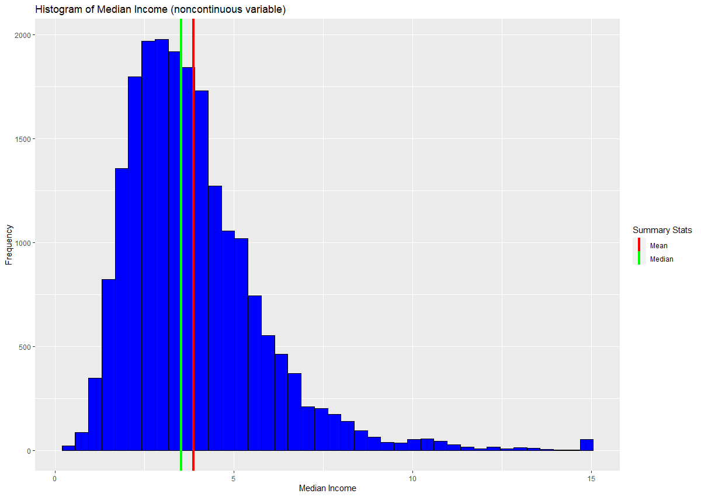
(3) EDA (Exploratory Data Analysis) [2]

Slide 13
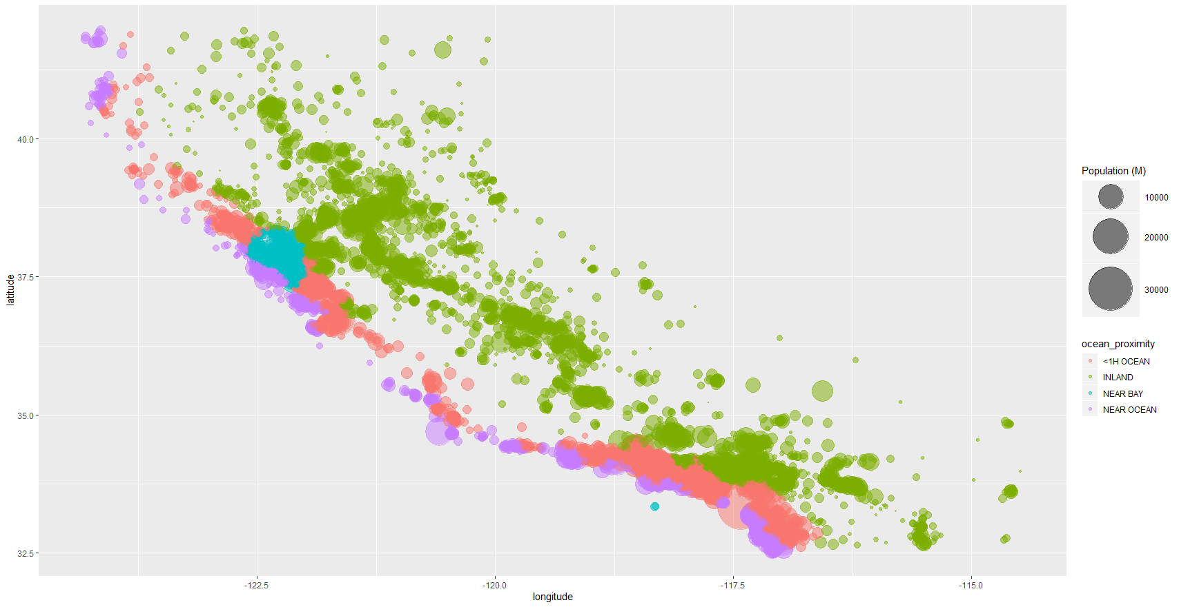
(3) EDA (Exploratory Data Analysis) [3]
Bubble plot

Slide 14
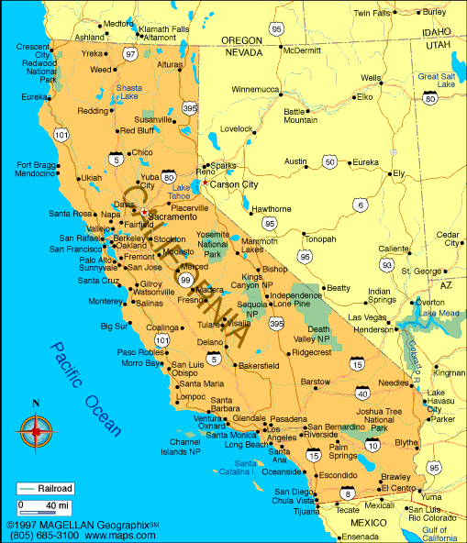


Slide 15
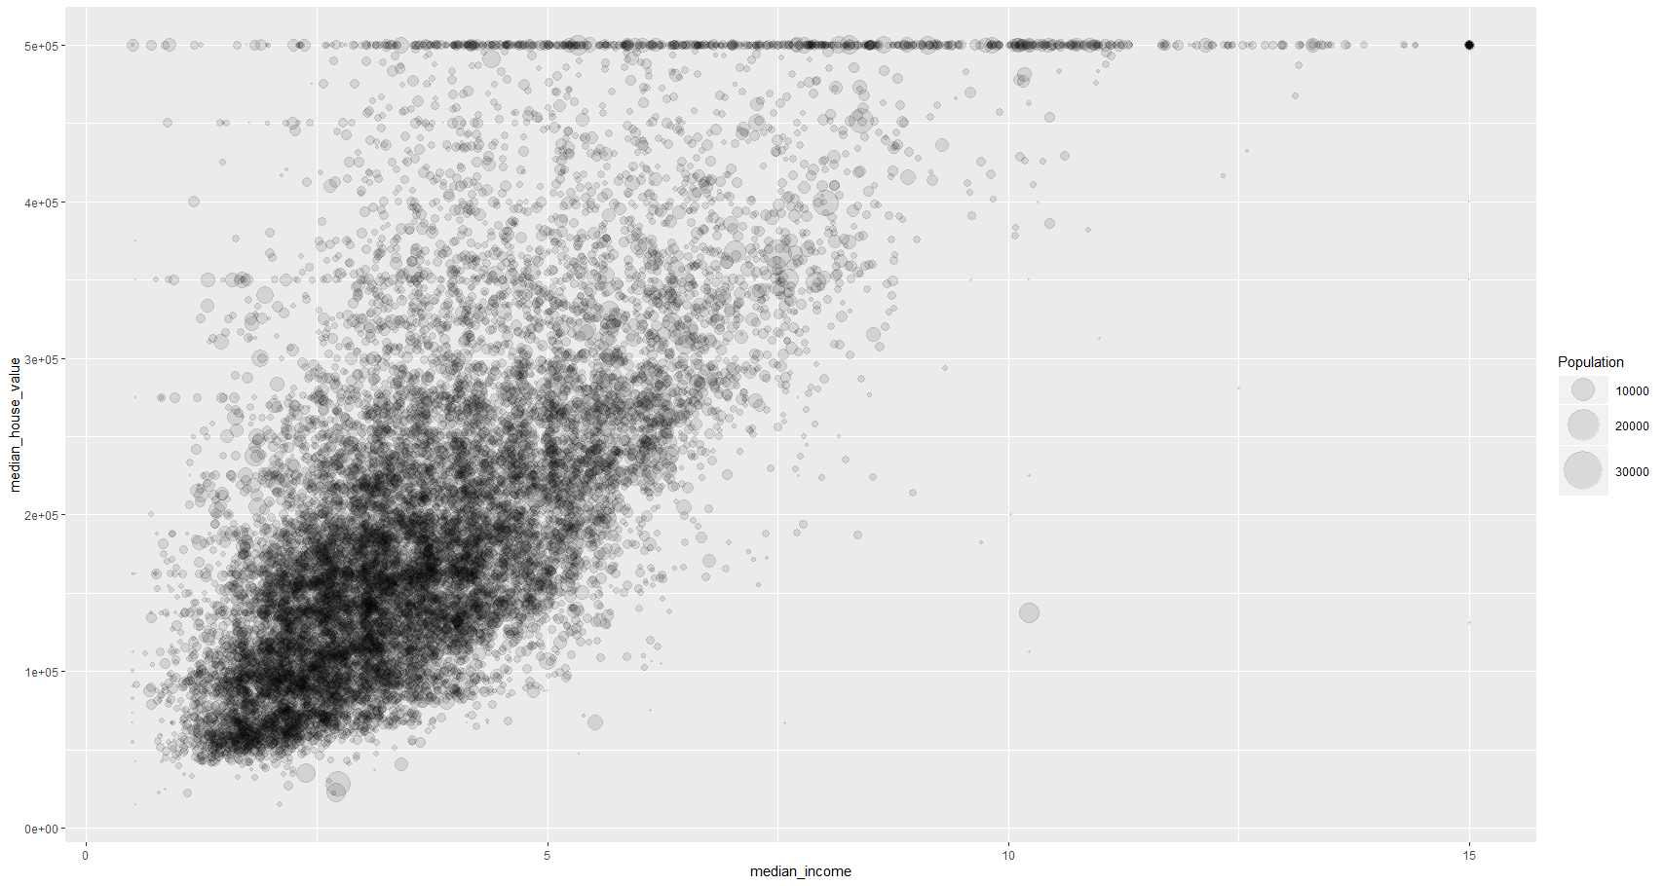
(3) EDA (Exploratory Data Analysis) [4]
Bubble plot

Slide 16
(4) Feature Engineering [1]
1. Create new variable terms
---- population_per_household
---- bedrooms_per_room
---- rooms_per_household
2. Use linear regression & RF to choose variables
importance(RF_model)
Ref : California Housing Prices https://jmyao17.github.io/Kaggle/California_Housing_Prices.html

Slide 17
(4) Feature Engineering [2]
importance(rf01,1)
# %IncMSE
# longitude 25.69620
# latitude 30.17928
# housing_median_age 43.77487
# total_rooms 13.99986
# total_bedrooms 17.31159
# population 11.77426
# households 13.73750
# median_income 61.48248
# ocean_proximity 61.04503
# population_per_household 63.91720
# bedrooms_per_room 17.43240
# rooms_per_household 16.25610
importance(rf01, 1)
# %IncMSE
# median_income 105.69750
# ocean_proximity 87.70960
# latitude 38.55366
# longitude 49.67933
# housing_median_age 61.37681
# households 18.60663
# total_rooms 21.33286
# population_per_household 125.71593
# bedrooms_per_room 28.13585
# rooms_per_household 27.52476
** %IncMSE is the most robust and informative measure compared to IncNodePurity
Ref : In a random forest, is larger %IncMSE better or worse? (2016). https://bit.ly/2BeuUAR

Slide 18
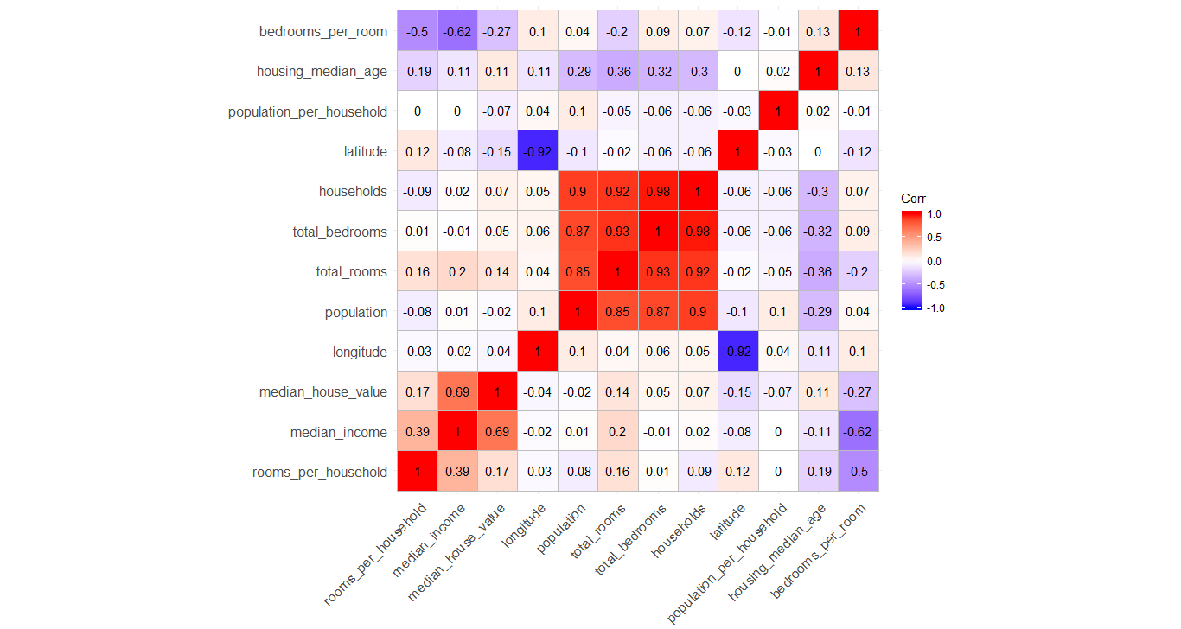
(4) Feature Engineering [3]

Slide 19
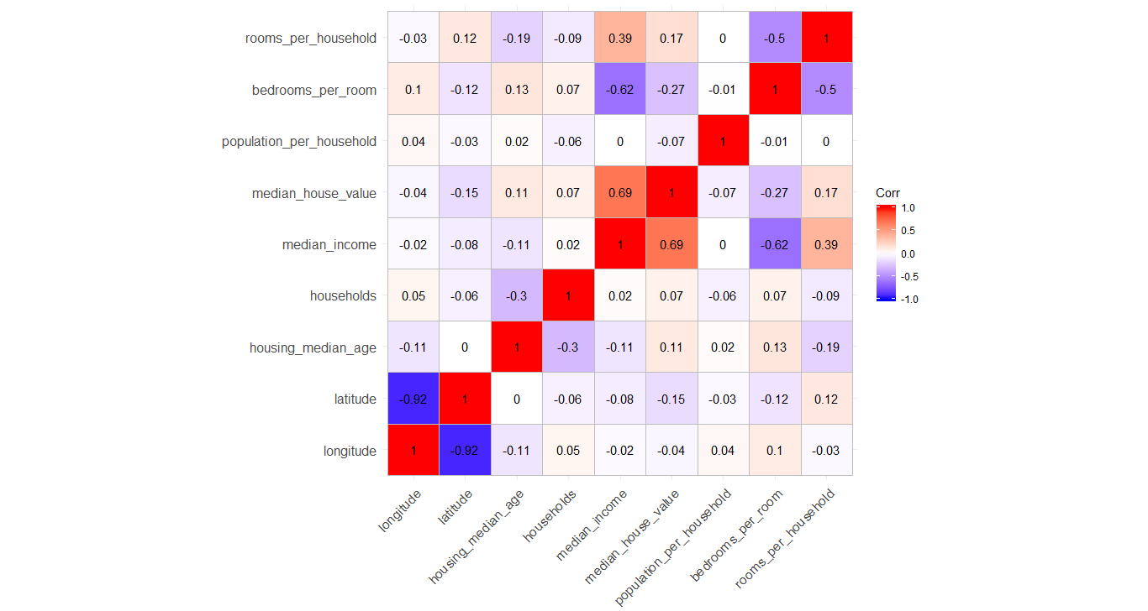
(4) Feature Engineering [4]

Slide 20
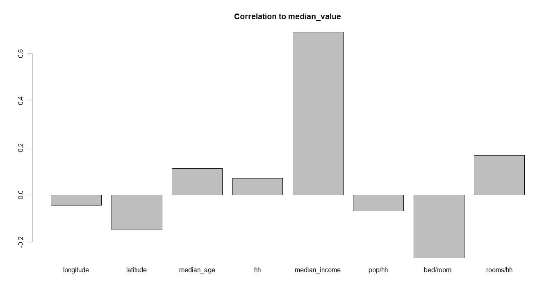
(4) Feature Engineering [5]

Slide 21
(5) Standardization & Normalization _ [1]
[ Standardization ]
(1) Affected by the scale
1. KNN 2. K-means 3. PCA, LDA
4. Logistic / Linear regression 5. SVM
6. NN
(2) NOT affected by the scale
treelike methods
(3) Use scale( ) to standardize
Ref : Ozdemir, S., Susarla, D. (2018). Feature Engineering Made Easy.

Slide 22
(5) Standardization & Normalization _ [2]
[ Standardization ]
We tried scale( ), but due to the property of the dataset, it didn’t yield better prediction results. It’s because the ones with bigger scale happen to be the more influential predictors.
Ref : Ozdemir, S., Susarla, D. (2018). Feature Engineering Made Easy.

Slide 23
(5) Standardization & Normalization _ [3]
[ Normalization ]
(1) Affected by the distribution
Only Logistic / Linear regression
(2) NOT affected by the distribution
The others, i.e. KNN , K-means, PCA, LDA, SVM, NN, treelike methods
(3) Use log( ) to normalize.
Ref : Ozdemir, S., Susarla, D. (2018). Feature Engineering Made Easy.

Slide 24
(5) Standardization & Normalization _ [4]
[ Normalization ]
We didn’t use log( ) to normalize since only the regression model could benefit from this action, and regression model isn’t our ideal model for prediction.
Ref : Ozdemir, S., Susarla, D. (2018). Feature Engineering Made Easy.

Slide 25
(6) Building models [01] Overall
Try every model by a split of (train, test) = (0.8, 0.2). NOT k-fold. Use MAPE to evaluate models.
1. linear regression: first order / lasso / elastic net
2. SVM
3. RF
4. GBT
5. Stacking

Slide 26
(6) Building models [02] Null Model
regr.eval(Data_train$median_house_value, dist_train)
# mae mse rmse mape
# 9.213218e+04 1.354364e+10 1.163771e+05 6.217385e-01
regr.eval(Data_test$median_house_value, dist_test)
# mae mse rmse mape
# 9.330438e+04 1.354752e+10 1.163938e+05 6.363672e-01

Slide 27
(6) Building models [03] Regression with first order
regr.eval(Data_train$median_house_value, dist_train)
# mae mse rmse mape
# 5.014067e+04 4.693704e+09 6.851061e+04 2.913840e-01
regr.eval(Data_test$median_house_value, dist_test)
# mae mse rmse mape
# 5.001414e+04 4.613932e+09 6.792593e+04 2.904215e-01

Slide 28
(6) Building models [04] Stepwise Regression
regr.eval(Data_train$median_house_value, step01)
# mae mse rmse mape
# 4.937236e+04 4.600638e+09 6.782800e+04 2.894012e-01
regr.eval(Data_test$median_house_value, step02)
# mae mse rmse mape
# 4.913165e+04 4.519027e+09 6.722371e+04 2.863699e-01

Slide 29
(6) Building models [05] Ridge Regression
alpha = 1
regr.eval(Data_train$median_house_value, pred_train)
# mae mse rmse mape
# 5.042093e+04 4.819133e+09 6.941998e+04 2.891660e-01
regr.eval(Data_test$median_house_value, pred_test)
# mae mse rmse mape
# 5.028658e+04 4.741019e+09 6.885506e+04 2.908131e-01

Slide 30
(6) Building models [06] Lasso Regression
alpha = 0
regr.eval(Data_train$median_house_value, lasso.train)
# mae mse rmse mape
# 4.931621e+04 4.614774e+09 6.793213e+04 2.855915e-01
regr.eval(Data_test$median_house_value, lasso.test)
# mae mse rmse mape
# 4.910622e+04 4.535826e+09 6.734854e+04 2.834369e-01

Slide 31
(6) Building models [07] Elastic Net Regression
We choose alpha = 0.5 since Lander, J. P. recommend to choose alpha < 0.5
regr.eval(Data_train$median_house_value, pred_train)
# mae mse rmse mape
# 4.931511e+04 4.616502e+09 6.794485e+04 2.855094e-01
regr.eval(Data_test$median_house_value, pred_test)
# mae mse rmse mape
# 4.911146e+04 4.538234e+09 6.736642e+04 2.833860e-01
Ref : Lander, J. P. (2017). R for Everyone: Advanced Analytics and Graphics, 2nd Edition.

Slide 32
(6) Building models [08] Summarize results to this point
(Null) 6.363672e-01 => (First order) 2.904215e-01 => (Stepwise)2.863699e-01 => (Ridge) 2.908131e-01 => (Lasso) 2.834369e-01 => (Elastic net) 2.833860e-01
Lasso usually performs better than Ridge according to practical experience.
Ref : Lander, J. P. (2017). R for Everyone: Advanced Analytics and Graphics, 2nd Edition.

Slide 33
(6) Building models [09] SVM
regr.eval(Data_train$median_house_value, rf_train)
# mae mse rmse mape
# 3.009128e+04 2.298531e+09 4.794300e+04 1.555334e-01
regr.eval(Data_test$median_house_value, rf_test)
# mae mse rmse mape
# 3.733928e+04 3.205611e+09 5.661811e+04 1.978888e-01

Slide 34
(6) Building models [10] SVM_02
svmM <- ksvm(FormulaV,data=Data_train, kernel=‘rbfdot’, C=10 , prob.model=T,cross=5)
Key parameter : C

Slide 35
(6) Building models [11] Random Forest
regr.eval(Data_train$median_house_value, rf_train)
# mae mse rmse mape
# 1.442719e+04 4.902147e+08 2.214079e+04 8.014738e-02
regr.eval(Data_test$median_house_value, rf_test)
# mae mse rmse mape
# 3.382165e+04 2.607849e+09 5.106711e+04 1.849024e-01

Slide 36
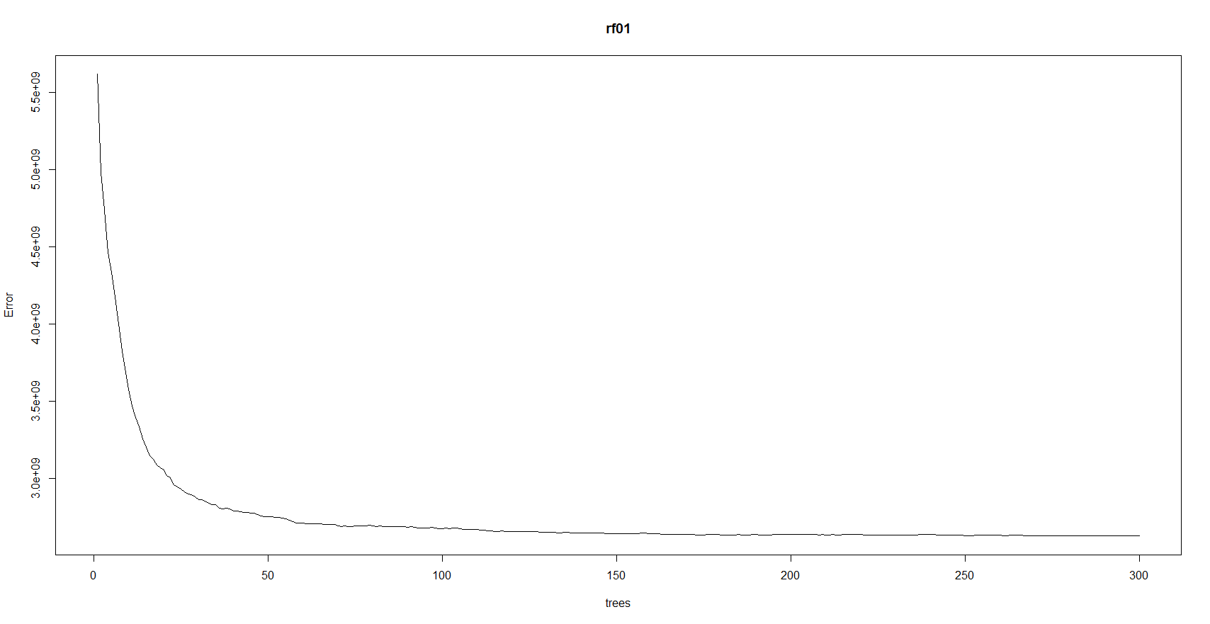
(6) Building models [12] Random Forest_02
rf01 <- randomForest(median_house_value ~ median_income + ocean_proximity +latitude + longitude +housing_median_age + households + total_rooms +population_per_household +bedrooms_per_room + rooms_per_household , data = Data_train ,
ntree = 300, mtry = 6, importance = T, replace = T)
tuneRF(Data_train[,-10], Data_train[,10]) # mtry = 6
# mtry OOBError
# 2 2 3080490877
# 4 4 2804299684
# 8 8 2865183670
plot(rf01)

Slide 37
(6) Building models [13] Random Forest – feature engineering
importance(rf01,1)
# %IncMSE
# longitude 25.69620
# latitude 30.17928
# housing_median_age 43.77487
# total_rooms 13.99986
# total_bedrooms 17.31159
# population 11.77426
# households 13.73750
# median_income 61.48248
# ocean_proximity 61.04503
# population_per_household 63.91720
# bedrooms_per_room 17.43240
# rooms_per_household 16.25610
importance(rf01, 1)
# %IncMSE
# median_income 105.69750
# ocean_proximity 87.70960
# latitude 38.55366
# longitude 49.67933
# housing_median_age 61.37681
# households 18.60663
# total_rooms 21.33286
# population_per_household 125.71593
# bedrooms_per_room 28.13585
# rooms_per_household 27.52476
** %IncMSE is the most robust and informative measure compared to IncNodePurity
Ref : In a random forest, is larger %IncMSE better or worse? (2016). https://bit.ly/2BeuUAR

Slide 38
(6) Building models [14] Gradient boosting tree
regr.eval(Data_train$median_house_value, xgb_train)
# mae mse rmse mape
# 1.158997e+04 2.620055e+08 1.618658e+04 6.790063e-02
regr.eval(Data_test$median_house_value, xgb_test)
# mae mse rmse mape
# 3.238790e+04 2.352802e+09 4.850569e+04 1.762927e-01

Slide 39
(6) Building models [15] Gradient boosting tree_02
xgb.params = list(
colsample_bytree = 0.5,
# col sampling proportion. Higher -> complexity up
subsample = 0.5, # row sampling proportion. Higher -> complexity up
booster = "gbtree",
max_depth = 4, # max depth of a tree. Higher -> complexity up
eta = 0.03, # boosting would increase the weight of wrong classification. Higher -> complexity down
eval_metric = "rmse", # rmse or mae
objective = "reg:linear",
gamma = 0 # Higher -> complexity down)

Slide 40
(6) Building models [16] Gradient boosting tree_03
cv.model = xgb.cv(
params = xgb.params,
data = dtrain,
nfold = 5, # 5-fold cv
nrounds = 130, # Trees
early_stopping_rounds = 100, # stop searching if overfitting happens when nrounds < some number
print_every_n = 100)

Slide 41
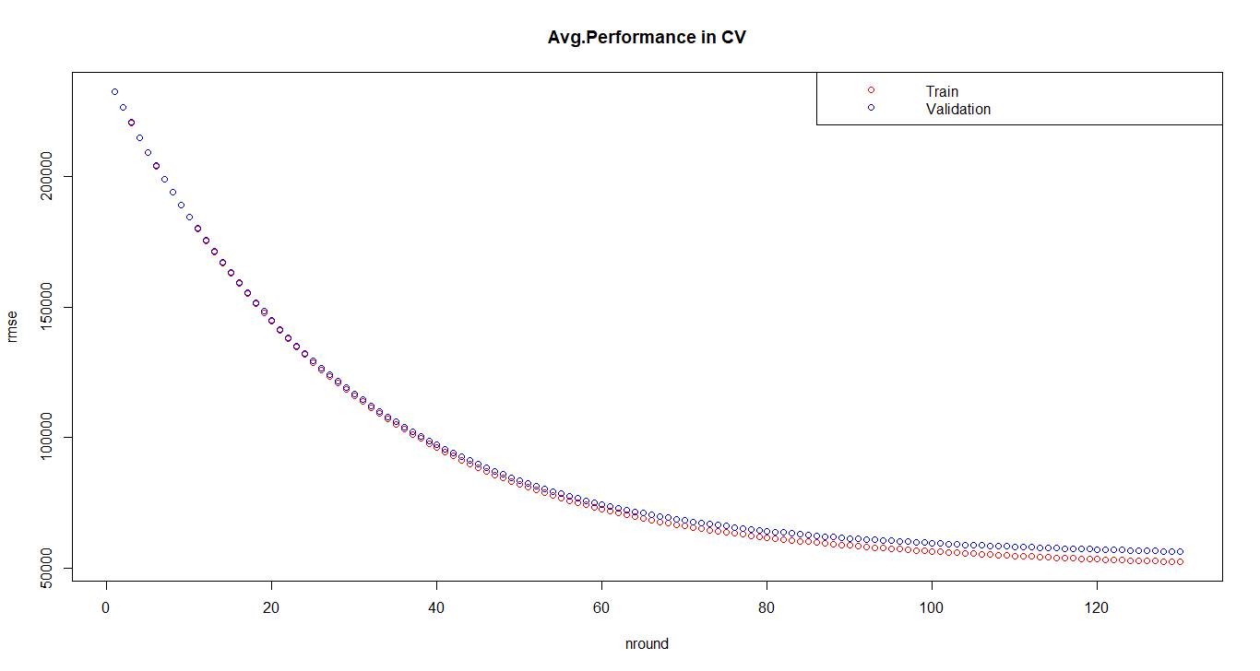
(6) Building models [17] Gradient boosting tree_04

Slide 42
(6) Building models [18] Summarize results to this point
(Null) 6.363672e-01 => (First order) 2.904215e-01 => (Stepwise)2.863699e-01 => (Lasso) 2.834369e-01 =>
(Elastic net) 2.833860e-01
(SVM) 1.978888e-01 => (RF) 1.849024e-01 =>
(GBT) 1.762927e-01
Are our improvements significant?

Slide 43
(6) Building models [19] Repeat with 2-way k-fold
(train MAPE , test MAPE)
SVM = (0.158367, 0.1990491)
RF = (0.0786388, 0.1919612)
GBT = (0.06874047, 0.1849165)

Slide 44
(7) Test models on test_30 to get our public score
# 1st submission => SVM : 0.2463727
# 2st submission => RF : 0.1991604
# 3st submission => GBT : 0.1904664
# 4st submission => Stacking : 0.1872631
** Stacking = (RF+GBT) / 2

Slide 45
(8) Test models on test_100 to get our final score
# 1st submission => SVM : 0.2111227
# 2st submission => RF : 0.1943278
# 3st submission => GBT : 0.1852774
# 4st submission => Stacking : 0.1816812
** Stacking = (RF+GBT) / 2

Slide 46

We are GROUP 6. Thank you !
0.1816812

