Slide 1
Don’t Overfit Using Ensemble Methods to Model High Dimensional Data
Stefan Pieper

Slide 2
Background
Common in data science: large number of features, small sample
Notorious problem in health care
Also encountered it at work (insurance consultancy)
Often overfits
Many proposed models to reduce dimension or select features:
PCA
LASSO
Random Forest
Would a combination (ensemble methods) be effective?

Slide 3
Objective
Explore if an ensemble method is effective at modeling high dimensional data
Compare the performance of different models:
Rotation Forest vs. Random Forest vs. LASSO

Slide 4
Data
Kaggle competition: Don’t Overfit! II (2019)
20,000 total observations
300 features or variables
Binary target variable

Slide 5
Data
Train set:
250 observations (Less than amount of features!)
73.2% 0’s 26.8% 1’s
Test set:
19,750 observations
50% / 49.5% 0’s (private / public test set on Kaggle)
Not able to download response for test set

Slide 6


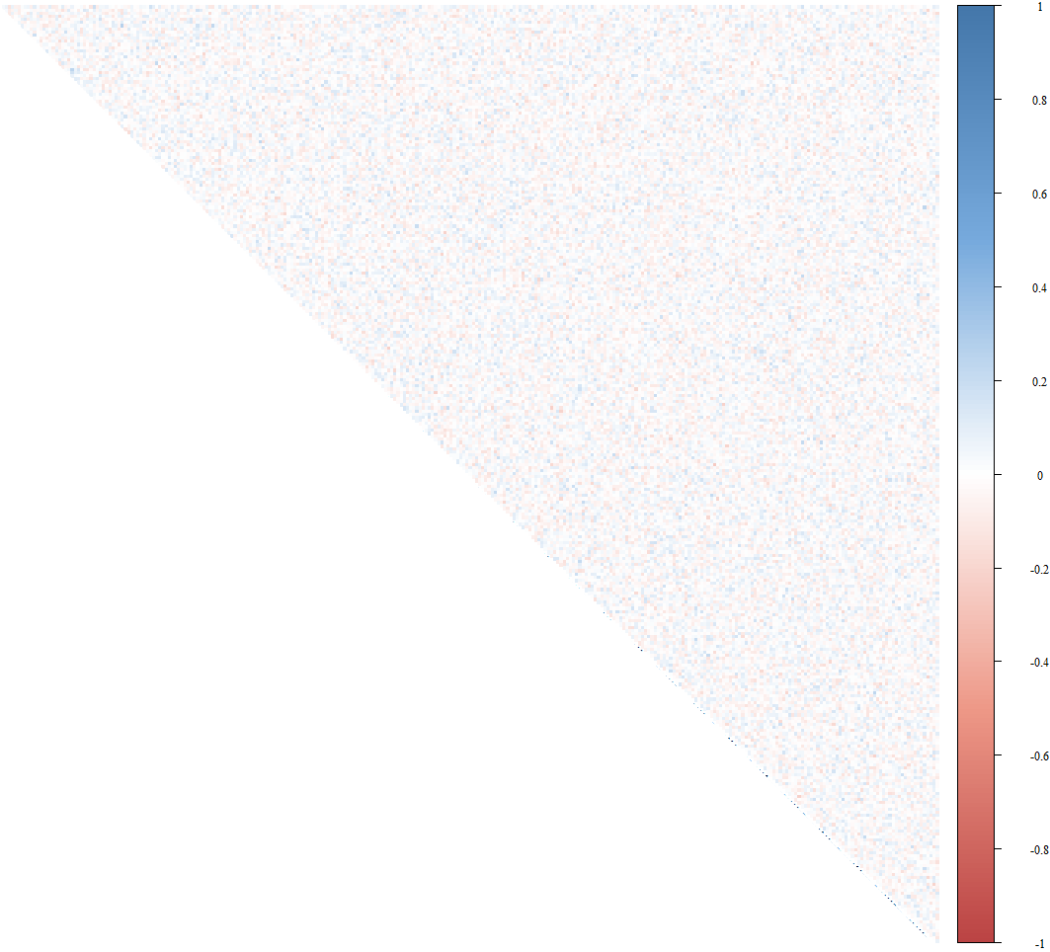



Not a lot of correlation….

Slide 7
Methodology
k-fold cross validation using four differnt models
Null model:
Only zero’s as prediction (no C.V.)
LASSO:
Vary in lambda
randomForest:
Vary in number of trees and replace (TRUE/FALSE)
rotationForest:
Vary in number of subsets and number of trees

Slide 8
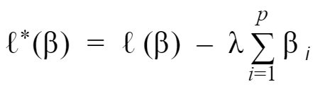
LASSO (Logistic) Package: randomForest
Feature selection model
Logistic regression
Mimimize penalized log likelihood:
ℓ (ℓ *): (penalized) log likelihood
λ: penalization factor
Variable for cross validation
β: coefficient of feature i
p: amount of features in data set
LASSO reduces some beta’s to 0 → reduces amount of variables

Slide 9
Random Forest Package: randomForest
Feature selection model
Bootstraps training data (takes samples with or without replacement)
Random sample of observations
Random sample of features
Decision tree on this sample
→ results in an expected value of 0 or 1

Slide 10
Random Forest
Repeats bootstrapping data and predicting 0 or 1 for this sample
→ results in many trees of many samples
These trees together are called a random forest
The algorithm then takes the average predicted value of each tree
Average > 0.5 → prediction is 1
Variable parameters:
number of trees
replace (if TRUE, take samples with replacement

Slide 11
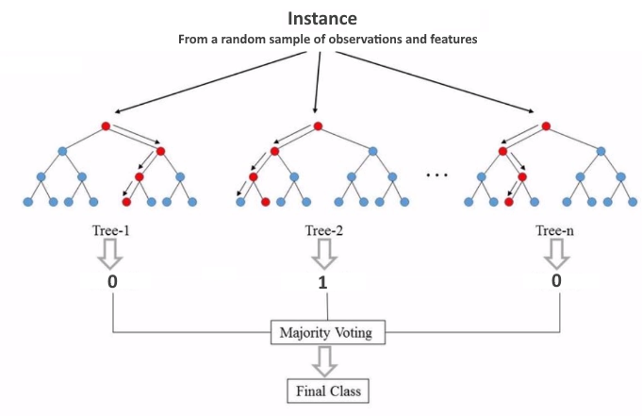

Slide 12
Rotation Forest Based on package: rotationForest
Similar to random forest, however:
Principal component analysis on K subsets of features
Loadings of the PCA of each K subset are combined into rotation matrix
Train and test data is projected on rotation matrix

Slide 13
Rotation Forest
For each decision tree:
K randomly selected non-overlapping subsets of features. For each subset:
Bootstrap 75% of the data
PCA rotates each boostrap sample into a set of orthogonal components
PCA loadings of all K subsets are put in a rotation matrix
Position of each component matches the position of its original feature
Training data is projected on rotation matrix (matrix multiplication)
Decision tree is build on the rotated training data
Test data is projected on rotation matrix
Decision tree makes prediction using this rotated test data

Slide 14
Rotation Forest
Variable parameters:
Number of trees
Number of subsets

Slide 15
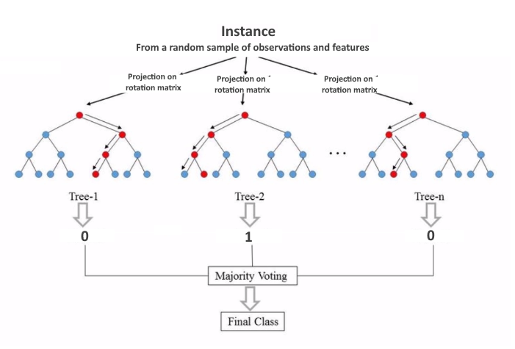

Slide 16
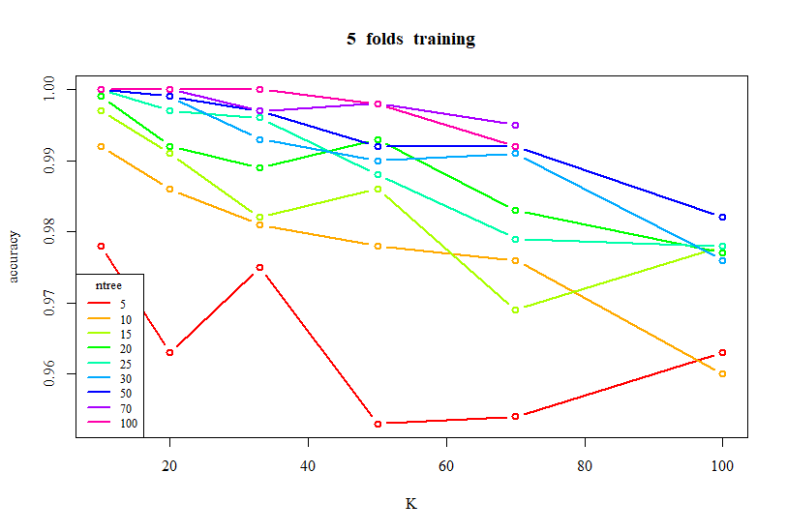
Results Rotation Forest (training accuracy)
Performs better as number of trees increases
Accuracy seems less ‘shocky’ as number of trees increases
Performs slightly worse as number of subsets increases
High accuracy at small K and large ntree might indicate overfitting

Slide 17
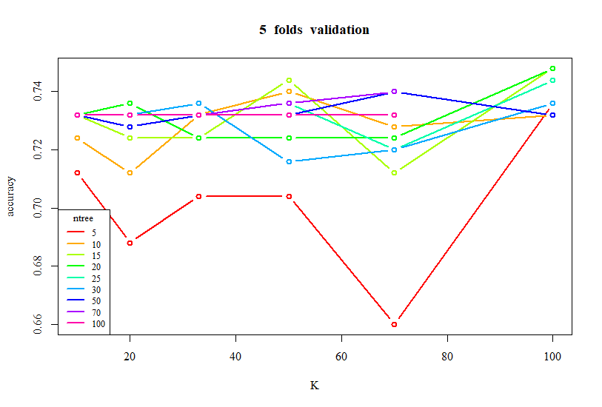
Results Rotation Forest (validation accuracy)
Performs slightly better as number of subsets increases
Performs similar for all number of trees except ntree = 5
Best model:
K = 100
Ntree = 48
Accuracy slightly better than using only zero’s (0.732)

Slide 18
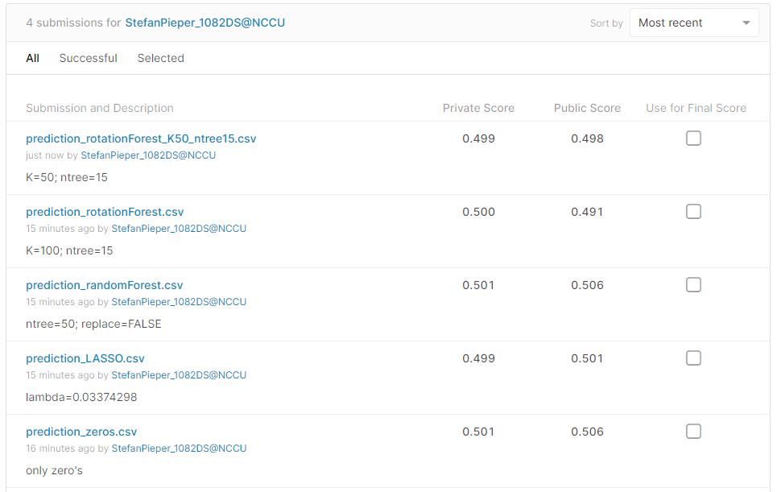
Results Kaggle accuracy
Bad accuracy
Highscore = 0.886
Random Forest performs the same as Null-model
Rotation Forest performs the worst
Difference insignificant
Previous uploads of same predictions resulted in slightly different accuracy

Slide 19
Conclusion & Discussion
All models still overfitted
None seem significantly better than Null-model
Possible explaination: not much correlation
→ PCA does not reduce dimensions effectively

Slide 20
Thanks for Listening Any Questions?

