Slide 1
HW4 Requirement

Slide 2
Keyword
A keyword is a tuple of [String name, Integer count, Double weight]
For example:
{
name: “Fang”,
count: 3,
Weight: 5.5
}
A key word should output in format [name,count,weight] :
[Fang,3,5.5]

Slide 3
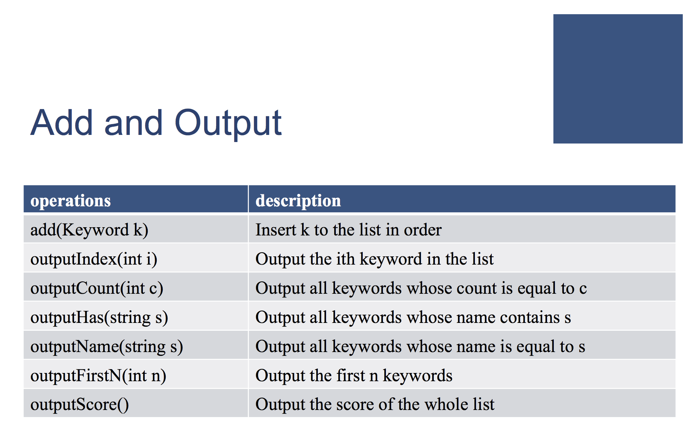

Slide 4
I/O Example: Add
Input:
Token1 : a constant “add”
Token2 : keyword name k
Token3: keyword count c
Token4: keyword weight w
EX:
To do: Insert a keyword [k,c,w] to the list in order
Output:
Simply output a line of constant “Done”
EX:
add Fang 3 0.5
Done

Slide 5
I/O Example: outputIndex
Input:
Token1 : a constant “outputIndex”
Token2 : an index i in our keyword list
EX:
To do: Output the ith keyword in the list
Output:
If i is out of bound, simply output a line of “InvalidOperation”:
If i is legal:
outputIndex 3
InvalidOperation
[NCCU,4,9.9]

Slide 6
I/O Example: outputCount
Input:
Token1 : a constant “outputCount”
Token2 : an integer c
EX:
To do: Output all keywords whose count is equal to c in order
Output:
If there is no keyword whose count is equal to c, simply output a line of constant “NotFound”:
If there’s any (split them in one space):
outputCount 4
NotFound
[NCCU,4,9.9] [MIS,4,3.3] [OK,4,2.2]

Slide 7
I/O Example: outputHas
Input:
Token1 : a constant “outputHas”
Token2 : a pattern string s
EX:
To do: Output all keywords whose name contains s
Output:
If there is no keyword whose name contains s, simply output a line of constant “NotFound”:
If there’s any (split them in one space):
outputHas ang
NotFound
[Fang,4,9.9] [Rang,4,3.3] [Stanger,4,2.2]

Slide 8
I/O Example: outputName
Input:
Token1 : a constant “outputName”
Token2 : a string s
EX:
To do: Output all keywords whose name is equal to s
Output:
If there is no keyword whose name is equal to s, simply output a line of constant “NotFound”:
If there’s any (split them in one space):
outputName Fang
NotFound
[Fang,4,9.9]

Slide 9
I/O Example: outputFirstN
Input:
Token1 : a constant “outputFirstN”
Token2 : an signed integer N
EX:
To do: Output the first N Keywords, if N <= size of list
Output:
If N > size of keyword list, simply output a line of constant “InvalidOperation”:
If N is legal (split them in one space):
outputFirstN 3
InvalidOperation
[Fang,4,9.9] [Rang,4,3.3] [Stanger,4,2.2]

Slide 10
I/O Example: outputScore
Input:
Token1 : a constant “outputScore”
EX:
To do: Output the score of the whole list
➔ Σ(count*weight)
Output:
Simply output a line of score
EX:
outputScore
108.5

Slide 11
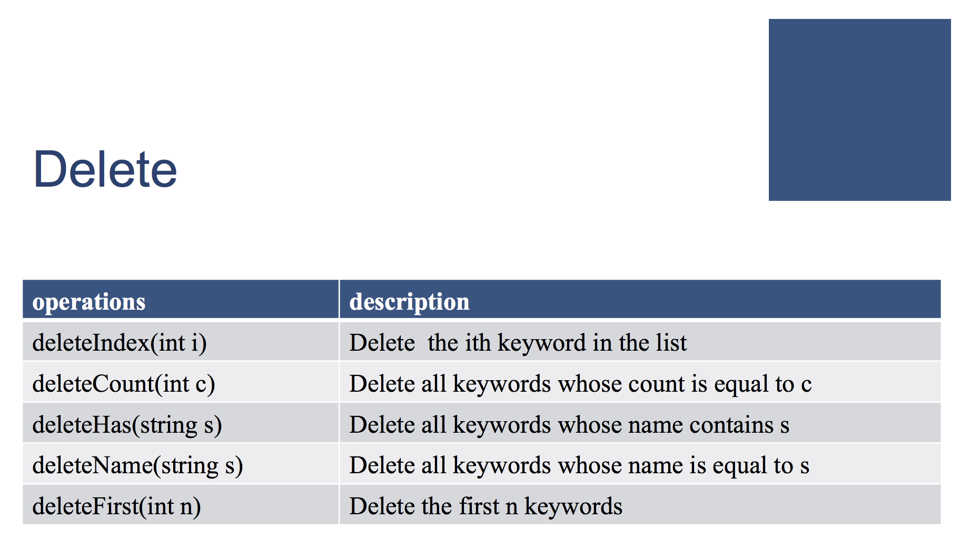

Slide 12
I/O Example: deleteIndex
Input:
Token1 : a constant “deleteIndex”
Token2 : an index i in our keyword list
EX:
To do: Delete the ith keyword in the list
Output:
If i is out of bound, simply output a line of “InvalidOperation”:
If i is legal, simply output a line of “Done”:
deleteIndex 3
InvalidOperation
Done

Slide 13
I/O Example: deleteCount
Input:
Token1 : a constant “deleteCount”
Token2 : an integer c
EX:
To do: Delete all keywords whose count is equal to c
Output:
If there is no keyword whose count is equal to c, simply output a line of constant “NotFound”:
If there’s any, simply output a line of “Done”
deleteCount 4
NotFound
Done

Slide 14
I/O Example: deleteHas
Input:
Token1 : a constant “deleteHas”
Token2 : a pattern string s
EX:
To do: Delete all keywords whose name contains s
Output:
If there is no keyword whose name contains s, simply output a line of constant “NotFound”:
If there’s any, simply output a line of “Done”:
deleteHas ang
NotFound
Done

Slide 15
I/O Example: deleteName
Input:
Token1 : a constant “deleteName”
Token2 : a string s
EX:
To do: Delete all keywords whose name is equal to s
Output:
If there is no keyword whose name is equal to s, simply output a line of constant “NotFound”:
If there’s any, Simply output a lline of “Done”:
deleteName Fang
NotFound
Done

Slide 16
I/O Example: deleteFirstN
Input:
Token1 : a constant “deleteFirstN”
Token2 : an signed integer N
EX:
To do: Delete the first N Keywords, if N <= size of list
Output:
If N > size of keyword list, simply output a line of constant “InvalidOperation”:
If N is legal, simply output a line of “Done”
deleteName Fang
InvalidOperation
Done

