Slide 1

Final Team Project
32-Row x1-Column Digital Computation-in-Memory Macro
for Matrix-Vector Multiplications
312514075 Jia-Jun Hu
312514086 Yu-cheng Pao
311514090 Cho-Ming Lo
312581006 Chen-Wei Chang

Slide 2
Content
1.
Results
Architecture trade-off
Matrix-Vector Multiplications
Pattern & Function correctness
Hspice
Hspice analylis
Demo

Slide 3
2.
Results - Throughputs
Throughputs $=\frac{\text{operation}}{\text{operation} \text{time}}=\frac{3200 }{38.6 ns}=82.9 (GOPS)$
operation = (The number of multiplications required to complete a complete operation) *2
= 32 * 2 * 50 = 3200
operation time = 51.5 * 0.75 ns(clk) = 38.6 ns
(The timing starts when the first input is given, and the timing stops when the last output is finished.)

Slide 4
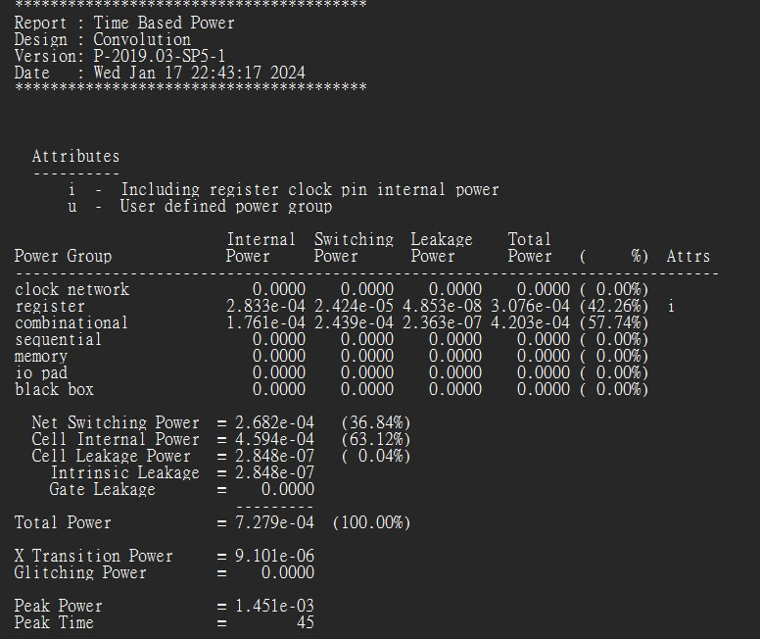
3.
Results – Energy efficiency
Energy efficiency $=\frac{82.9 GOPS}{7.279 × {10}^{−4} W}=113.35\left(\frac{TOPS}{W}\right)$

Slide 5
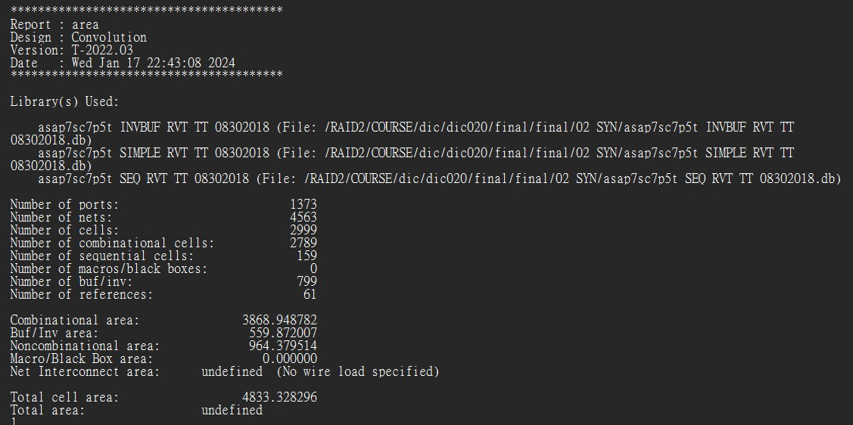
4.
Results – Area efficiency
Area efficiency $=\frac{82.9 GOPS}{4833.33 {μm}^{2}}=17.05 \left(\frac{TOPS}{{mm}^{2}}\right)$

Slide 6

5.
Architecture trade-off
Serial input & Parallel input
 | Serial input(2 cycles) | Parallel input
Clock cycle | 2*50 | 50
Area | 32reg(weight)+16reg(Ifm) +2reg(out_tmp) | 32reg(weight)+32reg(Ifm) +1reg(out_tmp)
Multiplier | 16 | 32

Slide 7
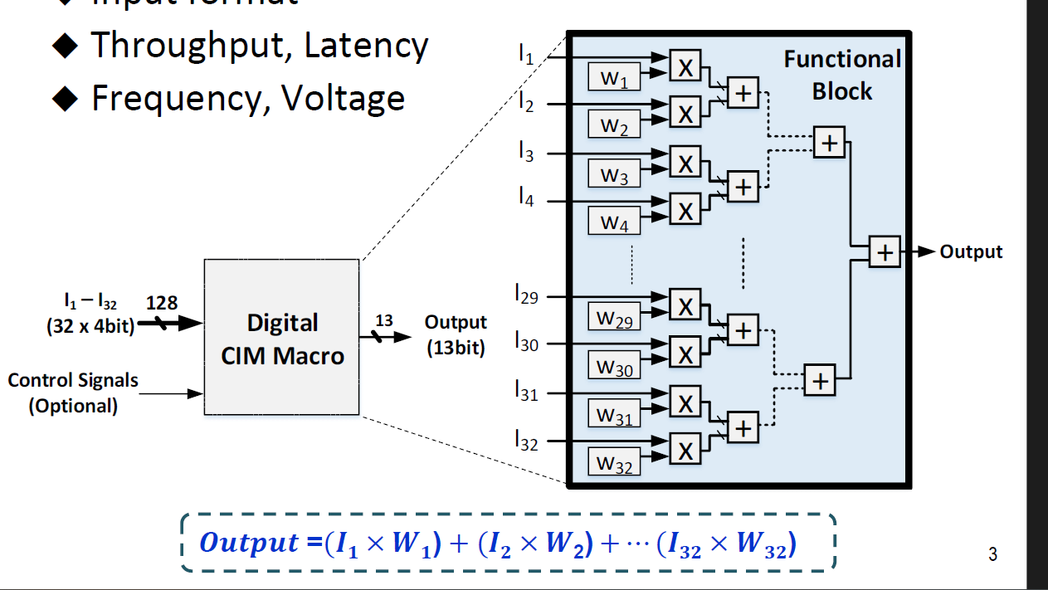
6.
Matrix-Vector Multiplications – pipeline
32 Multiplier
Register = 128bits Input_IFM + 128bits Input_Weight
+ 13bits Output_OFM + 13bits Reg_out *16 (pipeline)
Pipeline

Slide 8
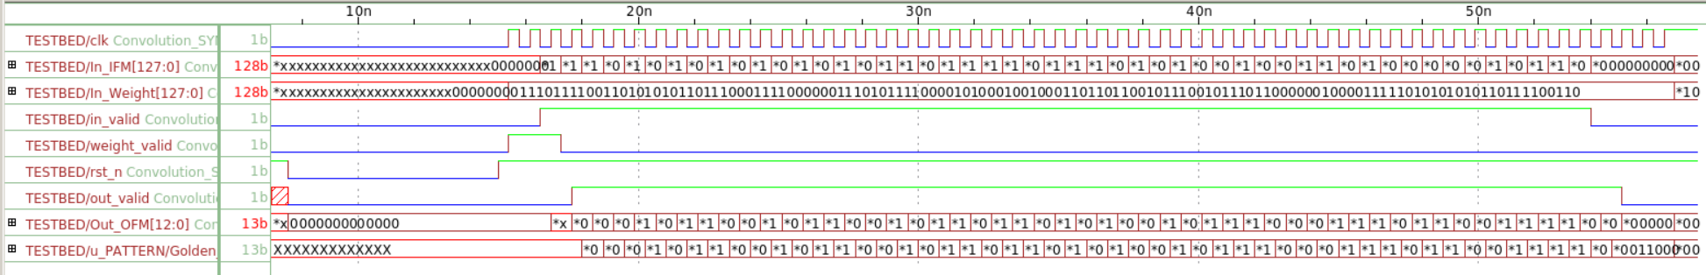
Pattern & Function correctness
7.
Signal
Input Feature Map
Weight
In valid
Weight valid
Reset
Out valid

Slide 9
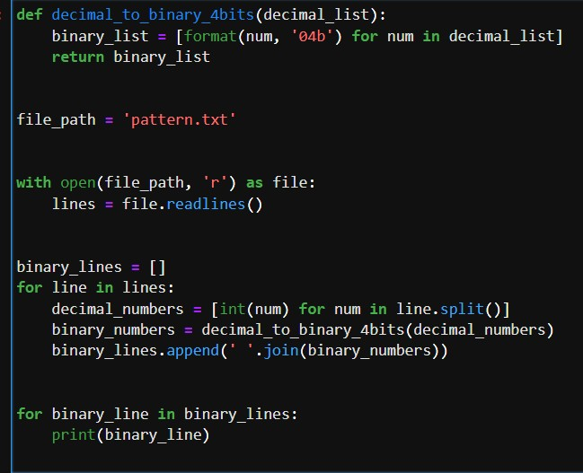
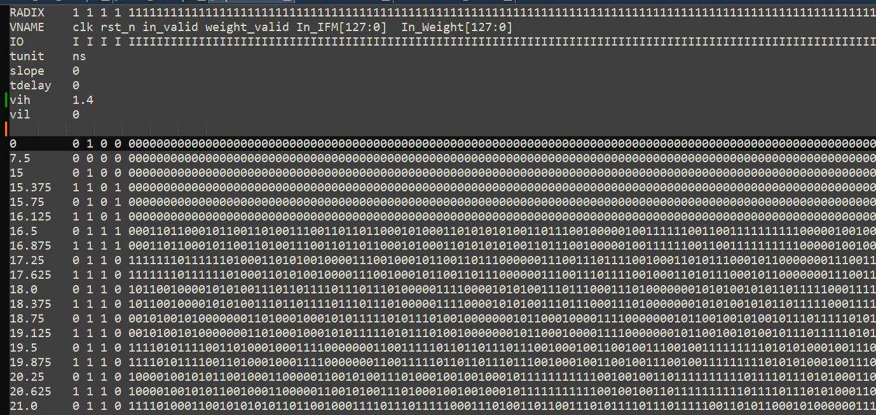
8.
Hspice – .vec file
Decimal to binary python code
.vec by python

Slide 10
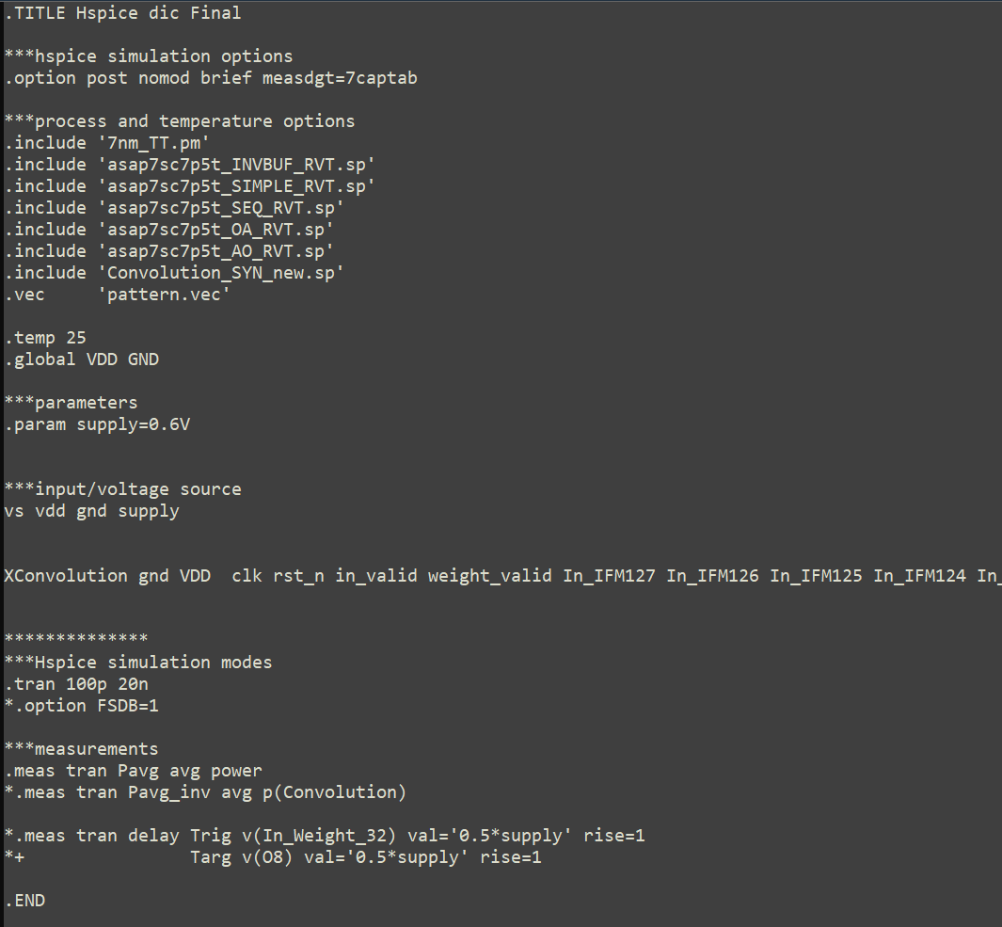
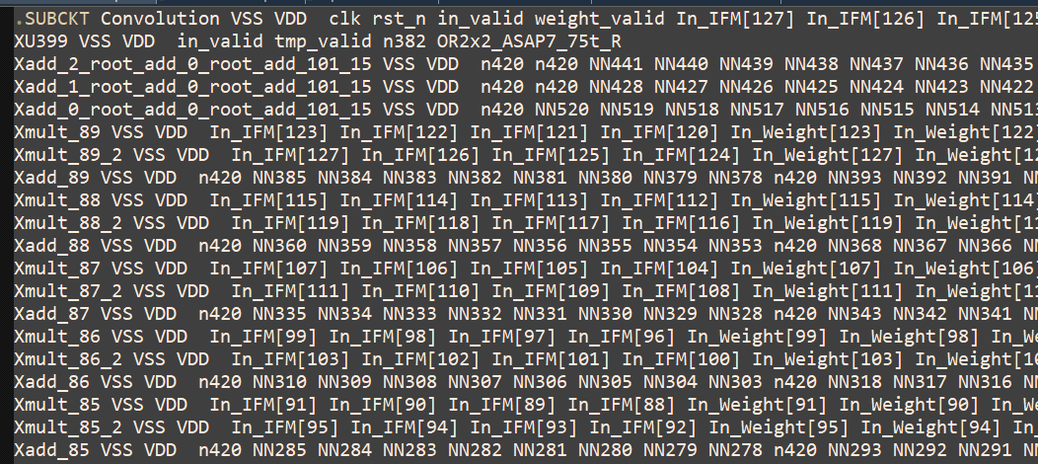
9.
Hspice – measurement
Verilog to spice
Hspice power measurement

Slide 11
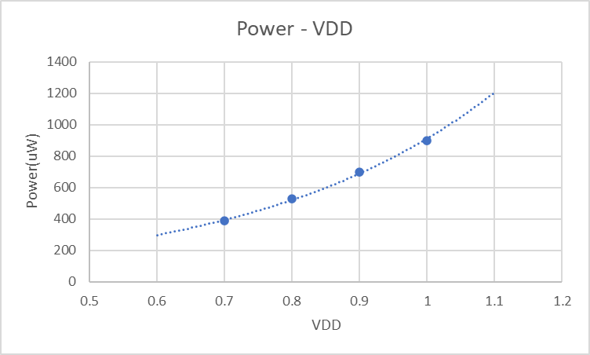
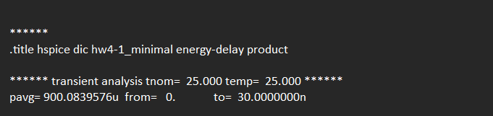
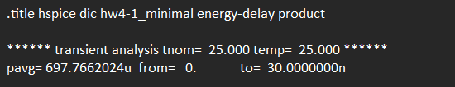
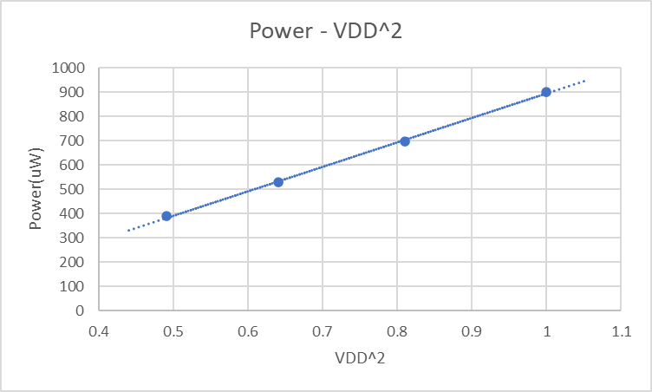

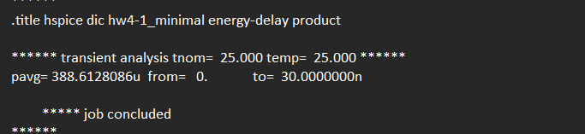
10.
Hspice Analylis
Voltage scaling
VDD = 1.0 V
VDD = 0.9 V
VDD = 0.8 V
VDD = 0.7 V

Slide 12
11.
Demo

