Slide 1
Prototype 2 Patent_parser_SelfDocs.ipynb
It can run your own documents

Slide 2
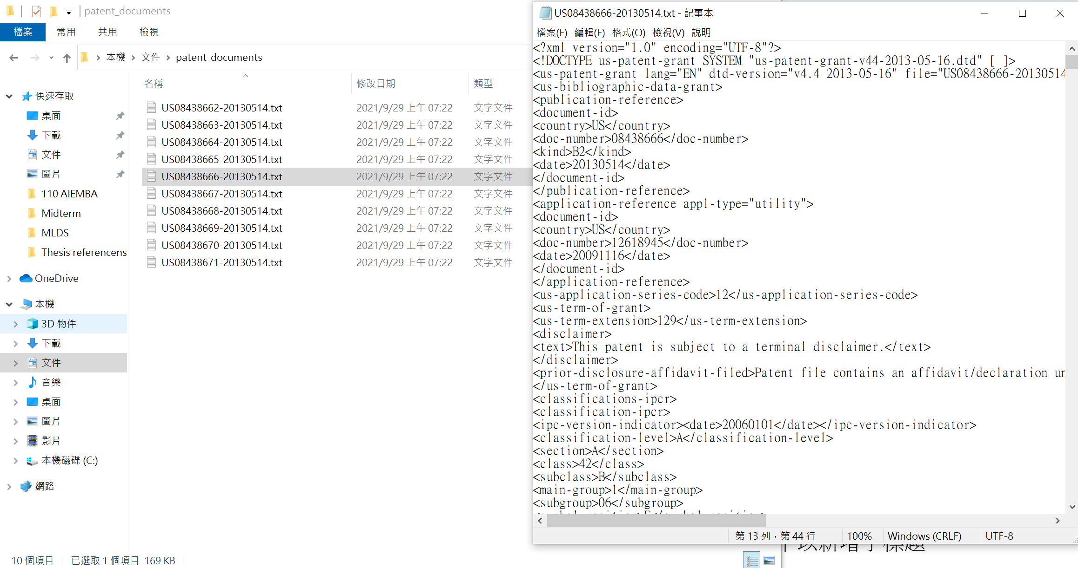
Prepare your own XML into one directory in widows.

Slide 3
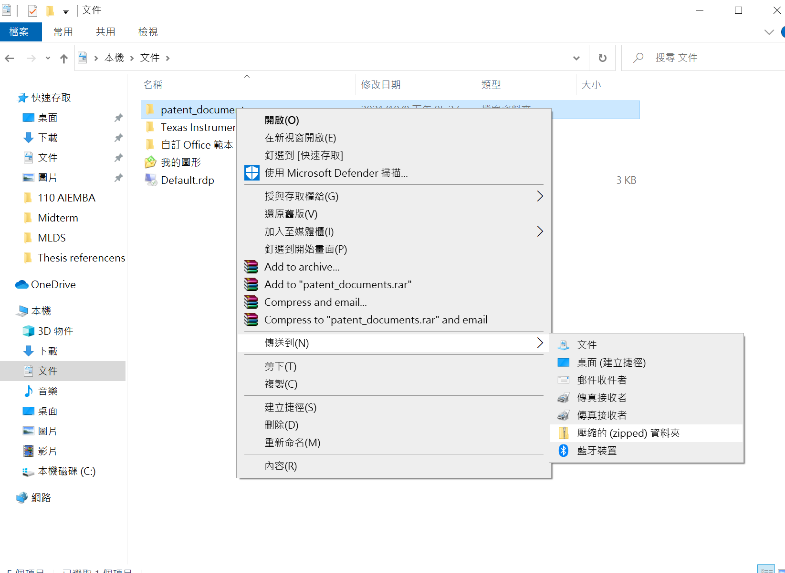
Compress the archieve into one zip file

Slide 4
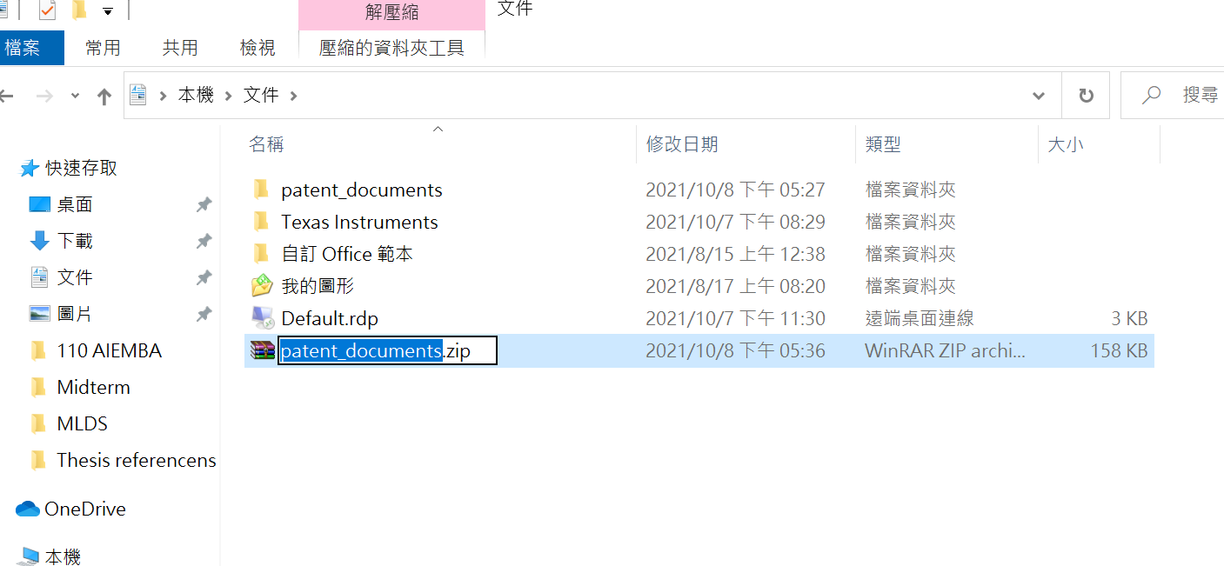
The zip file can be any file name.

Slide 5
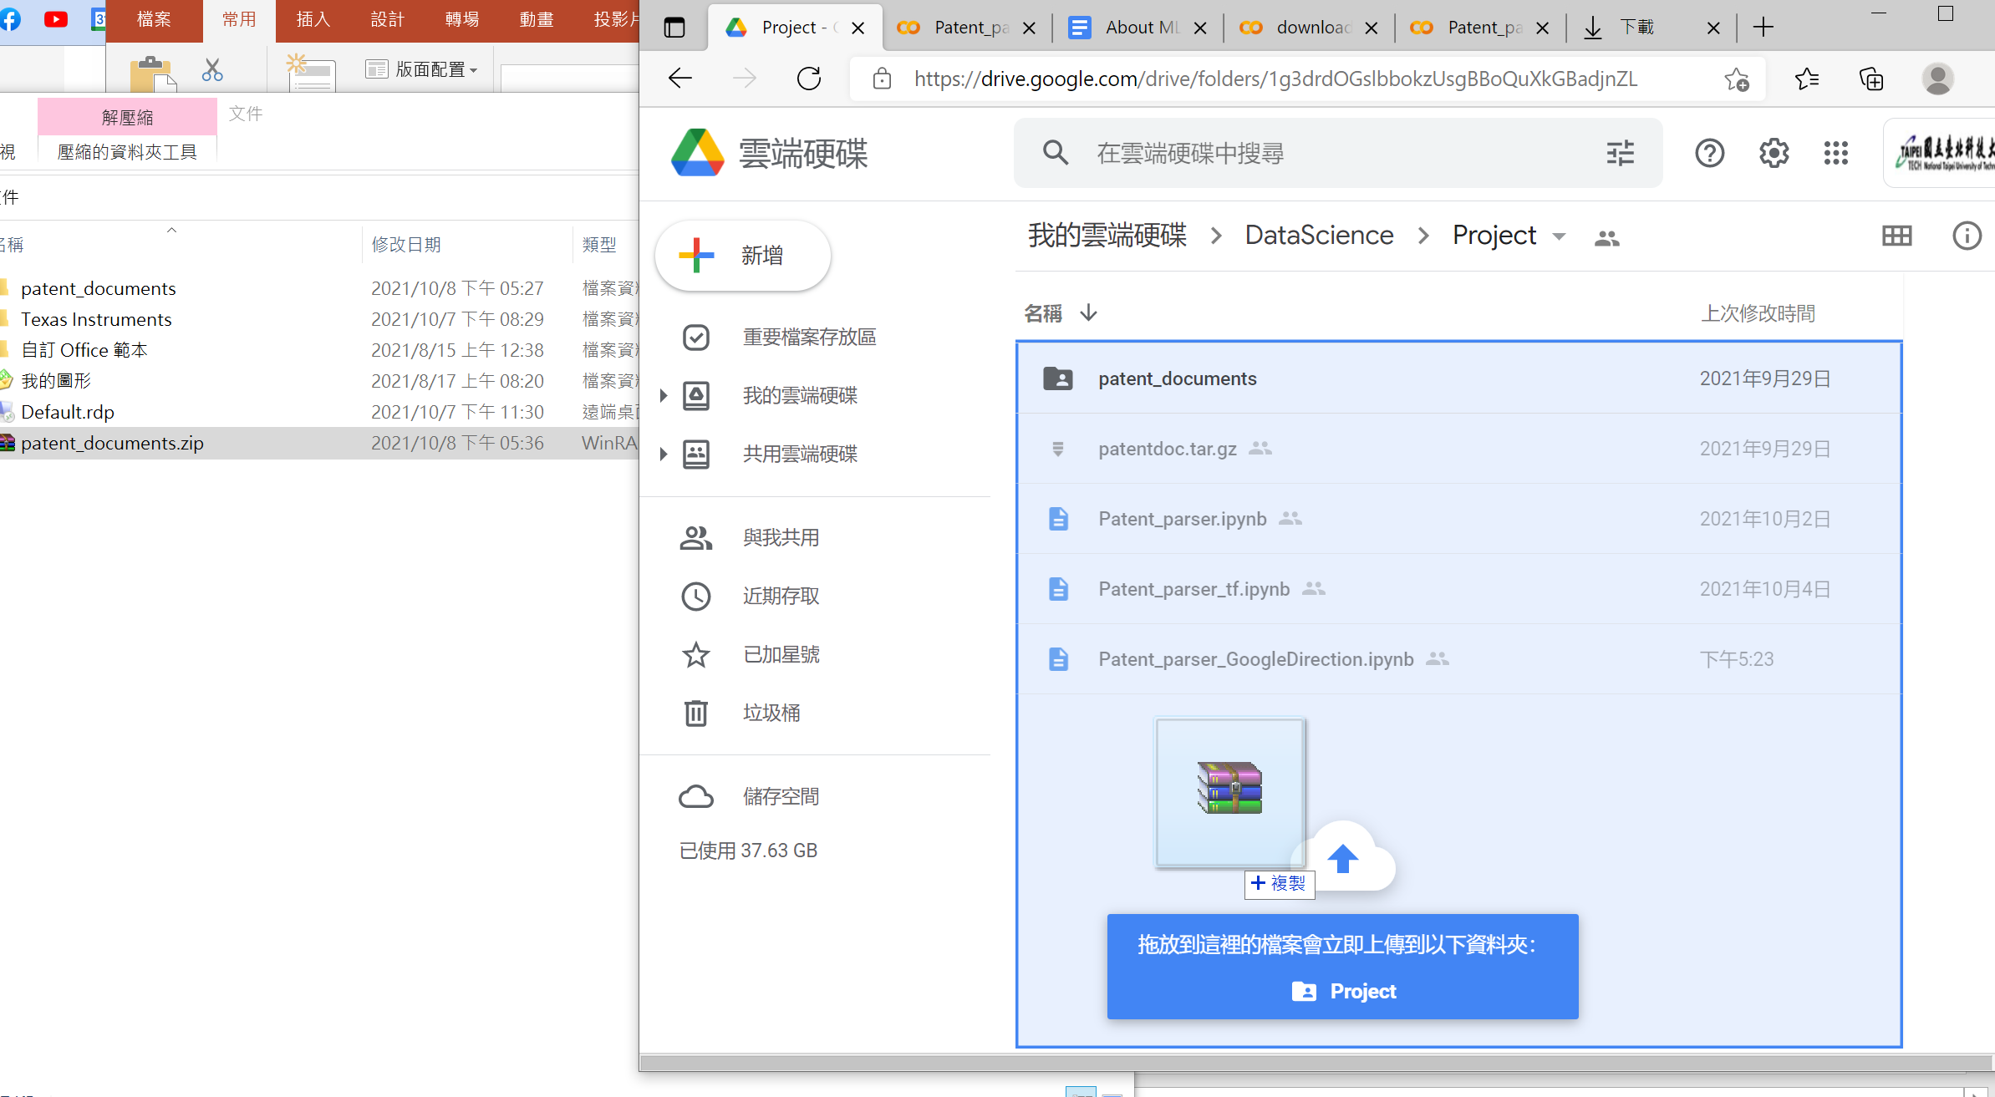
Upload the zip file to your own google drive

Slide 6
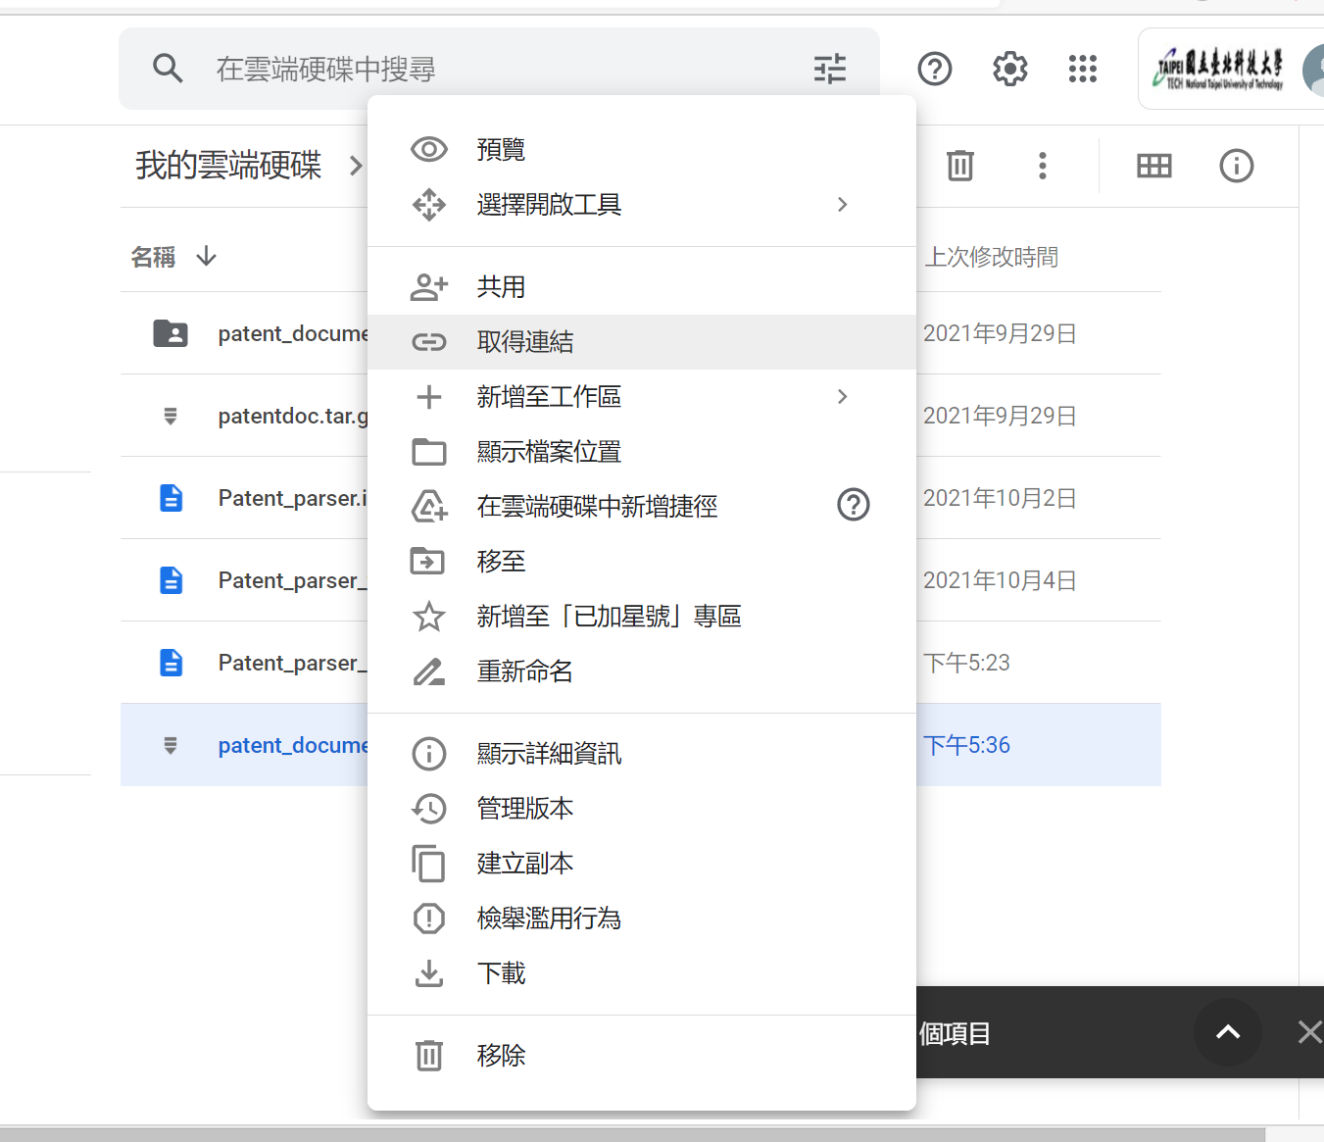
Right click the zip and get the sharing url

Slide 7
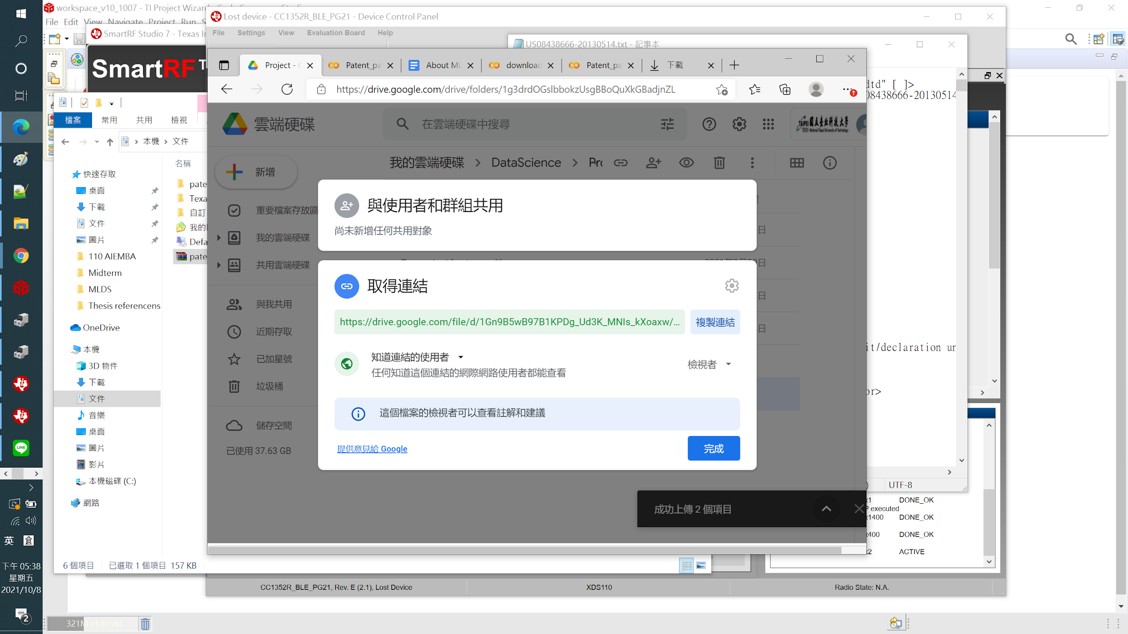
Copy the sharing url

Slide 8
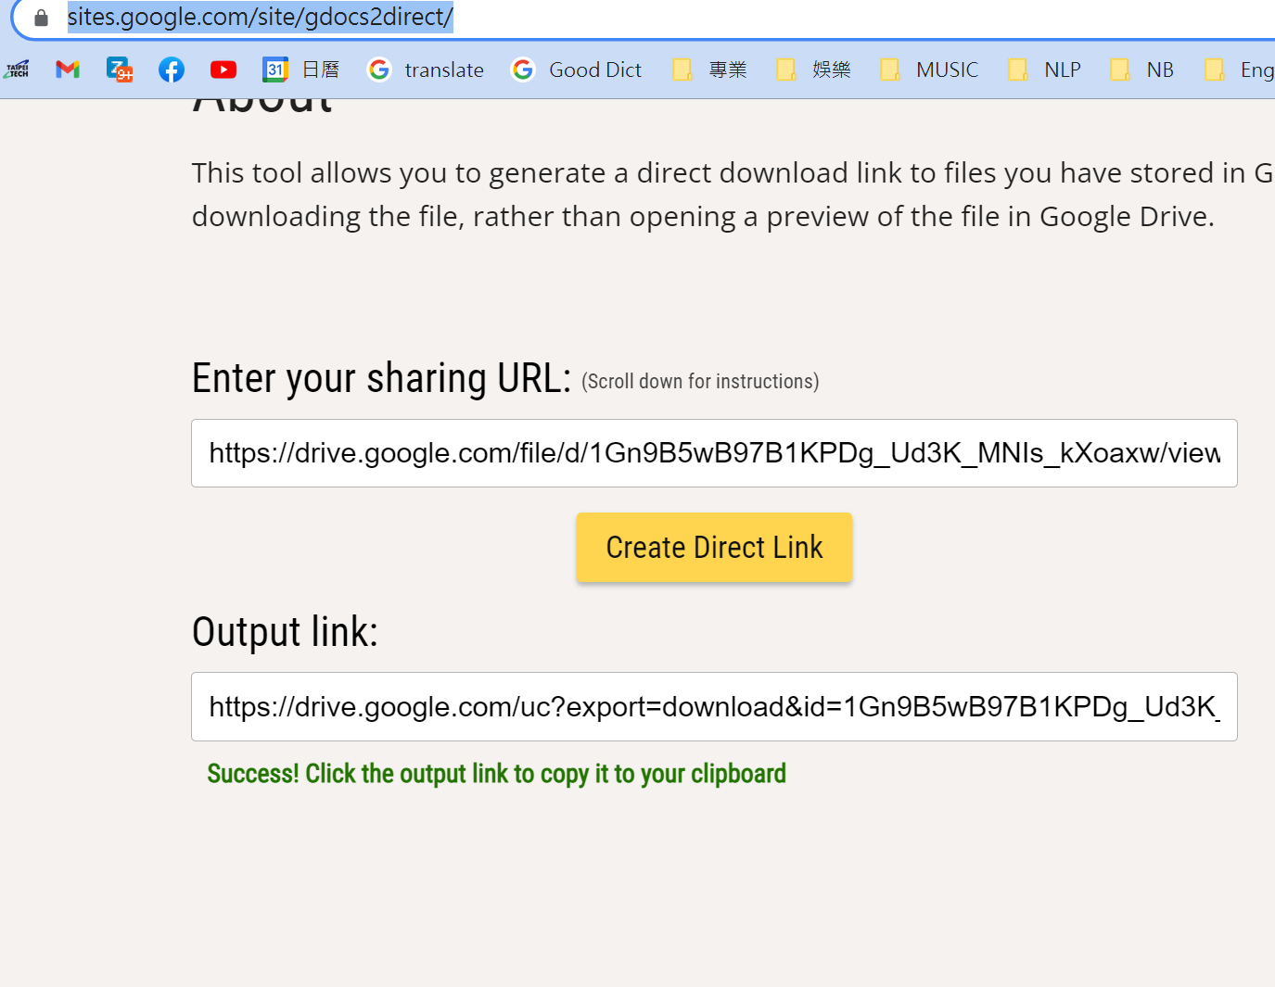
Paste in the https://sites.google.com/site/gdocs2direct/
1.Paste the sharing url
2.convert the sharing url
3.Get the downloadable url

Slide 9
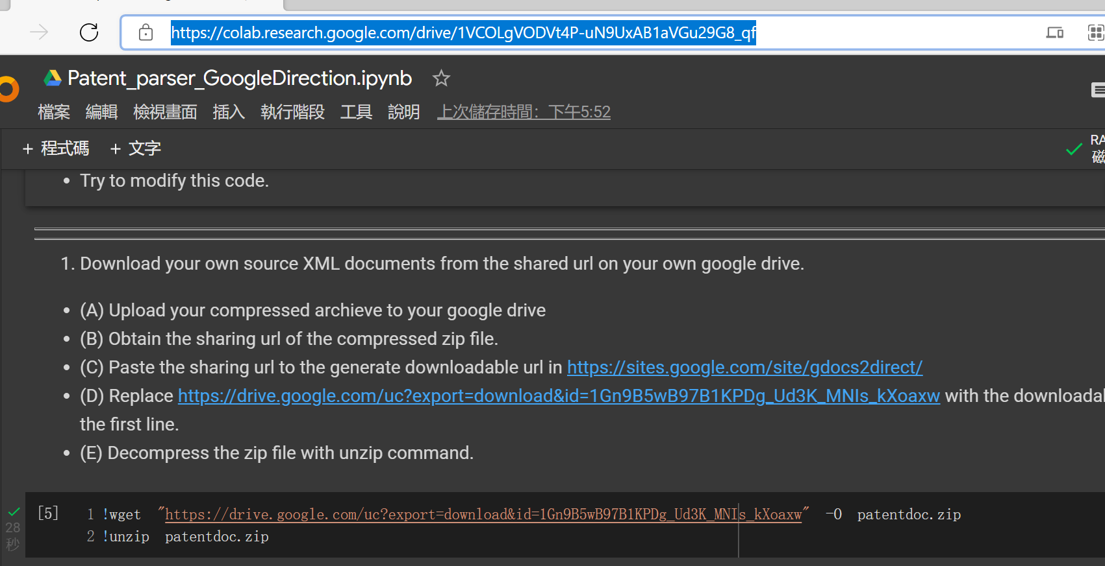
Go to
https://colab.research.google.com/drive/1VCOLgVODVt4P-uN9UxAB1aVGu29G8_qf
Replace the old url inside the red rectangle with the downloadable url

