Slide 1
Clinic Management System
108-1 Software Engineering – Team#1
108598044 劉孝忠（組長）
108598013 蕭文全
108598019 古兆瑋
108598026 黃俊凱
108598034 陳冠穎

Slide 2
Outline
I. Use cases
II. System Architecture Design
III. Analysis and Design Model
IV. The uses of CASE tools
V. Implementation
VI. Personal Evaluation to Project Contributions
VII. Project Retrospective

Slide 3
I. Use cases

Slide 4
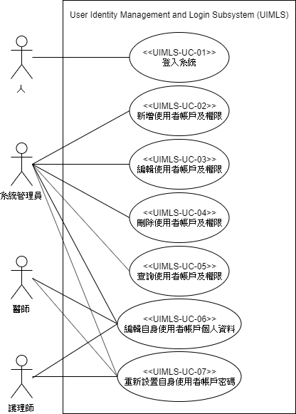
I. Use cases – UIMLS
User Identity Management and Login Subsystem

Slide 5
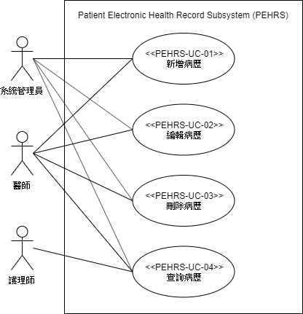
I. Use cases – PEHRS
Patient Electronic Health Record Subsystem (PEHRS)

Slide 6
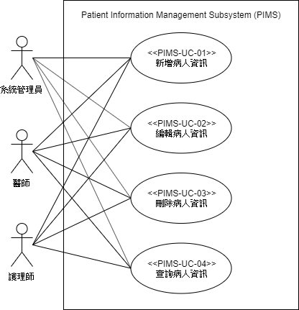
I. Use cases – PIMS
Patient Information Management Subsystem (PIMS)

Slide 7
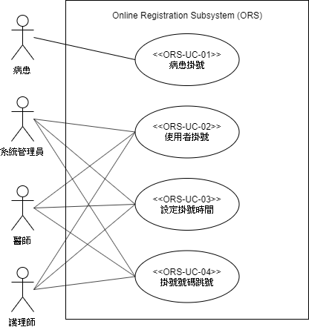
I. Use cases – ORS
Online Registration Subsystem (ORS)

Slide 8
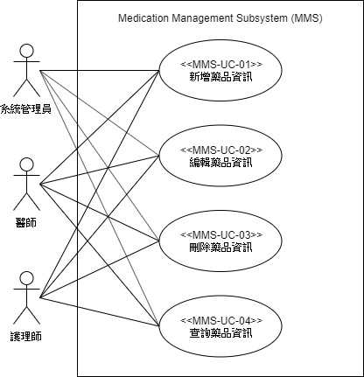
I. Use cases – MMS
Medication Management Subsystem (MMS)

Slide 9
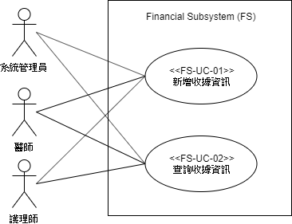
I. Use cases – FS
Financial Subsystem (FS)

Slide 10
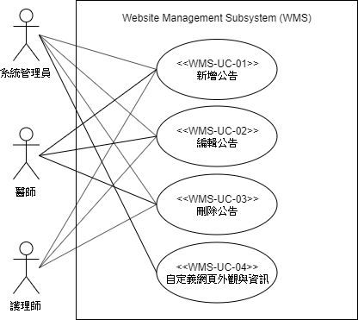
I. Use cases – WMS
Website Management Subsystem (WMS)

Slide 11
II. System Architecture Design

Slide 12
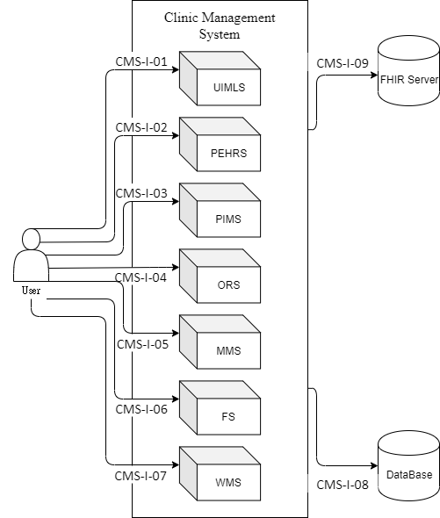
II. System Architecture

Slide 13
III. Analysis and Design Model

Slide 14
III. Analysis and Design Model
Use Cases Analysis
User Interfaces Analysis
Static Model
Dynamic Model
Traceability Matrix – Requirements v.s. Components
Traceability Matrix – Use Cases v.s. Classes
Traceability Matrix – Classes v.s. Classes

Slide 15
IV. The uses of CASE tools

Slide 16
IV. The uses of CASE tools
Unit Test: pytest
Configuration Management: Git
Continuous Integration: Github actions
Code coverage: codecov
Front-End Deploy: Github actions & gh-pages
GitHub Front-End: https://github.com/NTUT-108-SE/CMS-Frontend Back-End: https://github.com/NTUT-108-SE/CMS-Backend

Slide 17
V. Implementation

Slide 18
https://cms.mino.tw

Slide 19
VI. Personal Evaluation to Project Contributions

Slide 20
VI. Personal Evaluation to Project Contributions
Name | 前端 | 後端 | 文件
劉孝忠 | 10% | 70% | 20%
蕭文全 | 90% | 0% | 10%
古兆瑋 | 0% | 30% | 70%
黃俊凱 | 90% | 0% | 10%
陳冠穎 | 0% | 10% | 90%

Slide 21
VII. Project Retrospective

Slide 22
VII. Project Retrospective
開發時程評估與規劃
功能及架構設計
前端測試
FHIR速度

Slide 23
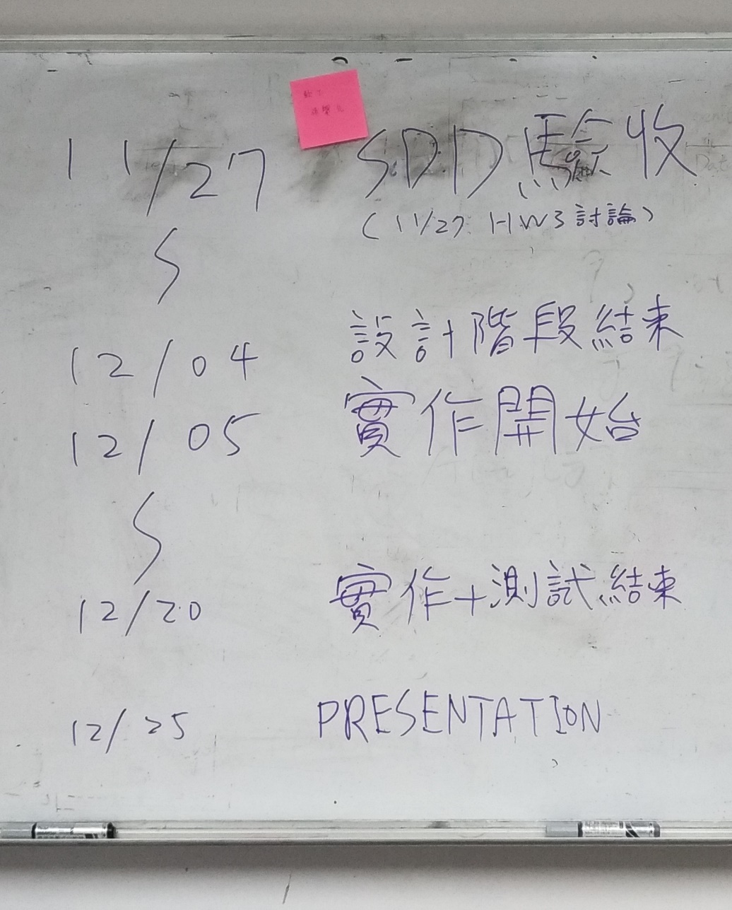
Informational Environment

Slide 24
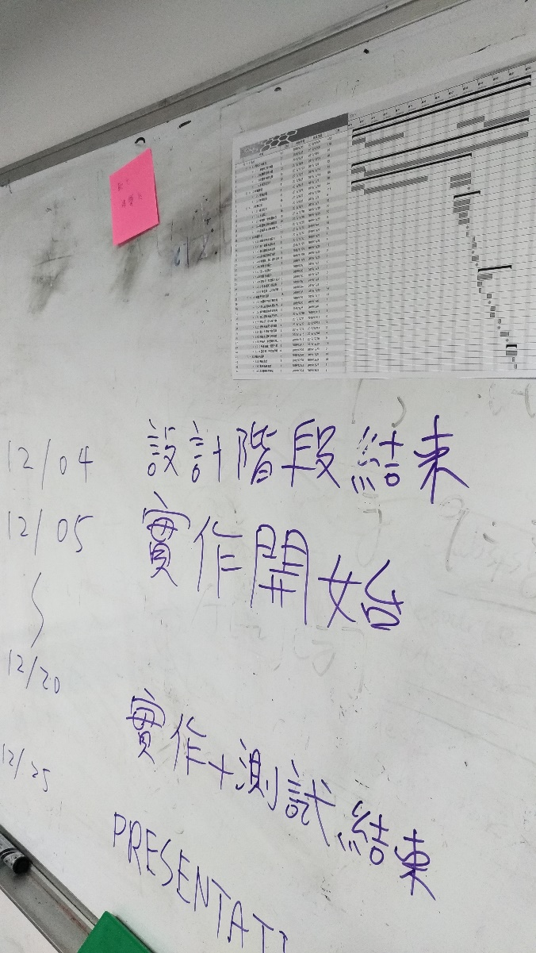
Informational Environment (cont.)

Slide 25
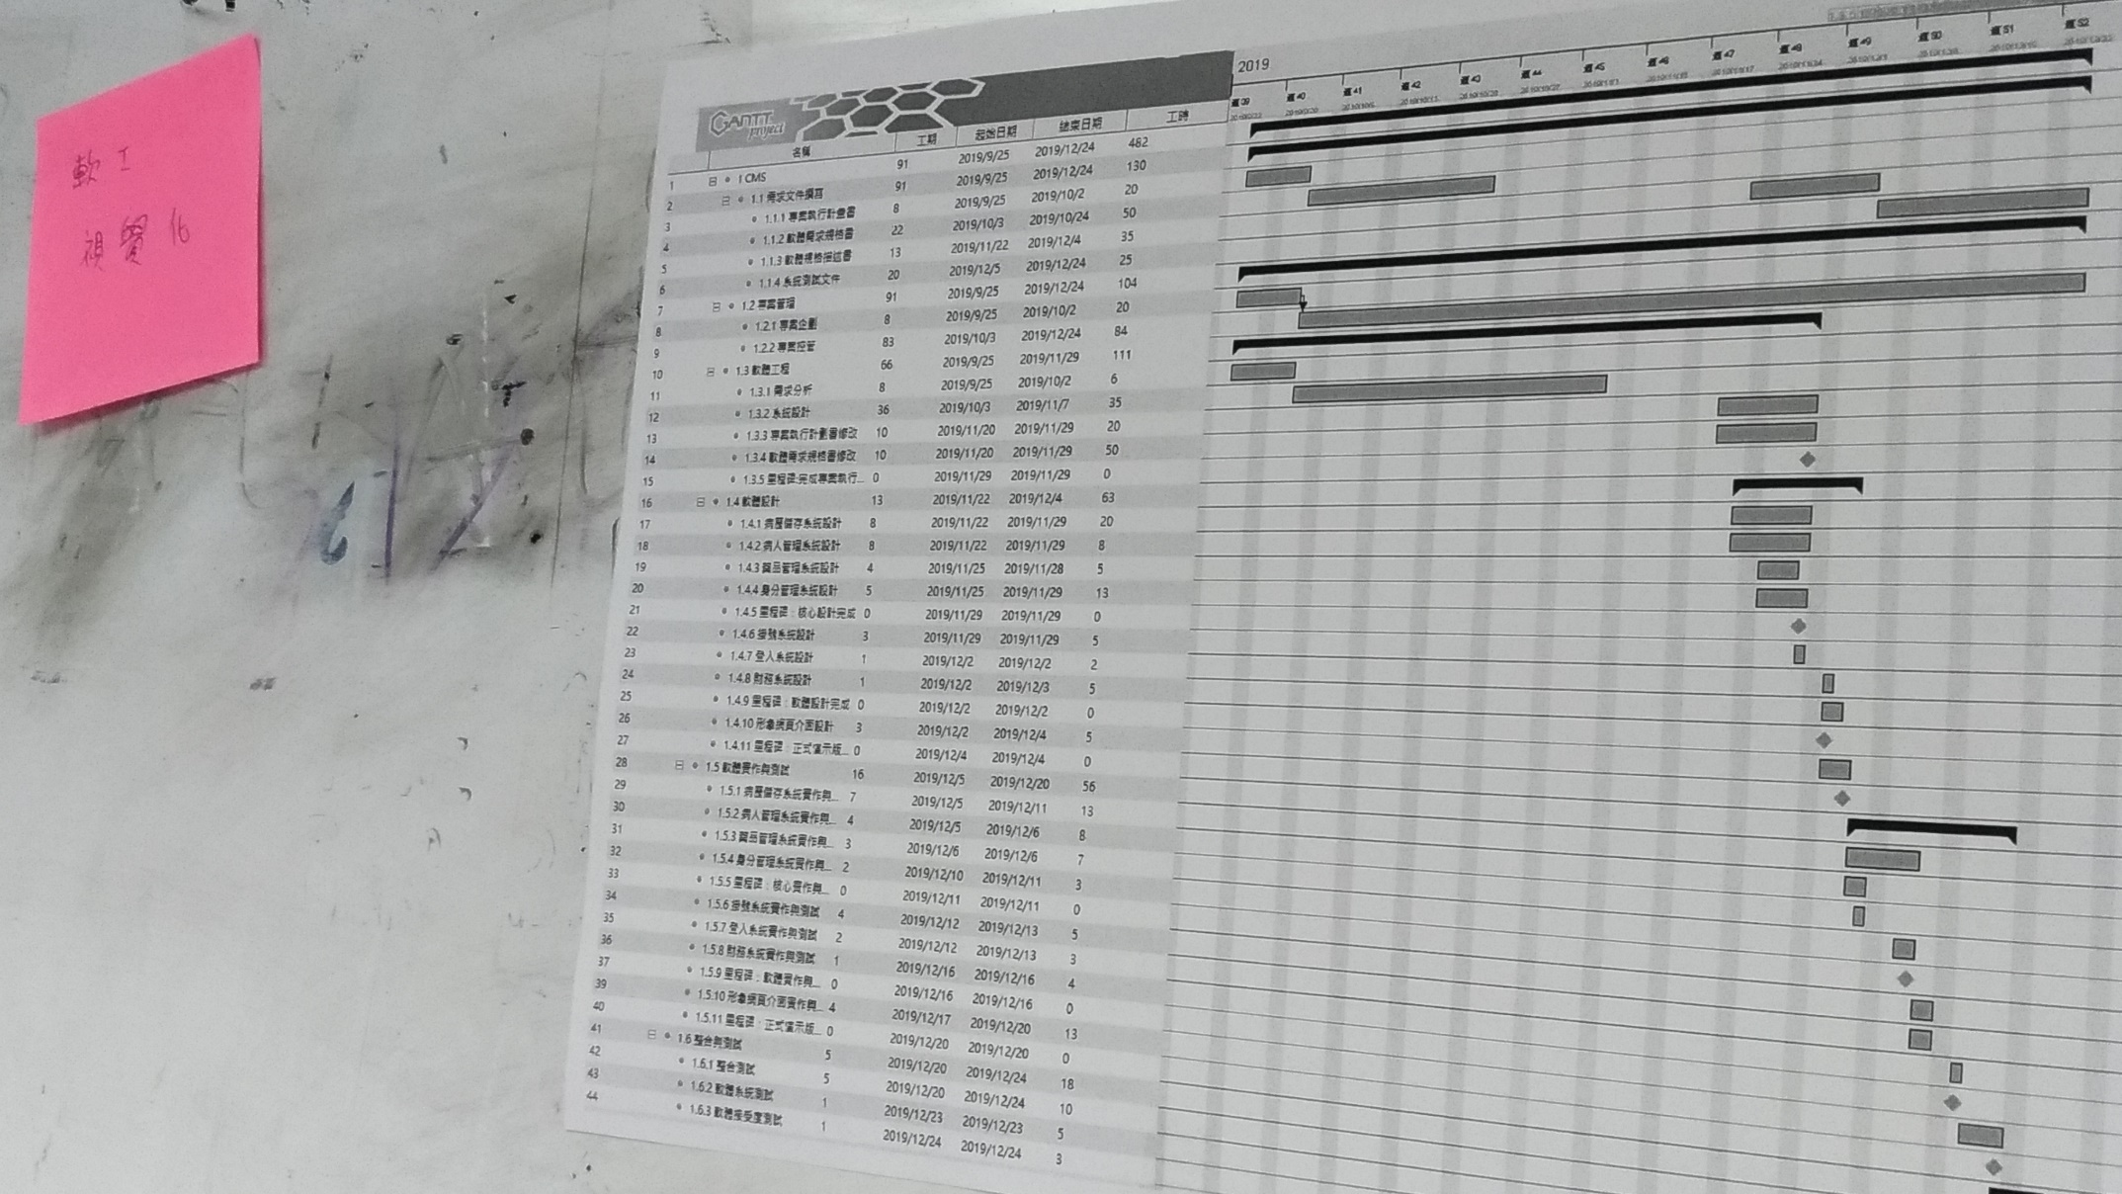
Informational Environment (cont.)

Slide 26
Q & A

