Slide 1
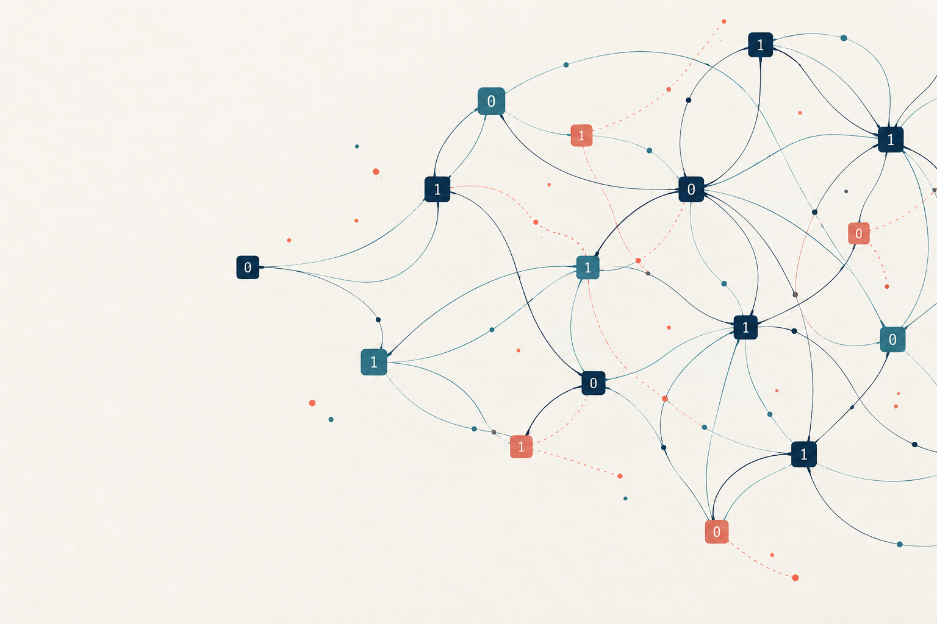
d-LIN
Sparse equations,
noisy answers
STUDENT EDITION
A visual introduction to parity, noise and hardness
Prajjwal Saxena’s notes, revised with ABW09
Notes:
This presentation summarizes the supplied notes. Assume only basic algebra. Introduce XOR before matrix notation. Invite learners to calculate parity by counting ones.
Generated cover illustration: conceptual artwork, not a quantitative diagram.
Primary source: Prajjwal Saxena, Understanding the d-LIN Problem, dLIN_explained.tex, Overleaf project https://www.overleaf.com/project/6ac3a275fa67840d6ebb88fb, accessed 5 October 2026.
Primary paper: Applebaum, Barak and Wigderson, Public-Key Cryptography from Different Assumptions, November 7, 2009, https://www.math.ias.edu/~avi/PUBLICATIONS/MYPAPERS/ABW09/ABW09.pdf. Page numbers are printed page numbers in this version.

Slide 2
The central equation
b = Mx + e
Symbol | Meaning | Size
M | Which variables enter each equation | m × n
x | Hidden binary assignment | n × 1
e | Bits that flip equation outputs | m × 1
b | Observed right-hand sides | m × 1
m counts equations. n counts variables. d counts variables per equation.
STUDENT EDITION
02
Notes:
Source sections 1 and 3. All operations take place in F₂. M and b are observed. The chosen assignment x and error vector e are hidden. For d-LIN, the public matrix has exactly d ones per row.
Primary source: Prajjwal Saxena, Understanding the d-LIN Problem, dLIN_explained.tex, Overleaf project https://www.overleaf.com/project/6ac3a275fa67840d6ebb88fb, accessed 5 October 2026.
Primary paper: Applebaum, Barak and Wigderson, Public-Key Cryptography from Different Assumptions, November 7, 2009, https://www.math.ias.edu/~avi/PUBLICATIONS/MYPAPERS/ABW09/ABW09.pdf. Page numbers are printed page numbers in this version.

Slide 3
Arithmetic with bits
a | b | a ⊕ b
0 | 0 | 0
0 | 1 | 1
1 | 0 | 1
1 | 1 | 0
1 ⊕ 0 ⊕ 1 = 0
Two ones cancel.
Only the parity of the number of ones matters.
a + a = 0
All additions in this deck use modulo 2 unless a slide says otherwise.
STUDENT EDITION
03
Notes:
Source section 2. Addition modulo two is XOR. For several bits, the output is one precisely when an odd number of inputs equal one. Subtraction equals addition.
Primary source: Prajjwal Saxena, Understanding the d-LIN Problem, dLIN_explained.tex, Overleaf project https://www.overleaf.com/project/6ac3a275fa67840d6ebb88fb, accessed 5 October 2026.
Primary paper: Applebaum, Barak and Wigderson, Public-Key Cryptography from Different Assumptions, November 7, 2009, https://www.math.ias.edu/~avi/PUBLICATIONS/MYPAPERS/ABW09/ABW09.pdf. Page numbers are printed page numbers in this version.

Slide 4
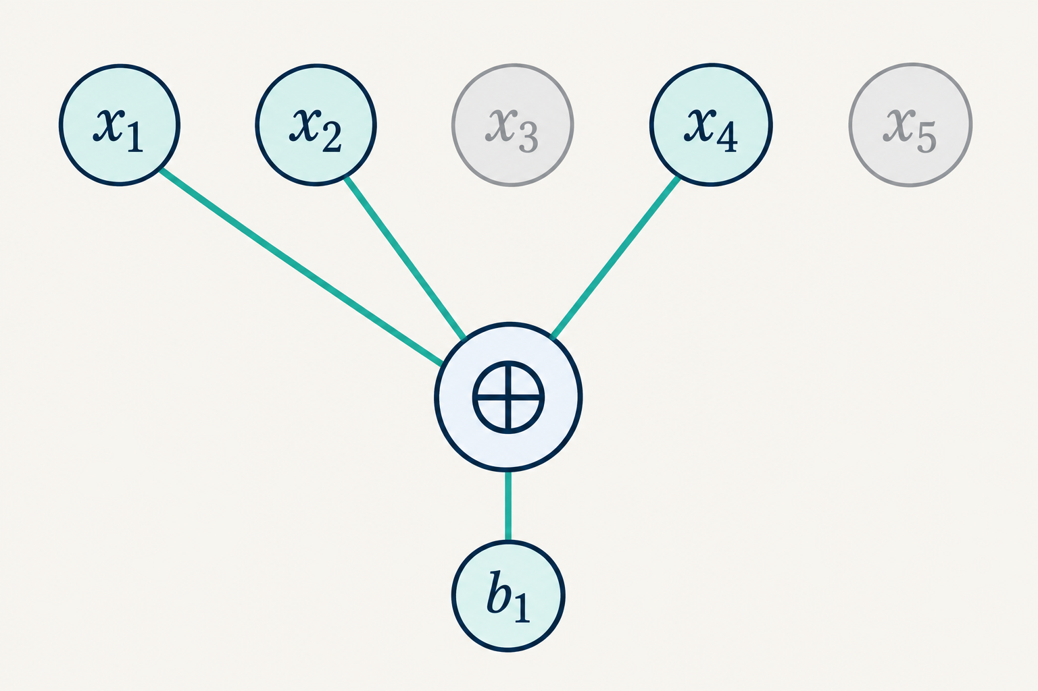
A sparse equation uses only a few variables
d = 3
Three selected variables
make one parity clause.
x₁ ⊕ x₂ ⊕ x₄ = b₁
A 0 in the matrix means that variable does not enter the clause.
STUDENT EDITION
04
Notes:
Source sections 4–5. The first row (1,1,0,1,0) selects x₁, x₂ and x₄. This is a noiseless clause diagram. With an error bit, the observed right side is b₁ = x₁ ⊕ x₂ ⊕ x₄ ⊕ e₁. Generated illustration checked for exactly three incoming connections.
Primary source: Prajjwal Saxena, Understanding the d-LIN Problem, dLIN_explained.tex, Overleaf project https://www.overleaf.com/project/6ac3a275fa67840d6ebb88fb, accessed 5 October 2026.
Primary paper: Applebaum, Barak and Wigderson, Public-Key Cryptography from Different Assumptions, November 7, 2009, https://www.math.ias.edu/~avi/PUBLICATIONS/MYPAPERS/ABW09/ABW09.pdf. Page numbers are printed page numbers in this version.

Slide 5
The matrix stores every clause
x
M 4 equations × 5 variables
x₁
x₂
x₃
x₄
x₅
b
1 | 1 | 0 | 1 | 0
0 | 1 | 1 | 0 | 1
1 | 0 | 1 | 1 | 0
0 | 1 | 0 | 1 | 1
b₁
b₂
b₃
b₄
×
=
Without noise, Mx = b packages all four equations into one statement.
STUDENT EDITION
05
Notes:
Source sections 3–5. M is the exact 4×5 example from the notes. Each row has three ones. x and b are column vectors, matching equations 11 and 12 of the edited notes.
Primary source: Prajjwal Saxena, Understanding the d-LIN Problem, dLIN_explained.tex, Overleaf project https://www.overleaf.com/project/6ac3a275fa67840d6ebb88fb, accessed 5 October 2026.
Primary paper: Applebaum, Barak and Wigderson, Public-Key Cryptography from Different Assumptions, November 7, 2009, https://www.math.ias.edu/~avi/PUBLICATIONS/MYPAPERS/ABW09/ABW09.pdf. Page numbers are printed page numbers in this version.

Slide 6
Exact equations and noisy equations
Exact system
Noisy observations
Mx = b
b = Mx + e
Gaussian elimination finds a solution, or detects inconsistency.
Some outputs have flipped. Their locations are hidden.
Noise creates an inference problem. Its difficulty depends on the parameters.
STUDENT EDITION
06
Notes:
Source sections 6 and 13. Gaussian elimination can find a solution or certify inconsistency for exact linear equations. When b=Mx+e, merely finding any exact fit does not in general recover the sampled x. Assumptions require a specified distribution and parameter regime.
Primary source: Prajjwal Saxena, Understanding the d-LIN Problem, dLIN_explained.tex, Overleaf project https://www.overleaf.com/project/6ac3a275fa67840d6ebb88fb, accessed 5 October 2026.
Primary paper: Applebaum, Barak and Wigderson, Public-Key Cryptography from Different Assumptions, November 7, 2009, https://www.math.ias.edu/~avi/PUBLICATIONS/MYPAPERS/ABW09/ABW09.pdf. Page numbers are printed page numbers in this version.

Slide 7
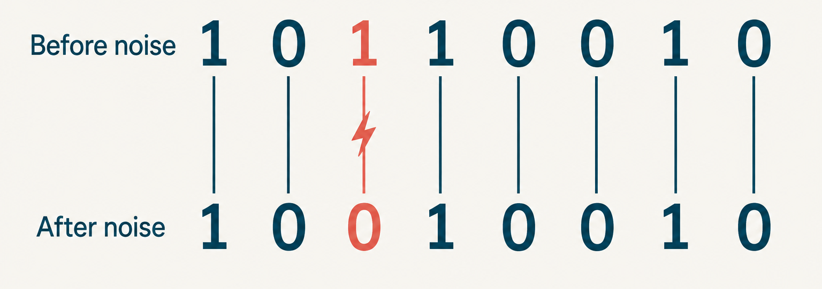
Noise flips the output of a clause
eᵢ = 0 unchanged
eᵢ = 1 flipped
STUDENT EDITION
07
Notes:
Source sections 9 and 18. The visual shows one particular error pattern. It does not assert that all sampled vectors have exactly one error. Generated illustration checked: only the third of eight bits differs.
Primary source: Prajjwal Saxena, Understanding the d-LIN Problem, dLIN_explained.tex, Overleaf project https://www.overleaf.com/project/6ac3a275fa67840d6ebb88fb, accessed 5 October 2026.
Primary paper: Applebaum, Barak and Wigderson, Public-Key Cryptography from Different Assumptions, November 7, 2009, https://www.math.ias.edu/~avi/PUBLICATIONS/MYPAPERS/ABW09/ABW09.pdf. Page numbers are printed page numbers in this version.

Slide 8
A worked example
Take x = (1, 0, 1, 0, 1)ᵀ
Clause | Computed Mx | Observed b | Mismatch
x₁ ⊕ x₂ ⊕ x₄ | 1 | 1 | 0
x₂ ⊕ x₃ ⊕ x₅ | 0 | 1 | 1
x₁ ⊕ x₃ ⊕ x₄ | 0 | 0 | 0
x₂ ⊕ x₄ ⊕ x₅ | 1 | 1 | 0
Only the second clause disagrees with the observed right-hand side.
STUDENT EDITION
08
Notes:
Source section 12. x=(1,0,1,0,1)ᵀ. Multiplication over F₂ yields (1,0,0,1)ᵀ. The published b=(1,1,0,1)ᵀ differs in only row 2. The chosen x satisfies 3/4 clauses. The table includes the same four clauses as the notes.
Primary source: Prajjwal Saxena, Understanding the d-LIN Problem, dLIN_explained.tex, Overleaf project https://www.overleaf.com/project/6ac3a275fa67840d6ebb88fb, accessed 5 October 2026.
Primary paper: Applebaum, Barak and Wigderson, Public-Key Cryptography from Different Assumptions, November 7, 2009, https://www.math.ias.edu/~avi/PUBLICATIONS/MYPAPERS/ABW09/ABW09.pdf. Page numbers are printed page numbers in this version.

Slide 9
Hamming weight counts the violations
Mx − b = (0, 1, 0, 0)ᵀ
wt(Mx − b) = 1
75%
3 of 4 clauses satisfied
This assignment has one violation.
A different assignment can do better.
“At least 3/4-satisfiable” is a lower bound for the instance.
STUDENT EDITION
09
Notes:
Source sections 7 and 12. The residual is (0,1,0,0)ᵀ. Hamming weight counts ones. The score shown applies to the chosen assignment; the optimum can be higher. Direct enumeration gives x′=(0,1,0,0,0)ᵀ as an exact solution to this toy instance.
Primary source: Prajjwal Saxena, Understanding the d-LIN Problem, dLIN_explained.tex, Overleaf project https://www.overleaf.com/project/6ac3a275fa67840d6ebb88fb, accessed 5 October 2026.
Primary paper: Applebaum, Barak and Wigderson, Public-Key Cryptography from Different Assumptions, November 7, 2009, https://www.math.ias.edu/~avi/PUBLICATIONS/MYPAPERS/ABW09/ABW09.pdf. Page numbers are printed page numbers in this version.

Slide 10
Almost satisfiable means few violations
wt(Mx − b) ≤ εm
An assignment satisfies at least a fraction 1 − ε of the clauses.
1,000
at most 10
clauses in total
violations when ε = 0.01
STUDENT EDITION
10
Notes:
Source section 8. This is a deterministic definition: there exists some assignment with at most εm violated clauses. It does not claim every Bernoulli sample obeys that upper bound. Example m=1000 and ε=0.01 is conditional on satisfying the stated bound.
Primary source: Prajjwal Saxena, Understanding the d-LIN Problem, dLIN_explained.tex, Overleaf project https://www.overleaf.com/project/6ac3a275fa67840d6ebb88fb, accessed 5 October 2026.
Primary paper: Applebaum, Barak and Wigderson, Public-Key Cryptography from Different Assumptions, November 7, 2009, https://www.math.ias.edu/~avi/PUBLICATIONS/MYPAPERS/ABW09/ABW09.pdf. Page numbers are printed page numbers in this version.

Slide 11
Bernoulli noise gives an average error count
Pr(eᵢ = 1) = ε
E[wt(e)] = mε
20 clauses
10% flip probability
2 errors on average
An average of 2 errors does not guarantee at most 2 errors.
STUDENT EDITION
11
Notes:
Source section 9. W=wt(e) has a Binomial(m,ε) distribution and E[W]=mε. The chart is calculated from the binomial probability mass function for an illustrative m=20, ε=0.10. Counts above 8 have total probability under 0.01%; the visible range is 0–8. There is positive probability of more than the mean number of errors.
Primary source: Prajjwal Saxena, Understanding the d-LIN Problem, dLIN_explained.tex, Overleaf project https://www.overleaf.com/project/6ac3a275fa67840d6ebb88fb, accessed 5 October 2026.
Primary paper: Applebaum, Barak and Wigderson, Public-Key Cryptography from Different Assumptions, November 7, 2009, https://www.math.ias.edu/~avi/PUBLICATIONS/MYPAPERS/ABW09/ABW09.pdf. Page numbers are printed page numbers in this version.

Slide 12
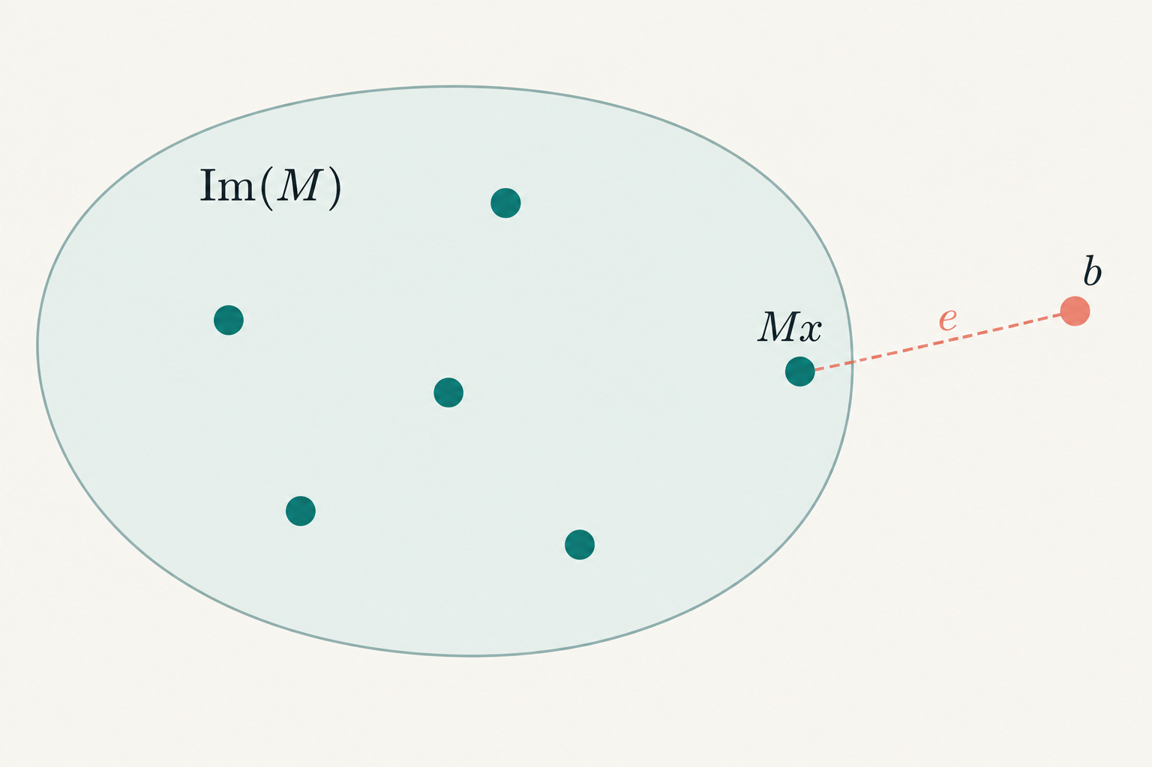
The image of M contains every noiseless output
Im(M) = {Mz : z ∈ F₂ⁿ}
Mx is one possible clean output.
b adds the error pattern e.
Hamming distance counts changed bits. The sketch shows one possible noisy observation.
STUDENT EDITION
12
Notes:
Source section 11. Im(M)={Mz:z∈F₂ⁿ}. Distance to the particular planted output Mx equals wt(e). Distance to the whole image is at most wt(e), and may be smaller. The schematic shows one possible case with b outside the image; noise can also leave b inside the image. The drawing is conceptual, not Euclidean geometry.
Primary source: Prajjwal Saxena, Understanding the d-LIN Problem, dLIN_explained.tex, Overleaf project https://www.overleaf.com/project/6ac3a275fa67840d6ebb88fb, accessed 5 October 2026.
Primary paper: Applebaum, Barak and Wigderson, Public-Key Cryptography from Different Assumptions, November 7, 2009, https://www.math.ias.edu/~avi/PUBLICATIONS/MYPAPERS/ABW09/ABW09.pdf. Page numbers are printed page numbers in this version.

Slide 13
The computational questions
Task | What the algorithm must do
Search3LIN | Recover the original hidden assignment x
Approximate recovery | Recover most bits of x
Decision | Tell noisy parity labels from independent random labels
Residual fitting | Find an assignment violating few equations
A low number of violated equations does not always identify the original assignment.
STUDENT EDITION
13
Notes:
Primary paper: Applebaum, Barak and Wigderson, Public-Key Cryptography from Different Assumptions, November 7, 2009, https://www.math.ias.edu/~avi/PUBLICATIONS/MYPAPERS/ABW09/ABW09.pdf. Page numbers are printed page numbers in this version.
Def5.1 p12: Search3LIN outputs the planted x. Def6.1 p16: approximate search outputs an assignment within .1n Hamming distance of x. Minimizing residual weight is a separate optimization problem. For even row weight, x and x+1 give the same clean labels, so exact x recovery needs a convention.
Primary source: Prajjwal Saxena, Understanding the d-LIN Problem, dLIN_explained.tex, Overleaf project https://www.overleaf.com/project/6ac3a275fa67840d6ebb88fb, accessed 5 October 2026.

Slide 14
The hardness assumption
Random instances from a specified distribution
ABW assumes efficient algorithms cannot reliably recover x for particular choices of m, d and ε.
Evidence
Remaining assumption
The paper rules out certain restricted attack families.
Hardness against every efficient algorithm remains unproved.
STUDENT EDITION
14
Notes:
Primary paper: Applebaum, Barak and Wigderson, Public-Key Cryptography from Different Assumptions, November 7, 2009, https://www.math.ias.edu/~avi/PUBLICATIONS/MYPAPERS/ABW09/ABW09.pdf. Page numbers are printed page numbers in this version.
Def5.1 and Assumption5.2 p12. Intractability quantifies over all probabilistic polynomial-time algorithms, average over random instances, with success below2/3 for all sufficiently large n. Exponential search space and worst-case NP-hardness alone do not imply this statement.
Primary source: Prajjwal Saxena, Understanding the d-LIN Problem, dLIN_explained.tex, Overleaf project https://www.overleaf.com/project/6ac3a275fa67840d6ebb88fb, accessed 5 October 2026.

Slide 15
d-LIN, LPN, LWE and Module-LWE
Problem | Linear structure | Error model
d-LIN | Binary rows with exactly d ones | Independent bit flips
LPN | Uniform binary rows, typically dense | Independent bit flips
LWE | Uniform matrices over Zq | Small centered modular errors
Module-LWE | Polynomial matrices over Rq | Small polynomial coefficients
Changing the matrix distribution or the noise changes the assumption.
STUDENT EDITION
15
Notes:
Primary paper: Applebaum, Barak and Wigderson, Public-Key Cryptography from Different Assumptions, November 7, 2009, https://www.math.ias.edu/~avi/PUBLICATIONS/MYPAPERS/ABW09/ABW09.pdf. Page numbers are printed page numbers in this version.
Regev, On lattices, learning with errors, random linear codes, and cryptography, Theorem 1.1, https://cims.nyu.edu/~regev/papers/qcrypto.pdf. The reduction is quantum and requires its stated parameters and error distribution.
Langlois and Stehlé, Worst-case to average-case reductions for module lattices, Theorems 4.7–4.8, https://perso.ens-lyon.fr/damien.stehle/downloads/MSIS.pdf.
Kiltz, Masny and Pietrzak, Provable Security of LPN-based Public-Key Encryption, https://eprint.iacr.org/2015/401.pdf. Yu and Zhang, Cryptography with Auxiliary Input and Trapdoor from Constant-Noise LPN, CRYPTO 2016, https://www.iacr.org/archive/crypto2016/98140212/98140212.pdf. PKE from LPN depends on noise and quantitative hardness. Do not infer impossibility from its common symmetric applications.
Primary source: Prajjwal Saxena, Understanding the d-LIN Problem, dLIN_explained.tex, Overleaf project https://www.overleaf.com/project/6ac3a275fa67840d6ebb88fb, accessed 5 October 2026.

Slide 16
LWE and Module-LWE structure
LWE: b = As + e (mod q)
A contains ordinary modular coefficients. Small errors perturb the outputs.
Module-LWE: t = As + e in Rqᵏ
A, s and e contain polynomials. Each polynomial equation represents many linked coefficient equations.
Module structure is different from fixing d nonzero bits in each d-LIN row.
STUDENT EDITION
16
Notes:
Regev, On lattices, learning with errors, random linear codes, and cryptography, Theorem 1.1, https://cims.nyu.edu/~regev/papers/qcrypto.pdf. The reduction is quantum and requires its stated parameters and error distribution.
Langlois and Stehlé, Worst-case to average-case reductions for module lattices, Theorems 4.7–4.8, https://perso.ens-lyon.fr/damien.stehle/downloads/MSIS.pdf.
NIST FIPS 203 (2024), Module-Lattice-Based Key-Encapsulation Mechanism Standard, §§1.2,3.2,4.2.2,5.1 and Tables 2–3, https://nvlpubs.nist.gov/nistpubs/FIPS/NIST.FIPS.203.pdf. ML-KEM uses centered binomial errors and compression. Its assumed quantum resistance is not a proof against all quantum attacks.
Schematic equations describe their algebraic templates. In LWE, A is uniform in Zq^(m×n). In module-LWE, A is uniform over an appropriate quotient ring Rq. Expanded coefficient matrices use structured convolution blocks, not independent entries.
Primary source: Prajjwal Saxena, Understanding the d-LIN Problem, dLIN_explained.tex, Overleaf project https://www.overleaf.com/project/6ac3a275fa67840d6ebb88fb, accessed 5 October 2026.

Slide 17
What ABW proves about public-key encryption
Theorem 2: one sparse-noise assumption
Hardness of 3-LIN at m = c n¹·⁴ and ε = n⁻⁰·² / c implies semantically secure public-key encryption.
Theorem 3: an additional graph assumption
A d-LIN assumption plus hidden unbalanced expansion allows another parameter regime.
Semantic security hides the message from efficient observers.
These are asymptotic existence theorems without a concrete parameter set.
STUDENT EDITION
17
Notes:
Primary paper: Applebaum, Barak and Wigderson, Public-Key Cryptography from Different Assumptions, November 7, 2009, https://www.math.ias.edu/~avi/PUBLICATIONS/MYPAPERS/ABW09/ABW09.pdf. Page numbers are printed page numbers in this version.
Theorems2–3 p5. Theorem2 has no DUE assumption. Theorem3 adds DUE for parameter flexibility. Both conclusions require the stated assumptions and give asymptotic semantically secure PKE.
Primary source: Prajjwal Saxena, Understanding the d-LIN Problem, dLIN_explained.tex, Overleaf project https://www.overleaf.com/project/6ac3a275fa67840d6ebb88fb, accessed 5 October 2026.

Slide 18
A hidden dependency cancels the assignment
A small cancellation example
y₁ = x₁ + x₂ + e₁
y₂ = x₂ + x₃ + e₂
y₃ = x₁ + x₃ + e₃
xᵢ + xᵢ = 0
Each variable
appears twice.
y₁ + y₂ + y₃ = e₁ + e₂ + e₃
ABW uses a secret short dependency as part of a public-key encryption construction.
STUDENT EDITION
18
Notes:
Source sections 18 and 20. The displayed toy example uses 2-variable rows purely to illustrate characteristic-two cancellation, not to instantiate the secure 3-LIN regime. Every variable occurs twice in the sum. In ABW, a suitable secret short row dependency plays the analogous role. Primary paper: Applebaum, Barak and Wigderson, Public-Key Cryptography from Different Assumptions, November 7, 2009, https://www.math.ias.edu/~avi/PUBLICATIONS/MYPAPERS/ABW09/ABW09.pdf. Page numbers are printed page numbers in this version.
Primary source: Prajjwal Saxena, Understanding the d-LIN Problem, dLIN_explained.tex, Overleaf project https://www.overleaf.com/project/6ac3a275fa67840d6ebb88fb, accessed 5 October 2026.
Primary paper: Applebaum, Barak and Wigderson, Public-Key Cryptography from Different Assumptions, November 7, 2009, https://www.math.ias.edu/~avi/PUBLICATIONS/MYPAPERS/ABW09/ABW09.pdf. Page numbers are printed page numbers in this version.

Slide 19
The ABW bit-encryption mechanism
Public key | Secret key
Sparse matrix M | Short set S with Σᵢ∈S Mᵢ = 0 and m ∈ S
Enc(σ) = Mx + e + σuₘ
Dec(c) = Σᵢ∈S cᵢ = σ + Σᵢ∈S eᵢ
σ is the message bit. uₘ has a 1 only in the last position.
Fresh x and e randomize every encryption.
STUDENT EDITION
19
Notes:
Primary paper: Applebaum, Barak and Wigderson, Public-Key Cryptography from Different Assumptions, November 7, 2009, https://www.math.ias.edu/~avi/PUBLICATIONS/MYPAPERS/ABW09/ABW09.pdf. Page numbers are printed page numbers in this version.
Figure 1, printed p.8, and §5.2 pp.13–14. This is the raw weak scheme. Public key M has a secret short row dependency S containing the last row. Each encryption samples fresh uniform x and fresh Bernoulli errors. Enc(1) differs from Enc(0) by flipping the final coordinate. It is not an independently uniform ciphertext distribution.
Primary source: Prajjwal Saxena, Understanding the d-LIN Problem, dLIN_explained.tex, Overleaf project https://www.overleaf.com/project/6ac3a275fa67840d6ebb88fb, accessed 5 October 2026.

Slide 20
A short dependency keeps decryption useful
Dec(c) = σ + the parity of r error bits
Example: r = 10, ε = 0.01
about 9.15%
raw decryption error
Longer dependencies accumulate noise. ABW uses amplification to obtain reliable encryption.
STUDENT EDITION
20
Notes:
Primary paper: Applebaum, Barak and Wigderson, Public-Key Cryptography from Different Assumptions, November 7, 2009, https://www.math.ias.edu/~avi/PUBLICATIONS/MYPAPERS/ABW09/ABW09.pdf. Page numbers are printed page numbers in this version.
Lemma5.3 pp13–14 and direct independent-parity calculation. For r=|S|, exact raw error=(1−(1−2ε)^r)/2≤rε. For r=10,ε=.01 exact error≈.0914636. ABW combines weak privacy and correctness then amplifies.
Primary source: Prajjwal Saxena, Understanding the d-LIN Problem, dLIN_explained.tex, Overleaf project https://www.overleaf.com/project/6ac3a275fa67840d6ebb88fb, accessed 5 October 2026.

Slide 21
Reasons to study d-LIN for public keys
A different foundation
ABW connects natural sparse noisy constraints to public-key encryption.
Simple local arithmetic
Core evaluation uses O(md) bit operations. Row index lists use O(md log n) bits.
A proved conditional construction
Theorems turn specified average-case hardness assumptions into semantic security.
STUDENT EDITION
21
Notes:
Primary paper: Applebaum, Barak and Wigderson, Public-Key Cryptography from Different Assumptions, November 7, 2009, https://www.math.ias.edu/~avi/PUBLICATIONS/MYPAPERS/ABW09/ABW09.pdf. Page numbers are printed page numbers in this version.
Introduction and Theorems 2–3. The operation and storage costs below are direct counts for the core sparse matrix representation, not benchmark claims about a final amplified construction.
Primary source: Prajjwal Saxena, Understanding the d-LIN Problem, dLIN_explained.tex, Overleaf project https://www.overleaf.com/project/6ac3a275fa67840d6ebb88fb, accessed 5 October 2026.

Slide 22
Costs and unresolved issues for public keys
Security assumptions
Implementation costs
Parameters and sampling matter.
A short hidden dependency must remain hard to exploit.
Restricted attack evidence leaves a general hardness assumption.
Noise and dependency length compete with correctness.
Amplification adds overhead.
Concrete parameters, CCA security and quantum analysis need more work.
Cheap sparse XOR operations alone do not establish an efficient final cryptosystem.
STUDENT EDITION
22
Notes:
Primary paper: Applebaum, Barak and Wigderson, Public-Key Cryptography from Different Assumptions, November 7, 2009, https://www.math.ias.edu/~avi/PUBLICATIONS/MYPAPERS/ABW09/ABW09.pdf. Page numbers are printed page numbers in this version.
Introduction, §§4–7 and §12. These are construction/design implications. ABW does not give a concrete standardized CCA KEM or a modern security-bit estimate. Quantum security requires a quantum-adversary assumption plus a compatible proof.
Primary source: Prajjwal Saxena, Understanding the d-LIN Problem, dLIN_explained.tex, Overleaf project https://www.overleaf.com/project/6ac3a275fa67840d6ebb88fb, accessed 5 October 2026.

Slide 23
ABW and a concrete Module-LWE standard
Aspect | ABW d-LIN construction | ML-KEM
Role | Asymptotic PKE existence result | Standardized key encapsulation
Security statement | Semantic security under stated assumptions | IND-CCA2 goal under Module-LWE and proof conditions
Parameters | No concrete 128-bit set in ABW09 | ML-KEM-512 / 768 / 1024
Example sizes | No like-for-like benchmark here | ML-KEM-768: key 1184 B, ciphertext 1088 B
PKE encrypts messages. A KEM establishes a shared secret for a larger protocol.
STUDENT EDITION
23
Notes:
Primary paper: Applebaum, Barak and Wigderson, Public-Key Cryptography from Different Assumptions, November 7, 2009, https://www.math.ias.edu/~avi/PUBLICATIONS/MYPAPERS/ABW09/ABW09.pdf. Page numbers are printed page numbers in this version.
NIST FIPS 203 (2024), Module-Lattice-Based Key-Encapsulation Mechanism Standard, §§1.2,3.2,4.2.2,5.1 and Tables 2–3, https://nvlpubs.nist.gov/nistpubs/FIPS/NIST.FIPS.203.pdf. ML-KEM uses centered binomial errors and compression. Its assumed quantum resistance is not a proof against all quantum attacks.
Primary source: Prajjwal Saxena, Understanding the d-LIN Problem, dLIN_explained.tex, Overleaf project https://www.overleaf.com/project/6ac3a275fa67840d6ebb88fb, accessed 5 October 2026.

Slide 24
Reading path and main distinctions
Question | Key distinction
What is the task? | Exact recovery, approximate recovery, decision or residual fitting
What makes it hard? | A precise sampled distribution and an unproved average-case assumption
What does ABW prove? | Semantic-security existence under specific theorem hypotheses
How does it compare? | Same noisy-linear template, different distributions and reductions
ABW09: §§2, 5–7 and 9
Regev on LWE, Langlois–Stehlé on Module-LWE, NIST FIPS 203
Try explaining why exact equations, noisy recovery and public-key encryption are different tasks.
STUDENT EDITION
24
Notes:
Primary paper: Applebaum, Barak and Wigderson, Public-Key Cryptography from Different Assumptions, November 7, 2009, https://www.math.ias.edu/~avi/PUBLICATIONS/MYPAPERS/ABW09/ABW09.pdf. Page numbers are printed page numbers in this version.
Regev, On lattices, learning with errors, random linear codes, and cryptography, Theorem 1.1, https://cims.nyu.edu/~regev/papers/qcrypto.pdf. The reduction is quantum and requires its stated parameters and error distribution.
Langlois and Stehlé, Worst-case to average-case reductions for module lattices, Theorems 4.7–4.8, https://perso.ens-lyon.fr/damien.stehle/downloads/MSIS.pdf.
NIST FIPS 203 (2024), Module-Lattice-Based Key-Encapsulation Mechanism Standard, §§1.2,3.2,4.2.2,5.1 and Tables 2–3, https://nvlpubs.nist.gov/nistpubs/FIPS/NIST.FIPS.203.pdf. ML-KEM uses centered binomial errors and compression. Its assumed quantum resistance is not a proof against all quantum attacks.
Kiltz, Masny and Pietrzak, Provable Security of LPN-based Public-Key Encryption, https://eprint.iacr.org/2015/401.pdf. Yu and Zhang, Cryptography with Auxiliary Input and Trapdoor from Constant-Noise LPN, CRYPTO 2016, https://www.iacr.org/archive/crypto2016/98140212/98140212.pdf. PKE from LPN depends on noise and quantitative hardness. Do not infer impossibility from its common symmetric applications.
Primary source: Prajjwal Saxena, Understanding the d-LIN Problem, dLIN_explained.tex, Overleaf project https://www.overleaf.com/project/6ac3a275fa67840d6ebb88fb, accessed 5 October 2026.

