Slide 1
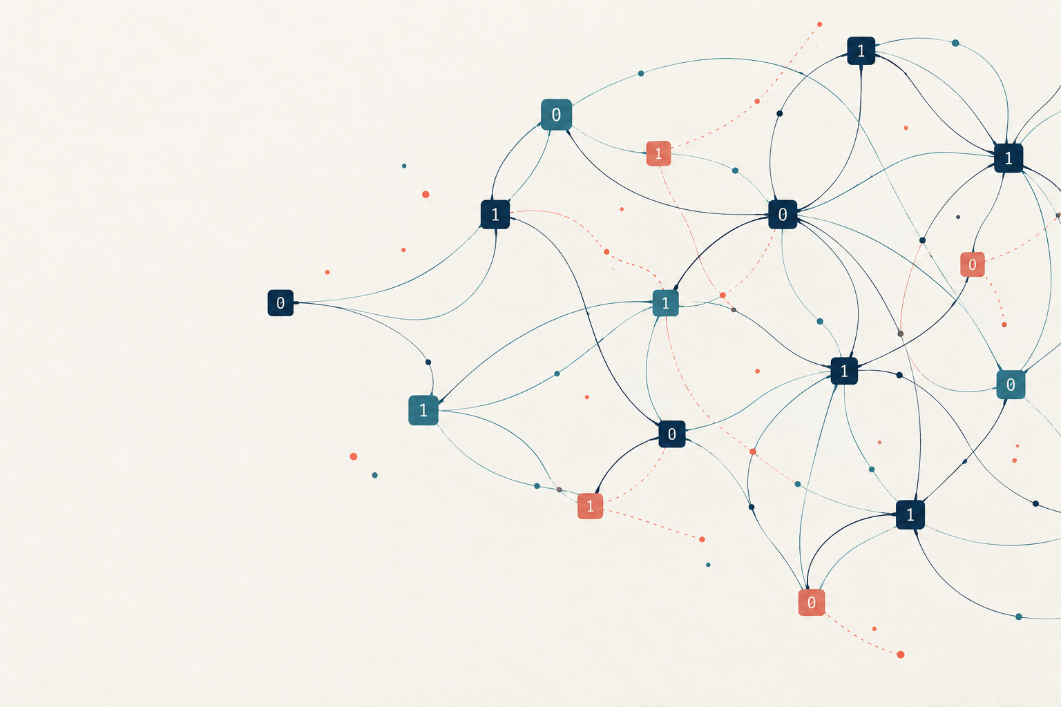
Public-key encryption
from sparse noisy
equations
An ABW research programme
Assumptions, feasibility and a plan for the first year
Research discussion · 6 October 2026
ABW research proposal
01
Notes:
A 25–30 minute research briefing for cryptography colleagues. Slides 1–20 form the main talk. Slides 21–25 provide technical details and references. Assessment date: 6 October 2026. The cover is conceptual artwork already prepared for the d-LIN project, not an actual sampled public key.
Sources
https://www.math.ias.edu/~avi/PUBLICATIONS/MYPAPERS/ABW09/ABW09.pdf

Slide 2
The research objective
Can a hidden sparse structure support
useful, concretely analysed encryption?
Research value
Evidence still needed
Different average-case assumptions
A clear algebraic trapdoor
Room for sharper security analysis
A defensible parameter set
Acceptable full construction cost
Security against active attackers
The initial commitment is a feasibility study with explicit decision points.
ABW research proposal
02
Notes:
Present the aim as a feasibility question. ABW offers a way to diversify assumptions, not an established claim of greater security or practical superiority. A credible project can produce a construction, a sharper reduction, or a negative result. The team should decide whether its primary aim is an assumption-minimizing theorem or an efficient concrete KEM. The proposed first phase serves either aim.
Sources
https://www.math.ias.edu/~avi/PUBLICATIONS/MYPAPERS/ABW09/ABW09.pdf

Slide 3
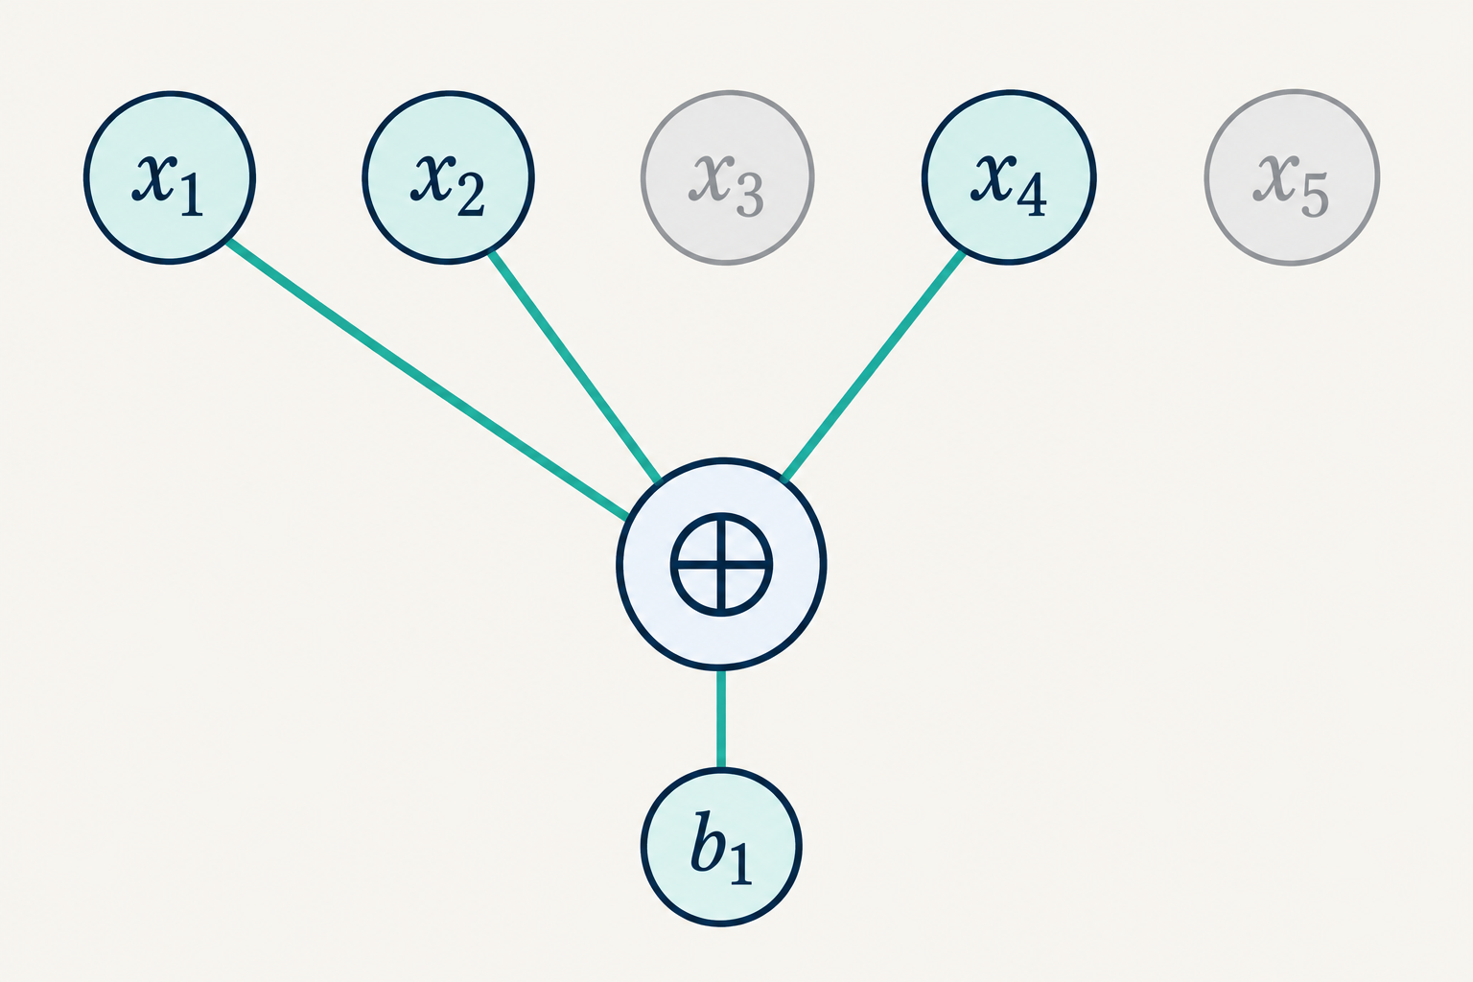
Sparse noisy linear equations
b = Mx + e
M: m × n binary matrix
Exactly d ones in each row
x: uniform hidden assignment
eᵢ: independent Ber(ε)
All arithmetic uses F₂. The diagram shows one noiseless row with d = 3.
ABW research proposal
03
Notes:
Each row of M is independently uniform among binary vectors of weight d in the basic problem distribution. Sample x uniformly and independent noise coordinates with probability epsilon. M and b are public observations. The graphic depicts the noiseless part of one row, not the full ABW key-generation law. Here d-LIN means sparse noisy parity equations, not the pairing-based Decisional Linear assumption.
Sources
https://www.math.ias.edu/~avi/PUBLICATIONS/MYPAPERS/ABW09/ABW09.pdf

Slide 4
The hardness task is part of the assumption
Task | Adversary’s goal
Search | Recover the sampled assignment x
Approximate search | Recover an assignment close to the planted x
Decision | Distinguish (M, Mx + e) from (M, uniform)
Prediction | Predict a specified additional parity of x
Every claim needs the distribution, parameter growth,
adversary model and success threshold.
ABW research proposal
04
Notes:
ABW’s single-assumption theorem starts from search 3LIN, not an unqualified decisional assumption. Approximate search in ABW Definition 6.1 means recovering an assignment within 0.1n Hamming distance of the planted x, not merely fitting many equations. The reductions change sample counts and success probabilities. Ordinary worst-case NP-hardness does not imply this average-case hardness. For even locality, complement symmetry needs attention in literal exact-recovery definitions.
Sources
https://www.math.ias.edu/~avi/PUBLICATIONS/MYPAPERS/ABW09/ABW09.pdf

Slide 5
Three routes in ABW
Route | Attraction | Main obstacle
3-LIN alone | Fewest named assumptions | Sampler and amplification cost
d-LIN + DUE | Flexible trapdoor parameters | Additional planted-expansion assumption
DSF + DUE | Nonlinear local construction | Predicate attacks and decoding cost
Proposed starting point: the 3-LIN route, with a separate
d-LIN + DUE prototype for comparison.
ABW research proposal
05
Notes:
ABW Theorem 2 and Section 5 provide the 3LIN-only route. Theorem 3 and Section 7 combine dLIN with DUE. Section 8 combines DUE with DSF, a suitable local pseudorandom generator assumption. DUE concerns distinguishing random hypergraphs from ones with a planted small set having unusually few neighbours. DSF is a nonlinear route, not merely linear equations with altered noise. Recommendation: use Section 5 as the theoretical reference, Section 7 as a useful experimental comparison, and keep Section 8 separate.
Sources
https://www.math.ias.edu/~avi/PUBLICATIONS/MYPAPERS/ABW09/ABW09.pdf

Slide 6
A short dependency is the trapdoor
Four illustrative 3-sparse rows
sᵀM = 0
1 | 1 | 1 | 0 | 0 | 0
1 | 0 | 0 | 1 | 1 | 0
0 | 1 | 0 | 1 | 0 | 1
0 | 0 | 1 | 0 | 1 | 1
sᵀb = sᵀe
Each column appears twice.
The assignment x cancels.
Toy algebra only. Security requires a much larger, precisely sampled public key.
ABW research proposal
06
Notes:
This 4 by 6 example has exactly three ones in each row and exactly two ones in each column. XOR of all four rows is zero, so s=(1,1,1,1)^T is a left-kernel vector. It illustrates cancellation only. The dependency is obvious at this toy size and the matrix is not a secure key. In a real key, hiding a useful short dependency under the exact public distribution is a separate security obligation. Ordinary elimination can find long dependencies, whose noise parity may be almost unbiased.
Sources
https://www.math.ias.edu/~avi/PUBLICATIONS/MYPAPERS/ABW09/ABW09.pdf

Slide 7
The basic ABW bit encryption
Public key: M
Secret: short s, with sₘ = 1
c = Mx + e + μuₘ
Encryption
sᵀc = μ + sᵀe
Decryption
μ is one message bit. Fresh randomness hides it.
The secret relation cancels Mx.
ABW research proposal
07
Notes:
The public key is M. The secret indicator s satisfies s^T M=0 and s_m=1. The message bit is mu. Each encryption samples fresh x and e. The last unit vector u_m flips the last ciphertext coordinate when mu=1. Decryption outputs the parity on the secret support, which equals the message plus noise parity. This is the raw weak bit-encryption construction, before the amplification used by the theorem.
Sources
https://www.math.ias.edu/~avi/PUBLICATIONS/MYPAPERS/ABW09/ABW09.pdf

Slide 8
Noise and dependency length control correctness
p = [1 − (1 − 2ε)ʳ] / 2
p ≤ rε
Reliable decoding needs
a controlled noise parity.
Illustrative calculations. A useful cryptographic parameter choice also needs an attack analysis.
ABW research proposal
08
Notes:
Calculated curves under independent Bernoulli noise, not measurements and not recommended cryptographic parameters. With r=wt(s), the exact raw failure probability is [1-(1-2epsilon)^r]/2. The union bound is r epsilon. Values use r=8,16,...,64 at equal numeric increments. A short dependency can retain useful bias, but the sampling distribution must conceal it. Raw constant correctness needs amplification for a finished scheme.
Sources
https://www.math.ias.edu/~avi/PUBLICATIONS/MYPAPERS/ABW09/ABW09.pdf

Slide 9
d-LIN, LPN, LWE and Module-LWE
Problem | Coefficients and noise | Security context
Sparse d-LIN | Fixed sparse binary rows Bernoulli output flips | Exact average-case regime matters
Dense LPN | Uniform binary rows Bernoulli output flips | PKE constructions already exist
LWE | Modular coefficients Small modular errors | Lattice reductions in suitable regimes
Module-LWE | Polynomial/module structure Small coefficient errors | Compact structured constructions
Shared equation syntax does not establish a reduction or a security ranking.
ABW research proposal
09
Notes:
This table compares distributions, not proven equivalences. Dense LPN uses uniform binary sample rows, typically with independent Bernoulli noise. Sparse dLIN fixes row weight. LWE uses modular equations with an appropriate small-error law. Module-LWE adds polynomial-ring/module structure. Regev-type worst-case reductions have parameter and distribution conditions. Module reductions concern module lattices, not arbitrary lattices at the same scalar dimension. Yu and Zhang give constant-noise LPN PKE under a stronger quantitative hardness assumption.
Sources
https://www.math.ias.edu/~avi/PUBLICATIONS/MYPAPERS/ABW09/ABW09.pdf
https://cims.nyu.edu/~regev/papers/qcrypto.pdf
https://perso.ens-lyon.fr/damien.stehle/downloads/MSIS.pdf
https://www.iacr.org/archive/crypto2016/98140212/98140212.pdf

Slide 10
Existing KEMs set concrete benchmarks
ABW-derived candidate
Key size: to establish
Ciphertext: to establish
Measure full amplification
and CCA conversion.
Category 1 targets. ML-KEM is standardized. HQC is selected for standardization (specification: 22 Aug 2025).
ABW research proposal
10
Notes:
Byte sizes are from FIPS 203 Table 3 and the HQC specification dated 22 August 2025. Both rows target NIST category 1, which is not a statement of identical concrete margins or implementation costs. ML-KEM is standardized. HQC was selected in March 2025 for standardization and the cited candidate specification is not a finalized FIPS. Compare complete KEMs, including CCA security. ABW has no concrete competitive parameter set supplied by its existence theorem. RSA/ECC offer mature conventional baselines but sufficiently capable quantum computers threaten their central assumptions.
Sources
https://nvlpubs.nist.gov/nistpubs/FIPS/NIST.FIPS.203.pdf
https://pqc-hqc.org/doc/hqc_specifications_2025_08_22.pdf
https://csrc.nist.gov/Projects/Post-Quantum-Cryptography/Post-Quantum-Cryptography-Standardization

Slide 11
Attractions and costs of an ABW foundation
Reasons to investigate
Costs to quantify
Assumption diversification
Simple sparse arithmetic
A trapdoor with clear algebra
Several proof bottlenecks to improve
Limited concrete calibration
Large raw bit ciphertexts
Key and ciphertext amplification
CCA and quantum proof obligations
The project needs a measurable advantage: a stronger theorem or a useful concrete trade-off.
ABW research proposal
11
Notes:
These are research judgments from the mechanism and proof structure. Sparse binary matrix multiplication uses simple local XOR operations, but full cost includes sampling, ciphertext length and amplification. A distinct assumption family is useful only if its relationship to existing attacks is understood. ABW is related to decoding and does not automatically supply independence from all code-based cryptography. Avoid post-quantum security claims until assumptions and reductions have been analysed against quantum adversaries.
Sources
https://www.math.ias.edu/~avi/PUBLICATIONS/MYPAPERS/ABW09/ABW09.pdf

Slide 12
Recent work changes the research agenda
01
BKR 2023: public-key sampling matters
Small-subgraph statistics break an alternative planting design.
02
Dao–Jain 2025: parameter boundaries matter
Sparse-LPN attacks apply in particular sample and noise regimes.
03
Hair–Sahai 2026 preprint: new CSP routes
New conjectures and parameters broaden the theoretical programme.
ABW research proposal
12
Notes:
BKR 2023 combines ABW ideas with local PRGs and low-degree analysis. Its alternative independent-random-hyperloop sampler leaks 4-clique counts; this is not a break of its proposed sampler or ABW. Dao–Jain provide sparse-LPN attacks in specific compression regimes and propose a distinct Dense-Sparse LPN assumption. Those attacks do not demonstrate a break of ABW’s 3LIN regime. Hair–Sahai, April 2026, is a preprint based on two high-corruption CSP conjectures and different parameters. It is not a practical upgrade of fixed-locality ABW. Low-degree evidence does not rule out all attacks.
Sources
https://eprint.iacr.org/2023/1049.pdf
https://eprint.iacr.org/2024/175.pdf
https://arxiv.org/abs/2604.10479

Slide 13
The attacker has two separate targets
Target A: the public matrix
Target B: noisy ciphertexts
Detect the planted structure.
Find any useful short relation.
Exploit the designated message row.
Predict the hidden message bit.
Solve or distinguish noisy equations.
Exploit repeated use of a public key.
Hard random equations do not by themselves hide a planted key.
ABW research proposal
13
Notes:
The distinction guides experiments; it is not a formal composition theorem. An attacker can exploit public-key structure, or distinguish/recover information in ciphertexts under the actual key law. For the 3LIN route, ABW’s Lemma 5.4 gives constant statistical overlap, not negligible statistical distance. The prediction reductions and amplification bridge that weaker statement to encryption. Multiple ciphertexts reuse the public matrix but sample fresh assignments and errors. All new structured samplers need their own analysis.
Sources
https://www.math.ias.edu/~avi/PUBLICATIONS/MYPAPERS/ABW09/ABW09.pdf
https://eprint.iacr.org/2023/1049.pdf

Slide 14
The first attack suite
Attack family | Question to answer
Short dependencies | Can an attacker find a relation with useful parity bias?
Graph statistics | Do degrees, cycles or small subgraphs expose planting?
Decoding and algebra | Do tailored decoding, SAT or noisy-equation solvers help?
Repeated-key attacks | Does reuse reveal structure absent from a single sample?
Report successful attacks and their limits. Failed experiments do not prove hardness.
ABW research proposal
14
Notes:
Suggested experimental work packages, not claims that each generic method directly applies without adaptation. Include success probability, runtime, memory, sample count, and the exact distribution. Keep training/tuning samples separate from evaluation samples for heuristic distinguishers. Analyse dependencies containing the designated message row and combinations that distinguish messages. Do not use dense-LPN estimators as calibrated sparse-LPN estimators. Quantum costs need separate models.
Sources
https://www.math.ias.edu/~avi/PUBLICATIONS/MYPAPERS/ABW09/ABW09.pdf
https://eprint.iacr.org/2023/1049.pdf
https://eprint.iacr.org/2024/175.pdf

Slide 15
Concrete feasibility includes the whole construction
Quantity | Required accounting
Security | Best attacks, success probabilities and reduction losses
Communication | All public keys and ciphertexts after amplification
Correctness | Proved failure bounds, including exceptional keys
Runtime and memory | Sampling, encryption, decoding and rejection costs
First decision point: does a useful parameter window exist?
ABW research proposal
15
Notes:
The raw bit ciphertext has m bits. A row-index representation uses O(md log n) bits for the sparse matrix before compression and extra keys. ABW’s cited amplification has genuine key and ciphertext costs; Holenstein–Renner Lemma 7 can use independently generated base key pairs. Average-key correctness is different from a bound excluding weak keys. An asymptotic polynomial-time hardness assumption is insufficient to derive a numerical work factor. Performance comparison must use full CPA or CCA constructions consistently.
Sources
https://www.math.ias.edu/~avi/PUBLICATIONS/MYPAPERS/ABW09/ABW09.pdf
https://crypto.ethz.ch/publications/files/HolRen05.pdf

Slide 16
A staged first-year programme
Planning estimate. Review feasibility near month 3. Later stages depend on the evidence.
ABW research proposal
16
Notes:
Illustrative planning estimate for a small research team, not a promise that a secure scheme will exist within one year. Work overlaps. Specify assumptions in month 0–1; reproduce and attack the baseline over months 0.5–4; concrete CPA analysis over months 2–6; improve one bottleneck over months 4–9; attempt a CCA KEM and independent review over months 7–12+, contingent on earlier gates. The first formal review should happen near month 3. Durations in the chart are proposed planning values.
Sources

Slide 17
First-quarter deliverables
01
An assumption and reduction ledger
Every sampler, task, parameter conversion and security claim.
02
A reproducible baseline and attack suite
Exact small-instance checks, benchmarks and attack outcomes.
03
A parameter report and continuation decision
Full cost estimates, uncertainty and the bottleneck worth studying.
ABW research proposal
17
Notes:
The first quarter is the proposed commitment. The assumption ledger should record which statements are proved, assumed, heuristic or measured. The baseline should include tests for finite-field cancellation, sampler behaviour and independent-noise correctness. The parameter report should document attack coverage, unresolved risks, and total projected size. These outputs remain useful if the candidate fails. The suggested team split is one proof lead and one attack/implementation lead with regular joint review.
Sources

Slide 18
Focused construction improvements
Candidate direction | Evidence needed
A better trapdoor sampler | A proof for the exact public-key distribution
Tighter reduction constants | A concrete improvement in the viable parameter range
Cheaper amplification | A complete privacy and correctness argument
More efficient encoding | A joint analysis of relation leakage and correlated errors
Choose one direction after the baseline identifies the dominant cost.
ABW research proposal
18
Notes:
Proposed research questions, not verified novelty claims. First check the current literature. A distribution-preserving sampler, tighter reduction or cheaper amplification could be valuable without producing an immediately deployable KEM. Multiple relations may improve throughput but may also leak structure or correlate errors. Changing row locality, adding circulant structure, regularising degrees or compressing keys changes the security analysis. Change one design feature at a time and compare with the faithful baseline.
Sources
https://www.math.ias.edu/~avi/PUBLICATIONS/MYPAPERS/ABW09/ABW09.pdf
https://eprint.iacr.org/2023/1049.pdf
https://crypto.ethz.ch/publications/files/HolRen05.pdf

Slide 19
The raw decoder exposes its secret to an oracle
Dec(c) = sᵀc
Separate construction work
Strong CPA security
Ciphertext validation
A proved CCA conversion
Failure-safe decapsulation
Dec(uᵢ) = sᵢ
m unit-vector queries
recover the secret support.
This is a limitation of the raw bit scheme. ABW’s existence theorem targets passive security.
ABW research proposal
19
Notes:
Direct deduction from ABW’s raw linear decoder. For every binary unit vector u_i, Dec(u_i)=s_i, because decryption takes the parity on the secret support and does not validate ciphertexts. Thus m chosen-ciphertext queries recover s, even before a challenge. This does not contradict the paper’s passive-security result. It shows why the raw scheme is not a CCA construction. First obtain an appropriate strong CPA PKE, then choose and prove a suitable conversion. A naive hash of a one-bit output does not create a secure KEM.
Sources
https://www.math.ias.edu/~avi/PUBLICATIONS/MYPAPERS/ABW09/ABW09.pdf
https://people.inf.ethz.ch/dhofheinz/pdf/conf/tcc/HofheinzHK17.pdf
https://csrc.nist.gov/pubs/sp/800/227/final

Slide 20
A concrete first project
Concrete security and feasibility
of sparse-equation public-key encryption
Proceed when
Redirect when
A defensible parameter window survives.
One bottleneck has a plausible remedy.
An attack invalidates the candidate.
Full costs overwhelm the intended benefit.
Suggested team: a proof lead and an attack/implementation lead, with independent review.
ABW research proposal
20
Notes:
Suggested project title: Concrete Security and Feasibility of Public-Key Encryption from Sparse Noisy Linear Equations. Begin with a bounded first-quarter programme. Continue toward a new construction if a credible parameter window and a tractable improvement emerge. Redirect toward a cryptanalytic result or sharper limitation if planting becomes distinguishable, short relations are cheap, amplification is impractical, or proof losses dominate. Organise weekly exchanges between proof and attack leads and obtain independent review before promoting any concrete security claim.
Sources

Slide 21
Appendix: parameter and proof distinctions
Issue | Precise interpretation
3-LIN-only regime | m = Θ(n¹·⁴), ε = Θ(n⁻⁰·²), with suitable constants
Public-key overlap | A constant overlap bound, not negligible distance
d-LIN + DUE conversion | Public locality D versus search locality D/2
Noise conversion | Ciphertext ε = 2η(1 − η) for the paired construction
Sample count | Public-key rows differ from reduction sample needs
Technical appendix
21
Notes:
ABW Theorem 2 uses Search3LIN(c n^1.4, n^-0.2/c) for a suitable constant c. The shorthand Theta notation suppresses constants that are essential to a concrete instantiation. Lemma 5.4 gives statistical distance at most 1-delta, not negligible distance. The weak security and correctness relation and amplification are integral. For the dLIN+DUE route, public degree D is even and the search degree is D/2; pairing produces ciphertext noise epsilon=2eta(1-eta). Public-key rows and reduction sample count must be kept separate. See ABW Sections 5 and 7.
Sources
https://www.math.ias.edu/~avi/PUBLICATIONS/MYPAPERS/ABW09/ABW09.pdf

Slide 22
Appendix: exact raw failure probability
E[(−1)^(Σ eᵢ)] = (1 − 2ε)ʳ
Pr[odd] = [1 − (1 − 2ε)ʳ] / 2
Illustration: ε = 0.01 | r = 4 | r = 16 | r = 64
Raw failure probability | 3.88% | 13.81% | 36.28%
The relevant noise is the parity on the secret relation, not the total number of errors.
Technical appendix
22
Notes:
Derivation: define Z=(-1)^(sum_i e_i). Independence gives E[Z]=(1-2epsilon)^r. Since E[Z]=P[even]-P[odd]=1-2P[odd], solve for P[odd]. The numerical examples are direct calculations, not crypto parameters. For epsilon=0.01 and r=4,16,64 the probabilities are approximately 3.88%,13.81%,36.28%. epsilon=0.5 erases signal. Known epsilon>0.5 can be reduced to 1-epsilon by complementing outputs. A lower empirical failure rate does not replace a rigorous bound.
Sources
https://www.math.ias.edu/~avi/PUBLICATIONS/MYPAPERS/ABW09/ABW09.pdf

Slide 23
Appendix: requirements for a complete KEM
Layer | Proof or implementation obligation
Base encryption | Message space, correctness and full CPA security
CCA transformation | Reencryption, validation, rejection and proof losses
Quantum analysis | Base hardness plus a valid quantum reduction chain
Implementation | Constant-time code, randomness and input handling
Protocol integration | Key authentication, derivation and authenticated encryption
Technical appendix
23
Notes:
A KEM establishes a shared symmetric key; authenticated symmetric encryption carries application messages. First prove an appropriate strong CPA construction and then check every hypothesis of a selected CCA transformation. Specify ROM or QROM assumptions and decryption-failure treatment. Quantum security requires both a quantum-hard base assumption and quantum-valid reductions. Near-quartic quantum and later classical planted-kXOR speedups apply to specified regimes, with stated even-k requirements, not automatically to ABW k=3. Engineering must address constant-time execution, randomness, key authentication and failure-safe rejection.
Sources
https://people.inf.ethz.ch/dhofheinz/pdf/conf/tcc/HofheinzHK17.pdf
https://csrc.nist.gov/pubs/sp/800/227/final
https://arxiv.org/abs/2406.19378
https://arxiv.org/abs/2508.09422

Slide 24
Selected references: foundations
Applebaum, Barak & Wigderson
Public-Key Cryptography from Different Assumptions (2009 / 2010)
Regev
On Lattices, Learning with Errors, Random Linear Codes, and Cryptography
Langlois & Stehlé
Worst-Case to Average-Case Reductions for Module Lattices
Yu & Zhang
Public-Key Encryption from Constant-Noise LPN (CRYPTO 2016)
NIST FIPS 203
Module-Lattice-Based Key-Encapsulation Mechanism Standard (2024)
Holenstein & Renner
One-Way Secret-Key Agreement and Applications to Circuit Polarization and Immunization (2005)
Technical appendix
24
Notes:
These references support the comparison of assumptions and the transition from weak encryption to a complete KEM. Full URLs also appear in the notes of the relevant slides. The ABW document is the November 2009 full manuscript; a conference version appeared at STOC 2010. ML-KEM sizes are from FIPS 203 Table 3.
Sources
https://www.math.ias.edu/~avi/PUBLICATIONS/MYPAPERS/ABW09/ABW09.pdf
https://cims.nyu.edu/~regev/papers/qcrypto.pdf
https://perso.ens-lyon.fr/damien.stehle/downloads/MSIS.pdf
https://www.iacr.org/archive/crypto2016/98140212/98140212.pdf
https://nvlpubs.nist.gov/nistpubs/FIPS/NIST.FIPS.203.pdf
https://crypto.ethz.ch/publications/files/HolRen05.pdf

Slide 25
Selected references: current research
Bogdanov, Kothari & Rosen (2023)
Public-Key Encryption, Local Pseudorandom Generators, and the Low-Degree Method
Dao & Jain (2025)
Lossy Cryptography from Code-Based Assumptions: Dense-Sparse LPN
Hair & Sahai (April 2026 preprint)
Public Key Encryption from High-Corruption Constraint Satisfaction Problems
HQC team (22 August 2025)
HQC specification and NIST selection status
Hofheinz, Hövelmanns & Kiltz (2017)
A Modular Analysis of the Fujisaki–Okamoto Transformation
NIST SP 800-227 (2025)
Recommendations for Key-Encapsulation Mechanisms
Technical appendix
25
Notes:
Primary links for current research and implementation guidance. Hair–Sahai is a preprint and its conclusions should be described as conditional theoretical proposals. HQC sizes come from the August 2025 specification, not older parameter tables. The exact attack scope matters for all local-PRG and sparse-LPN results.
Sources
https://eprint.iacr.org/2023/1049.pdf
https://eprint.iacr.org/2024/175.pdf
https://arxiv.org/abs/2604.10479
https://pqc-hqc.org/doc/hqc_specifications_2025_08_22.pdf
https://people.inf.ethz.ch/dhofheinz/pdf/conf/tcc/HofheinzHK17.pdf
https://csrc.nist.gov/pubs/sp/800/227/final
https://csrc.nist.gov/Projects/Post-Quantum-Cryptography/Post-Quantum-Cryptography-Standardization

