Slide 1
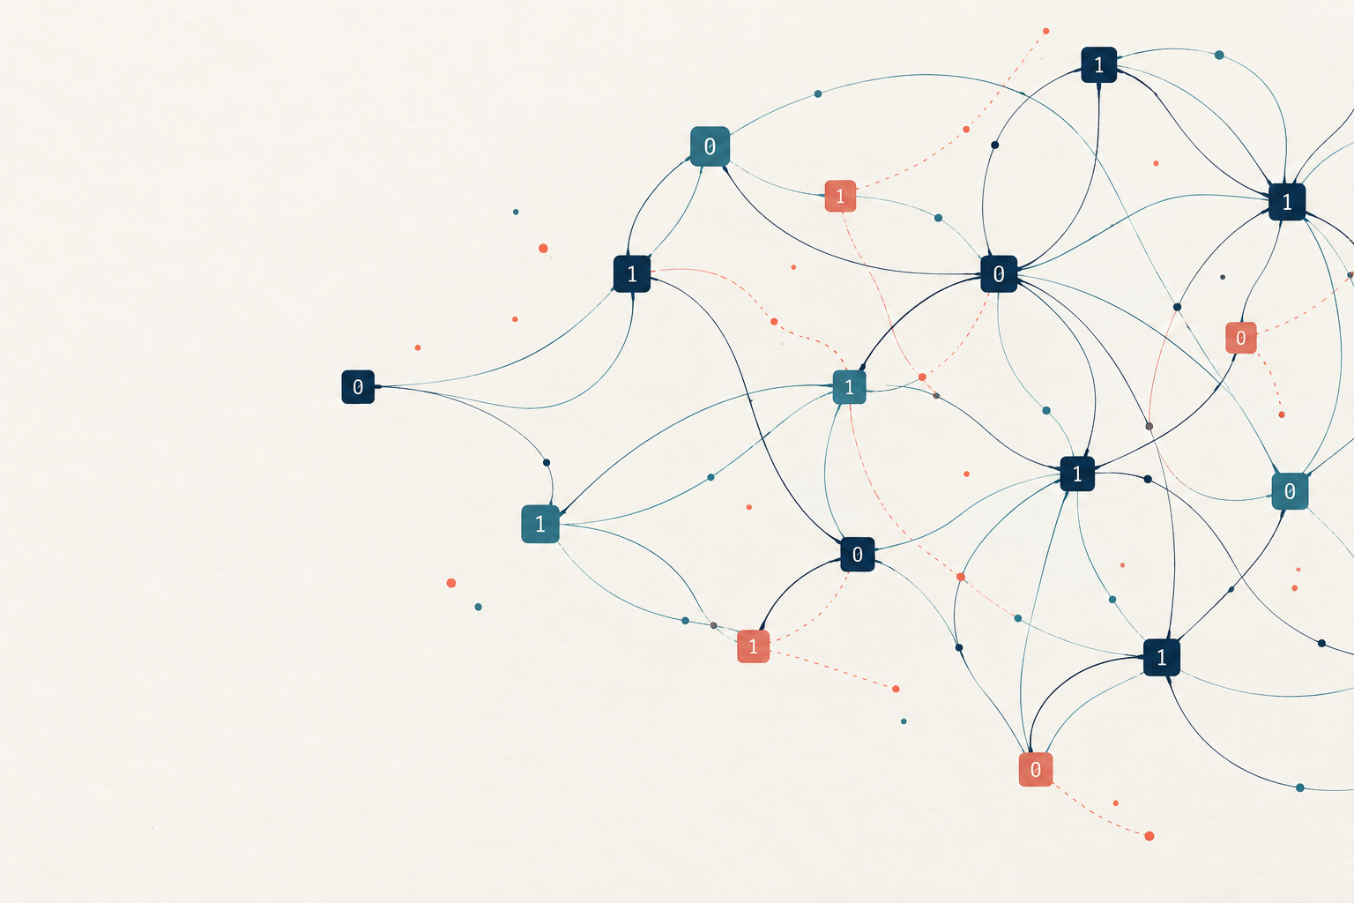
d-LIN
Sparse noisy
linear systems
EXPERT SEMINAR
Definitions, assumptions and the ABW connection
Prajjwal Saxena’s notes, revised with ABW09
Notes:
This presentation summarizes the supplied notes. The audience is assumed to know linear algebra over finite fields and basic cryptographic security definitions. Added calculations are labeled or explained in notes.
Generated cover illustration: conceptual artwork, not a quantitative diagram.
Primary source: Prajjwal Saxena, Understanding the d-LIN Problem, dLIN_explained.tex, Overleaf project https://www.overleaf.com/project/6ac3a275fa67840d6ebb88fb, accessed 5 October 2026.
Primary paper: Applebaum, Barak and Wigderson, Public-Key Cryptography from Different Assumptions, November 7, 2009, https://www.math.ias.edu/~avi/PUBLICATIONS/MYPAPERS/ABW09/ABW09.pdf. Page numbers are printed page numbers in this version.

Slide 2
The sampled d-LIN distribution
M ← M(m, n, d) x ← U(F₂ⁿ) e ← Ber(ε)ᵐ
(M, b) = (M, Mx + e)
Parameter | Role
m / n | Equation count relative to variable count
d | Exactly d ones in each matrix row
ε | Independent output-flip probability
All arithmetic in the sampled system is over F₂.
EXPERT SEMINAR
02
Notes:
Source sections 1, 3, 9 and 10. M is sampled from the ensemble with exactly d ones in each row, x is independent uniform in F₂ⁿ, e has independent Bernoulli(ε) coordinates. The notation specifies a distribution rather than a promise for every realization.
Primary source: Prajjwal Saxena, Understanding the d-LIN Problem, dLIN_explained.tex, Overleaf project https://www.overleaf.com/project/6ac3a275fa67840d6ebb88fb, accessed 5 October 2026.
Primary paper: Applebaum, Barak and Wigderson, Public-Key Cryptography from Different Assumptions, November 7, 2009, https://www.math.ias.edu/~avi/PUBLICATIONS/MYPAPERS/ABW09/ABW09.pdf. Page numbers are printed page numbers in this version.

Slide 3
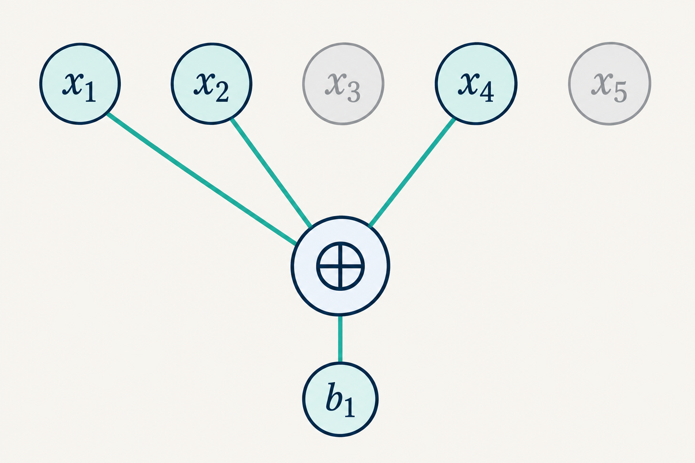
Sparse rows encode local constraints
bᵢ = ⨁ xⱼ + eᵢ
j in the support of row i
|supp(Mᵢ)| = d
Column weights can vary.
The row ensemble matters.
The diagram shows a noiseless row. Add eᵢ to model its observed output.
EXPERT SEMINAR
03
Notes:
Source sections 4–5. Row sparsity constrains the number of variables involved in each parity equation. It does not constrain the number of appearances of a variable across different equations. Generated diagram illustrates one row with support {1,2,4}.
Primary source: Prajjwal Saxena, Understanding the d-LIN Problem, dLIN_explained.tex, Overleaf project https://www.overleaf.com/project/6ac3a275fa67840d6ebb88fb, accessed 5 October 2026.
Primary paper: Applebaum, Barak and Wigderson, Public-Key Cryptography from Different Assumptions, November 7, 2009, https://www.math.ias.edu/~avi/PUBLICATIONS/MYPAPERS/ABW09/ABW09.pdf. Page numbers are printed page numbers in this version.

Slide 4
ABW task definitions and a separate optimization
Task | Target
Search3LIN | Recover the sampled x, with success at least 2/3
AppSearch3LIN | Return x̂ with dH(x̂, x) ≤ 0.1n
Decision | Distinguish (M, Mx + e) from (M, u), u uniform
Residual optimization | Minimize wt(Mz − b) over z
For even d, M1 = 0, so x and x + 1 produce identical clean labels.
EXPERT SEMINAR
04
Notes:
Primary paper: Applebaum, Barak and Wigderson, Public-Key Cryptography from Different Assumptions, November 7, 2009, https://www.math.ias.edu/~avi/PUBLICATIONS/MYPAPERS/ABW09/ABW09.pdf. Page numbers are printed page numbers in this version.
Def5.1 p12: Search3LIN returns x, success threshold2/3. Def6.1 p16: AppSearch3LIN returns x-hat with dH(x-hat,x)≤.1n, threshold.7. Decide compares noisy labels with independent uniform labels. Low-residual optimization is separate. For even d, M1=0 makes x and x+1 indistinguishable, requiring an up-to-complement formulation (paper notes this in§7.4).
Primary source: Prajjwal Saxena, Understanding the d-LIN Problem, dLIN_explained.tex, Overleaf project https://www.overleaf.com/project/6ac3a275fa67840d6ebb88fb, accessed 5 October 2026.

Slide 5
Error count: expectation and concentration
Illustration: m = 20, ε = 0.10
W ∼ Binomial(m, ε)
E[W] = mε
Var(W) = mε(1 − ε)
Pr[W/m > ε + t]
≤ exp(−2mt²) (t > 0)
A high-probability bound needs slack above ε, or a separate tail calculation.
EXPERT SEMINAR
05
Notes:
Source section 9. Direct derivation: W=sum_i e_i ~ Binomial(m,ε), E[W]=mε and Var(W)=mε(1−ε). Hoeffding for independent variables in [0,1] gives Pr[W/m>ε+t]≤exp(−2mt²), t>0. This clarifies the distinction between the expectation in section 9 and the deterministic satisfiability promise in section 8. Chart calculated for m=20, ε=.10; display k=0...8.
Primary source: Prajjwal Saxena, Understanding the d-LIN Problem, dLIN_explained.tex, Overleaf project https://www.overleaf.com/project/6ac3a275fa67840d6ebb88fb, accessed 5 October 2026.
Primary paper: Applebaum, Barak and Wigderson, Public-Key Cryptography from Different Assumptions, November 7, 2009, https://www.math.ias.edu/~avi/PUBLICATIONS/MYPAPERS/ABW09/ABW09.pdf. Page numbers are printed page numbers in this version.

Slide 6
The same error model at three noise rates
W ∼ Binomial(20, ε)
ε = 0.5
ε = 0.25
ε = 0.7
Mean = 10
Mean = 5
Mean = 14
ε = 0.5 hides x completely. Flipping all labels changes ε = 0.7 into ε = 0.3.
EXPERT SEMINAR
06
Notes:
Primary paper: Applebaum, Barak and Wigderson, Public-Key Cryptography from Different Assumptions, November 7, 2009, https://www.math.ias.edu/~avi/PUBLICATIONS/MYPAPERS/ABW09/ABW09.pdf. Page numbers are printed page numbers in this version.
Direct calculation of Pr[W=k]=C(20,k)ε^k(1−ε)^(20−k). User-requested ε=.5,.25,.7 are illustrative, not ABW PKE parameter choices. At ε=.5, Mx+e is exactly uniform and independent of x. For ε>.5, complementing every observed label produces noise rate1−ε.
Primary source: Prajjwal Saxena, Understanding the d-LIN Problem, dLIN_explained.tex, Overleaf project https://www.overleaf.com/project/6ac3a275fa67840d6ebb88fb, accessed 5 October 2026.

Slide 7
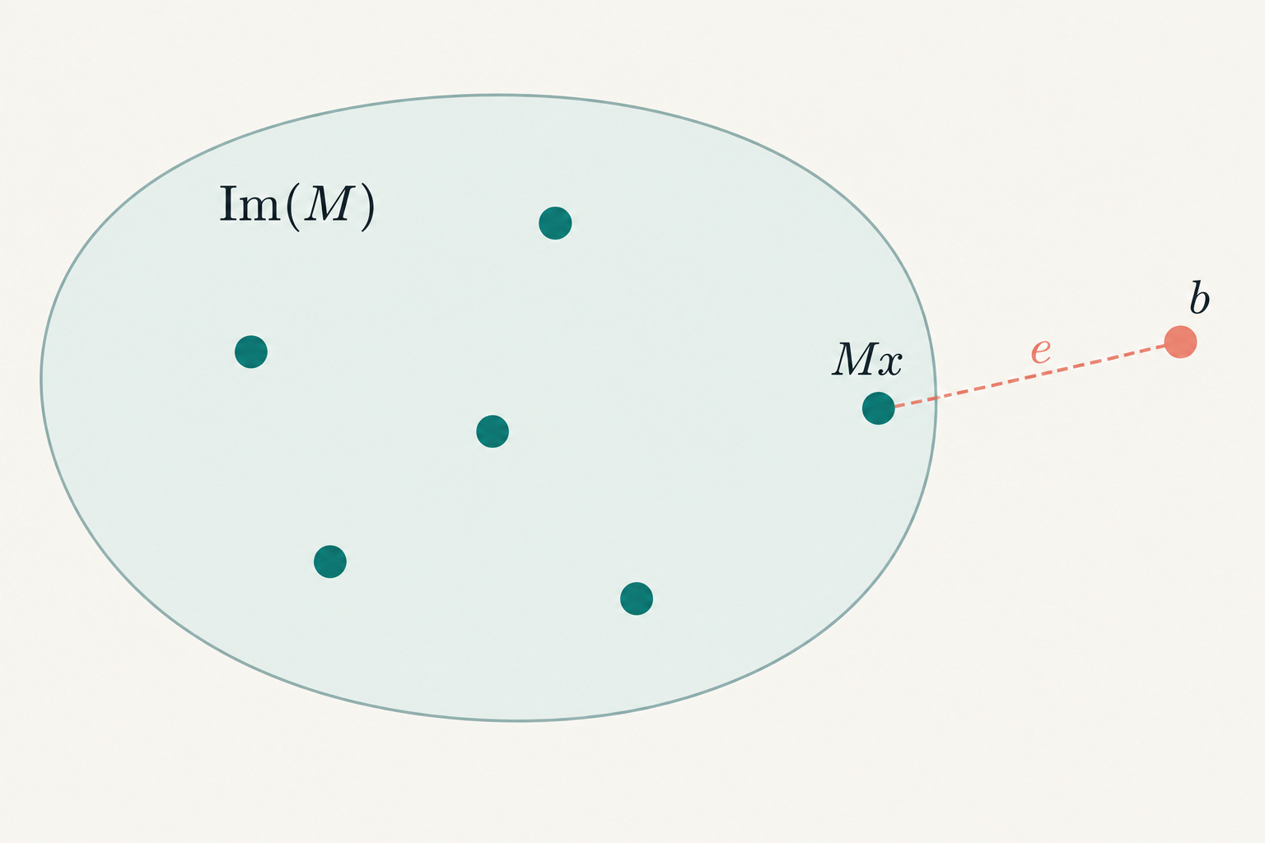
Distance to the planted output and to the image
C = Im(M)
dH(b, Mx) = wt(e)
dH(b, C) ≤ wt(e)
E[dH(b, C)] ≤ mε
Equality to the planted distance does not imply equality to the nearest-image distance.
EXPERT SEMINAR
07
Notes:
Source section 11, with the distinction made explicit. dH(b,Mx)=wt(e) holds exactly. Distance to Im(M) minimizes over all assignments, so it can be strictly less. Thus E[dH(b,Im(M))]≤mε rather than a general equality. Schematic shows a possible b outside the image and is not a Euclidean metric embedding.
Primary source: Prajjwal Saxena, Understanding the d-LIN Problem, dLIN_explained.tex, Overleaf project https://www.overleaf.com/project/6ac3a275fa67840d6ebb88fb, accessed 5 October 2026.
Primary paper: Applebaum, Barak and Wigderson, Public-Key Cryptography from Different Assumptions, November 7, 2009, https://www.math.ias.edu/~avi/PUBLICATIONS/MYPAPERS/ABW09/ABW09.pdf. Page numbers are printed page numbers in this version.

Slide 8
The notes’ toy instance has an exact fit
b = (1, 1, 0, 1)ᵀ
M
1 | 1 | 0 | 1 | 0
0 | 1 | 1 | 0 | 1
1 | 0 | 1 | 1 | 0
0 | 1 | 0 | 1 | 1
Sampled x = (1, 0, 1, 0, 1)ᵀ
Residual weight = 1
x′ = (0, 1, 0, 0, 0)ᵀ
Mx′ = b
rank(M) = 4, so Im(M) = F₂⁴. A planted error need not create distance from the image.
EXPERT SEMINAR
08
Notes:
Source section 12 plus direct finite-field calculation. The four rows of M are independent. All exact solutions for b=(1,1,0,1)ᵀ are (0,1+t,t,t,0)ᵀ for t in F₂. The sample x=(1,0,1,0,1)ᵀ has residual (0,1,0,0)ᵀ. This is an arithmetic example, not an instance in a hardness regime.
Primary source: Prajjwal Saxena, Understanding the d-LIN Problem, dLIN_explained.tex, Overleaf project https://www.overleaf.com/project/6ac3a275fa67840d6ebb88fb, accessed 5 October 2026.
Primary paper: Applebaum, Barak and Wigderson, Public-Key Cryptography from Different Assumptions, November 7, 2009, https://www.math.ias.edu/~avi/PUBLICATIONS/MYPAPERS/ABW09/ABW09.pdf. Page numbers are printed page numbers in this version.

Slide 9
Hardness depends on the ensemble and task
Specification | Why it changes the claim
Matrix distribution | Row supports, dependencies and rank affect information
Parameters m, n, d, ε | Sample density and noise affect attack costs
Success criterion | Exact recovery, approximation and advantage differ
Adversary model | PPT, restricted circuit classes and other models differ
2ⁿ candidate assignments ≠ a hardness proof
EXPERT SEMINAR
09
Notes:
Source sections 13–14 and 22. Exact consistent systems admit polynomial-time Gaussian elimination. Exponentially many possible assignments do not establish a lower bound. State the distribution, asymptotic parameters, adversary class and success criterion whenever presenting a cryptographic assumption.
Primary source: Prajjwal Saxena, Understanding the d-LIN Problem, dLIN_explained.tex, Overleaf project https://www.overleaf.com/project/6ac3a275fa67840d6ebb88fb, accessed 5 October 2026.
Primary paper: Applebaum, Barak and Wigderson, Public-Key Cryptography from Different Assumptions, November 7, 2009, https://www.math.ias.edu/~avi/PUBLICATIONS/MYPAPERS/ABW09/ABW09.pdf. Page numbers are printed page numbers in this version.

Slide 10
Theorem 2: PKE from 3-LIN alone
3LIN(c n¹·⁴, n⁻⁰·² / c)
For a suitable constant c, this assumption implies semantically secure public-key encryption.
Parameter | Asymptotic role
m = Θ(n¹·⁴) | Superlinear number of sparse equations
ε = Θ(n⁻⁰·²) | Noise decreases, expected count is Θ(n¹·²)
DUE | No DUE assumption in this theorem
EXPERT SEMINAR
10
Notes:
Primary paper: Applebaum, Barak and Wigderson, Public-Key Cryptography from Different Assumptions, November 7, 2009, https://www.math.ias.edu/~avi/PUBLICATIONS/MYPAPERS/ABW09/ABW09.pdf. Page numbers are printed page numbers in this version.
Theorem2 p5. Def5.1 and Assumption5.2 p12. The theorem asserts there exists c so that intractability of Search3LIN(c n^1.4,n^−.2/c) implies semantically secure PKE. The formal sufficient assumption in§5 quantifies over every positive constant C0,C1. Do not infer concrete security from asymptotics.
Primary source: Prajjwal Saxena, Understanding the d-LIN Problem, dLIN_explained.tex, Overleaf project https://www.overleaf.com/project/6ac3a275fa67840d6ebb88fb, accessed 5 October 2026.

Slide 11
Theorem 3: d-LIN together with DUE
dLIN(c′ n log n, 1 / (c′q))
DUE(cn, q, 2d)
Both assumptions imply semantically secure PKE for the theorem’s parameter regime.
DUE hides a set of q rows supported on only q/3 columns. The public matrix has locality 2d.
Here q counts planted rows. It is unrelated to the modulus q used in LWE.
EXPERT SEMINAR
11
Notes:
Primary paper: Applebaum, Barak and Wigderson, Public-Key Cryptography from Different Assumptions, November 7, 2009, https://www.math.ias.edu/~avi/PUBLICATIONS/MYPAPERS/ABW09/ABW09.pdf. Page numbers are printed page numbers in this version.
Theorem3 p5, §§7.1–7.2 pp22–25. For constants d,c and q=q(n), some c-prime makes the two stated assumptions sufficient. DUE compares a random bipartite graph with one containing a planted q-set of left vertices having only q/3 neighbors. In this slide q is the planted-set size, not an LWE modulus. Known attacks constrain admissible q and graph degree.
Primary source: Prajjwal Saxena, Understanding the d-LIN Problem, dLIN_explained.tex, Overleaf project https://www.overleaf.com/project/6ac3a275fa67840d6ebb88fb, accessed 5 October 2026.

Slide 12
d-LIN, LPN, LWE and Module-LWE
Problem | Linear structure | Error model
d-LIN | Binary rows with exactly d ones | Independent bit flips
LPN | Uniform binary rows, typically dense | Independent bit flips
LWE | Uniform matrices over Zq | Small centered modular errors
Module-LWE | Polynomial matrices over Rq | Small polynomial coefficients
Changing the matrix distribution or the noise changes the assumption.
EXPERT SEMINAR
12
Notes:
Primary paper: Applebaum, Barak and Wigderson, Public-Key Cryptography from Different Assumptions, November 7, 2009, https://www.math.ias.edu/~avi/PUBLICATIONS/MYPAPERS/ABW09/ABW09.pdf. Page numbers are printed page numbers in this version.
Regev, On lattices, learning with errors, random linear codes, and cryptography, Theorem 1.1, https://cims.nyu.edu/~regev/papers/qcrypto.pdf. The reduction is quantum and requires its stated parameters and error distribution.
Langlois and Stehlé, Worst-case to average-case reductions for module lattices, Theorems 4.7–4.8, https://perso.ens-lyon.fr/damien.stehle/downloads/MSIS.pdf.
Kiltz, Masny and Pietrzak, Provable Security of LPN-based Public-Key Encryption, https://eprint.iacr.org/2015/401.pdf. Yu and Zhang, Cryptography with Auxiliary Input and Trapdoor from Constant-Noise LPN, CRYPTO 2016, https://www.iacr.org/archive/crypto2016/98140212/98140212.pdf. PKE from LPN depends on noise and quantitative hardness. Do not infer impossibility from its common symmetric applications.
Primary source: Prajjwal Saxena, Understanding the d-LIN Problem, dLIN_explained.tex, Overleaf project https://www.overleaf.com/project/6ac3a275fa67840d6ebb88fb, accessed 5 October 2026.

Slide 13
LWE and Module-LWE structure
LWE: b = As + e (mod q)
A contains ordinary modular coefficients. Small errors perturb the outputs.
Module-LWE: t = As + e in Rqᵏ
A, s and e contain polynomials. Coefficient expansion creates correlated convolution blocks.
Module structure is different from fixing d nonzero bits in each d-LIN row.
EXPERT SEMINAR
13
Notes:
Regev, On lattices, learning with errors, random linear codes, and cryptography, Theorem 1.1, https://cims.nyu.edu/~regev/papers/qcrypto.pdf. The reduction is quantum and requires its stated parameters and error distribution.
Langlois and Stehlé, Worst-case to average-case reductions for module lattices, Theorems 4.7–4.8, https://perso.ens-lyon.fr/damien.stehle/downloads/MSIS.pdf.
NIST FIPS 203 (2024), Module-Lattice-Based Key-Encapsulation Mechanism Standard, §§1.2,3.2,4.2.2,5.1 and Tables 2–3, https://nvlpubs.nist.gov/nistpubs/FIPS/NIST.FIPS.203.pdf. ML-KEM uses centered binomial errors and compression. Its assumed quantum resistance is not a proof against all quantum attacks.
Schematic equations describe their algebraic templates. In LWE, A is uniform in Zq^(m×n). In module-LWE, A is uniform over an appropriate quotient ring Rq. Expanded coefficient matrices use structured convolution blocks, not independent entries.
Primary source: Prajjwal Saxena, Understanding the d-LIN Problem, dLIN_explained.tex, Overleaf project https://www.overleaf.com/project/6ac3a275fa67840d6ebb88fb, accessed 5 October 2026.

Slide 14
What hardness support each setting provides
Setting | Relevant support and its limits
d-LIN / ABW | Average-case assumption, task reductions and restricted attack evidence
LPN | Separate binary-noise assumptions. PKE depends on parameters and quantitative hardness
LWE | Worst-case lattice reductions under specified parameters and error laws
Module-LWE | Reductions from module-lattice problems under specified conditions
The original LWE and Module-LWE reductions cited here are quantum reductions.
EXPERT SEMINAR
14
Notes:
Primary paper: Applebaum, Barak and Wigderson, Public-Key Cryptography from Different Assumptions, November 7, 2009, https://www.math.ias.edu/~avi/PUBLICATIONS/MYPAPERS/ABW09/ABW09.pdf. Page numbers are printed page numbers in this version.
Regev, On lattices, learning with errors, random linear codes, and cryptography, Theorem 1.1, https://cims.nyu.edu/~regev/papers/qcrypto.pdf. The reduction is quantum and requires its stated parameters and error distribution.
Langlois and Stehlé, Worst-case to average-case reductions for module lattices, Theorems 4.7–4.8, https://perso.ens-lyon.fr/damien.stehle/downloads/MSIS.pdf.
Kiltz, Masny and Pietrzak, Provable Security of LPN-based Public-Key Encryption, https://eprint.iacr.org/2015/401.pdf. Yu and Zhang, Cryptography with Auxiliary Input and Trapdoor from Constant-Noise LPN, CRYPTO 2016, https://www.iacr.org/archive/crypto2016/98140212/98140212.pdf. PKE from LPN depends on noise and quantitative hardness. Do not infer impossibility from its common symmetric applications.
ABW§6 reductions incur sample/parameter changes. The paper’s search-to-decision arguments are specific to sparse ensembles and do not transfer a dense-LPN assumption to sparse d-LIN. Standard LPN PKE results require their own noise and quantitative-hardness hypotheses.
Primary source: Prajjwal Saxena, Understanding the d-LIN Problem, dLIN_explained.tex, Overleaf project https://www.overleaf.com/project/6ac3a275fa67840d6ebb88fb, accessed 5 October 2026.

Slide 15
A short row dependency removes x
Four 3-sparse rows
Σᵢ∈S Mᵢ = 0
1 | 1 | 1 | 0 | 0 | 0
1 | 0 | 0 | 1 | 1 | 0
0 | 1 | 0 | 1 | 0 | 1
0 | 0 | 1 | 0 | 1 | 1
Σᵢ∈S bᵢ = Σᵢ∈S eᵢ
The hidden assignment cancels
when the selected rows sum to zero.
Each column appears twice in this illustrative dependency.
EXPERT SEMINAR
15
Notes:
Source sections 18 and 20. Let S select rows with XOR sum zero. The displayed 4×6 matrix is a new illustrative 3-sparse dependency: supports {1,2,3}, {1,4,5}, {2,4,6}, {3,5,6}. Every column has even weight, so the XOR of all four rows is zero. This example demonstrates algebra only and is not a key-generation proposal.
Primary source: Prajjwal Saxena, Understanding the d-LIN Problem, dLIN_explained.tex, Overleaf project https://www.overleaf.com/project/6ac3a275fa67840d6ebb88fb, accessed 5 October 2026.
Primary paper: Applebaum, Barak and Wigderson, Public-Key Cryptography from Different Assumptions, November 7, 2009, https://www.math.ias.edu/~avi/PUBLICATIONS/MYPAPERS/ABW09/ABW09.pdf. Page numbers are printed page numbers in this version.

Slide 16
The ABW bit-encryption mechanism
Public key | Secret key
Sparse matrix M | Short set S with Σᵢ∈S Mᵢ = 0 and m ∈ S
Enc(σ) = Mx + e + σuₘ
Dec(c) = Σᵢ∈S cᵢ = σ + Σᵢ∈S eᵢ
σ is the message bit. uₘ has a 1 only in the last position.
Fresh x and e randomize every encryption.
EXPERT SEMINAR
16
Notes:
Primary paper: Applebaum, Barak and Wigderson, Public-Key Cryptography from Different Assumptions, November 7, 2009, https://www.math.ias.edu/~avi/PUBLICATIONS/MYPAPERS/ABW09/ABW09.pdf. Page numbers are printed page numbers in this version.
Figure 1, printed p.8, and §5.2 pp.13–14. This is the raw weak scheme. Public key M has a secret short row dependency S containing the last row. Each encryption samples fresh uniform x and fresh Bernoulli errors. Enc(1) differs from Enc(0) by flipping the final coordinate. It is not an independently uniform ciphertext distribution.
Primary source: Prajjwal Saxena, Understanding the d-LIN Problem, dLIN_explained.tex, Overleaf project https://www.overleaf.com/project/6ac3a275fa67840d6ebb88fb, accessed 5 October 2026.

Slide 17
Key generation must hide the short dependency
Theorem 2 route
Theorem 3 route
Condition an appropriate random 3-sparse ensemble on a short dependency.
The proof establishes sufficient statistical overlap.
Plant a shrinking set of rows with too few neighbors.
DUE controls whether an observer can detect this structure.
Finding an arbitrary left-kernel vector does not implement the required short trapdoor.
EXPERT SEMINAR
17
Notes:
Primary paper: Applebaum, Barak and Wigderson, Public-Key Cryptography from Different Assumptions, November 7, 2009, https://www.math.ias.edu/~avi/PUBLICATIONS/MYPAPERS/ABW09/ABW09.pdf. Page numbers are printed page numbers in this version.
§5.2 and Lemma5.4 pp13–14: T_p,n with p=n^−1.6 conditioned on a suitable short even-incidence submatrix through the last row, q=Θ(n^.2). Statistical distance from the unconditioned ensemble is at most1−δ. §7 plants q rows on q/3 columns, chooses a dependent row and moves it to last position. DUE and Theorem7.4 control the key distribution.
Primary source: Prajjwal Saxena, Understanding the d-LIN Problem, dLIN_explained.tex, Overleaf project https://www.overleaf.com/project/6ac3a275fa67840d6ebb88fb, accessed 5 October 2026.

Slide 18
Noise accumulates along the dependency
p = [1 − (1 − 2ε)ʳ] / 2
p ≤ rε
Short dependencies preserve
a useful parity bias.
The horizontal labels double r at each step. Values follow the independent-noise model.
EXPERT SEMINAR
18
Notes:
Source sections 9 and 18 support this direct derivation. If r=|S| and errors are independent Bernoulli(ε), E[(-1)^(sum e_i)]=(1−2ε)^r. Consequently Pr[odd parity]=(1−(1−2ε)^r)/2≤rε by a union bound. Curves are calculated values, not experimental measurements. This is the noise contribution to failure in the basic parity decoder.
Primary source: Prajjwal Saxena, Understanding the d-LIN Problem, dLIN_explained.tex, Overleaf project https://www.overleaf.com/project/6ac3a275fa67840d6ebb88fb, accessed 5 October 2026.
Primary paper: Applebaum, Barak and Wigderson, Public-Key Cryptography from Different Assumptions, November 7, 2009, https://www.math.ias.edu/~avi/PUBLICATIONS/MYPAPERS/ABW09/ABW09.pdf. Page numbers are printed page numbers in this version.

Slide 19
Weak encryption and amplification
α < (1 − √β) / 2
ABW first obtains constant correctness and privacy. Amplification gives semantic security and reliable encryption.
Quantity | Meaning
α | Raw decryption-error bound
β | ABW privacy parameter
Section 7 noise conversion | εcipher = 2η(1 − η), where η is search noise
EXPERT SEMINAR
19
Notes:
Primary paper: Applebaum, Barak and Wigderson, Public-Key Cryptography from Different Assumptions, November 7, 2009, https://www.math.ias.edu/~avi/PUBLICATIONS/MYPAPERS/ABW09/ABW09.pdf. Page numbers are printed page numbers in this version.
§4 pp11–12 defines (1−α)-correctness and β-privacy. Constant α,β with α<(1−sqrt(β))/2 permit HR05 amplification to semantically secure PKE supporting polynomially long messages. β follows ABW’s distinguishing convention. Lemma5.3 bounds raw error by |S|ε. Theorem7.3 uses public locality2d and ciphertext noise2η(1−η) when SearchLIN uses localityd and noiseη.
Primary source: Prajjwal Saxena, Understanding the d-LIN Problem, dLIN_explained.tex, Overleaf project https://www.overleaf.com/project/6ac3a275fa67840d6ebb88fb, accessed 5 October 2026.

Slide 20
Evidence covers particular attack families
Family | Scope of the evidence
Myopic algorithms | Restricted access to noisy outputs or their combinations
Low-degree polynomials / AC⁰ | Restricted algebraic or circuit computation
Lasserre / SDP hierarchy | Specified relaxation levels and parameter regimes
A cryptographic assumption remains after these restricted lower bounds.
EXPERT SEMINAR
20
Notes:
Source sections 14 and 22. ABW analyzes restricted attacks in specific parameter ranges, including myopic access to noisy bits, low-degree polynomial approaches, AC⁰ circuits, and Lasserre/SDP methods. These results do not prove hardness against all polynomial-time algorithms and do not constitute a modern parameter recommendation. Primary paper: Applebaum, Barak and Wigderson, Public-Key Cryptography from Different Assumptions, November 7, 2009, https://www.math.ias.edu/~avi/PUBLICATIONS/MYPAPERS/ABW09/ABW09.pdf. Page numbers are printed page numbers in this version.
Primary source: Prajjwal Saxena, Understanding the d-LIN Problem, dLIN_explained.tex, Overleaf project https://www.overleaf.com/project/6ac3a275fa67840d6ebb88fb, accessed 5 October 2026.
Primary paper: Applebaum, Barak and Wigderson, Public-Key Cryptography from Different Assumptions, November 7, 2009, https://www.math.ias.edu/~avi/PUBLICATIONS/MYPAPERS/ABW09/ABW09.pdf. Page numbers are printed page numbers in this version.

Slide 21
Reasons to study d-LIN for public keys
A different foundation
ABW connects natural sparse noisy constraints to public-key encryption.
Simple local arithmetic
Core evaluation uses O(md) bit operations. Row index lists use O(md log n) bits.
A proved conditional construction
Theorems turn specified average-case hardness assumptions into semantic security.
EXPERT SEMINAR
21
Notes:
Primary paper: Applebaum, Barak and Wigderson, Public-Key Cryptography from Different Assumptions, November 7, 2009, https://www.math.ias.edu/~avi/PUBLICATIONS/MYPAPERS/ABW09/ABW09.pdf. Page numbers are printed page numbers in this version.
Introduction and Theorems 2–3. The operation and storage costs below are direct counts for the core sparse matrix representation, not benchmark claims about a final amplified construction.
Primary source: Prajjwal Saxena, Understanding the d-LIN Problem, dLIN_explained.tex, Overleaf project https://www.overleaf.com/project/6ac3a275fa67840d6ebb88fb, accessed 5 October 2026.

Slide 22
Costs and unresolved issues for public keys
Security assumptions
Implementation costs
Parameters and sampling matter.
A short hidden dependency must remain hard to exploit.
Restricted attack evidence leaves a general hardness assumption.
Noise and dependency length compete with correctness.
Amplification adds overhead.
Concrete parameters, CCA security and quantum analysis need more work.
Cheap sparse XOR operations alone do not establish an efficient final cryptosystem.
EXPERT SEMINAR
22
Notes:
Primary paper: Applebaum, Barak and Wigderson, Public-Key Cryptography from Different Assumptions, November 7, 2009, https://www.math.ias.edu/~avi/PUBLICATIONS/MYPAPERS/ABW09/ABW09.pdf. Page numbers are printed page numbers in this version.
Introduction, §§4–7 and §12. These are construction/design implications. ABW does not give a concrete standardized CCA KEM or a modern security-bit estimate. Quantum security requires a quantum-adversary assumption plus a compatible proof.
Primary source: Prajjwal Saxena, Understanding the d-LIN Problem, dLIN_explained.tex, Overleaf project https://www.overleaf.com/project/6ac3a275fa67840d6ebb88fb, accessed 5 October 2026.

Slide 23
ABW and a concrete Module-LWE standard
Aspect | ABW d-LIN construction | ML-KEM
Role | Asymptotic PKE existence result | Standardized key encapsulation
Security statement | Semantic security under stated assumptions | IND-CCA2 goal under Module-LWE and proof conditions
Parameters | No concrete 128-bit set in ABW09 | ML-KEM-512 / 768 / 1024
Example sizes | No like-for-like benchmark here | ML-KEM-768: key 1184 B, ciphertext 1088 B
PKE encrypts messages. A KEM establishes a shared secret for a larger protocol.
EXPERT SEMINAR
23
Notes:
Primary paper: Applebaum, Barak and Wigderson, Public-Key Cryptography from Different Assumptions, November 7, 2009, https://www.math.ias.edu/~avi/PUBLICATIONS/MYPAPERS/ABW09/ABW09.pdf. Page numbers are printed page numbers in this version.
NIST FIPS 203 (2024), Module-Lattice-Based Key-Encapsulation Mechanism Standard, §§1.2,3.2,4.2.2,5.1 and Tables 2–3, https://nvlpubs.nist.gov/nistpubs/FIPS/NIST.FIPS.203.pdf. ML-KEM uses centered binomial errors and compression. Its assumed quantum resistance is not a proof against all quantum attacks.
Primary source: Prajjwal Saxena, Understanding the d-LIN Problem, dLIN_explained.tex, Overleaf project https://www.overleaf.com/project/6ac3a275fa67840d6ebb88fb, accessed 5 October 2026.

Slide 24
Reading path and main distinctions
Question | Key distinction
What is the task? | Exact recovery, approximate recovery, decision or residual fitting
What makes it hard? | A precise sampled distribution and an unproved average-case assumption
What does ABW prove? | Semantic-security existence under specific theorem hypotheses
How does it compare? | Same noisy-linear template, different distributions and reductions
ABW09: §§2, 5–7 and 9
Regev on LWE, Langlois–Stehlé on Module-LWE, NIST FIPS 203
Technical definitions and source links appear in the speaker notes.
EXPERT SEMINAR
24
Notes:
Primary paper: Applebaum, Barak and Wigderson, Public-Key Cryptography from Different Assumptions, November 7, 2009, https://www.math.ias.edu/~avi/PUBLICATIONS/MYPAPERS/ABW09/ABW09.pdf. Page numbers are printed page numbers in this version.
Regev, On lattices, learning with errors, random linear codes, and cryptography, Theorem 1.1, https://cims.nyu.edu/~regev/papers/qcrypto.pdf. The reduction is quantum and requires its stated parameters and error distribution.
Langlois and Stehlé, Worst-case to average-case reductions for module lattices, Theorems 4.7–4.8, https://perso.ens-lyon.fr/damien.stehle/downloads/MSIS.pdf.
NIST FIPS 203 (2024), Module-Lattice-Based Key-Encapsulation Mechanism Standard, §§1.2,3.2,4.2.2,5.1 and Tables 2–3, https://nvlpubs.nist.gov/nistpubs/FIPS/NIST.FIPS.203.pdf. ML-KEM uses centered binomial errors and compression. Its assumed quantum resistance is not a proof against all quantum attacks.
Kiltz, Masny and Pietrzak, Provable Security of LPN-based Public-Key Encryption, https://eprint.iacr.org/2015/401.pdf. Yu and Zhang, Cryptography with Auxiliary Input and Trapdoor from Constant-Noise LPN, CRYPTO 2016, https://www.iacr.org/archive/crypto2016/98140212/98140212.pdf. PKE from LPN depends on noise and quantitative hardness. Do not infer impossibility from its common symmetric applications.
Primary source: Prajjwal Saxena, Understanding the d-LIN Problem, dLIN_explained.tex, Overleaf project https://www.overleaf.com/project/6ac3a275fa67840d6ebb88fb, accessed 5 October 2026.

