Slide 1
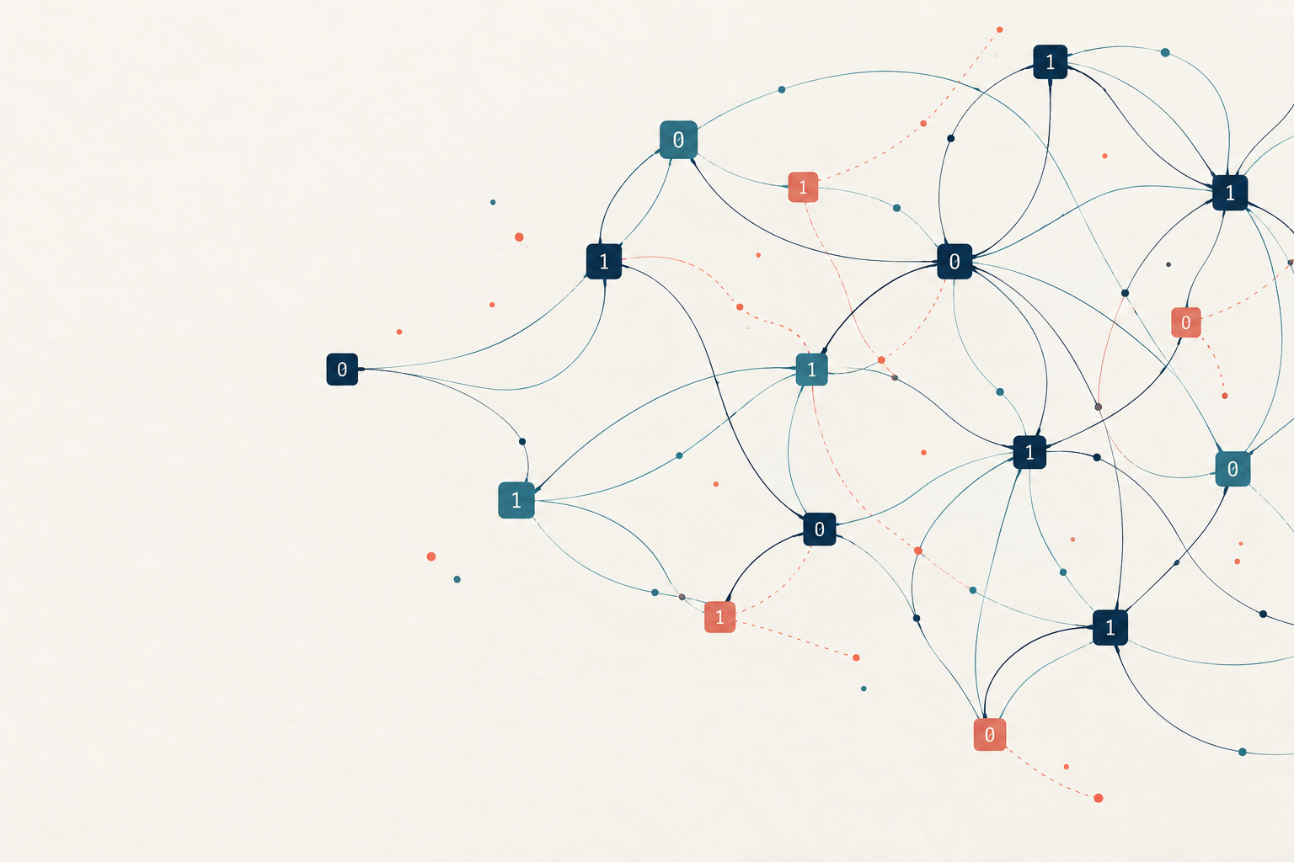
RSA, Kyber
and the next
public-key scheme
A case study for an ABW research programme
Practical appeal, security evidence and design tradeoffs
Cryptography research discussion · 6 October 2026
RSA, ML-KEM and an ABW research agenda
01
Notes:
A technical case study for cryptography colleagues. Main talk: slides 1–24, approximately 25–30 minutes. Appendix: slides 25–30. Assessment date: 6 October 2026. Lucrative is interpreted as attractive for adoption and deployment, without estimating commercial revenue. RSA adoption explanations are a synthesis of its capabilities and standards, not a causal market study. The ABW programme is a proposal, not a claimed secure new scheme. Cover artwork is conceptual.
Sources

Slide 2
The common adoption lesson
01
RSA made useful public-key operations practical
Encryption and signatures gained standard encodings and ecosystem support.
02
Kyber balanced competing deployment requirements
Security confidence, speed and communication cost supported selection.
03
ABW needs a complete, quantitatively analysed scheme
A distinct assumption and inexpensive XORs are a starting point.
RSA, ML-KEM and an ABW research agenda
02
Notes:
Synthesis. A mathematical foundation enables a primitive, but a deployable cryptosystem also needs a secure full interface, practical implementation and an ecosystem. This is a research framing rather than a measured ranking. RSA and Kyber serve different historical contexts and primitive roles.
Sources

Slide 3
RSA: a useful capability package
Public-key encryption
Publicly verifiable signatures
A recipient publishes an encryption key.
The sender encrypts without sharing
the recipient’s decryption secret.
A signer uses a private key.
Verifiers use a public key.
No shared signing secret is necessary.
Public keys still need authentication. Encryption and signature roles require suitable schemes.
RSA, ML-KEM and an ABW research agenda
03
Notes:
Interpretive case study grounded in the 1978 proposal. Public encryption without sending the decryption key and publicly verifiable signatures were compelling capabilities. The original proposal described both. The inference is that combining such roles in a coherent arithmetic family helped practical appeal. Public-key authenticity still requires an authentication mechanism. Use separate keys and modern encodings for distinct roles.
Sources
https://people.csail.mit.edu/rivest/Rsapaper.pdf

Slide 4
RSA’s compact trapdoor description
N = pq ed ≡ 1 mod λ(N)
Public operation
Trapdoor inverse
c = aᵉ mod N
a = cᵈ mod N
λ(N) = lcm(p − 1, q − 1). The encoded representative a differs from the application message.
RSA, ML-KEM and an ABW research agenda
04
Notes:
Algebraic summary. For two distinct odd primes and a valid exponent, ed=1 mod lambda(N). Public exponentiation has an inverse computable from the factorization. Correctness follows modulo both primes and CRT. Factoring gives the private exponent, while general equivalence between RSA inversion and factoring is not known. Formulas are the RSA primitive, not a secure standalone encryption scheme.
Sources
https://people.csail.mit.edu/rivest/Rsapaper.pdf
https://www.rfc-editor.org/rfc/rfc8017.html

Slide 5
A cheap public operation helps deployment
65537 = 2¹⁶ + 1
16 modular squarings
+ 1 modular multiplication
This asymmetry favours public encryption and signature verification.
Arithmetic count for the RSA primitive. It is not an end-to-end latency benchmark.
RSA, ML-KEM and an ABW research agenda
05
Notes:
Original operation count. For the conventional public exponent 65537=2^16+1, left-to-right binary exponentiation initialized with the base needs 16 modular squarings and one additional modular multiplication. This counts arithmetic operations, not CPU cycles, and excludes encoding and hashing. Private operations have a larger exponent, can use CRT and require side-channel and fault protections. The asymmetry is useful when many parties verify signatures or encrypt to a recipient.
Sources
https://www.rfc-editor.org/rfc/rfc8017.html

Slide 6
RSA’s surrounding standards mattered
Layer | Practical contribution
RSAES-OAEP | Randomized encryption encoding
RSASSA-PSS | A dedicated probabilistic signature scheme
Certificates and key formats | Public-key authentication and interoperability
Libraries and hardware support | Implementations that applications can reuse
The case-study inference: lower integration effort can matter as much as arithmetic elegance.
RSA, ML-KEM and an ABW research agenda
06
Notes:
Interpretive adoption lesson. PKCS #1 specifies RSAES-OAEP and RSASSA-PSS with their respective security goals. RFC 5280 defines the certificate framework for associating public keys with subjects and verifying paths. These standards do not prove that RSA was always the fastest choice; they illustrate reusable integration machinery. Padding, encoding and protocol validation are integral to the deployed cryptosystem.
Sources
https://www.rfc-editor.org/rfc/rfc8017.html
https://www.rfc-editor.org/rfc/rfc5280.html

Slide 7
RSA’s advantages have boundaries
Boundary | Consequence
Raw deterministic exponentiation | Textbook RSA lacks semantic encryption security
Private-key computation | Constant-time code, blinding and fault checks matter
Static key transport | Later key compromise can expose recorded sessions
Quantum factoring | RSA is not a post-quantum foundation
TLS 1.3 removed RSA key transport. RSA signatures are a separate role.
RSA, ML-KEM and an ABW research agenda
07
Notes:
RSA primitive outputs are deterministic and multiplicative. Randomized encoding is essential for modern encryption security. Private-key implementations face timing and fault attacks. Static RSA key transport does not provide forward secrecy on later compromise of the long-term decryption key. TLS 1.3 removed static RSA cipher suites while retaining RSA signature support. Shor gives a polynomial-time quantum factoring algorithm, threatening RSA on a sufficiently capable quantum computer.
Sources
https://www.rfc-editor.org/rfc/rfc8017.html
https://www.rfc-editor.org/rfc/rfc8446.html
https://arxiv.org/abs/quant-ph/9508027

Slide 8
CRYSTALS-Kyber and standardized ML-KEM
01
2017: Kyber submission
A concrete CCA-secure KEM candidate with code and test vectors.
02
2022: NIST selection
A multi-round evaluation of security and deployment costs.
03
2024: FIPS 203 publishes ML-KEM
A standardized derivative with its own exact specification.
RSA, ML-KEM and an ABW research agenda
08
Notes:
Kyber is the submitted KEM family. NIST selected it in 2022. FIPS 203 published ML-KEM in August 2024, derived from Kyber with specified modifications. Treat specification identity as material: old Kyber code and test vectors cannot be assumed ML-KEM conformant. ML-KEM establishes a shared symmetric key, and is not a digital signature scheme. Historical milestones are factual rather than a current deployment share estimate.
Sources
https://pq-crystals.org/kyber/resources.shtml
https://csrc.nist.gov/projects/post-quantum-cryptography/post-quantum-cryptography-standardization/selected-algorithms
https://nvlpubs.nist.gov/nistpubs/FIPS/NIST.FIPS.203.pdf

Slide 9
The Module-LWE design behind Kyber
t = As + e
u = Aᵀr + e₁
v = tᵀr + e₂ + Encode(μ)
Rq = ℤ₃₃₂₉[X]/(X²⁵⁶ + 1). These equations omit the specified ciphertext compression.
RSA, ML-KEM and an ABW research agenda
09
Notes:
Simplified uncompressed CPA algebra over Rq=Zq[X]/(X^256+1), q=3329. A is a k by k matrix, k=2,3,4. Short vectors and errors produce a noisy public key and a noisy encryption. Encodings, NTT domain details and compression are omitted here and accounted for in the full specification. The security obligation covers the actual distributions, not any generic small-error choice.
Sources
https://pq-crystals.org/kyber/data/kyber-specification-round3-20210804.pdf

Slide 10
Kyber’s engineering choices work together
Design choice | Deployment benefit
Polynomial modules and NTT | Fast arithmetic with compact representations
Public seed for A | Avoid transmitting the entire public matrix
Centered binomial errors | Simple small-error sampling
Quantified compression | Reduce ciphertext size within a decoding budget
Each saving has an accompanying assumption or correctness obligation.
RSA, ML-KEM and an ABW research agenda
10
Notes:
Design lessons from the Kyber specification. Module structure allows fast polynomial arithmetic and scalable module rank, without removing the need for structured-assumption analysis. The NTT speeds multiplication. A public seed expands the public matrix, not the secret. Centered binomial sampling avoids a complex Gaussian sampler. Ciphertext compression introduces additional noise that must remain within the decoding margin. These choices jointly balance implementation costs, correctness and security.
Sources
https://pq-crystals.org/kyber/data/kyber-specification-round3-20210804.pdf

Slide 11
ML-KEM offers concrete deployment sizes
Parameter set | Category | Public key | Ciphertext
ML-KEM-512 | 1 | 800 B | 768 B
ML-KEM-768 | 3 | 1,184 B | 1,088 B
ML-KEM-1024 | 5 | 1,568 B | 1,568 B
Every parameter set outputs a 32-byte shared secret.
FIPS 203, Table 3. Parameter names are not counts of symmetric security bits.
RSA, ML-KEM and an ABW research agenda
11
Notes:
FIPS 203 Tables 2 and 3. Values are bytes. Categories 1,3,5 are NIST comparison targets, not identical concrete attack margins across schemes. Encapsulation keys are public keys. Decapsulation keys in the standard representation are larger and can have seed representations in implementations. The 512,768,1024 names do not denote symmetric security-bit counts.
Sources
https://nvlpubs.nist.gov/nistpubs/FIPS/NIST.FIPS.203.pdf

Slide 12
Communication cost is one reason Kyber stands out
Public key + one ciphertext, in bytes. Category 1 examples; security margins and runtime differ.
RSA, ML-KEM and an ABW research agenda
12
Notes:
Calculated sums of specified public-key and ciphertext sizes at category 1. ML-KEM-512: 800+768=1568 bytes. HQC-1 in the August 2025 specification: 2241+4433=6674 bytes. FrodoKEM-640 in the September 2025 proposal: 9616+9752=19368 bytes. This is ordinary FrodoKEM, not ephemeral eFrodoKEM. This chart excludes certificates, transport framing and computation. Category labels are not evidence of equal attack margins.
Sources
https://nvlpubs.nist.gov/nistpubs/FIPS/NIST.FIPS.203.pdf
https://pqc-hqc.org/doc/hqc_specifications_2025_08_22.pdf
https://frodokem.org/files/FrodoKEM_standard_proposal_20250929.pdf

Slide 13
NIST’s choice was a balance of evidence and cost
Comparison | What distinguished the choice
NTRU | Kyber’s key generation and broader performance
Saber | Similar efficiency, with more confidence in MLWE evidence
Unstructured LWE | Structure offers substantial efficiency savings
HQC | A code-based alternative serves assumption diversity
NIST assessments in 2022 and 2025. A smaller ciphertext alone does not settle the decision.
RSA, ML-KEM and an ABW research agenda
13
Notes:
NIST’s 2022 assessment favoured Kyber’s broad performance and MLWE evidence. It mentioned NTRU key-generation cost and greater familiarity with MLWE than Saber’s MLWR. Saber sometimes had smaller messages and strong performance, so Kyber was not a universal metric winner. NIST’s 2025 HQC selection addresses diversity from ML-KEM’s math, not a claim that HQC should replace it for general encryption. Historical assessment, not a fresh independent benchmark.
Sources
https://nvlpubs.nist.gov/nistpubs/ir/2022/NIST.IR.8413-upd1.pdf
https://nvlpubs.nist.gov/nistpubs/ir/2025/NIST.IR.8545.pdf

Slide 14
A reusable KEM fits existing systems
01
A narrow KeyGen / Encaps / Decaps interface
The KEM supplies a symmetric key for the surrounding protocol.
02
Code, test vectors and standard encodings
Applications can reuse implementations, including OpenSSL 3.5 support.
03
Operational and adoption work
Authentication, validation, interoperability and licensing still matter.
RSA, ML-KEM and an ABW research agenda
14
Notes:
A KEM API creates a shared secret, with application data protected using symmetric authenticated encryption. Public-key authentication and transcript/context binding are separate protocol obligations. Kyber submission packages contain reference and optimized implementations and test vectors. OpenSSL added ML-KEM functionality in 3.5. FIPS 203 documents two patent licence agreements; neither standards status nor those agreements establish absence of every possible patent or certify a specific deployment. The patent observation is descriptive, not a legal conclusion.
Sources
https://csrc.nist.gov/pubs/sp/800/227/final
https://pq-crystals.org/kyber/resources.shtml
https://docs.openssl.org/3.5/man7/EVP_PKEY-ML-KEM/
https://nvlpubs.nist.gov/nistpubs/FIPS/NIST.FIPS.203.pdf

Slide 15
The use case can change the communication winner
Cached public keys
Small ciphertexts can repay
a large initial key transfer.
T ≥ 388
Calculated wire cost only, with equal increments in T. No runtime ranking is implied.
RSA, ML-KEM and an ABW research agenda
15
Notes:
Original wire-only amortization calculation. Suppose each recipient public key is transferred once and reused for T encapsulations. B(T)=PK+T*CT. ML-KEM-512 uses 800+768T bytes. Classic McEliece mceliece348864 uses 261120+96T bytes from NIST IR 8545 Table 8. The latter becomes smaller for integer T>=388. No per-session ciphertext compression or shared secret overhead is included. This comparison excludes CPU, key generation, certificate overhead and actual reuse security policies. It does not imply overall superiority.
Sources
https://nvlpubs.nist.gov/nistpubs/FIPS/NIST.FIPS.203.pdf
https://nvlpubs.nist.gov/nistpubs/ir/2025/NIST.IR.8545.pdf

Slide 16
What a new cryptosystem needs to reproduce
Attractive feature | Lesson for an ABW candidate
Clear useful primitive | Start with a complete KEM for one deployment setting
Credible security evidence | Analyse exact samplers and concrete attack costs
Balanced total cost | Count communication, key generation and amplification
Safe integration | Include CCA security, failure handling and implementation
A competitive niche may be a realistic first goal before a general-purpose replacement.
RSA, ML-KEM and an ABW research agenda
16
Notes:
Original synthesis of the case studies. The criteria are practical research goals rather than a proof that any one ingredient caused adoption. A new ABW candidate should choose one primitive and one use case, and compare complete constructions at explicitly justified parameters. RSA encryption and signatures should not be conflated with a KEM.
Sources

Slide 17
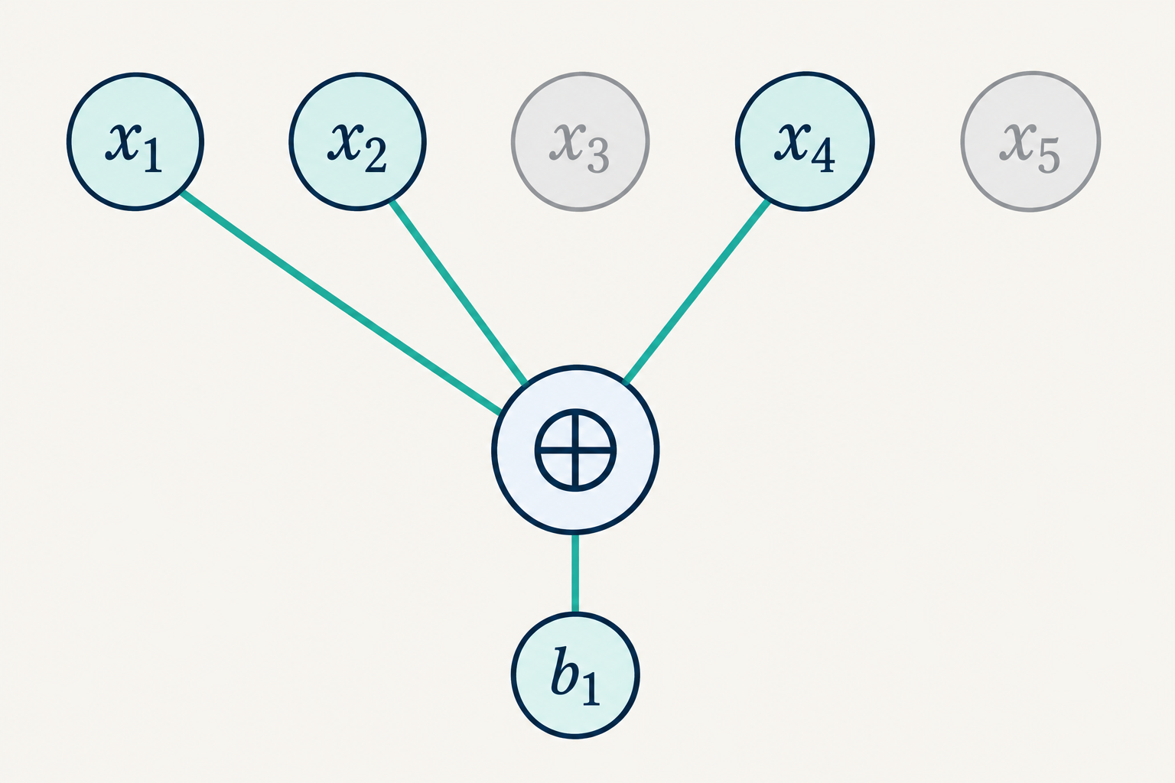
ABW’s sparse noisy-equation foundation
b = Mx + e
Sparse binary rows
Uniform planted x
Independent output flips
Recover x from M and b.
Search3LIN: m = Θ(n¹·⁴), ε = Θ(n⁻⁰·²), with suitable constants. Arithmetic is mod 2.
RSA, ML-KEM and an ABW research agenda
17
Notes:
ABW Search3LIN samples independent rows of weight 3, uniform x and Bernoulli errors, then challenges recovery of the planted x. Definition 5.1 bounds every PPT attacker’s success below 2/3 eventually. Theorem 2 uses m=c n^1.4 and epsilon=n^-0.2/c for suitable c. Exact constants matter. This is an average-case assumption, not a consequence of worst-case NP-hardness. A search instance uses independently sampled rows, while the encryption public key has a planted dependency under a separately analysed sampling law.
Sources
https://www.math.ias.edu/~avi/PUBLICATIONS/MYPAPERS/ABW09/ABW09.pdf

Slide 18
ABW’s trapdoor is a short row dependency
sᵀM = 0 sₘ = 1
c = Mx + e + μuₘ
sᵀc = μ + sᵀe
This raw bit mechanism needs correctness and security amplification before becoming a finished primitive.
RSA, ML-KEM and an ABW research agenda
18
Notes:
Raw bit scheme: M is public, an indicator s is secret with s^T M=0 and s_m=1. Encryption adds the message at the last coordinate u_m. A short dependency cancels the linear image but preserves a bias against noise. ABW uses amplification to obtain its final passive-security result. This slide separates the mechanism from the full theorem.
Sources
https://www.math.ias.edu/~avi/PUBLICATIONS/MYPAPERS/ABW09/ABW09.pdf
https://crypto.ethz.ch/publications/files/HolRen05.pdf

Slide 19
Correctness is a central cost bottleneck
P[error] =
½[1 − (1 − 2ε)ʳ]
At r = 32, ε = 0.01
23.8% error
Calculated curves. Complete correctness amplification has real communication and key costs.
RSA, ML-KEM and an ABW research agenda
19
Notes:
Original computation for independent Bernoulli noise and a fixed secret support of size r. P_odd=[1-(1-2epsilon)^r]/2, giving .0310275555..., .2380584298... and .4309662732... at r=32 for epsilon=.001,.01,.03 respectively. These are illustrative values, not parameters with a security claim. Adding a code or repetition requires an analysis of correlations and decoding tails, rather than assuming independent bit failures or free security amplification.
Sources
https://www.math.ias.edu/~avi/PUBLICATIONS/MYPAPERS/ABW09/ABW09.pdf
https://crypto.ethz.ch/publications/files/HolRen05.pdf

Slide 20
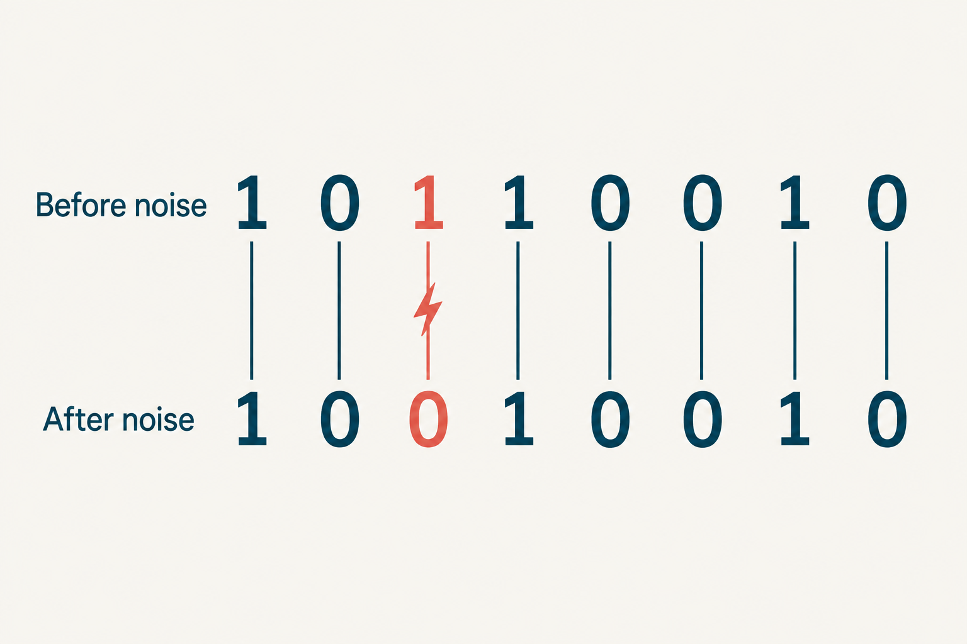
Research track 1: cheaper correctness amplification
The possible improvement
Retain useful decoding bias
with less repetition or coding overhead.
The security obligation
Keep short relations hidden.
Control correlated error events.
Research proposal. Shorter trapdoors improve correctness and may also help the attacker.
RSA, ML-KEM and an ABW research agenda
20
Notes:
Proposed research direction, not a theorem. Shortening secret relations helps the parity bias, but can make the relation easier to find. Combining outputs or coding the message might lower errors, but shared noise can correlate them. Separately identify the construction for strong secrecy and for correctness: success on one does not imply the other. Useful results include a tighter correctness bound or evidence that the desired tradeoff cannot be reached.
Sources

Slide 21
Research track 2: increase payload per ciphertext
SᵀM = 0 SᵀG = Iℓ
c = Mx + e + Gμ
Sᵀc = μ + Sᵀe
Proposed ℓ-bit interface. A sampler, noise analysis and security proof remain open obligations.
RSA, ML-KEM and an ABW research agenda
21
Notes:
Proposed algebraic target, not a secure construction. Let S be m by ell and G be public m by ell, with S^T M=0 and S^T G=I_ell. For ell message bits, c=Mx+e+G mu gives S^T c=mu+S^T e. This demonstrates a desired multi-bit cancellation interface. It does not prove suitable key sampling, hidden S, secrecy, capacity or acceptable noise. Many hidden relations can reveal structural features and induce correlated errors. Rounding or hashing does not remove the need for a security reduction.
Sources

Slide 22
Research track 3: compact public keys
An appealing compression idea
M = Expand(ρ) + Δ
What publishing ρ also reveals
Δ = M + Expand(ρ)
A public base seed can expose planting edits. Compression requires a new distribution analysis.
RSA, ML-KEM and an ABW research agenda
22
Notes:
Original design warning. Kyber seeds the public uniform matrix, not an object whose secret planting can be reconstructed from the seed. Suppose an ABW variation publishes rho and M=Expand(rho)+Delta over F2. The public rho allows anyone to compute Delta=M+Expand(rho), potentially exposing where the trapdoor was planted. This need not reveal the entire secret automatically, but it changes the attack surface. Circulant or regular graph restrictions likewise change the distribution. This is an original research caution, not an identified break of ABW.
Sources

Slide 23
A competitive scheme needs CCA and quantum analysis
Raw Dec(uᵢ) = sᵢ
01
A strong CPA foundation
Resolve correctness, repeated ciphertexts and quantitative security.
02
A justified CCA-secure KEM
Analyse rejection, reduction losses and quantum adversaries.
A generic hash of the raw bit output does not supply a secure KEM.
RSA, ML-KEM and an ABW research agenda
23
Notes:
Direct deduction for the raw ABW decoder: Dec_s(u_i)=s_i, so chosen unit-vector ciphertexts reveal the secret in m decryption queries. This is not a contradiction of passive security. Obtain a suitable strong CPA primitive before applying a conversion whose hypotheses actually hold. The quantum claim needs quantum-hard assumptions, quantum-valid reductions and a QROM treatment if random oracles are used. Parameters need classical and quantum attack cost estimates and failure-tail bounds. CCA security alone does not authenticate the peer.
Sources
https://people.inf.ethz.ch/dhofheinz/pdf/conf/tcc/HofheinzHK17.pdf
https://csrc.nist.gov/pubs/sp/800/227/final

Slide 24
A bounded first project and decision gates
Phase | Concrete result | Decision gate
Weeks 1–3 | Exact sampler, assumptions and cost ledger | Can we reproduce the foundation?
Weeks 4–8 | Attacks and complete baseline measurements | Is any credible parameter window left?
Weeks 9–12 | One focused improvement and proof audit | Does the saving survive the full scheme?
Initial objective: a defensible feasibility result or a specific cryptanalytic finding.
RSA, ML-KEM and an ABW research agenda
24
Notes:
Recommended 90-day study, not a promise of a deployable cryptosystem. First define a niche such as a preprovisioned recipient with cached keys and cheap binary arithmetic. Such a niche must still count ciphertext traffic and total energy, and compete with mature implementations. Reproduce the exact ABW sampler and proof assumptions, measure a baseline, then vary one bottleneck. Continuation requires a plausible window supported by proofs and attacks. A negative result is a worthwhile research outcome.
Sources

Slide 25
Appendix: RSA arithmetic on a small example
p = 61 q = 53 N = 3233
e = 17 d = 2753
65¹⁷ mod 3233 = 2790
2790²⁷⁵³ mod 3233 = 65
Tiny textbook arithmetic only. It provides no practical security.
Technical appendix
25
Notes:
Original teaching calculation using conventional toy values. p=61, q=53, N=3233, phi(N)=3120, lambda(N)=780. e=17, d=2753 satisfy ed=1 mod lambda(N), also mod phi(N). 65^17 mod3233=2790 and 2790^2753 mod3233=65. These sizes are trivially insecure. A textbook primitive example does not demonstrate OAEP encryption or PSS signature security.
Sources
https://people.csail.mit.edu/rivest/Rsapaper.pdf
https://www.rfc-editor.org/rfc/rfc8017.html

Slide 26
Appendix: MLWE cancellation and its noise budget
v − sᵀu = Encode(μ) + ν
ν = eᵀr + e₂ − sᵀe₁
The real noise budget also includes compression error.
The full scheme needs a tail bound and failure-safe rejection.
FIPS 203 failure estimates average over honest generation. They do not bound every key separately.
Technical appendix
26
Notes:
Original expansion of the simplified algebra on slide 9. With t=As+e, u=A^T r+e1, v=t^T r+e2+Encode(mu), subtracting s^T u leaves e^T r+e2-s^T e1+Encode(mu). Compression/decompression contributes additional rounding error in the actual scheme. Correctness requires a tail bound for the full resultant noise, not just the public-key error e. FIPS 203 reports heuristic average decapsulation failure rates 2^-138.8,2^-164.8,2^-174.8, averaged over honest seed choices, conditioned on successful randomness generation and modelling hashes/XOFs as random. These are not worst-key or adversarial-ciphertext guarantees.
Sources
https://pq-crystals.org/kyber/data/kyber-specification-round3-20210804.pdf
https://nvlpubs.nist.gov/nistpubs/FIPS/NIST.FIPS.203.pdf

Slide 27
Appendix: the comparison data ledger
Category 1 variant | Public key | Ciphertext | PK + CT
ML-KEM-512 | 800 | 768 | 1,568
HQC-1 (Aug 2025) | 2,241 | 4,433 | 6,674
FrodoKEM-640 (Sep 2025) | 9,616 | 9,752 | 19,368
mceliece348864 | 261,120 | 96 | 261,216
All sizes are bytes. Variant and specification dates matter, especially for HQC and FrodoKEM.
Technical appendix
27
Notes:
Sources and exact variants. ML-KEM FIPS203 Table3. HQC Aug2025 Table6. FrodoKEM Sept2025 proposal TableA.5, including a salt, not eFrodo. mceliece348864 from NIST IR8545 Table8. Original sums use only public key and ciphertext. The schemes differ in security maturity, assumptions and concrete margins. No mixed-hardware CPU comparisons were made.
Sources
https://nvlpubs.nist.gov/nistpubs/FIPS/NIST.FIPS.203.pdf
https://pqc-hqc.org/doc/hqc_specifications_2025_08_22.pdf
https://frodokem.org/files/FrodoKEM_standard_proposal_20250929.pdf
https://nvlpubs.nist.gov/nistpubs/ir/2025/NIST.IR.8545.pdf

Slide 28
Appendix: related directions sharpen the agenda
01
Local PRGs and low-degree analysis
Bogdanov–Kothari–Rosen (2023): a related ABW construction route.
02
Dense-Sparse LPN and lossy trapdoors
Dao–Jain (2024): a changed distribution and different capabilities.
03
High-corruption CSP trapdoors
Hair–Sahai (2026 preprint): a different planting and decoding approach.
Technical appendix
28
Notes:
Literature directions rather than interchangeable assumptions. Bogdanov–Kothari–Rosen 2023 combines ABW proposals with local PRGs and low-degree analysis. Dao–Jain 2024 introduces Dense-Sparse LPN and lossy trapdoor functions, with a modified matrix law. Hair–Sahai April2026 preprint develops PKE from high-corruption CSP conjectures with label-extended factor-graph trapdoors. These works motivate sampler, decoding and proof improvements but do not demonstrate a practical upgrade of fixed-locality ABW. Low-degree evidence does not exclude all efficient attacks.
Sources
https://eprint.iacr.org/2023/1049
https://eprint.iacr.org/2024/175
https://arxiv.org/abs/2604.10479

Slide 29
References: case-study foundations
Rivest–Shamir–Adleman (1978)
A Method for Obtaining Digital Signatures and Public-Key Cryptosystems
RFC 8017 and RFC 5280
RSA schemes, encoding and the public-key certificate framework
RFC 8446 and Shor (1995 / 1997)
TLS 1.3 and quantum factoring limitations
CRYSTALS-Kyber specification, v3.02 (2021)
Module-LWE design and implementation rationale
NIST FIPS 203 and IR 8413-upd1
ML-KEM parameters and NIST’s third-round selection analysis
OpenSSL 3.5 documentation
ML-KEM API and integration support
Technical appendix
29
Notes:
Full primary sources. Relevant URLs also appear in slide notes. Historical facts and exact standards have been separated from original interpretation and proposed research.
Sources
https://people.csail.mit.edu/rivest/Rsapaper.pdf
https://www.rfc-editor.org/rfc/rfc8017.html
https://www.rfc-editor.org/rfc/rfc5280.html
https://www.rfc-editor.org/rfc/rfc8446.html
https://pq-crystals.org/kyber/data/kyber-specification-round3-20210804.pdf
https://nvlpubs.nist.gov/nistpubs/FIPS/NIST.FIPS.203.pdf
https://nvlpubs.nist.gov/nistpubs/ir/2022/NIST.IR.8413-upd1.pdf
https://docs.openssl.org/3.5/man7/EVP_PKEY-ML-KEM/

Slide 30
References: comparisons and the ABW programme
Applebaum–Barak–Wigderson (2009 / STOC 2010)
Public-Key Cryptography from Different Assumptions
Holenstein–Renner (2005) and Hofheinz–Hövelmanns–Kiltz (2017)
Weak encryption amplification and modular FO analysis
NIST IR 8545 and SP 800-227 (2025)
Code-based comparison and KEM use requirements
HQC specification (Aug 2025) and FrodoKEM proposal (Sep 2025)
Exact key and ciphertext sizes for the compared variants
Bogdanov–Kothari–Rosen (2023) and Dao–Jain (2024)
Local PRGs, low-degree evidence and Dense-Sparse LPN
Hair–Sahai (April 2026 preprint)
Public Key Encryption from High-Corruption CSPs
Technical appendix
30
Notes:
Full primary sources for quantitative comparisons and the proposed research agenda. Sources cover exact candidate versions, weak-encryption amplification, CCA conversion and recent CSP-related construction research. This case study does not assert novelty or security for the proposed changes.
Sources
https://www.math.ias.edu/~avi/PUBLICATIONS/MYPAPERS/ABW09/ABW09.pdf
https://crypto.ethz.ch/publications/files/HolRen05.pdf
https://people.inf.ethz.ch/dhofheinz/pdf/conf/tcc/HofheinzHK17.pdf
https://csrc.nist.gov/pubs/sp/800/227/final
https://pqc-hqc.org/doc/hqc_specifications_2025_08_22.pdf
https://frodokem.org/files/FrodoKEM_standard_proposal_20250929.pdf
https://nvlpubs.nist.gov/nistpubs/ir/2025/NIST.IR.8545.pdf
https://eprint.iacr.org/2023/1049
https://eprint.iacr.org/2024/175
https://arxiv.org/abs/2604.10479

