Slide 1

A SELF-STUDY & TEACHING DECK
Quantum
Imaginary-Time
Evolution
QITE
Ground-state filtering → measured linear algebra → quantum circuits
Worked examples • Molecular hydrogen • QITE–Krylov benchmark design
Notes:
This deck teaches normalized imaginary-time evolution, the local-unitary QITE construction, and a fair comparison with a specified quantum Krylov method. It accompanies a longer PDF with derivations, a self-contained LaTeX source, and a reproducible Python script. The sequence is designed for someone comfortable with basic matrix algebra. None of the numerical examples is a hardware experiment. The deck does not assume the exact setup of the colleague’s Krylov project.

Slide 2
LEARNING MAP
Five questions organize the whole topic
01
Why does it work?
02
What can a circuit do?
Relative suppression of excited-state amplitudes.
A state-dependent unitary, not the universal filter.
03
What must be learned?
04
Where can it fail?
A real linear system from Pauli expectations.
Missing directions, noise, conditioning, and depth.
5 How do we compare it fairly? Match the scientific problem and count the full cost.
QITE / A LEARNING GUIDE
02
Notes:
Use the deck in three passes. First understand why normalized imaginary time is a ground-state filter. Next understand the first-order tangent fit and verify the one-qubit sign convention. Finally inspect the toy model and the molecular example before designing a hardware experiment. The main question is not merely whether an energy decreases. Ask which directions the pool permits, which data determine those directions, and which resources the experiment actually spends.

Slide 3
FOUNDATIONS
The minimum quantum vocabulary
A STATE
A HAMILTONIAN
AN EXPECTATION
A normalized vector. N qubits have 2ᴺ basis amplitudes.
A Hermitian energy operator. Its eigenvectors define energy levels.
An average estimated over repeated state preparations.
QITE / A LEARNING GUIDE
03
Notes:
A quantum state is a normalized complex vector. The computational basis is the basis in which circuits normally prepare and measure qubits; it is not generally the energy eigenbasis. A Hermitian Hamiltonian has real eigenvalues. The goal is the lowest eigenvalue within the chosen physical sector, not automatically the lowest eigenvalue across all particle-number sectors. Pauli strings are tensor products of I, X, Y, and Z, and form a basis for qubit operators.

Slide 4
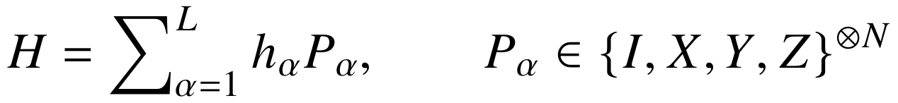
THE TARGET
The molecular objective is easy to state
Find the ground-state energy of the chosen molecular model.
MODEL
START
REFERENCE
Geometry, basis, active space, electron and spin sector.
An explicitly defined initial state, often Hartree–Fock.
FCI or exact diagonalization in the same finite model.
[6] Google Quantum AI: OpenFermion electronic-structure tutorial (accessed 8 Oct 2026).
QITE / A LEARNING GUIDE
04
Notes:
Molecular energy estimation requires fixing a geometry, orbital basis, electron count, spin sector, and any active-space approximation. A Hartree–Fock determinant is a natural initial state, but its overlap with the target must not be assumed to be universally good. The qubit Hamiltonian contains the information to be measured. Preparing a ground-state circuit and merely extracting a low-energy estimate are different output tasks; this distinction becomes important for Krylov methods.
[6] Google Quantum AI: OpenFermion electronic-structure tutorial (accessed 8 Oct 2026).
https://quantumai.google/openfermion/tutorials/intro_workshop_exercises

Slide 5


THE PHYSICS
Real time changes phases; imaginary time filters
REAL TIME
IMAGINARY TIME
Populations stay fixed. Only phases rotate.
Relative populations change. Lower energies gain weight.
The useful quantity is an energy difference—not the arbitrary zero of energy.
QITE / A LEARNING GUIDE
05
Notes:
Expand the state in the Hamiltonian eigenbasis. Under real time each amplitude is multiplied by a complex number of unit magnitude, so the populations remain fixed. Imaginary time uses real exponential weights. Do not say that every weight shrinks: a negative energy produces a growing weight. What matters is suppression relative to a lower-energy component, followed by normalization. Real-time states can still be useful as a Krylov basis even though their individual energy populations are unchanged.

Slide 6
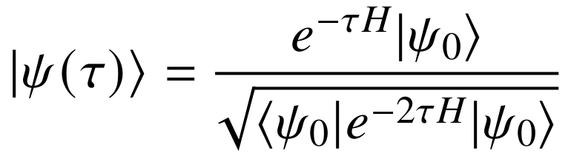
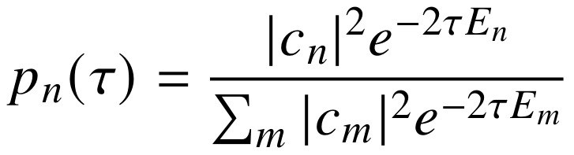
EXACT IMAGINARY TIME
Normalize the filter before interpreting the state
Amplitude ratios decay with exp(−τΔE); population ratios with exp(−2τΔE).
QITE / A LEARNING GUIDE
06
Notes:
The expression exp(-tau H)|psi0> is an unnormalized vector. Its norm may grow or shrink. A physical state is obtained by dividing by the norm, giving the displayed formula. Squaring the amplitudes explains why the population weights contain twice the exponent. This normalization is not a minor cosmetic correction: it makes the state transformation nonlinear as a map on arbitrary input vectors.

Slide 7
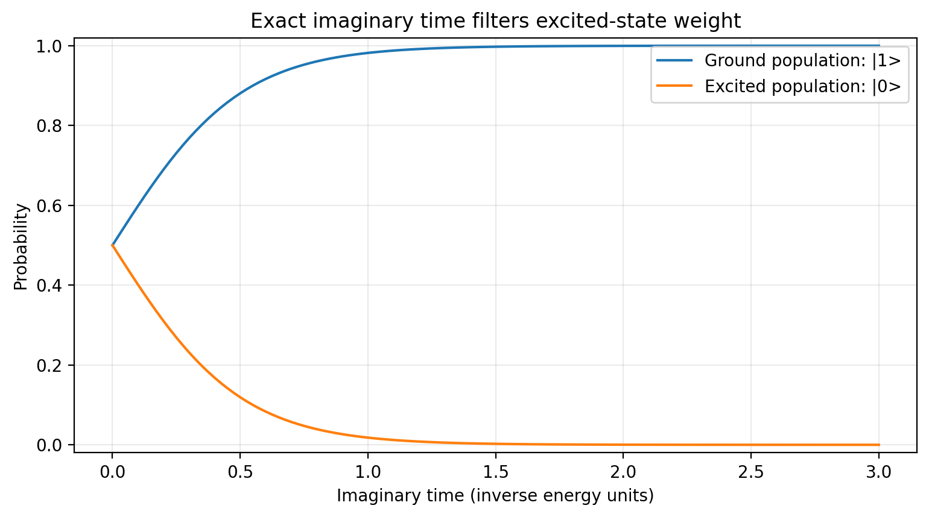
A FIRST VISUAL EXAMPLE
Watch the excited-state weight disappear
H = Z
Start: |+⟩
Ground: |1⟩
Energy: −1
Original calculation for this guide. Exact statevectors; no device noise, shots, or gate-synthesis error.
QITE / A LEARNING GUIDE
07
Notes:
This analytic plot uses H=Z and the initial plus state. Here |1> has energy -1 and is the ground state; |0> has energy +1. Initially both populations equal one half. The ground population becomes 1/(1+exp(-4 tau)). This is a derived mathematical curve, not measurement data. The associated energy is -tanh(2 tau). It is a useful test because every sign and normalization factor can be checked by hand.
Original calculation for this guide. Exact statevectors; no device noise, shots, or gate-synthesis error.

Slide 8
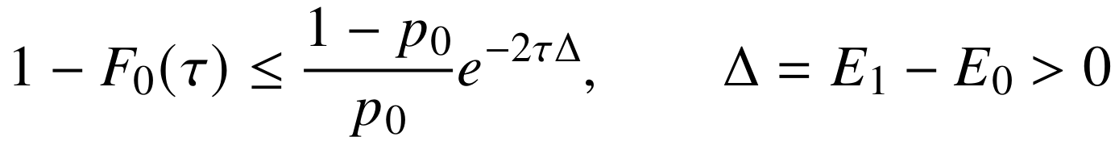
ASSUMPTIONS
Convergence has conditions—not a universal promise
OVERLAP
GAP
SECTOR
A ground-space component must be present initially.
A small relevant gap requires longer imaginary time.
Use the correct electron number and symmetry sector.
Degenerate ground energy → projection into the ground space, not a unique eigenvector.
QITE / A LEARNING GUIDE
08
Notes:
The initial state must contain a component in the desired ground eigenspace. Exact imaginary time cannot create a missing spectral component. A smaller gap slows filtering, and a smaller initial ground population worsens the bound shown. With a degenerate ground space, the limit is the normalized initial projection into that space. The normalized state is unchanged by an energy shift. These statements describe exact filtering, not a generic efficiency guarantee for practical QITE.

Slide 9
THE IMPLEMENTATION OBSTACLE
Why not implement exp(−τH) as an ordinary circuit?
ORDINARY CIRCUIT
NORMALIZED FILTER
One unitary must preserve inner products for all input states.
The normalization depends on the input state; the map is nonlinear.
Non-unitarity is not “forbidden physics”: measurement-based protocols have different costs.
QITE / A LEARNING GUIDE
09
Notes:
A deterministic closed-system circuit is unitary and preserves every norm and inner product. The imaginary-time filter does not have that property for a generic Hamiltonian. Normalizing it does not fix the operator issue, because normalization depends on the input. Ancillas and conditioned measurements can implement non-unitary transformations on a subsystem, but this introduces success probabilities and overhead. The local-unitary QITE method studied here takes another route.

Slide 10
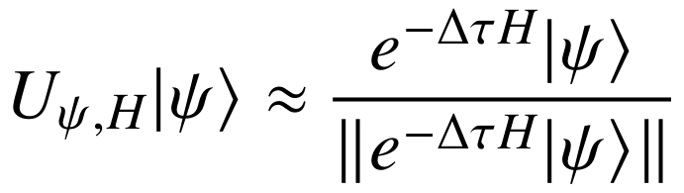
THE KEY IDEA
The QITE unitary is tailored to the current state
WHAT IS MATCHED?
WHAT MUST BE RELEARNED?
The action on one current state—not on every possible input.
The generator after the state changes, usually at each update.
State dependence is the way around the universal-unitary obstruction.
[1] Motta et al., Nature Physics 16, 205–210 (2020); arXiv:1901.07653.
QITE / A LEARNING GUIDE
10
Notes:
For a specified normalized input and a specified normalized target, some unitary connects them. This is a state-to-state existence statement, not an efficient construction. QITE fits a useful approximate unitary by measuring the current state and restricting the generator to a manageable pool or domain. Once the state changes, its fitted generator generally changes. The equation should never be read as an operator identity U≈exp(-dt H).
[1] Motta et al., Nature Physics 16, 205–210 (2020); arXiv:1901.07653.
https://arxiv.org/abs/1901.07653

Slide 11
THE DIFFERENTIAL EQUATION
Normalization gives a centered flow
H |ψ⟩
(H − E) |ψ⟩
Contains both state-changing and norm-changing components.
Removes the component that only changes normalization.
A scalar energy offset changes the energy label, not the normalized trajectory.
QITE / A LEARNING GUIDE
11
Notes:
Differentiate the normalized state. The derivative of the normalization contributes +E|psi>, giving -(H-E)|psi>. Since the expectation of H-E is zero, this direction is orthogonal to the current state in the relevant normalization sense. The centering removes changes that would merely rescale the vector. The identity term in a Hamiltonian cancels from this target direction, though it must remain in the reported energy.

Slide 12
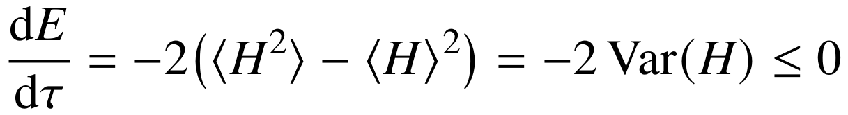
A DIAGNOSTIC WITH LIMITS
Exact imaginary time cannot increase energy
LARGE VARIANCE
ZERO VARIANCE
NOISY ENERGY
The ideal state is still changing strongly.
An energy eigenstate—possibly an excited state.
Small upward fluctuations do not alone prove a bug.
An exact identity is a diagnostic baseline, not a promise about each noisy data point.
QITE / A LEARNING GUIDE
12
Notes:
For a time-independent H, differentiate the energy using the normalized flow. The two terms combine to minus twice the variance. Therefore exact continuous imaginary time has nonincreasing energy. Zero variance means an energy eigenstate, not necessarily the ground state. In practice, finite steps, local approximations, synthesis errors, and noisy measurements can violate pointwise monotonicity. Judge measured upward fluctuations against uncertainty and repetition, and investigate persistent increases.

Slide 13


FROM FILTERING TO A GENERATOR
Match the first-order state change
NORMALIZED TARGET
UNITARY UPDATE
QITE / A LEARNING GUIDE
13
Notes:
Expand both the normalized imaginary-time target and the proposed unitary to first order in the time step. Matching their linear terms gives iA|psi>≈(H-E)|psi>. This sign convention is used throughout the notes and code. It is a tangent-space fit: the chosen generator approximates the instantaneous direction. The finite-step exponential is a separate approximation, and eventually compiling that exponential to native gates adds another layer.

Slide 14
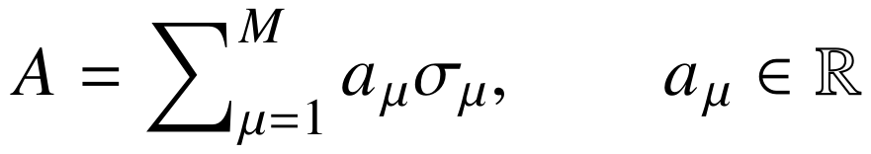
CHOOSING DIRECTIONS
The generator pool is not the Hamiltonian term list
HAMILTONIAN STRINGS
GENERATOR STRINGS
What determines the energy?
What directions can the state move in?
Example: H = Z and |ψ⟩ = |+⟩ require A = Y, not A = Z.
[1] Motta et al., Nature Physics 16, 205–210 (2020); arXiv:1901.07653.
QITE / A LEARNING GUIDE
14
Notes:
Write A as a real linear combination of Hermitian pool operators. The Hamiltonian Pauli strings describe energy, while the generator operators describe accessible directions of state motion. There is no reason for the two lists to coincide. H=Z with a plus-state input needs the Y generator. Restricting the pool to Z alone produces no useful first-order direction. The choice of pool is an algorithmic assumption, not a bookkeeping decision.
[1] Motta et al., Nature Physics 16, 205–210 (2020); arXiv:1901.07653.
https://arxiv.org/abs/1901.07653

Slide 15
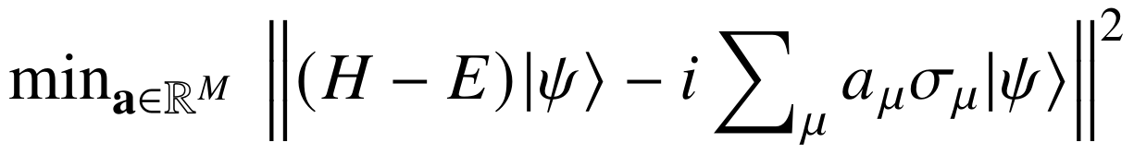
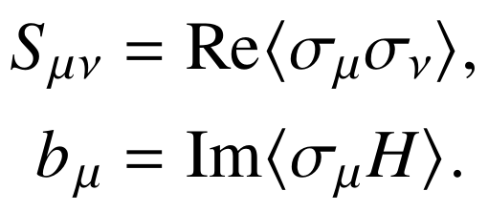

THE CENTRAL COMPUTATION
Measurements determine a real linear system
Convention used here: U = exp(−i Δτ A). The sign of b is tied to this choice.
[1] Motta et al., Nature Physics 16, 205–210 (2020); arXiv:1901.07653.
QITE / A LEARNING GUIDE
15
Notes:
Minimize the squared residual over real coefficients. Expanding the square gives Var(H)+aᵀSa−2aᵀb. The real Gram matrix contains Re⟨sigma_mu sigma_nu⟩, and b contains Im⟨sigma_mu H⟩. The expectation-value centering term has no imaginary contribution because each pool operator is Hermitian. Differentiating gives Sa=b. Some papers use different signs and factors; always match their convention for the exponent and residual before copying equations.
[1] Motta et al., Nature Physics 16, 205–210 (2020); arXiv:1901.07653.
https://arxiv.org/abs/1901.07653

Slide 16
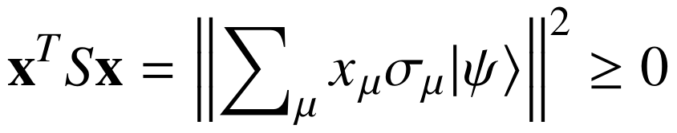
NUMERICAL LINEAR ALGEBRA
The Gram matrix can be singular for a good reason
REDUNDANCY
CONDITIONING
REPAIR
Different operator coefficients can produce the same state motion.
Tiny eigenvalues can turn modest data noise into large updates.
Inspect the spectrum. Truncate or regularize; do not invert blindly.
QITE / A LEARNING GUIDE
16
Notes:
The displayed quadratic form proves that S is real symmetric and positive semidefinite in exact arithmetic. A zero eigenvalue can mean that different operators act identically on the current state. Hence singularity is often structural, not a defect that more shots can remove. Use a pseudoinverse or a noise-aware spectral cutoff and report retained rank. Very small eigenvalues amplify noise when inverted. Matrix entries estimated independently can also produce asymmetry or nonphysical negative eigenvalues.

Slide 17
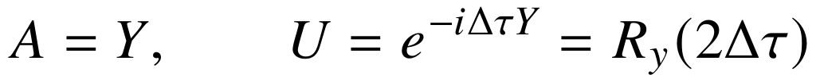
WORKED EXAMPLE 1
One qubit: calculate the first QITE step by hand
AT Δτ = 0.1
QITE: −0.198669 | Exact ITE: −0.197375
QITE / A LEARNING GUIDE
17
Notes:
The pool order is X,Y,Z. Pauli anticommutation gives the identity Gram matrix. For the plus state, the only nonzero component of b is b_Y=Im⟨YZ⟩=⟨X⟩=1. Therefore A=Y, and exp(-i dt Y) equals a Y rotation by angle 2dt. At dt=0.1 the QITE energy is -sin(0.2), approximately -0.198669, while exact normalized imaginary time gives -tanh(0.2), approximately -0.197375. The small difference is expected; a positive sign on the energy change would not be.

Slide 18
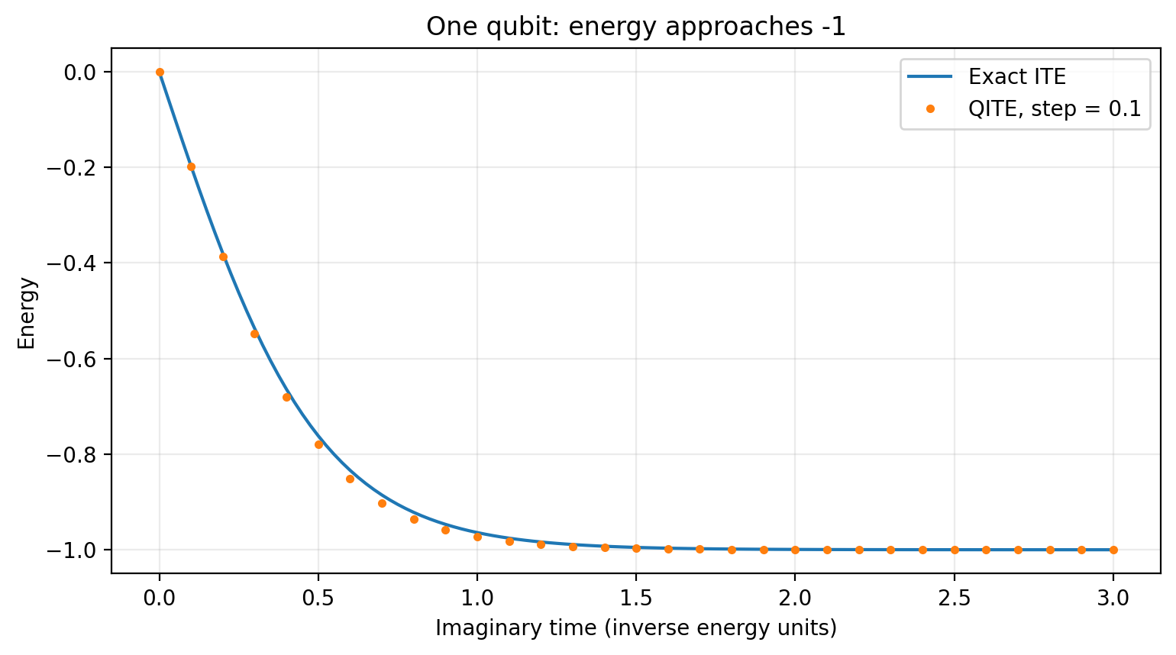

WORKED EXAMPLE 1 / RESULT
The one-qubit energy tends to −1
Before any molecule:
Check the sign.
Check normalization.
Recompute A.
Original calculation for this guide. Exact statevectors; no device noise, shots, or gate-synthesis error.
QITE / A LEARNING GUIDE
18
Notes:
The solid line is the analytic energy -tanh(2 tau). Markers come from repeated QITE updates with exact expectation values and step size 0.1. The generator is recalculated at every step. Agreement need not be exact at finite step size, and one should compare states or trajectories at fixed total time when studying discretization. This tiny example is also a check that the code prepares a normalized state and uses the correct rotation angle.
Original calculation for this guide. Exact statevectors; no device noise, shots, or gate-synthesis error.

Slide 19


WORKED EXAMPLE 2
A local pool can miss an entangling direction
ONE-QUBIT-ONLY POOL
A TWO-QUBIT GENERATOR
No |11⟩ tangent direction. The update stalls.
Provides the missing direction.
QITE / A LEARNING GUIDE
19
Notes:
This is a deliberately chosen toy Hamiltonian, not a molecular Hamiltonian. At |00>, the energy is -2, so the centered target is 0.6|11>. A single-qubit operator can leave the state unchanged or flip only one bit; it cannot produce |11> to first order. The one-qubit-only pool therefore has b=0 and stalls. The two-qubit generator shown provides the missing direction. Decreasing the time step cannot fix a zero projected direction.

Slide 20
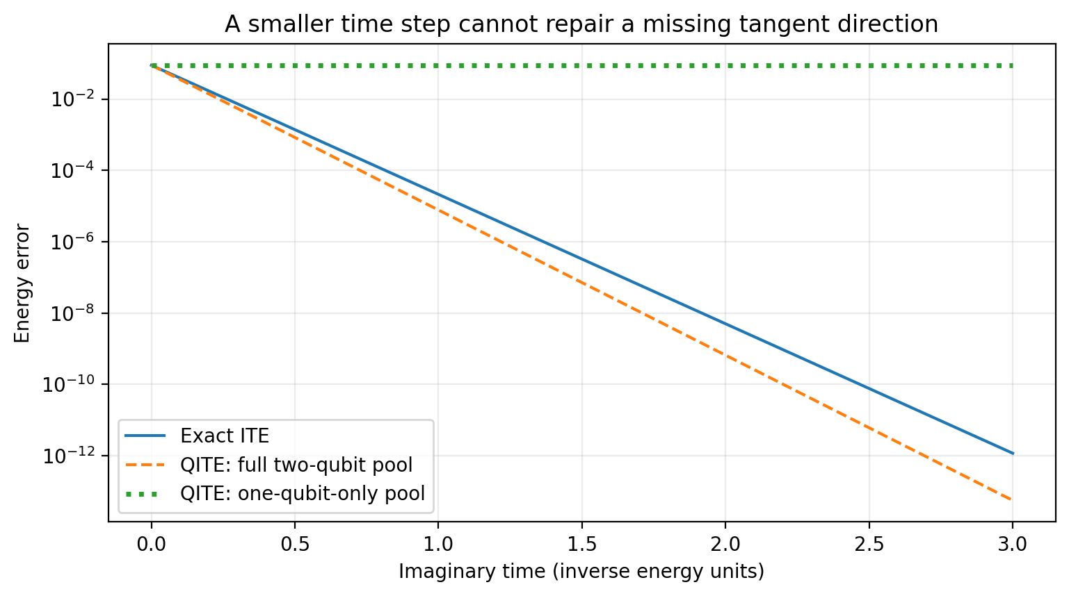
WORKED EXAMPLE 2 / RESULT
Smaller steps cannot repair missing directions
Original calculation for this guide. Exact statevectors; no device noise, shots, or gate-synthesis error.
QITE / A LEARNING GUIDE
20
Notes:
The restricted pool stays at energy -2, whereas the exact ground energy is -sqrt(4.36), approximately -2.0880613. Full-pool QITE follows a useful trajectory toward the ground state. The plotted full-pool trajectory has step 0.05 and exact matrix exponentials. Domain restriction is different from step-size error. This is why a parameter study should vary step size and pool or domain separately rather than treating a plateau as automatic convergence.
Original calculation for this guide. Exact statevectors; no device noise, shots, or gate-synthesis error.

Slide 21

FROM THE MODEL TO GATES
Three approximations must be tracked separately
1 SPLIT H
2 FIT THE STATE
3 SYNTHESIZE U
Approximate one exponential by a product of term filters.
Replace each normalized filter by a fitted unitary.
Compile the generator exponential into native gates.
A sweep through L terms advances τ by Δτ—not by LΔτ.
[1] Motta et al., Nature Physics 16, 205–210 (2020); arXiv:1901.07653.
QITE / A LEARNING GUIDE
21
Notes:
A term-by-term implementation first splits the Hamiltonian filter into a product of term filters. It then fits each normalized term update with a unitary from a pool. Finally it synthesizes the fitted unitary into device gates, possibly with another product formula. Each approximation has its own control parameters. One full sweep through the terms represents imaginary time dt; L term updates do not represent Ldt. The teaching script omits Hamiltonian splitting and uses dense exponentials to isolate the QITE fit.
[1] Motta et al., Nature Physics 16, 205–210 (2020); arXiv:1901.07653.
https://arxiv.org/abs/1901.07653

Slide 22

THE DEPTH CAVEAT
The full preparation circuit usually grows
|ψ₀⟩
U₁
measure
|ψ₀⟩
U₁
U₂
measure
|ψ₀⟩
U₁
U₂
U₃
U₄
Uₛ
measure
Each shot generally pays for the entire current-state preparation.
QITE / A LEARNING GUIDE
22
Notes:
Each small update can be local, yet the complete circuit preparing the current state includes all previous updates. Every expectation-value measurement generally requires a new preparation of that accumulated circuit. The diagram shows that a later measurement is not just a run of the newest gate. Compression, cancellation, recompilation, or a fixed variational ansatz can reduce depth, but those choices and their costs must be explicit. Do not infer a shallow hardware workload solely from the locality of one update.

Slide 23
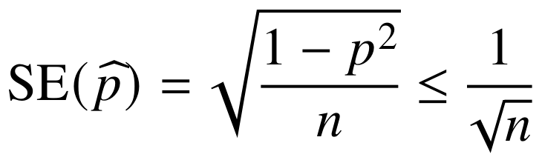
MEASUREMENTS
Pauli products turn the fit into measurable averages
MEASUREMENT PLAN
COST PLAN
Reduce products, remove duplicates, group compatible strings.
Matrix entries ≠ distinct settings ≠ total circuit executions.
QITE / A LEARNING GUIDE
23
Notes:
Pauli products reduce to another Pauli string multiplied by ±1 or ±i. Real and imaginary parts therefore become ordinary signed Pauli expectations. The displayed YZ example explains the one-qubit sign test. Each Pauli outcome is ±1, yielding the standard-error formula. A naive Gram matrix has M squared entries, but many entries require the same expectation or vanish by symmetry. Deduplicate and group compatible measurements before allocating shots. Shared measurement data have covariance, which matters for uncertainty propagation.

Slide 24


PRACTICAL NUMERICS
Stabilize the solve before trusting the trajectory
INSPECT
REGULARIZE
VALIDATE
Symmetrize S. Check its spectrum and retained rank.
Truncate unresolved directions or penalize large coefficients.
Test step size and pool separately; evaluate the final state independently.
A flat energy can mean success—or an inadequate pool, wrong sector, or excessive regularization.
QITE / A LEARNING GUIDE
24
Notes:
Symmetrize the estimated Gram matrix and inspect its spectrum. Use a documented spectral cutoff or a ridge penalty on generator coefficients. The displayed ridge equation comes from adding lambda times the squared coefficient norm to the original tangent objective; it is not the same as ridge regression on the already formed system residual Sa-b. Log coefficient norm, retained rank, and conditioning. The tangent residual distinguishes representation error from finite-step error, but evaluating it can require an H-squared measurement. Validate the selected final state independently instead of reporting the minimum noisy energy.

Slide 25
ALGORITHM
The hybrid loop in one slide
1 PREPARE
2 MEASURE
3 SOLVE
4 UPDATE
Repeated copies of the current state.
→
Pauli expectations for S and b.
→
Regularized linear system.
→
Compile and append exp(−iΔτA).
After each sweep: measure total energy, log costs, and test the stopping rule.
[1] Motta et al., Nature Physics 16, 205–210 (2020); arXiv:1901.07653.
QITE / A LEARNING GUIDE
25
Notes:
This loop applies at each local term in a term-by-term QITE sweep. Prepare copies of the current state, measure the expectations needed for S and b, solve classically, compile and append the update, and then move to the next term. The state used for the next fit must include all preceding updates. After a complete sweep, measure total energy and check the stopping rule. Final independent evaluation, diagnostics, and failed attempts all belong in the resource ledger. A full-Hamiltonian small-statevector implementation simplifies the first learning pass.
[1] Motta et al., Nature Physics 16, 205–210 (2020); arXiv:1901.07653.
https://arxiv.org/abs/1901.07653

Slide 26
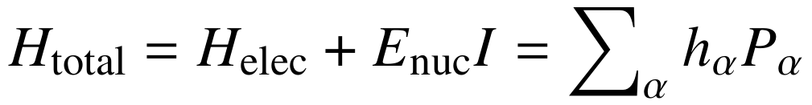
MOLECULAR WORKFLOW
Chemistry conventions must match before algorithms do
Geometry + basis + sector
Integrals + HF state
Mapping + optional tapering
Identical qubit Hamiltonian
[6] Google Quantum AI: OpenFermion electronic-structure tutorial (accessed 8 Oct 2026).
QITE / A LEARNING GUIDE
26
Notes:
The molecular Hamiltonian is produced by a chain of modeling choices. Geometry, charge, spin, orbital basis, active space, frozen core, orbital ordering, mapping, and tapering all affect the final representation or reference. The nuclear contribution may already be in the identity coefficient. Hartree–Fock provides a starting determinant; FCI is exact only within the selected finite orbital model and sector. A benchmark is not meaningful if the two methods solve different Hamiltonians or use different energy offsets.
[6] Google Quantum AI: OpenFermion electronic-structure tutorial (accessed 8 Oct 2026).
https://quantumai.google/openfermion/tutorials/intro_workshop_exercises

Slide 27
WORKED EXAMPLE 3 / SETUP
Hydrogen: an explicit test case, not a performance claim
MODEL
INITIAL STATE
SIMULATION
H₂, 0.8 Å
STO-3G
4 qubits, Jordan–Wigner
Hartree–Fock: |1100⟩
Leftmost label = q₀
Nuclear offset included
Full-Hamiltonian QITE
120 odd-Y strings
Δτ = 0.05 Hartree⁻¹
[6] OpenFermion | Original ideal-statevector calculation; not hardware data
QITE / A LEARNING GUIDE
27
Notes:
The exact coefficients are reproduced in the notes and companion script from the official OpenFermion tutorial. This is neutral singlet H2 at 0.8 angstrom in STO-3G, with a four-qubit Jordan–Wigner mapping and nuclear repulsion included. The leftmost tensor factor is q0 and the HF basis state is |1100>. Since the Hamiltonian and state are real, all four-qubit Pauli strings with an odd number of Y factors form a complete real-state generator pool of size 120. This is a global, redundant teaching pool, not a scalable small-domain method.
[6] Google Quantum AI: OpenFermion electronic-structure tutorial (accessed 8 Oct 2026).
https://quantumai.google/openfermion/tutorials/intro_workshop_exercises
Original calculation for this guide. Exact statevectors; no device noise, shots, or gate-synthesis error.

Slide 28
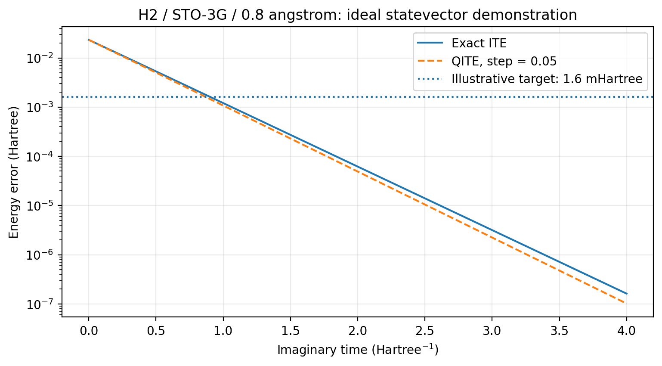
WORKED EXAMPLE 3 / RESULT
Hydrogen converges in the ideal teaching simulation
80 updates
τ = 4 Hartree⁻¹
Final error:
1.02 × 10⁻⁷ Hartree
No hardware
conclusion follows.
Original calculation for this guide. Exact statevectors; no device noise, shots, or gate-synthesis error.
QITE / A LEARNING GUIDE
28
Notes:
The final ideal QITE energy after 80 updates, total imaginary time 4 inverse Hartree, is -1.134147564737410 Hartree. The matching finite-basis reference is -1.134147666677096 Hartree, so the error is approximately 1.02e-7 Hartree. There are no shots, device errors, or synthesis errors in this calculation. The 1.6 millihartree line is an illustrative target, not a universal scientific criterion. The actual HF trajectory occupies a two-dimensional invariant subspace, so two noiseless real-time Krylov vectors also recover the ground energy. H2 is a debugging example, not a demonstration of comparative advantage.
Original calculation for this guide. Exact statevectors; no device noise, shots, or gate-synthesis error.

Slide 29
HANDS-ON IMPLEMENTATION
The code mirrors the mathematics
B = (operators @ psi).T
S = (B.conj().T @ B).real
b = (B.conj().T @ (H @ psi)).imag
a = spectral_pseudoinverse_solve(S, b)
A = sum(a[m] * operators[m] for m in range(M))
psi = expm(-1j * dt * A) @ psi
First pass the one-qubit sign test. Then reproduce the toy failure and the H₂ reference.
QITE / A LEARNING GUIDE
29
Notes:
The full companion code has error checking, exact reference evolution, model definitions, and diagnostic assertions. Here B has columns sigma_mu|psi>. Its Gram product gives S; projecting H|psi> onto those columns gives b after taking the imaginary part. A spectral pseudoinverse is used in the full script rather than blindly inverting S. Dense exponentiation is only practical for tiny systems, and the program evaluates expectations classically. It is a reference for correctness, not a hardware resource model.

Slide 30
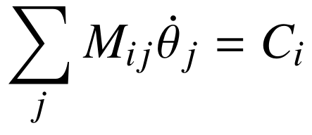
TERMINOLOGY MATTERS
“QITE” can refer to different algorithm families
LOCAL-UNITARY QITE
VARIATIONAL QITE
VQE
Fit A for the current state. Append a unitary. Domain and pool matter.
Fit parameter velocities inside a chosen ansatz. Expressivity matters.
Optimize circuit parameters for low energy. No trajectory is required.
[2] McArdle et al. | [3] Yuan et al. | [7] Qiskit Algorithms
QITE / A LEARNING GUIDE
30
Notes:
The local-unitary QITE construction fits a generator and appends its update. Variational imaginary-time evolution instead assumes a parameterized circuit and solves for a velocity in its parameter space. VQE also uses an ansatz but minimizes energy through an explicitly selected optimizer rather than necessarily following imaginary time. The simple variational equation shown has a metric built from ansatz derivatives and an energy-force vector; gauge and phase conventions must be chosen consistently. A software class named VarQITE should not automatically be described as the original local-unitary algorithm.
[2] McArdle et al., npj Quantum Information 5, 75 (2019); arXiv:1804.03023.
https://arxiv.org/abs/1804.03023
[3] Yuan et al., Quantum 3, 191 (2019).
https://quantum-journal.org/papers/q-2019-10-07-191/
[7] Qiskit Algorithms: Variational Quantum Time Evolution tutorial (accessed 8 Oct 2026).
https://qiskit-community.github.io/qiskit-algorithms/tutorials/11_VarQTE.html

Slide 31
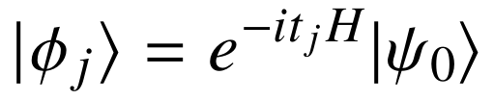

THE COMPARISON METHOD
Quantum Krylov builds a subspace, then diagonalizes
[4] Cortes & Gray, Quantum Krylov subspace algorithms; arXiv:2109.06868.
QITE / A LEARNING GUIDE
31
Notes:
A common quantum Krylov construction uses states generated by real-time evolution. Their linear combinations can change energy populations even though individual real-time states do not. Minimizing the Rayleigh quotient in their span yields a generalized eigenvalue problem. O is the basis-state overlap matrix and script-H is the Hamiltonian projected into that basis. They are not the same objects as the QITE tangent Gram matrix. There are other Krylov variants, so the colleague’s precise protocol is an input to the benchmark.
[4] Cortes & Gray, Quantum Krylov subspace algorithms; arXiv:2109.06868.
https://arxiv.org/abs/2109.06868

Slide 32
PROJECTED EIGENSOLVES
Krylov has its own conditioning problem
ESTIMATE
TRUNCATE
WHITEN
Hermitian projected Hamiltonian and overlap matrices.
Remove unresolved overlap eigenmodes; record effective rank.
Transform the retained problem into an ordinary eigensolve.
An estimated Ritz energy is not automatically a hardware-prepared Ritz state.
[5] Epperly, Lin & Nakatsukasa, SIAM J. Matrix Anal. Appl. 43, 1263–1290 (2022).
QITE / A LEARNING GUIDE
32
Notes:
If the prepared basis states are nearly dependent, the overlap matrix has tiny eigenvalues and noisy data can lead to unstable energies. Diagonalize O, retain reliable eigenvalues, whiten that retained subspace, and solve an ordinary Hermitian eigenproblem. The cutoff changes the effective subspace and must be reported. A low Ritz energy is an estimate from projected matrices. The coefficients specifying the Ritz state do not by themselves provide a circuit that prepares the corresponding coherent superposition. Include that extra cost only when state preparation is part of the target.
[5] Epperly, Lin & Nakatsukasa, SIAM J. Matrix Anal. Appl. 43, 1263–1290 (2022).
https://arxiv.org/abs/2110.07492

Slide 33
QITE VERSUS KRYLOV
Distinct approaches—but not opposites
QITE
REAL-TIME KRYLOV
State trajectory
Repeated tangent solves
Pool / domain bias
Accumulated update circuit
Prepared basis states
Projected eigensolve
Overlap conditioning
Matrix reconstruction cost
Connection: selected QITE states can seed a quantum Lanczos subspace.
[1] Motta et al. | [4] Cortes & Gray
QITE / A LEARNING GUIDE
33
Notes:
QITE directly updates a preparation circuit, while real-time Krylov prepares a family of basis states and extracts a subspace estimate. Their dominant numerical problems differ, but both can be measurement intensive and ill-conditioned. QITE-generated imaginary-time states can also be used in a quantum Lanczos subspace, a connection already in the original QITE work. Consequently the methods are not fundamentally unrelated. No universal rule orders their shot counts, total depth, or robustness. The implementation and the physical problem decide.
[1] Motta et al., Nature Physics 16, 205–210 (2020); arXiv:1901.07653.
https://arxiv.org/abs/1901.07653
[4] Cortes & Gray, Quantum Krylov subspace algorithms; arXiv:2109.06868.
https://arxiv.org/abs/2109.06868

Slide 34
EXPERIMENT DESIGN
A fair benchmark separates four sources of difficulty
01
Ideal
02
Finite shots
Validate against the same exact finite-model reference.
Isolate sampling error in the fit and matrix reconstruction.
03
Noisy simulation
04
Hardware
Use the same justified, documented device assumptions.
Record device, versions, calibration window, and native costs.
Freeze the Hamiltonian, sector, starting-state policy, and output task first.
QITE / A LEARNING GUIDE
34
Notes:
This is a proposed protocol, not a claim about an existing hardware experiment. First establish correctness with deterministic simulations of the same Hamiltonian and sector. Then add finite sampling alone to isolate statistical sensitivity. Next use a documented device-informed noise model. Finally execute on the same selected hardware with comparable compilation and mitigation policies. Hyperparameters need not be identical, but tuning effort and accounting rules should be declared. The exact Krylov basis, measurement procedure, and output target must be confirmed before finalizing the comparison.

Slide 35
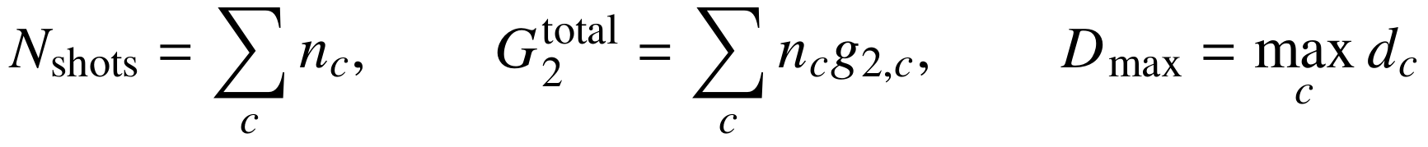
THE COST LEDGER
Equal shots alone do not imply equal resources
INCLUDE
SEPARATE
VERIFY
Training, evaluation, mitigation, calibration, and failed attempts.
Peak depth, total gates, device time, classical time, and waiting.
Use the chosen backend’s current native counts and cost estimator.
[8–9] Quantinuum Systems and Job Costing documentation (accessed 8 Oct 2026).
QITE / A LEARNING GUIDE
35
Notes:
Total shots are the sum over every circuit execution, including all fitting iterations, diagnostics, final evaluation, and any included mitigation or calibration. Shot-weighted native two-qubit gate count measures cumulative gate workload. Peak depth is a separate constraint because two workloads with equal gate totals can have very different sensitivity to long circuits. Distinguish unique settings from repeated executions and record ancillas. On Quantinuum, use the selected system’s current cost estimator and compilation route; do not hard-code a platform-wide shot-to-credit formula.
[8–9] Quantinuum Systems and Job Costing documentation (accessed 8 Oct 2026).
https://docs.quantinuum.com/systems/ ; https://docs.quantinuum.com/systems/trainings/helios/getting_started/costing.html

Slide 36
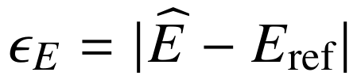
REPORTING THE EXPERIMENT
Make accuracy versus full cost the central result
MAIN FIGURE
SECOND FIGURE
Energy error + uncertainty
versus cumulative cost
Success probability
versus a fixed resource budget
H₂ is a validation case. Add geometries and larger active spaces before claiming scaling.
QITE / A LEARNING GUIDE
36
Notes:
Use the same matching FCI or exact-diagonalization reference. Plot absolute error versus cumulative cost with uncertainty or repeated-run quantiles. Add the probability of meeting the target tolerance within budget, including failed runs. Do not select the lowest of many noisy estimates and call it the algorithm’s accuracy. Use a prespecified stopping rule and independent final evaluation. Save the Hamiltonian, all hyperparameters, circuit costs, measured matrices or generators, seeds, and software versions. A simulation-only curve must not be assigned guessed hardware costs.

Slide 37
MISCONCEPTIONS
Four shortcuts that lead to wrong conclusions
“NO NORMALIZATION NEEDED”
“A PLATEAU MEANS SUCCESS”
The unnormalized vector can grow or vanish.
A wrong sector or restricted pool can also stall.
“LOCAL MEANS SHALLOW”
“BELOW FCI MEANS BETTER”
The full preparation circuit usually accumulates.
Check noise, conditioning, and the reference model.
QITE / A LEARNING GUIDE
37
Notes:
Each statement on this slide confuses distinct levels of the problem. The normalized state is the target, not the unnormalized vector. A constant energy curve may indicate an excited eigenstate or a missing tangent direction. A small update domain does not bound the accumulated preparation depth. An energy below the matching exact ground energy in noisy reconstruction is not a better physical ground state; it indicates estimation, mitigation, conditioning, or reference issues. These checks are useful before attributing an apparent advantage to an algorithm.

Slide 38
SELF-TEST
Three checks before you move on
01
Explain
Why can negative energies give growing amplitudes while filtering still works?
02
Predict
For H = Z and |+⟩, what happens when the pool contains only Z?
03
Audit
One method uses fewer shots but deeper circuits. Which resource comparison is missing?
QITE / A LEARNING GUIDE
38
Notes:
Answers: First, negative energies can make absolute amplitudes grow, but ratios relative to the ground component still decay, and normalization removes the common scale. Second, with H=Z and a plus-state input, a pool containing only Z gives b=0, so it cannot reproduce the target tangent. Third, fewer shots do not imply lower total gate workload. Multiply shots by native gate count for each setting and also inspect peak depth, ancillas, mitigation, and feedback costs. The notes contain ten exercises with worked solutions and a simulation investigation.

Slide 39
TAKE-HOME
The mental model to keep
01
The filter supplies the target direction.
02
The pool limits the available directions.
03
Measurements estimate a Gram system.
04
A classical solve chooses the unitary update.
05
The full circuit and every measurement have a cost.
QITE / A LEARNING GUIDE
39
Notes:
The filter defines a desired state direction. The chosen operator pool determines whether that direction can be represented. Measurements estimate the Gram system, and the classical solve specifies a unitary update. Subsequent measurements must pay for the complete state-preparation circuit. These five statements connect the mathematics to the experimental resource question. Reproduce the small demonstrations first, then use the benchmark ledger to identify which resource is actually limiting your proposed comparison.

Slide 40
REFERENCES / FOUNDATIONS
Primary papers: read with a purpose
[1] Motta et al.
Local-unitary QITE and quantum Lanczos. Nature Physics 16, 205–210 (2020).
arXiv:1901.07653
[2–3] McArdle et al.; Yuan et al.
Variational imaginary-time evolution and its broader theory.
arXiv:1804.03023; Quantum 3, 191 (2019)
[4] Cortes & Gray
Quantum Krylov subspace algorithms for energy estimation.
arXiv:2109.06868
[5] Epperly, Lin & Nakatsukasa
Conditioning and thresholding in quantum subspace diagonalization.
arXiv:2110.07492
[1] Motta et al. | [2] McArdle et al.
QITE / A LEARNING GUIDE
40
Notes:
These are the primary sources underlying the algorithmic discussion. Begin with Motta and collaborators after understanding the one-qubit example. McArdle and Yuan explain variational imaginary-time evolution and phase or metric issues. Cortes and Gray provide a real-time Krylov perspective. Epperly, Lin, and Nakatsukasa focus on the conditioning of noisy projected eigenproblems. The longer notes include clickable references and a guided order. No paper figures were reproduced in this deck.
[1] Motta et al., Nature Physics 16, 205–210 (2020); arXiv:1901.07653.
https://arxiv.org/abs/1901.07653
[2] McArdle et al., npj Quantum Information 5, 75 (2019); arXiv:1804.03023.
https://arxiv.org/abs/1804.03023

Slide 41
REFERENCES / PRACTICE
Documentation and reproducible learning files
[6] OPENFERMION
[7] QISKIT ALGORITHMS
Electronic-structure tutorial
Explicit H₂ Hamiltonian and conventions
Variational time-evolution tutorial
A separate ansatz-based formulation
[8–9] QUANTINUUM
YOUR COMPANION MATERIALS
Selected-system workflow and costing
Verify device and software versions
PDF + self-contained LaTeX
Python tests, figures, and raw CSV data
[6] OpenFermion | [7] Qiskit Algorithms | [8–9] Quantinuum documentation
QITE / A LEARNING GUIDE
41
Notes:
The OpenFermion electronic-structure tutorial is the source of the explicit H2 Hamiltonian in the notes and Python script. The Qiskit Algorithms page is an example of variational quantum time evolution, which should not be confused with the local-unitary formulation. Quantinuum documentation supplies current system-specific workflow and costing guidance; actual benchmark choices must be verified for the selected backend. The accompanying code, plots, CSV files, LaTeX source, notes, and presentation source are included in the archive. Documentation was checked on 8 October 2026.
[6] Google Quantum AI: OpenFermion electronic-structure tutorial (accessed 8 Oct 2026).
https://quantumai.google/openfermion/tutorials/intro_workshop_exercises
[7] Qiskit Algorithms: Variational Quantum Time Evolution tutorial (accessed 8 Oct 2026).
https://qiskit-community.github.io/qiskit-algorithms/tutorials/11_VarQTE.html
[8–9] Quantinuum Systems and Job Costing documentation (accessed 8 Oct 2026).
https://docs.quantinuum.com/systems/ ; https://docs.quantinuum.com/systems/trainings/helios/getting_started/costing.html

