Slide 1
Quantum Imaginary-Time Evolution (QITE)
Ground-state energies on a quantum computer — and how to benchmark it against Quantum Krylov on Quantinuum hardware
Prajjwal · 2026-10-08 · companion to quantum-imaginary-time-evolution.pdf

Slide 2
Goal and roadmap
• Goal: find the molecular ground-state energy E₀ = min ⟨ψ|H|ψ⟩
• Idea: evolve in imaginary time, e^{−τH}, which filters out excited states
• Obstacle: e^{−τH} is not unitary, so it is not a circuit
• QITE: replace each small step by a unitary e^{−iΔτA}, with A fitted from measured Pauli expectation values
• Then: cost, pitfalls, comparison with Quantum Krylov, a worked H₂ check, and a benchmark plan
2

Slide 3
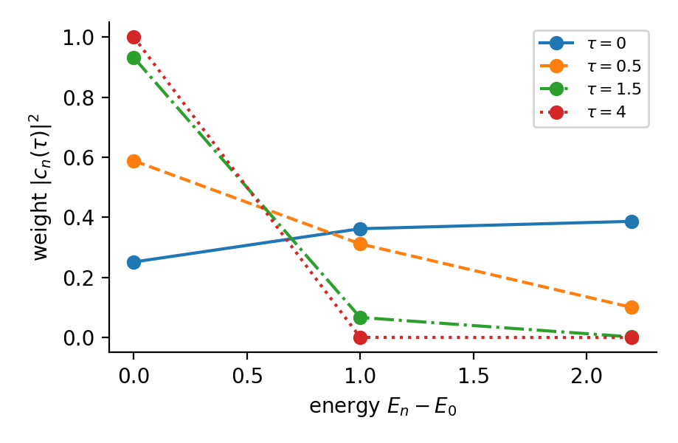
Why imaginary time finds the ground state
|ψ(τ)⟩ ∝ e^{−τH}|ψ₀⟩ = e^{−τE₀}[ c₀|E₀⟩ + Σₙ>₀ cₙ e^{−τ(Eₙ−E₀)} |Eₙ⟩ ]
• Excited weight decays like e^{−2τ(Eₙ−E₀)}
• Needs overlap c₀ ≠ 0 (HF: |c₀|² ≈ 0.99 for H₂)
• E(τ) − E₀ = O(e^{−2τΔ}): the gap Δ sets the cost
• Only the gap within the starting symmetry sector matters
• Continuous power iteration
3

Slide 4
The energy only goes down (exact ITE)
d|ψ⟩/dτ = −(H − E)|ψ⟩ dE/dτ = −2 Var_ψ(H) ≤ 0
• Proof: dE/dτ = 2 Re⟨ψ|H|ψ̇⟩ = −2 Re⟨ψ|H(H−E)|ψ⟩ = −2(⟨H²⟩ − ⟨H⟩²)
• Monotone descent, stationary only at eigenstates
• Practical diagnostic: if measured E rises, suspect domain size, Δτ, ill-conditioned S, or noise
• Var(H) → 0 certifies an eigenstate: an eigenvalue lies within √Var of E
4

Slide 5
Why we cannot just run e^{−τH}
• A circuit implements a unitary: U†U = I
• (e^{−τH})† e^{−τH} = e^{−2τH} ≠ I — it rescales each eigencomponent by e^{−τEₙ}
• Three workarounds:
– QITE: local unitary surrogate fitted to the current state (Motta et al. 2020)
– VarQITE: parametrised ansatz + McLachlan ODE for the parameters
– Probabilistic / block-encoding: ancilla + post-selection, success decays like e^{−τ}
• QITE and VarQITE are the NISQ-friendly options
5

Slide 6
QITE in one slide
e^{−Δτ H} ≈ Π_m e^{−Δτ h_m} e^{−Δτ h_m}|ψ⟩ / √c_m ≈ e^{−iΔτ A_m}|ψ⟩
• H = Σ_m h_m, with h_m = α_m P_m a Pauli string: e^{−Δτ h_m} = cosh(Δτα_m) − sinh(Δτα_m) P_m
• c_m = ⟨ψ|e^{−2Δτ h_m}|ψ⟩ is the norm that is lost
• A_m = Σ_μ a_μ σ_μ over a domain of Pauli strings near the support of h_m
• Unitary step: e^{−iΔτ A_m} = product of Pauli rotations (CNOT ladder + R_z, or native ZZ gates)
• Repeat over all terms m, then over steps, until E converges
6

Slide 7
Deriving the linear system for the coefficients a
• Expand to first order: −iA|ψ⟩ ≈ |d⟩ := (|ψ′⟩ − |ψ⟩)/Δτ
• Minimise ‖ −iA|ψ⟩ − |d⟩ ‖² over real a
S a = b S_μν = Re⟨ψ|σ_μ σ_ν|ψ⟩ b_μ = −Im⟨ψ|σ_μ|d⟩
b_μ = sinh(Δτ α_m) / (Δτ √c_m) · Im⟨ψ|σ_μ P_m|ψ⟩
• Nonzero only when σ_μ anticommutes with P_m ⇒ each entry is one Pauli expectation
• Only basis rotations + Z-measurements: no ancillas, no Hadamard test
7

Slide 8
The algorithm (one imaginary-time step)
• 1. Prepare |ψ⟩ = U_k ⋯ U₁ |ψ₀⟩ (all previous unitaries)
• 2. For each Hamiltonian term m:
– choose domain D_m; measure ⟨h_m⟩, S_μν, b_μ on the device
– solve S a = b (regularised least squares, classical)
– append U = exp(−iΔτ Σ a_μ σ_μ) to the circuit
• 3. Measure E = ⟨H⟩ and Var(H); stop when converged
• Quantum device: measurements + state prep. Classical computer: small linear solves.
8

Slide 9
Cost and pitfalls
• Circuit depth grows linearly with the number of steps: step k runs U_k ⋯ U₁|ψ₀⟩
– each step is shallow, the total is not — re-preparing the prefix is part of the cost
• Domain size D: strings grow like 4^D; error falls like e^{−D/ξ} only for finite correlation length ξ
– molecules after fermion→qubit maps are non-local: domain can be exponential
• S becomes singular near the ground state; shot noise is amplified by cond(S)
– regularise / truncated SVD; adaptive Δτ
• Δτ: too large → Trotter and first-order error; too small → many noisy steps
9

Slide 10
Related: variational QITE (McLachlan)
Σ_j M_ij θ̇_j = −C_i M_ij = Re⟨∂ᵢψ|∂ⱼψ⟩ C_i = ½ ∂ᵢE
• Equivalent to natural-gradient descent on E(θ)
• Fixed circuit depth (set by the ansatz) but limited by ansatz expressibility and local minima
• QITE has no ansatz but a growing circuit — a growing-ansatz version of the same linear system
10

Slide 11
QITE vs Quantum Krylov
 | Quantum Krylov | QITE
Idea | Build subspace, solve eigenproblem | Drive state toward E₀ step by step
Quantum work | Overlaps ⟨ψ₀|e^{−iHt}|ψ₀⟩, ⟨ψ₀|H e^{−iHt}|ψ₀⟩ | Pauli expectations S, b at every step
Circuit | Fixed e^{−iHt} (Trotter), depth ∝ t | Prefix grows with step number
Classical work | One small generalised eigenproblem H C = E S C | Least-squares solve per term per step
Main error | Trotter; ill-conditioned S | Domain, first-order Δτ, ill-conditioned S
Noise | Enters overlaps; threshold needed | Accumulates in the state
11

Slide 12
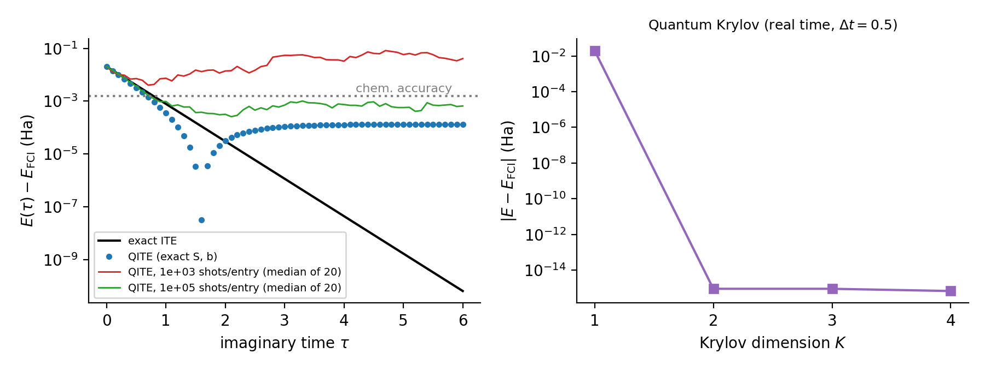
Worked check: H₂ (STO-3G, 0.735 Å, 2 qubits)
• E_FCI = −1.857275 Ha; HF error 20.3 mHa
• Exact S, b: chemical accuracy in 7 steps; best error 3×10⁻⁸ at τ=1.6, then settles at 1.3×10⁻⁴: Trotter error, ∝ Δτ²
• 10³ shots/entry: error ≈0.15 Ha, worse than HF; ridge ≫ noise fixes it
• 10⁵ shots/entry: ≈2×10⁻³ Ha
• Krylov exact at K=2: H₂ is a 2×2 sector, so it tests correctness, not scaling
Shot noise, not algorithmic error, dominates; use ≥ 4-qubit systems (LiH, H₄) to discriminate methods.
12

Slide 13
Benchmark design on Quantinuum
Metric | Definition
Accuracy | |E − E_FCI| (mHa), Var(H) if available
Shots / circuits | Totals over ALL circuits incl. S, b, overlaps; distinct executions
Depth, 2Q gates | Max depth and total N₂q
Qubits, runtime | N_q (+ancilla); wall time, queue separately
• A ideal simulation B shared noisy simulation C Quantinuum hardware
• D fixed budget (shots / N₂q) → compare accuracy
• E scaling: |E − E_FCI| vs hardware cost, vary K (Krylov) and steps N (QITE) ← central figure
13

Slide 14
Fair-comparison rules and caveats
• Same HF start, mapping, tapering, Hamiltonian grouping
• Count every circuit, including repeated QITE prefixes and Hadamard-test ancillas
• Tune hyper-parameters (Δτ, domain, regularisation; δt, K, threshold) on a noisy simulator, then freeze
• Repeat over seeds; add HF and fixed-ansatz VQE baselines
• QITE is not better just because it is another ground-state method
Research question: under identical Quantinuum resource constraints, how do QITE and Quantum Krylov trade accuracy, circuit depth, measurements and robustness?
14

Slide 15
References (check before citing)
• Motta et al., Nature Physics 16, 205 (2020) — QITE
• McArdle et al., npj Quantum Information 5, 75 (2019) — variational ITE
• Parrish & McMahon, arXiv:1909.08925 — quantum filter diagonalisation
• Stair, Huang, Evangelista, JCTC 16, 2236 (2020) — multireference quantum Krylov
• Epperly, Lin, Nakatsukasa, SIMAX 43, 1263 (2022) — theory of quantum subspace diagonalisation
• Companion notes and code: quantum-imaginary-time-evolution.pdf, code/qite_h2.py
15

