Slide 1
A SIP Security Testing Framework
Hemanth B Srinivasan, Aug 2008

Slide 2
Outline
Introduction
  What is SIP?
  Threats to SIP
  Related Work
Fuzz Testing
  Fuzz Testing
  Automated Fuzz Testing
Fuzz Data Generation
  GA Terminology
  Fuzz Data Generation Algorithm
SSTF Architecture
  Framework Design
  Control Flow & Module Interaction
Evaluations
  Performance Tests
  DoS Tests
  Fuzz Data Gen Tests
  Strezz Tests
Conclusion
Demo

Slide 3
Session Initiation Protocol (SIP)
Data - Voice Convergence (VoIP)
Used to setup VoIP calls between two or more participants
IETF RFC 3261 defines it as "an application-layer control protocol that can establish, modify, and terminate multimedia sessions (conferences) such as Internet telephony calls"
ASCII/text based; request-response protocol; works on a client-server model (similar to HTTP)
A typical SIP Uniform Resource Identifier (URI) is of the form
‘sip: user@domain’

Slide 4
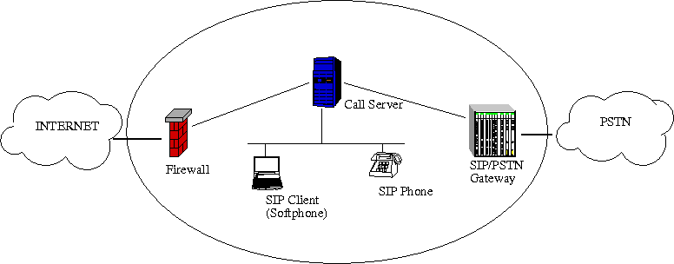
SIP Architecture
SIP ENTITIES
SIP user agent
SIP Call Server
  SIP proxy server
  SIP redirect server
SIP registrar
Notes:
SIP user agent (UAS/UAC) IP phone, soft-phone (PC), conference bridge
SIP Call Server
SIP proxy server routes call requests
SIP redirect server returns new location (address) for requests
SIP registrar maintains mappings from names to addresses on location database

Slide 5
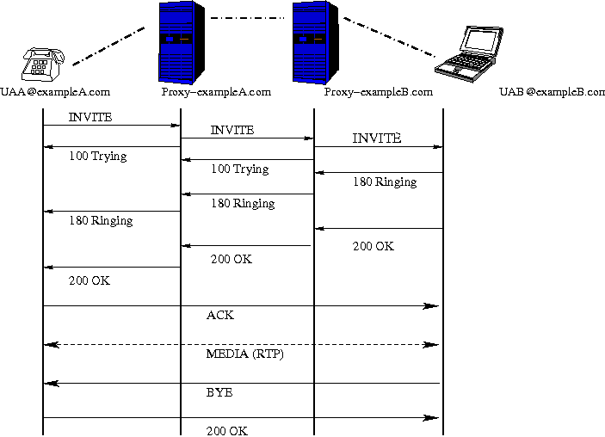
SIP Call Flow
SIP MESSAGES
INVITE, REGISTER, BYE, CANCEL, REFER, ACK etc.
1XX Informational 2XX Success 3XX Redirection
4XX Request failure 5XX Server failure 6XX Global failure

Slide 6
SIP Message Structure
Start line
INVITE sip:UAB@example.com SIP/2.0
Via: SIP/2.0/UDP 10.20.30.40:5060
From: UserA <sip:UAA@example.com>;tag=589304
To: UserB <sip:UAB@example.com>
Call-ID: 8204589102@example.com
CSeq: 1 INVITE
Contact: <sip:UserA@10.20.30.40>
Content-Type: application/sdp
Content-Length: 141
v=0
o=UserA 2890844526 2890844526 IN IP4 10.20.30.40
s=Session SDP
c=IN IP4 10.20.30.40
t=3034423619 0
m=audio 49170 RTP/AVP 0
a=rtpmap:0 PCMU/8000
Header
Blank line
Body (Session description - SDP)
Notes:
SDP Body: describes the for multimedia session, audio, video, various codecs, media transport protocol etc

Slide 7
SIP Security Mechanisms
RFC 3261defines the following mechanisms:
HTTP Digest Authentication
S/MIME usage within SIP
IPsec usage within SIP
SSL/TLS usage within SIP
Media data confidentiality using secure RTP (SRTP)
Notes:
SIP is an application layer IP protocol, like say HTTP. It can use several existing security mechanisms
For authentication purposes, it can use..
For privacy it use mime encapsulation similar to emails.
IPSec suite provides, integrity, authentication and confidentiality for all IP Services
Entire Transport sessions can be encrypted using TLS
Secure/Multipurpose Internet Mail Extension (S/MIME) encapsulation can be used to encrypt SIP bodies

Slide 8
Threats to SIP
VoIP Network - Open to all security issues of IP based networks (IP Spoofing, DoS, etc.,)
Attacks due to protocol flexibilities
ASCII/Text based nature
Attacks can either be internal or external
Notes:
How/Why the Threats
PSTN/Cellular Network – Closed, hence more secure.
VoIP Network - runs on IP, hence Open to all security issues of IP based networks (IP Spoofing, DoS, etc.,)
RFC 3261 recommends only the UA to authenticate itself to the proxy but not vice versa, this clearly opens up the door for server impersonation attacks.

Slide 9
Attack Types
SIP message flooding DoS attacks
(INVITE floods, REGISTER floods, Authentication DoS , etc)
SIP message flow based DoS attacks
(BYE attack, CANCEL attack, un-REGISTER attack, etc)
Malformed message/Parser attacks
(Buffer Overflow Exploits, SQL Injection)
Attacks derived from the underlying Transport and Network layer
(IP flooding, spoofing, wiretapping, TCP SYN floods)
Others
(SPIT/SPIM, DNS attacks, etc)
Notes:
With our frame work we address the 3 highlighted ones. With special focus to the 3rd.
(Focus on Malformed message attacks – more serious, eg: embed shellcode and try node compromise)

Slide 10
Attack Mitigation
Reactive Approach
  Constant Monitoring and Filtering
  Intrusion Detection Systems
OUR APPROACH
Proactive
  Thorough testing of SIP devices before deployment
  Requires a comprehensive security testing system
Notes:
Requires a comprehensive security testing system that would simulate various attack scenarios

Slide 11
Related Work
SIP Forum Test Framework: Conformance test suite
SNOCER Project [Geneiatakis et al, ‘05]: A signature based detection mechanism for SIP message tampering.
PROTOS Framework [Wieser et al, ‘03]: Fuzzing capability to assess the robustness of SIP implementations.
KiF [Humberto et al, ‘07]: A stateful SIP/VoIP fuzz framework
Several SIP testing tools are available
Our Contribution
Automated way of protocol aware fuzz testing
Generate effective fuzz data using our genetic algorithm
Provide a comprehensive testing platform
Notes:
Most existing SIP security testing solutions target a specific aspect of SIP security or focus on a specific entity within a SIP architecture.
Provide a comprehensive testing platform to integrate any aspect of SIP security testing into a uniform and easy to use platform.
J. Rosenberg, H. Schulzrinne, G. Camarillo, A. Johnston, J. Peterson, R. Sparks, M. Handley, and E. Schooler, “SIP: Session initiation protocol,” Internet Engineering Task Force (IETF), RFC 3261, July 2002.
S. Vuong and Y. Bai, “A survey of VoIP intrusions and intrusion detection systems,” 6th International Conference on Advanced Communication Technology, vol. 1, pp. 317–322, Sep 2004.
“SIP Forum Test Framework (SFTF),” http://www.sipfoundry.org/sipforum- test-framework/.
[Geneiatakis et al]D. Geneiatakis, G. Kambourakis, and et al., “A Framework for Detecting Malformed Messages in SIP Networks,” in Proceedings of 14th IEEE Workshop on Local and Metropolitan Area Networks (LANMAN), Chania-Crete, Greece, Sep 2005.
“SNOCER: Low Cost Tools for Secure and Highly Available VoIP Communication Services,” http://www.snocer.org/.
D. Geneiatakis, D. Kambourakis, and et al., “SIP Message Tampering: THE SQL code INJECTION attack,” in Proceedings of 13th International Conference on Software, Telecommunications and Computer Networks (SoftCOM 2005) IEEE, Split, Croatia, Sept 2005.
“PROTOS: Security Testing of Protocol Implementations,” http://www.ee.oulu.fi/research/ouspg/protos/testing/c07/sip/.
[Wieser et al] C. Wieser, M. Laakso, and et al., “Security testing of SIP implementations,” Dept of Comp Sci, Columbia University, NY,, Tech. Rep., 2003, http://compose.labri.fr/documentation/sip/Documentation/Papers/ Security/ Papers/462.pdf.
J. Humberto, R. State, and et al., “KiF: A stateful SIP Fuzzer,” in Proceedings of IPTComm - Principles, Systems and Applications of IP Telecommunications, New York, USA, Jul 2007.
“VOIP Security Alliance,” http://www.voipsa.org/.
D. Geneiatakis, T. Dagiouklas, and et al., “Survey of Security Vulnerrabilities in SIP,” IEEE Communications Tutorials and Surveys, vol. 8, no. 3, pp. 68–81, Oct 2006.
“SIPp: Open Source test tool/traffic generator for the SIP protocol,” http://sipp.sourceforge.net/.
“Asterisk: Open source PBX,” http://www.asterisk.org/
http://www.obitko.com/tutorials/genetic-algorithms/index.php
W.T.Tsai, L.Yu, and et al., “Scenario-Based Object-Oriented Test Frameworks for Testing Distributed Systems,” in 11th IEEE International Workshop on Future Trends of Distributed Computing Systems, San Juan, Puerto Rico, May 2003.

Slide 12
Outline
Introduction
  What is SIP?
  Threats to SIP
  Related Work
Fuzz Testing
  Fuzz Testing
  Automated Fuzz Testing
Fuzz Data Generation
  GA Terminology
  Fuzz Data Generation Algorithm
SSTF Architecture
  Framework Design
  Control Flow & Module Interaction
Evaluations
  Performance Tests
  DoS Tests
  Fuzz Data Gen Tests
  Strezz Tests
Conclusion
Demo

Slide 13
Fuzz Testing
Fuzz Testing (or Fuzzing): software testing using malformed input data
Goal is to find implementation defects
Valuable method of assessing security vulnerabilities of software systems
Current approaches
  Manual fuzz testing
  PROTOS has about 4500+ tests cases (Fuzzed INVITEs)
Our approach
  Automatically generate fuzz test cases
  Dynamically replace fuzz data values at runtime
  Generate your own fuzz data values
Notes:
We want to automate this process and give more control to the user.
Outcome of a fuzz test, if successful, usually a program crash possibly due to boundary check failure, buffer overflow, or some semantic error. Hence, fuzzing is considered a valuable method in assessing the robustness and security vulnerabilities of software systems.

Slide 14
Automated Fuzzing
Our automated fuzz testing mechanism
Sample Message Template
INVITE sip:6001@[remote_ip]:[remote_port] SIP/2.0
Via: SIP/2.0/[transport] [local_ip]:[local_port];branch=[branch]
From: sstf <sip:6000@[SIP_src_ip_spoof]:[local_port]>;tag=[call_number]
To: target <sip:6001@[remote_ip]:[remote_port]>
Call-ID: [call_id]
CSeq: 1 INVITE
Contact: sip[SIP_colon]6000@[local_ip]:[local_port]
:
Sample Rules
<rule name="Rule1">
<message type=“invite" />
<testdevice type="uac" />
<targetdevice type=“proxy" />
<header type="from">
<![CDATA[
1 [local_ip] [SIP_src_ip_spoof]
]]>
</header>
<header type=“contact">
<![CDATA[
2 : [SIP_colon]
]]>
</header>
<header type="via" />
:
<build>start,via,from,to,call-id,cseq,contact,content-length</build>
</rule>
Notes:
In the simplest form we can use random data values in fuzzing, but we wanted to use an effective data value, so we came up with an algorithm to generate fuzz data values.
Control the fields to be fuzzed
Dynamically pick fuzz data values at runtime
Template and Rule based fuzz test case generation
Auto Generate fuzz data values

Slide 15
Outline
Introduction
  What is SIP?
  Threats to SIP
  Related Work
Fuzz Testing
  Fuzz Testing
  Automated Fuzz Testing
Fuzz Data Generation
  GA Terminology
  Fuzz Data Generation Algorithm
SSTF Architecture
  Framework Design
  Control Flow & Module Interaction
Evaluations
  Performance Tests
  DoS Tests
  Fuzz Data Gen Tests
  Strezz Tests
Conclusion
Demo

Slide 16
Fuzz Data
The fuzz input data space can be very large
Current practice
  a brute force data set
  a random data set
  a known problematic data set
Often tradeoff between completeness and cost
Our Approach
Classify fuzz data based on the application (Ex: SIP_int, SIP_string, etc., - Initial data set)
Rank data based on their potential ability to expose defects
Use these as input to generate new data values
Notes:
Fuzz data types: SIP_int, SIP_ip, SIP_string, etc. Each of these types can have data from any/all of above three data sets.
Rather than using data directly from the above sets, we have come up with an algorithm to derive new fuzz data from these. We have categorized the data based on the SIP message format, into certain fuzz data types
Use these as input to generate new data, using a genetic algorithm with a unique fitness function that ranks data based on their potential ability to expose defects.

Slide 17


Genetic Algorithms
Terminology
Chromosome, Reproduction, Fitness, Selection, Crossover, Mutation
Example
Offspring 1
Parent 1
AA
BBBB
Parent 2
CCC
DDD
Offspring 2
Notes:
With Biology being the inspiration for GA, most terms and definitions are directly derived from the underlying biological concepts.
Chromosome: represents the data or population we wish to improve. Usually encoded in binary.
Reproduction: process of generating new chromosomes from chosen existing ones.
Fitness: Every chromosome is associated with a fitness level; Higher fitness level, higher is the chance of being chosen for reproduction.
Selection: process of choosing parents that participate in reproduction; Is governed by the fitness level.
Crossover: determines how the offspring is generated from the two parent chromosomes; Performed either by randomly choosing one or more crossover points in the chromosomes or, by applying some mathematical operation.
Mutation: process where the value at a random location in the chromosome is changed; To avoid a 'local minima' by preventing the population from becoming too similar to one another, thus slowing or even stopping evolution (change).

Slide 18
Fuzz Data Generation Genetic Algorithm
begin FuzzGA
Initialize population P(parent1, parent2)
Compute Fitness P(parent1, parent2)
while not done do
Select P(parent1, parent2)
Crossover P(parent1, parent2)
Mutate P(offspring1, offspring2)
Compute Fitness P(offspring1, offspring2)
Accept P(offspring1, offspring2)
if (improvise) then
parent1 = offspring1
parent2 = offspring2
end if
end while
end FuzzGA
Notes:
Begin: Choose initial (parent) population from one of our fuzz data types. (each parent may be of same type or different)
Fitness: Evaluate the fitness/rank of each data value in the population.
New Population: Create a new population by repeating the following steps until the new population is complete
Selection: Select one data value from each parent according to their fitness
Crossover: Cross over the parents to form a new offspring. We use a single crossover point technique with a random crossover point.
Mutation: Mutate the new offspring at a chosen position, by altering a random number of bytes in each of the newly generated data values.
Acceptance: Place the new offspring in a new population.
Improvisation: Use the newly generated population for a further run of algorithm.
Test: If the end condition is satisfied, stop and return the best solution in current population.
Repeat: Go to Fitness computation step.

Slide 19
Fitness Function
Fitness values determine the data we choose as parents
Our fitness function ranks data based on their potential ability to expose defects
Fitness Parameters
Native Character Set
Native Size
Native Type
Parents Fitness
Damage Co-efficient
User Defined
Notes:
Native Size: Higher the deviation of the data from its original acceptable input size, higher is its contribution to the overall fitness value.
Native Type: Higher the deviation from its original type (number, string etc), higher is the contribution.
Parents Fitness: Either the max, min or avg of the parents fitness values can be used.
Damage Co-efficient: More damage a particular data has caused on previous occasions, higher is its damage coefficient and contribution to the fitness.
Native Character Set: Higher the presence of non-native (e.g., non-ASCII) characters, higher is the contribution.
User Defined: User defined parameters; In many applications, format strings are very effective, so presence of such characters should increase the fitness level of that fuzz data. Similarly, Target/Attack specific data (e.g., SQL data in an SQL injection attack) can also be taken into account.

Slide 20
Fitness Computation
Let N be the number of parameters chosen to contribute to the fitness
value. The overall fitness value is calculated as follows:
Deviation factor DF = 1 / N (or weighted)
Deviation contribution DC = A * DF, for each parameter (A is the deviation percentage)
Total deviation contribution TDC = SUM(DC) for all N
Final Fitness Value F = Ceiling [TDC * 10]
Notes:
All parameters need not always be used; a subset of them can
be used depending on the input population and the application
being fuzzed.

Slide 21
Outline
Introduction
  What is SIP?
  Threats to SIP
  Related Work
Fuzz Testing
  Fuzz Testing
  Automated Fuzz Testing
Fuzz Data Generation
  GA Terminology
  Fuzz Data Generation Algorithm
SSTF Architecture
  Framework Design
  Control Flow & Module Interaction
Evaluations
  Performance Tests
  DoS Tests
  Fuzz Data Gen Tests
  Strezz Tests
Conclusion
Demo

Slide 22
SIP Security Testing Framework (SSTF)
REQUIREMENTS
Ability to test different aspects
  Protocol Conformance Tests
  Performance/Stress Tests
  DoS Tests
  Penetration/Fuzz Tests and others.
Continual upgrade to incorporate new techniques to test new attack scenarios.
Flexible, scalable, and conducive to the user’s changing needs.
Notes:
Testing the security strength of a SIP architecture is a demanding process involving various test activities.
In many cases, vulnerabilities are discovered
just by the creativity of the tester or by using some unconventional
approaches. A test framework should be conducive to
such techniques and assist in developing such techniques

Slide 23
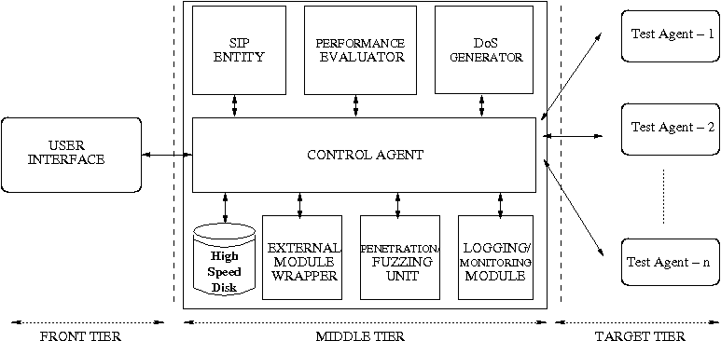
SSTF Design
Notes:
Our framework consists of three tiers
This 3 tier structure is based on a model proposed by group of software engineering researchers from Arizona State University. Their mod a Scenario-Based Object-Oriented Test Framework for Testing Software Systems
[15] Scenario-Based Object-Oriented Test Frameworks for Testing Distributed Systems – From ASU
The framework consists of three tiers as:
A Front Tier that serves as the user interface,
A Middle Tier that constitutes the central control engine and other core components
A Target Tier that interacts with the test targets.

Slide 24
Module Roles
Front Tier: provides uniform GUI
Control Agent: controls and orchestrates the entire test activity
SIP Entity: the sanity controlling component
Performance Evaluator: provides various performance metrics
DoS Generator: simulates various DoS attacks
Penetration Test/Fuzzing Unit: capable of altering a SIP message in malicious ways
Notes:
Front Tier: uniform GUI to setup the test cases involving the different test modules.
Control Agent: controls and orchestrates the entire test activity. Acts as an interface for the various test modules. Reads from the front tier and generates the XML like test scenarios. Spawn Test agents and instructs them.
SIP Entity: the sanity controlling component; forms a part of any kind of test activity.
Performance Evaluator: provides various performance metrics; crucial for estimating the performance benchmarks of a target device.
DoS Generator: simulates DoS attacks; ability to spoof usernames and IP addresses; key requirement for testing SIP firewalls and other security devices for intrusion detection.
Penetration Test/Fuzzing Unit: capable of altering a SIP message in malicious ways; Crucial for detecting implementation vulnerabilities like buffer overflows.

Slide 25
Module Roles…Contd
External Module Wrapper: wrapper for external tools
Logging/Monitoring Module: monitors the test progress and logs key information
Target Tier: direct interface to the test targets
Advantages of the target tier:
Carry out several tests in parallel
Provides a level of redundancy
Notes:
The independent (multithreaded) nature of the target tier
Carry out several tests in parallel thereby increasing the efficiency and effectiveness
should a test agent fail/crash during a test, only that test is affected, the control agent and other test agents continue to function.

Slide 26
Module Interactions
Control flow (GUI Steps)
Select Events
Configure Event
Configure Message
Other Setting
Launch
Test
Notes:
Module Interactions and Control flow can be mapped to
the following 5 Step Test Design Process:
Step 1: Determine the set of events that will constitute the test case (send, receive etc).
Step 2: Configure each event .
Step 3: For a send event message, use existing templates, or design the template file yourself or auto-generate the template using certain rules
Step 4: Once the base message template is ready, you can alter the various header fields and specify whether some of them will be fuzzed or spoofed. This is done by replacing a header field by one of the various fuzz or spoof keywords.
Step 5: Now decide on the other modules (performance, SIP settings, logging, and other external settings) to include and configure each of them.
Step 6: Launch and monitor the Test.

Slide 27
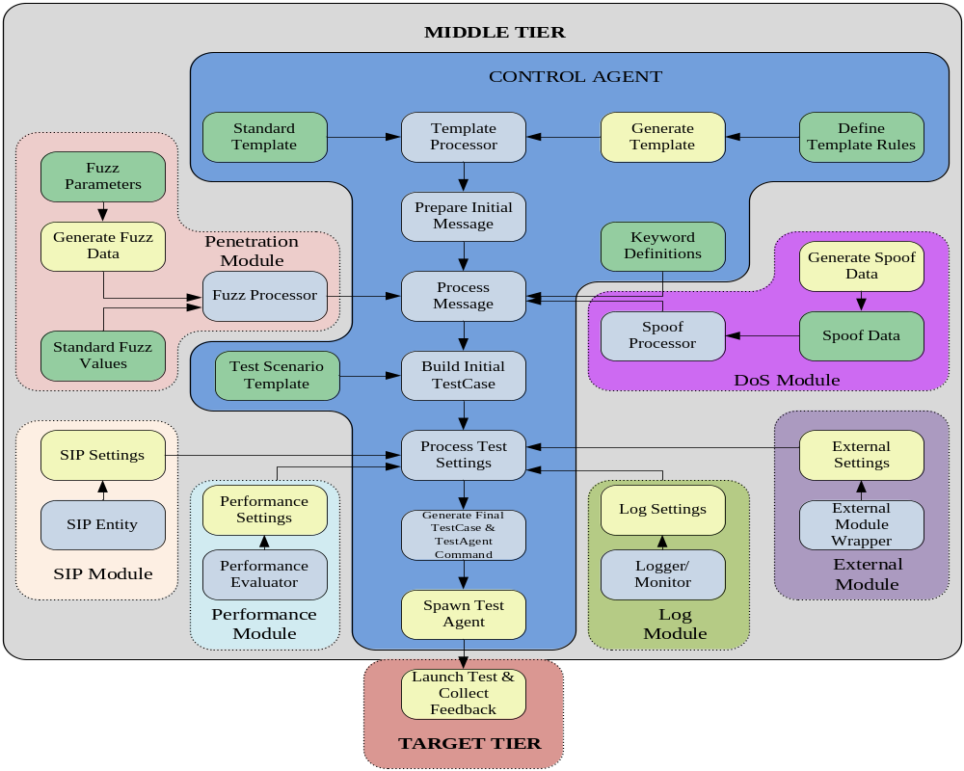
Notes:
Explain color coding: All components in yellow are accessible by the user from the front tier (GUI). All components in green are accessible only through configuration files and all other components (in Tint) are not visible to the user.
Talk about the flow and interactions in detail. What processing occurs at each stage.
Thus, if the user wishes to make use of his/her own type, all he/she needs to do is, define a new fuzz data type in the ./fuzz/Keyword.lst file, have a corresponding fuzz data file (.fz) and then use the data type as a keyword in the message template.
Template Processor: process the template read the Fuzz/Spoof Keywords, give the keywords to the respective modules
Fuzz Processor: read the fuzz keyword and set up the fuzz keyword-fuzz data file mapping., generates temp data files
Spoof Processor: read the spoof keyword and set up the spoof keyword-spoof data file mapping, generates temp data files
Message Processor: read the mappings, generate master data file using the temp data files, set up the actual mapping within message (field:file)
Test Setting Processor: read the corresponding GUI settings and supply to the respective modules
Test Agents: Carry out the test based on the control module instruction and provide feedback. At one, interact with control agent and at the other interact with the test targets.

Slide 28
Recap
SIP Operation & Threats
Current Mitigation Schemes
Fuzz Testing
Fuzz Data Generation
Our Test Framework (SSTF)
Notes:
All parameters need not always be used; a subset of them can
be used depending on the input population and the application
being fuzzed.

Slide 29
Outline
Introduction
  What is SIP?
  Threats to SIP
  Related Work
Fuzz Testing
  Fuzz Testing
  Automated Fuzz Testing
Fuzz Data Generation
  GA Terminology
  Fuzz Data Generation Algorithm
SSTF Architecture
  Framework Design
  Control Flow & Module Interaction
Evaluations
  Performance Tests
  DoS Tests
  Fuzz Data Gen Tests
  Strezz Tests
Conclusion
Demo

Slide 30
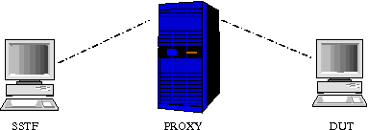
Evaluation - Setup
Set up a SIP network in our lab
Limited resources; Used soft-phones as SIP UAs; Open source SIP Proxy
SSTF Modules: used existing SIP tool as SIP entity; Implemented others
Java based platform independent simulation
Tests
  Performance Test
  Denial of Service (DoS) Test
  Fuzz Data Generation Test
  Strezz (Stress + Fuzz) Test
Notes:
We used SIPp [12] as our SIP entity module.
The test topology consisted of our framework, an open source state-ful SIP proxy named Asterisk [13], and the device under the test (DUT).
Due to limited resources, used only soft-phones and an open source proxy as DUT
The soft-phones were installed on a PC running Microsoft Windows XP Service Pack 2 and Asterisk was run on an Intel P4, 2.6 GHz Processor, with 1GB of RAM.

Slide 31
Performance Tests
Call Rate | UA1 |  | UA2 |  | UA3 |  | UA4 |  | UA5
 | R(ms) | D (%) | R(ms) | D (%) | R(ms) | D (%) | R(ms) | D (%) | R(ms) | D (%)
1/s | 1.97 | 0 | 1.88 | 0 | 10.63 | 0 | 0.94 | 0 | 1.84 | 0
5/s | 2.05 | 0 | 1.97 | 0 | 42.08 | 0 | 0.79 | 0 | 2402 | 4
10/s | 2.11 | 0 | 2.06 | 0 | 42.71 | 8 | 63.10 | 1 | 1481 | 33
50/s | 2.14 | 0 | 1.23 | 0 | 33.76 | 13 | 59.89 | 3 | 1011 | 17
Notes:
Test
Made calls to the UAs at different rates; measured response times and percentage of dropped calls.
Response time was calculated by taking the average of the time taken for the first response
message from the UA.
Observation
Some UAs (UA1 & UA2) were not affected by the increased rates of calling;
Some UAs (UA3) dropped calls to maintain a consistent response time;
At higher rates, response times of some UAs (UA4) was very high, however the dropped call percentage was low;
In some UAs (UA5), increased rates caused both increased response times and dropped calls. These UAs usually hanged during the test which caused a sharp jump in response times.

Slide 32
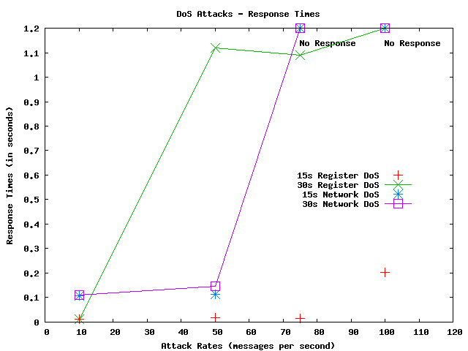
Denial of Service (DoS) Tests
Notes:
Test
Considered two attack scenarios; 1) a Register DoS; REGISTER requests at different rates; 2) a Network DoS: bogus/genuine calls at various rates. Measured the response time of the proxy for different attack durations.
Response time :
Register DoS: time taken to receive a 200 OK message for a single test request
Network DoS: time taken to receive a 180 RINGING message for a single genuine test call.
Observation
For Register DoS lasting 15s, response times marginally increased.
However, for attacks lasting 30s or more, the response times increased more rapidly
At attack rates of 100cps or more, there was no response (i.e. message dropped).
For Network DoS response times were much higher even for short duration attacks and calls were dropped at attack rates of 75cps and above. Thus, devices were less tolerant to Network DoS attacks.

Slide 33
Fuzz Data Generation Tests
Parent 1 | Parent 2 | Generation | Defects Found
SIP_int | SIP_int | 0 | 4
 |  | 1 | 8
 |  | 2 | 10
 |  | 3 | 8
SIP_string | SIP_string | 0 | 4
 |  | 1 | 5
 |  | 2 | 4
 |  | 3 | 5
SIP_colon | SIP_slash | 0 (colon) | 1
 |  | 0 (slash) | 1
 |  | 1 | 3
 |  | 2 | 3
 |  | 3 | 5
Notes:
Test
Made calls to the UAs at 1cps with fuzzed INVITE messages. First tested using only parent fuzz data set (Gen 0); Then carried out the same tests using data generated using our algorithm.
Observation
Offspring found many new defects that their parents did not find.
Possible indication that our fitness function and parameters indeed ranked data based on their effectiveness.
Number of defects found in successive generations was never less than their original parent types.
Indication that our GA indeed generated populations that were an improved version of their parents.

Slide 34
Strezz Tests
TEST | UA1 | UA2 | UA3 | UA4 | UA5
1 | PASS | PASS | PASS | PASS | PASS
2 | PASS | PASS | PASS | PASS | PASS
3 | PASS | PASS | PASS | FAIL/CRASH | FAIL/FREEZE
4 | PASS | FAIL/CRASH | FAIL/CRASH | FAIL/CRASH | FAIL/CRASH
Notes:
Tests
Simple stress test on the DUTs where we send 50 INVITE messages/sec;
Simple fuzz test where we send a single INVITE message with one or more fields fuzzed;
Call fuzz test where messages deeper in a call flow (e.g., ACK) were fuzzed;
Strezz (Stress+Fuzz) test where the test agent sends 5 fuzzed INVITE messages/sec.
Observation
DUTs handled 50 INVITE messages/sec and fuzzed INVITE messages without crashing.
However, two of DUTs failed when fuzzed messages were used beyond the initial INVITE.
When fuzzing and performance testing were used together, most DUTs failed by crashing. Demonstrates the importance of a comprehensive test environment that combines different test methods.
This sample test scenario thus demonstrates the importance of a comprehensive test environment that combines different test methods. We believe that many such effective test techniques can be developed using our framework to expose hidden vulnerabilities in a SIP service infrastructure.

Slide 35
Conclusion
We Presented:
  Automated protocol aware fuzz testing
  Fuzz data ranking and generation
  Design and prototype of a comprehensive testing framework for SIP
Our evaluations:
  Demonstrated the importance of combining different test strategies
  Showed that our ranking parameters and fitness function depict the effectiveness of fuzz data to some extent

Slide 36
Future Work
Evaluations with real world commercial devices
The framework itself requires continual update
Refine our fuzz generation algorithm
GUI can be refined in many ways

Slide 37
Demo

Slide 38
Q & A

Slide 39
THANK YOU

Slide 40
References
J. Rosenberg, H. Schulzrinne, G. Camarillo, A. Johnston, J. Peterson, R. Sparks, M. Handley, and E. Schooler, “SIP: Session initiation protocol,” Internet Engineering Task Force (IETF), RFC 3261, July 2002.
S. Vuong and Y. Bai, “A survey of VoIP intrusions and intrusion detection systems,” 6th International Conference on Advanced Communication Technology, vol. 1, pp. 317–322, Sep 2004.
“SIP Forum Test Framework (SFTF),” http://www.sipfoundry.org/sipforum- test-framework/.
[Geneiatakis et al] D. Geneiatakis, G. Kambourakis, and et al., “A Framework for Detecting Malformed Messages in SIP Networks,” in Proceedings of 14th IEEE Workshop on Local and Metropolitan Area Networks (LANMAN), Chania-Crete, Greece, Sep 2005.
“SNOCER: Low Cost Tools for Secure and Highly Available VoIP Communication Services,” http://www.snocer.org/.
D. Geneiatakis, D. Kambourakis, and et al., “SIP Message Tampering: THE SQL code INJECTION attack,” in Proceedings of 13th International Conference on Software, Telecommunications and Computer Networks (SoftCOM 2005) IEEE, Split, Croatia, Sept 2005.
“PROTOS: Security Testing of Protocol Implementations,” http://www.ee.oulu.fi/research/ouspg/protos/testing/c07/sip/.
[Wieser et al] C. Wieser, M. Laakso, and et al., “Security testing of SIP implementations,” Dept of Comp Sci, Columbia University, NY,, Tech. Rep., 2003, http://compose.labri.fr/documentation/sip/Documentation/Papers/ Security/ Papers/462.pdf.
[Humberto et al, ‘07]: J. Humberto, R. State, and et al., “KiF: A stateful SIP Fuzzer,” in Proceedings of IPTComm - Principles, Systems and Applications of IP Telecommunications, New York, USA, Jul 2007.
“VOIP Security Alliance,” http://www.voipsa.org/.
D. Geneiatakis, T. Dagiouklas, and et al., “Survey of Security Vulnerrabilities in SIP,” IEEE Communications Tutorials and Surveys, vol. 8, no. 3, pp. 68–81, Oct 2006.
“SIPp: Open Source test tool/traffic generator for the SIP protocol,” http://sipp.sourceforge.net/.
“Asterisk: Open source PBX,” http://www.asterisk.org/
http://www.obitko.com/tutorials/genetic-algorithms/index.php
W.T.Tsai, L.Yu, and et al., “Scenario-Based Object-Oriented Test Frameworks for Testing Distributed Systems,” in 11th IEEE International Workshop on Future Trends of Distributed Computing Systems, San Juan, Puerto Rico, May 2003.

