Slide 1

Java
JDBC
Сергей Рыбалкин

Slide 2
JDBC
Отметьтесь на портале.
2

Slide 3
План лекции
Flashback
Database
SQL
JDBC
3
Notes:
3

Slide 4
План лекции
Flashback
Database
SQL
JDBC
4
Notes:
4

Slide 5
Try with resources
try (A a = getA(); B b = a.getB())
…
} catch (SQLException | IOException e) {
…
}
A implements AutoClosable
B implements AutoClosable
5

Slide 6
Thread and Runnable
class Thread implements Runnable {
// here all the interface for thread management
}
@FunctionalInterface
interface Runnable {
// will be executed when thread starts
public abstract void run();
}
6

Slide 7
Thread public methods (some)
start(); // executes run() of provided Runnable
static sleep(long millis);
interrupt(); //Throws InterruptedException if waiting
// sets Thread.isInterrupted otherwise
targetThread.join(); //Block current Thread until target finishes
7

Slide 8
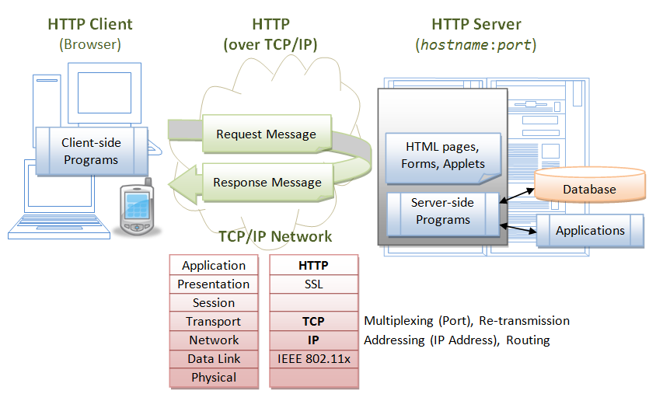
Tinder Server
8

Slide 9
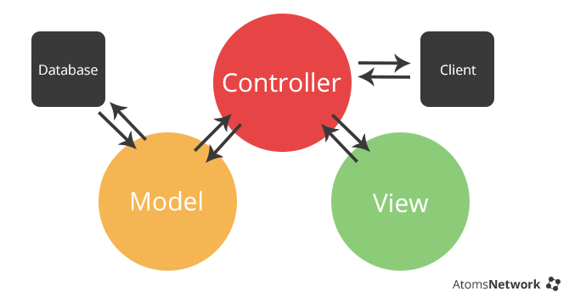
MVC
9

Slide 10
План лекции
Flashback
Database
SQL
JDBC
10
Notes:
10

Slide 11
Database
RAM vs File
11

Slide 12
Database
RAM vs File
Capacity
Speed
Durability
12

Slide 13
Database
File vs Database
13

Slide 14
Database
File vs Database
Store overhead
Consistency
Guarantees
...
х-х и в продакшн
14

Slide 15
Database (DBMS)
DataBase Management System
Collection of related data
Data can be easily accessed
Management over data
15

Slide 16
Database. Transaction
Transaction is a unit of work
Recovery
and ACID
Atomicity
Consistency
Isolation
Durability
16

Slide 17
JDBC
Java Database Connectivity
Collection of related data
Data can be easily accessed
Management over data
17

Slide 18
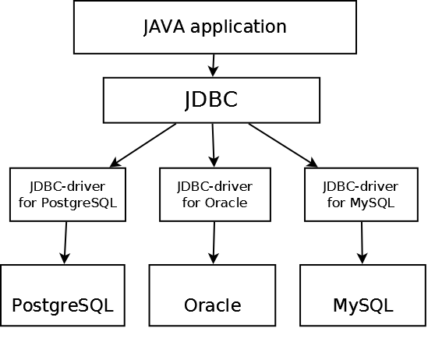
JDBC. Architecture
18

Slide 19
SQL
Structured Query Language
SELECT * FROM persons
WHERE age < 20
ORDERED BY name
19

Slide 20
SQL. CRUD
CRUD – persistent storage primitives
INSERT
SELECT
UPDATE
DELETE
20

Slide 21
DAO
Data Access Object
Low level abstraction over database type (table)
@See ru.atom.model.dao
21

Slide 22
SQL. INSERT
INSERT INTO persons (name, gender, age)
VALUES
(‘Marge Simpson’, ‘FEMALE’, 34);
22

Slide 23
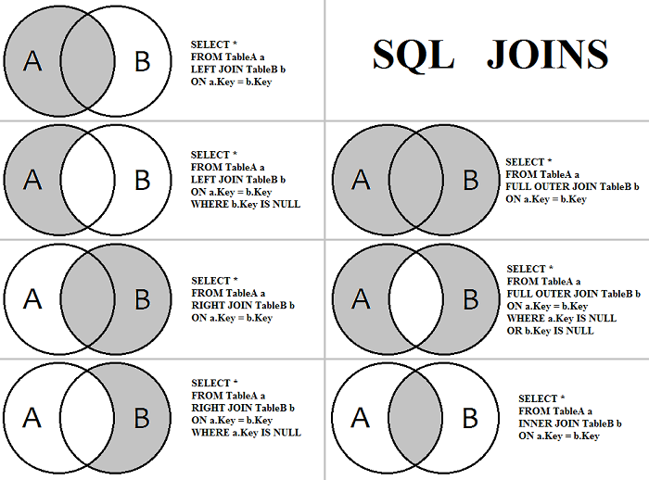
SQL. JOIN
23

Slide 24
SQL. INNER JOIN
SELECT persons.name FROM
persons INNER JOIN images
ON persons.id = images.ownerId
24

Slide 25
SQL – Java data mapping
VARCHAR – String
BIT – Boolean
INTEGER – int
BIGINT – long
DOUBLE – double
25

Slide 26
Less talk more work
RAM → DB migration
Entities
Person
Like
Match
26

Slide 27
Match maker
Like is …
source → target relation
Match is …
27

Slide 28
Match maker
Like is …
source → target relation
Match is …
a like b & b like a
28

Slide 29
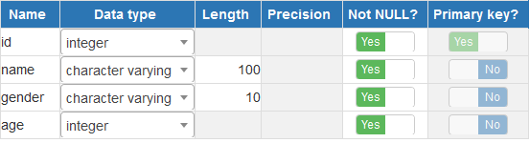
Persons table
29

Slide 30
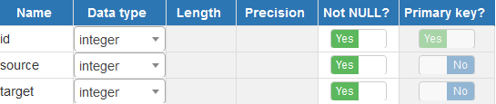
Likes table
30

Slide 31
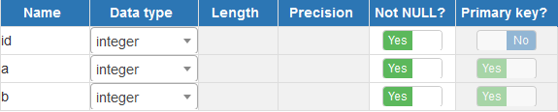
Matches table
31

Slide 32
JDBC
Оставьте отзыв.
32

Slide 33

Спасибо
за внимание!
Сергей Рыбалкин
s.rybalkin@corp.mail.ru

