Slide 1

Java
JDBC
Сергей Рыбалкин

Slide 2
JDBC
Отметьтесь на портале.
2

Slide 3
План лекции
Flashback
Database
SQL
JDBC
3
Notes:
3

Slide 4
План лекции
Flashback
Database
SQL
JDBC
4
Notes:
4

Slide 5
Try with resources
try (A a = getA(); B b = a.getB())
…
} catch (SQLException | IOException e) {
…
}
A implements AutoClosable
B implements AutoClosable
5

Slide 6
Thread and Runnable
class Thread implements Runnable {
// here all the interface for thread management
}
@FunctionalInterface
interface Runnable {
// will be executed when thread starts
public abstract void run();
}
6

Slide 7
Thread public methods (some)
start(); // executes run() of provided Runnable
static sleep(long millis);
interrupt(); //Throws InterruptedException if waiting
// sets Thread.isInterrupted otherwise
targetThread.join(); //Block current Thread until target finishes
7

Slide 8
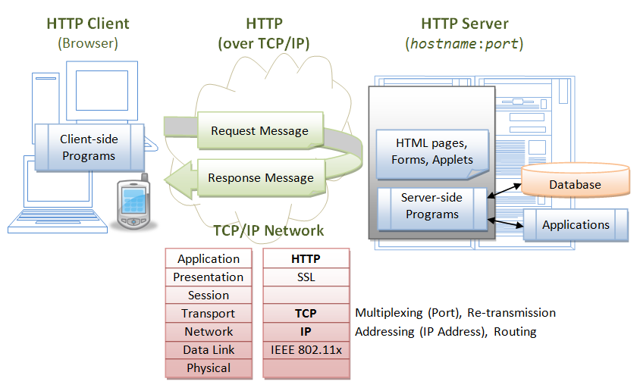
Tinder Server
8

Slide 9
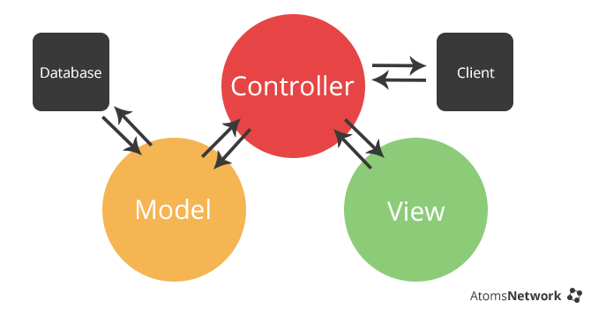
MVC
9

Slide 10
План лекции
Flashback
Database
SQL
JDBC
10
Notes:
10

Slide 11
Database
RAM vs File
11

Slide 12
Database
RAM vs File
Capacity
Speed
Durability
12

Slide 13
Database
File vs Database
13

Slide 14
Database
File vs Database
Store overhead
Consistency
Guarantees
...
х-х и в продакшн
14

Slide 15
Database (DBMS)
DataBase Management System
Collection of related data
Data can be easily accessed
Management over data
15

Slide 16
Database. Transaction
Transaction is a unit of work
Recovery
and ACID
Atomicity
Consistency
Isolation
Durability
16

Slide 17
JDBC
Java Database Connectivity
Collection of related data
Data can be easily accessed
Management over data
17

Slide 18
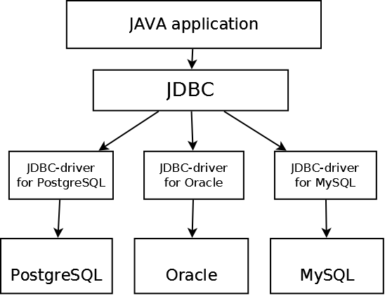
JDBC. Architecture
18

Slide 19
SQL. CRUD
CRUD – persistent storage primitives
INSERT
SELECT
UPDATE
DELETE
19

Slide 20
DAO
Data Access Object
Low level abstraction over database type (table)
@See ru.atom.model.dao
20

Slide 21
SQL. INSERT
INSERT INTO persons (name, gender, age)
VALUES
(‘Marge Simpson’, ‘FEMALE’, 34);
21

Slide 22
Collections, Annotations, HTTP
Оставьте отзыв.
22

Slide 23

Спасибо
за внимание!
Сергей Рыбалкин
s.rybalkin@corp.mail.ru

