Slide 1
Cryptanalysis of RC4

Slide 2
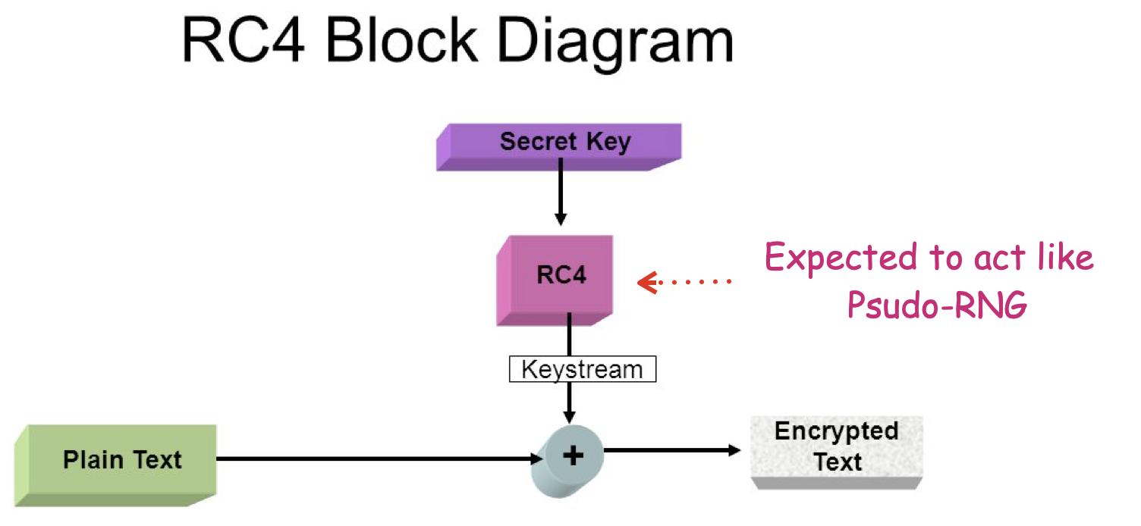
Image Credit: shorturl.at/syBNU

Slide 3
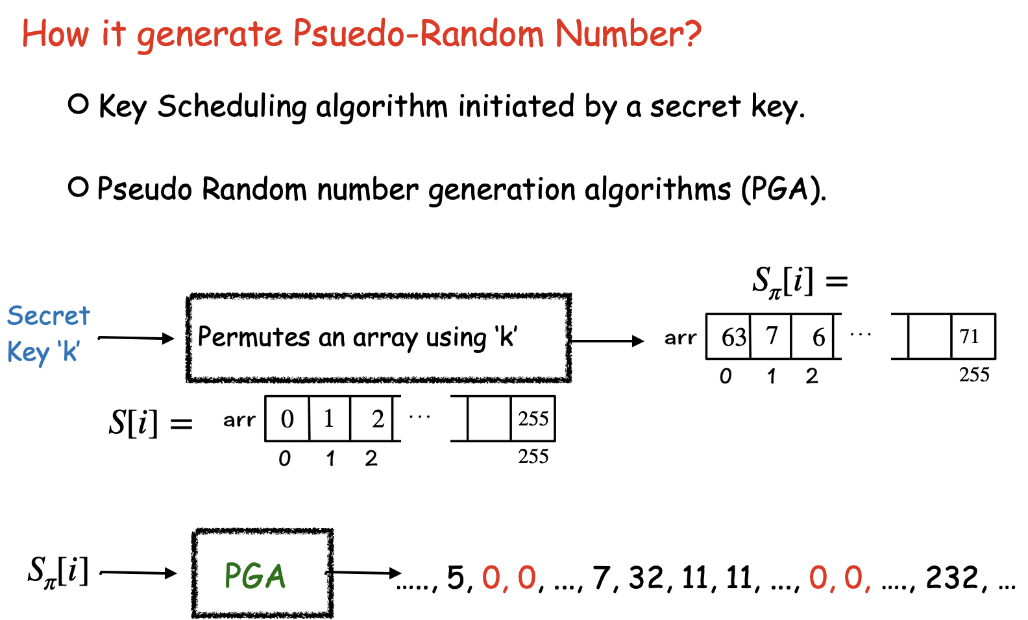

Slide 4
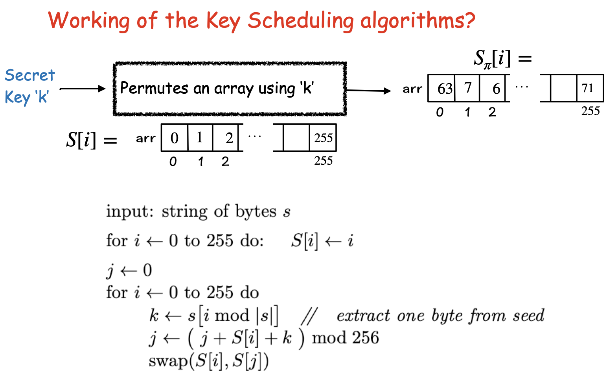
Psuedo Code: Boneh & Shoup

Slide 5
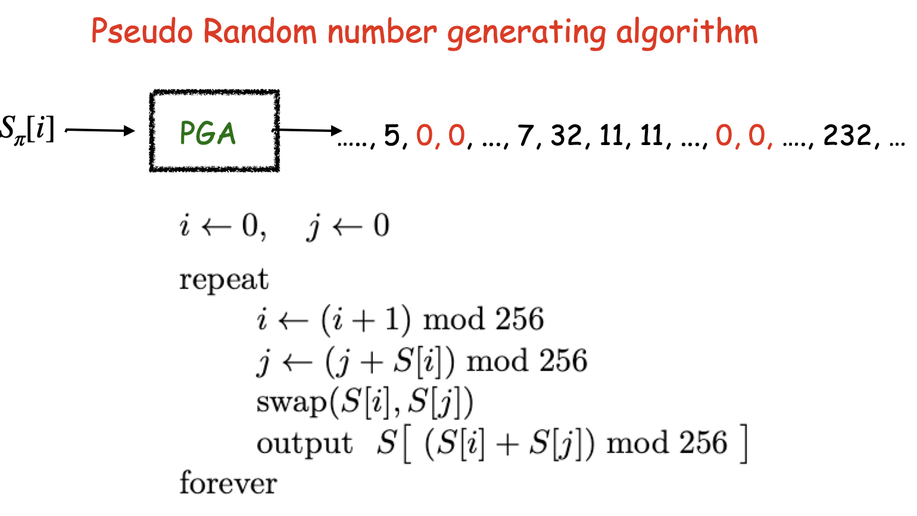
Psuedo Code: Boneh & Shoup

Slide 6
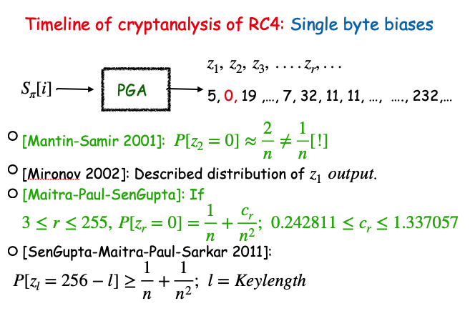

Slide 7
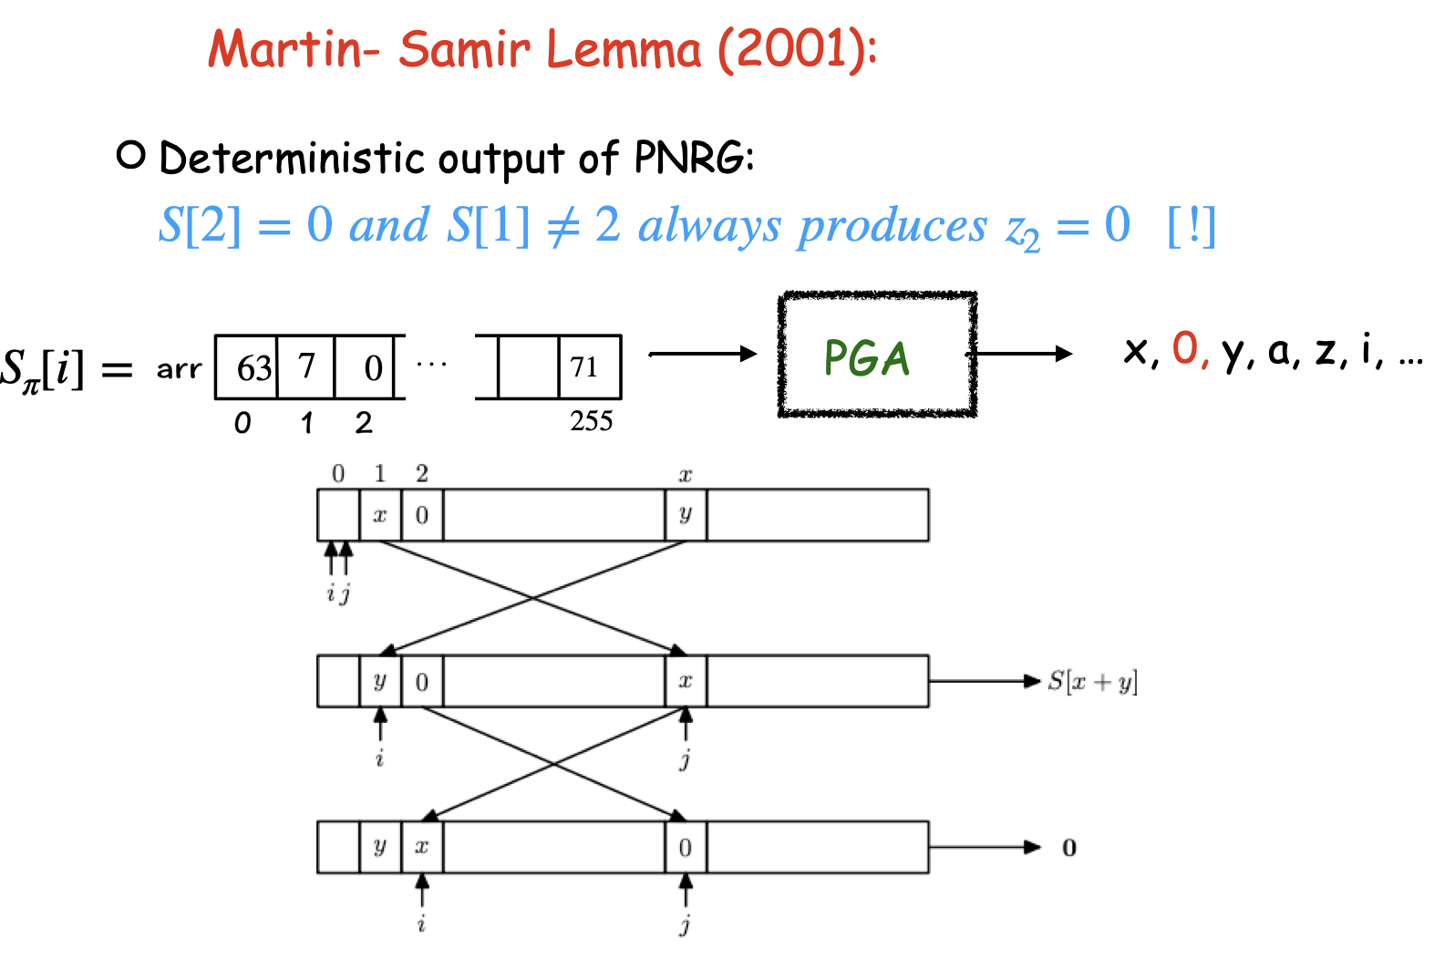
Image: Boneh & Shoup

Slide 8
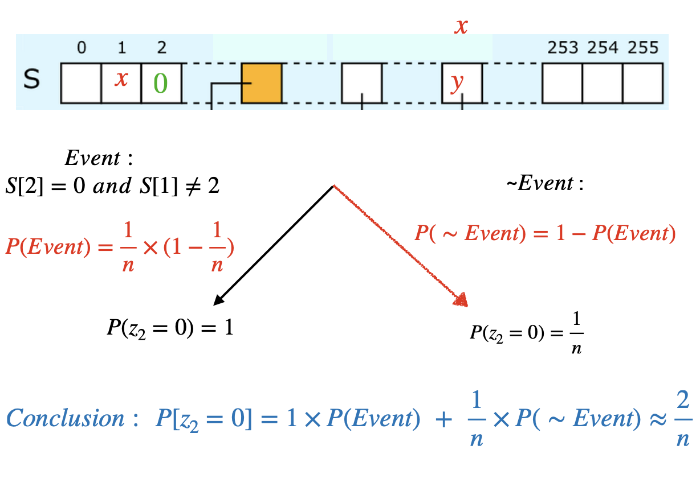

Slide 9
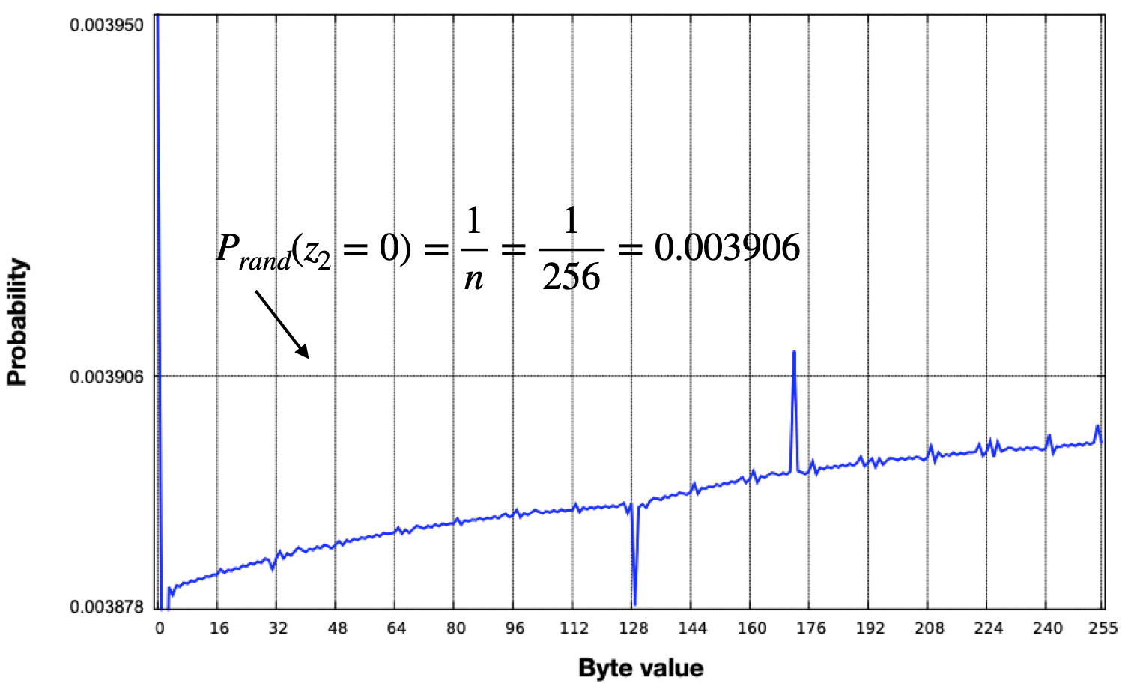
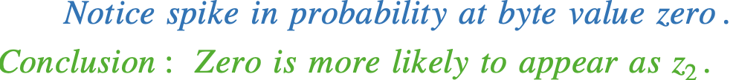
Image: AlFardan et.al (2013)

Slide 10
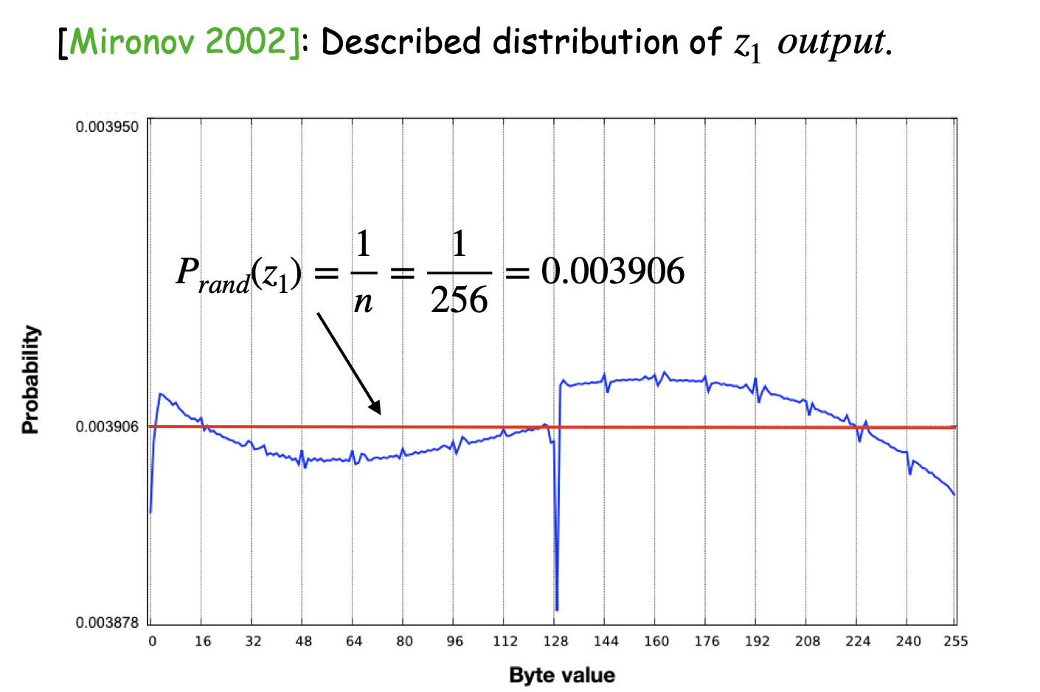
Image: AlFardan et.al (2013)

Slide 11
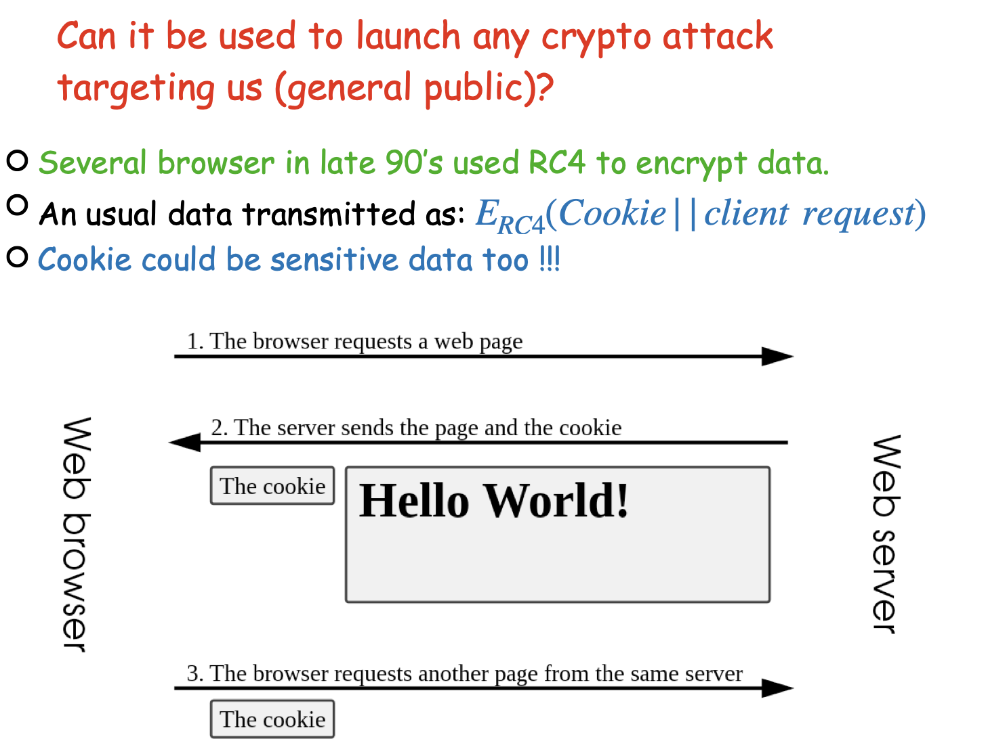
Image: WIkipedia HTTP cookies

Slide 12

Image Credit: www.isg.rhul.ac.uk/tls/

Slide 13
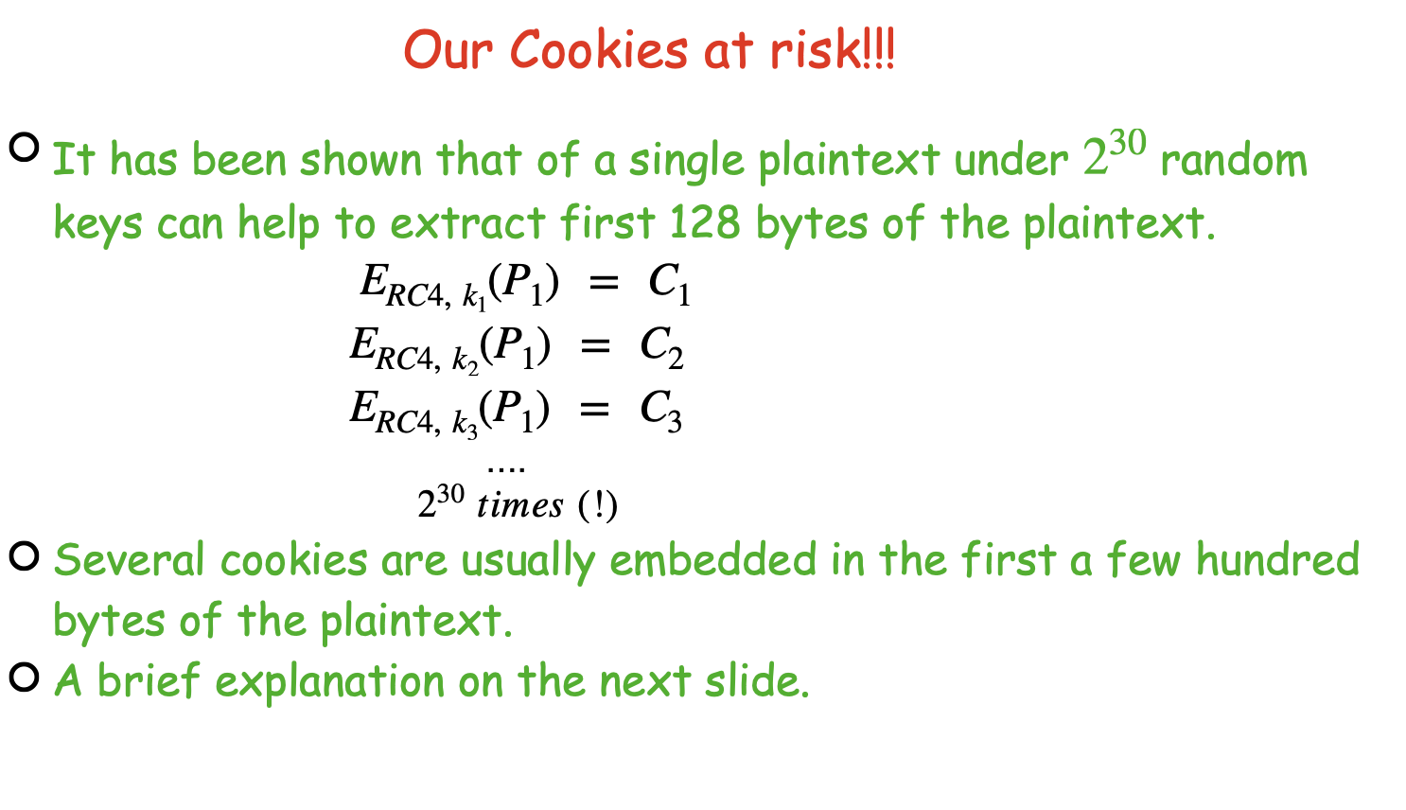

Slide 14
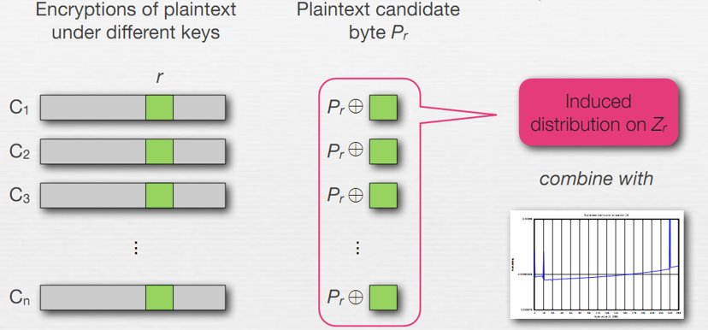
Image: AlFardan et.al (2013)

Slide 15

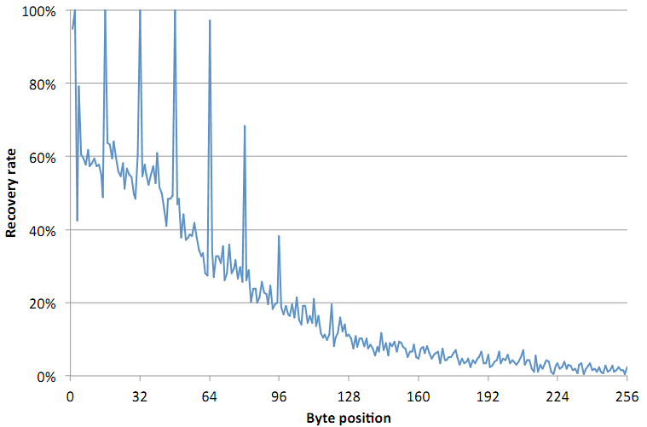
Image Credit: www.isg.rhul.ac.uk/tls/

Slide 16

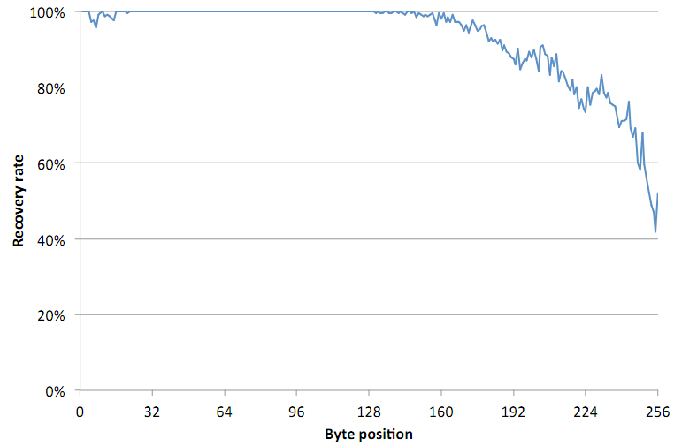
Image Credit: www.isg.rhul.ac.uk/tls/

Slide 17
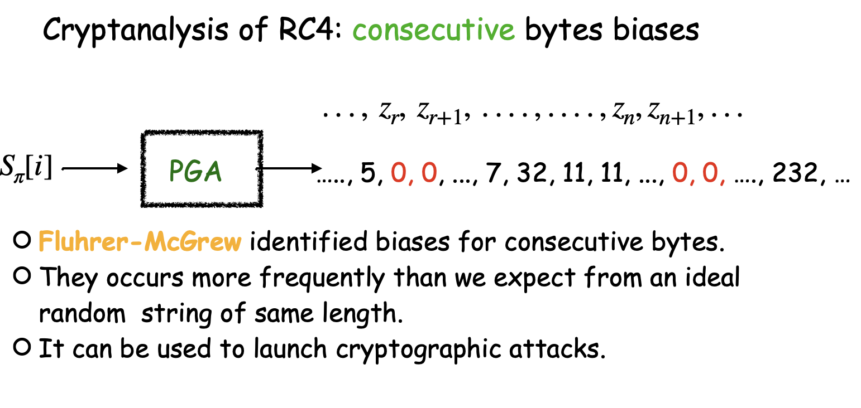

Slide 18
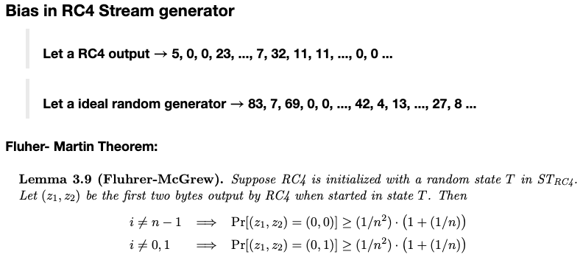

Result: Boneh & Shoup

Slide 19
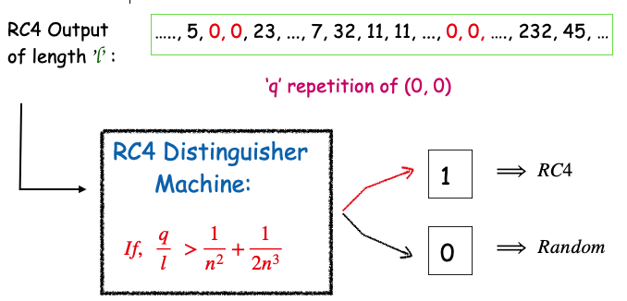

Slide 20
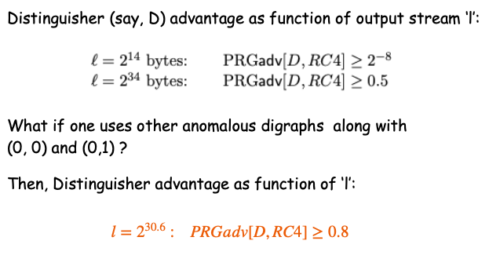
Result: Boneh & Shoup

Slide 21
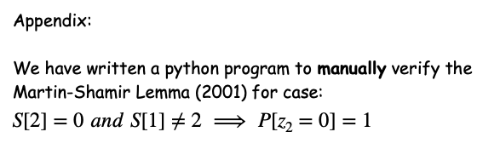
https://colab.research.google.com/drive/1cEblhoQ9gVXtGIqXSgHfACx9Rqb9ruqL?usp=sharing
Thank You

