Slide 1
Convolution
Team 9
113062573 余侞璇
112078502 楊婷婷

Slide 2
Outline
Problem formulation
Implementation
Expirement
Future work

Slide 3
Outline
Problem formulation
Implementation
Expirement
Future work

Slide 4
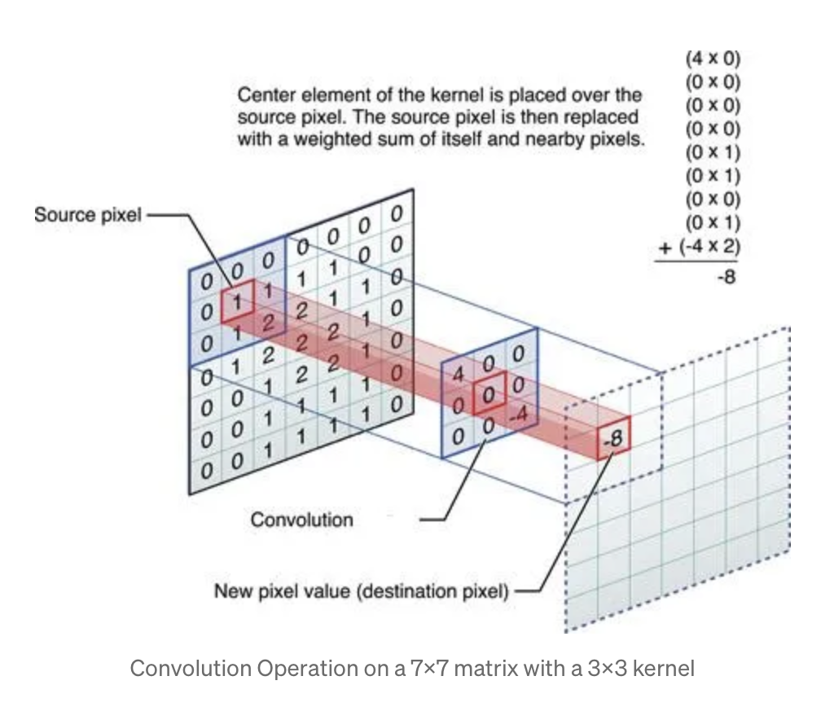
Convolution and Applications
Convolution is a fundamental operation in image processing, deep learning or signal processing etc. It involves the element-wise multiplication of two functions, one typically being a signal or image, and the other a kernel or filter. This operation captures local relationships and patterns, making it a powerful tool for feature extraction, system analysis.

Slide 5
Outline
Problem formulation
Implementation
sequential with vectorization
OpenMP
Pthread
MPI
Hiybrid
single-GPU (regular version: global v.s shared)
Expirement
Future work

Slide 6
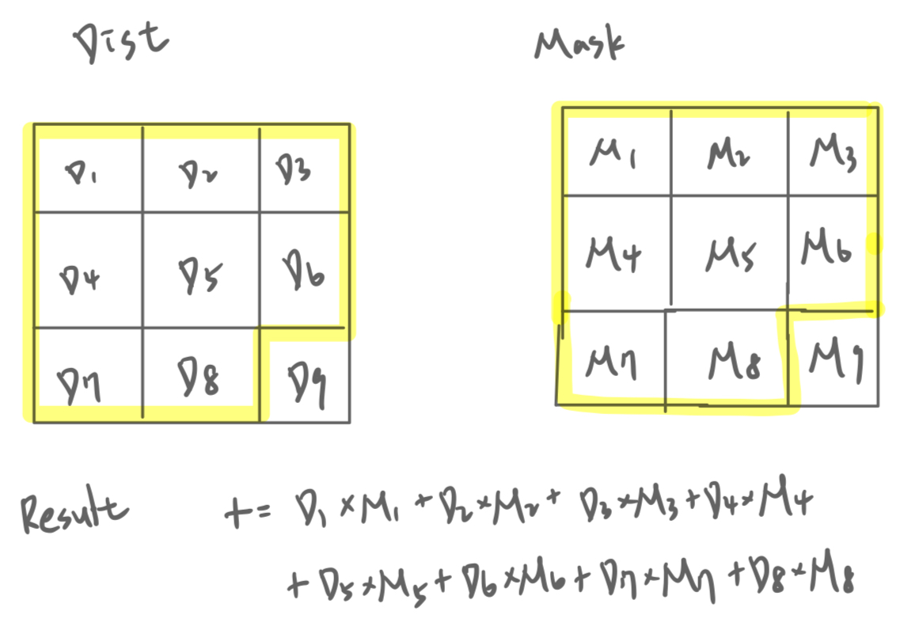
Implementation - Vectorization
version 1
256 bits-registers in AVX
256 / 32 = 8, 8 floats can be computed simultaneously
version 2
Same as verion 1, but using two __m256 registers
16 floats can be computed simultaneously
Notes:
convolution 內的sum累加，是用256 bit avx register
使用SIMD（Single Instruction, Multiple Data）並行處理，一條指令處理多個數據，達到加速
一次性從內存中加載多個數據（如 _mm256_load_ps），減少了內存訪問的頻率，從而提高了內存帶寬的利用效率。

Slide 7
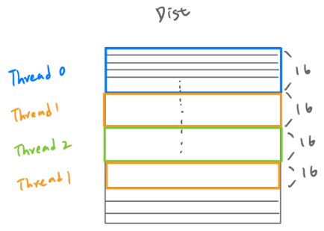
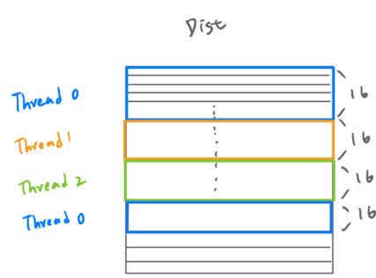
Implementation - OpenMP
Dynamic Scheduling
#pragma omp parallel for schedule(dynamic, 16)
height partitioning
Static Scheduling
#pragma omp parallel for schedule(static, 16)
height partitioning
Notes:
dnamic是看哪個thread先做完就可以要下一個工作
static則是一開始就安排好每個thread要做的工作是哪些

Slide 8
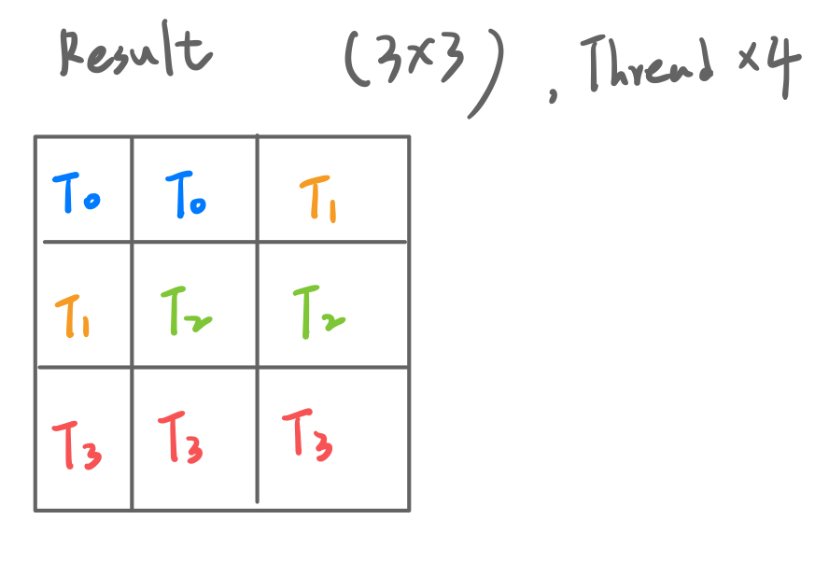
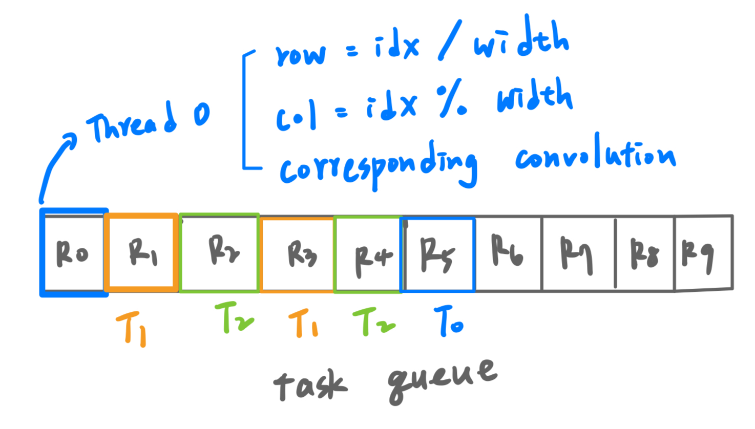
Implementation - Pthread
Static Scheduling
divides the total number of elements in the output matrix equally among threads, with each thread handling a contiguous range of elements based on its thread ID
Dynamic Scheduling
master thread
task_queue : store #(result matrix size) tasks and one termination signal (-1) at the end
mutex lock
Notes:
task partition的方式，根據input image與kernel做convolution得到的result matrix的 大小，比如右上角是3*3，現在有四個thread，平均把3*3=9個element分給每個thread，做對應的convolution
dynamic有master thread創建task queue, 裡面存剛才result matrix的9個element, 最後一個存-1當作termination signal
每個thread從queue裡面pop出一個element index，算出對應到input image的row跟col, 執行corresponding 的convolution
mutex lock管理task queue, 避免race condition
task_queue : A task queue is created to store the indices of the tasks that need to be processed (e.g., each task might correspond to computing a convolution for a specific element in the result matrix)

Slide 9
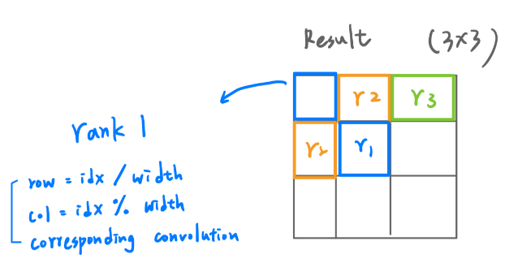

Implementation - MPI
master process : rank 0
send -1 to work process if all tasks are done
Ex : 4 process, input = 5*5, kernel = 3*3, result = 3*3
How the master process collects result data ?
Notes:
Rank 0管理work pool
Task partition與pthread一樣，每個work process可以分配到一個result matrix的element，進行對應的convolution 運算
收到-1代表所有task 做完
Rank0 collect data的方式，透過receive work process回傳的idx跟result，存回output matrix

Slide 10
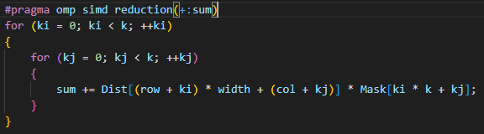
Implementation - Hybrid
Task partition and process communication same as MPI
Convolution of each work process use :

Slide 11
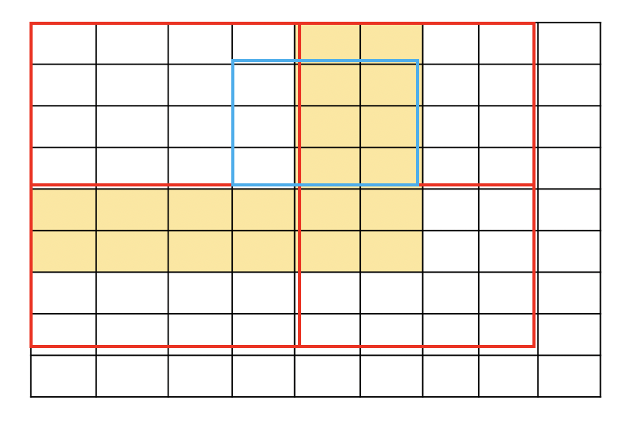
CUDA - Regular Convolution
Global Memory: all compute fetches from global, no boundary issue
Share Memory :
need apron to load additional data to the thread block
e.g when threadblock = 4*4 , kernel = 3*3 at block (0,0) need the data from the other threadblocks → need additional data in share mem

Slide 12
Outline
Problem formulation
Implementation
Expirement
Future work

Slide 13
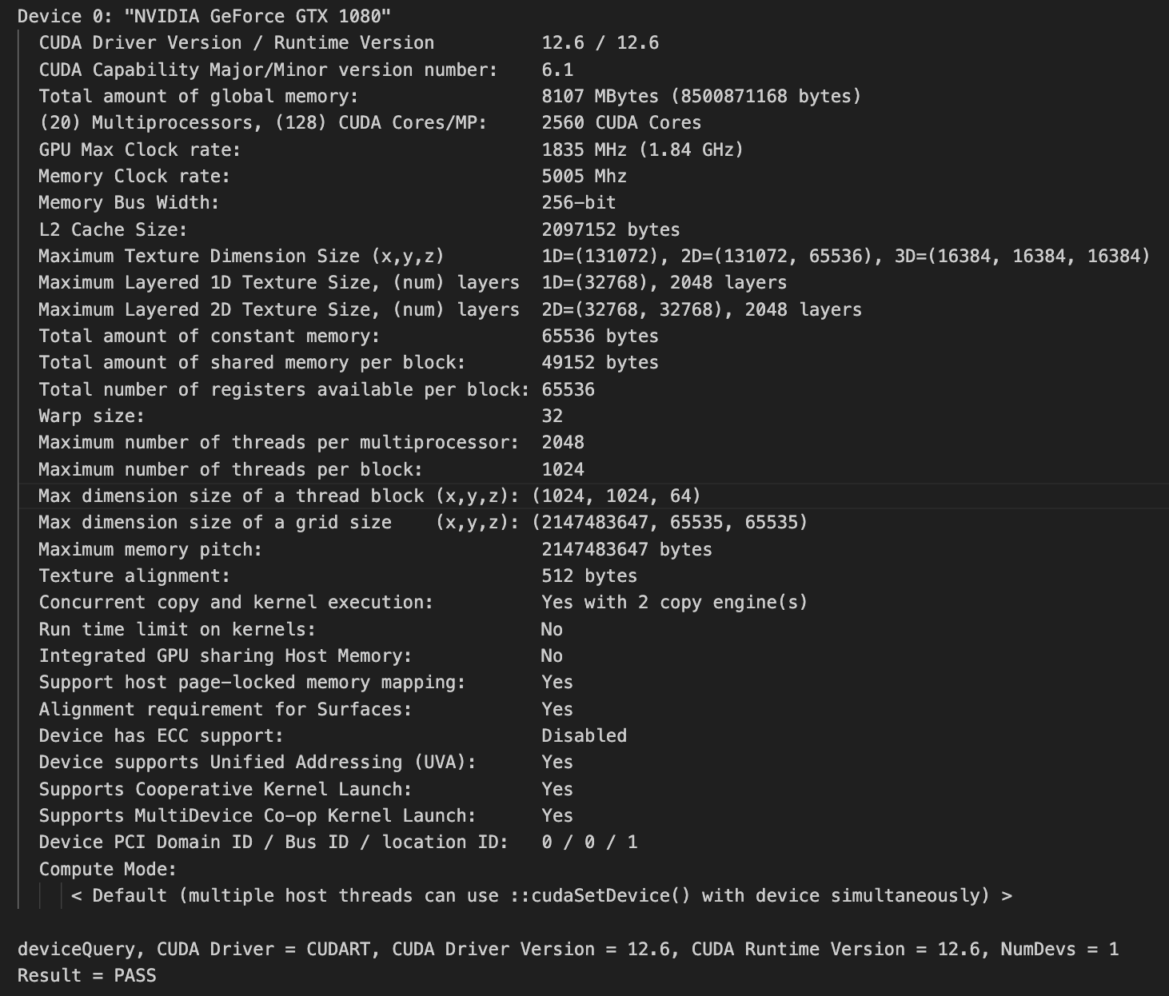
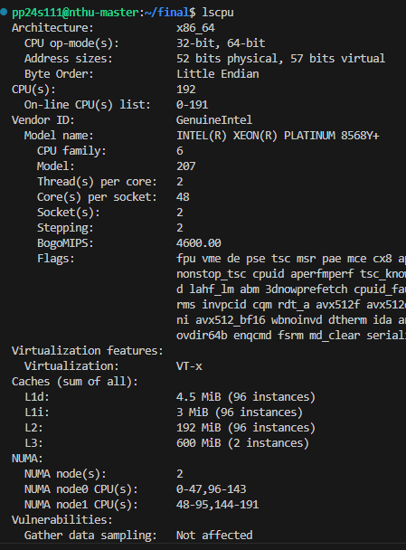
Experiment - Set up
Environment of CPU
Environment of GPU
Notes:
cpu與gpu環境，都是使用課堂的server

Slide 14
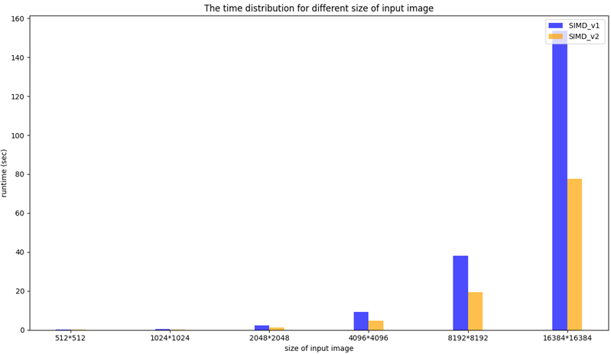
Experiment - Vectorization
Sequential version with SIMD-v1 vs SIMD-v2
kernel size : 96*96
Notes:
比較兩種vectorization在不同input image 的執行時間差異，version 2時間快了一倍，可能是因為多開了一條register，可以減少cache miss
Improved Cache Efficiency
By processing 16 elements at a time, the code accesses memory in larger, more contiguous chunks. This better aligns with the CPU's cache line size (typically 64 bytes), reducing cache misses compared to processing only 8 elements per iteration.

Slide 15
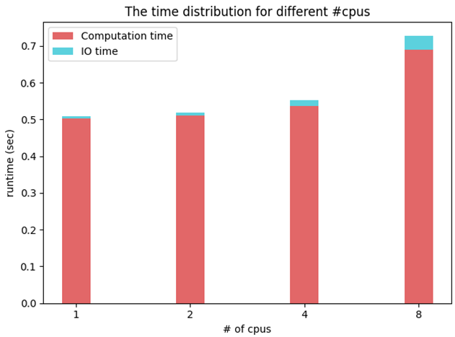
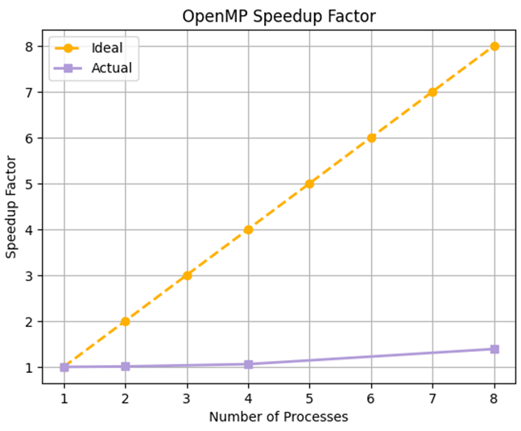
Experiment - OpenMP
static scheduling with SIMD-v1
testcase : input size = 1024*1024, kernel size = 96*96
Notes:
比較static shechuding 搭配 version 1的vectorization在不同cpu數量下的執行時間
speedup factor 差
runtime沒有隨著cpu數量增多而下降，可能因為ˋload 沒有良好balancing
改善方法也許 task partition改成採用分block的方式

Slide 16
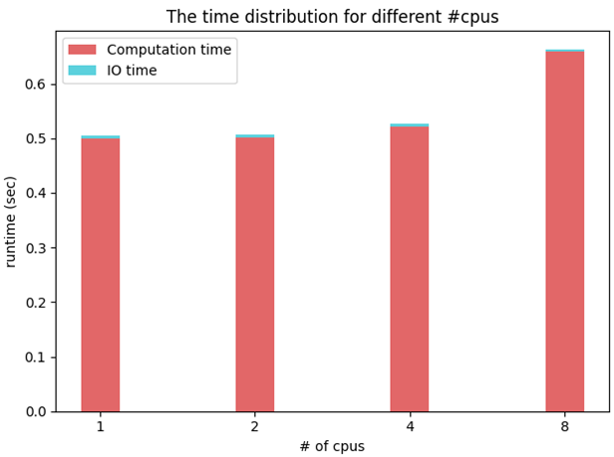

Experiment - Pthread
static scheduling with SIMD-v1
testcase : input size = 1024*1024, kernel size = 96*96
Notes:
一樣比較static shechuding 搭配 version 1的vectorization在不同cpu數量下的執行時間
speedup factor 差
runtime也沒有隨著cpu數量增多而下降
load unbalancing
每個 thread (可能還有synchronization overhead的問題，要join)要輪流 access critical section 去 request 工作，造成了一些 overhead

Slide 17
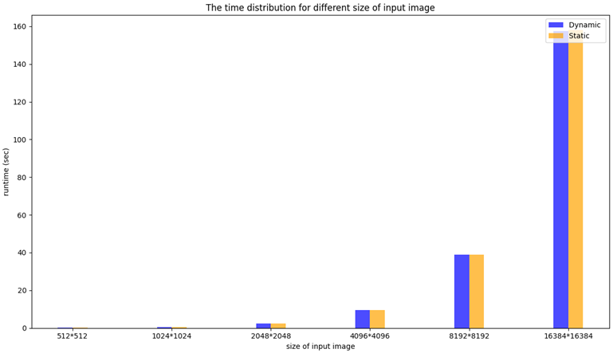
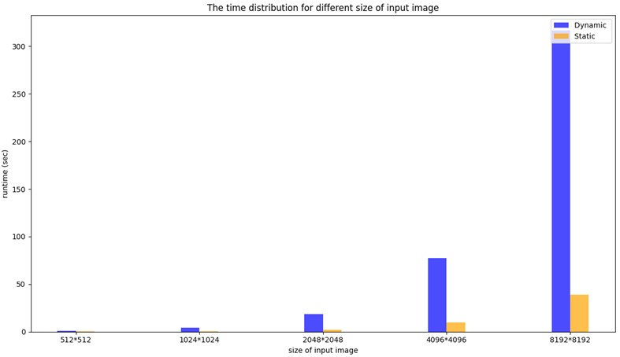
Experiment - OpenMP & Pthread
Scheduling method : dynamic , static
kernel size = 96*96, 4 cores
OpenMP
Pthread
Notes:
比較Openmp與pthread在不同Input image size下，dynamic與static scehduling執行時間差異
dynamic Pthread version 有mutex lock管理task queue, 可能會有overhead

Slide 18
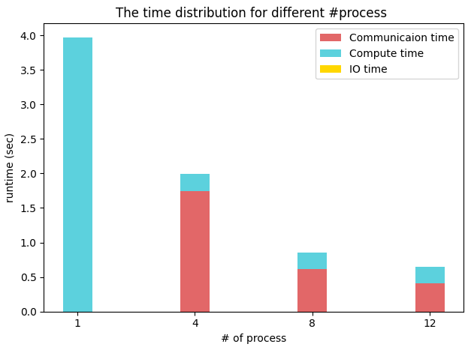
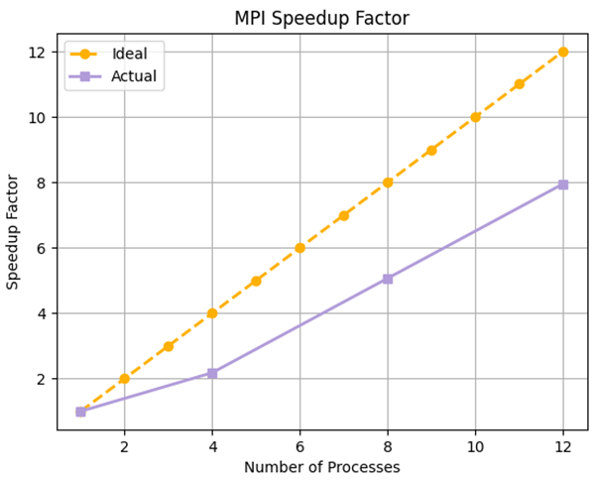
Experiment - MPI
4 nodes
testcase : input size = 1024*1024, kernel size = 96*96
Notes:
比較4 node在不同process數量下的執行時間
speed up factor有線性成長
computation time 沒有隨著process變多而降低，load不夠balancing。
communication算是主要的bottleneck，可能是因為隨著process變多，rank 0就要跟更多的process溝通
改善方法也許使用non-blocking的send receive
因為使用 MPI_Send + MPI_Recv 需要彼此互相等待。可能改成non-blocking 作法

Slide 19
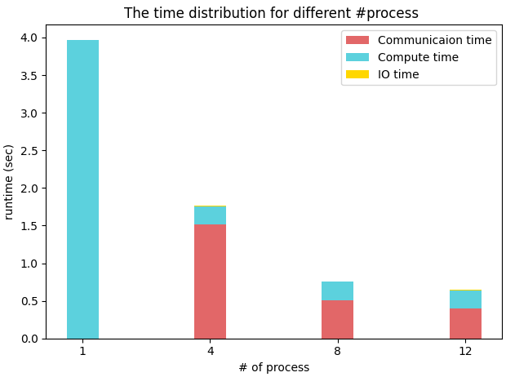
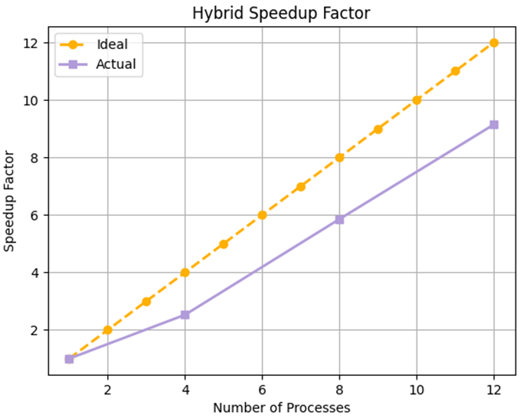
Experiment - Hybrid
4 nodes
testcase : input size = 1024*1024, kernel size = 96*96
Notes:
比較4 node在不同數量process下的執行時間
speedup factor也是線性增長
但遇到跟mpi一樣的問題，有communication overhead

Slide 20
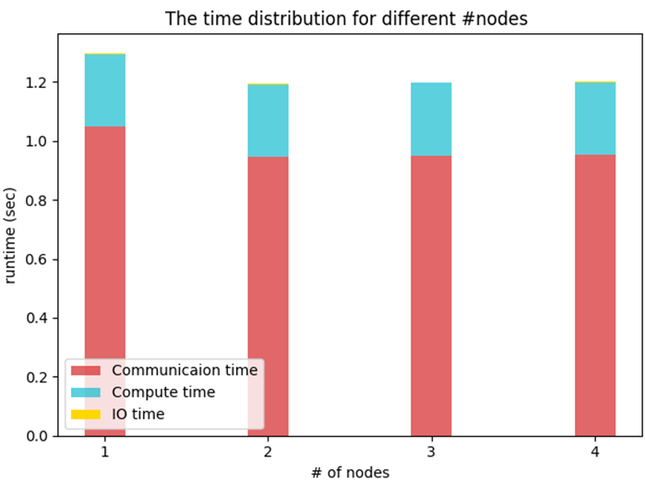
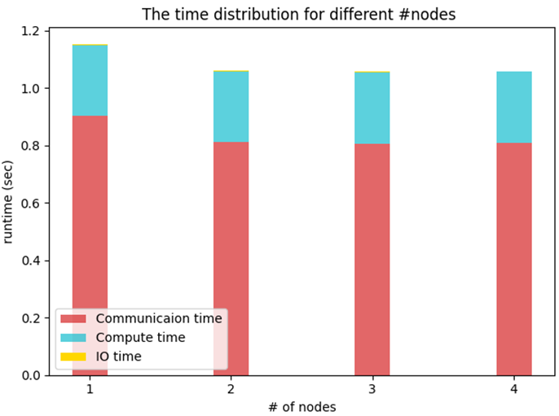
Experiment - MPI & Hybrid
Comparison of different #nodes
testcase : input size = 1024*1024, kernel size = 96*96, ppn = 6
MPI
Hybrid
Notes:
比較MPI跟Hybrid在不同node數量下的執行時間
node變多，跨node的溝通增加的communication time 也沒有'讓整體溝通時間明顯增長。故communication overhead主因，主要還是來自rank0頻繁的分配task、與其他process溝通造成
master負擔過重：如果主進程負責分配工作並收集結果，主進程的負擔可能會變得非常重，特別是在進程數量增多時。主進程與工作進程之間的頻繁通信可能會成為瓶頸

Slide 21
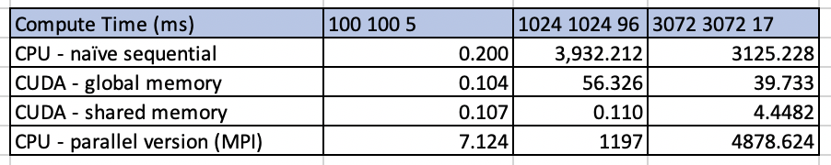
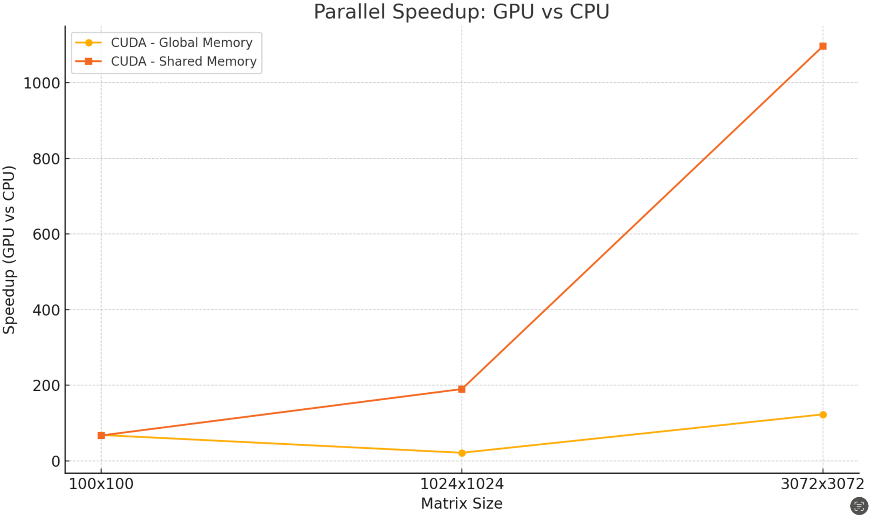
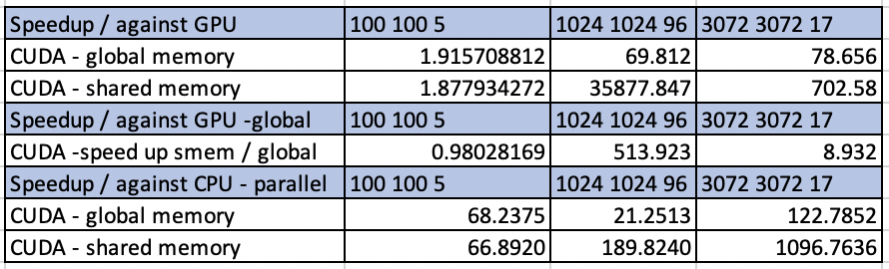
Experiment - Speedup GPU v.s sequential CPU

Slide 22
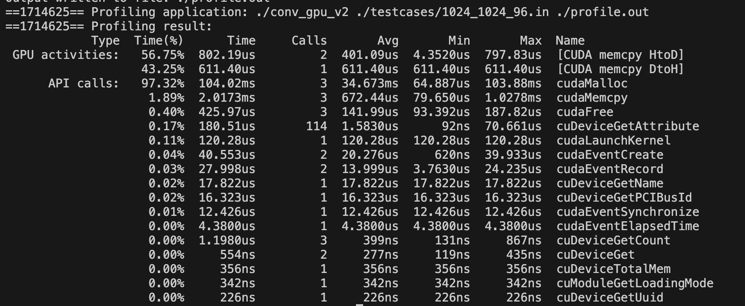
GPU Analysis
CGMA ratio
align shared memory

Slide 23
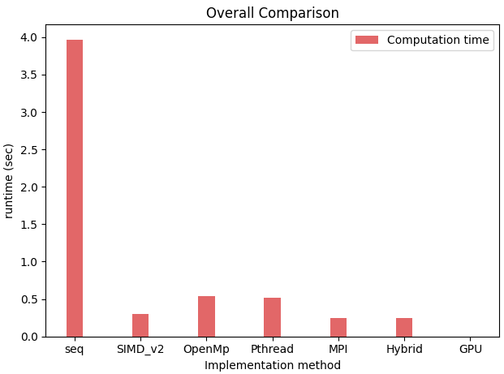
Experiment - Overall Comparison
testcases : input size = 1024*1024, kernel size = 96*96
Only consider the computing time and communication time
Sequential
SIMD_v2
OpenMP + SIMD_v1 + 4 cores
Pthread + SIMD_v1 + 4 cores
MPI + 4 nodes + (ppn=12)
Hybrid + 4 nodes + (ppn=12)
GPU ( shared memory)
Notes:
gpu pros : more computing resources ； cons : long Host to Device memory time

Slide 24
Outline
Problem formulation
Implementation
Expirement
Future work

Slide 25
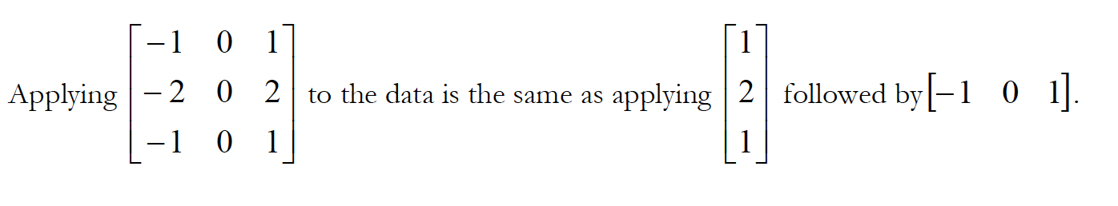
Future work: Separatable Convolution
Devide into two one dimensional filter (row convolution -> col convolution)
Constraint: kernel matrix must be rank-1 → so can be written as two rank-1 kernel matrix outer product
Application example of kernel matrix are rank-1 : Gaussian Blur, Sobel Edge detect (lab practice)
https://github.com/NVIDIA/cuda-samples/tree/master/Samples/2_Concepts_and_Techniques/convolutionSeparable

Slide 26
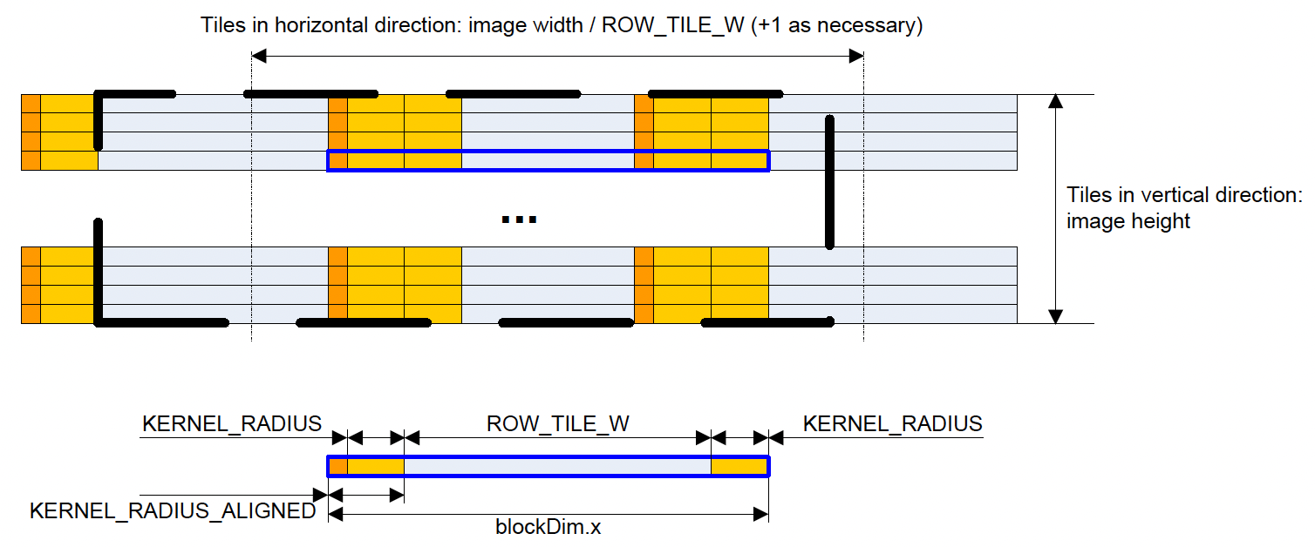


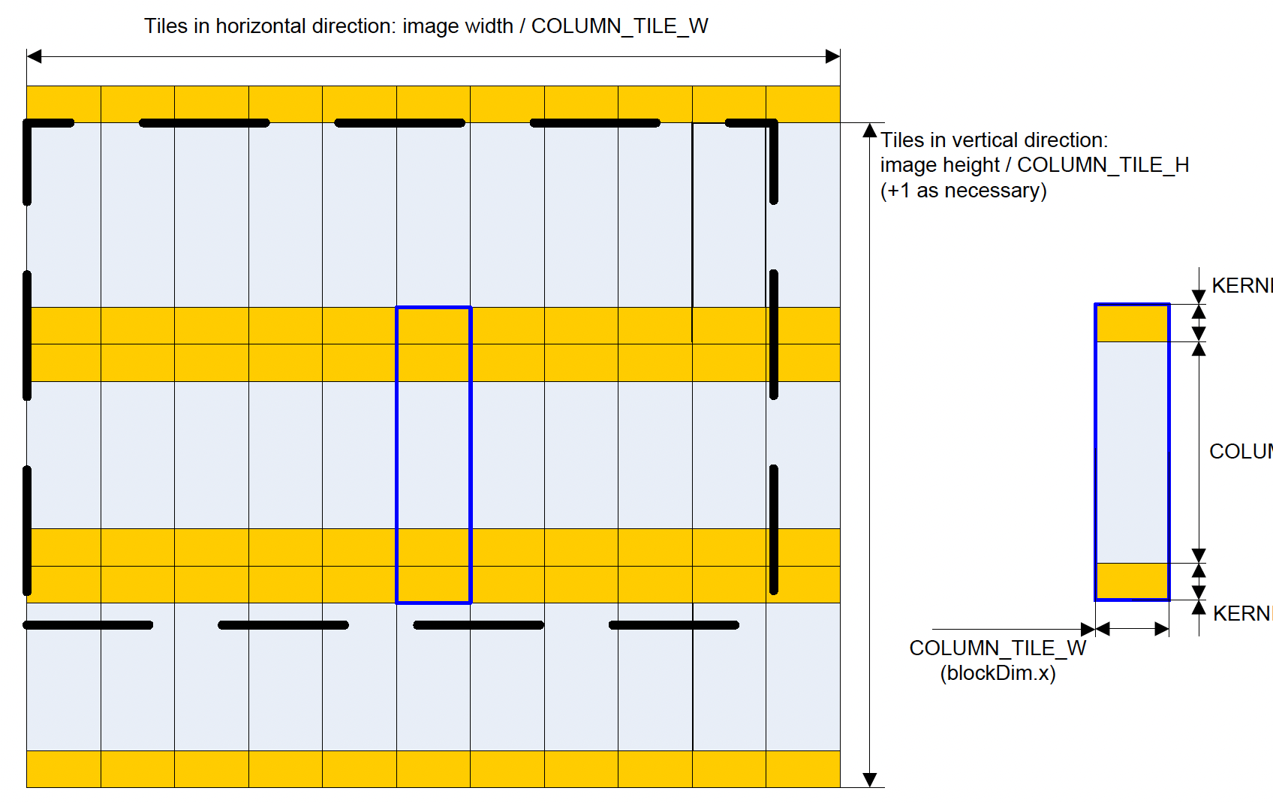


How it works and Application
Good for big kernel size
Time complexity:
—->
save share memory usage, store k, instead of k*k in each pass (can process the real data)
Better scalability
direct: growth quadratic
seperatable: growth lineary

Slide 27
Thanks

