Slide 1
資料科學
final project
Team02
張家瑜, 108356015 謝嘉倫,108354024
黃俊鈞, 108971005 林晉毅, 107207426

Slide 2
目標
Hospital Readmissions prediction
目標：預測病人是否再次住院
背景：A hospital readmission is an episode when a patient who had been discharged from a hospital is admitted again within a specified time interval. Readmission rates have increasingly been used as an outcome measure in health services research and as a quality benchmark for health systems. Generally, higher readmission rate indicates ineffectiveness of treatment during past hospitalizations.

Slide 3
資料集介紹
Data Source
SOCIETY OF ACTUARIES:Predictive Analytics Exam
Input format
66782 observations and 8 features

Slide 4
資料集介紹
Variables | Description
Readmission.Status | 分類目標，指調查的時間週期內，病人再入院的情況，1 是再入院，0 則否
Gender | 性別，F 為女性，M 為男性
Race | 種族: Black(非裔), Hispanic(西裔或拉美), Others, White(白人)
ER | 住院期間出入急診室次數
DRG.CIass | 診療分類：MED (門診)、SURG(手術)，UNGROUP(其他類)

Slide 5
資料集介紹
Variables | Description
LOS | 住院天數
Age | 病患年齡，需注意的是病患會有醫療保險的議題
HCC.Riskscore | Hierarchical Condition Category risk score. 聯邦分層分類風險指標，根據病患的能力與預期，評估病患付費的風險情況，指數越高則風險越大
DRG.Complication | 併發症，病患前次治療(或手術) 過程中，是否有併發症產生，NoC 代表沒有

Slide 6
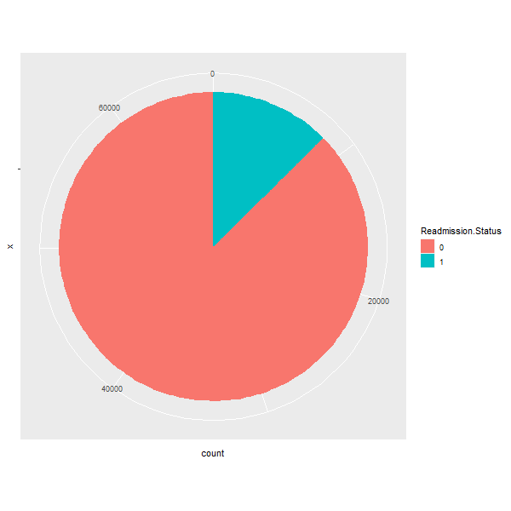
資料集介紹

Slide 7
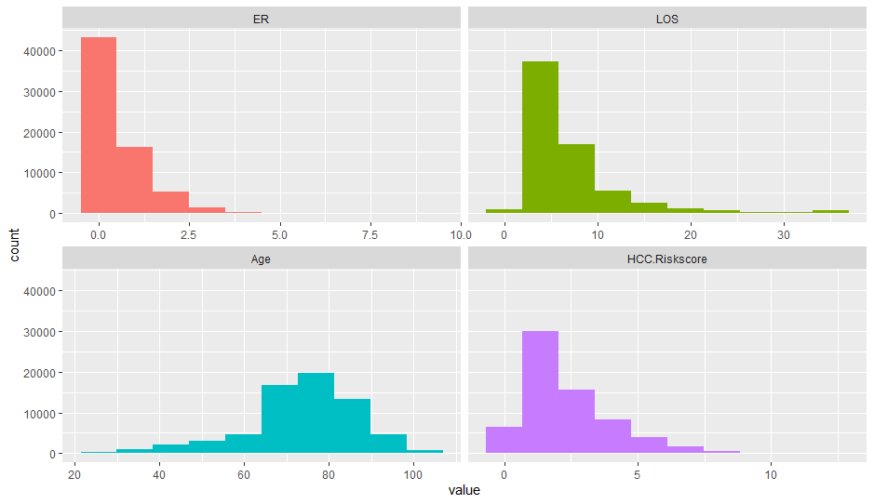
特徵介紹

Slide 8
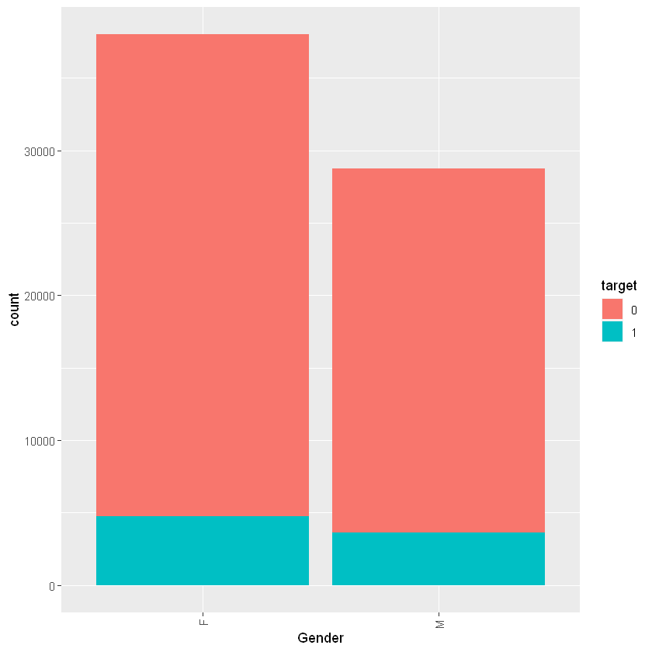
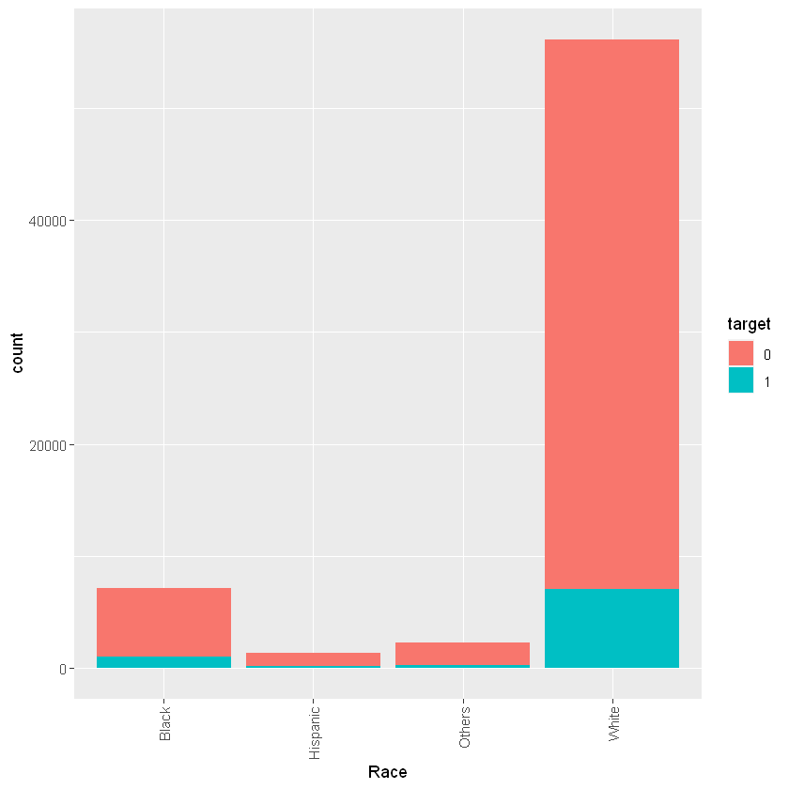
特徵介紹

Slide 9
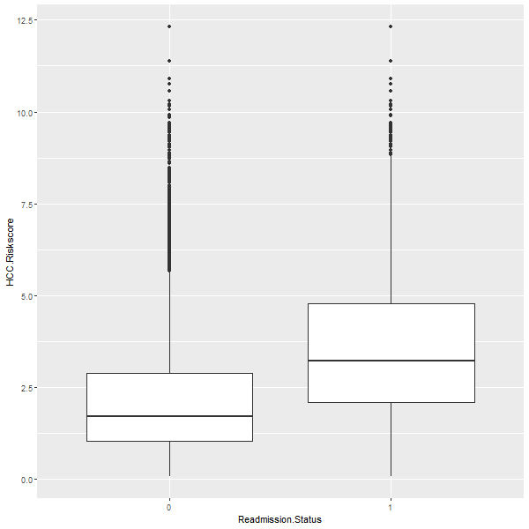
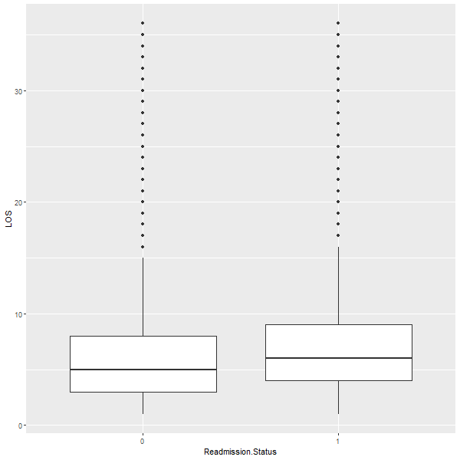
特徵介紹
Risk.score
LOS

Slide 10
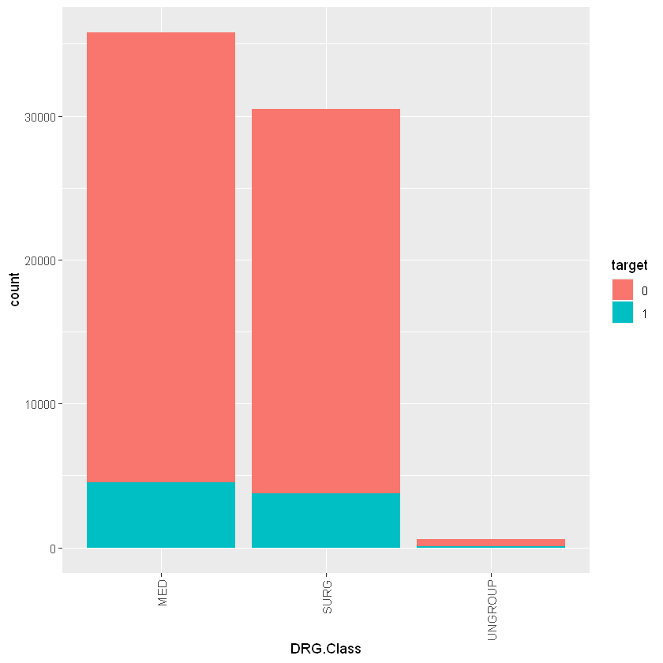
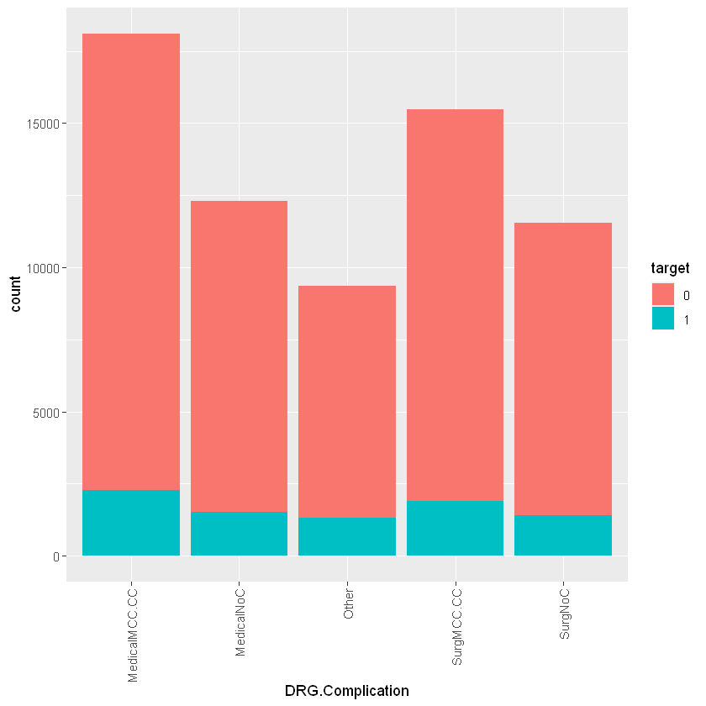
特徵介紹

Slide 11
資料前處理
One-hot encoding
DRG.Class
MED
SURG
Ungroup
MED | SURG | Ungroup
1 | 0 | 0
0 | 1 | 0
0 | 0 | 1

Slide 12
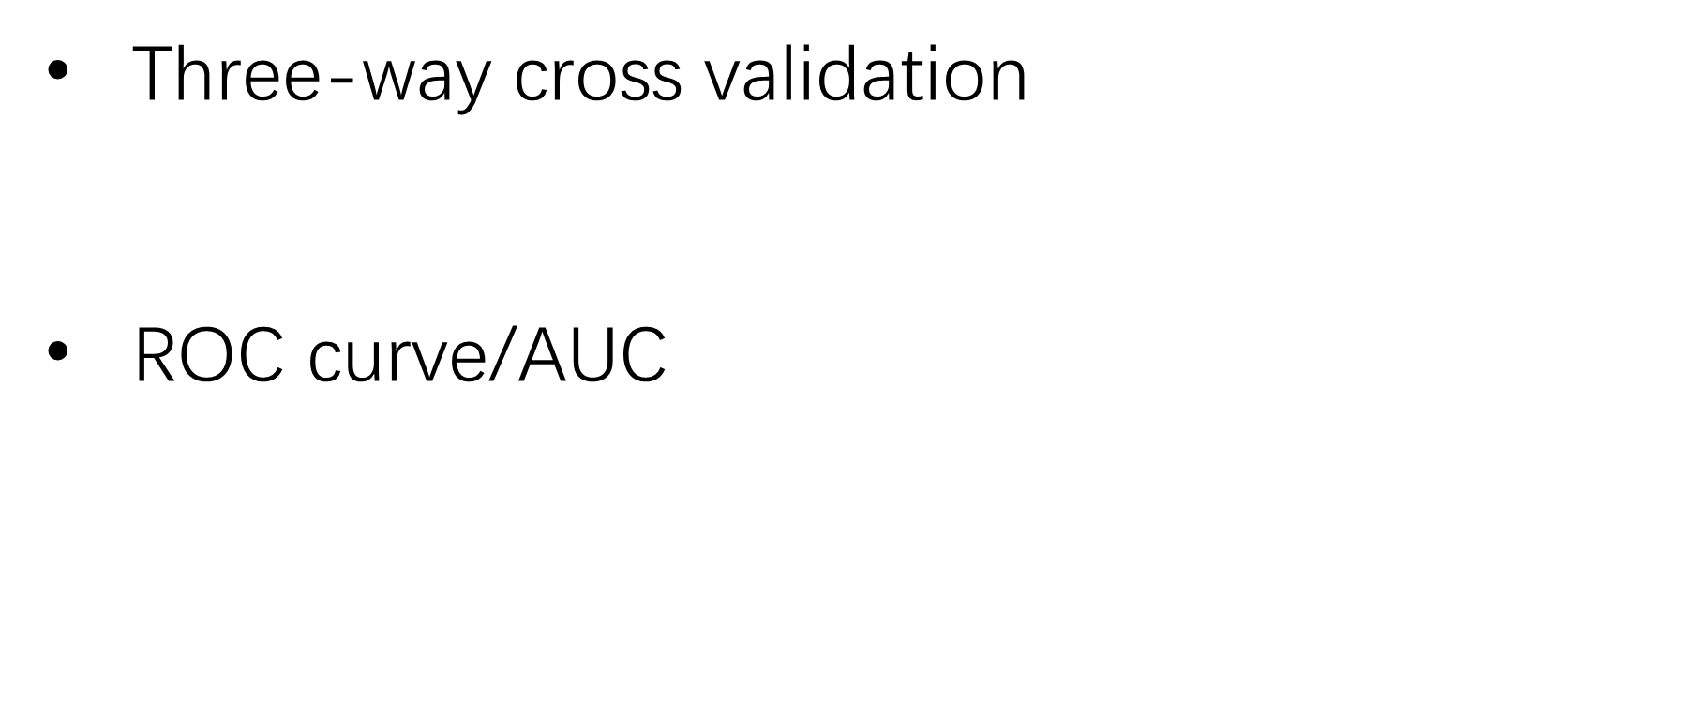
模型評估

Slide 13
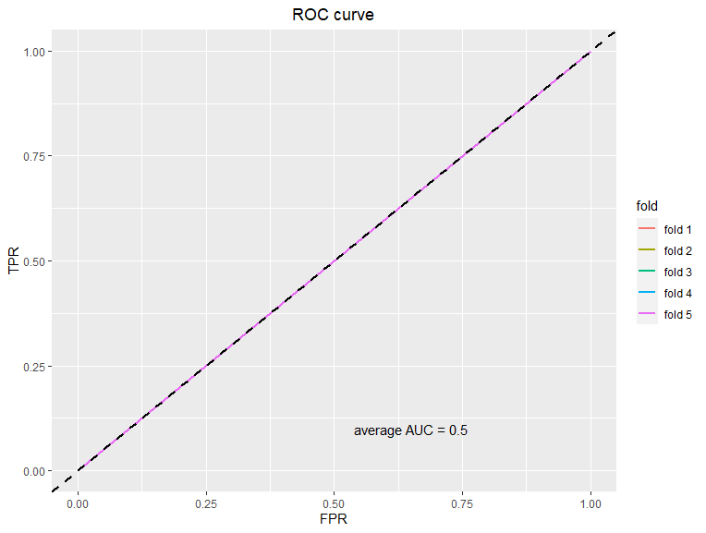
Null Model
Predictions set to a constant
percentage of the positive observations
AUC = 0.5

Slide 14
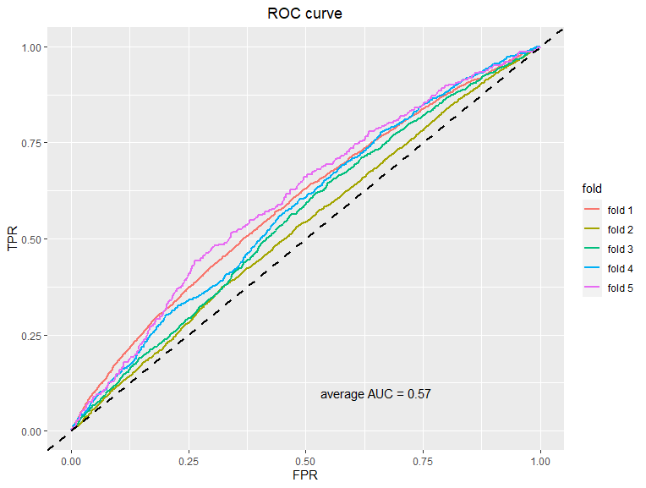
Baseline
Logistic Regression
no feature engineering
trained with all features
AUC = 0.57

Slide 15
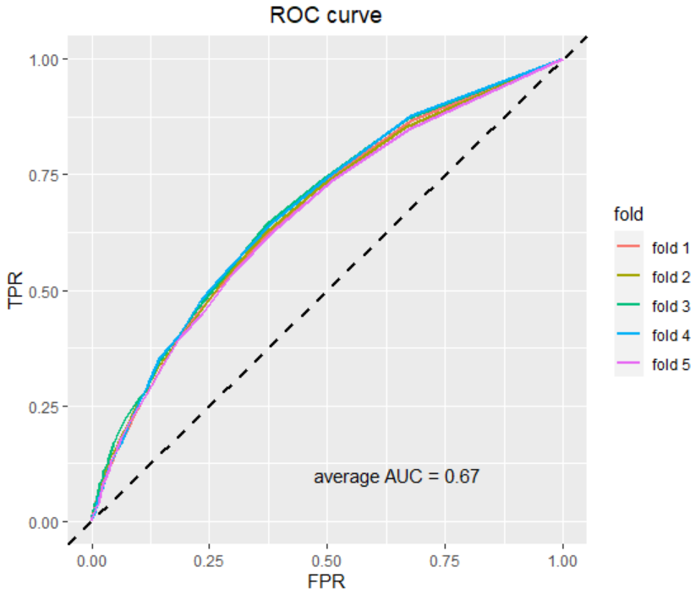
random forest
no feature engineering
trained with all features
AUC = 0.67

Slide 16
XGboost
Tree Ensemble
基於多個決策樹的集成學習
additive training
每次訓練的模型基於前次訓練的模型疊加優化
regularization
帶有懲罰項機制避免過度擬合

Slide 17
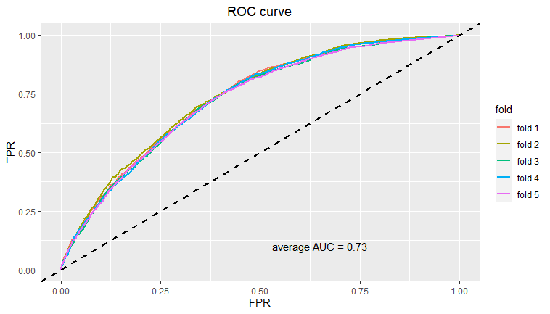
AUC = 0.73
no feature engineering
trained with all features

Slide 18
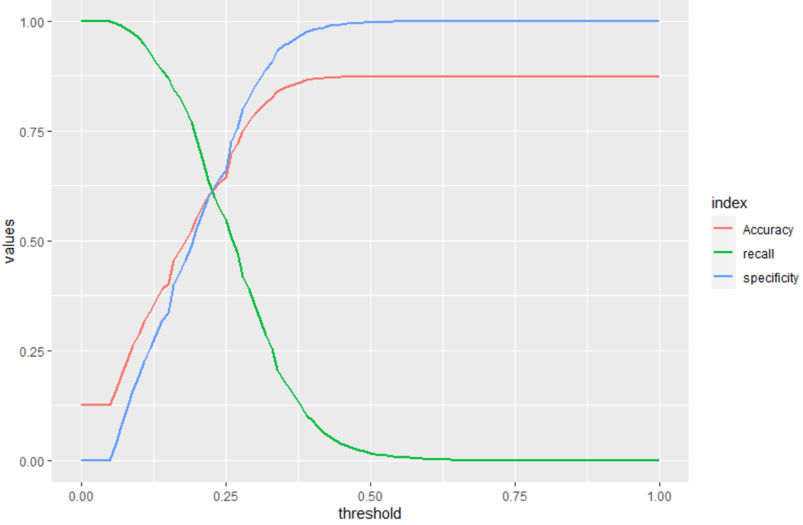
xgboost threshold

Slide 19
討論-模型比較

Slide 20
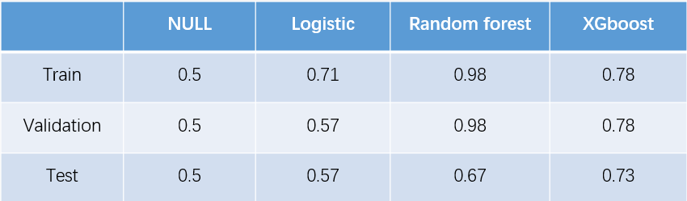
四種模型的5 folds平均AUC
相較於random forest，XGboot更好地避免overfitting

Slide 21
討論-影響再次住院的因素

Slide 22
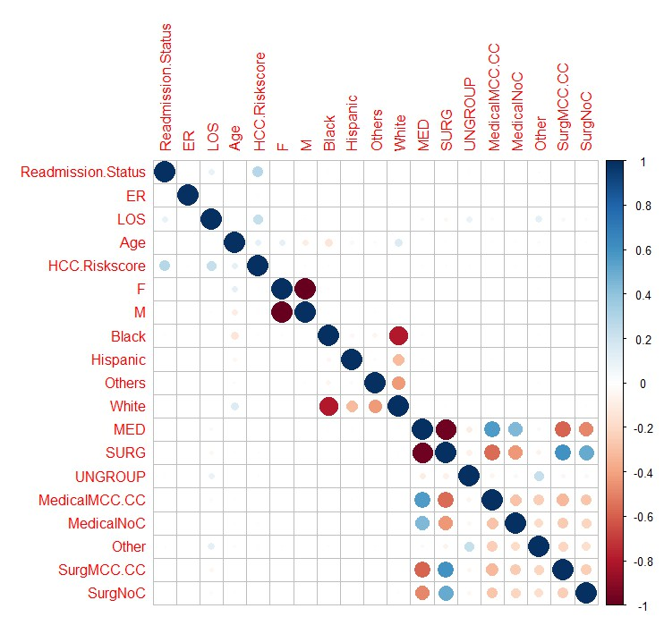

Slide 23
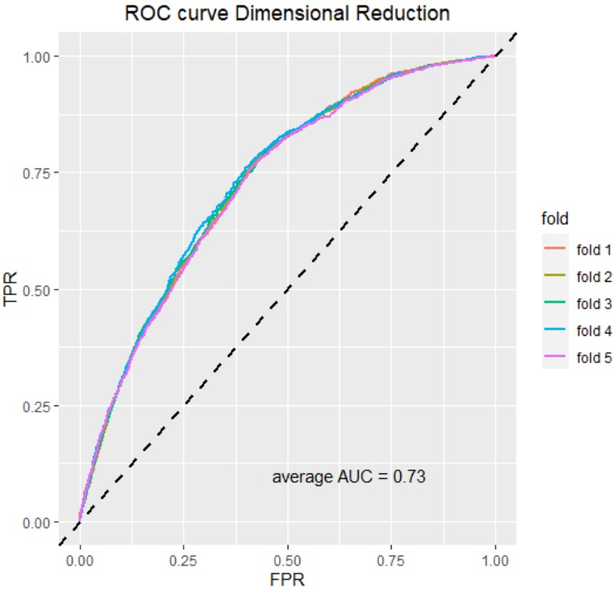
XGboost 維度縮減
僅保留
HCC.Riskscore
LOS
AUC = 0.73
未因刪除特徵損失資訊影響模型預測能力

Slide 24
The End
Thank You

