Slide 1
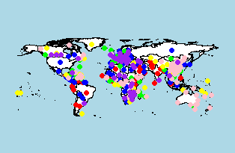
1091 Data Science - Group 9
Clustering Countries By Their COVID-19 Time Series
AND
Plotting Covid-19 Time series
Choi Pui Shan 蔡佩珊(109753158)
Armando 王神鐸(107753048)

Slide 2
Table Of Contents
Motivations
Goals
Introduction of Time Series Clustering
Importing Data
Preprocessing
Time Series Clustering for Confirmed Cases
Time Series Clustering for Death Cases
Time Series Clustering for Recovered Cases
Plotting Covid-19 Data
References

Slide 3
Motivations
COVID-19 spread around the world
Want to know if there are similar patterns between the time series of different countries
But what we learnt from class are not for analyzing time series….
We also do not familiar with neural networks...
WHAT CAN WE DO??

Slide 4
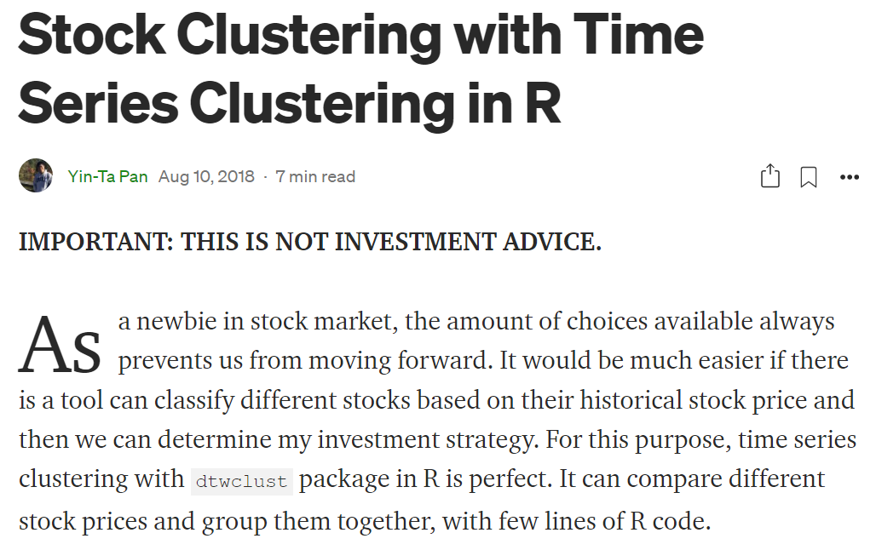
Motivations
A passage talking about how to cluster stocks by their time series in R for investment
=>Inspiration from this passage : Found method to cluster trend of COVID-19 of each state in R

Slide 5
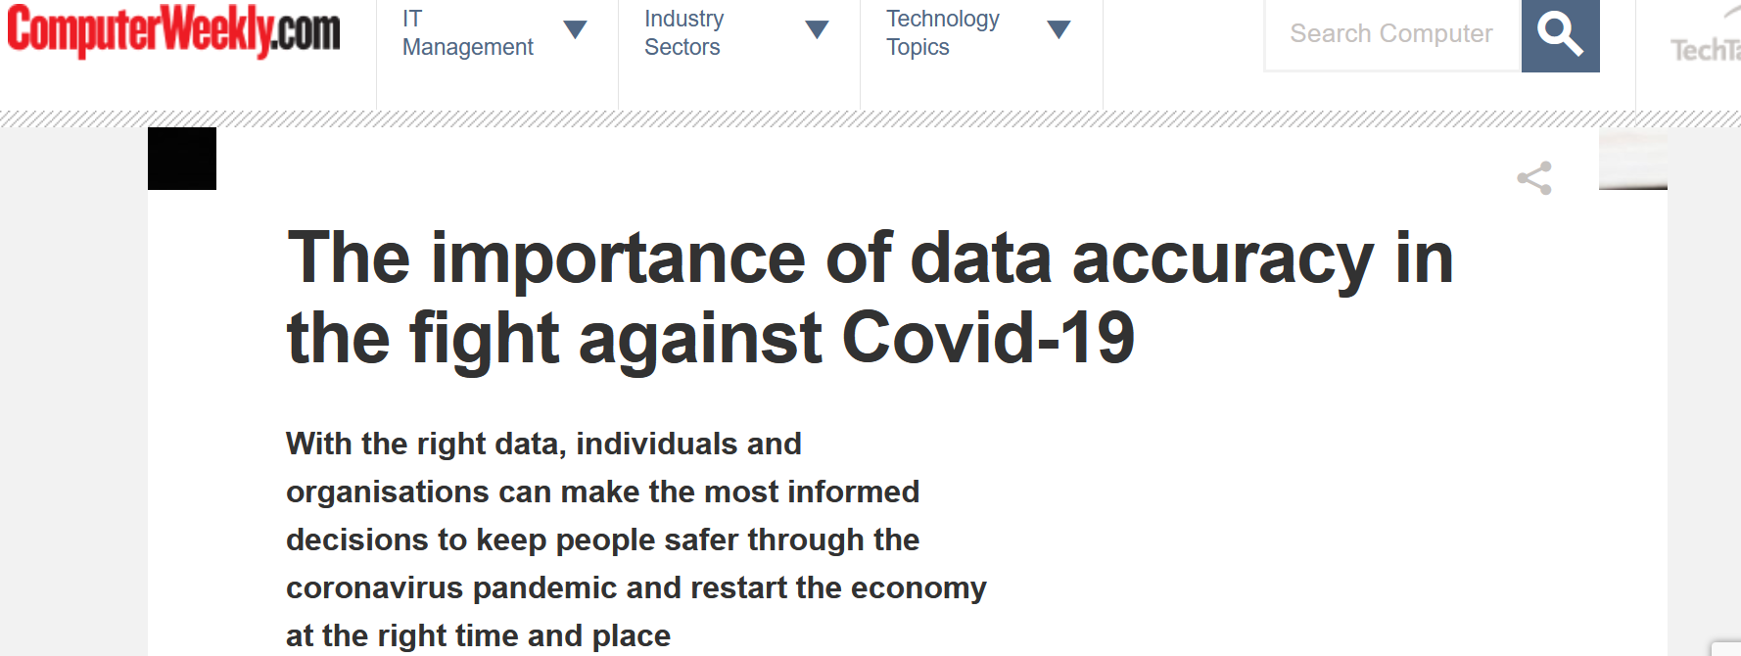
Motivations
“Data visualizations make big and small data easier for the human brain to understand, and visualization also makes it easier to detect patterns, trends, and outliers in groups of data.”
=> We can also make some visualization of the COVID-19 Data!!

Slide 6
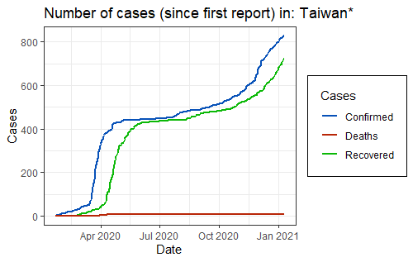
With Covid-19 being such a prevalent and relevant topic in these recent times, we got inspired to understand all the broadly available data by applying the analytical and formatting methods we have learned in this course.
Notes:
此部分為半成品, 原本是想做成Shiny App, 但最後因為組員能力不足, 最後只能手動在R上面改國家名字來產出各個國家的趨勢圖表

Slide 7
2. Goals
Clustering Countries By Their Covid-19 Confirmed/Death/Recovered Time Series
Plotting Covid-19 Data
Ultimate Goal : To Understand Which Countries Have Similar Time Series Of Covid-19 Cases & Their Trends =>Make A Reference When Doing Business

Slide 8
3. Introduction of Time Series Clustering & Required R library

Slide 9
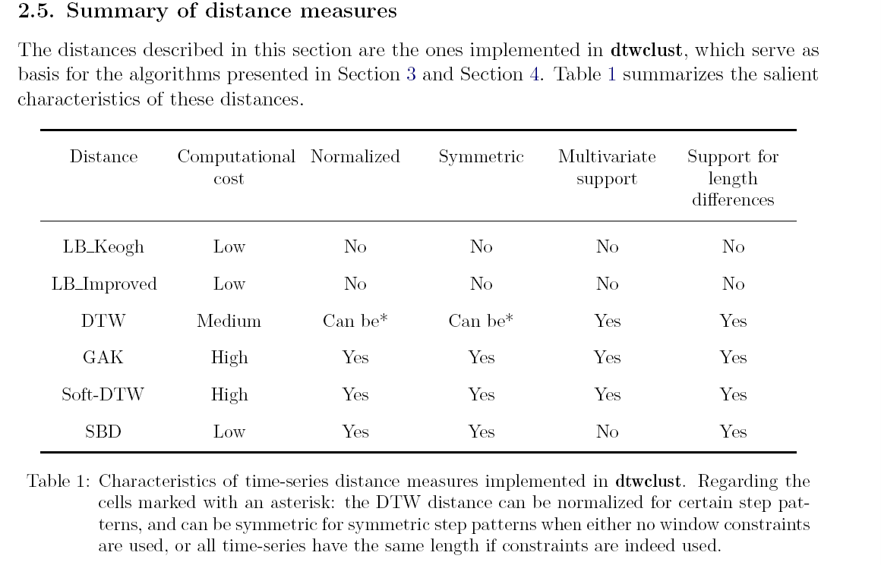
3. Introduction of Time Series Clustering
Clustering: Unsupervised Learning to form groups of object with high similarity, where inter-groups have a high dissimilarity.
Time Series Clustering A type of clustering algorithm made to handle dynamic data -Common Approaches: ->Hierarchical Clustering ->Partitional Clustering ->Fuzzy Clustering -Types: ->Shape-based ->Feature-based ->Model-based
Metrics -Dynamic Time Warping(DTW) distance : Dissimilarity measure

Slide 10

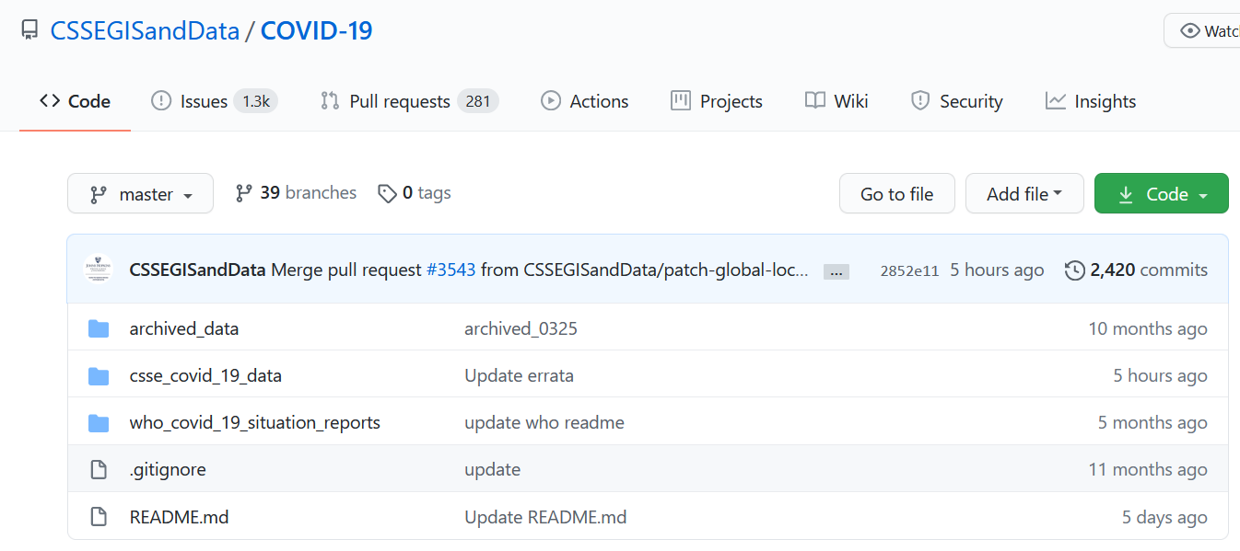
Data Source

Slide 11
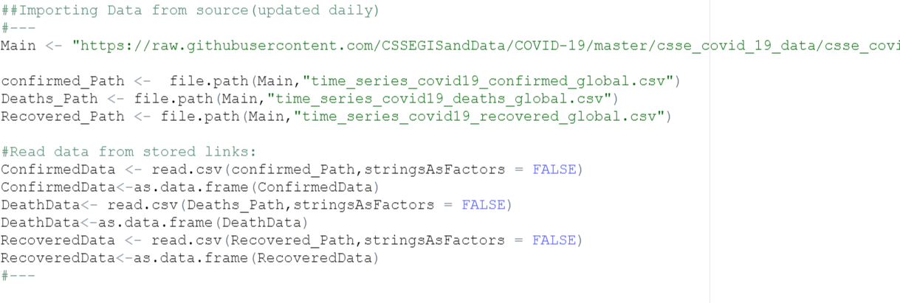
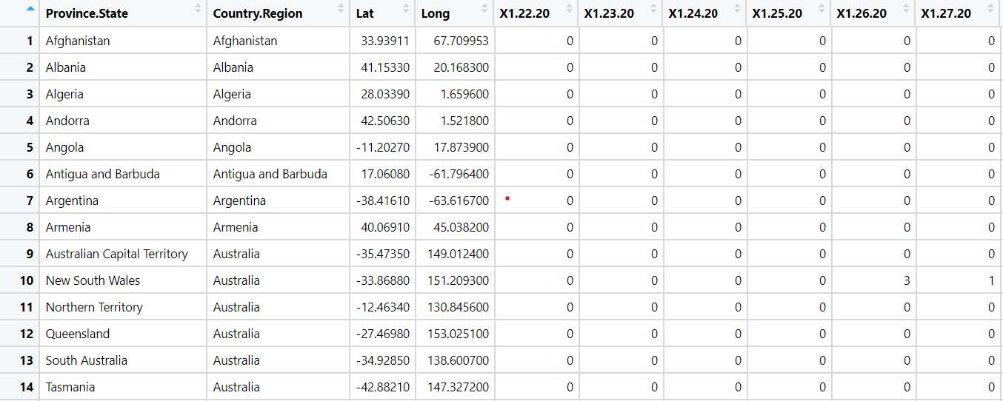
4. Importing Data As we are using data source from github that will be updated daily, so there is no input .csv file needed.
Input format : Province.State, Country.Region, Latitude, Longitude, Time Series of Cases

Slide 12
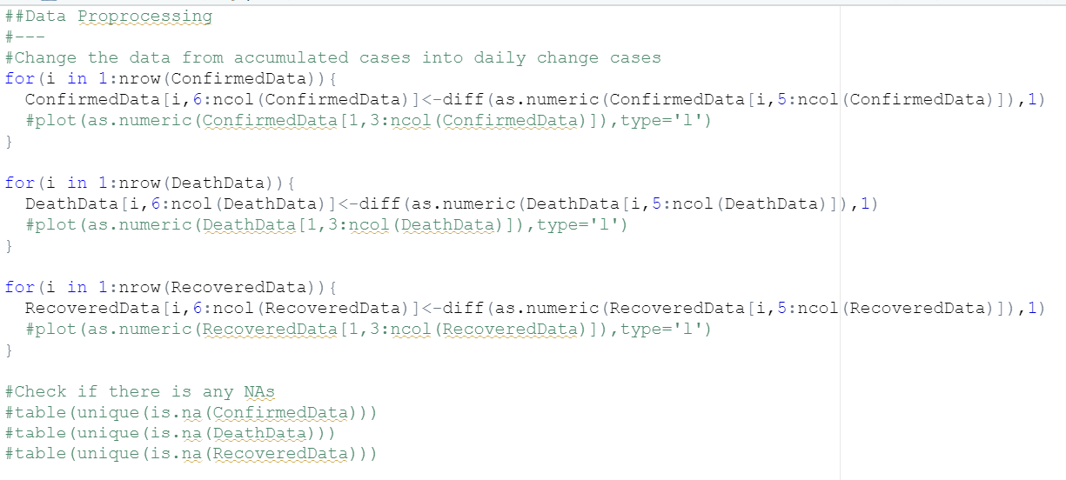
5. Preprocessing
Change the data from accumulated cases into daily change cases

Slide 13
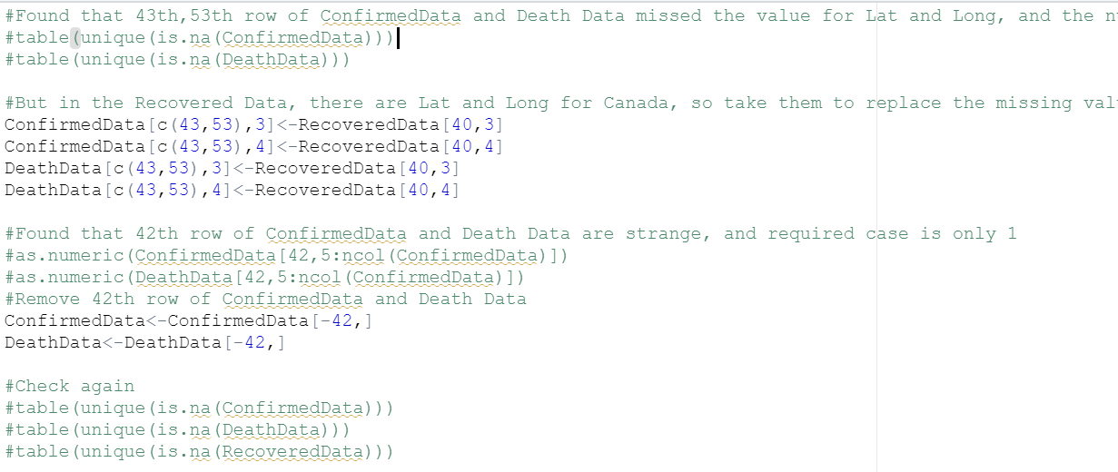
5. Preprocessing
Take Lat and Long for Canada in the Recovered Data to replace the missing value in Confirmed Data and Death Data Remove 42th row of Confirmed Data and Death Data because of strange data from that row and only required 1 case

Slide 14
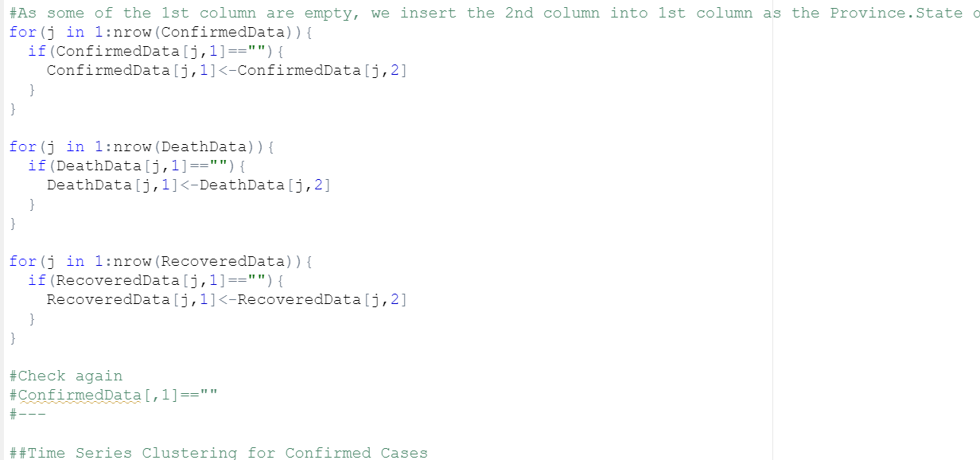
5. Preprocessing Insert the 2nd column into 1st column as the Province.State of that row if missing

Slide 15
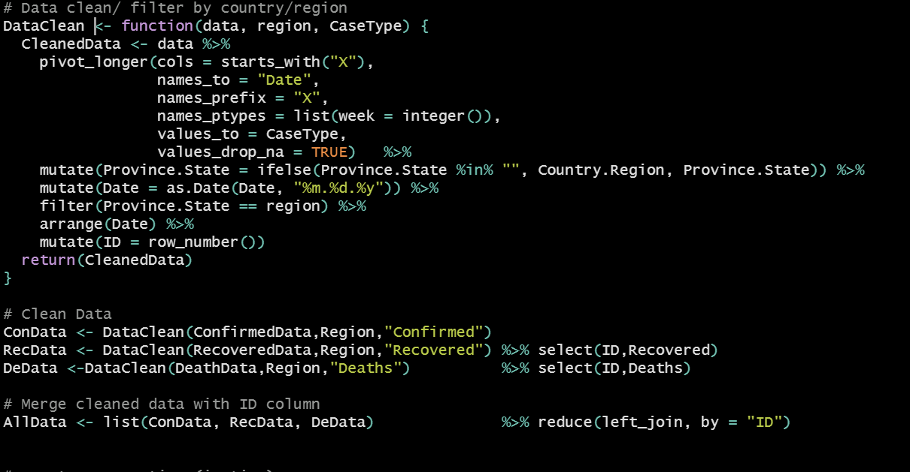
5. Preprocessing Filtering data per country/region
Notes:
此部分為半成品, 原本是想做成Shiny App, 但最後因為組員能力不足, 最後只能手動在R上面改國家名字來產出各一個國家的趨勢圖表。此為半成品的前處理部分。

Slide 16
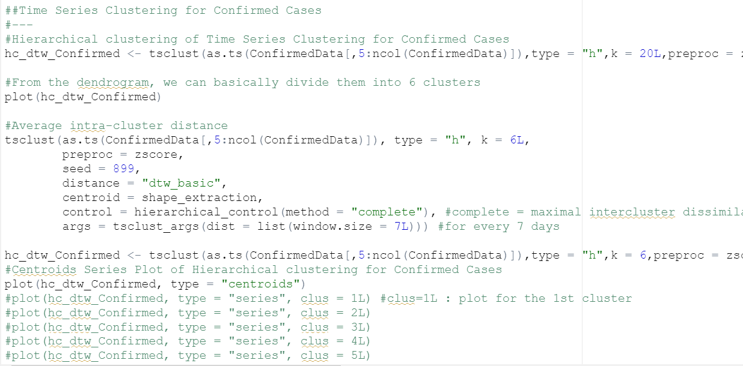
6. Time Series Clustering for Confirmed Cases Standandize the data as zscore when doing hierarchical clustering Hierarchical clustering of Time Series and Plot Dendrogram Calculate DTW Distances to determine which k to choose
Plot Centroids Series of The Clustering Results

Slide 17
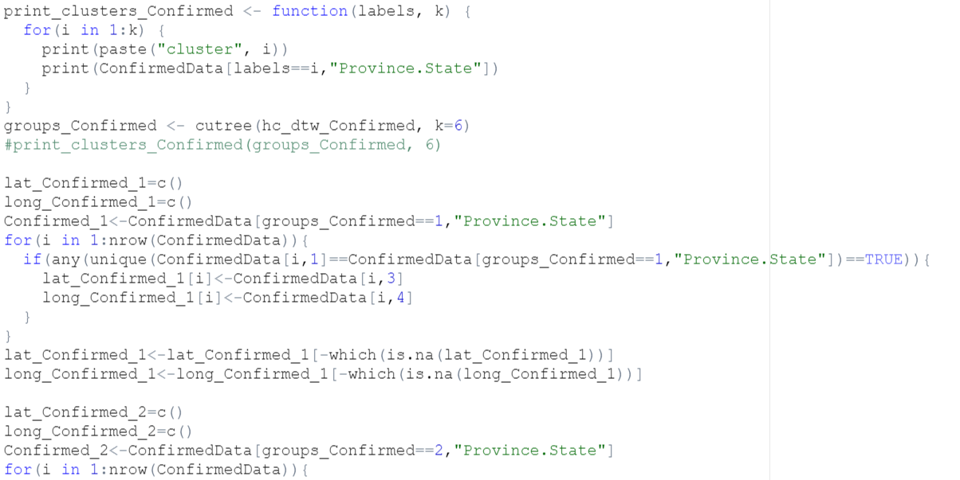
6. Time Series Clustering for Confirmed Cases Print out the state names of the states in each cluster
Extract their corresponding latitude and longitude for further mapping

Slide 18
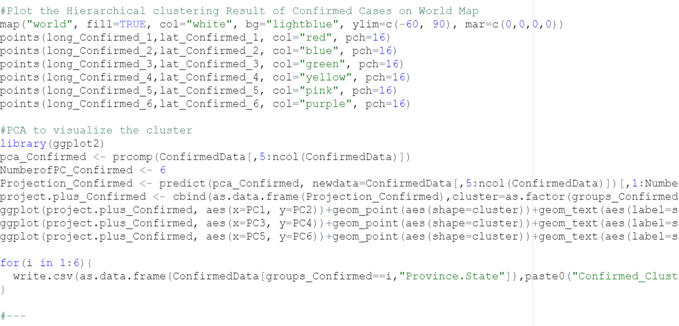
6. Time Series Clustering for Confirmed Cases
Plot each cluster in different colors on the World Map Projection of clustering results on PCA Save the state name list of each cluster

Slide 19
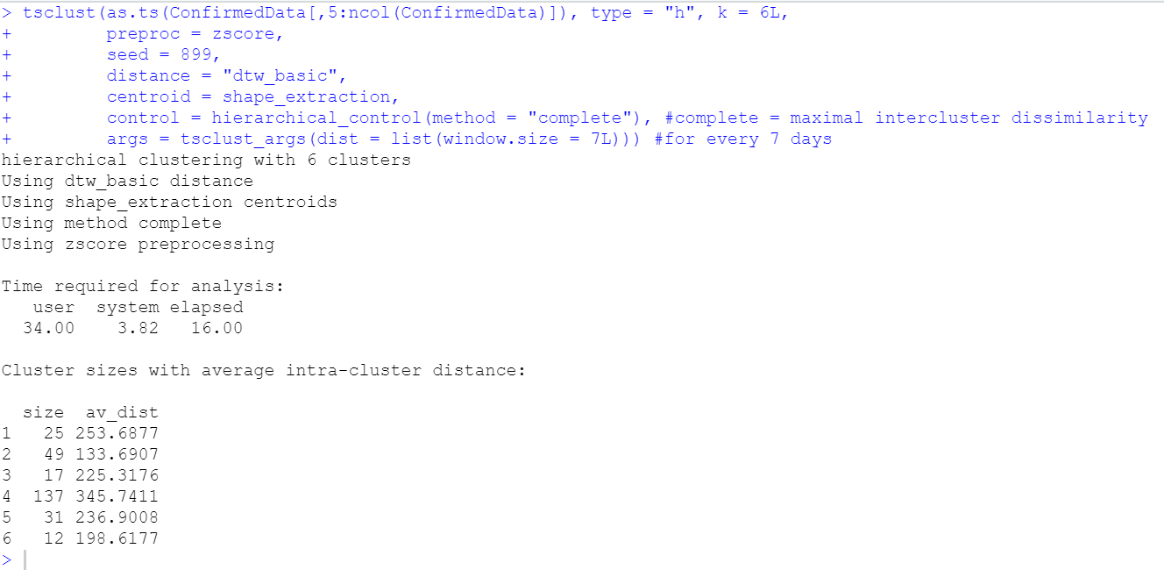
6. Time Series Clustering for Confirmed Cases The DTW Distance Result of the clustering

Slide 20
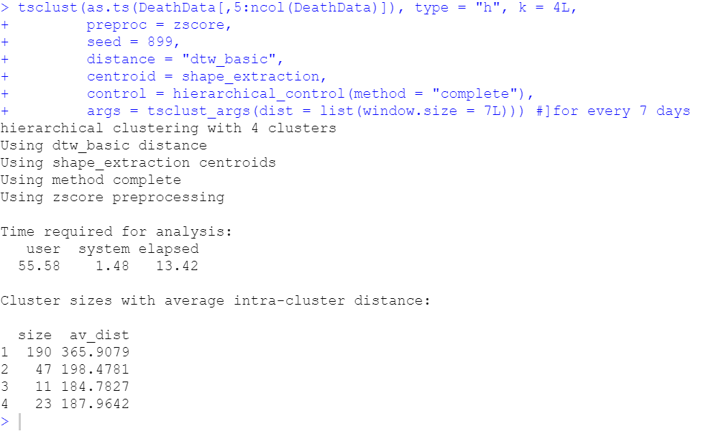
7. Time Series Clustering for Death Cases
As the steps for death cases is the same with above, just show the DTW Distance Result of the clustering for Death Cases Here

Slide 21
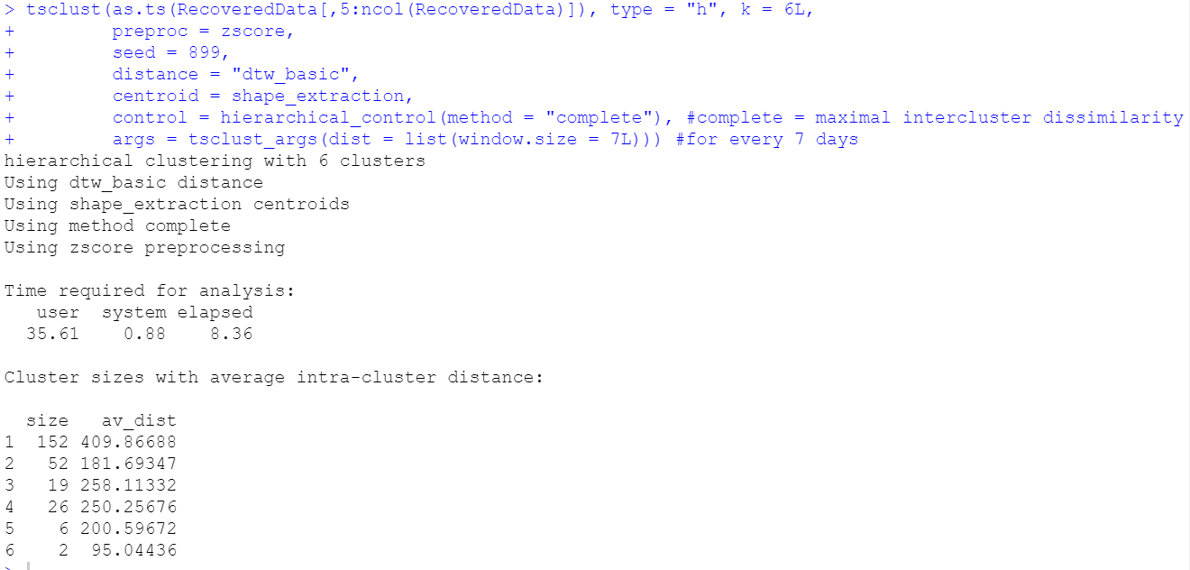
8. Time Series Clustering for Recovered Cases The DTW Distance Result of the clustering for Death Cases Here

Slide 22
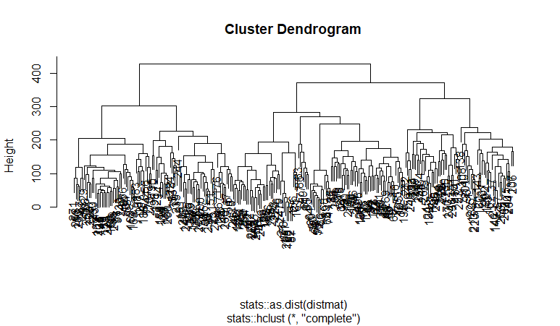
9. Plotting Covid-19 Data
-Confirmed Cases From this dendrogram, we can choose k=6, which means group them into 6 clusters

Slide 23
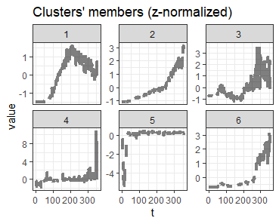
9. Plotting Covid-19 Data -Confirmed Cases The Centroids Series Plot of The Clustering Results

Slide 24
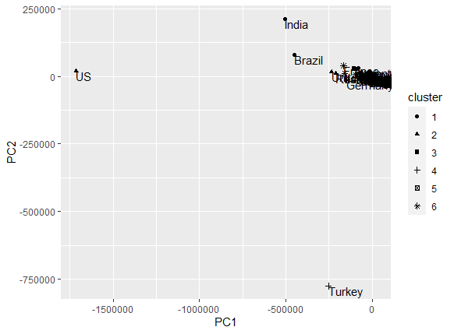
9. Plotting Covid-19 Data -Confirmed Cases
Projection on PCA(Here we just show PC1 VS PC2)
Clustering Result Represented in different colors on the World Map

Slide 25
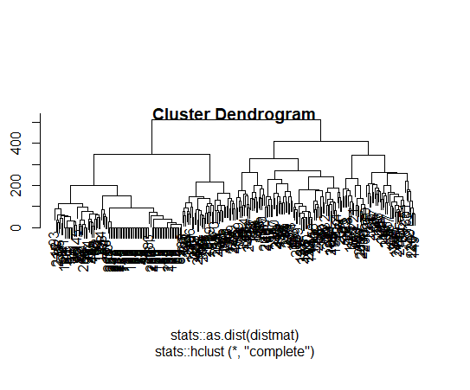
9. Plotting Covid-19 Data
-Death Cases From this dendrogram, we can choose k=4, which means group them into 4 clusters

Slide 26
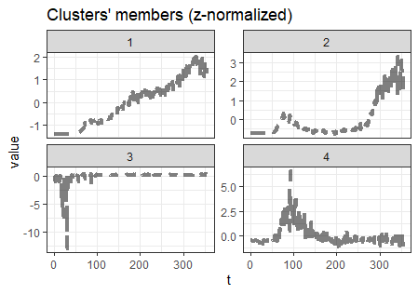
9. Plotting Covid-19 Data
-Death Cases The Centroids Series Plot of The Clustering Results

Slide 27
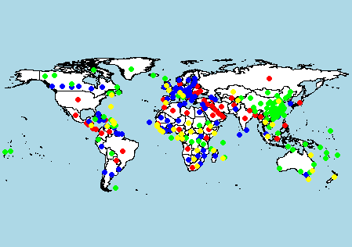
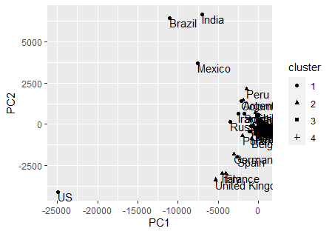
9. Plotting Covid-19 Data
-Death Cases Projection on PCA(Here we just show PC1 VS PC2)
Clustering Result Represented in different colors on the World Map

Slide 28
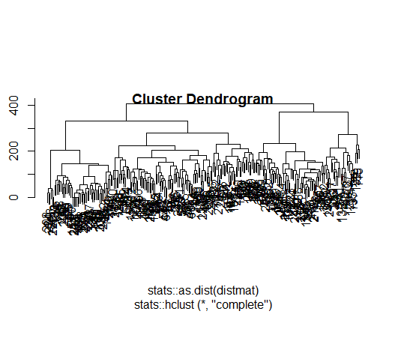
9. Plotting Covid-19 Data
-Recovered Cases From this dendrogram, we can choose k=6, which means group them into 6 clusters

Slide 29
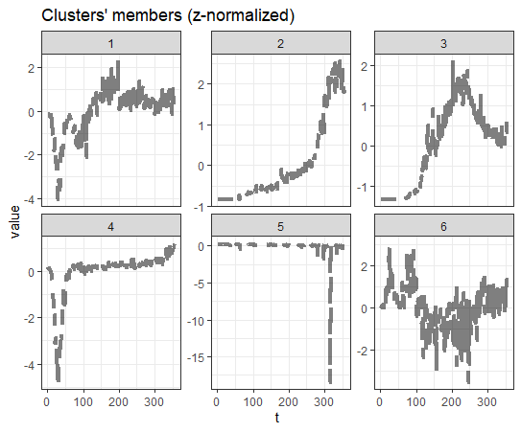
9. Plotting Covid-19 Data
-Recovered Cases The Centroids Series Plot of The Clustering Results

Slide 30
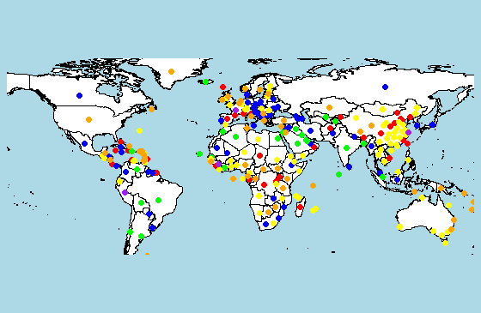
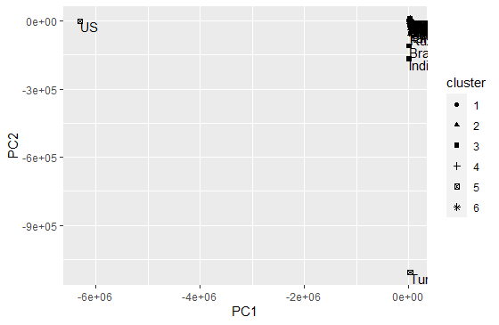
9. Plotting Covid-19 Data
-Recovered Cases Projection on PCA(Here we just show PC1 VS PC2)
Clustering Result Represented in different colors on the World Map

Slide 31
What’s next?
After being able to better understand Covid-19 data by visualizing methods, we speculate that future applications and research can be done by trying do find correlations in other areas that may characterize causes and/or consequences of number of cases in a particular region. Examples of these may be the implementation of mandatory mask use (cause) or an impact in a nation’s economy (consequence).

Slide 32
References
Code and methods reference:
https://cran.r-project.org/web/packages/dtwclust/dtwclust.pdf
https://www.rdocumentation.org/packages/dtwclust/versions/3.1.1/topics/tsclust
https://www.r-bloggers.com/2013/04/r-beginners-plotting-locations-on-to-a-world-map/
https://github.com/rehanzfr/R_Codes/tree/master/Corona/
Data source:John’s Hopkins Covid-19 publid data set (daily)
JHU CSSE - Center For Systems Science and Engineering at JHU
https://github.com/CSSEGISandData/COVID-19

