Slide 1
scHiCTools: A computational toolbox for analyzing single-cell Hi-C data
資科碩一 109753102 黃渝庭

Slide 2
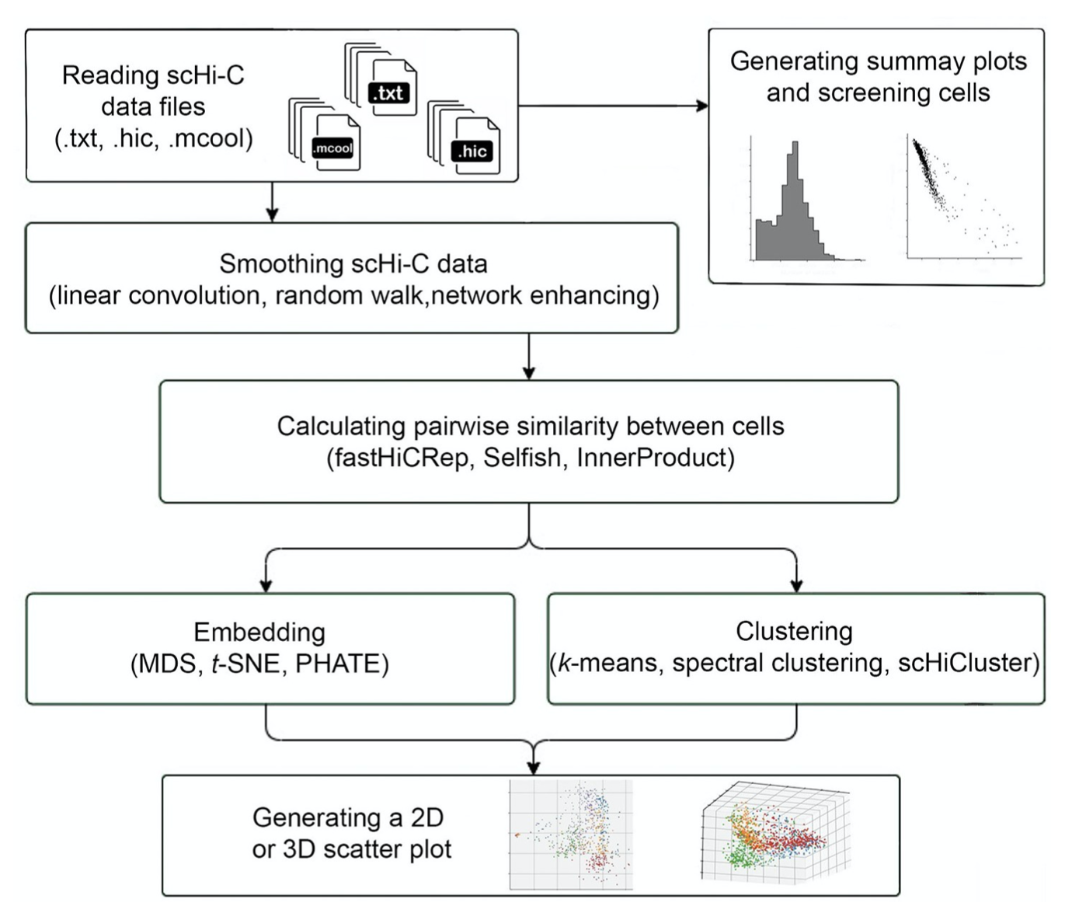
Ｗorkflow
Fig1. The workflow of scHicTools.

Slide 3
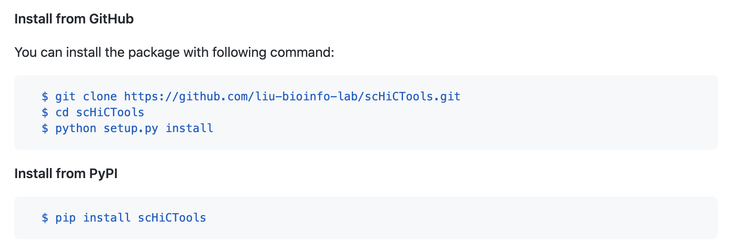
Install
scHiCTools

Slide 4
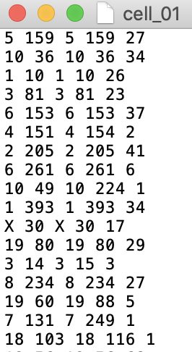
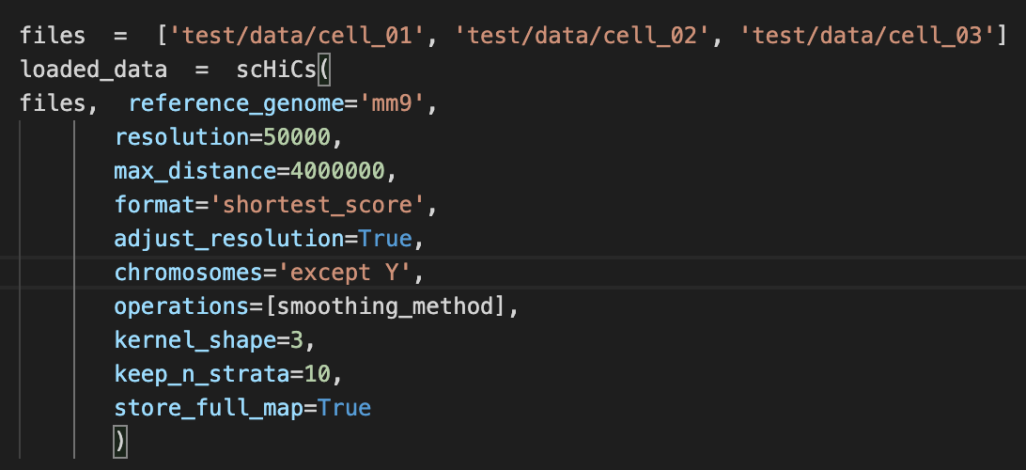
Loading scHiC Data
.txt
.hic
.mcool
Shortest_Score Format
<chr1> <pos1> <chr2> <pos2> <score>

Slide 5
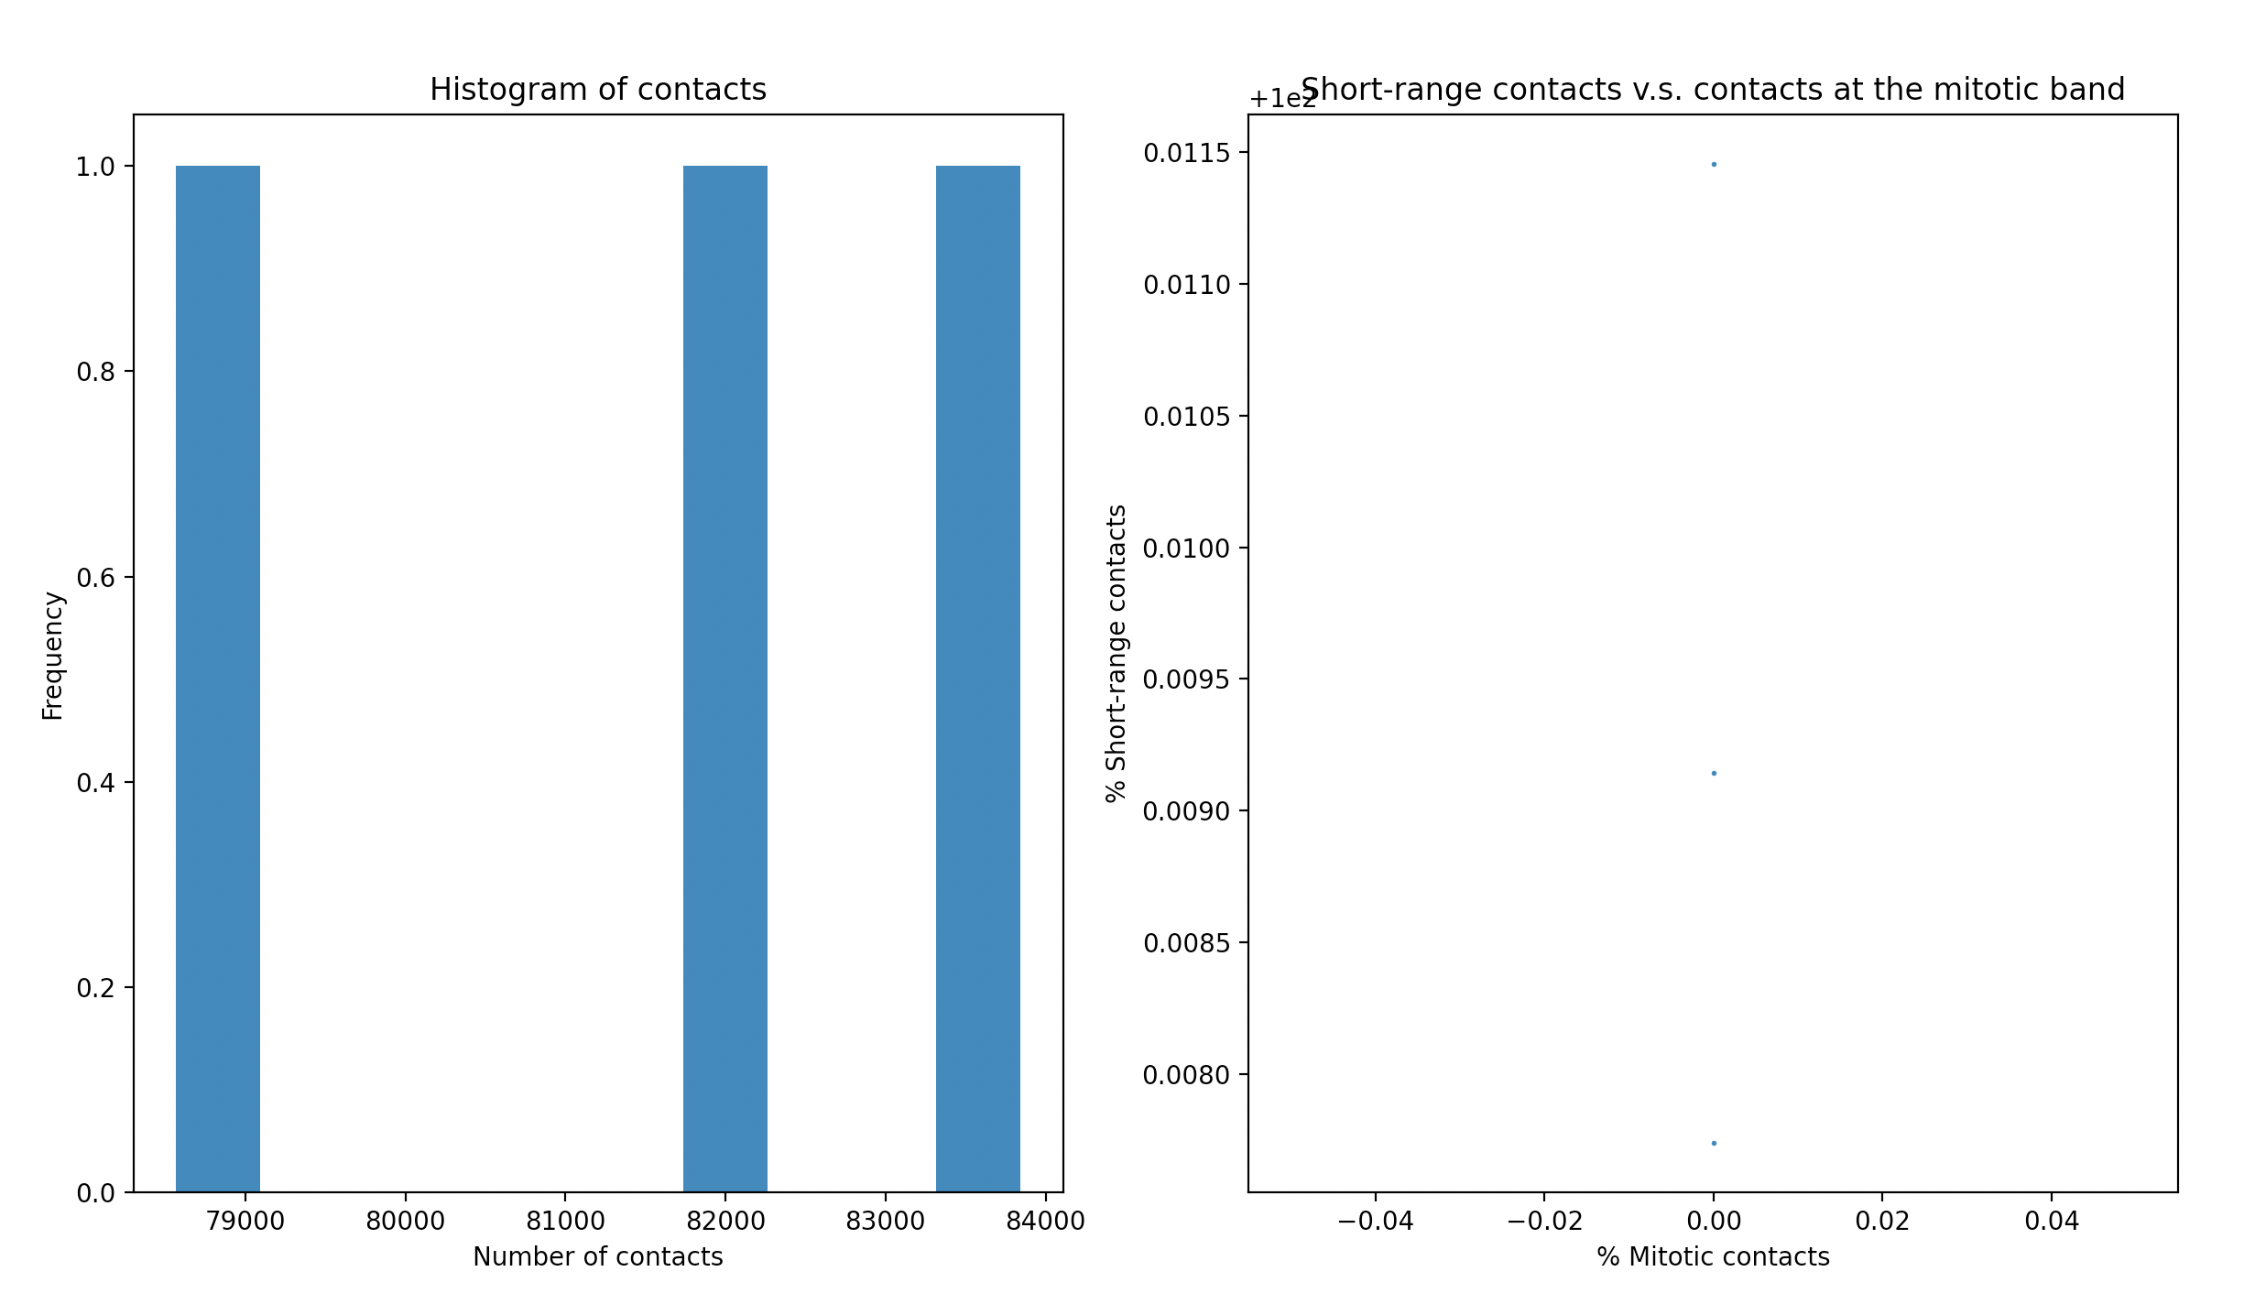
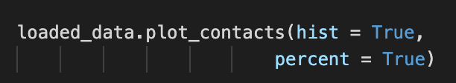

Plot number of contacts and select cells

Slide 6
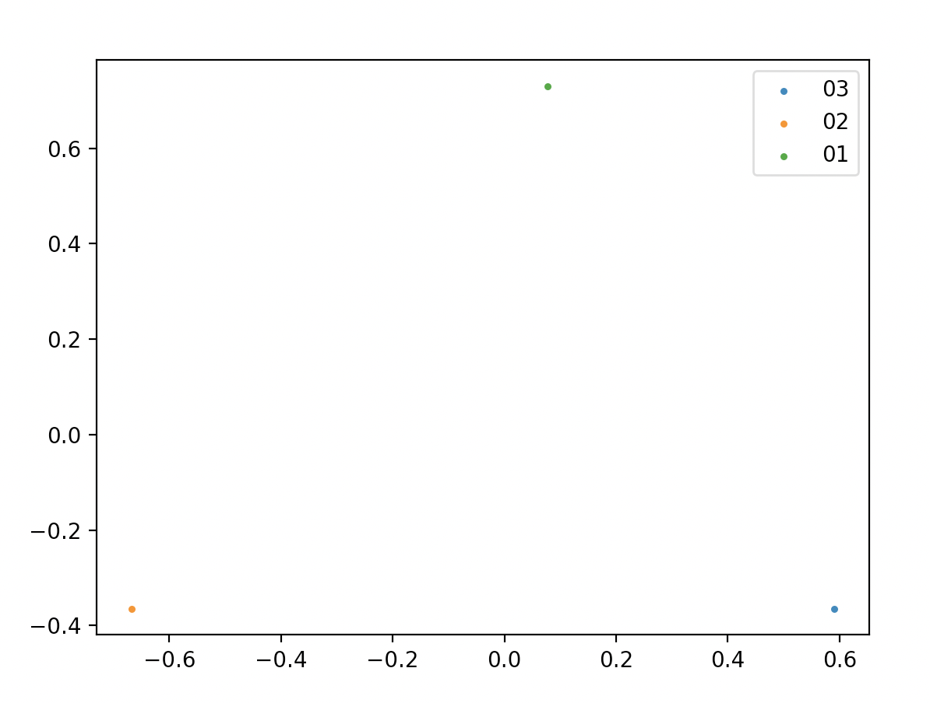
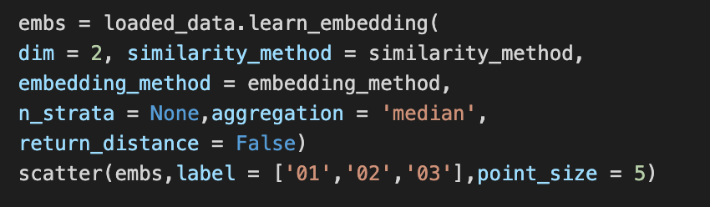
Smoothing & Embedding Data and Visualize

Slide 7
Both of them do for analyzing single-cell
scHiCTools is only for HiC data and Seurat is only for RNA-Seq
The workflow of two tools is similar, but scHicTools have on more step for calculating pairwise similarity
Compare
With
Seurat

Slide 8
The End

