Slide 1
HiC Explorer
HiC DC+
109753144
陳韋翰

Slide 2


HiCExplorer
sequencing data
reference genome
.fasta (.fa)
Drosophila melanogaster (dm3)
Build
reference genome index
map fragments to index
(double-strand)
.bam
build
hi-c matrix
.h5
correct
hi-c matrix
.h5
TAD calling
A/B Compartment Computation
loop detection

Slide 3
HiCExplorer
Drosophila melanogaster (dm3)
.bam
build
hi-c matrix
.h5
correct
hi-c matrix
.h5
TAD calling
A/B Compartment Computation
loop detection

Slide 4
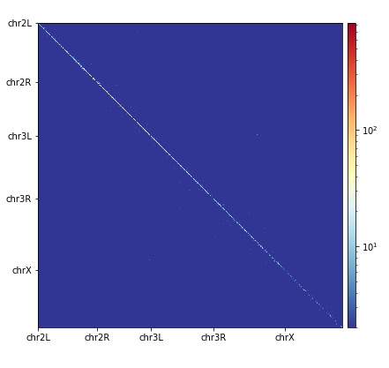
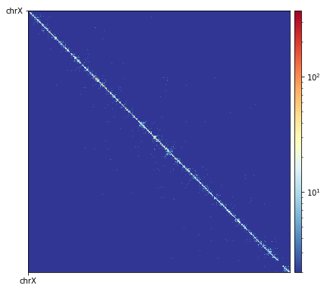
HiCExplorer
Drosophila melanogaster (dm3)
bin size : 10k
.bam
build
hi-c matrix
.h5
correct
hi-c matrix
.h5
TAD calling
A/B Compartment Computation
loop detection

Slide 5
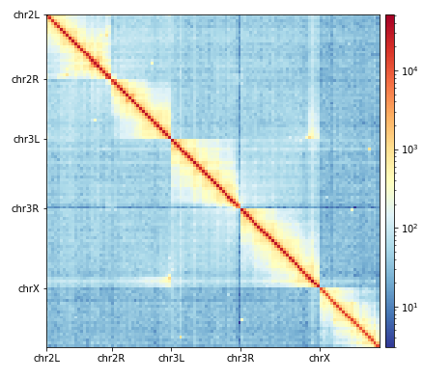
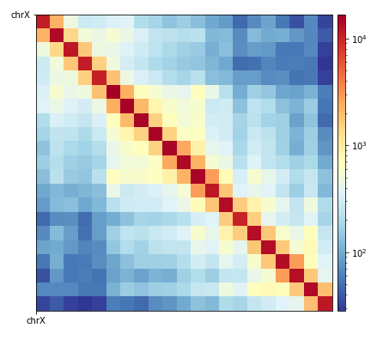
HiCExplorer
Drosophila melanogaster (dm3)
bin size : 1M
.bam
build
hi-c matrix
.h5
correct
hi-c matrix
.h5
TAD calling
A/B Compartment Computation
loop detection

Slide 6
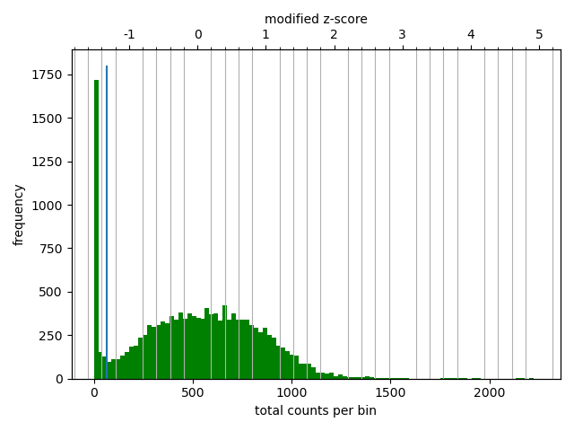
HiCExplorer
bin size : 10k
Drosophila melanogaster (dm3)
.bam
build
hi-c matrix
.h5
correct
hi-c matrix
.h5
TAD calling
A/B Compartment Computation
loop detection
Remove bins of low coverage to -1.6
Remove bins of large coverage to 1.8

Slide 7
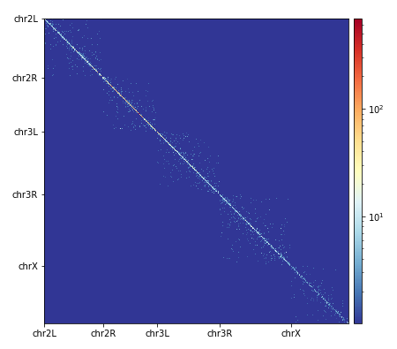
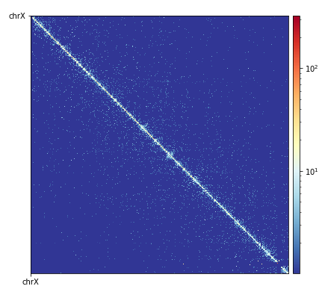
HiCExplorer
Drosophila melanogaster (dm3)
bin size : 10k
.bam
build
hi-c matrix
.h5
correct
hi-c matrix
.h5
TAD calling
A/B Compartment Computation
loop detection
Remove bins of low coverage to -1.6
Remove bins of large coverage to 1.8

Slide 8
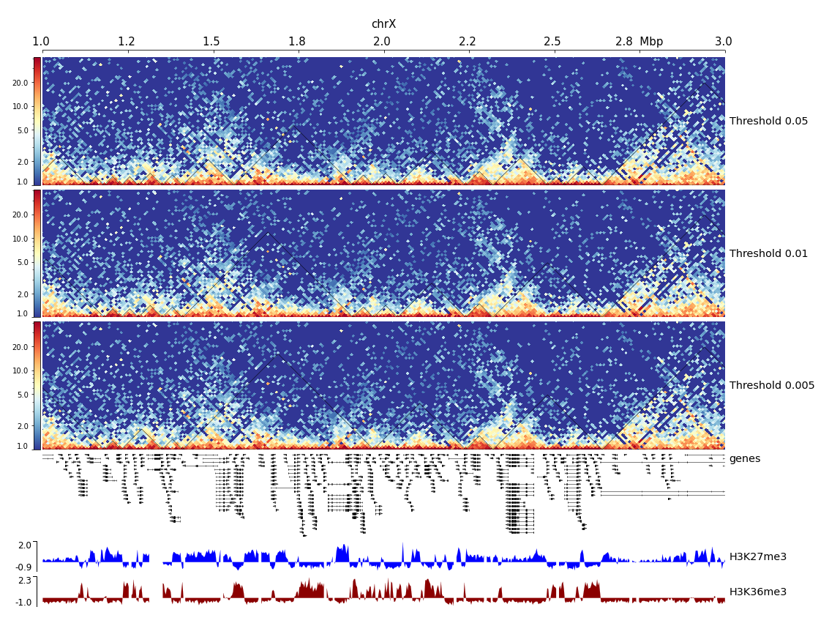
HiCExplorer
Drosophila melanogaster (dm3)
.bam
build
hi-c matrix
.h5
correct
hi-c matrix
.h5
TAD calling
A/B Compartment Computation
loop detection

Slide 9
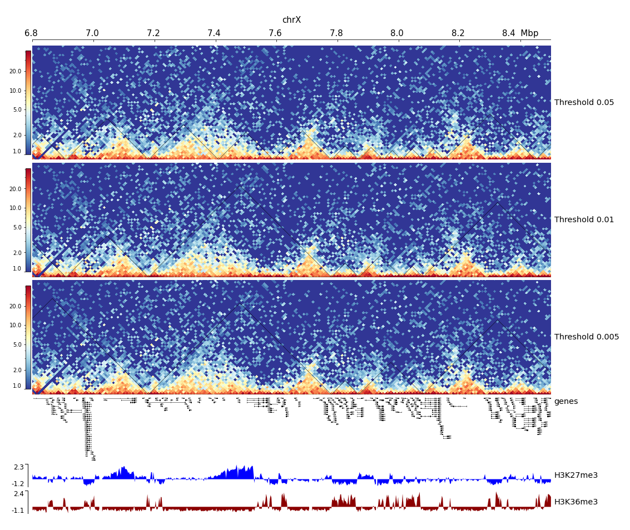
HiCExplorer
Drosophila melanogaster (dm3)
.bam
build
hi-c matrix
.h5
correct
hi-c matrix
.h5
TAD calling
A/B Compartment Computation
loop detection

Slide 10
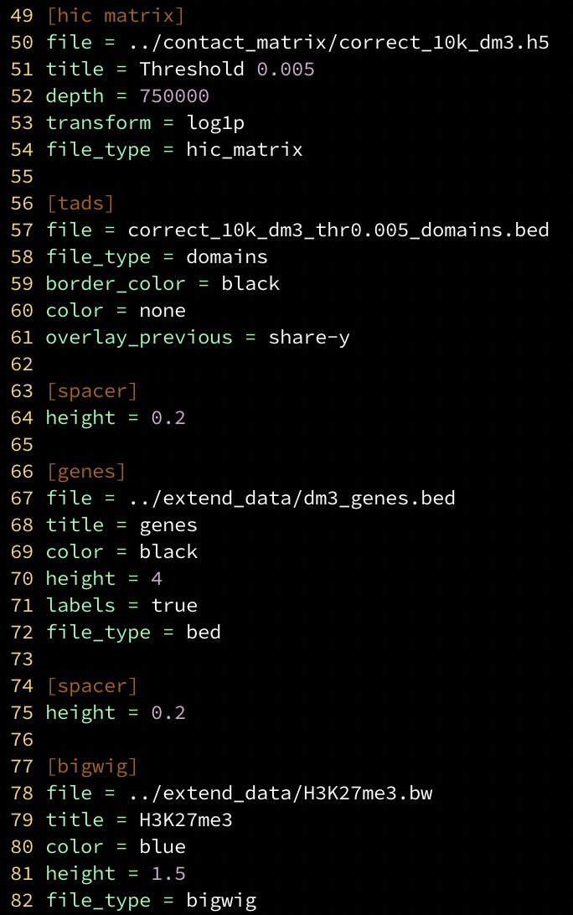
HiCExplorer
Drosophila melanogaster (dm3)
.bam
build
hi-c matrix
.h5
correct
hi-c matrix
.h5
TAD calling
A/B Compartment Computation
loop detection

Slide 11
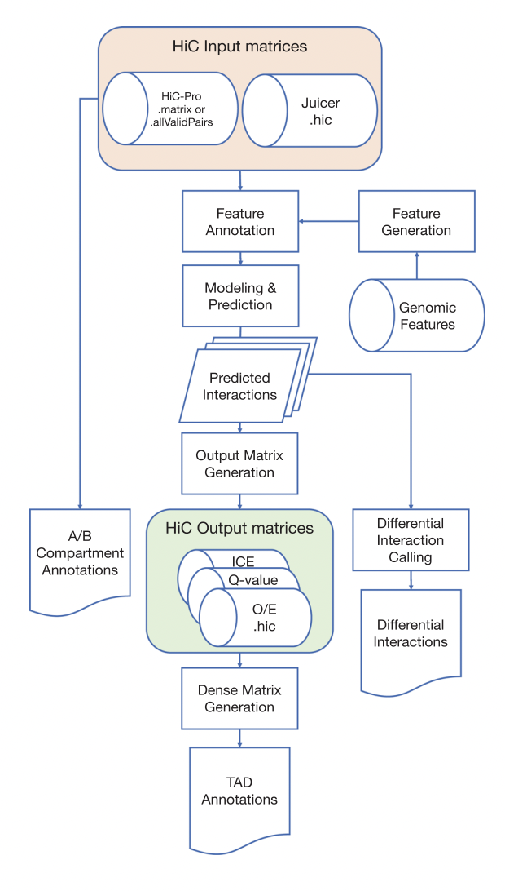
HiC DC+
call significant interactions
GSE63525 (hg19)

Slide 12
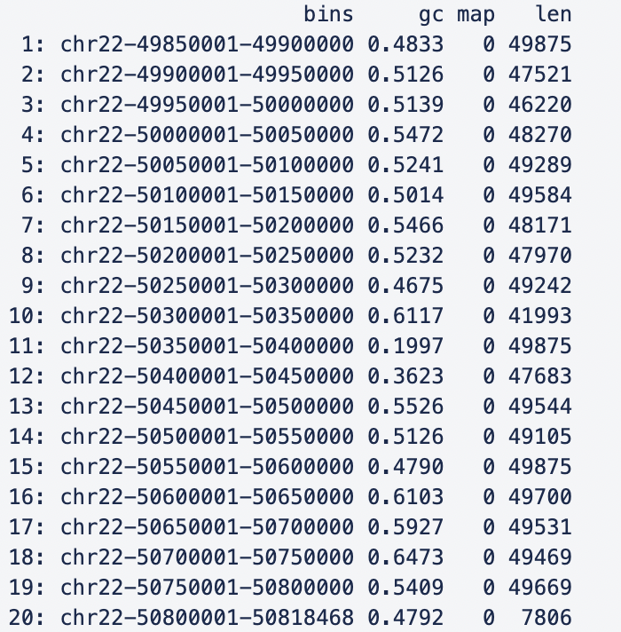
HiC DC+
GSE63525 (hg19)
construct_features : finds all restriction enzyme cutsites of a given genome and genome version and computes GC content, mappability (if a relevant .bigWig file is provided) and effective fragment length for uniform bin

Slide 13
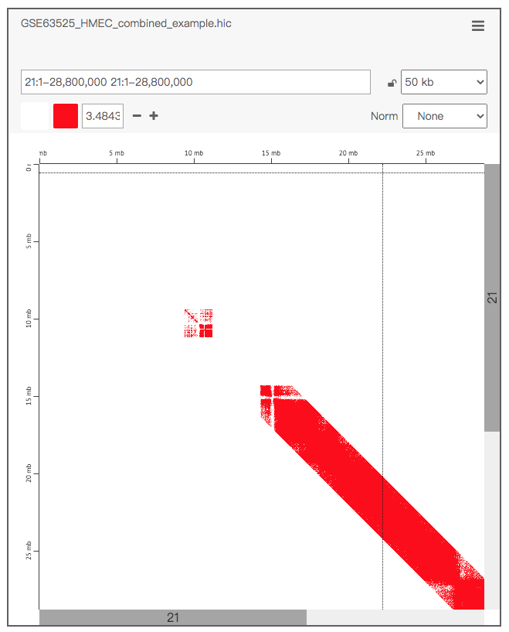
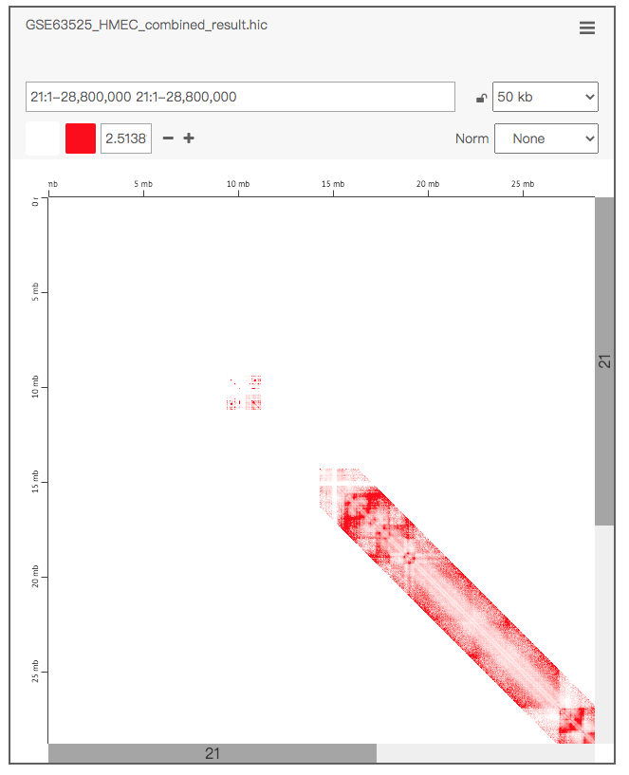
HiC DC+
GSE63525 (hg19)
chr21

Slide 14
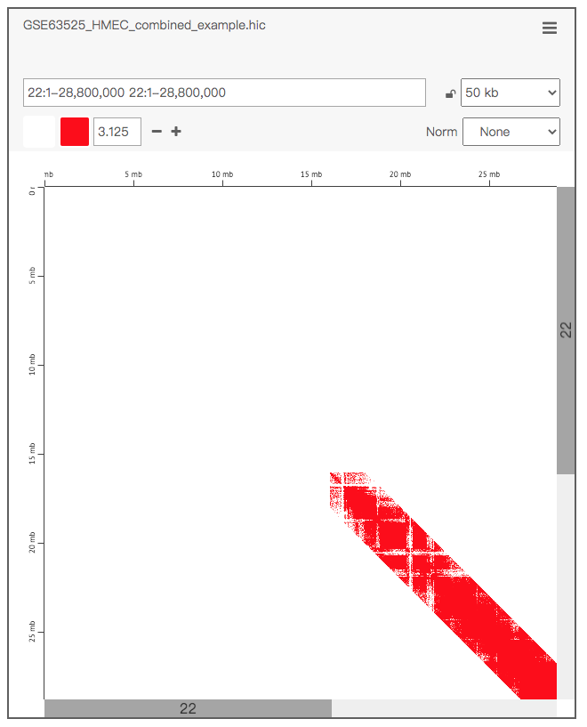
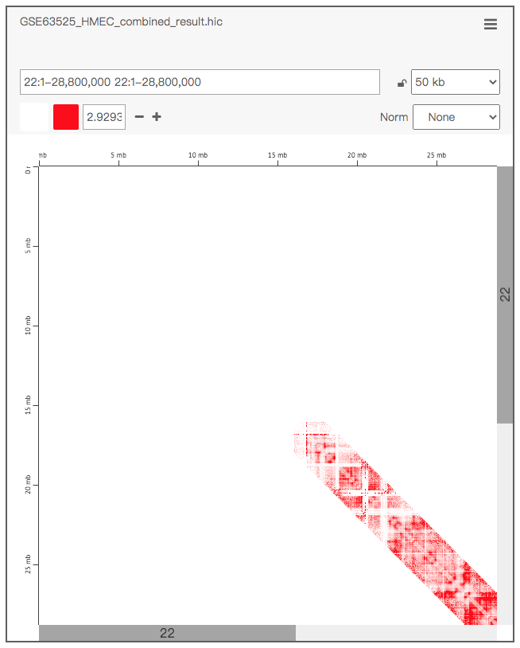
HiC DC+
GSE63525 (hg19)
chr22

Slide 15
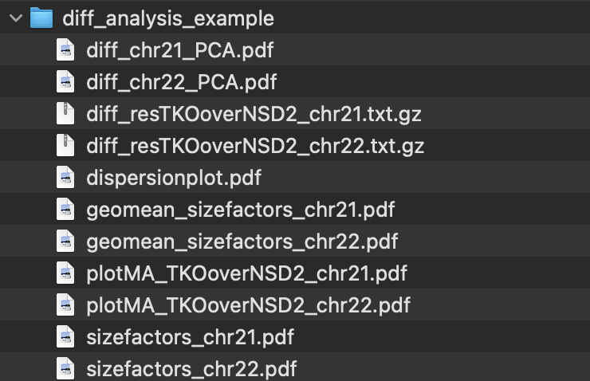
HiC DC+
GSE131651 (hg38)

Slide 16
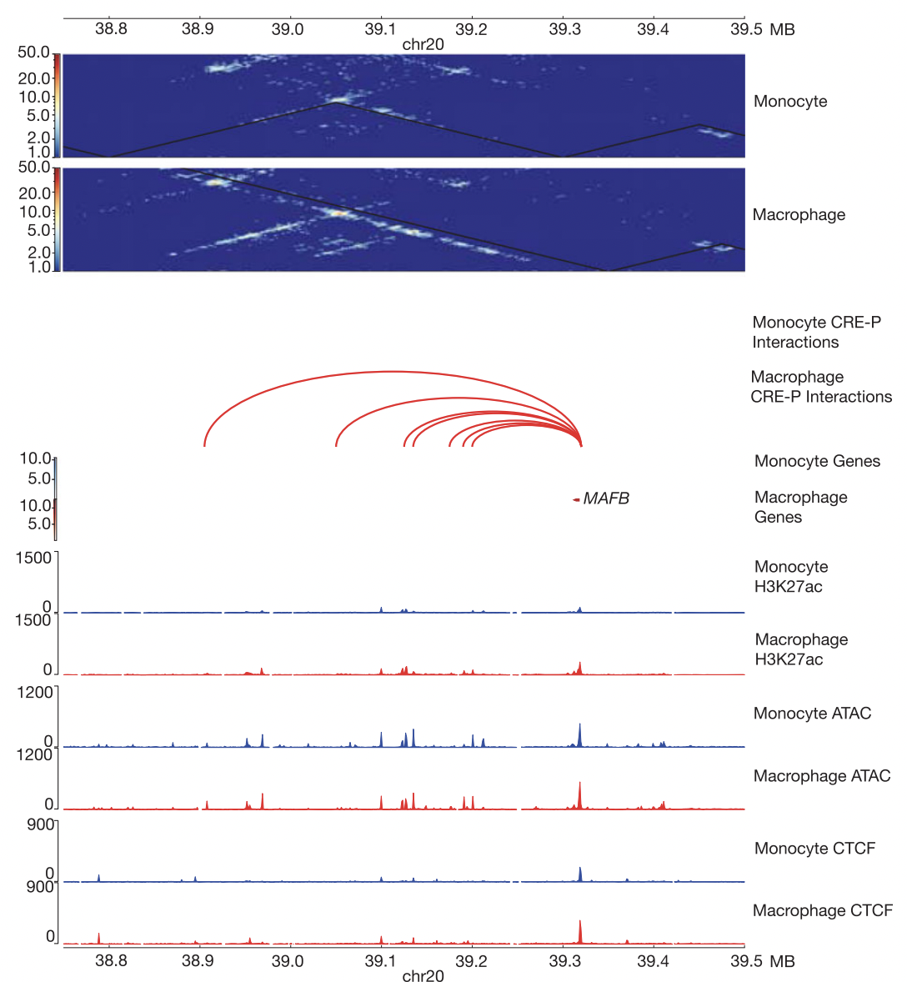
HiC DC+

