Slide 1
Cards Against Humanity
Philipp Czarnetzki Max Schäfer

Slide 2
Idee
Frontend
Backend
Infrastruktur
Live-Test
github.com/10ITX3-CardsAgainstHumanity
Notes:
1

Slide 3
Idee
github.com/10ITX3-CardsAgainstHumanity

Slide 4
Frontend
Angular 2+
Programmiersprachen: HTML5, CSS3, Typescript
Single-Page Application (SPA)
github.com/10ITX3-CardsAgainstHumanity
Notes:
1

Slide 5
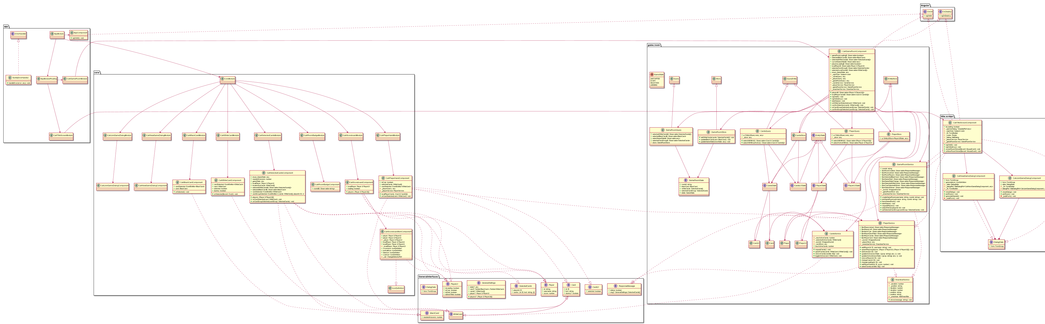
Frontend Klassendiagramm
github.com/10ITX3-CardsAgainstHumanity

Slide 6
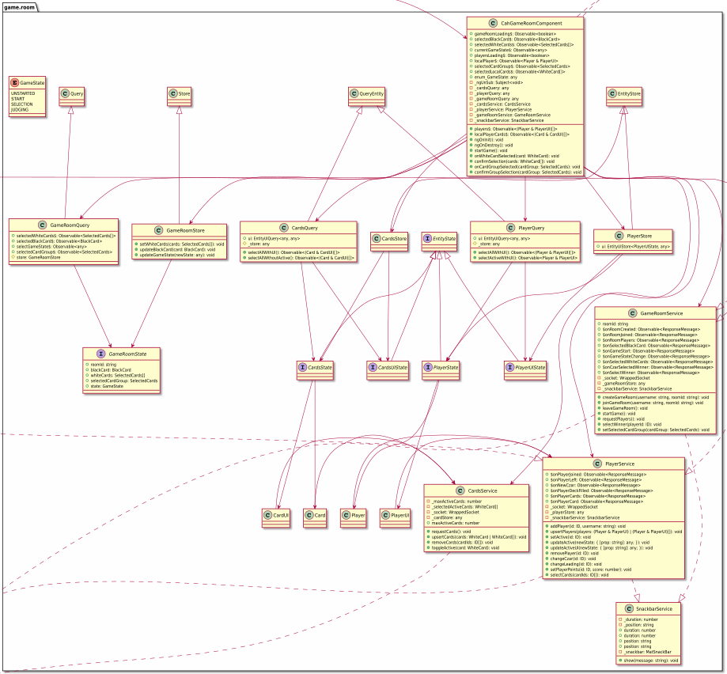
Frontend Klassendiagramm

Slide 7
Socket.IO github.com/socketio/socket.io
Echtzeit
Bidirektional
Eventbasiert
Protokolle
WebSocket
Fallback HTTP (Long Polling)
github.com/10ITX3-CardsAgainstHumanity
Notes:
1

Slide 8
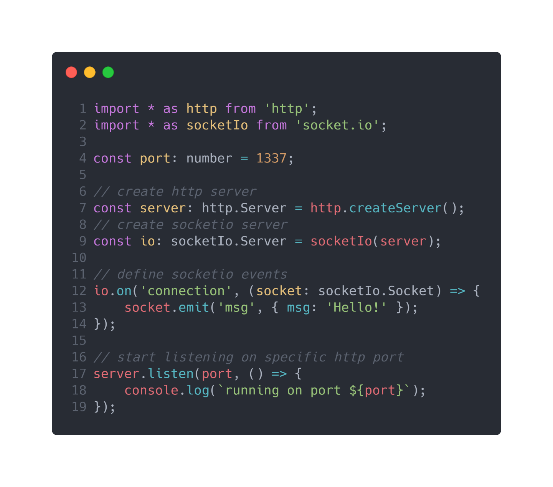
Socket.IO github.com/socketio/socket.io
github.com/10ITX3-CardsAgainstHumanity
Notes:
1

Slide 9
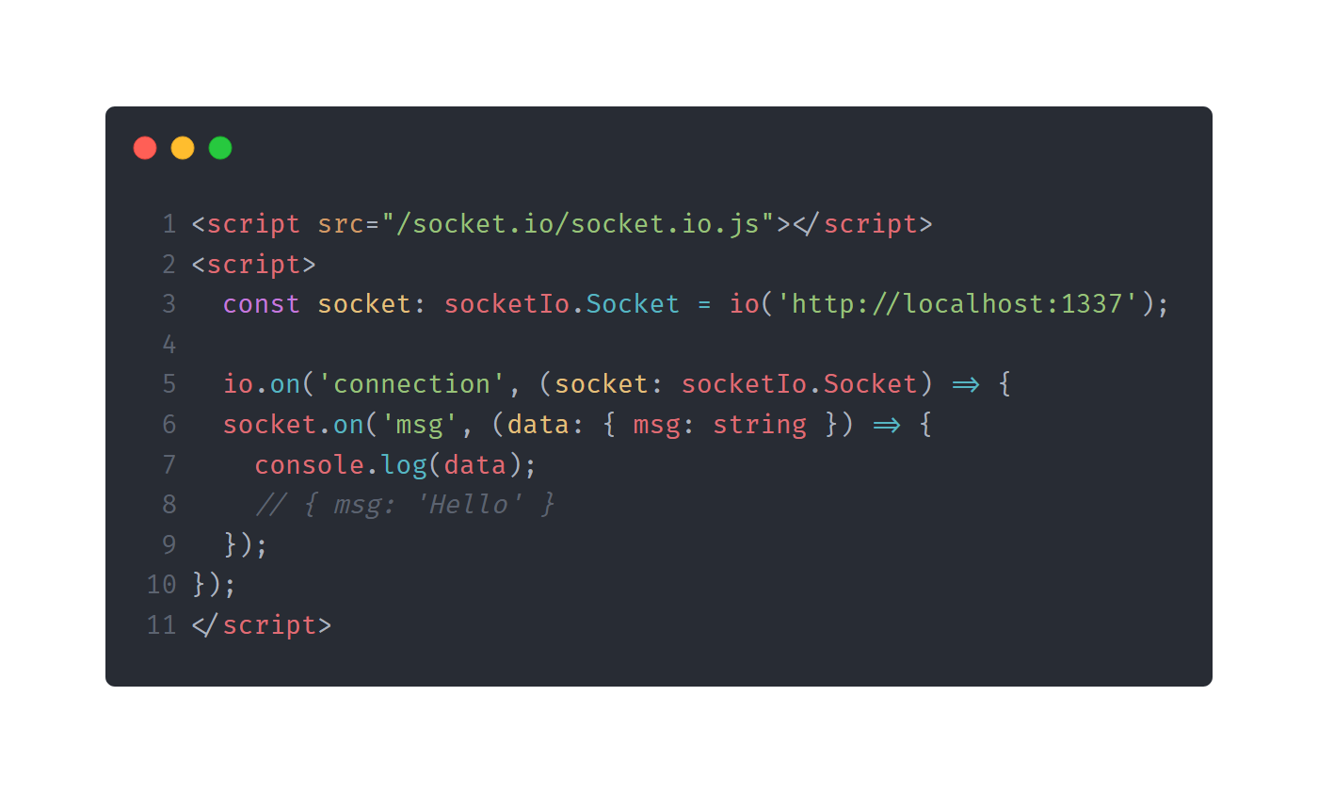
Socket.IO github.com/socketio/socket.io
github.com/10ITX3-CardsAgainstHumanity

Slide 10
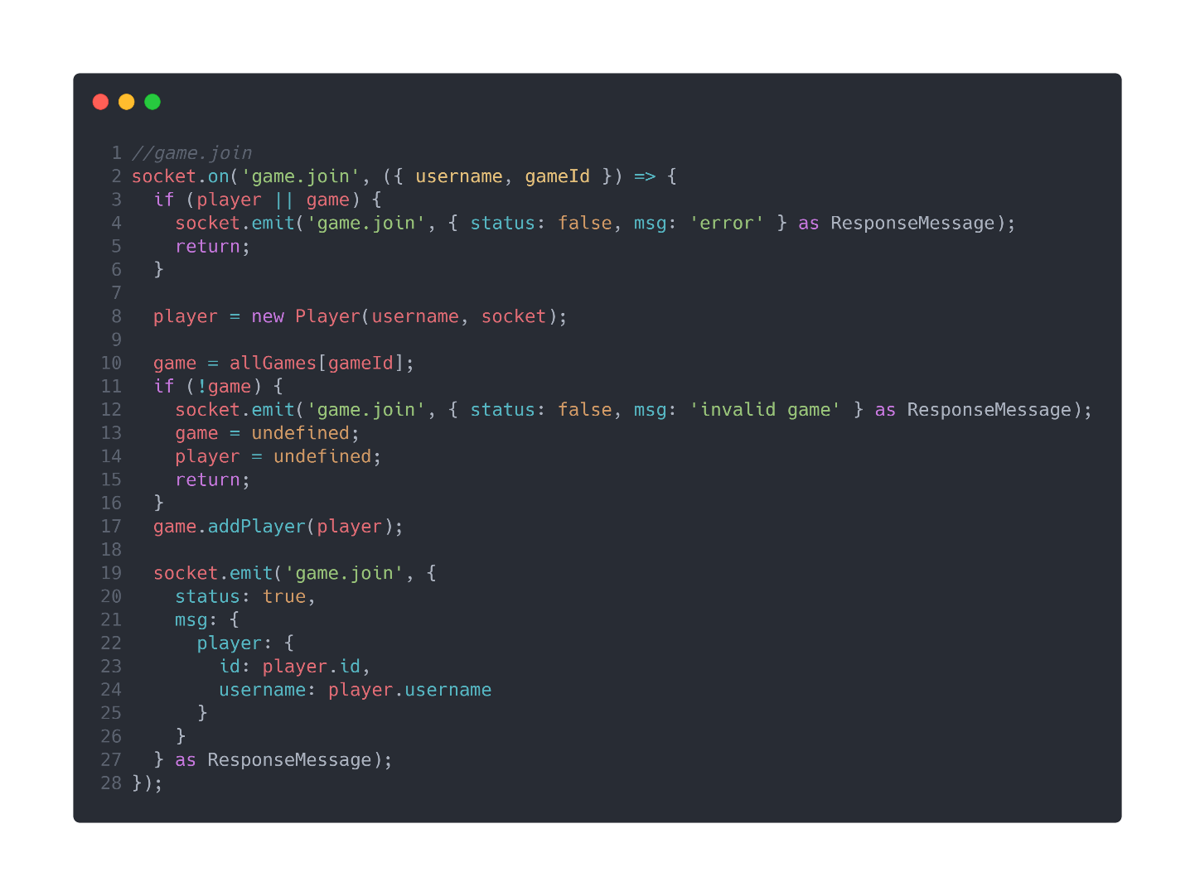
Socket.IO github.com/socketio/socket.io
github.com/10ITX3-CardsAgainstHumanity
Notes:
1

Slide 11

Socket.IO github.com/socketio/socket.io
github.com/10ITX3-CardsAgainstHumanity
Notes:
1

Slide 12
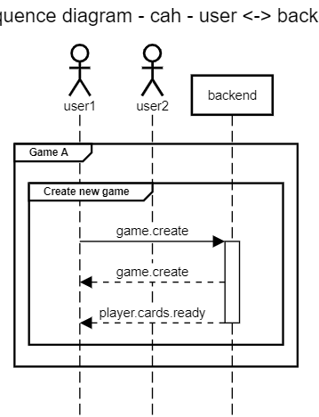
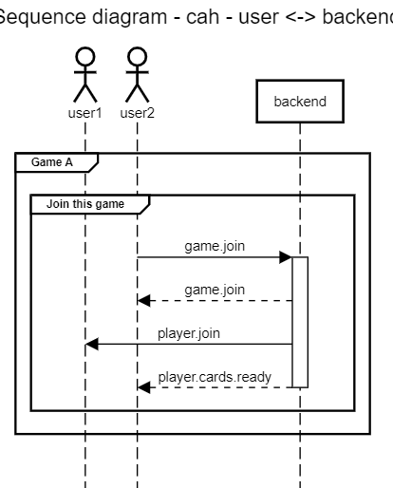
Sequenzdiagramm stand github.com/10ITX3-CardsAgainstHumanity/cah-backend/commit/28474e3
github.com/10ITX3-CardsAgainstHumanity

Slide 13
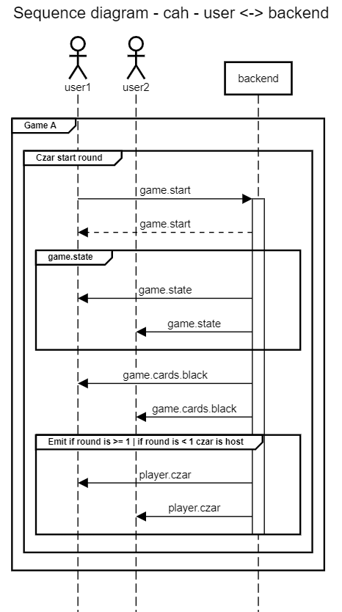
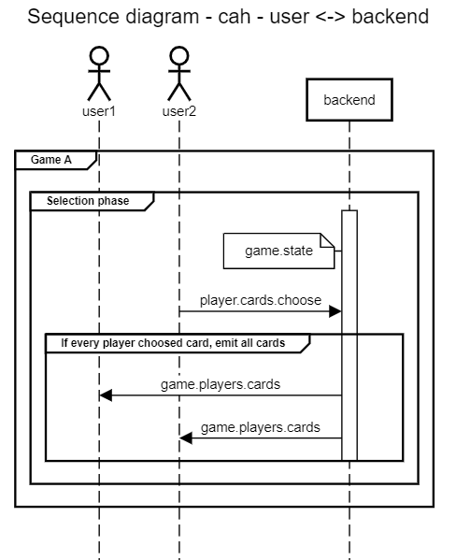
Sequenzdiagramm stand github.com/10ITX3-CardsAgainstHumanity/cah-backend/commit/28474e3
github.com/10ITX3-CardsAgainstHumanity

Slide 14
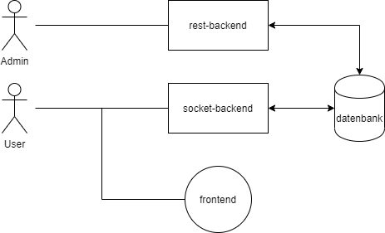
Infrastruktur
github.com/10ITX3-CardsAgainstHumanity
Notes:
1

Slide 15
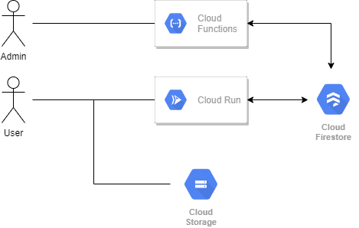
Infrastruktur
github.com/10ITX3-CardsAgainstHumanity
Notes:
<Foliennummer>

Slide 16
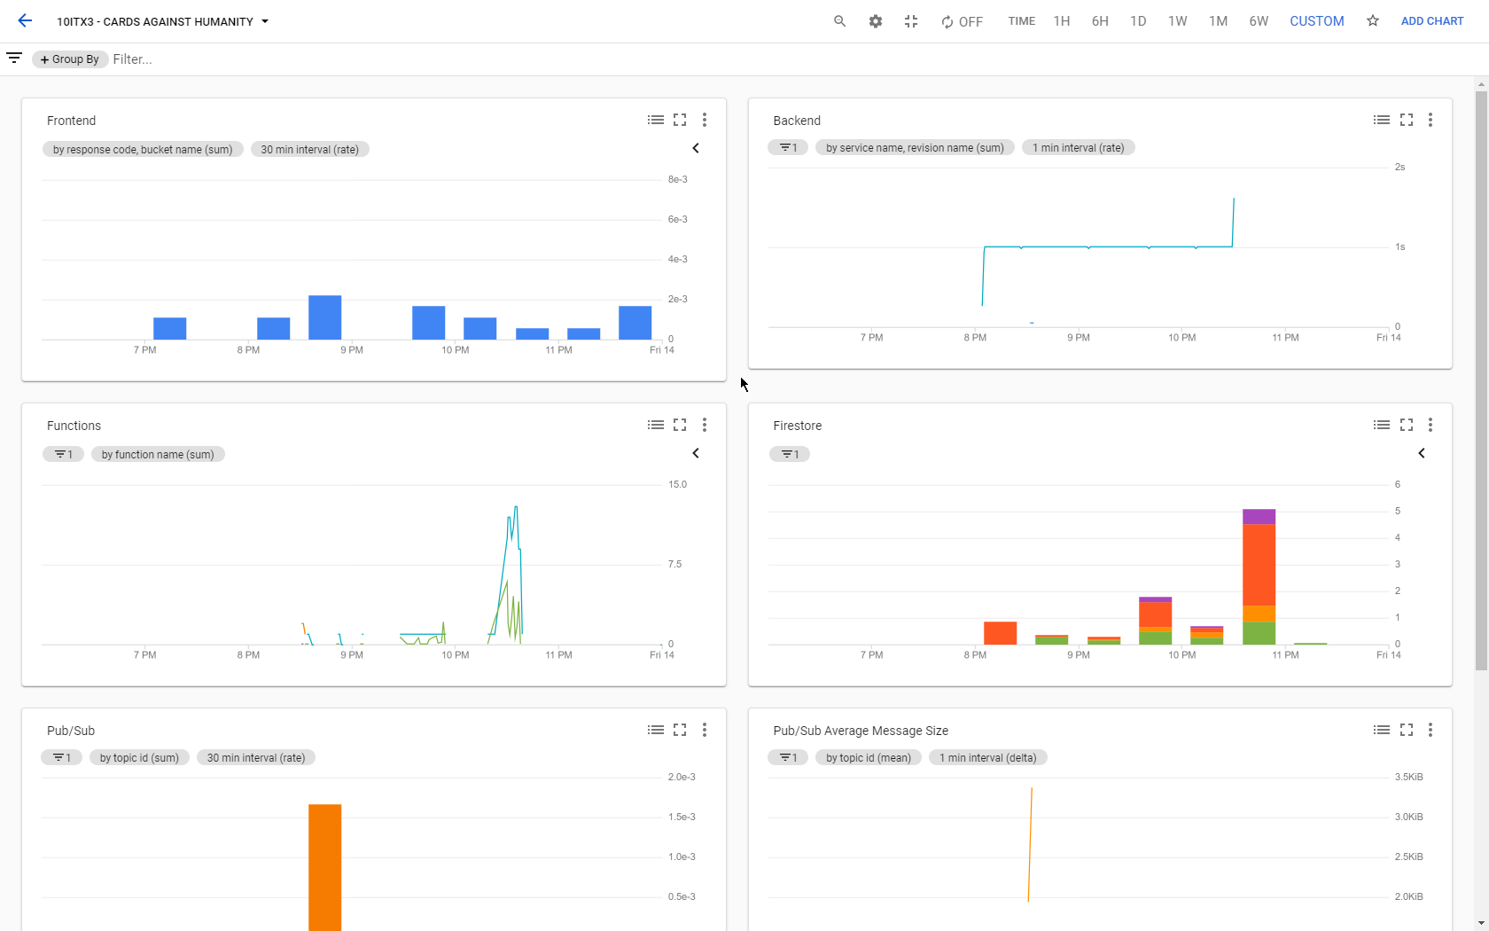
Infrastruktur
github.com/10ITX3-CardsAgainstHumanity
Notes:
<Foliennummer>

Slide 17
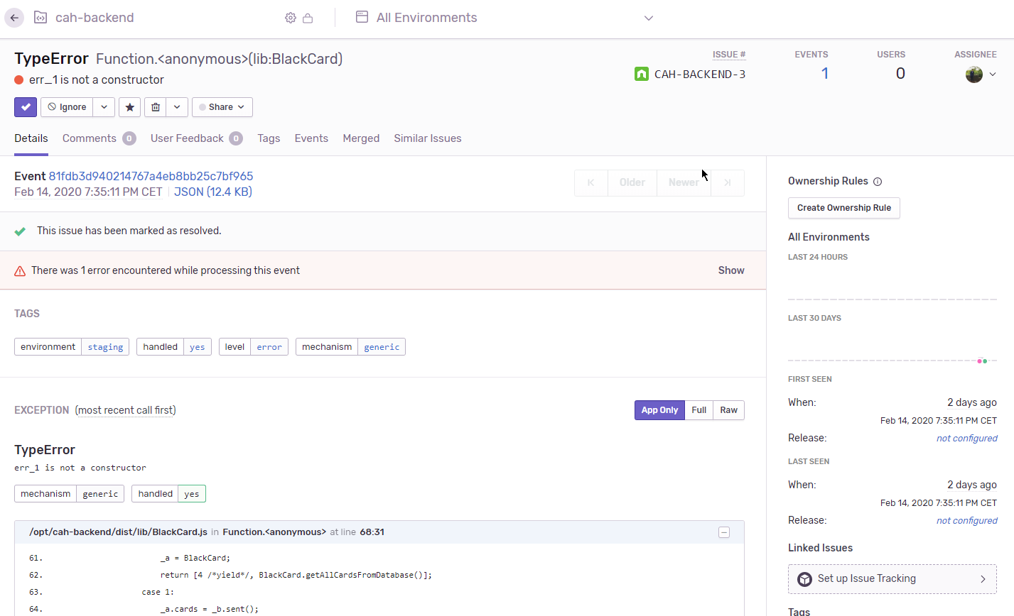
Infrastruktur
github.com/10ITX3-CardsAgainstHumanity
Notes:
<Foliennummer>

Slide 18
cah.maxrs.de
Game ID: XXX
github.com/10ITX3-CardsAgainstHumanity

Slide 19
Cards Against Humanity
Philipp Czarnetzki Max Schäfer

