Slide 1
Cards Against Humanity
Philipp Czarnetzki Max Schäfer

Slide 2
Idee
Frontend
Socket.IO
Backend
Infrastruktur
Live-Test
github.com/10ITX3-CardsAgainstHumanity
Notes:
2

Slide 3
Frontend
Angular 2+
Programmiersprachen: HTML5, CSS3, Typescript
Single-Page Application (SPA)
github.com/10ITX3-CardsAgainstHumanity
Notes:
3

Slide 4
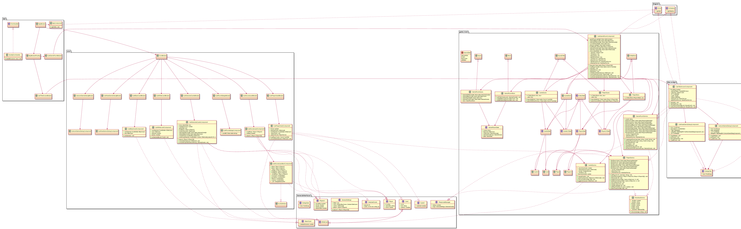
Frontend Klassendiagramm
github.com/10ITX3-CardsAgainstHumanity

Slide 5
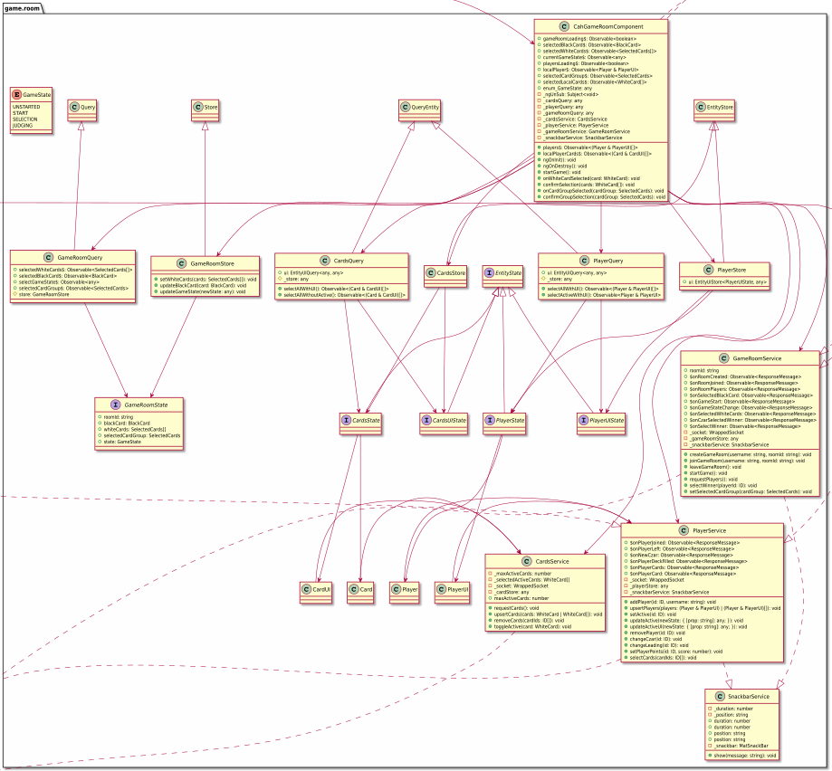
Frontend Klassendiagramm

Slide 6
Socket.IO github.com/socketio/socket.io
Echtzeit
Bidirektional
Eventbasiert
Protokolle
WebSocket
Fallback HTTP (Long Polling)
github.com/10ITX3-CardsAgainstHumanity
Notes:
6

Slide 7
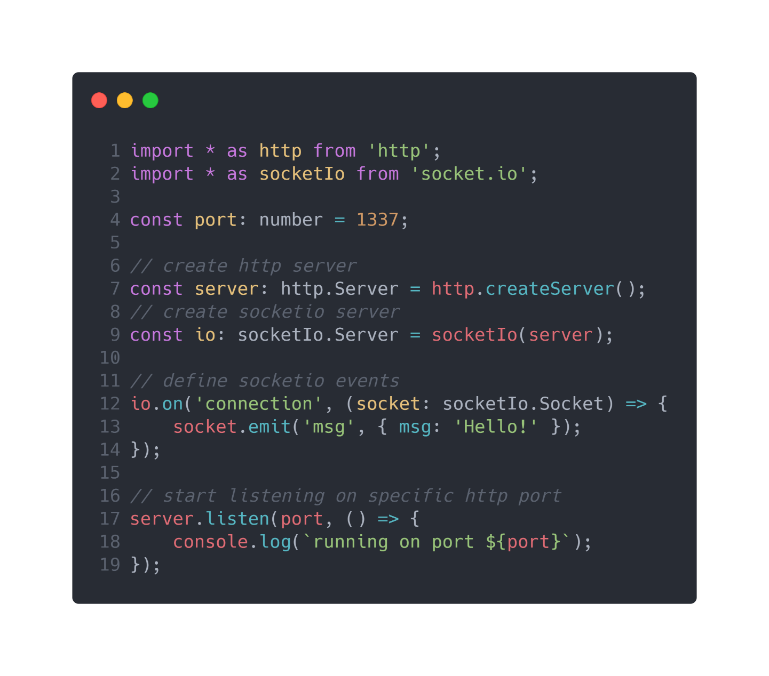
Socket.IO github.com/socketio/socket.io
github.com/10ITX3-CardsAgainstHumanity
Notes:
7

Slide 8
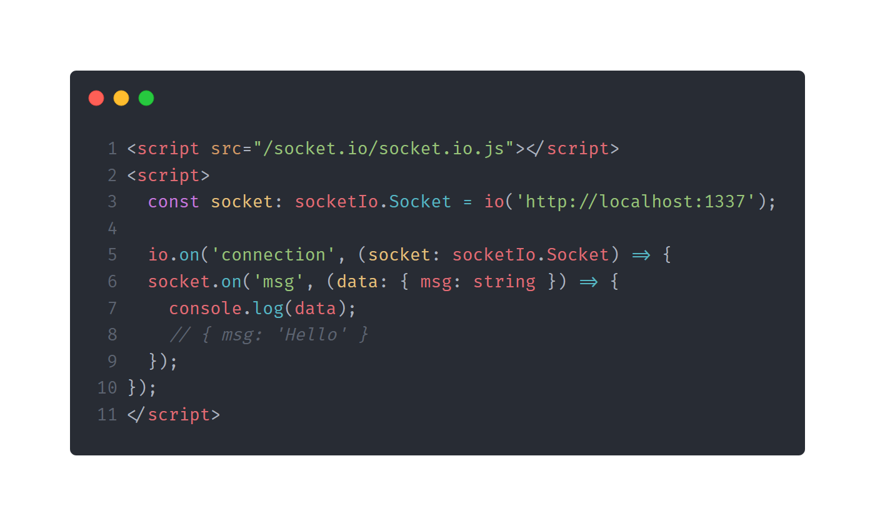
Socket.IO github.com/socketio/socket.io
github.com/10ITX3-CardsAgainstHumanity

Slide 9
Backend
github.com/10ITX3-CardsAgainstHumanity
Notes:
9

Slide 10
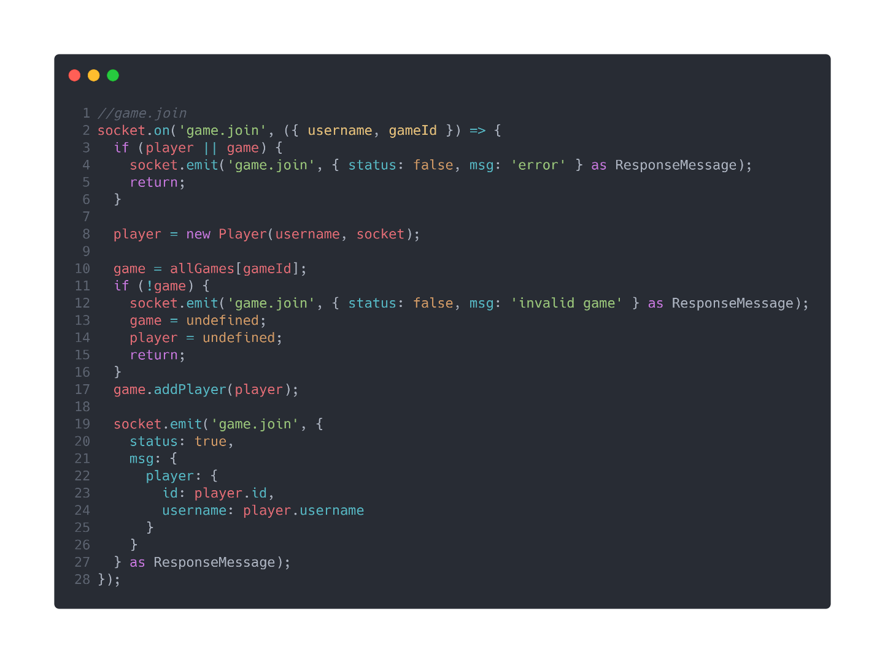
Backend
github.com/10ITX3-CardsAgainstHumanity
Notes:
10

Slide 11

Backend
github.com/10ITX3-CardsAgainstHumanity
Notes:
11

Slide 12
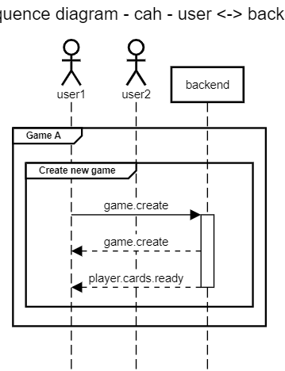
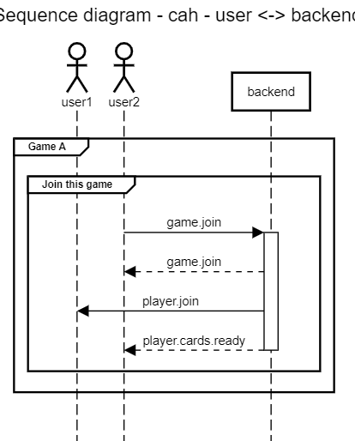
Backend Sequenzdiagramm stand github.com/10ITX3-CardsAgainstHumanity/cah-backend/commit/28474e3
github.com/10ITX3-CardsAgainstHumanity

Slide 13
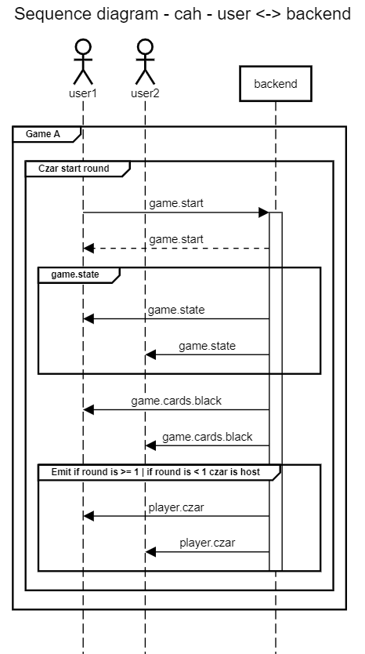
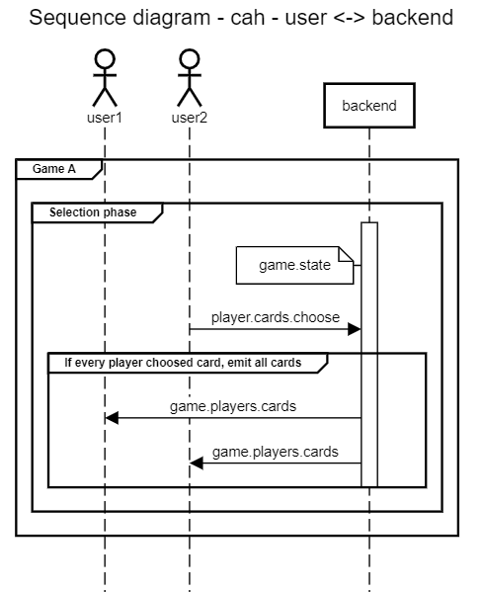
Backend Sequenzdiagramm stand github.com/10ITX3-CardsAgainstHumanity/cah-backend/commit/28474e3
github.com/10ITX3-CardsAgainstHumanity

Slide 14
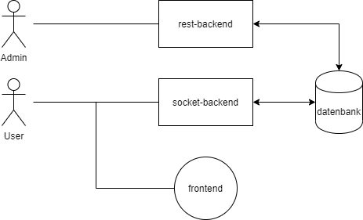
Infrastruktur
github.com/10ITX3-CardsAgainstHumanity
Notes:
14

Slide 15
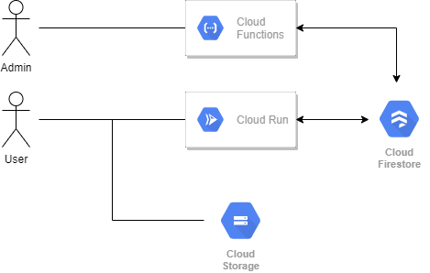
Infrastruktur
github.com/10ITX3-CardsAgainstHumanity
Notes:
15

Slide 16
cah.maxrs.de
Game ID: XXX
github.com/10ITX3-CardsAgainstHumanity

Slide 17
Cards Against Humanity
Philipp Czarnetzki Max Schäfer

