Slide 1
Cards Against Humanity
Philipp Czarnetzki Max Schäfer

Slide 2
Idee
Frontend
Backend
Infrastruktur
Live-Test

Slide 3
Idee

Slide 5
Socket.IO github.com/socketio/socket.io
Echtzeit
Bidirektional
Eventbasiert
Protokolle
WebSocket
Fallback HTTP (Long Polling)

Slide 6
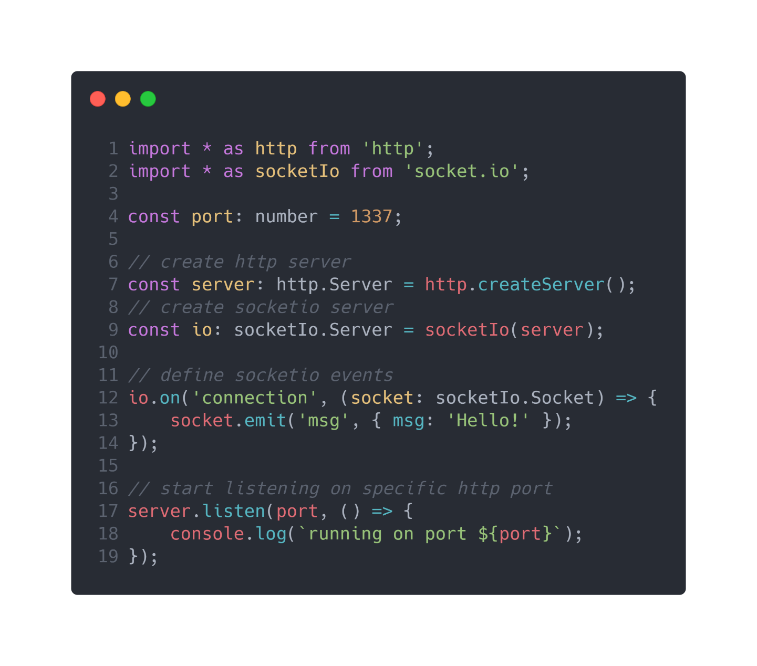
Socket.IO github.com/socketio/socket.io

Slide 7
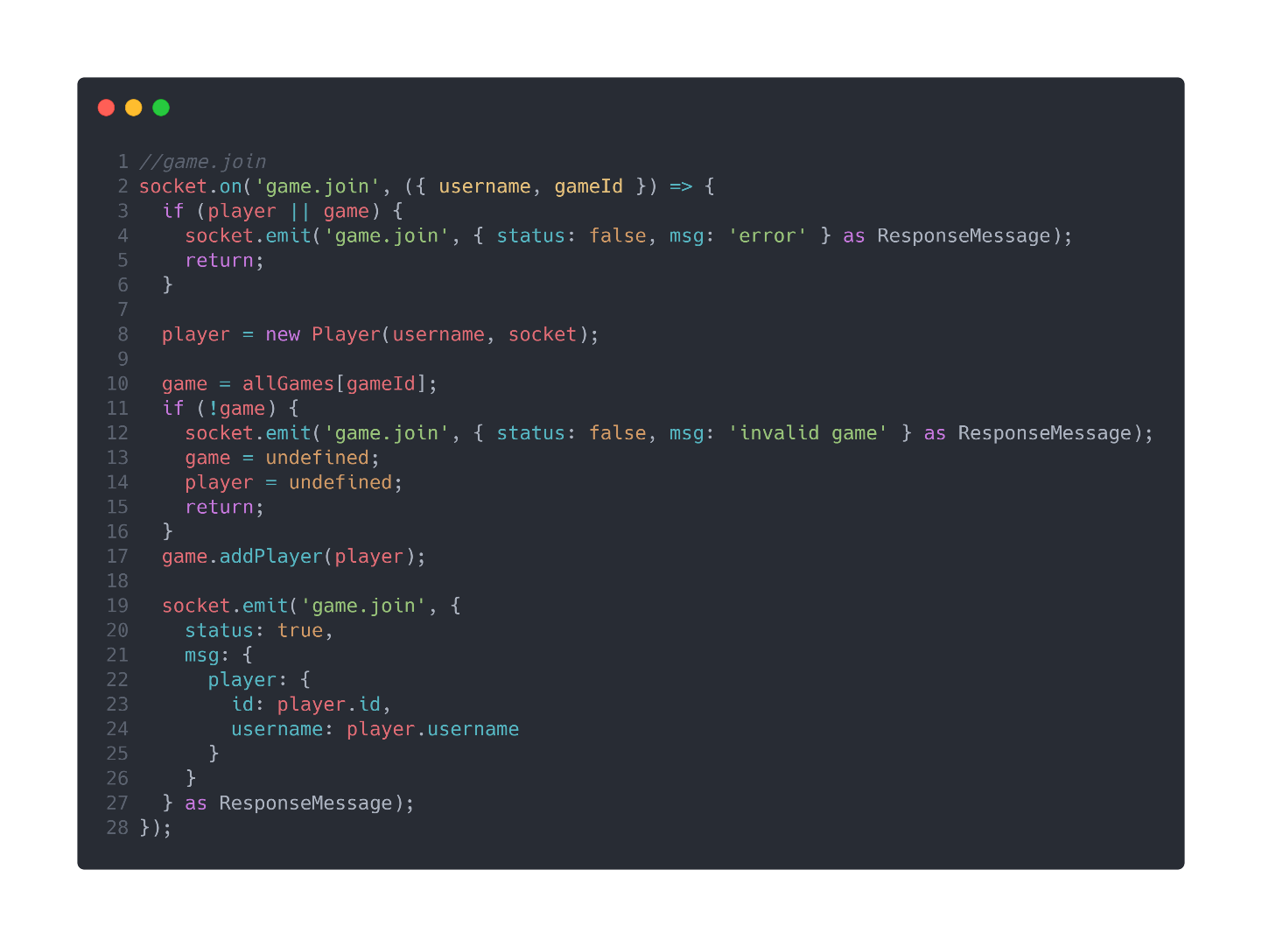
Socket.IO github.com/socketio/socket.io

Slide 8

Socket.IO github.com/socketio/socket.io

Slide 9
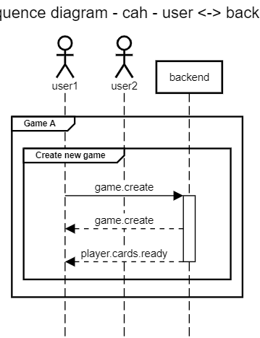
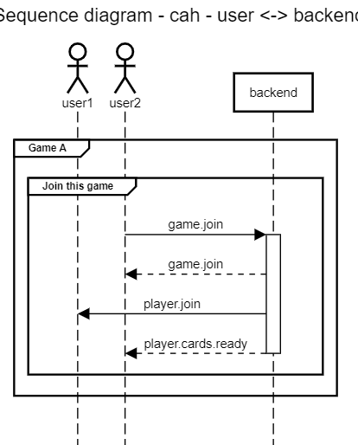
Sequenzdiagramm stand github.com/10ITX3-CardsAgainstHumanity/cah-backend/commit/28474e3

Slide 10
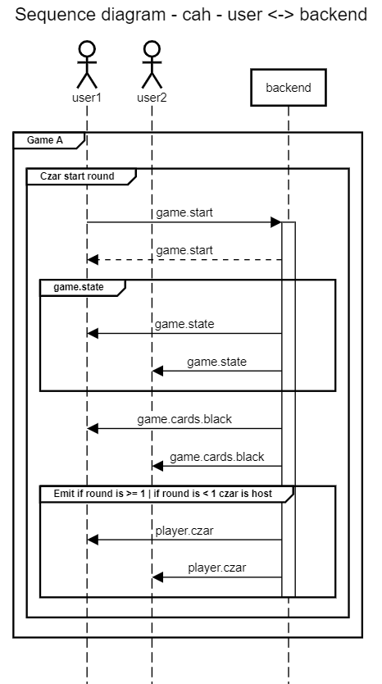
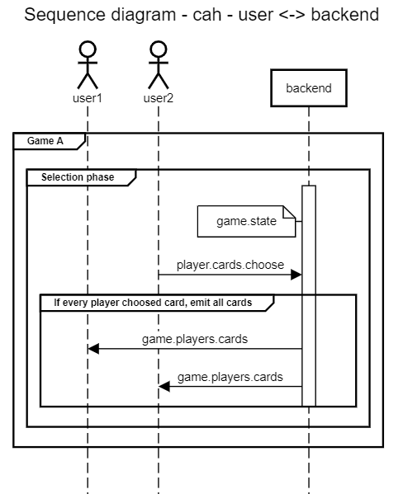
Sequenzdiagramm stand github.com/10ITX3-CardsAgainstHumanity/cah-backend/commit/28474e3

Slide 11
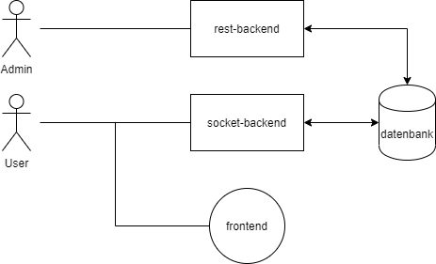
Infrastruktur

Slide 12
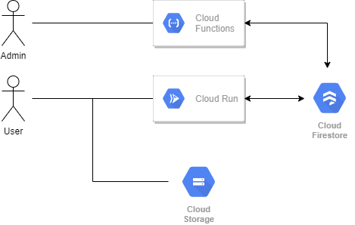
Infrastruktur

Slide 13
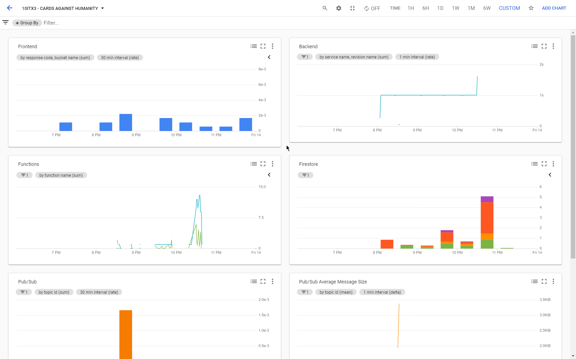
Infrastruktur

Slide 14
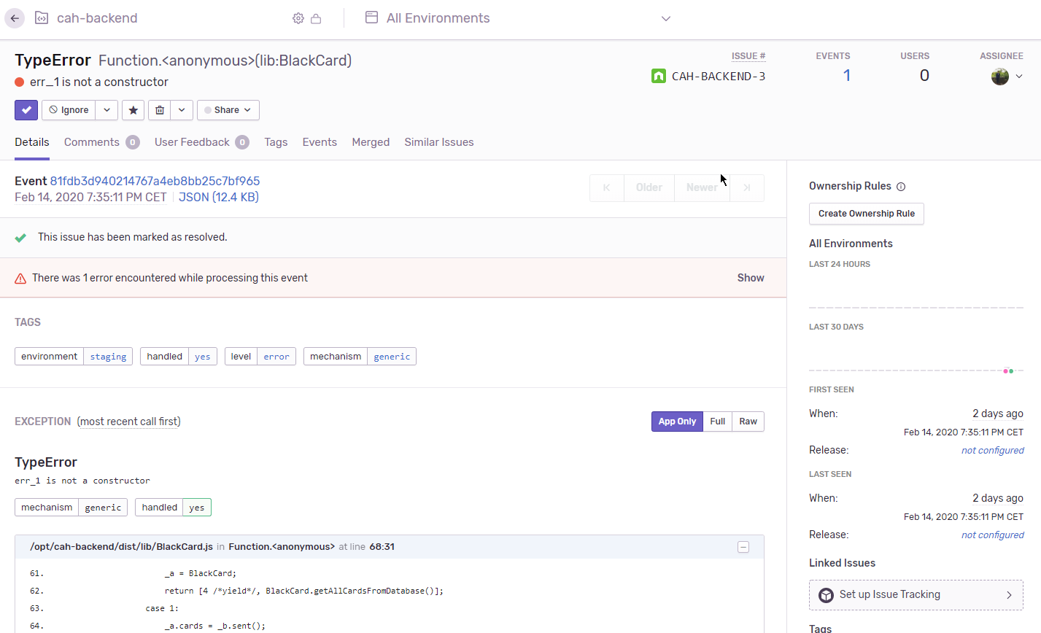
Infrastruktur

Slide 15
cah.maxrs.de
Game ID: XXX

Slide 16
Cards Against Humanity
Philipp Czarnetzki Max Schäfer

