Slide 1
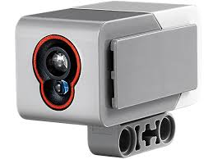
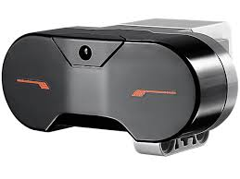
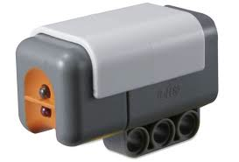
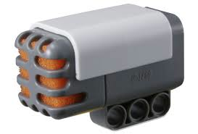
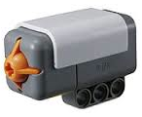
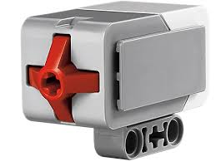
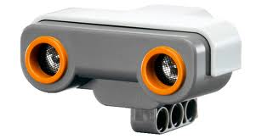
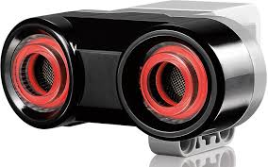
TYPE | VALUE | SENSOR | MODEL NAME | MODEL NUMBER | Ev3 | BrickPi
COLOR | Color Name (None, black, blue, green, yellow, red, white, brown) |  | EV3 Color Sensor | LEGO 45506 | ✓
INFRARED | Number – Percent Distance (0 to 100) |  | EV3 Infrared Sensor | LEGO 45509 | ✓
LIGHT | Number – Percent Reflected light intensity (0 to 100) |  | NXT Light Sensor | LEGO 9844 | ✓
SOUND | Number – percent Sound pressure level (0 to 100) |  | NXT Sound Sensor | LEGO 9845 | ✓
TOUCH | Boolean (0 or 1) Button pressed |  | NXT Touch Sensor | LEGO 9843 | ✓ | ✓
 |  |  | EV3 Touch Sensor | LEGO 45507 | ✓
ULTRASONIC | Number – centimeters Distance (0 to 255cm) |  | NXT Ultrasonic Sensor | LEGO 9846 | ✓ | ✓
 |  |  | EV3 Ultrasonic Sensor | LEGO 45504 | ✓

