Slide 1
Image Classification CIFAR100
Deep Learning,
Nicolas Hahn,
s91886

Slide 2
Task: Image Classification
CIFAR-100 (Canadian Institute for Advanced Research)
100 classes (grouped into 20 superclasses, each superclass has 5 subclasses)
Compare different network architectures, increase complexity
Compare techniques to improve accurancy and reduce overfiting
Implement networks from scratch and use pretrained from PyTorch
Analyse the results, which architectures works best

Slide 3
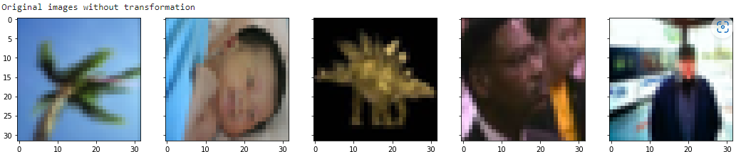
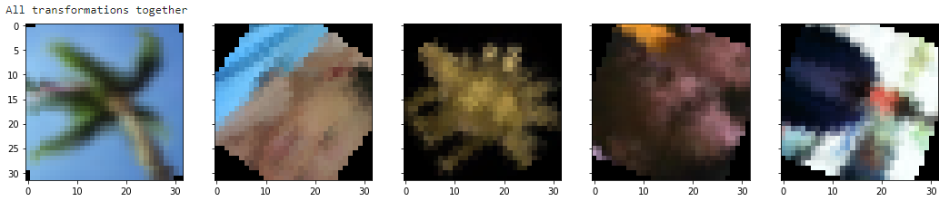
CIFAR-100 Dataset
60.000 images, 32x32 pixel, 600 per classes (500 training, 100 testing):
Every image : “fine” label and a “coarse” label:
→ Superclass: people, subclasses: baby, boy, girl, man, woman (predict)
Data augmentation for training:

Slide 4
Models
Architecture | Data augmenation | Additional information | Parameter
VGG16_Scratch | None | 50 training epochs (overfitting) Weight Decay | 34.015.396
VGG16_Scratch | Rotation RandomHorizontalFlip RandomErasing RandomResizedCrop | Dropout LearningRateScheduler (StepLR) 100 training epochs Weight Decay | 34.015.396
ResNet_Scratch | RandomHorizontalFlip RandomCrop | LearningRateScheduler (StepLR) 100 training epochs Weight Decay | 22.927.972
SpinalNet_ResNet101¹ | Resize RandomRotation RandomCrop RandomHorizontalFlip | Pretrained ResNet (PyTorch) LearningRateScheduler (StepLR) 35 training epochs Weight Decay | 125.857.796
1: source: https://paperswithcode.com/paper/reduction-of-class-activation-uncertainty
https://arxiv.org/abs/2007.03347
* All networks trained with momentum, weight decay and a batch size of 64 images

Slide 5
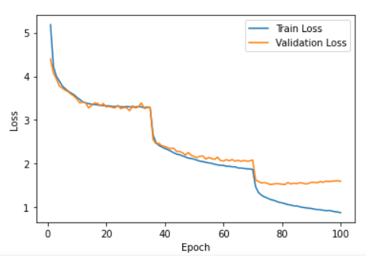
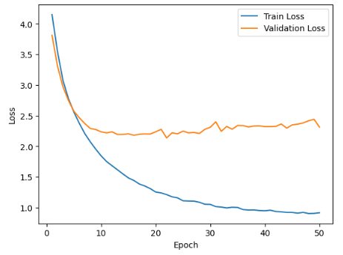
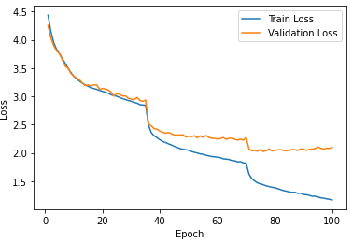
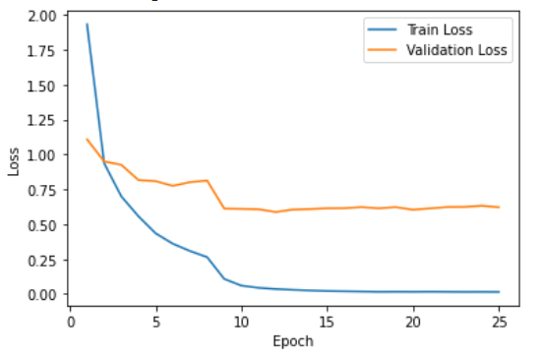
Results
1. VGG_Scratch: 49.69% Acc 3. ResNet_Scratch: 58.82% Acc
2. VGG_Dropout_DataAug.: 53.5% Acc. 4. SpinalNet_ResNet101: 84.98% Acc.

Slide 6
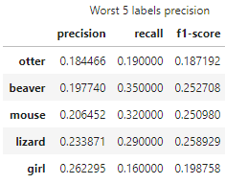
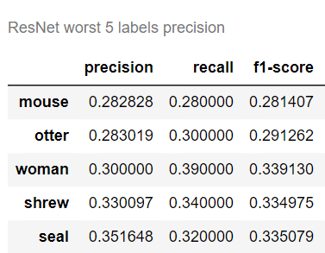
Overview/Discussion
CIFAR100 is a difficult data set (see also papers Overview)
All networks have problems with the same classes:
Big improve: complexity, Small improve: augmentation, dropout
SpinalNet_ResNet101 (top solution from „papers with code“):
→ did not reach the promised 96% Acc on my test data
→ but made big improve

