Slide 1
ANN Based System for Price Prediction of Share Market
Presented by,
1. Md. Kamrul Hasan Tuhin (Roll: ASH1701002M)
2. Md. Jafar Sadique (Roll: ASH1701049M)
3. Md. Ashikur Rahman (Roll: ASH1701062M)
4. Abdullah Al Numan (Roll: ASH1701018M)
5. Aumrina Akter (Roll: BKH1701020F)
6. Abdul Ali Mishu(Roll: ASH1601063M)

Slide 2
Introduction
Background & Statement of the Problem:
The stock market is the collection of markets and exchanges where regular activities of buying, selling, and issuance of shares of publicly-held companies take place.
Forecasting stock prices plays an important role in setting a trading strategy or determining the appropriate timing for buying or selling a stock.
Among various possibilities, artificial neural networks (ANNs) have demonstrated high predictive ability and have become popular financial forecasting tools.
Objectives:
In this project, we will explore the application of ANNs in the field of stock price and trend prediction.
We will test several neural network architectures on stock prices to see which one performs the best at predicting prices.

Slide 3
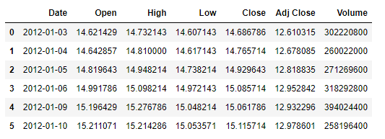
Methodology
Data preparation:
In this project, we are using Apple stock index data of 9 years from 2012 to 2020.
The data is loaded in csv format. Below table shows how data looks.
We're interested in intra-day stock closing price since investors typically make buying decisions based only on the company closing value.

Slide 4

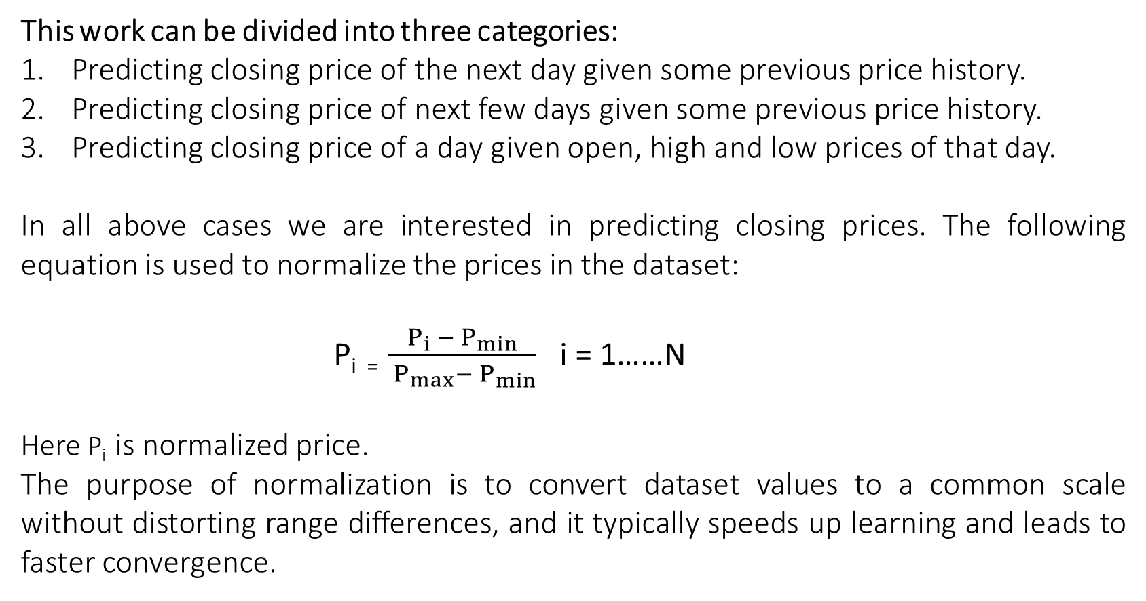


This work can be divided into three categories:
Predicting closing price of the next day given some previous price history.
Predicting closing price of next few days given some previous price history.
Predicting closing price of a day given open, high and low prices of that day.
In all above cases we are interested in predicting closing prices. The following equation is used to normalize the prices in the dataset:
P_{i =} $\frac{P_{i} −{ P}_{min}}{{ P}_{max}− P_{min}}$ i = 1……N
Here P_{i} is normalized price.
The purpose of normalization is to convert dataset values to a common scale without distorting range differences, and it typically speeds up learning and leads to faster convergence.
$$\sim$$
$$\sim$$
$$\sim$$

Slide 5
Next, dataset is organized to inputs and targets by moving a window of fixed sized along closing prices column of the dataset.
The dataset is divided into training, validation and testing sets with 70% for training, 30% for validation and testing.
Inputs |  |  | Target
t-3 | t-2 | t-1 | t
14.686786 | 14.765714 | 14.929643 | 15.085714
14.765714 | 14.929643 | 15.085714 | 15.061786
14.929643 ….. ….. | 15.085714 ….. ….. | 15.061786 ….. ….. | 15.115714 ….. …..

Slide 6
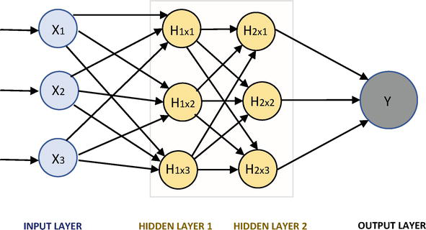


Network architecture:
Artificial Neural Network (Dense): An artificial neural network is an interconnected group of nodes, inspired by a simplification of neurons in a brain. In any artificial neural network, a dense layer is a layer that is deeply connected with its preceding layer which means the neurons of the layer are connected to every neuron of its preceding layer. This layer is the most commonly used layer in artificial neural network networks.
$$\sim$$
$$\sim$$

Slide 7
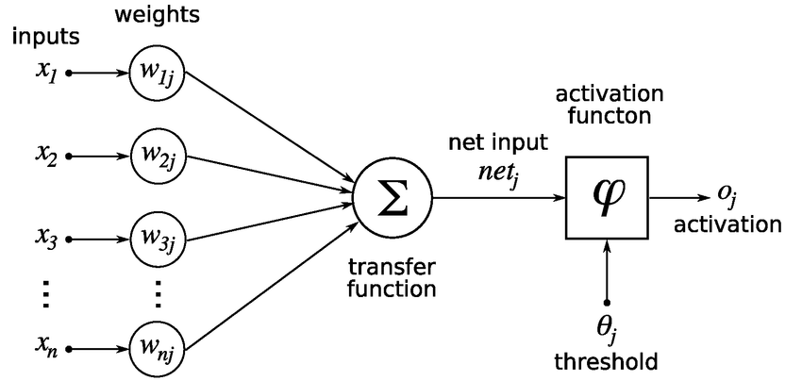
Single ANN neuron

Slide 8
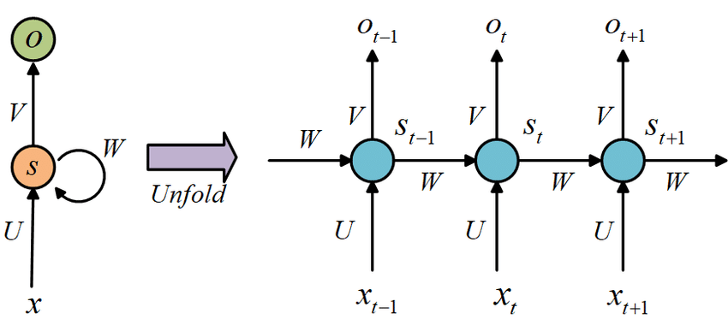
Recurrent Neural Network: Recurrent neural network is a network that works on time series or sequence data. Recurrent Neural Networks accept input from two sorts of sources: current and past. This is important because the sequence of data contains crucial information about what is coming next, which is why a RNN can do things other algorithms can’t.

Slide 9
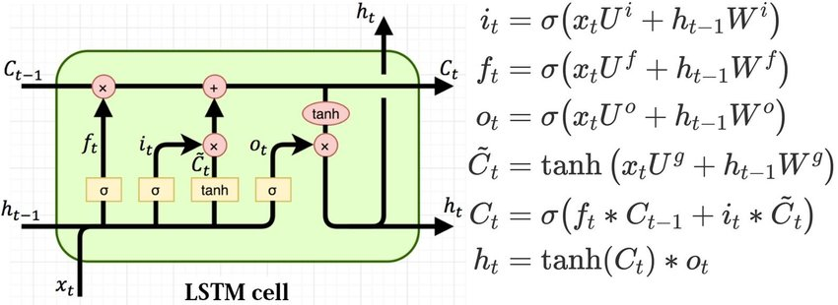
In our project we will use LSTM version of RNN

Slide 10
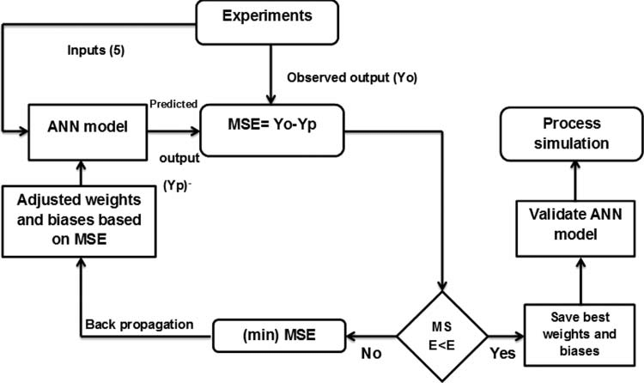
Training:
We will train neural network using backpropagation algorithm. Backpropagation is a short form for "backward propagation of mistakes" in a neural network. It's a common way to train artificial neural networks. This approach is useful for calculating the gradient of a loss function with respect to all of the network's weights.

Slide 11
Expected Results
Artificial neural networks (ANNs) have shown to be effective financial forecasting tools due to their excellent predictive power. We expect that, by employing ANN models, we will be able to develop a good predictor that can accurately forecast stock prices with minimum mistakes.
Conclusion
In this proposal, we have discussed Artificial Neural Network models to forecast the stock price of the company Apple, which is one of the most competitive companies in the world. These models are reasonably efficient in recognizing patterns that exist in the domain of stock market.

