Slide 1
TEROS NETWORK UPDATE – 02/27/2021
Visualizing TEROS data from 09/2020 to present
Documenting sensor-specific data gaps for records and to understand network failure cascade
Data are shown per logger. Each logger covers one-third of a plot. Location highlighted in yellow
5 cm=blue; 15 cm=black; 30 cm=red
Sensors not recording data as of 02/27/2021 are bold (2 in Control Plot, 5 in Freshwater Plot, 4 in Seawater Plot)

Slide 2
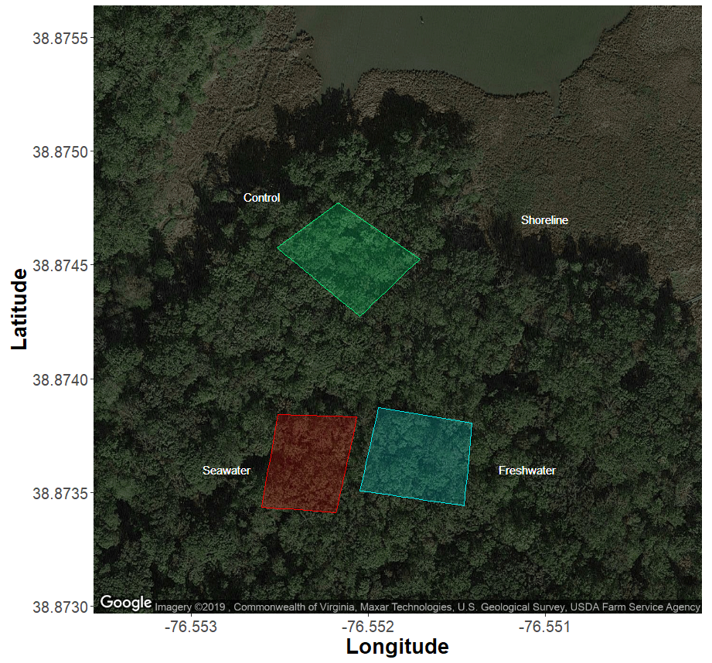
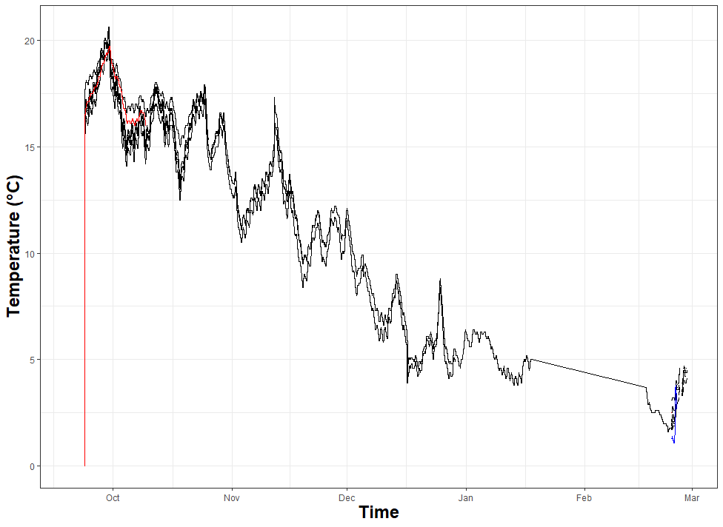
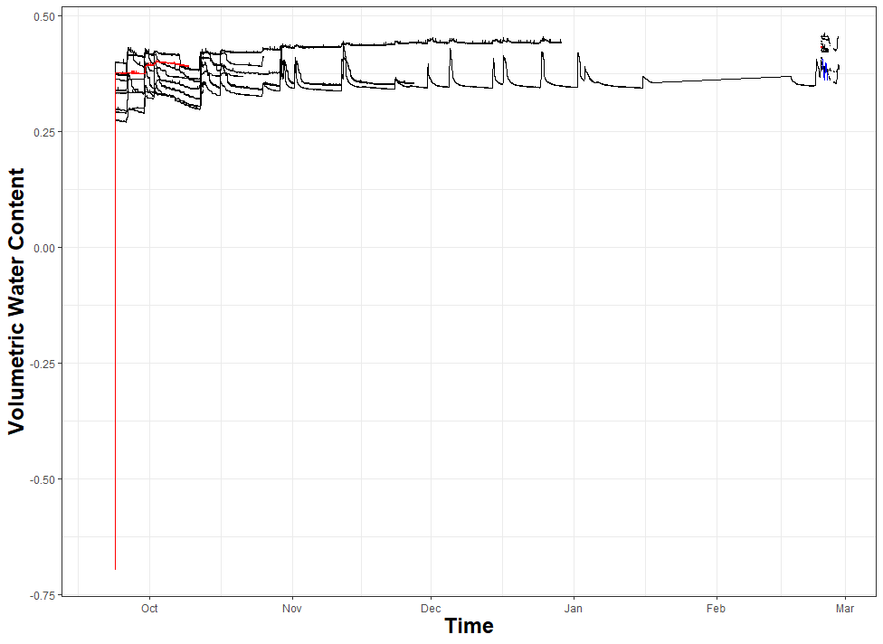
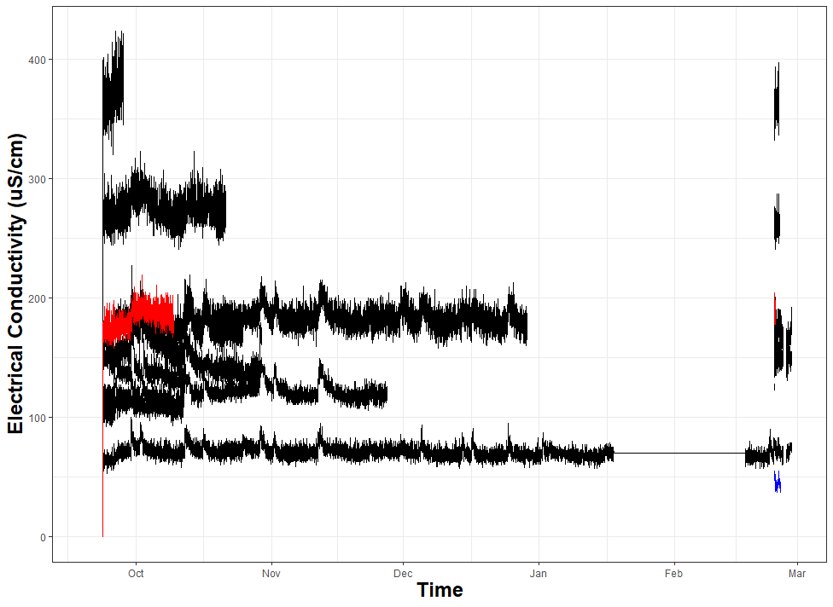
CONTROL PLOT – NORTHWESTERN THIRD (PNNL11)
5 cm
15 cm
30 cm
14 sensors:
#no gaps; T135
#gap from late October-present; T100
#gap from October-February; T132
#gap from late October-February; T160
#gap from late November-present; T133
#gap from late December-present;T019
#no data until February; T056
#no data until February;T129
#gap from mid-October-February; T058
#no data; T059
#no data until February; T060
#no data until February; 5cm; T138
#gap from November-present; T055
#big jump sensor; 30 cm; gap from late-October-present; T101

Slide 3
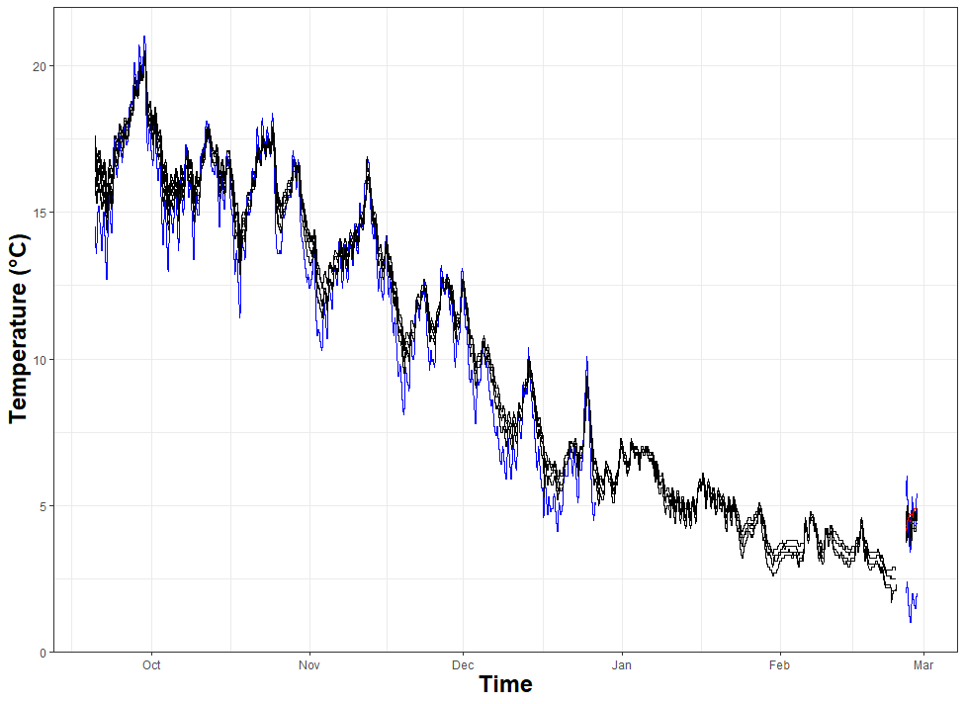
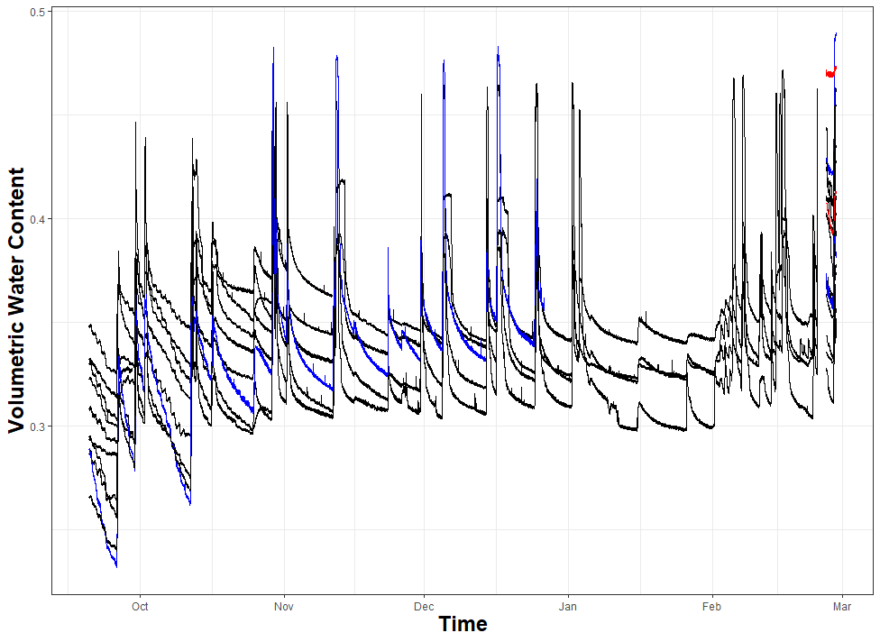
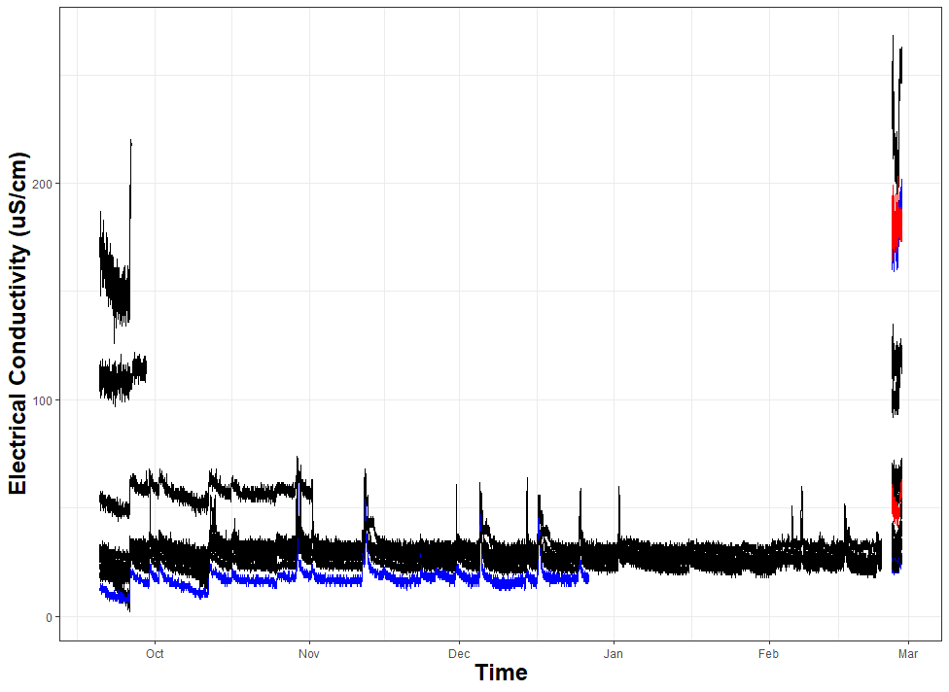
CONTROL PLOT – NORTHEASTERN THIRD (PNNL13)
5 cm
15 cm
30 cm
17 sensors:
#maintenance gap in February; T099
#no data until February; T113
#gap from late-October-February; T137
#gap from late September-February; T109
#maintenance gap in February; T103
#gap from late September-February; T104
#no data until February; T033
#gap from November-February; T057
#maintenance gap in February; T035
#no data until February; T110
#gap from mid November-February; T111
#gap from late December-February; T134
#maintenance gap in February; T107
#no data until February; T117
#no data until February; T095
#no data until February; T039
#no data until February; T130

Slide 4
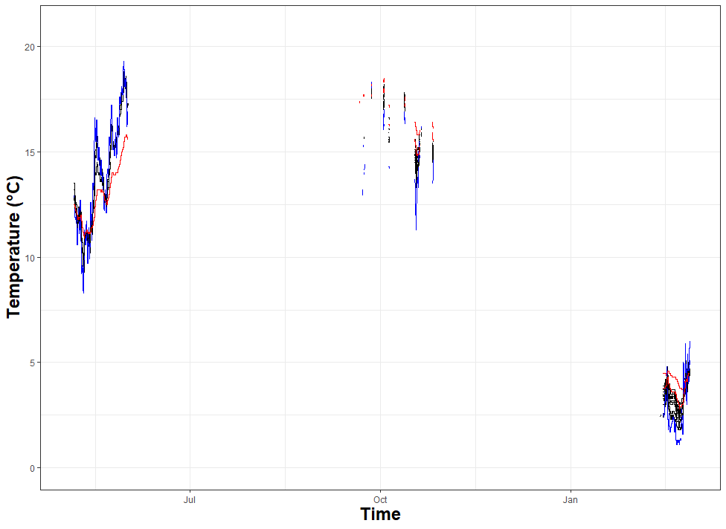
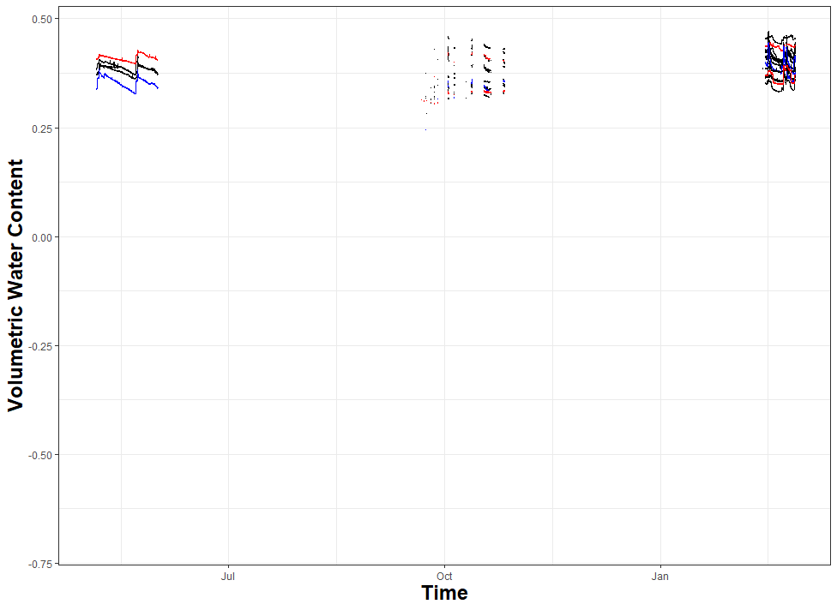
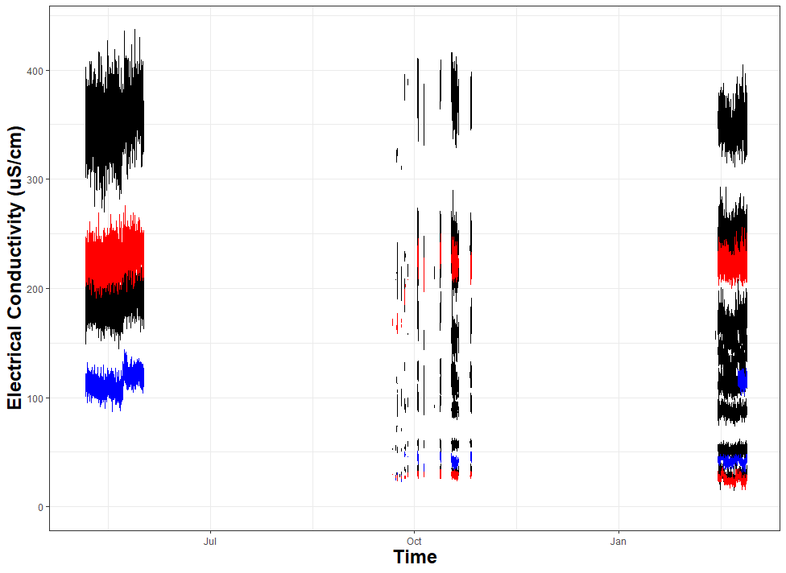
CONTROL PLOT – SOUTHERN THIRD (PNNL12)
15 sensors:
#on in February; T112
#data for all chunks; on in February; T136
#on in February; T114
#on in February; T115
#on in February; T116
#data for all chunks; on in February; T036
#on in February; T037
#on in February; T074
#on in February; T062
#data for all chunks; on in February; T108
#data for all chunks; on in February; T097
#data for all chunks; on in February; T079
#on in February; T131
#on in February; T034
#on in February; T127
5 cm
15 cm
30 cm
Why is there data for June? All data files pulled and processed in same way. Could not find summer dates in data frame.

Slide 5
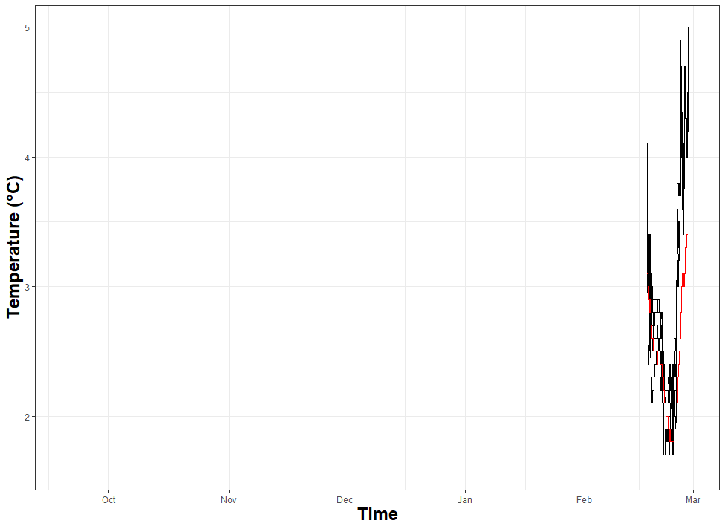
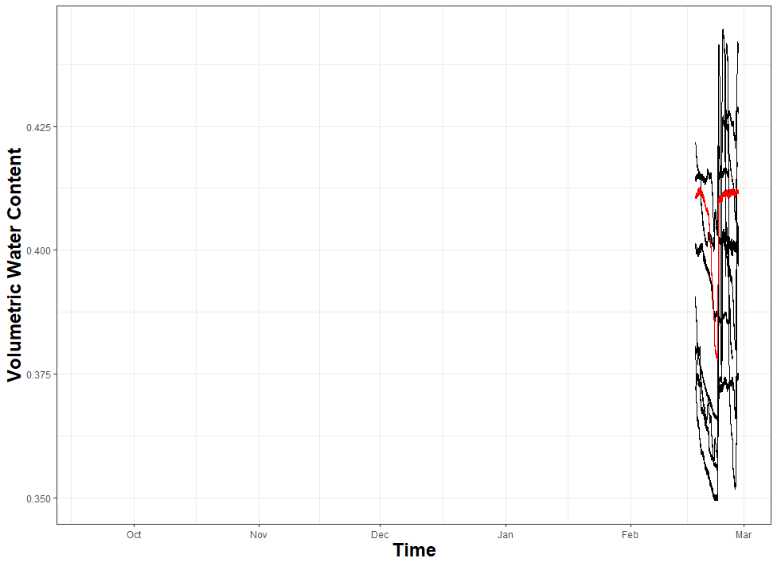
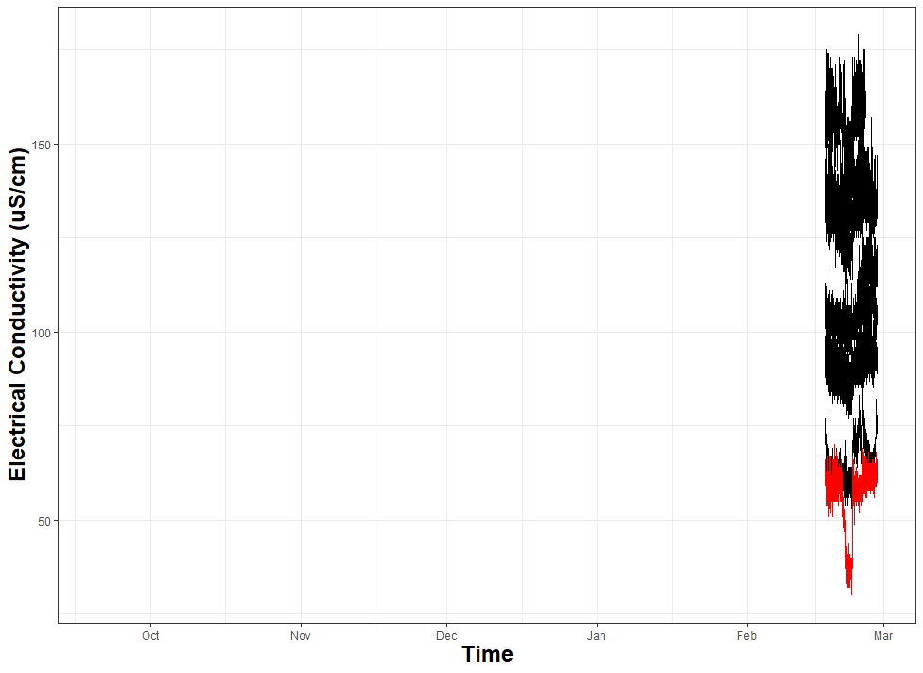
FRESHWATER PLOT – NORTHWESTERN THIRD (PNNL22)
5 cm
15 cm
30 cm
14 sensors:
#no data until February; T076
#no data until February; T077
#no data until February; T078
#no data until February; T053
#no data; T080
#no data until February; T081
#no data; T082
#no data until February; T083
#no data until February; T084
#no data until February; T085
#no data until February; T086
#no data; T040
#no data until February; T041
#no data until February; T042

Slide 6
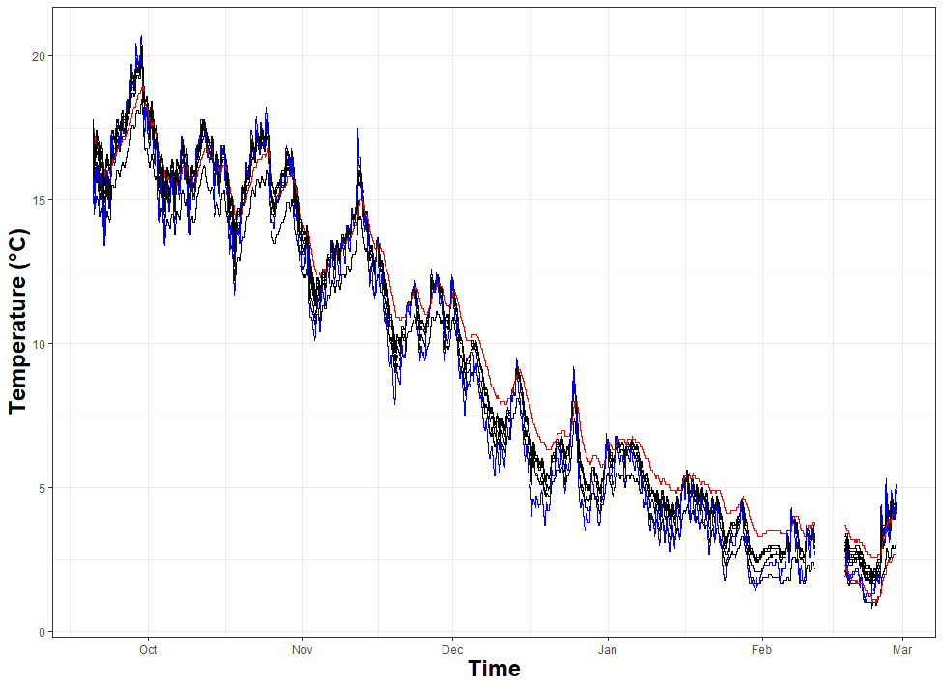
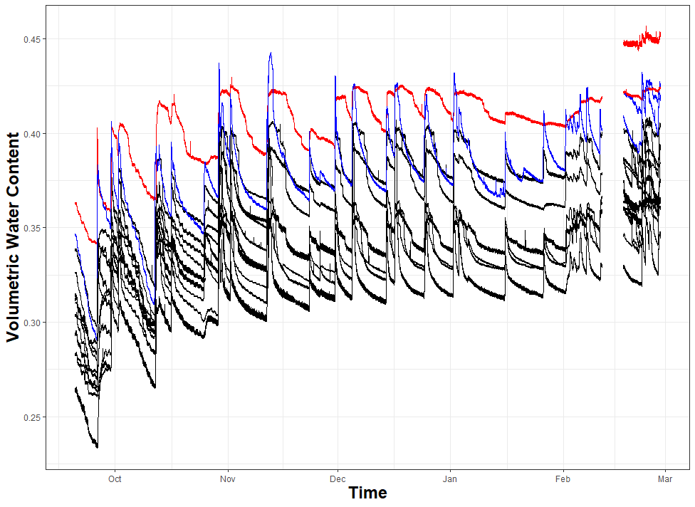
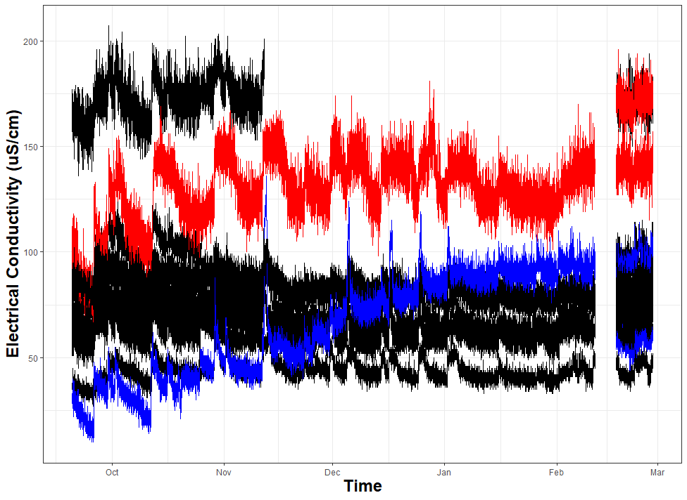
FRESHWATER PLOT – NORTHEASTERN THIRD (PNNL21)
5 cm
15 cm
30 cm
17 sensors:
#gap from mid-November-February; T001
#no data until February; T002
#maintenance gap in February; T003
#gap from late October-present; T004
#maintenance gap in February; T005
#maintenance gap in February; T006
#gap from late October-February; T007
#maintenance gap in February; T008
#maintenance gap in February; T009
#maintenance gap in February; T012
#gap from late-November-February; T013
#no data until February; T121
#no data until February; T122
#maintenance gap in February; T123
#maintenance gap in February; T124
#gap from late November-February; T125
#no data until February; T126

Slide 7
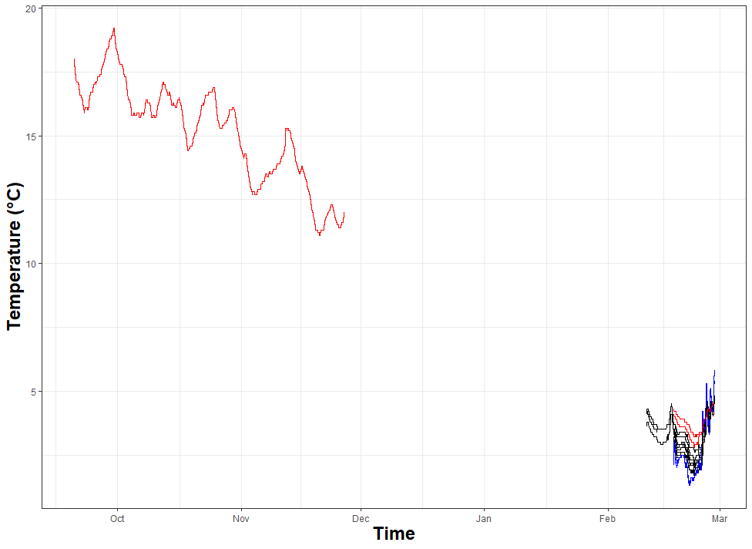
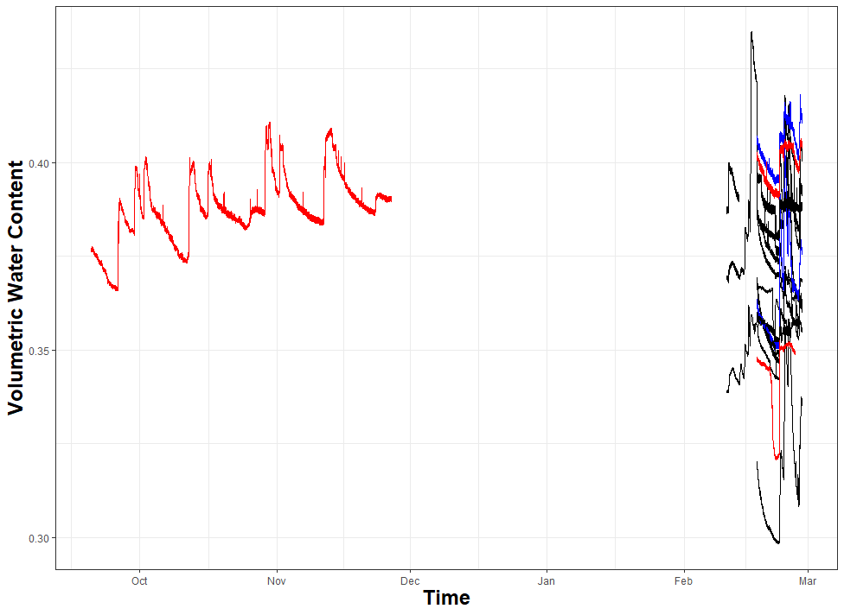
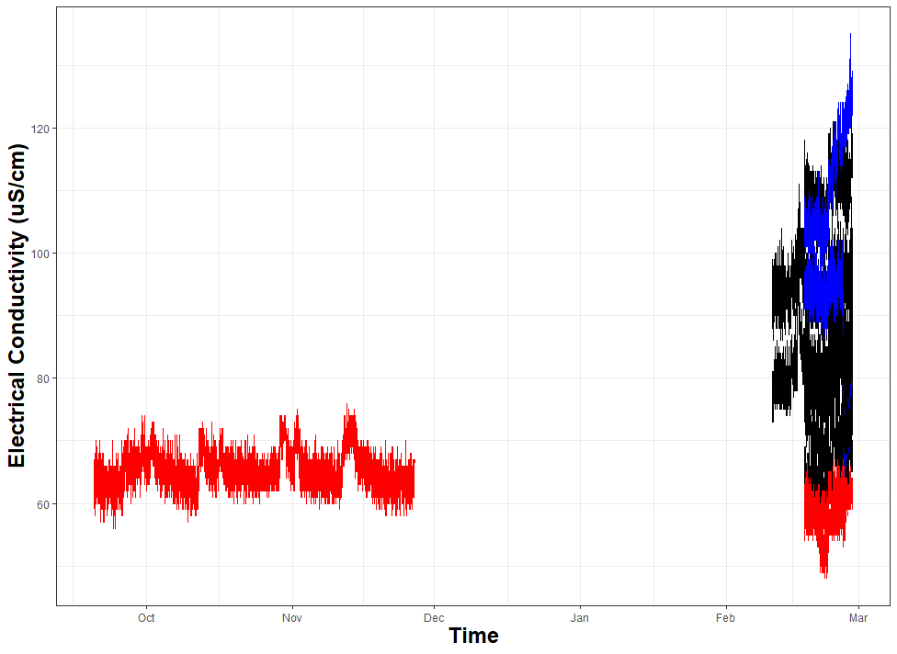
FRESHWATER PLOT – SOUTHERN THIRD (PNNL23)
5 cm
15 cm
30 cm
15 sensors:
#no data until February; T014
#briefly on in February, then off; T015
#no data until February; T016
#no data until February; T017
#no data until February; T018
#no data until February; T010
#no data until February; T011
#no data until February; T025
#no data until February; T026
#no data until February; T118
#no data until February; T119
#no data until February; T120
#no data until February; T043
#no data until February; T044
#gap from late December-February; T045

Slide 8
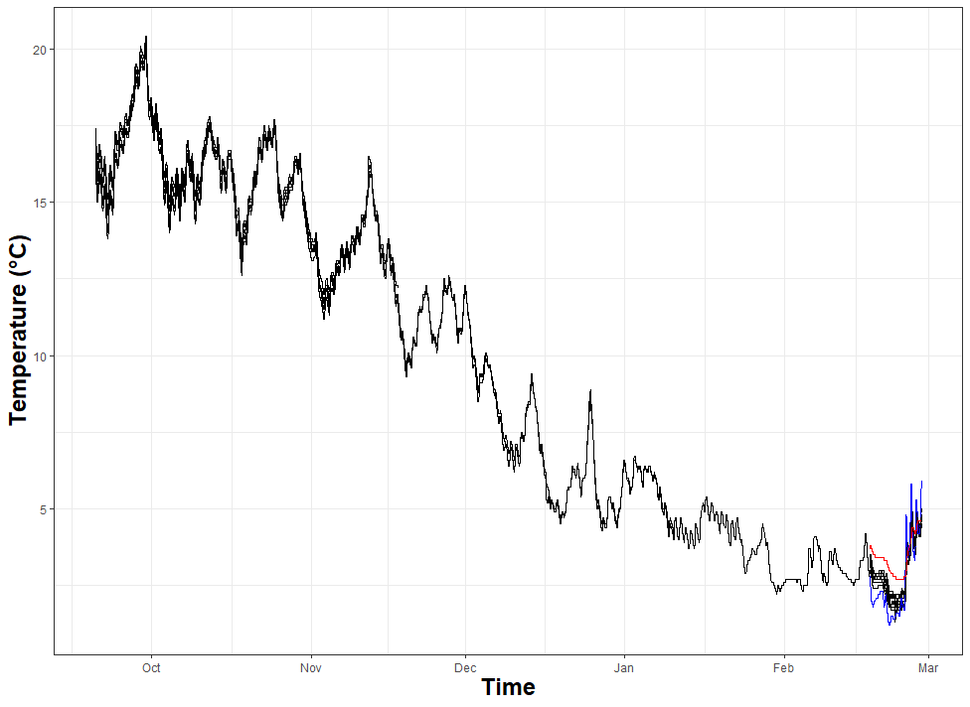
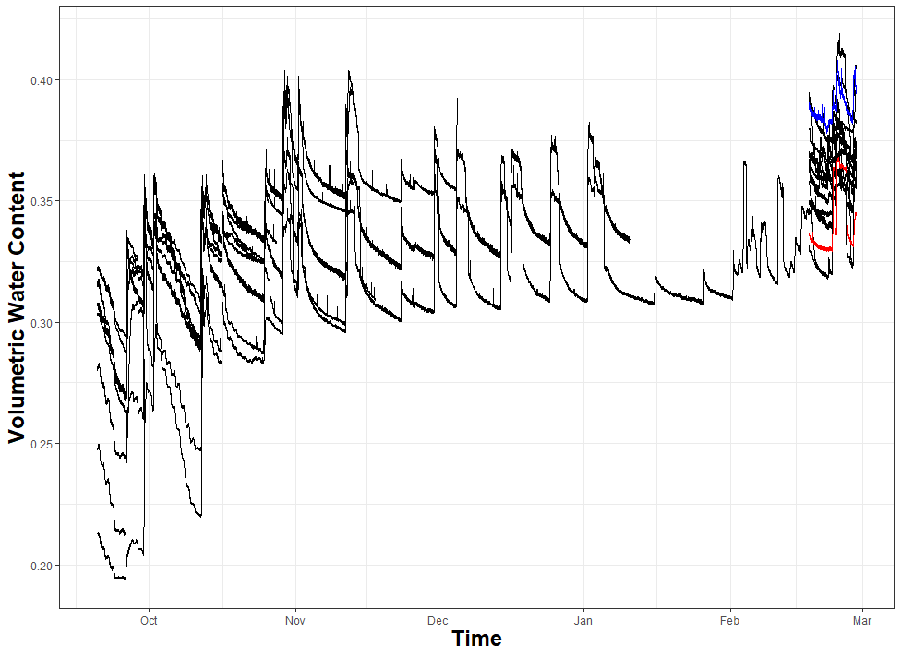
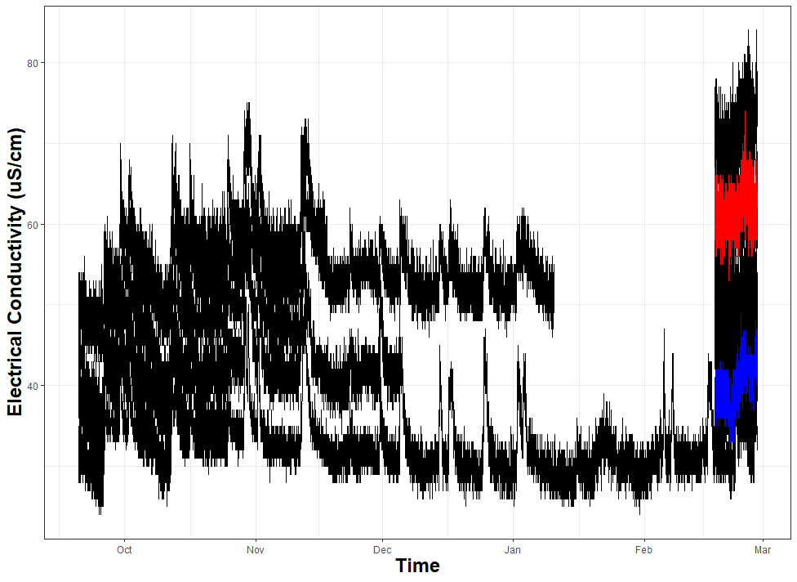
SEAWATER PLOT – NORTHWESTERN THIRD (PNNL31)
5 cm
15 cm
30 cm
14 sensors:
#no data until February; T027
#no data until February; T028
#gap from mid November-February; T029
#maintenance gap in February; T030
#gap from late October-February; T031
#gap from mid December-February; T032
#gag from late October-February; T020
#gap from mid January-February; T021
#gap from mid November-February; T022
#no data until February; T023
#no data until February; T024
#no data until February; T089
#no data until February; T090
#no data until February; T091

Slide 9
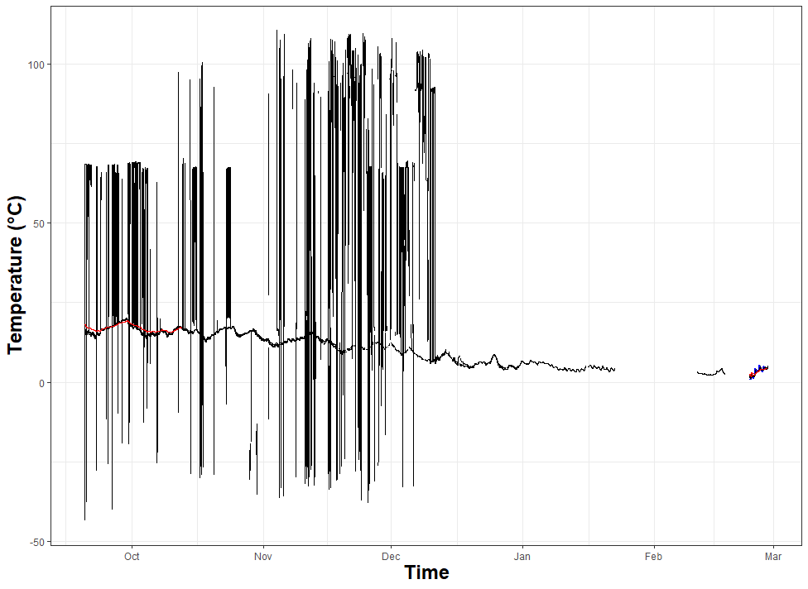
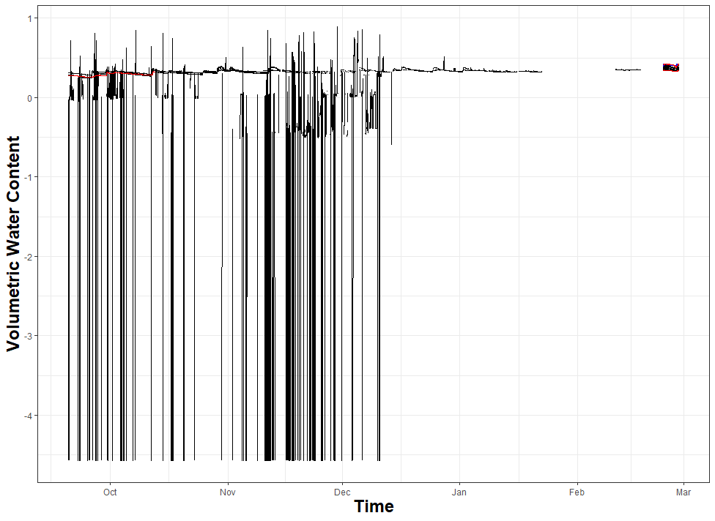
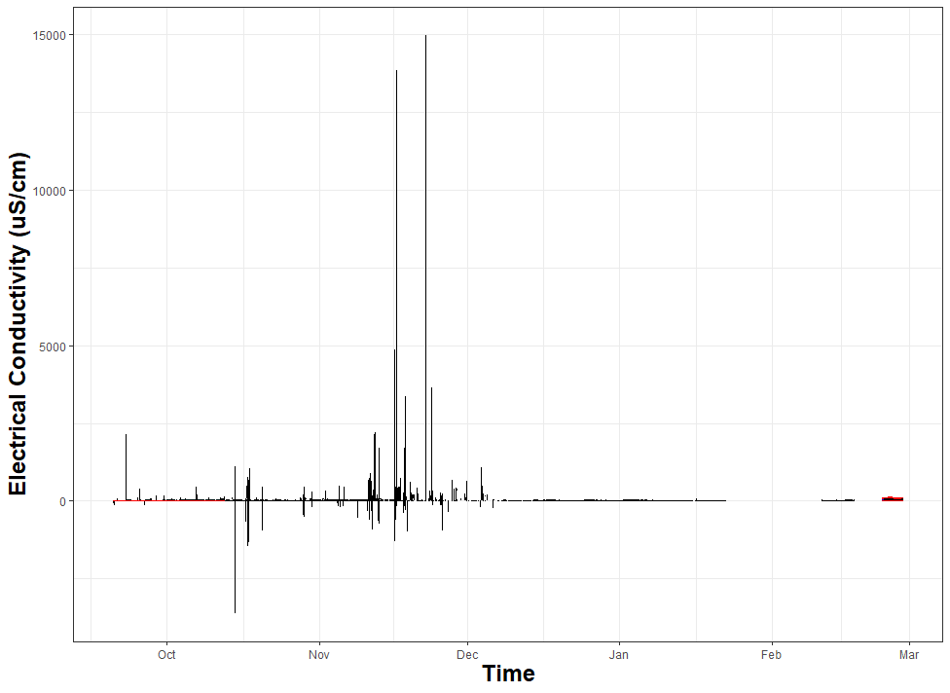
SEAWATER PLOT – SOUTHWESTERN THIRD (PNNL33)
17 sensors:
#gap from late January-February; T063
#on in February T064
#gap from mid November-February (no jumps); T065
#gap from mid November-February; T066
#no data until February; T067
#no data until February; T068
#no data until February; T069
#no data until February; T070
#no data until February; T071
#no data until February; T087
#gap from mid December-February (no jumps); T088
#briefly on in February then off; T092
#gap from mid January-February (no jumps); T093
#gap mid October-February (no jumps); T094
#no data until February; T046
#no data until February; T047
#no data until February; T048
5 cm
15 cm
30 cm
What causes huge sensor jumps?

Slide 10
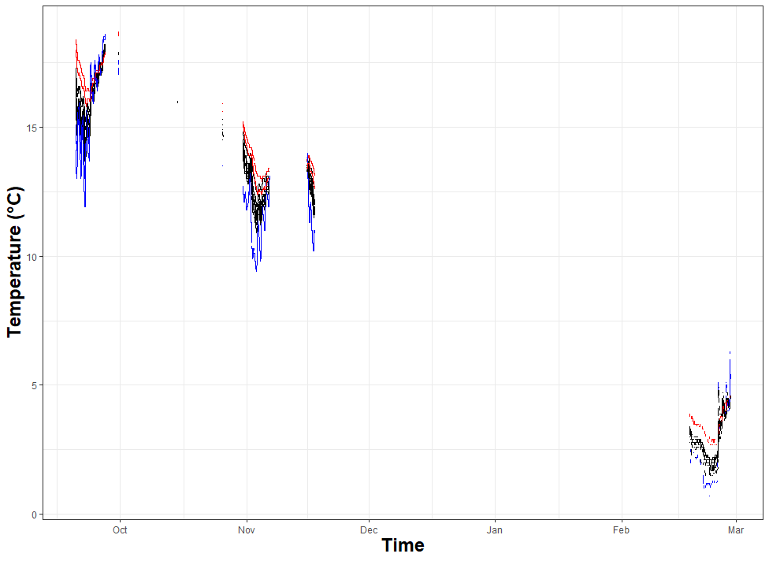
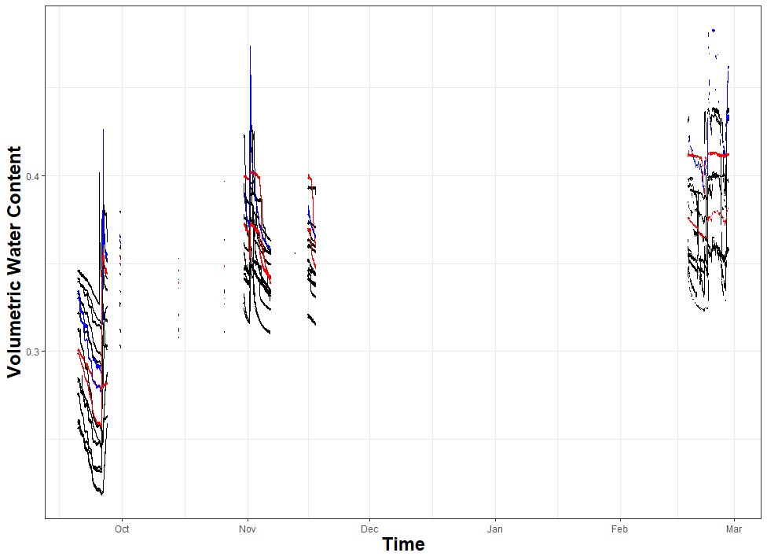
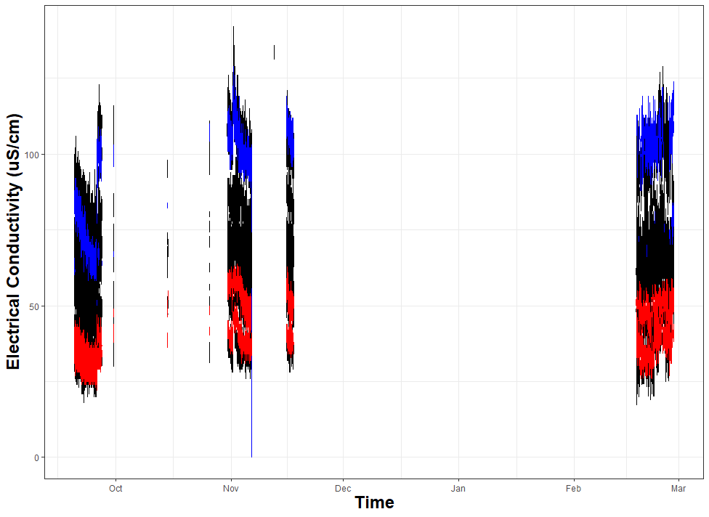
SEAWATER PLOT – WESTERN (N&S) THIRD (PNNL32)
15 sensors:
#data for all chunks; on in February; T050
#data first two chunks; off in February; T051
#data for all chunks; on in February; T052
#data for all chunks; on in February; T102
#data for first two chunks; off in February; T054
#data for all chunks; on in February; T072
#data for all chunks; on in February; T073
#data for all chunks; on in February; T038
#data for first two chunks; briefly on in February, then off; T075
#data for first chunk; on in February; T105
#data for all chunks; on in February; T049
#data for all chunks; on in February; T098
#data for all chunks; on in February; T106
#data for all chunks; on in February; T096
#data for all chunks; on in February; T128
5 cm
15 cm
30 cm

