Slide 1
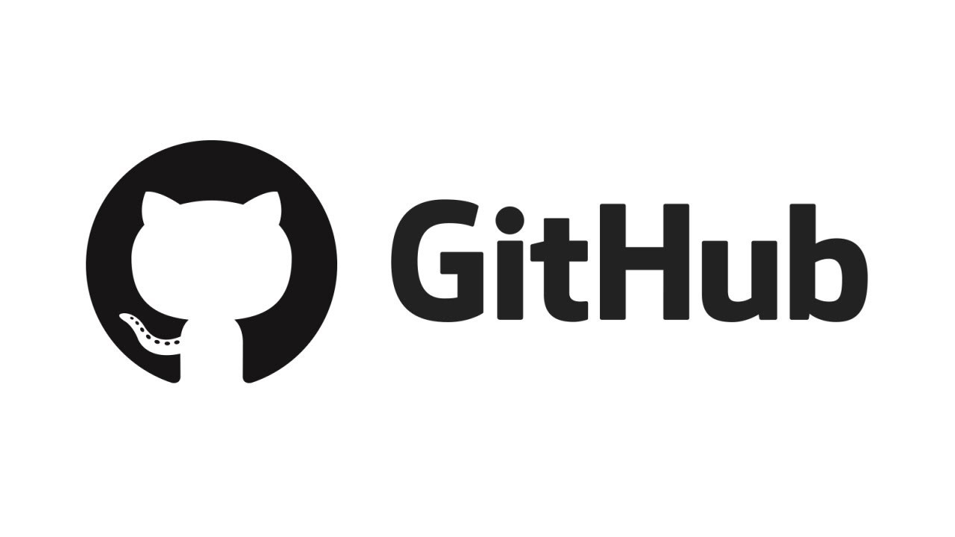
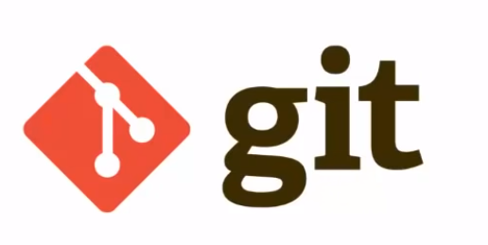
An Introduction to Version Control, Git, and Github
Andrew Davis
5/4/2021

Slide 2
Why should I use Version Control?

Slide 3
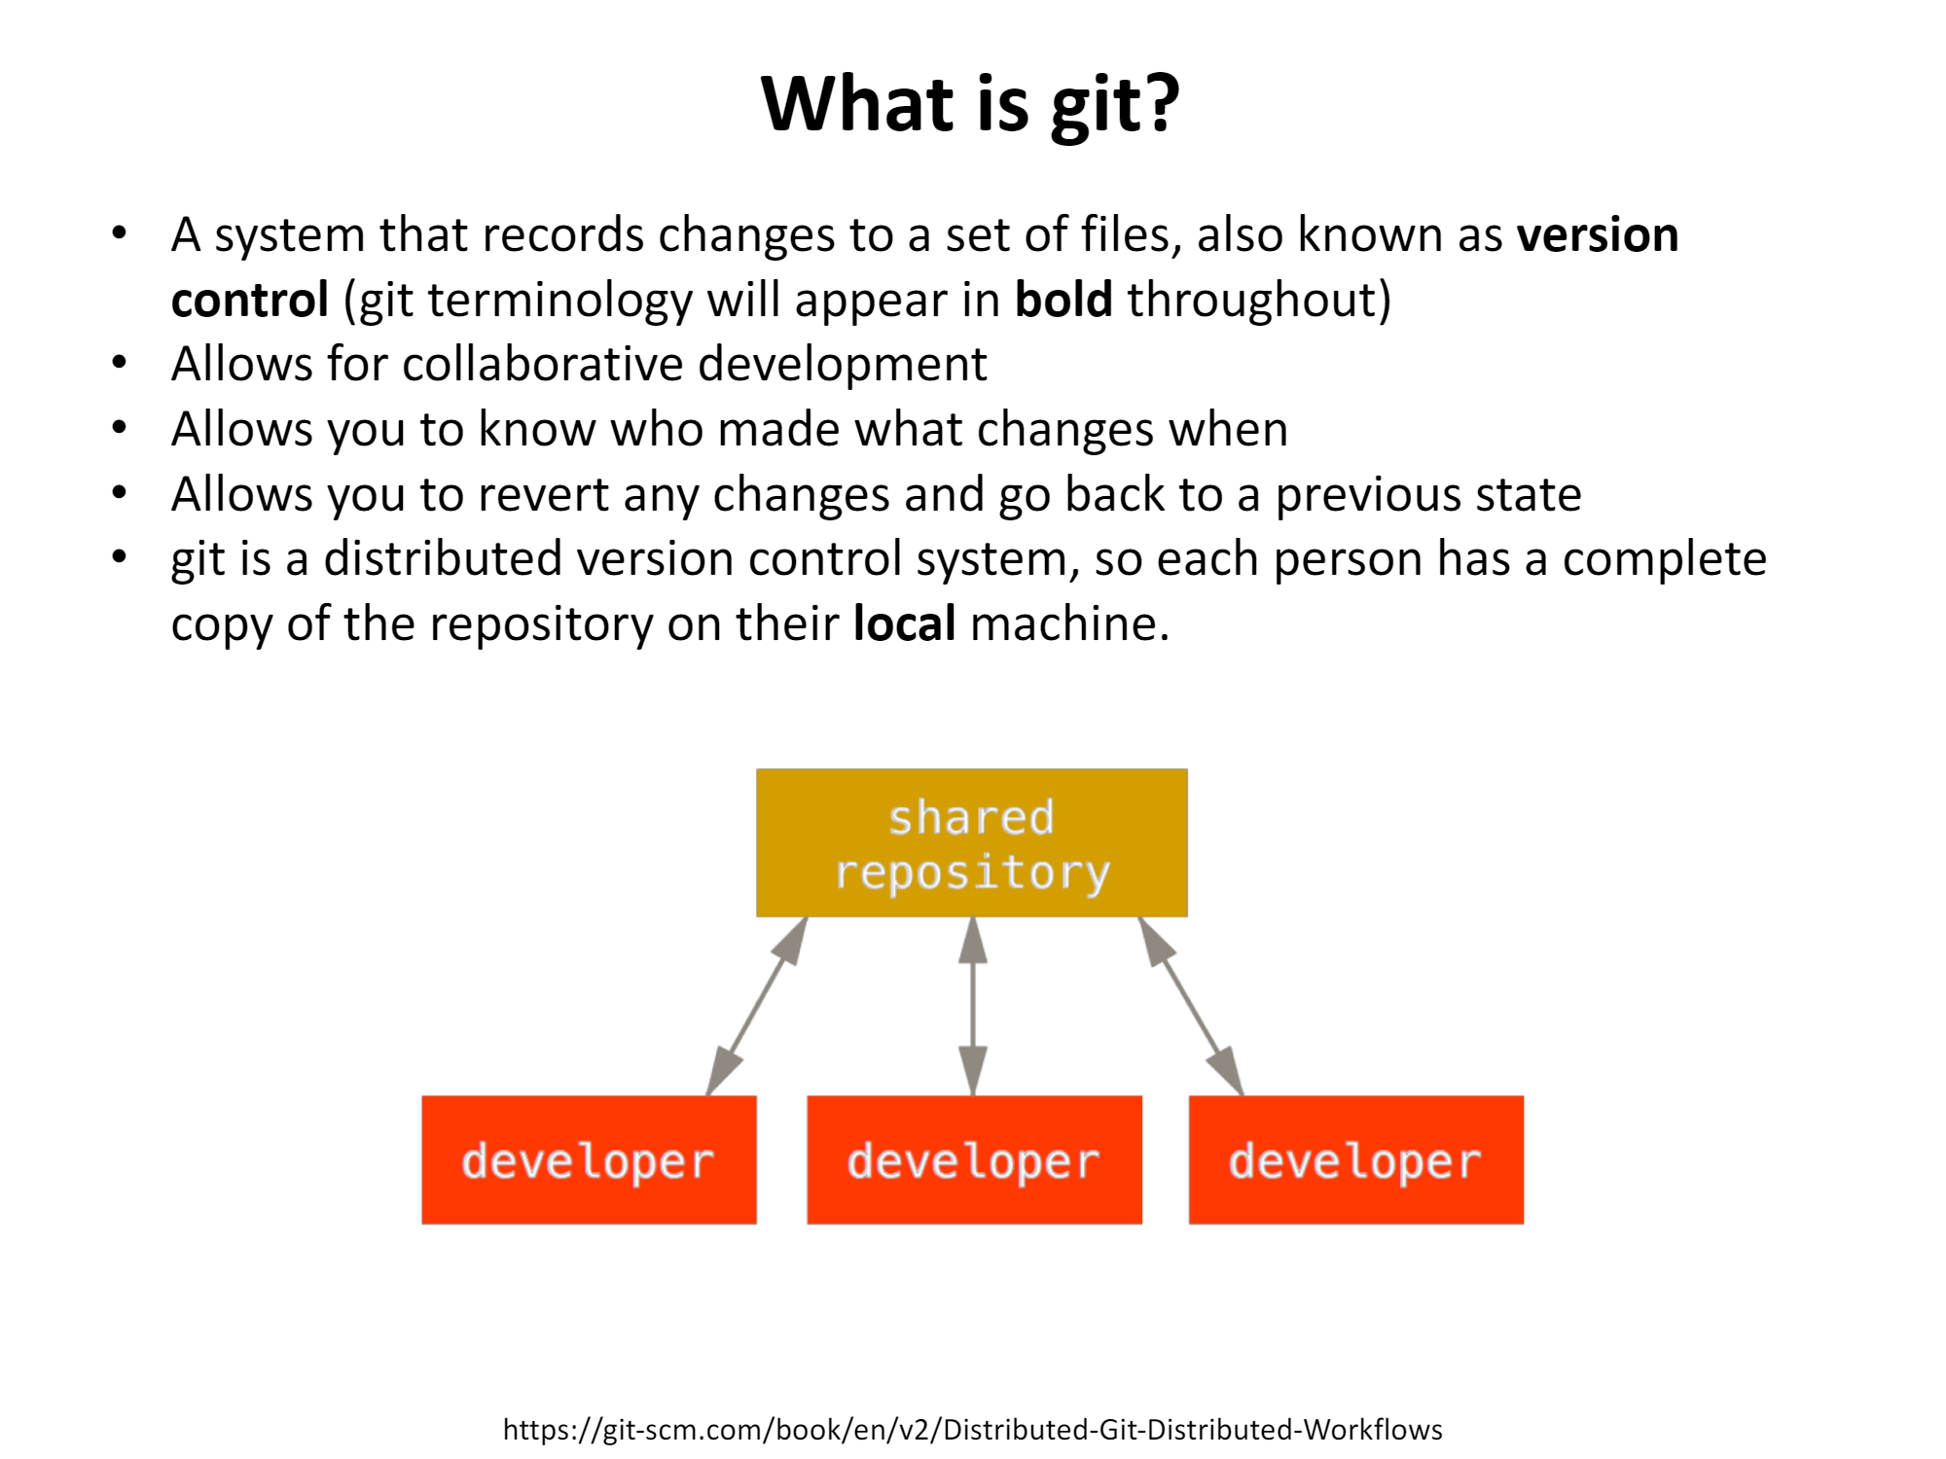
What is Git?
A system that records changes to a set of files, also known as version control (git terminology will appear in bold throughout)
Allows for collaborative development
Allows you to know who made what changes and when
Allows you to revert any changes and go back to a previous state
Works with any programming language
git is a distributed version control system, so each person has a complete copy of the repository on their local machine.
Adapted from P. Stewart: An introduction to version control with git. 2018

Slide 4
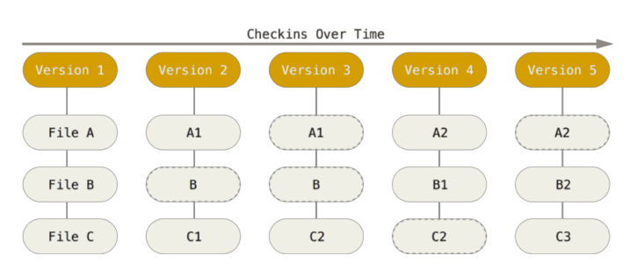
How is git used?
The purpose of git is to track snapshots of files as they change over time.
git stores information in a repository (i.e. a folder)
A commit is the act of creating a snapshot of files.
Adapted from P. Stewart: An introduction to version control with git. 2018

Slide 5
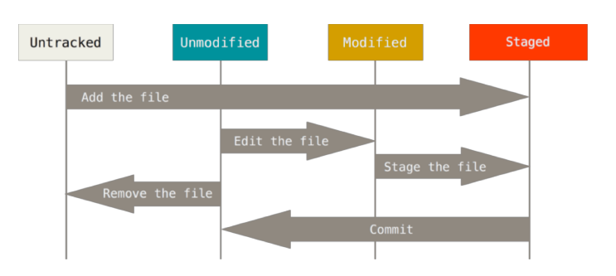
The lifecycle of files in a git repository
Each file in your working directory can be in one of two states: tracked or untracked.
Tracked files are files that were in the last snapshot; they can be unmodified, modified, or staged.
Tracked files are files that git knows about.
Adapted from P. Stewart: An introduction to version control with git. 2018

Slide 6
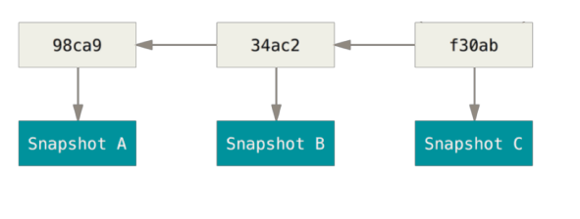
Commits and their parents
Each commit has a unique checksum pointer or “address”.
Commits also track author’s name, author’s email, commit message, and pointers to parents.
Adapted from P. Stewart: An introduction to version control with git. 2018

Slide 7
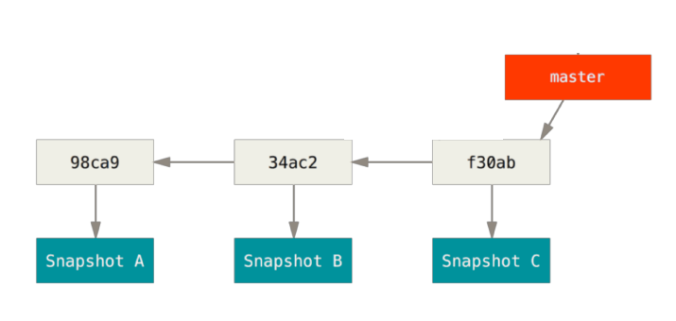
Commits and branches
A branch is a pointer to a commit.
The default branch in git is called main (formerly master), referred to as the “main branch”.
Main
Adapted from P. Stewart: An introduction to version control with git. 2018

Slide 8
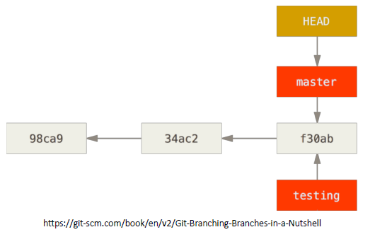
Adding a branch
Using a new branch allows you to run some test analyses or try out a new feature that you might not want to keep later.
Branches allows collaborators to work on different pieces of the same code simultaneously.
Pretend we created a new branch called “testing”.
We now need to distinguish what branch we’re currently working on.
git keeps track of the branch you are working on by a pointer called HEAD.
Main
Adapted from P. Stewart: An introduction to version control with git. 2018

Slide 9
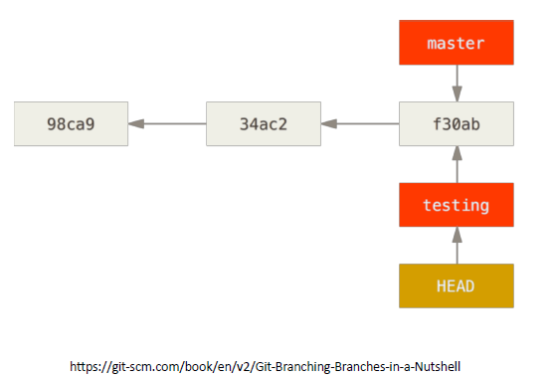
Switching branches
Switching a branch is referred to as a check out .
HEAD is now on “testing”, which means “testing” is checked out.
Right now master and testing are identical, but any changes made to “testing” will not be reflected in “main”.
Main
Adapted from P. Stewart: An introduction to version control with git. 2018

Slide 10
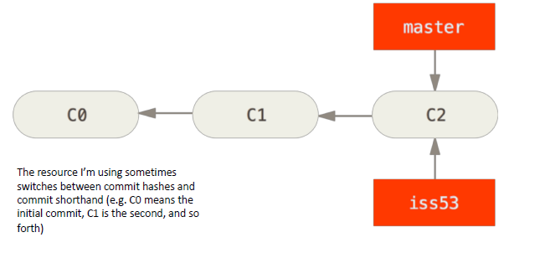
Make changes to a branch
Pretend we’ve made some commits under “main” and have just created a branch “iss53”.
Main
Adapted from P. Stewart: An introduction to version control with git. 2018

Slide 11
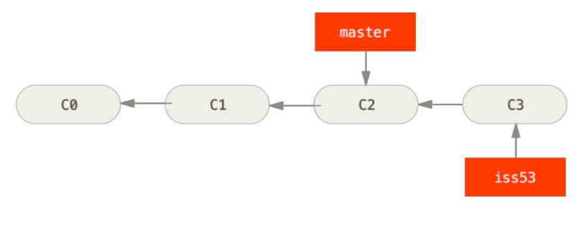
Make changes to a branch
Commits to “iss53” are not reflected in “main”.
Main
Adapted from P. Stewart: An introduction to version control with git. 2018

Slide 12
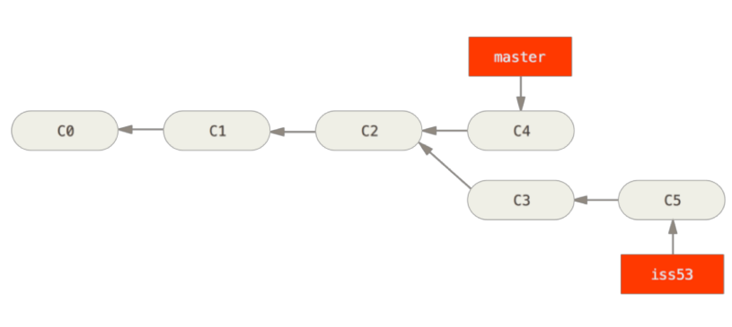
Make changes to a branch
Commits to “iss53” are not reflected in “main”.
Main
Adapted from P. Stewart: An introduction to version control with git. 2018

Slide 13
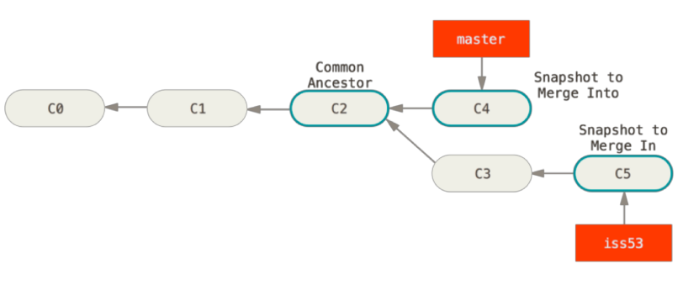
Merge Changes
Merging is the process of combining changes from different branches.
Main
Adapted from P. Stewart: An introduction to version control with git. 2018

Slide 14
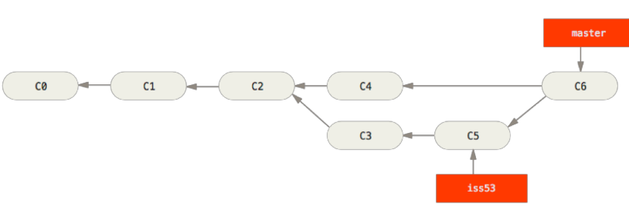
Merge Changes
Merging is the process of combining changes from different branches.
Main
Adapted from P. Stewart: An introduction to version control with git. 2018

Slide 15
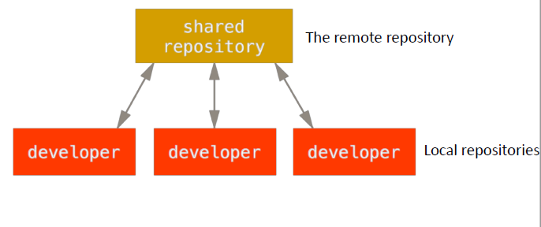
Working with a remote repository
A remote repository (aka simply remote) is a git repository that sits on an external server.
The origin is the default nickname that git uses for a remote repository.
Origin is used since it’s much easier to refer to “origin” instead of the address
E.g. “https://github.com/Unilever-BPC-S-T/stability_mining_tool.git”.
Adapted from P. Stewart: An introduction to version control with git. 2018

Slide 16
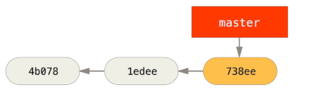
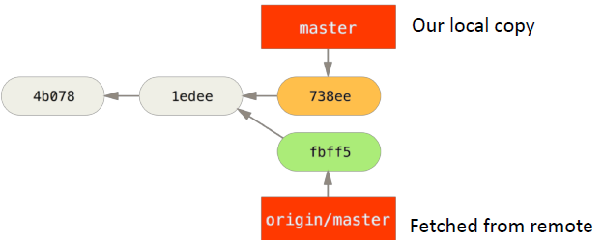
Working with a remote repository
Pretend we have made some commits locally.
Main
Our collaborator informs us they have pushed some changes to the remote repository, and we would like to incorporate those changes ourselves.
We perform a fetch to retrieve the collaborator’s changes.
Notice how this looks very similar to branching.
Main
Adapted from P. Stewart: An introduction to version control with git. 2018

Slide 17
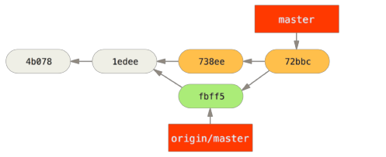
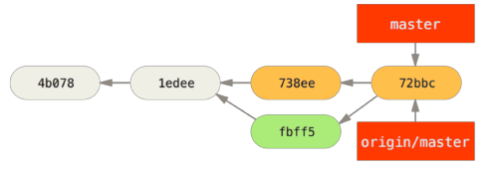
Working with a remote repository
Our collaborator’s code looks good, so we merge it with our own changes.
Main
We want our collaborator to be able to see their changes combined with our own, so now we push the changes back to the origin. This causes the origin/ main branch and the main branch to be at the same commit.
Main
Adapted from P. Stewart: An introduction to version control with git. 2018

Slide 18
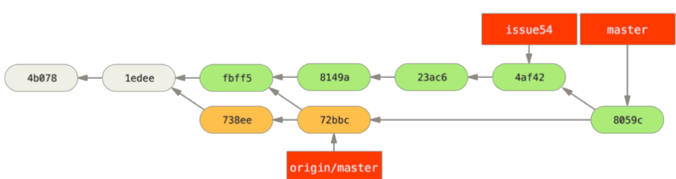
Working with a remote repository
• In practice, this get much more complicated….
Main
Adapted from P. Stewart: An introduction to version control with git. 2018

Slide 19
Demo! https://github.com/10adavis/Git_Training.git

