Slide 1

AI reinvention made real
Accenture Innovation Challenge 2026

Slide 2
Instructions
Reference slide– Remove before submission
Use the given template for your idea submission.
Follow file naming format: Team name_Idea Name.pptx
Ensure the spell check is done before submitting
Use standard Arial font, alignment and relevant images (as required)

Slide 3



Team details
TEAM NAME: O(N)
Aditya Kumar Sahu
Aayush Dubey
College: National Institute of Technology Karnataka, Surathkal
Stream: Mining Engineering
Year of graduation: 2027
College: National Institute of Technology Karnataka, Surathkal
Stream: Mining Engineering
Year of graduation: 2027
Anubhav Vishal
Photo
College: National Institute of Technology Karnataka, Surathkal
Stream: Mining Engineering
Year of graduation: 2027
All fields are mandatory

Slide 4




Describe the problem statement (200 words)
PatientTriage.ai
The Challenge at Hand
Our Problem Statement
The Critical Minutes
The Real Descion Making Factors
Who is most at risk of harm from waiting right now?
Overwhelmed emergency departments
Limited staff and critical resources
High-stakes decisions under pressure
What should AI recommend vs what should humans?
What data is realistically available at arrival?
How should uncertainty be handled?
What if the patient's condition changes?
How do we design for the worst case?
WHY PATIENT TRIAGE.AI ?
Why we choose this over other problem statements
The Insight That Shaped Our Approach
The brainstorming and debate that gave us this outcome
High-impact, real-world problem
AI can augment critical decisions
High Scope for meaningful innovation
Human expertise remains central
Technology for a cause ️
AI should support, not replace clinicians
Risk assessment must be continuous
Recommendations must be explainable
Uncertainty should trigger human attention
Right patient. Right priority. Right time.
“ It isn't AI versus humans. When a life is on the line, the only thing that matters is who gets there in time. ” - Team O(N)

Slide 5
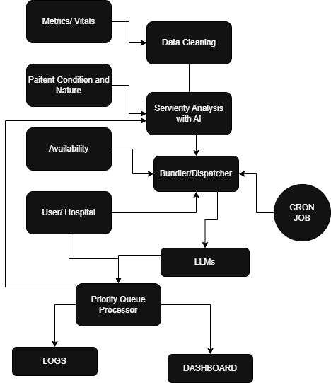



Proposed solution (200 words)
JUST AN ENGINEER
→
Technical Breakdown
A Rough Architecture
Our Approach
Our first intuition: a modern operating system
Patients is like Processes competing for attention
Doctors, beds are System Resources
Triage is like Scheduling / Priority Management
Deterioration is Interrupt requiring immediate attention like a high priority process
AI is Intelligent Scheduler that learns from multiple signals rather than fixed rules helping us decide the priority
1. Sense the symptoms, vitals, history & observations
2. Assess the risk, urgency & confidence
3. Prioritize on dynamically rank patients
4. Route, match patient with appropriate capacity
5. Monitor and detect deterioration while waiting
6. Re-prioritize and continuously update the queue.
AI recommends. Human decide.
Engineering it for PatientTriage.ai
AI-based dynamic priority
Continuous risk + deterioration assessment
Patients move between risk / care queues
Resource-aware routing & reallocation
Human override whenever confidence is low
Dynamic Priority Queue + Multi-Queue Routing + Intelligence

Slide 6
Video
Video Link - Video (https://drive.google.com/file/d/1ITE3m_hamP8frhJO7_r3OAliZ_Kd5w3p/view)

Slide 7
Thank you

