Slide 1
PPG MONITOR · iOS APP
Build Progress
From the first BluetoothManager prototype to today's session/recording layer — what's been built, verified, and what's still open.
DEADLINE SEP 4, 2026
BRANCH IOS-DEV
TIER 1 OF 3
Updated Aug 20, 2026

Slide 2
COMMIT 7AC7F3D · JUL 6, 2026
Origins — the first iOS prototype
— “Add PPG monitor, iOS app, and updated firmware” — the commit that started the iOS side of this project.
— Two loose Swift files, no Xcode project yet: BluetoothManager.swift (186 lines) and ContentView.swift (135 lines).
— CoreBluetooth wired directly into BluetoothManager — scanning, connecting, and line-parsing all mixed into one file.
— That mixed-together shape is exactly the seam the next commit (6 weeks later) splits apart into a real project.
FILES ADDED
ios_app/BluetoothManager.swift
ios_app/ContentView.swift
321 lines total. No .xcodeproj — not yet buildable as a standalone app.
ppg-monitor / ios_app
1 / 6

Slide 3
COMMIT C379B4A · AUG 19, 2026
Xcode project created, BLE code refactored
— Formalized BluetoothManager's existing text-line seam into a PPGDataSource protocol, with BLEDataSource and MockReplayDataSource implementations.
— App now builds and tests end-to-end in the Simulator — no hardware required.
— Two bugs fixed along the way: BLE scan wasn't filtering by device name; channel display was wiped on every disconnect.
— Added CLAUDE.md, PLANNING.md, TODO.md documenting scope, architecture decisions, and checklist progress.
DIFF
17 files touched
+2,230 / −186 lines
REAL DATA, NOT SYNTHETIC
MockReplayDataSource replays Mock/sample_session.txt — 1,203 lines captured live from the real sensor. Replay interval is retuned to the measured ~101 lines/sec real throughput, not the 25 SPS nominal spec.
ppg-monitor / ios_app
2 / 6

Slide 4
TODO.MD · PROGRESS LOG
2026-08-19
No checklist items checked yet, intentionally: everything below depends on real hardware behavior, and nothing's been run against real hardware yet.
WHAT'S REAL SO FAR
KNOWN ISSUE · §2 FAILING
— PPGDataSource protocol + BLEDataSource/MockReplayDataSource split built and compiling; app runs end-to-end against mock data (live 6-channel waveform, connection-status reporting).
— Two bugs fixed while doing this: BLE scan wasn't filtering by device name (PPG_DK_2026A); channel display was wiped on every disconnect.
— Next: swap real capture data into the mock source, then build participant/session, recording workflow, storage/export. ✓ completed later the same day — see previous slide.
4.2–4.3 SPS
observed vs. 25 SPS spec
Verified against a real hardware capture log. Root cause identified and flagged upstream: per-sample bt_nus_send() calls flooding the BLE queue. Fix is firmware-side — not something this app can address.
ppg-monitor / ios_app
3 / 6

Slide 5
TODAY · AUG 20, 2026 · PAIRED IMPLEMENTATION
Session/recording layer, built concept-by-concept
01
Data source
DONE
BLEDataSource · MockReplayDataSource
02
Model
DONE
ParsedSample.swift
03
Parser
DONE
PacketParser.swift
04
Session state
LOGIC DONE, UNWIRED
SessionController.swift
05
Recorder
NOT STARTED
SessionRecorder.swift
06
Screens
NOT STARTED
ParticipantEntryView · RecordingControlsView
ppg-monitor / ios_app
4 / 6

Slide 6
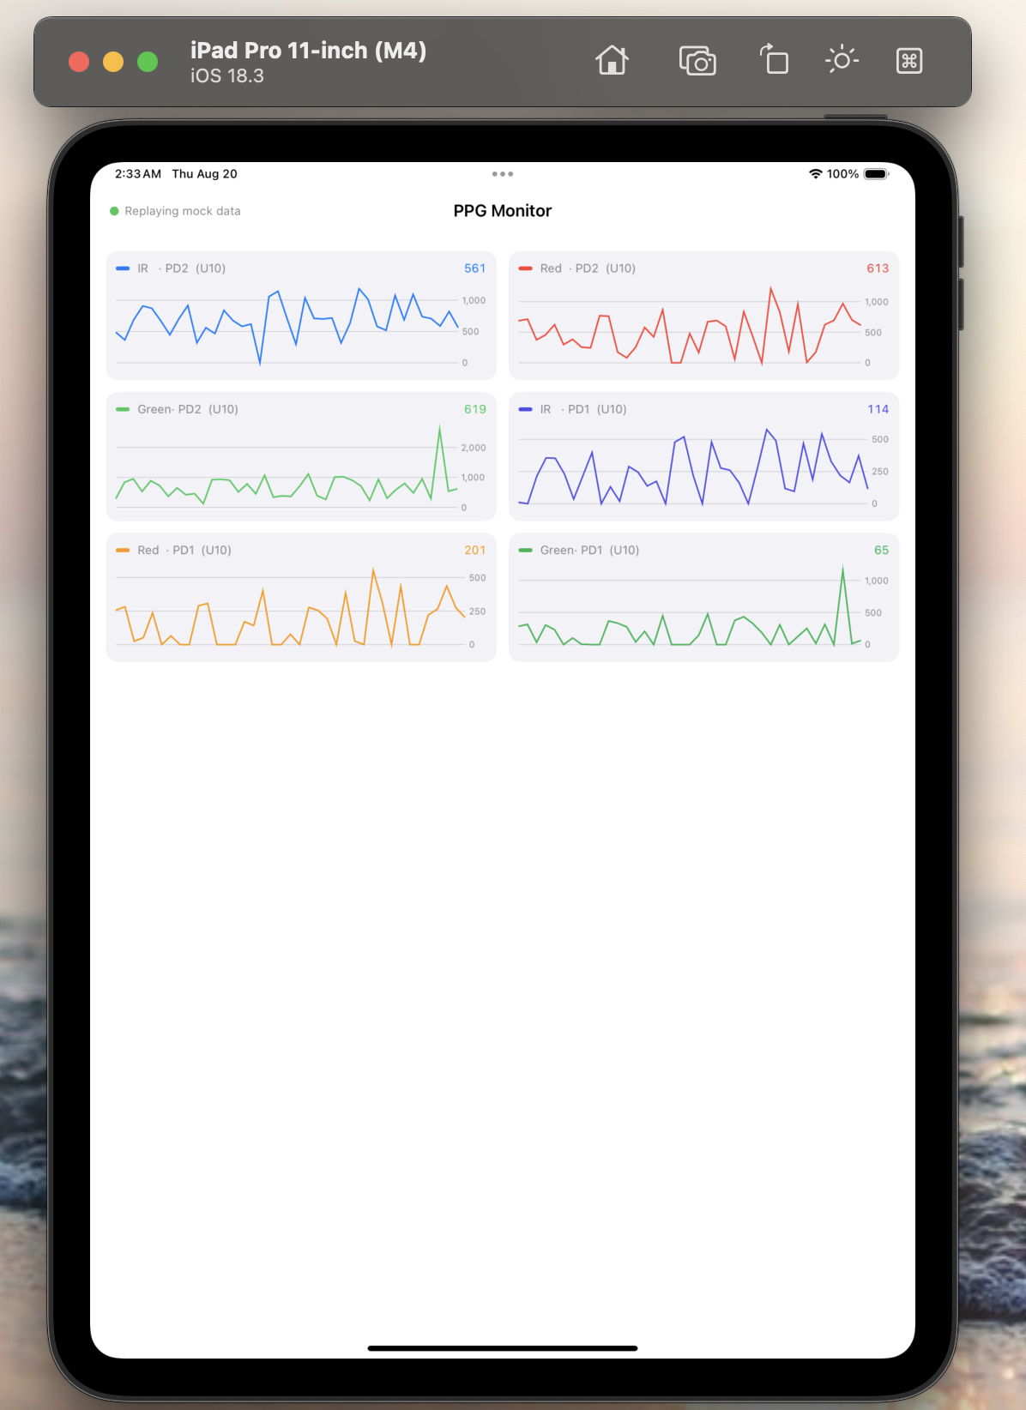
RUNNING PROTOTYPE
Live in the Simulator
— Six-channel PPG waveform, iPad Pro 11" (M4) Simulator — replaying a real BLE capture log (Mock/sample_session.txt), not synthetic data.
ppg-monitor / ios_app
5 / 6

