Slide 1

PROJECT : Oil Price Prediction
Team Name : Group 4
Mentor Name : Mr. Karthik Muskula
Team members:
Mr. Aditya Singh Rathore
Mr. Harsh Baid
Ms. Pallavi Prakhya
Mr. Sreehari Nair
Ms. Susmita Ajagekar
Ms. Swati Dhake
Mr. Venkat Pulavarthi

Slide 2
Project Architecture / Project Flow
Business Objective
Model Deployment
Data set Details
Model Building & Evaluation
EDA

Slide 3
Exploratory Data Analysis (EDA) and
Feature Engineering

Slide 4
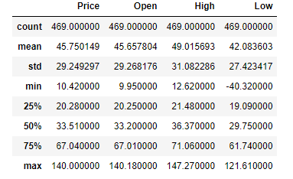
Data set details
The following data set is extracted form the Investing.com. It is a popular financial website that provides a wide range of information and tools for investors. It provides a platform for users to access financial data, research investment opportunities, and stay updated on market trends and news.
Link :- https://www.investing.com/commodities/crude-oil-historical-data
Dataset consists of 469 Rows and 7 Features.
Below image shows statistic's of dataset.

Slide 5
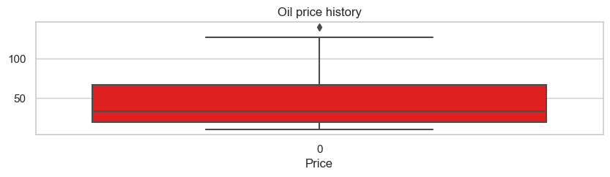
Exploratory Data Analysis (EDA)
No missing value found
There is only one extreme observation
No duplicated found in dataset
No null values found in dataset

Slide 6
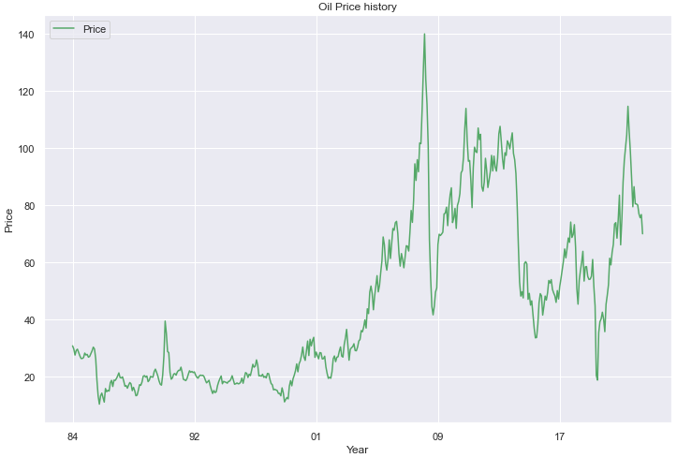
Visualization
Highest average Price of crude oil in 2008 was 132.
From 1984 to 2001 oil price is between 10-40.
From 2001, the average price of crude oil started increasing gradually. And after 2008 there are up and down in oil price.

Slide 7
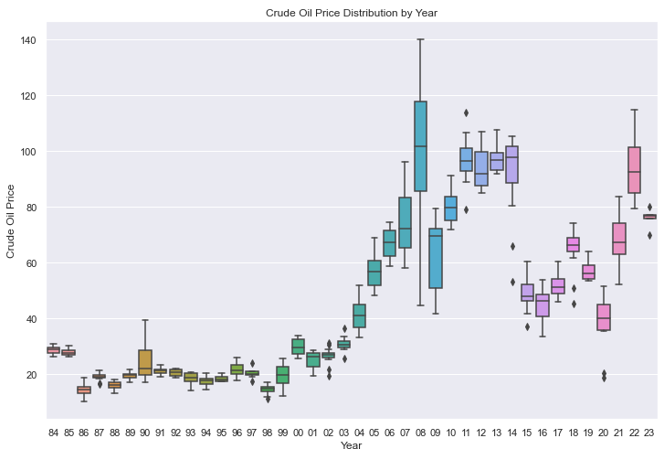
Box Plot Yearly Oil Price Distribution

Slide 8
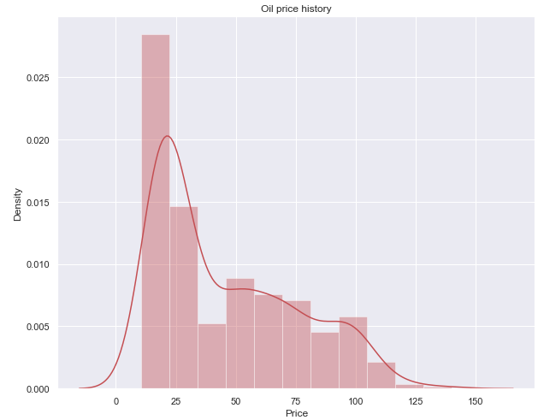
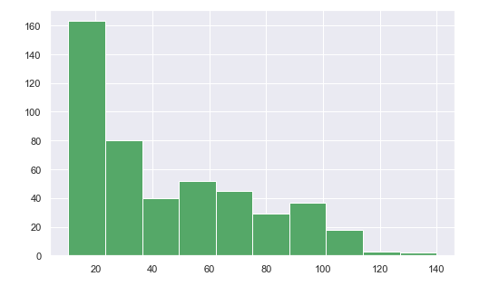
Density Plot
For more than 180 months in the selected time range the price point of crude oil has been in the range of 0 to 20 dollar/barrel.
The price point of crude oil has surpassed 125dollar for few no. of times

Slide 9
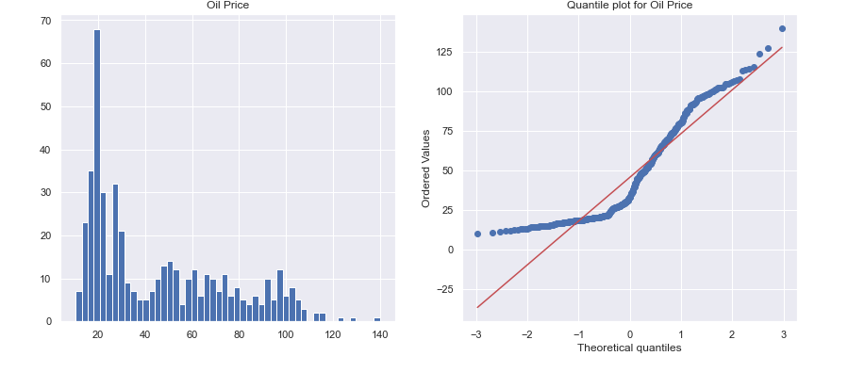
Histogram and Q-Q Plot To Check Distribution Errors

Slide 10
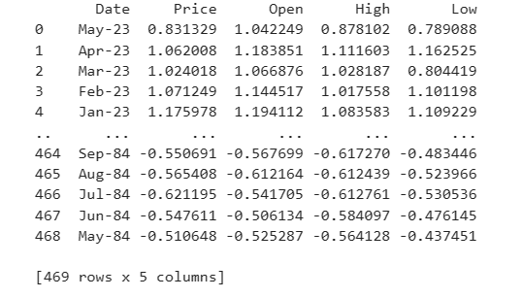
Data Standardization

Slide 11
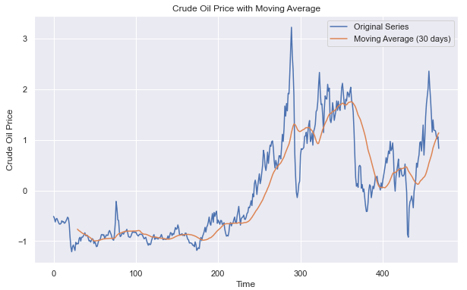
Moving Average Method
Moving average for next 30 days is shown in below graph.

Slide 12
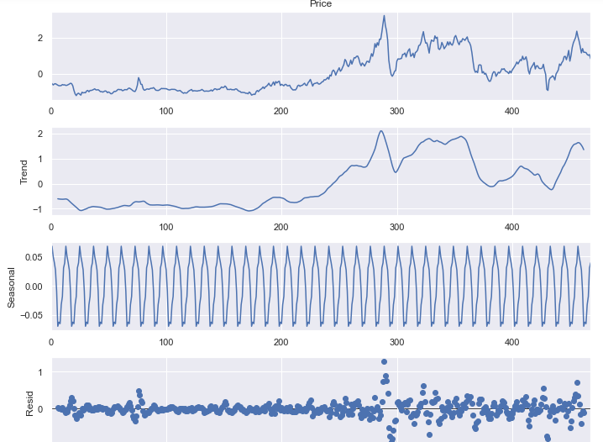
Seasonally Plot
Using seasonal decompose function, timeseries data is divided into trend, seasonal, and residual.
Additive Model
Trend: Initially oil price is stable .after 2001 there is sudden peak and frequent up and down. then decreasing.
Seasonal: Seasonality is present as we can clearly observe periodic pattern.
Residual: It has higher variance at some point.

Slide 13
Stationarity Check
-
First data point: -2.290121018409085 : Critical value of the data in your case
Second data point: 0.17517393813671528
: Probability that null hypothesis will not be rejected(p-value)
Third data point: 1: Number of lags used in regression to determine t-statistic. So there are no auto correlations going back to '0' periods here.
Forth data point: 467: Number of observations used in the analysis.
Fifth data point: {'1%': -3.4444305322234365, '5%': -2.8677488864580885, '10%': -2.5700770984781443}, -303.7449485784539
}: T values corresponding to adfuller test.
Augmented Dickey Fuller (ADF Test)
Result: 0.1751, that is greater than 0.05
The time series data is non-stationary.
After differencing, the time series is Stationery.

Slide 14
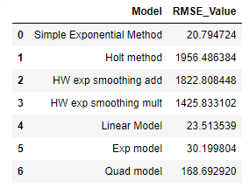
MODEL BUILDING
Data Driven Forecasting Methods
Simple Exponential Method, Holt Method ,Holt exp smoothing additive seasonality, holt exp smoothing multiplicative seasonality.
Model Based Forecasting Methods
Linear Model, Exponential Model, Quadratic Model.
Smiple Exponential Model gave Least RMSE value 20

Slide 15
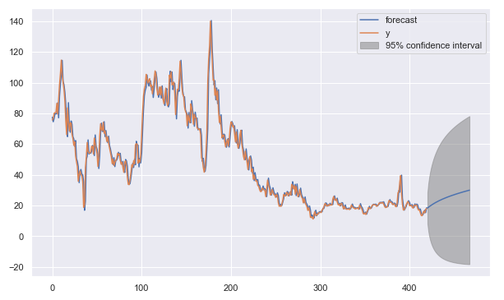
ARIMA MODEL
Data set splited 90%-training data and 10% test data.
Evaluated persistent base model. Walk through forward validation.
Used Arima Hyperparameter p=2,d=0,q=2.
RMSE =27 and MAPE =0.36
In below graph we can see how data forecast is visible at 95% Confidence Interval.
Forecast says oil price is decreasing gradually..

Slide 16

Arima Model is selected for Deployment. Fitted Model is saved on disk and dumped on pickle. Below is code Screenshot.
Model Deployment

Slide 17
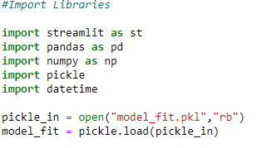
In Our Project we did deployment using web services with Streamlit for that Installed streamlit using below command on anaconda command prompt. pip install streamlit Created a python file called “app.py” for creating web page form for future oil price prediction. Below are imported libraries in .py file. Opened the .pkl file in read format and loaded using pickle.load.
Defined a function predict_oil_price() to forecast the the prices.
In main() function taken user input as date . And given starting date
s = datetime.date(2022,3,22).

Slide 18
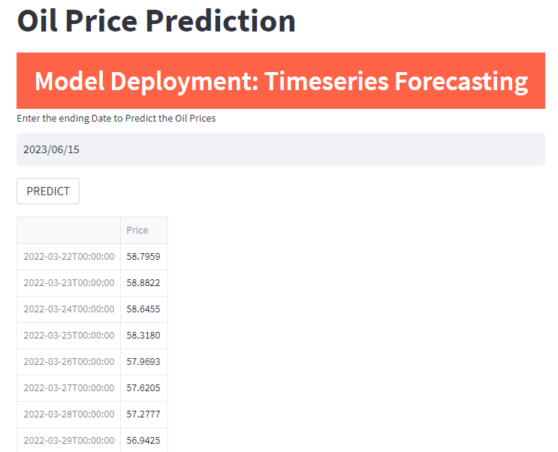
User have to enter the ending date for oil price prediction.

Slide 19
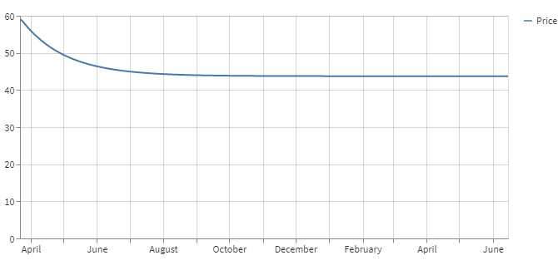
Oil price prediction line chart
In below line chart it is clearly visible that there is down trend and after few months price is stable.

Slide 20
Challenges faced By a Data Scientist?
Finding the right data
Getting access to it
Understanding tables and their purpose
Cleaning of data
Making data stationary ,standardizing data, hyper tunning parameters for model building
Selecting model for deployment

Slide 21
How did you overcome?
Selected dataset from Investing.com.
We standardize data by differencing to make the time series stationary
Removed unnecessary columns in data cleaning
Selected model for deployment who gives least RMSE value and predicting accurate value for oil prediction
For parameter tunning used GridSearch

