Slide 1
URL: https://www.burgerking.it/

Slide 2
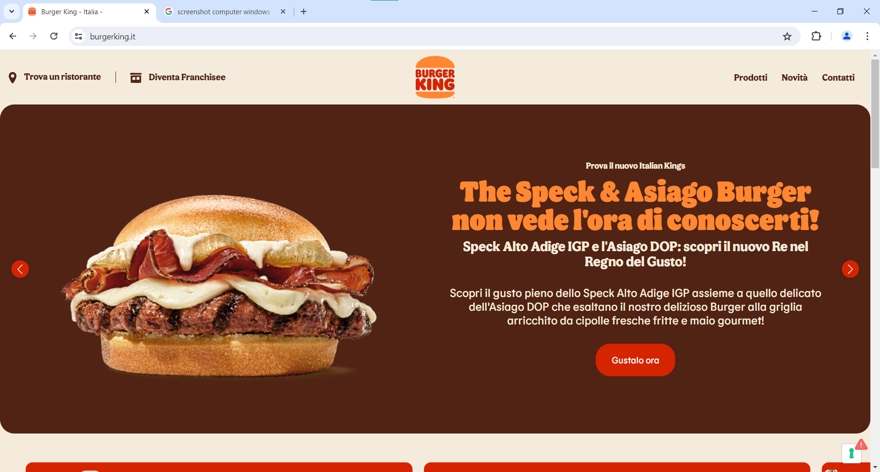

Slide 3
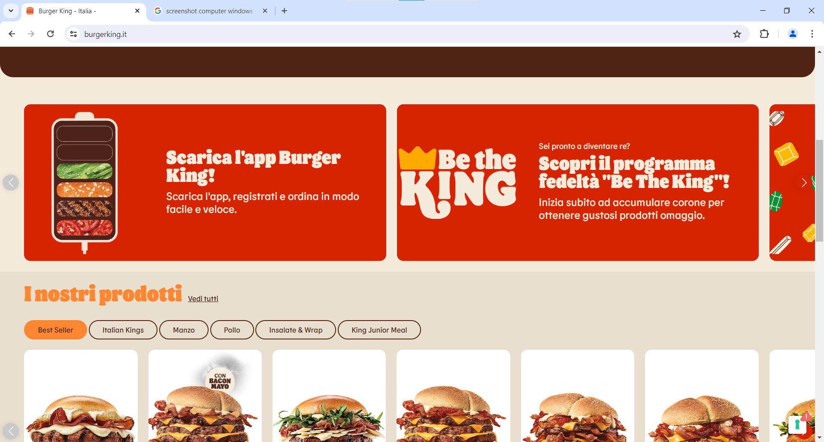

Slide 4
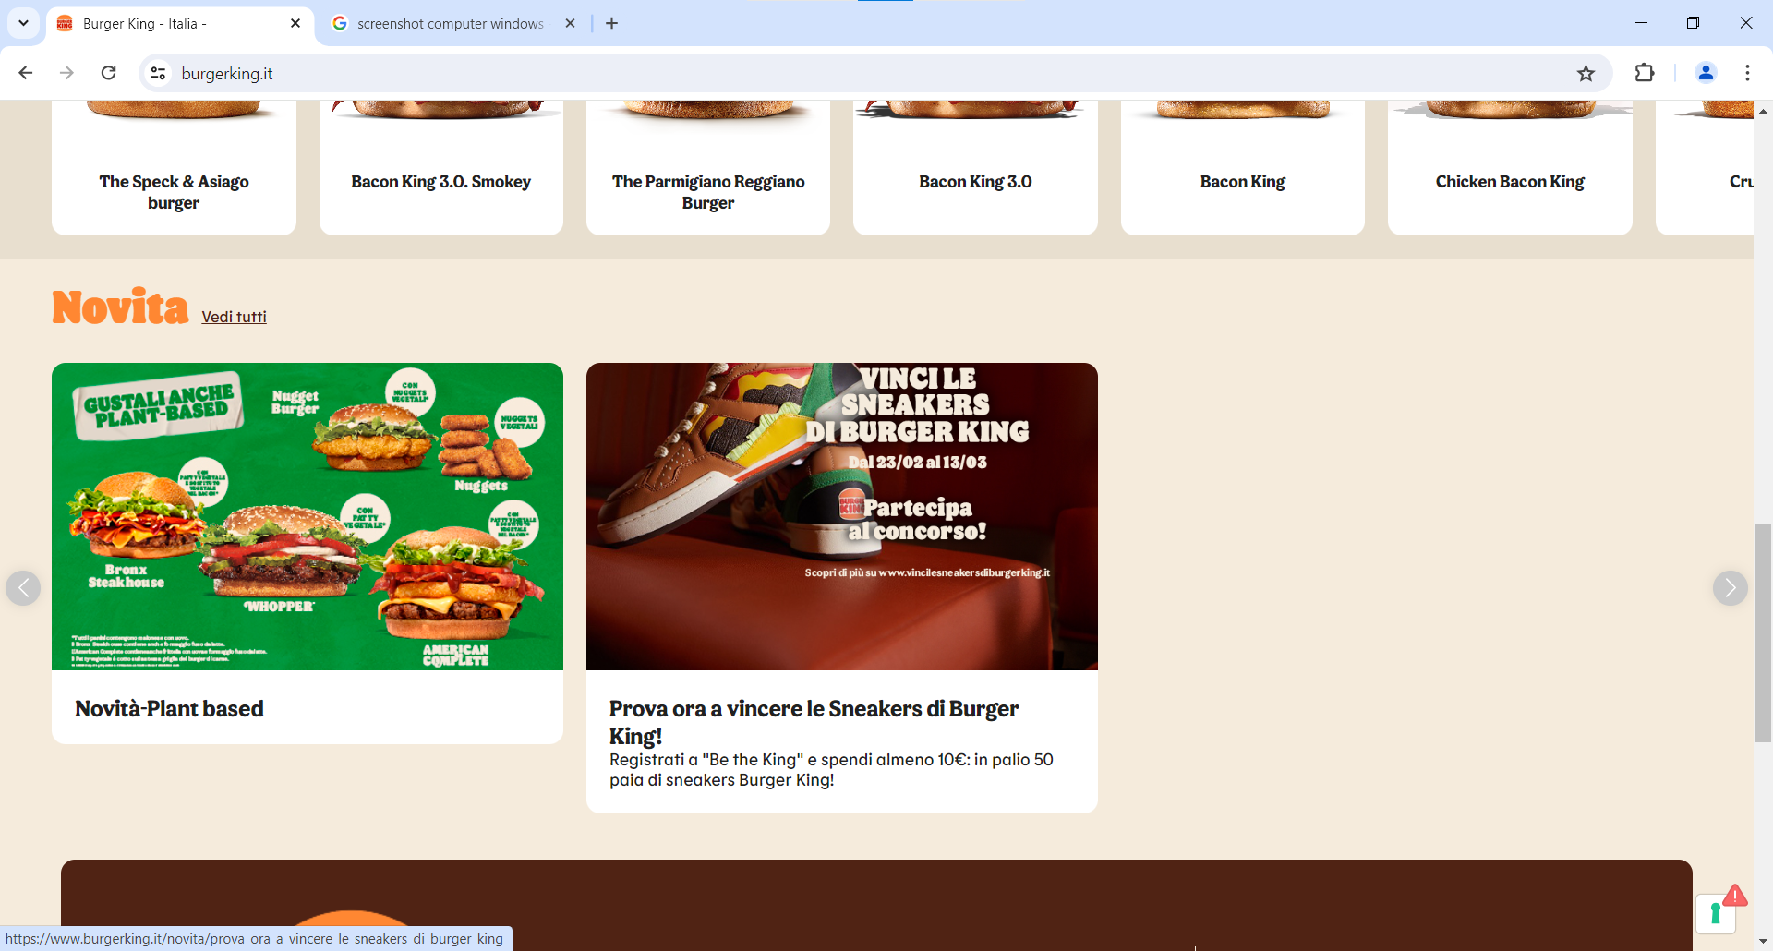

Slide 5
