Slide 1
CONTROLLED OBJECT-DETECTION EXPERIMENTS
FRAMEWORK V1 REBUILD
A 系列训练分支
模型 | 训练数据 | 新增数据 | 主要变量
A0 | 干净背景 | 无 | 基线
A1 | A0 + 合成图 | 合成小目标 | 尺度与噪声
A2 | A0 + 手机视频 | 手机小目标 | 真实手机画面
A3 | A0 + 相机视频 | 部署相机 | 场景适配
A4-P / A4-S | A0 + 相机 | 手机 / 合成 | 组合数据
A5 | A0 + 相机 | Think Bar、Ziploc 新视频 | 类别平衡
A6 | A5 + 手机视频 | 手机小目标 | 平衡相机 + 手机
1
Notes:
[Sources]
configs/dataset_a0_base.yaml through dataset_a6_p_balanced_camera_phone.yaml
src/train_a0_base.py through train_a6_p_balanced_camera_phone.py
data/videos_A/camera/more_thinkbar and data/videos_A/camera/more_ziploc

Slide 2
CONTROLLED OBJECT-DETECTION EXPERIMENTS
FRAMEWORK V1 REBUILD
A 系列 A6 mAP50 最高
2
Notes:
[Sources]
outputs/A_series/tests/*/ground_truth_metrics.json
Fixed held-out set: 241 images, 1,031 boxes. Inference imgsz=1024; AP confidence floor=0.001; NMS IoU=0.7.

Slide 3
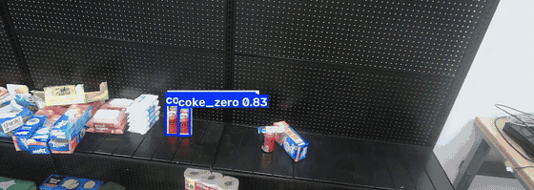
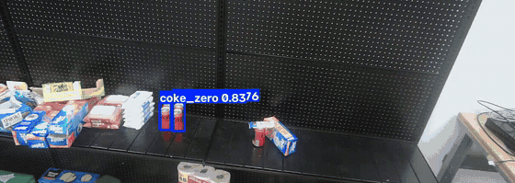
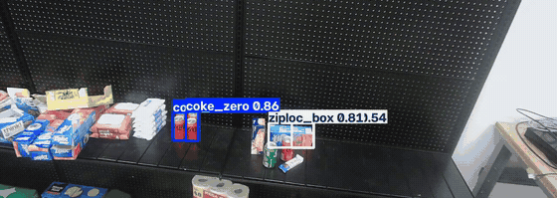
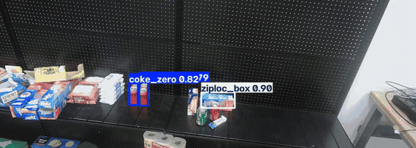
CONTROLLED OBJECT-DETECTION EXPERIMENTS
FRAMEWORK V1 REBUILD
A 系列 A5 多商品覆盖更稳
A5 Balanced Camera
A6 Camera + Phone
视频 1
Coke 100% Think 45.7% Ziploc 65.4%
Coke 100% Think 45.6% Ziploc 60.3%
视频 2
Coke 100% Think 11.0% Ziploc 93.7%
Coke 100% Think 6.0% Ziploc 58.4%
3
Notes:
[Sources]
outputs/A_series/tests/a5_balanced_camera_img1024_conf035/videos_mp4/multiple{1,2}.mp4
outputs/A_series/tests/a6_p_balanced_camera_phone_img1024_conf035/videos_mp4/multiple{1,2}.mp4
outputs/A_series/tests/a5_balanced_camera_img1024_conf035/video_summary.csv
outputs/A_series/tests/a6_p_balanced_camera_phone_img1024_conf035/video_summary.csv
Frame coverage at confidence 0.35. GIFs are four-second excerpts from annotated outputs.

Slide 4
CONTROLLED OBJECT-DETECTION EXPERIMENTS
FRAMEWORK V1 REBUILD
B 系列训练分支
模型 | 训练数据 | 新增数据 | 主要变量
B0 | 干净背景 | 无 | 基线
B1 | B0 + 相机视频 | 部署相机 | 场景适配
B2 | B0 + 手机视频 | 手机小目标 | 真实手机画面
B4 | B0 + 相机 + 手机 | 两类真实数据 | 场景与尺度
4
Notes:
[Sources]
docs/B_SERIES_EXPERIMENT.md
configs/dataset_b0_base.yaml; dataset_b1_camera.yaml; dataset_b2_phone.yaml; dataset_b4_camera_phone.yaml
src/train_b0_base.py; train_b1_camera.py; train_b2_phone.py; train_b4_camera_phone.py

Slide 5
CONTROLLED OBJECT-DETECTION EXPERIMENTS
FRAMEWORK V1 REBUILD
B 系列 B1 综合精度最高
5
Notes:
[Sources]
outputs/B_series/tests/*/ground_truth_metrics.json
Fixed held-out set: 439 images, 976 boxes. Inference imgsz=1024; AP confidence floor=0.001; NMS IoU=0.7.

Slide 6
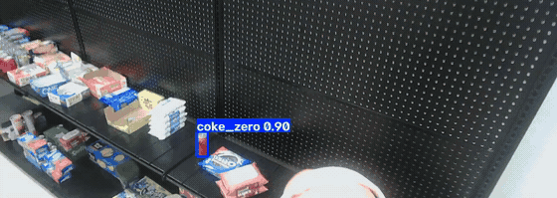
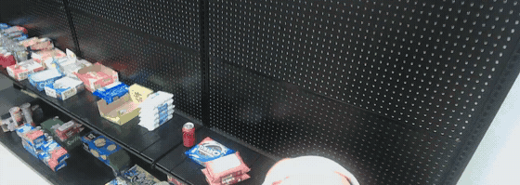
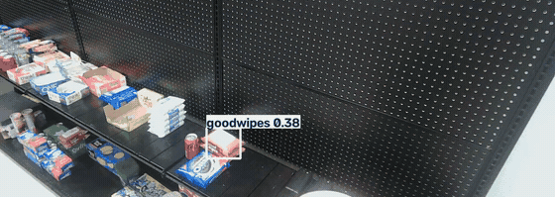
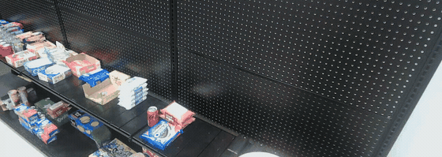
CONTROLLED OBJECT-DETECTION EXPERIMENTS
FRAMEWORK V1 REBUILD
B 系列 B4 类别覆盖更均衡
B1 Camera
B4 Camera + Phone
视频 1
Coke 63.2% Oreo 0% Goodwipes 15.7%
Coke 34.9% Oreo 26.8% Goodwipes 23.4%
视频 2
Coke 39.4% Oreo 25.3% Goodwipes 13.6%
Coke 29.7% Oreo 21.4% Goodwipes 42.8%
6
Notes:
[Sources]
outputs/B_series/tests/b1_camera_img1024_conf035/videos/multiple_new{1,2}/multiple_new{1,2}.mp4
outputs/B_series/tests/b4_camera_phone_img1024_conf035/videos/multiple_new{1,2}/multiple_new{1,2}.mp4
outputs/B_series/tests/b1_camera_img1024_conf035/video_summary.csv
outputs/B_series/tests/b4_camera_phone_img1024_conf035/video_summary.csv
Frame coverage at confidence 0.35. GIFs are four-second excerpts from annotated outputs.

