Slide 1
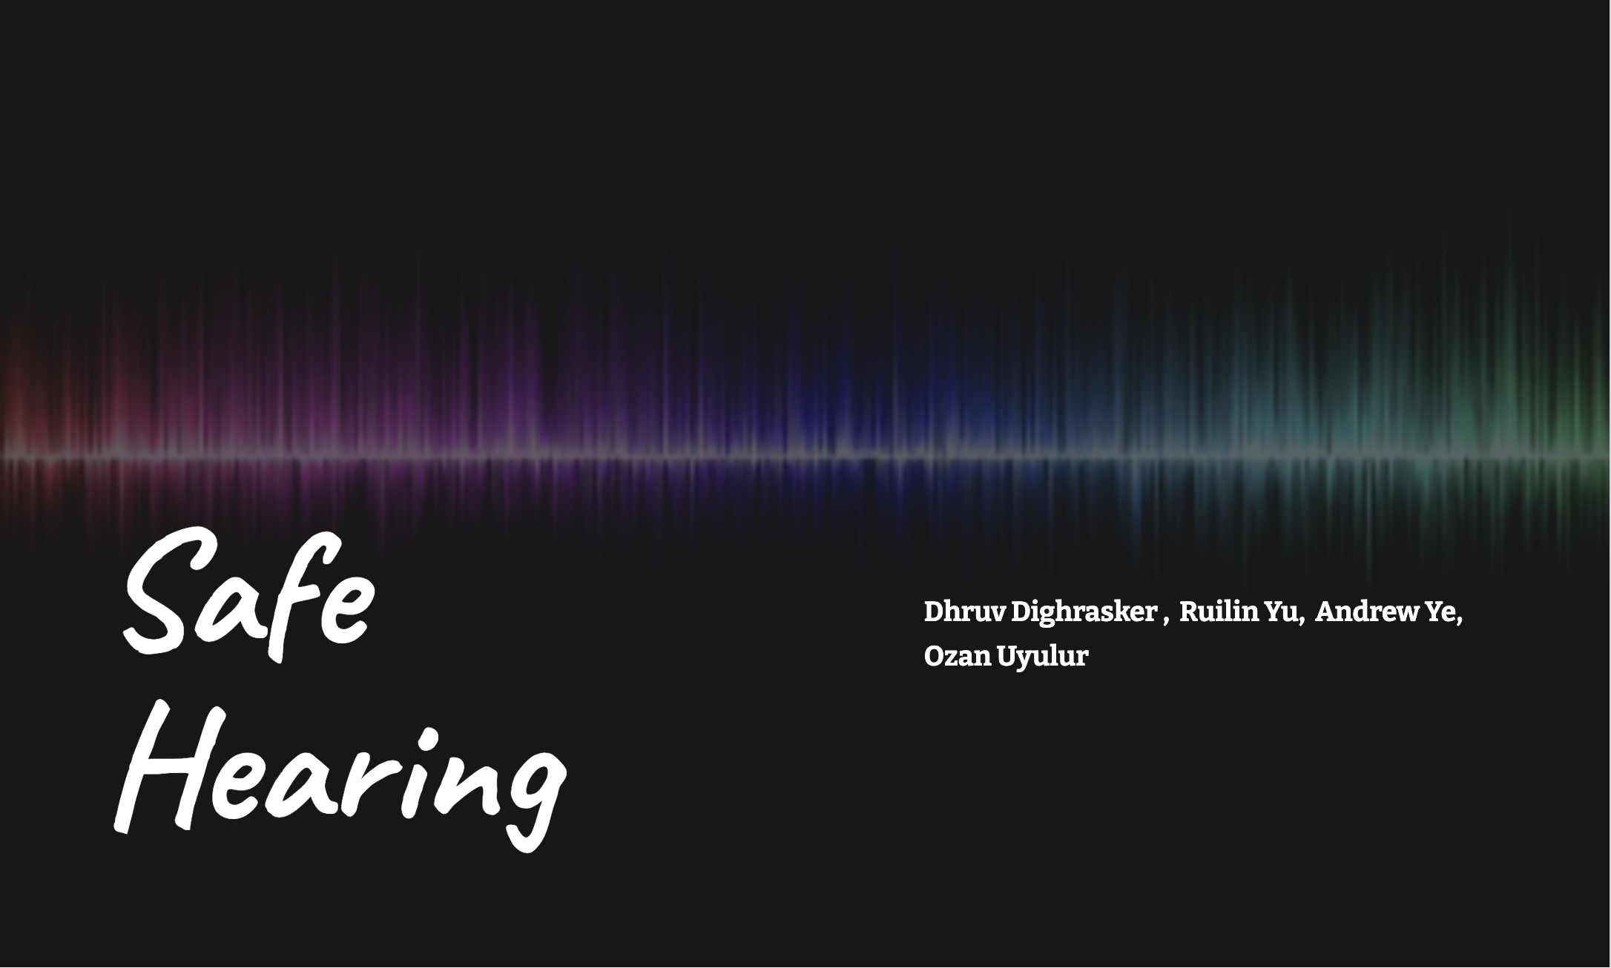

Slide 2
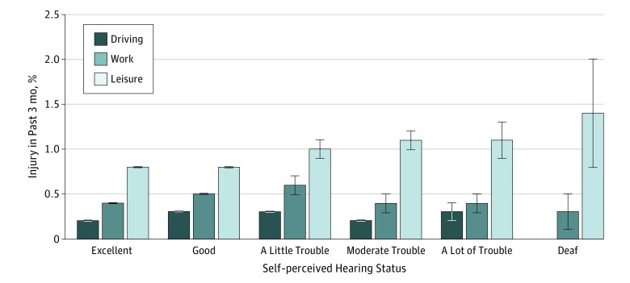
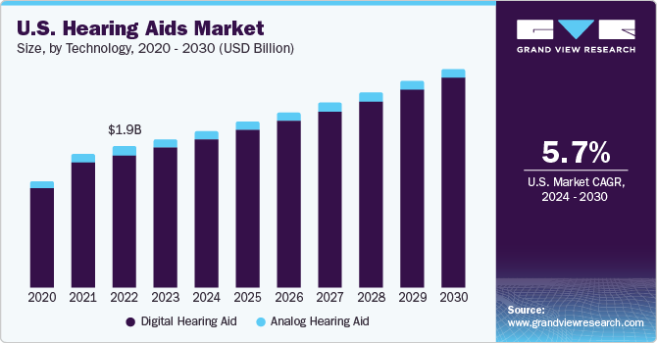
Background & Motivation
Why it matters:
People with hearing difficulty miss horns, sirens, construction cues
Increases injury risk, especially in traffic and work
We need a real-time sound safety assistant
Our idea:
Detect hazardous street sounds
Ouput class label, calibrated confidence, risk tier
Preprocessing → slice → log-Mel → features → classifier
Figure [1]: Risk of injury correlated with hearing difficulty.
Figure [2]: Projected growth of Hearing Aids Market
Notes:
Let's start with why this matters. People who have hearing difficulties often miss critical sounds like horns or sirens. This significantly increases their risk of injury, especially in traffic or on job sites.
Look at the first chart: you can see that as self-perceived hearing trouble increases, the risk of injury goes up, particularly during work and leisure time.
Our idea is simple: We want to build a real-time sound safety assistant. This system will detect hazardous street sounds—like construction or emergency vehicles—and give the user a clear Risk Tier alert.
To do this, we need to take raw sound, process it, and feed it into a classifier. That's what the rest of our presentation is about.

Slide 3
Dataset
For this project we start from two public environmental sound datasets: UrbanSound8K and ESC-50. We don’t use their 17 original labels directly; instead, we map them into eight target classes that are meaningful for safety — things like car horns, sirens, construction, engines, impulse bangs, airplanes, plus an ‘other’ bucket.
Each of these target classes is also tagged with is_hazard, which is either 1 or 0, and a risk weight for hazardous classes. That lets us treat something like a gunshot or siren as higher-risk than, say, an airplane engine, when we eventually build an alert system.
After preprocessing and slicing the audio into 1-second chunks, we end up with about seventy thousand segments. That’s a substantial dataset, but the bar chart shows a big imbalance: classes like car horn have tens of thousands of slices, while rare events like sirens have only a few thousand or less. So a key challenge for our models is learning from this imbalanced but realistic data.
Data Used
Source Class | Target Class | Hazardous? | Risk Weight
Air Conditioner | Other | 0 | 0
Car Horn | Car Horn | 1 | 0.8
Children Playing | Other | 0 | 0
Dog Bark | Other | 0 | 0
Drilling | Construction | 1 | 0.7
Gunshot | Impulse Bang | 1 | 1
Airplane | Engine | 1 | 0.4
Chainsaw | Construction | 1 | 0.7
Siren | Siren | 1 | 1
Datasets: UrbanSound8K and ESC-50
Over 17 original classes
8 clean, project-specific target classes
Table[1]. Sample Audio data originated from noise source classes
Class Distribution
About 70,000 segments
Large gap in sample size of different classes
Substantial amount of data
But severe imbalance
Figure[3]. Preprocessed 1-second slices, organized by class

Slide 4
Pipeline
This slide summarizes our end-to-end pipeline from raw audio to model-ready features.
We start with setup, where we download information from our datasets into a consistent folder structure. The Meta stage then scans all audio files and builds a master CSV with file paths, original labels, and a split hint based on the original recording or fold. That’s important later to avoid data leakage between train and test.
In the Clean stage, every clip goes through a 4th order butterworth high-pass filter, is resampled to 16 kHz mono, and RMS-normalized so loudness is comparable. We also compute a clipping ratio as a basic quality check.
Next, Label merges in our custom class map, assigning each clip a target class plus is_hazard and risk_weight. Segment then chops each processed file into overlapping 1-second slices with 50% overlap and carries the label to each slice.
Finally, Feature computes two representations: a log-Mel spectrogram and a 1D aggregated vector. All of this is indexed in CSVs so training and visualization are fully reproducible.
Scan audio and create initial metadata
Apply custom class map and risk weights
Extract 2D log-Mel and 1D aggregated features
1. Meta
3. Label
5. Feature
0. Setup
2. Clean
4. Segment
High-pass filter, resample, RMS normalization
Slide-window segmentation and label propagation
Pull raw data

Slide 5
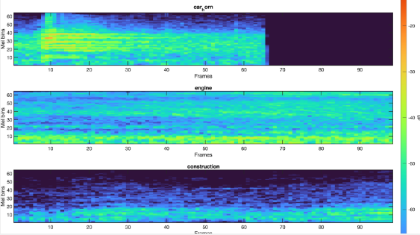
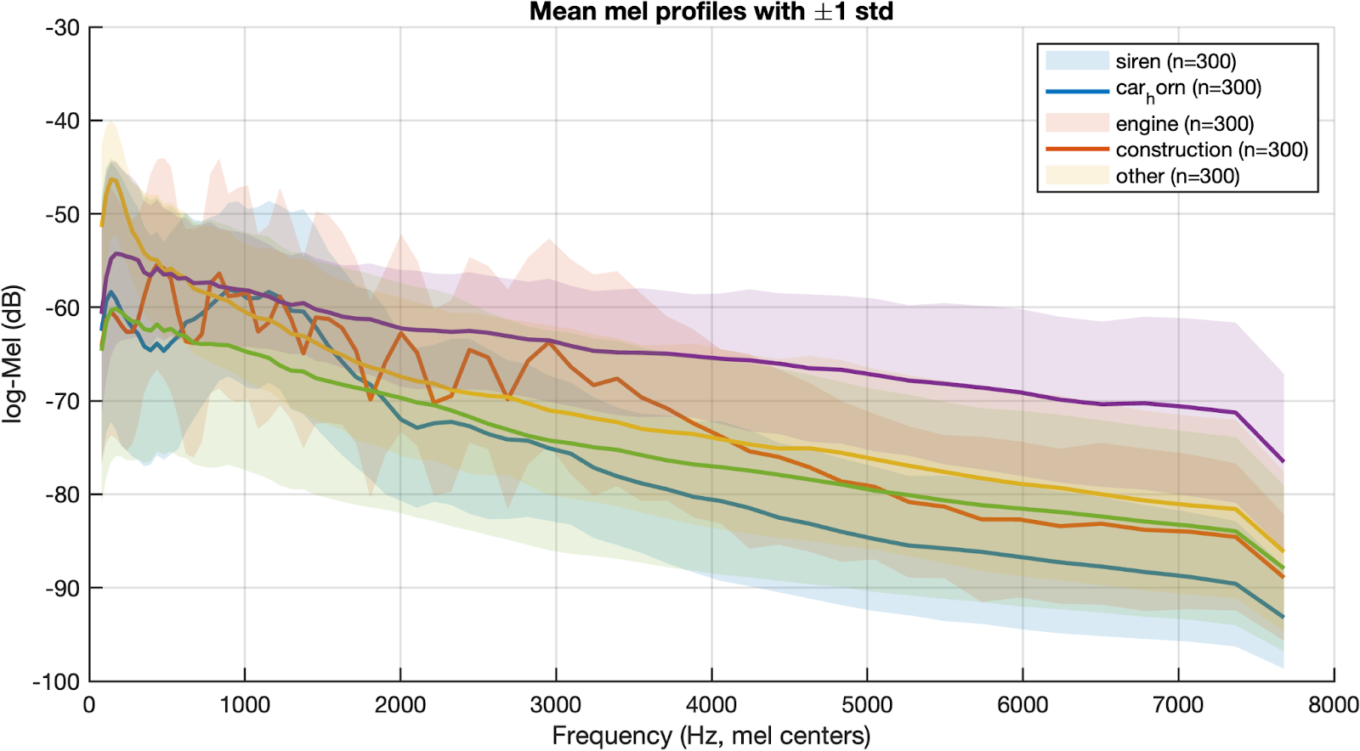
Processed Data
Log-Mel Spectrogram
Mean Mel Profiles
Figure[4]. Log Mel Spectrogram slices highlighting frequencies for 3 example audios
Figure[5]. Mel profiles with variability showing spectral patterns across sound classes
Car horn: short, mid-high band burst → bright stripe(s)
Engine: steady low bands + harmonics → horizontal ridges
Construction: broadband, noisy, intermittent → speckled texture
Per class: average of up to n=300 slices; shade = ±1 SD
Engine highest below ~500 Hz; fast decay at high bands
Siren stronger in mid–high bands (slow decay)
Construction flatter/broader energy than others
Takeaway: classes show distinct time–frequency patterns
Takeaway: curves separate by band, confirmed Mel features are discriminatory

Slide 6
Challenges
Severe Class Imbalance
Preventing Data Leakage
Classes like 'CarHorn' (33K slices) vs. 'Siren' (1.2K slices) require advanced handling
Ensure test sets are split by the original recording ID (fold/session) rather than by slice to guarantee model generalization
Reducing False Alarms
Hazardous events require extremely low False Positive Rates (FPR). Standard classification accuracy is not sufficient.

Slide 7
Future Plans
Implementation
Improving our classifier to minimize outlying data that decreases reliability for our solution
Include Python script examples on website to showcase methodology
Think of ways to incorporate our solution for real world use
Process
Incorporating our findings, data, and methods into each respective tab on the website
Noting any challenges faced throughout the process
Improve pipeline and models
Retrain after improving classifier to showcase our most reliable solution
Brainstorm implementation of solution onto a device for use

Slide 8
External References
[1] Lin, H. W., Mahboubi, H., & Bhattacharyya, N. (2018). Self-reported Hearing Difficulty and Risk of Accidental Injury in US Adults, 2007 to 2015. JAMA otolaryngology-- head & neck surgery, 144(5), 413–417. https://doi.org/10.1001/jamaoto.2018.0039
[2] U.S. hearing aids market size, share | industry report, 2030. (n.d.). https://www.grandviewresearch.com/industry-analysis/us-hearing-aids-market-report

Slide 9
Thank You!
Group 17
Dhruv Dighrasker, Ozan Uyulur, Andrew Ye, Ruilin Yu
https://sites.google.com/umich.edu/eecs351group17/home

