Slide 1
AAW Python Intro Course
Created by Matt Deady & Gus Cavanaugh

Slide 2
Agenda
Class Introductions
Purpose of this Class
Programming Topics:
Intro for Python
Import Data
Data Manipulation
Export Data
Wrap-Up
Notes:
IBM Confidential

Slide 3
Class Introductions
Instructors
Matt Deady, mjdeady@us.ibm.com
Gus Cavanaugh, gcavana@us.ibm.com
Intro
Python Basics
Input Data
Manipulate Data
Output Data
*
Notes:
IBM Confidential

Slide 4
Purpose
Review Basic Concepts & Syntax for Python
Go through a sample case study of building an application prototype that pulls data from an API and displays it on a local host
Notes:
IBM Confidential

Slide 5
Python Basics

Slide 6
Python
Python is a general purpose, object-oriented, high-level programing language with an open source implementation¹:
High Level: High level of abstraction from the base code that actually is sent to your machine
Object-Oriented Programming (OOP)² is a programming paradigm that represents the concept of "objects" that have data fields (attributes that describe the object) and associated procedures known as methods.
The Zen of Python¹:
Readability counts
Complex is better than complicated
Simple is better than complex
Explicit is better than implicit
Beautiful is better than ugly
Basic Python Skills:
Variables & Variable Types
Object Oriented Programming
Loops/IF-THEN statements
Functions
Common Errors in Python Code:
Python is case-sensitive Yes does not equal yes
Python does not require a marker for end of code line such as a semicolon
Python code is not always indention or whitespace ambivalent: code must be correctly formatted to run
http://en.wikipedia.org/wiki/Python_%28programming_language%29
http://en.wikipedia.org/wiki/Object-oriented_programming
Notes:
IBM Confidential

Slide 7
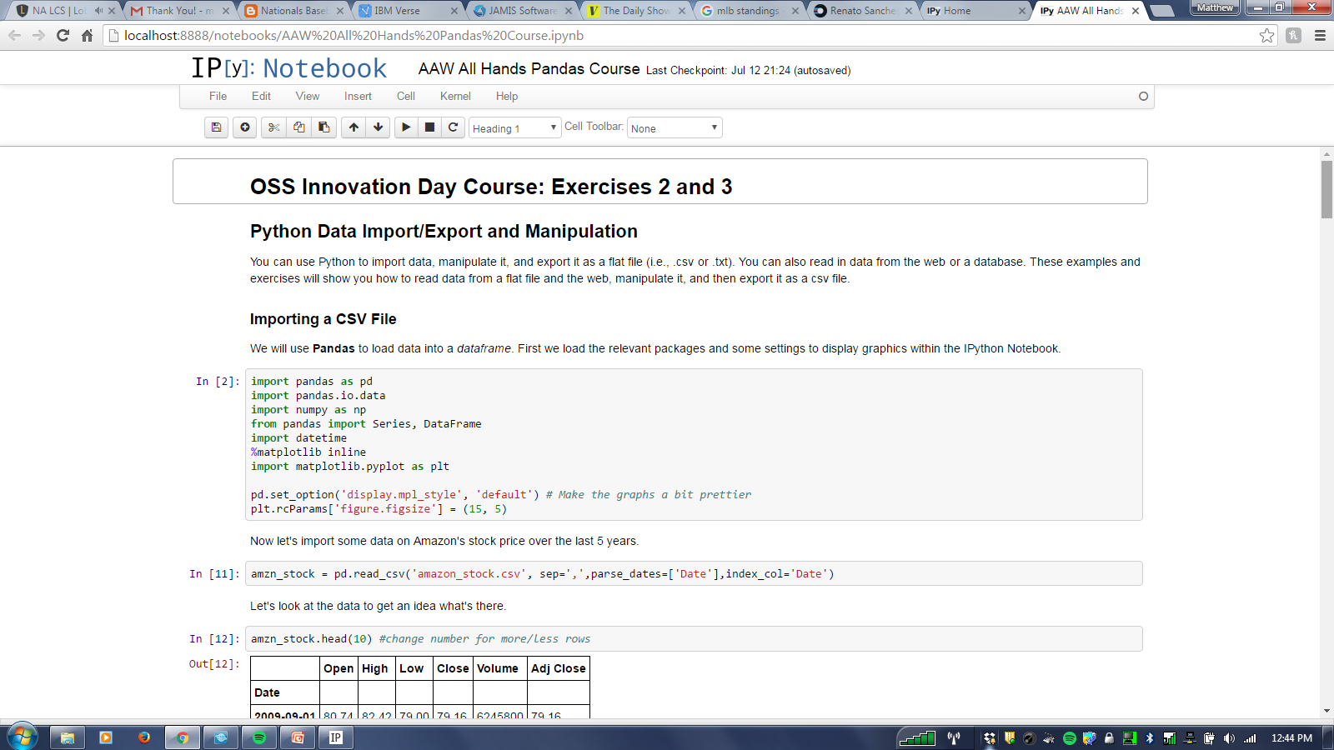
Python: Using Python
There are several ways to code in Python
When you are writing something by yourself, you can use Ipython Notebook
Ipython Notebook will run sequential blocks of code
When you want to run a whole program at once, you can run your code from the command line if you point the command line to a text file you have saved using the suffix .py
Source Control
If you are working on a project with more than one person, it is helpful to have a source control system that will manage any changes to the code and make sure you are always using the most up to date code
We will use Git and Github
Notes:
IBM Confidential

Slide 8
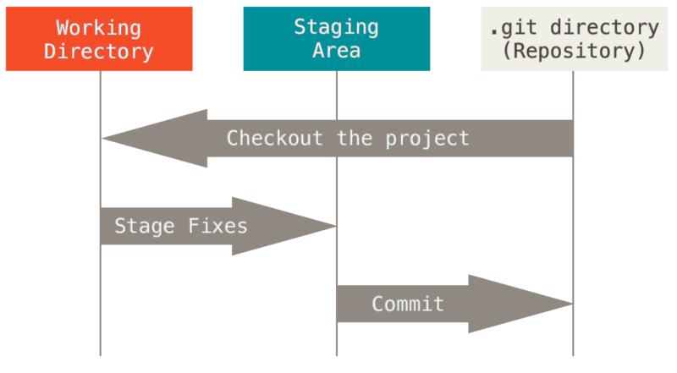
Python: Git
Git is widely used open source version control system
The basic Git workflow goes something like this:
You modify files in your working directory (in our case a folder created on your laptop).
You stage the files, adding snapshots of them to your staging area.
You do a commit, which takes the files as they are in the staging area and stores that snapshot permanently to your Git directory (the online Github repository).
Common Git Commands:
#This command will create a local copy of a github repository
git clone <github repository>
#This command will pull the most recent code from the github repository
git pull
#This command will add all or a singular file
git add <-A> <filename>
git commit –m <comment>
git push
Notes:
IBM Confidential

Slide 9
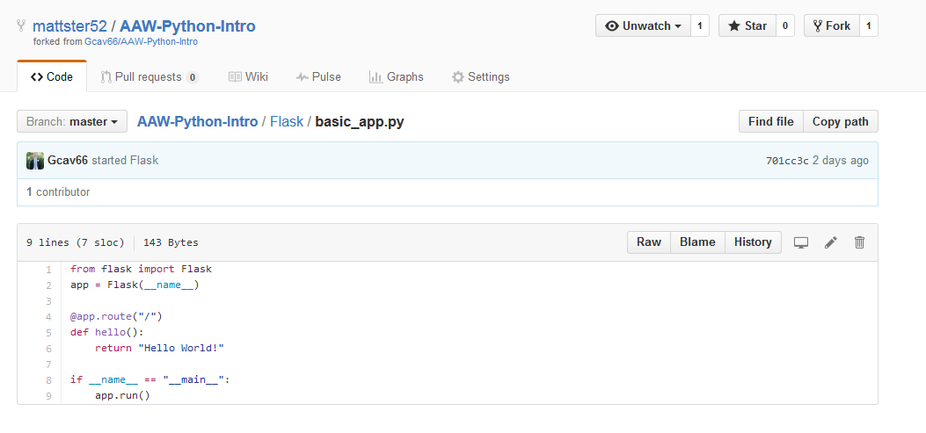
Python: GitHub (Gus)
GitHub is a free repository for hosting public open-source code
This means the code is hosted in the cloud rather than on your local machine
You can store your own projects on Github
And access thousands of other projects
As well as have access to features like wikis and a GUI for doing some git commands
Vast majority of open-source projects are on Github
http://en.wikipedia.org/wiki/Python_%28programming_language%29
http://en.wikipedia.org/wiki/Object-oriented_programming
Notes:
IBM Confidential

Slide 10
Python: Variables
Variables can be used to store information for use throughout your code
Python will automatically assign a type to your variable. In the example above:
year is an integer
team is a string
To see a variable, you can use the print command
Variables of two different types do not work well together so you have to reassign one variable to the type of the other:
year=2014
team=’seahawks’
Console
2014
seahawks
print year
print team
year_string = str(year)
year_team = year_string + team
print year_team
Console
2014seahawks
Notes:
IBM Confidential

Slide 11
Python: Lists
A third python variable type is a list
Constructed by several pieces of information separated by comma between two brackets
List Examples:
Lists will accept several variables between two brackets
To see an individual member of a list, use print <listname>[<listnum>]
Several more list methods can be found at: https://developers.google.com/edu/python/lists
years =[2014,2013,2012]
teams = [’seahawks’,’ravens’,’giants’]
Lists start at 0 instead of 1
print years[0]
print str(teams[1]).capitalize()
print years[2]
Console
2014
Ravens
2012
Notes:
IBM Confidential

Slide 12
Python: Dictionaries
A fourth python variable type is a dictionary
A dictionary is an associative array. Any key of the dictionary is associated (or mapped) to a value. The values of a dictionary can be any Python data type.
Dictionaries are unordered key-value-pairs. Items in dictionaries are accessed via keys and not via their position (like lists)
Dictionary Examples:
To see an individual member of a dictionary, use print <listname>[<listnum>]
Several more list methods can be found at: https://developers.google.com/edu/python/dictionary
superbowl_chmp ={2014:'seahawks',2013:'ravens',2012:'giants'}
qtr_bcks={'seahawks':'Russel Wilson','ravens':'Joe Flacco'}
Print superbowl_chmp[2014]
print str(superbowl_chmp[2014]).capitalize()
print qtr_bcks['seahawks']
Console
seahawks
Seahawks
Russel Wilson
Lists start at 0 instead of 1
Notes:
IBM Confidential

Slide 13
Python: Object Oriented Programming
The variables we defined in our last slide (strings and integers) are classes that are pre-set-up by python
Both integers and strings have different actions that can be taken on them to form a new object and they both only take in certain information
The description of what data and what functionality an object has is a Class
The functions that can be taken by a certain class are called Methods
teamcap= team.capitalize()
print teamcap
Console
Seahawks
Object: A unique instance of a data structure that's defined by its class. An object comprises both data members and methods.
Class: A user-defined prototype for an object that defines a set of attributes that characterize any object of the class.
Method : A special kind of function that is defined in a class definition.
yearcap= year.capitalize()
print yearcap
Console
AttributeError: 'int' object has no attribute 'capitalize'
http://www.tutorialspoint.com/python/python_classes_objects.htm
Notes:
IBM Confidential

Slide 14
Python: Object Oriented Programming
Some Classes are not built into python, you have to import them from a file
sklearn: file you download
datasets: class definition found in sklearn file
iris: name of object defined
load_iris(): a method defined in the class datasets
Note that methods are called by dot notation (object.methodname)
The online documentation for Sklearn.datasets explains what the method does:
http://scikit-learn.org/stable/modules/classes.html
The object iris will be a sample dataset defined in sklearn
from sklearn import datasets iris = datasets.load_iris()
Notes:
IBM Confidential

Slide 15
Python: Loops
Loops can be used to repeat a task for a given list using For or While Loops
For Loops: Repeat for all values “in” <list>
Console
In 2014, Seahawks won the Super Bowl
In 2013, Ravens won the Super Bowl
In 2012, Giants won the Super Bowl
yrs_ago=[0,1,2]
years =[2014,2013,2012]
teams = ['seahawks','ravens','giants']
for i in yrs_ago:
print "In " + str(years[i]) + ", " + teams[i].capitalize() + " won the Super Bowl"
While Loops: Repeat while condition is satisfied
Console
2012
2013
done
count=2012
while (count<2014):
print count
count+1
print “done”
If the condition is never met than you have an “infinite loop”
The indented lines are run repeatedly until the condition is met
Notes:
IBM Confidential

Slide 16
Python: IF-ELIF-ELSE statements
Python has a standard if then else functionality
Syntax Notes:
Use colon to represent “then” (“:”)
Use double equals sign (“==”) to evaluate
Use elif for else if
Make sure to properly indent the statements after the if & then statements to avoid errors
if years[0] == 2013:
print years[0]
elif years[1] == 2013:
print years[1]
else:
print ‘Nothing’
Console
2013
Notes:
IBM Confidential

Slide 17
Python: Functions
Users can write their own functions to
Syntax Notes:
Use colon to represent “then” (“:”)
Use double equals sign (“==”) to evaluate
Use elif for else if
Make sure to properly indent the statements after the if & then statements to avoid errors
if years[0] == 2013:
print years[0]
elif years[1] == 2013:
print years[1]
else:
print ‘Nothing’
Console
2013
Notes:
IBM Confidential

Slide 18
Python Basics:
Exercise #1

Slide 19
Data Import/Export

Slide 20
Python: File Formats and Databases
Flat files: txt, csv, xlsx
Web data: HTML, XML, JSON
Relational Databases: SQL
NoSQL Databases: Key-value stores
Notes:
IBM Confidential

Slide 21
Python: Import Text Files and CSVs
Text Files
CSV – use csv library
Helpful links
Txt
CSV
with open(“myfile.txt”) as f:
for row in f:
print row
import csv
with open(“mycsv.csv”) as f:
data = csv.reader(f)
for row in data:
print row
Pro Tip: you can open files with syntax like “data = open(myfile)”, however you have to make sure you close the file later. By using “with open…”, you do not.

Slide 22
Python: HTML, XML, JSON
JSON is the standard data format of the web: Python has an aptly named json library
XML is an older web format that you will still see: lxml is a great choice for parsing xml
Scraping HTML, e.g., web scraping, is a painful but sometimes necessary task. Beautiful Soup and Xquery are two good choices for parsing web pages
Notes:
IBM Confidential

Slide 23
Python: Web Scraping, XML, JSON
Scraping
JSON
Helpful Links
Scraping
XML
JSON
import requests
#import bs4
webpage = requests.get(“someurl.com”)
import json
import pprint
with open(“myfile.json”) as f:
data = json.load(f)
pprint(data)
Pro Tip: use pretty print “pprint” to print JSON to console so that it doesn’t look like a hot mess*
*industry term

Slide 24
Python: Relational Databases
Relational databases are the main storage for most business data
Oracle, Microsoft (SQL Server), IBM (DB2) all sell enterprise relational databases
Free options also exist: MySQL and PostgreSQL are two popular alternatives
You’ll likely encounter two use cases for relational databases
Transactional Databases – support applications, composed of many small tables joined together to allow for fast create, update, delete operations
Data Warehouses – larger, flatter tables designed for analytics and business users
Notes:
IBM Confidential

Slide 25
Python: Relational Databases
Let’s connect and query
Helpful Links
SQL (Structured Query Language)
sqlite3
mysql
import sqlite3
conn = sqlite3.connect('test.db')
print "Opened database successfully";
cursor = conn.execute("SELECT id, name, address, salary from COMPANY")
for row in cursor:
print "ID = ", row[0]
print "NAME = ", row[1]
print "ADDRESS = ", row[2]
print "SALARY = ", row[3], "\n"
print "Operation done successfully"; conn.close()
Pro Tip: For the example to the left, assume a table already exists with called “COMPANY” with lots of awesome data in it. Also, we are just writing SQL here.

Slide 26
Python: NoSQL Databases
NoSQL databases are the new hot technology
They are generally used when a relational database is unsuitable
Two situations where this often occurs are when you have unstructured or semi-structured data, e.g., JSON, or when you have an insane amount of data and it’s too expensive to buy IBM DB2’s or Netezza’s anymore
There are several flavors of NoSQL databases, two examples are:
Document object stores, which store data as documents. MongoDB is an example and the document format is very similar to JSON
Columnar databases, which store data as columns rather than rows. This is an effective pattern for large data, and HBase is a good example of a columnar database. HBase (the Hadoop Database), is often used with Hadoop, a popular software framework for Big Data.
Notes:
IBM Confidential

Slide 27
Python: Relational Databases
Let’s connect and query MongoDB
Helpful Links
Intro to NoSQL
PyMongo (Python driver for MongoDB)
from pymongo import MongoClient
client = MongoClient(“exampleurl")
db = client.test
cursor = db.restaurants.find()
for document in cursor:
print(document)
Pro Tip: For the example to the left, assume a table already exists with called “test” with lots of awesome data in it. Notice that we are just writing Python here, not SQL

Slide 28
Python Data Import/Export:
Exercise #2: Gus

Slide 29
Data Manipulation

Slide 30
Python: Pandas
Pandas is Python’s library for data manipulation. It saves structured data in a Python data frame and contains several functions to aggregate or filter data
Some common Pandas methods:
Viewing Data
.head(n)/.tail(n) will show the first/last n rows of a data frame
Summarizing Data
.mean()/.max()/.min()/.quantile() etc.
.describe() will show a quick statistic summary of your data
Aggregating Data
.groupby(colname).sum() will sum by the col
.size() can be used compute the size of each group
.agg() can also aggregate the data by using numpy functions
Syntax Notes:
Use colon to represent “then” (“:”)
Use double equals sign (“==”) to evaluate
Use elif for else if
Make sure to properly indent the statements after the if & then statements to avoid errors
Notes:
IBM Confidential

Slide 31
Python Data Manipulation:
Exercise #3

Slide 32
Python Web App

Slide 33
Python: Web App (Flask)
Web frameworks make building web applications easier
The drawback is that one has to often learn the framework separate from the language
Flask is a micro-framework written in Python (it handles all the logic for making HTTP requests)
This means that has very little boilterplate code. We can get up and running with Flask very easily
Notes:
IBM Confidential

Slide 34
Python Web App:
Exercise #4

Slide 35
Wrap-Up
&
Questions
*
Notes:
IBM Confidential

