Slide 1




NDN Passive Name Visualizer (10th NDN hackathon)
https://talks.ndn.today
@yoursunny
@Proyash56952
@sanjeevr93
@llxxee

Slide 2
Motivation and Impact
PCAP traffic trace from tcpdump or Wireshark is useful to:
understand a network protocol
diagnose network problems
Existing tools to analyze NDN packets in PCAP traffic trace:
ndndump
NDN dissector for Wireshark
They can analyze the structure of each individual packet, but provide no information beyond a single packet.
NDN Passive Name Visualizer provides insights into:
time dimension: traffic volume over time
space dimension: name hierarchy

Slide 3






System Architecture
NFD, NDN-DPDK, etc
live capture
-or-
pcap file
WebSocket
JSON messages {
"timestamp": 123456789000,
"name": "/8=P/8=A/8=1",
"type": "I"
}
namevis webapp
namevis server
Chart.js
Parcel bundler
GoPacket library

Slide 4
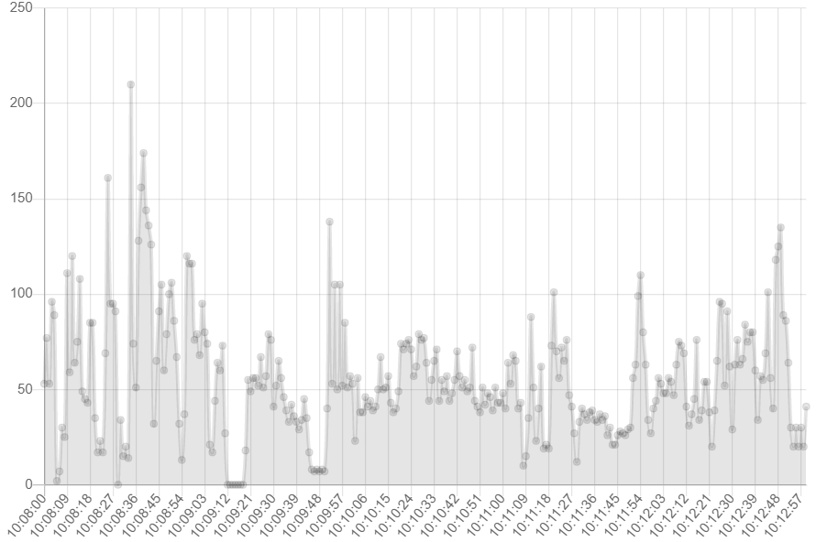
Traffic Volume Over Time

Slide 5
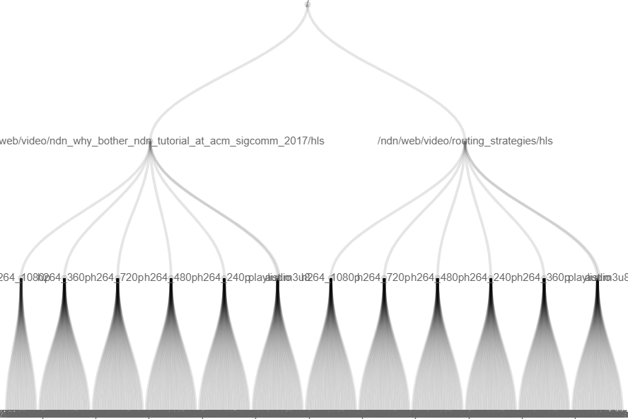
Name Hierarchy

Slide 6
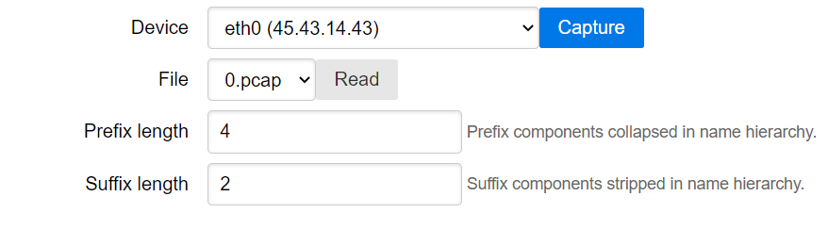
Lessons and Challenges
Nobody on our team knows how to do data visualization.
Charts are working with dynamic updates.
We hoped to "select a time range and display name hierarchy" but did not achieve that. The name hierarchy is for the whole trace.
Displaying every packet name is infeasible.
Page is too slow with thousands of nodes in the name hierarchy chart.
Solution: strip away a few suffix components (e.g. version and segment).

Slide 7
Future Directions
Network topology visualization:
Capture traffic from multiple network links (or read multiple PCAP files).
Show how packets under specified prefix flow through the network.
Useful for understanding forwarding strategies and attack scenarios.
Server-side packet filtering and aggregation:
Filter packets by name on the server side.
Perform certain aggregations on the server side, to reduce burden in webapp.
Bring back the testbed NDNMAP:
Install (a secure version of) namevis server on testbed routers.
Visitors can view real-time traffic (with filtering capability) across the testbed.

Slide 8
Project Links
Server: https://github.com/10th-ndn-hackathon/namevis
Webapp: https://github.com/10th-ndn-hackathon/namevis-web
Demo video: https://youtu.be/6t2y_-8asiw
Slides: https://talks.ndn.today/

