Slide 1

COMBAT FAKE NEWS TODAY USING NDN PRINCIPLES
Goal: Image watermark published content in a way that is subtle, yet easy to decrypt even after some amount of lossy conversion.
Technology should be usable by websites – the next step would be to make it a wordpress plugin, for example.
Goal is to port NDN principles onto the current web.
Stop fake news by making all published web and app content verifiable!
ORIGINATOR: Aditya Advani
Inspired by: Aaron Swartz

Slide 2
Screenshot Verification Service - WIP
Found great research papers of image-based steganography that survives degrading
Consensus is that 2 or 3 pixel-based steganography techniques used together should provide sufficient
Deep learning can be trained to try to hack any particular schema choice
Found a successful commercial product that provides exactly photo watermarking + crawling service to pro photographers – with PhD and MScs in signal processing and related disciplines from INRI France and consultants to Hollywood film industry
Decided to implement two demos - WIP
Copy of workflow of commercial product demo
Notebook style explanation of steganography academic paper using RGB-pixel steganography
Further challenges – is there a way in software to embed this watermarking at the browser layer? Would be much easier for mixed content demo of entire web pages. Basically a browser extension should take a screenshot of the page and visually embed the watermark into the DOM using canvas … this is the true crossover with NDN
Looking for collaborators please – help me write a paper! And build a demo!
Anyone with grad level understanding of cryptography and steganography
Anyone interested in building out a genuinely interesting deep learning data set and solution

Slide 3
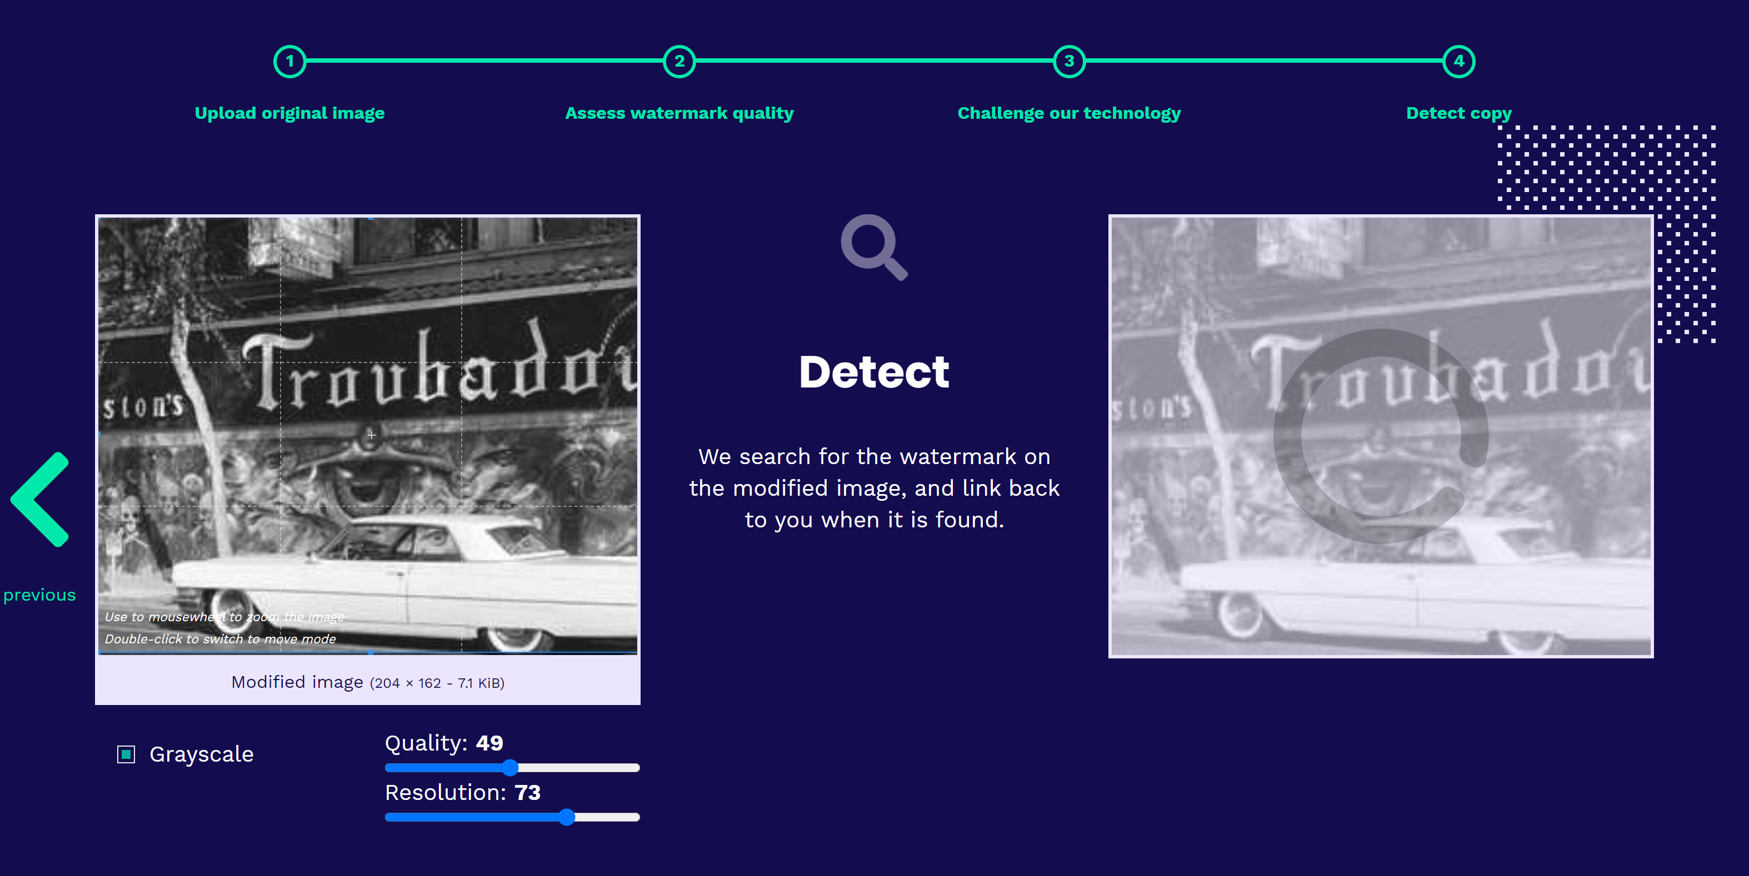
Proposed demo flow

Slide 4
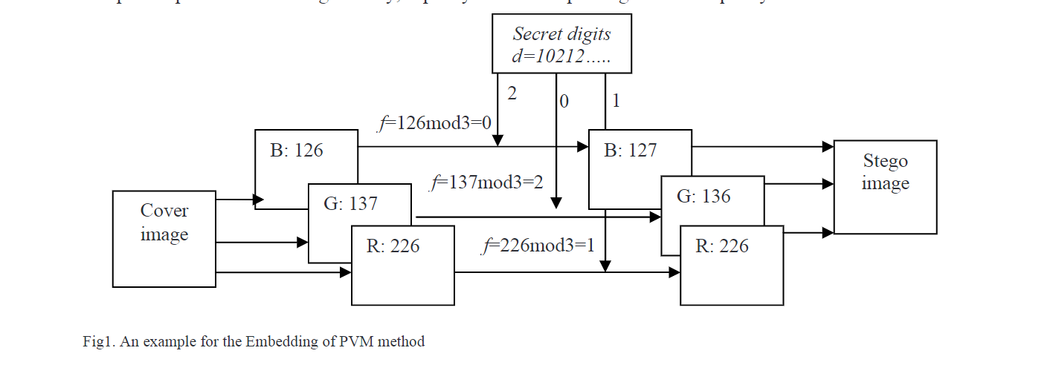
Proposed first steganography schema
2013 International Conference on Electronic Engineering and Computer Science - Color Image Steganography based on Pixel Value Modification Method Using Modulus Function - V.Nagaraja, Dr. V. Vijayalakshmi and Dr. G. Zayarazc
TBD
Number of bits per pixel area possible
Number of bits required
Conflict with grayscale steganography schema

