Slide 1
STRICTLY CONFIDENTIAL · OFFERING MEMORANDUM · POST-NDA
CARAMBA NORTH
Up to 1,300 contiguous acres of powered land on the ERCOT 765 kV backbone
PECOS COUNTY, TEXAS · FAR WEST ERCOT · PERMIAN BASIN · I-10 CORRIDOR
1,300
47,418
15 mi
20 mi
12.0 GW
CONTIGUOUS ACRES
AF/YR WATER RIGHTS
TO 765 KV SOLSTICE SUB
TO WAHA GAS HUB
ERCOT QUEUE, PECOS CO.
Prepared by Land Resource Partners · lrp-tx-gis.netlify.app
2026-08-23 · Executive summary deck — editable working draft

Slide 2












CONTENTS
What's in this deck
01 Executive Summary
Feature Amazon / GW Ranch
02 The Property
Feature Longfellow / Project Horizon
03 Transmission
08 The Diligence Platform
04 Regional Power Cluster
09 Subsurface & Drilling Activity
05 / 06 Water & Natural Gas
Appendix Access, Sources & Notices
07 Regional Data Center Pipeline
Full data compendium — every table, footnote, and source citation — is in the companion PDF and Word document.
CARAMBA NORTH — STRICTLY CONFIDENTIAL, POST-NDA
2

Slide 3

01 · EXECUTIVE SUMMARY
Transmission, water, gas, and proven hyperscale demand
Structural power cost
Waha-basis gas at a structural discount to Henry Hub, with recurring negative prints 2024–2025.
765 kV transmission anchor
AEP Solstice Substation 15 mi north — western terminus of the three PUCT-approved 765 kV Permian import paths.
Water at institutional scale
47,418 AF/yr permitted on adjacent affiliated lands — ≈ two-thirds of Middle Pecos GCD rights.
Demand already on the ground
12,039 MW ERCOT queue in Pecos Co.; 9.7 GW of announced hyperscale capacity within 60 mi.
As-of-right development
Unincorporated Pecos County — no zoning ordinance; industrial and energy uses permitted as of right.
CARAMBA NORTH — STRICTLY CONFIDENTIAL, POST-NDA
3

Slide 4
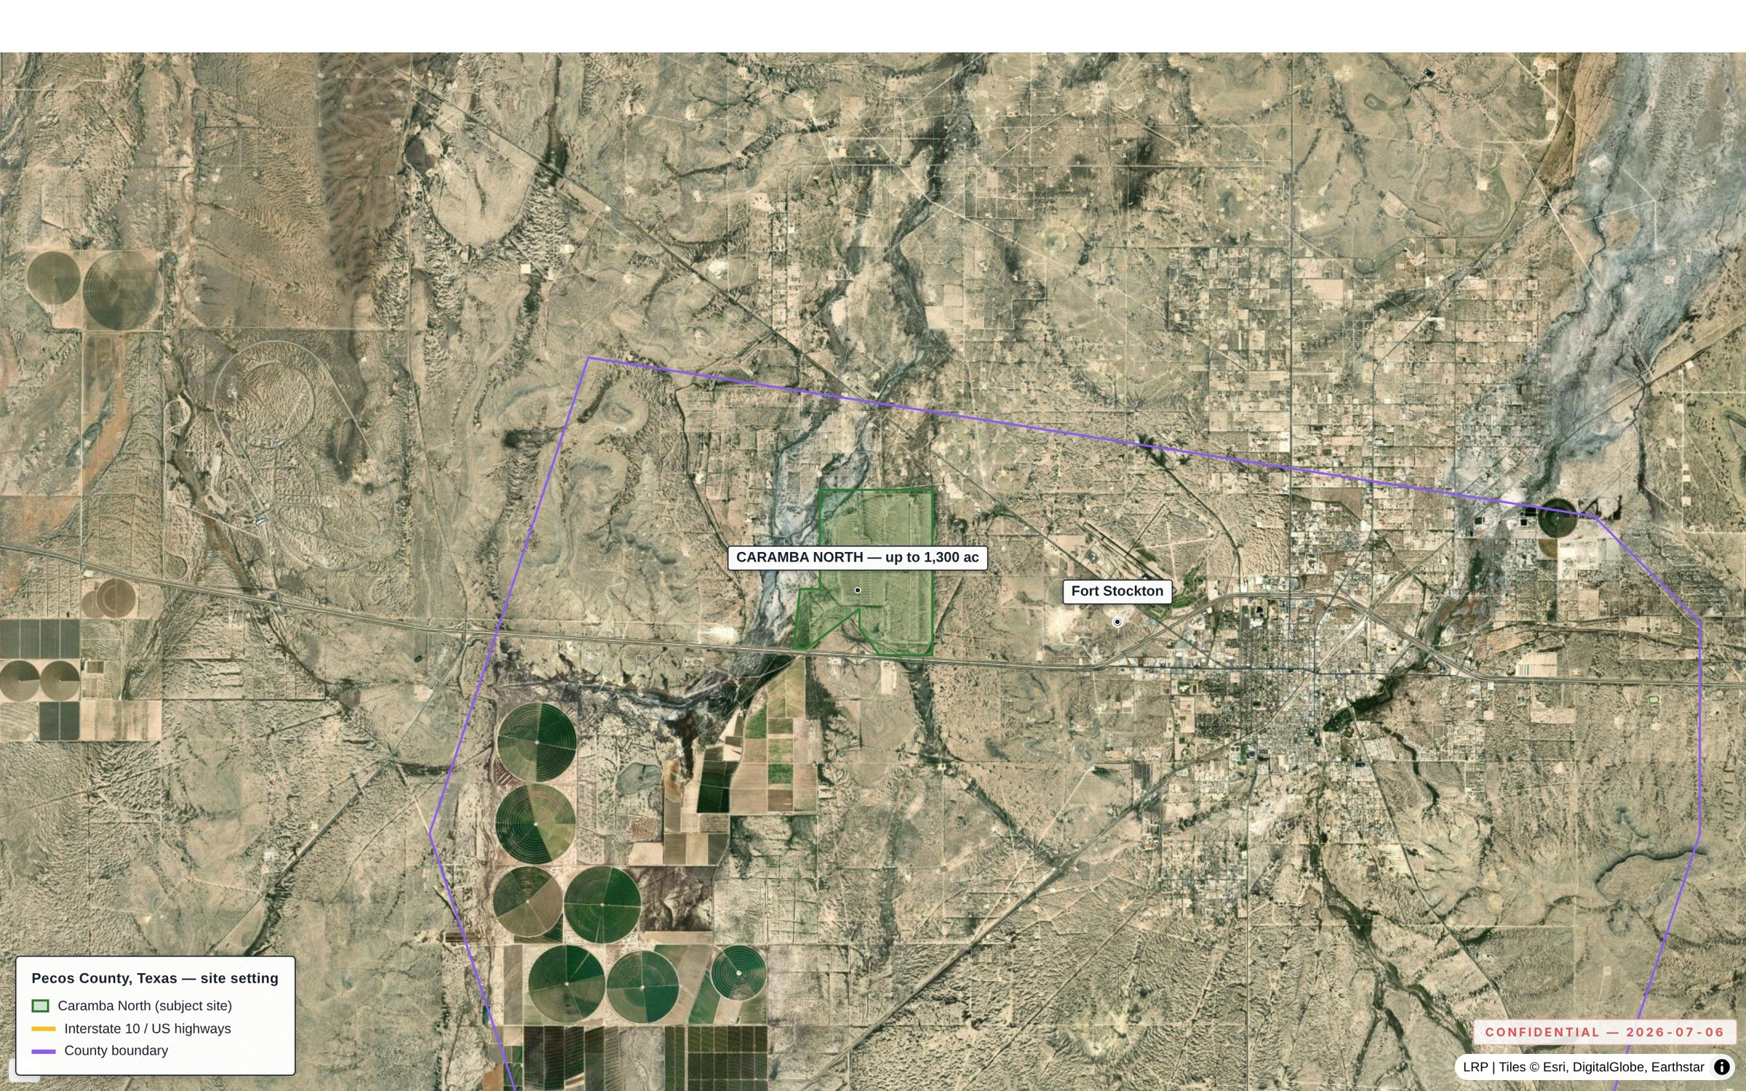
02 · THE PROPERTY
Contiguous, interstate-front acreage, five miles from Fort Stockton
ATTRIBUTE | DETAIL
Size / configuration | Up to 1,300 contiguous acres, north side of I-10
Access | Direct I-10 frontage; UP Sunset Route proximate; long-haul fiber
Municipal services | Fort Stockton (~5 mi): services, regional airport
Land-use regime | No zoning ordinance; industrial/energy uses as of right
ERCOT position | Far West weather zone — highest-growth large-load pocket
Exhibit 2.1 — The Caramba North tract on the north side of I-10, five miles from Fort Stockton.
CARAMBA NORTH — STRICTLY CONFIDENTIAL, POST-NDA
4

Slide 5
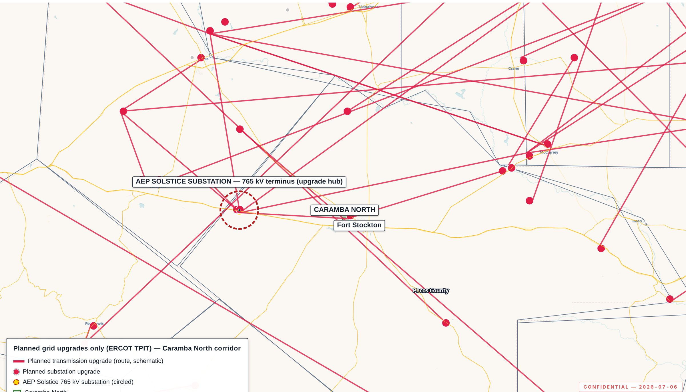
03 · TRANSMISSION
15 miles from the western terminus of ERCOT's 765 kV backbone
ELEMENT | DETAIL
765 kV PUCT approval | Three import paths approved Apr 24, 2025 (PBRP, No. 55718)
Solstice Substation | AEP/CPS Energy; 15 mi north of the Property
Local substations | Fort Stockton Plant (2 mi), Airport (3.3 mi), Fort Stockton (5.4 mi), 16th Street (6 mi)
Planned upgrades (TPIT) | 141 substation + 133 line upgrades tracked ERCOT-wide
Exhibit 3.1 — Planned grid upgrades only (ERCOT TPIT); Solstice terminus circled.
CARAMBA NORTH — STRICTLY CONFIDENTIAL, POST-NDA
5

Slide 6
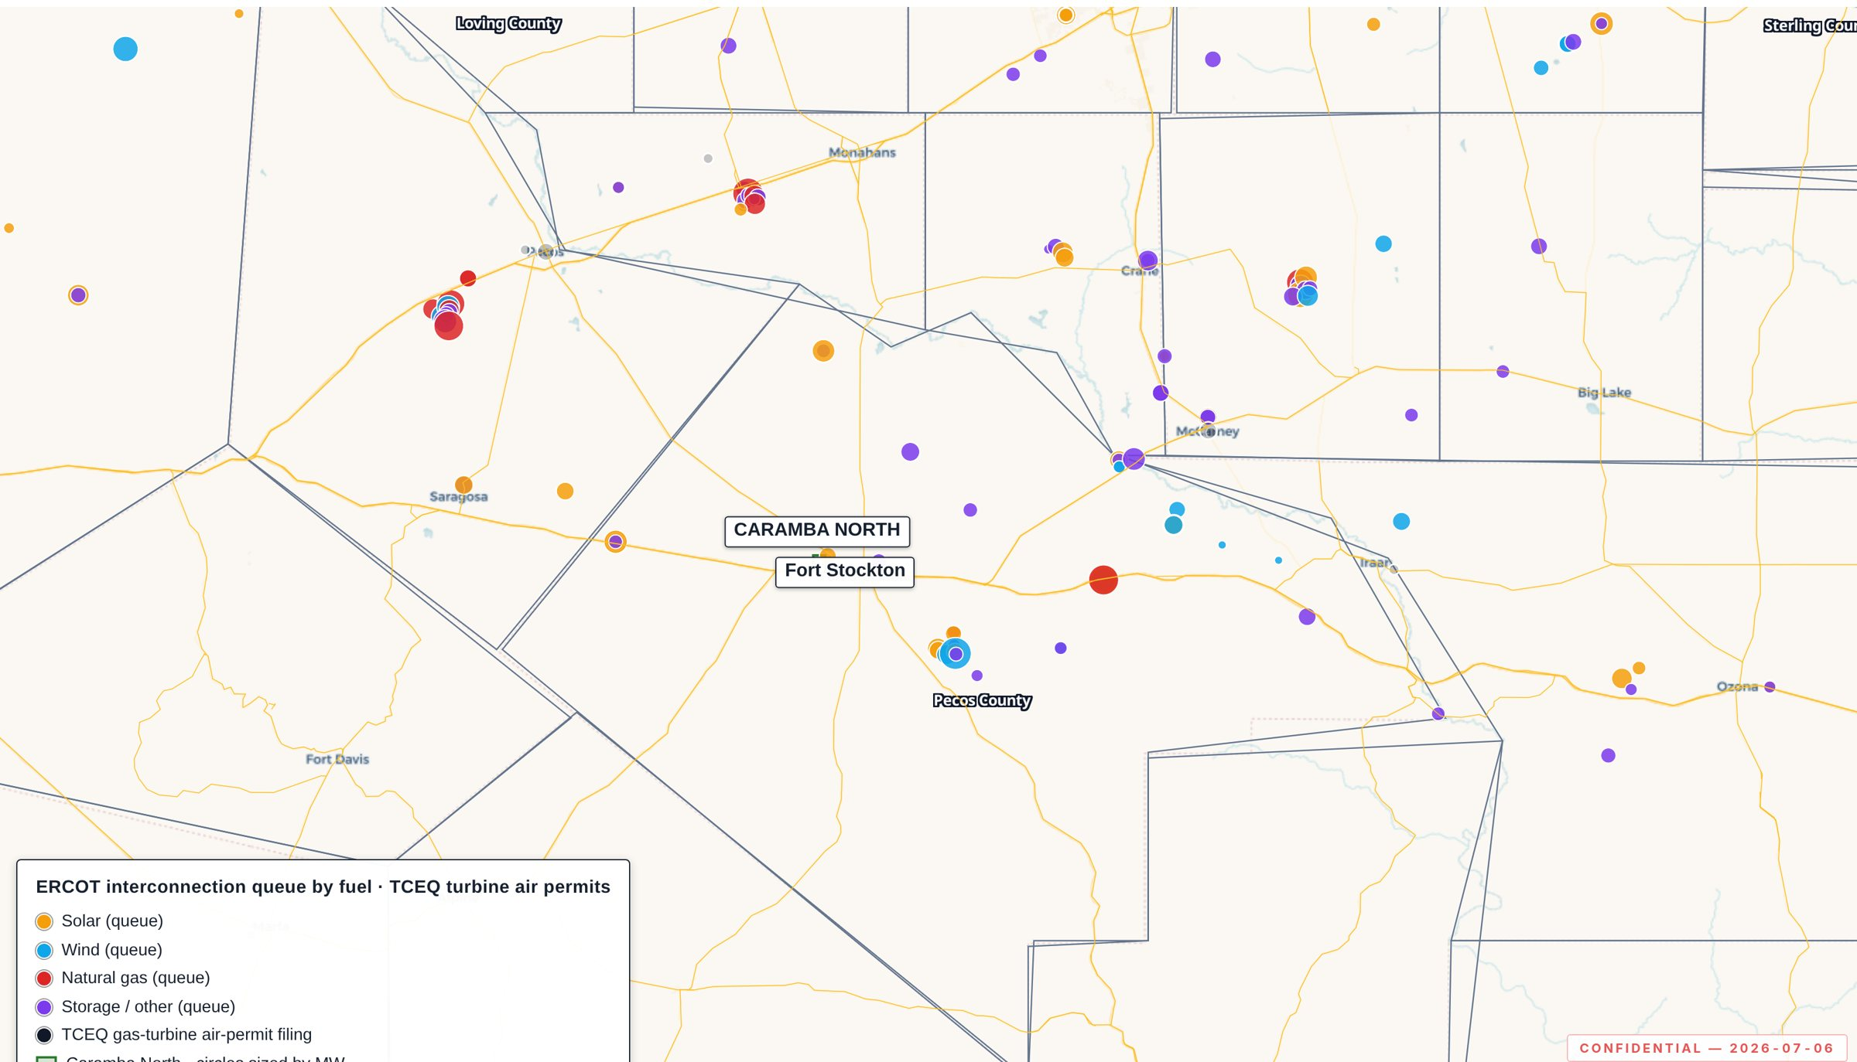
04 · REGIONAL POWER CLUSTER
12.0 GW queued in Pecos County — densest renewable cluster in ERCOT
TECHNOLOGY | PECOS — OPERATING | PECOS — ERCOT QUEUE
Solar | 13 · 2.2 GW | 16 · 6.3 GW
Wind | 5 · 542 MW | 10 · 3.0 GW
BESS | 6 · 505 MW | 11 · 1.4 GW
Gas | 1 · 1 MW | 2 · 1.4 GW
Total | 3.2 GW | 12.0 GW
Exhibit 4.1 — Operating fleet and ERCOT interconnection queue over one footprint.
Adjacent counties (Reeves, Crane, Ward, Upton, Ector, Crockett): 7.0 GW operating, 24.6 GW queued. Named-project detail in the full document.
CARAMBA NORTH — STRICTLY CONFIDENTIAL, POST-NDA
6

Slide 7

05 / 06 · WATER & NATURAL GAS
Permitted water at scale, and a Waha-basis gas quote in hand
WATER
NATURAL GAS
47,418 AF/yr
20 mi to Waha
(~42.3 MGD) permitted on adjacent affiliated lands — ≈ two-thirds of total Middle Pecos GCD rights. Source: Edwards-Trinity (Plateau) aquifer; recharge held through the 1950s drought of record.
Indicative supply quote: 200,000 MMBtu/day, 15-year term, Waha-index pricing. CIAC $15–25M; lead time 9–15 months (counterparty-supplied terms).
Groundwater district: Middle Pecos GCD · Permitted use: industrial (cooling, hyperscale loads)
Basis: structural discount to Henry Hub; negative prints 2024–2025 as Matterhorn, Blackcomb, Hugh Brinson, GCX rebalance egress.
CARAMBA NORTH — STRICTLY CONFIDENTIAL, POST-NDA
7

Slide 8
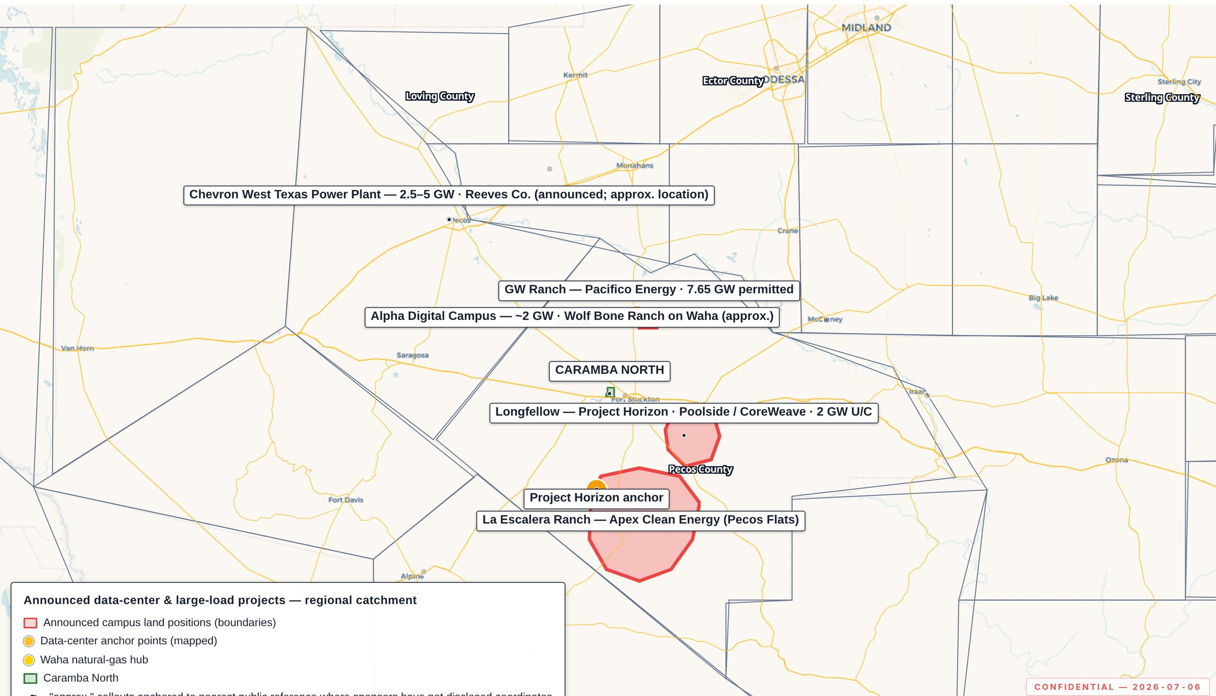
07 · REGIONAL DATA CENTER PIPELINE
9.7 GW of announced hyperscale capacity within 60 miles
PROJECT | SPONSOR | CAPACITY | DISTANCE
GW Ranch | Amazon | 7.7 GW | ~17.3 mi
Project Horizon | Poolside Infrastructure Company | 2.0 GW | ~19.7 mi
Elsewhere in Texas (context, not catchment): 6 campuses, 15.9 GW — not included above.
GW Ranch's ownership changed in Aug 2026, and Longfellow's anchor tenant exited in Apr 2026 — see the following feature slides.
Exhibit 7.1 — Announced data-center and large-load projects surrounding the site.
CARAMBA NORTH — STRICTLY CONFIDENTIAL, POST-NDA
8

Slide 9
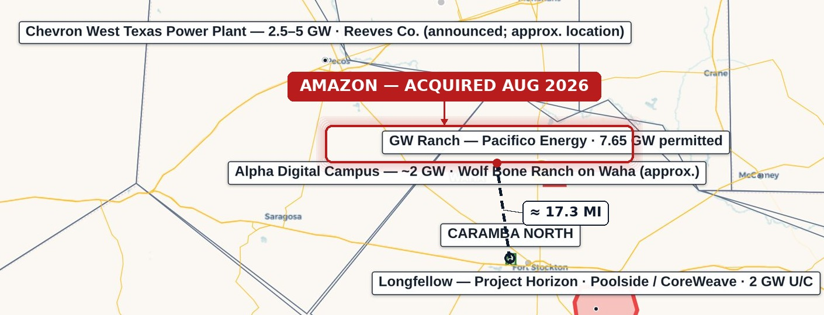
FEATURE · AMAZON / GW RANCH
Amazon acquires GW Ranch — ≈ 17.3 miles from Caramba North
8,000-acre site, Pecos County
≈ 17 miles north of Fort Stockton — the same siting logic as Caramba North.
35 gas turbines · 7.65 GW TCEQ air permit
Largest air permit issued in the US (Jan/Feb 2026) — plus 1.8 GW battery storage and up to 750 MW solar.
Three data-center buildings
189,000 sq ft each, Gensler design, ≈ $300M per building — targeted completion Dec 2026.
≈ $12B estimated total project investment
Exhibit — GW Ranch site (highlighted) and its straight-line distance to the Caramba North tract centroid, ≈ 17.3 miles. Base map: Exhibit 7.1.
Amazon has not disclosed its specific investment amount or ultimate buildout plans.
Off-grid initially
Amazon has not disclosed an ERCOT large-load interconnection filing or queue position — exploring a transition to grid-connected service.
Clarification — the 7.65 GW figure is a TCEQ generation air permit, not an ERCOT interconnection queue position; subject to Texas Gov. Abbott's Aug 3, 2026 data-center permitting pause pending state audits.
CARAMBA NORTH — STRICTLY CONFIDENTIAL, POST-NDA
9

Slide 10
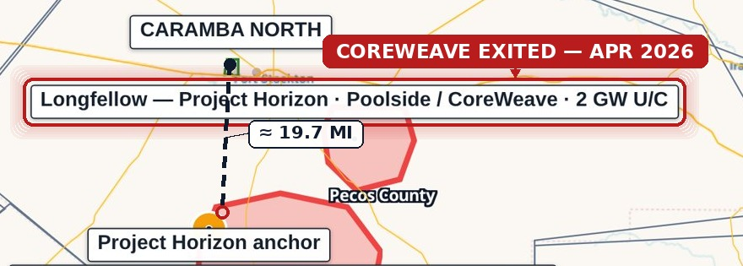
FEATURE · LONGFELLOW / PROJECT HORIZON
CoreWeave exits Project Horizon — ≈ 19.7 miles from Caramba North
568-acre site, Pecos County
Longfellow Ranch (Mitchell family), ≈ 25 miles from Fort Stockton — announced Oct 2025 as a 2 GW, 8-phase campus.
CoreWeave exited the anchor lease, Apr 2026
250 MW / 15-yr lease (to 500 MW) plus 40,000+ GPUs — exited after Poolside missed its GPU timeline and its funding round fell through.
Behind-the-meter gas, no confirmed permit on file
SCR-equipped aero-derivative turbines planned; no TCEQ air-permit or ERCOT queue record found for this site as of Aug 2026.
Revised to ~1.2 GW initial, scaling toward ~7 GW
Exhibit — Longfellow / Project Horizon site (highlighted) and its straight-line distance to the Caramba North tract centroid, ≈ 19.7 miles. Base map: Exhibit 7.1.
Per Jun 2026 reporting — down from the original 2 GW first-phase framing, pending a new anchor tenant.
Now under Poolside Infrastructure Company
Spun-off infra arm continuing the site without the AI lab; named a new CFO Jul 2026 and is courting a replacement anchor tenant.
Clarification — the original 2 GW / CoreWeave framing on Exhibit 7.1 predates the Apr 2026 lease termination; treat capacity and timeline figures for this site as unresolved pending a new anchor tenant.
CARAMBA NORTH — STRICTLY CONFIDENTIAL, POST-NDA
10

Slide 11
08 · THE DILIGENCE PLATFORM
Every figure is independently verifiable, feature by feature
PLATFORM PROPERTY | WHY IT MATTERS FOR DILIGENCE
Source-cited features | Every point/line/boundary traces to a cited public dataset; per-feature popups
Refresh discipline | RRC weekly; ERCOT queue/TPIT monthly; EIA/USGS/OSM annually
Analytical tooling | Filters by county/depth/spud year/fuel/status; time scrubber; measure/share/print
Reproducibility | Static, versioned build; deployed bundle byte-verified on release; access logged
lrp-tx-gis.netlify.app · access credentials issued to the deal team separately (see Appendix)
CARAMBA NORTH — STRICTLY CONFIDENTIAL, POST-NDA
11

Slide 12
09 · SUBSURFACE & DRILLING ACTIVITY
No new drilling is occurring at or near the site
0
0
1
0
NEW-DRILL WELLS ≤ 2 MI SINCE 2020
NEW-DRILL WELLS ≤ 5 MI SINCE 2020
NEW-DRILL WELLS ≤ 10 MI SINCE 2020
NEW-DRILL FRACKS ≤ 2 MI, EVER
BOTTOM LINE
Shallow drilling, hydraulic fracturing, or new drilling of any kind — three independent public records point the same way: it is not happening at or near this site.
Pecos: 115 new wells since 2020 vs. peer average 1,181. 83% of non-plugged wellbores ≤10 mi are marginal/end-of-life.
CARAMBA NORTH — STRICTLY CONFIDENTIAL, POST-NDA
12

Slide 13
APPENDIX
GIS platform access & source register
ELEMENT | DETAIL
URL | https://lrp-tx-gis.netlify.app
Login | Business email + access password (issued to deal team separately)
Primary sources | ERCOT (GIS Report, TPIT), PUCT, EIA-860, TCEQ, RRC (dbf900, production, W-1), FracFocus, Middle Pecos GCD, HIFLD, USGS, BTS, U.S. Census TIGER
Refresh cadence | RRC weekly; ERCOT queue/TPIT monthly; EIA/USGS/OSM annually
Full footnotes (13), source register, and exhibit-provenance table are in Appendix A.1–A.2 of the companion PDF and Word document.
CARAMBA NORTH — STRICTLY CONFIDENTIAL, POST-NDA
13

Slide 14
IMPORTANT NOTICES
This Confidential Offering Memorandum has been prepared solely for the use of a limited number of prospective counterparties, under executed non-disclosure agreement, in connection with the potential acquisition of, or investment in, the Caramba North property. It contains proprietary data of Harvest Energy, LLC and is delivered on a strictly confidential basis; it may not be reproduced or distributed without consent.
This document does not constitute an offer to sell or a solicitation of an offer to buy any security or interest. Information is preliminary and indicative, compiled from sources believed reliable, and subject to revision without notice. No representation or warranty, express or implied, is made as to accuracy or completeness.
Public data is drawn from ERCOT, PUCT, EIA, TCEQ, RRC, FracFocus, Middle Pecos GCD, HIFLD, USGS, BTS, and U.S. Census TIGER, supplemented by project-level GIS analysis and counterparty-supplied indicative terms. News on third-party transactions (e.g. Section "Feature") is drawn from public reporting cited in the companion Word/PDF data model. Recipients should conduct their own independent investigation, including consultation with their own legal, tax, accounting, and engineering advisors.
CARAMBA NORTH — STRICTLY CONFIDENTIAL, POST-NDA
14

