Slide 1
STRICTLY CONFIDENTIAL · OFFERING MEMORANDUM · POST-NDA
CARAMBA
NORTH
A 1,300-acre parcel inside an already-forming power and data-center corridor — two hyperscale-scale projects sit on the same north-south line through the property at 15.5 and 19.3 miles, backed by a transmission, water, and gas position that is already permitted, not proposed.
1,300
15.5 mi
19.3 mi
32.7 GW
CONTIGUOUS ACRES
TO GW RANCH (7.65 GW)
TO LONGFELLOW
WITHIN 60 MILES
Prepared by Land Resource Partners · lrp-tx-gis.netlify.app
2026-08-24

Slide 2

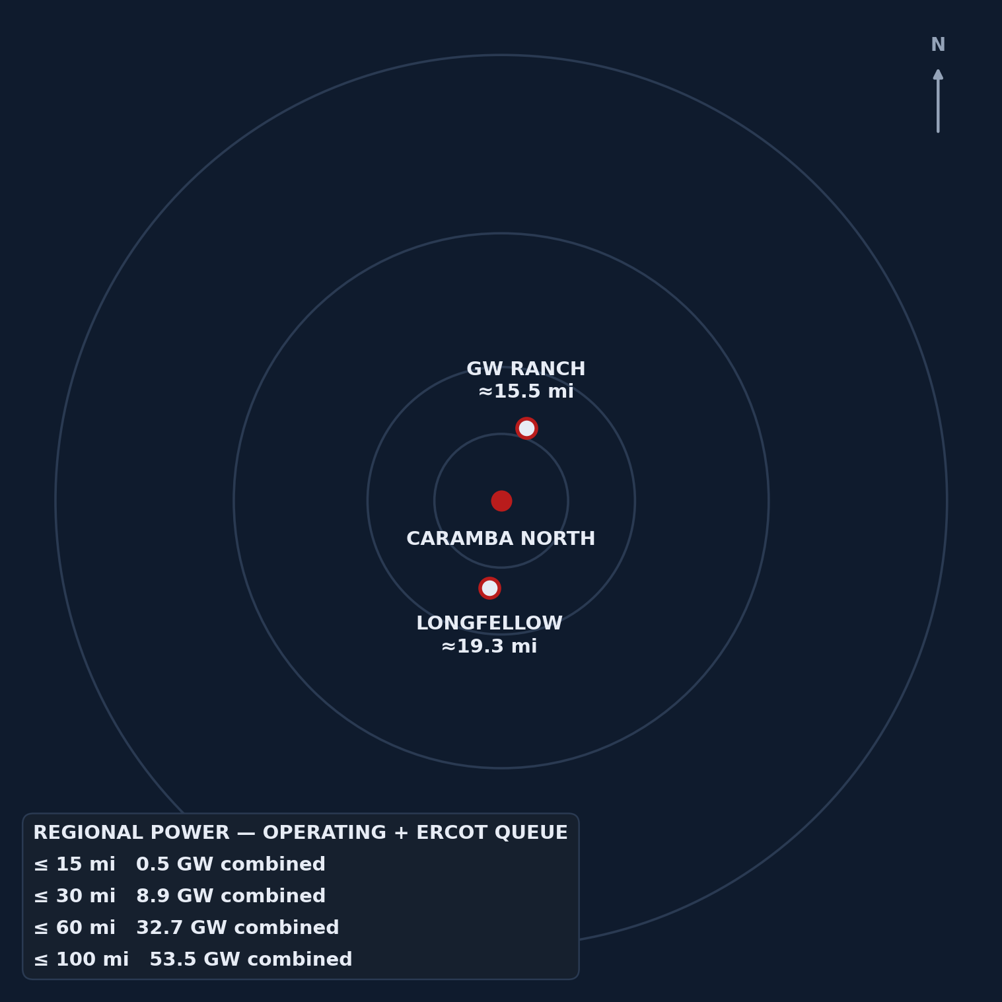
THE POWER GRAVITY MAP
GW Ranch sits almost due north (~19°) and Longfellow almost due south (~188°) of Caramba North — the property sits on the north-south line between them, not off to one side.
0.5 GW
OPERATING + QUEUED, WITHIN 15 MILES
8.9 GW
OPERATING + QUEUED, WITHIN 30 MILES
32.7 GW
OPERATING + QUEUED, WITHIN 60 MILES
Ring analysis: region-wide operating + ERCOT-queue capacity from the same EIA-860 + ERCOT-queue layers used throughout — not county-bounded. Caramba North at center; GW Ranch and Longfellow plotted at true bearing and distance.
CARAMBA NORTH — STRICTLY CONFIDENTIAL, POST-NDA
2

Slide 3

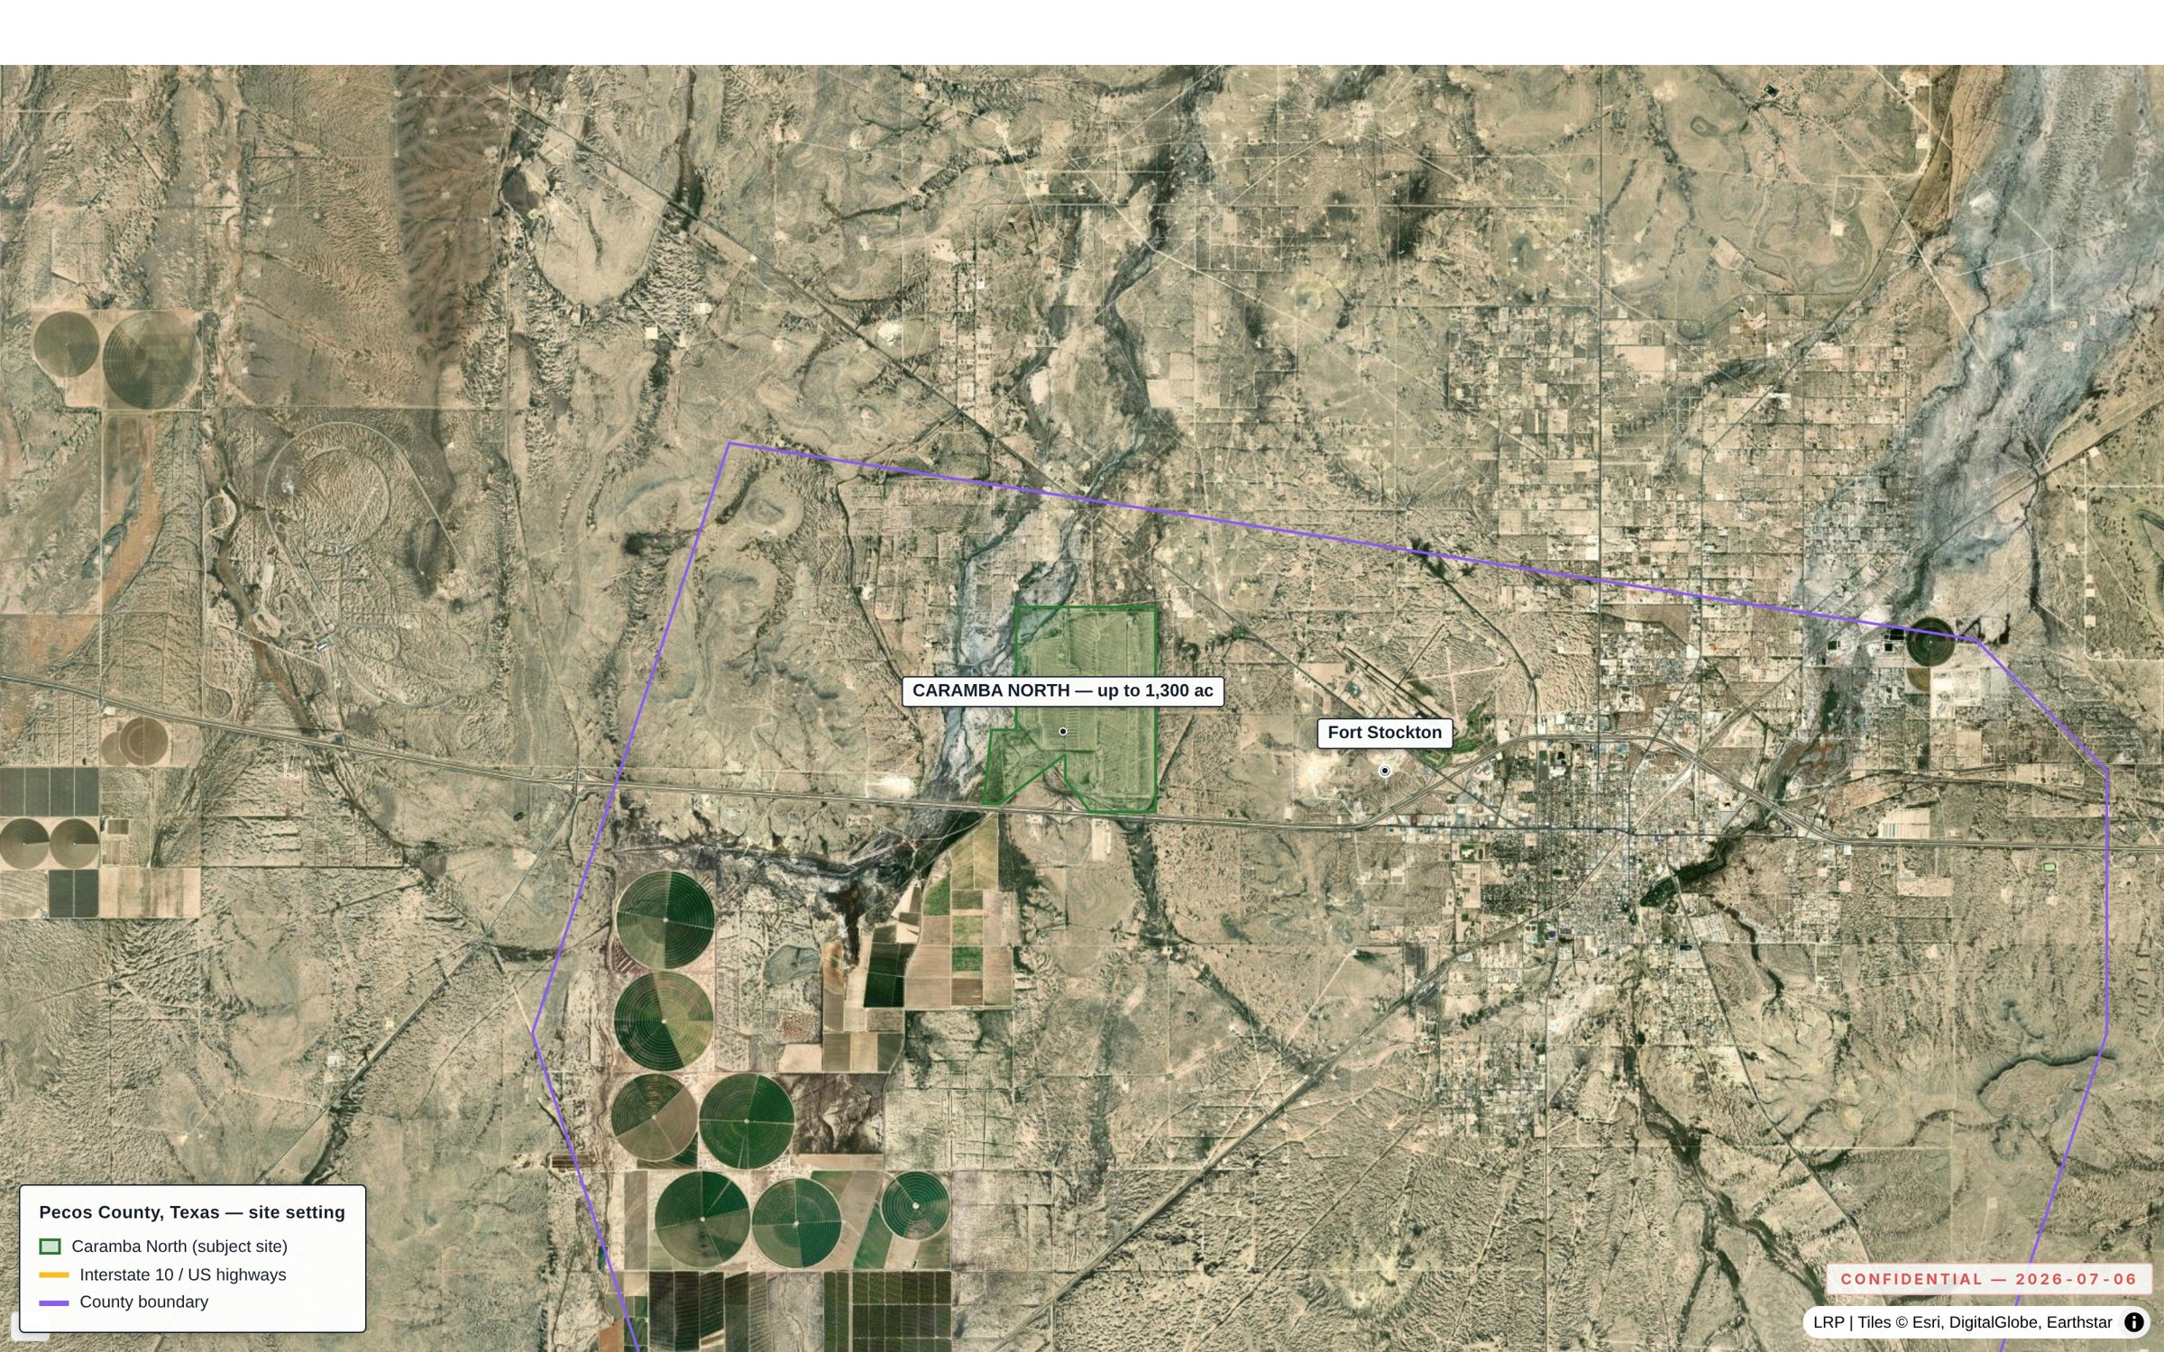
THE PROPERTY
As-of-right industrial land inside the fastest-growing load pocket in ERCOT — not a rezoning story.
1,300
~5 mi
MAX CONTIGUOUS ACRES
TO FORT STOCKTON
North side of I-10, Pecos County. No zoning ordinance — industrial and energy use as of right, inside ERCOT's Far West weather zone, its highest-growth large-load pocket.
Exhibit 2.1 — the Caramba North tract on the north side of I-10, five miles from Fort Stockton.
CARAMBA NORTH — STRICTLY CONFIDENTIAL, POST-NDA
3

Slide 4

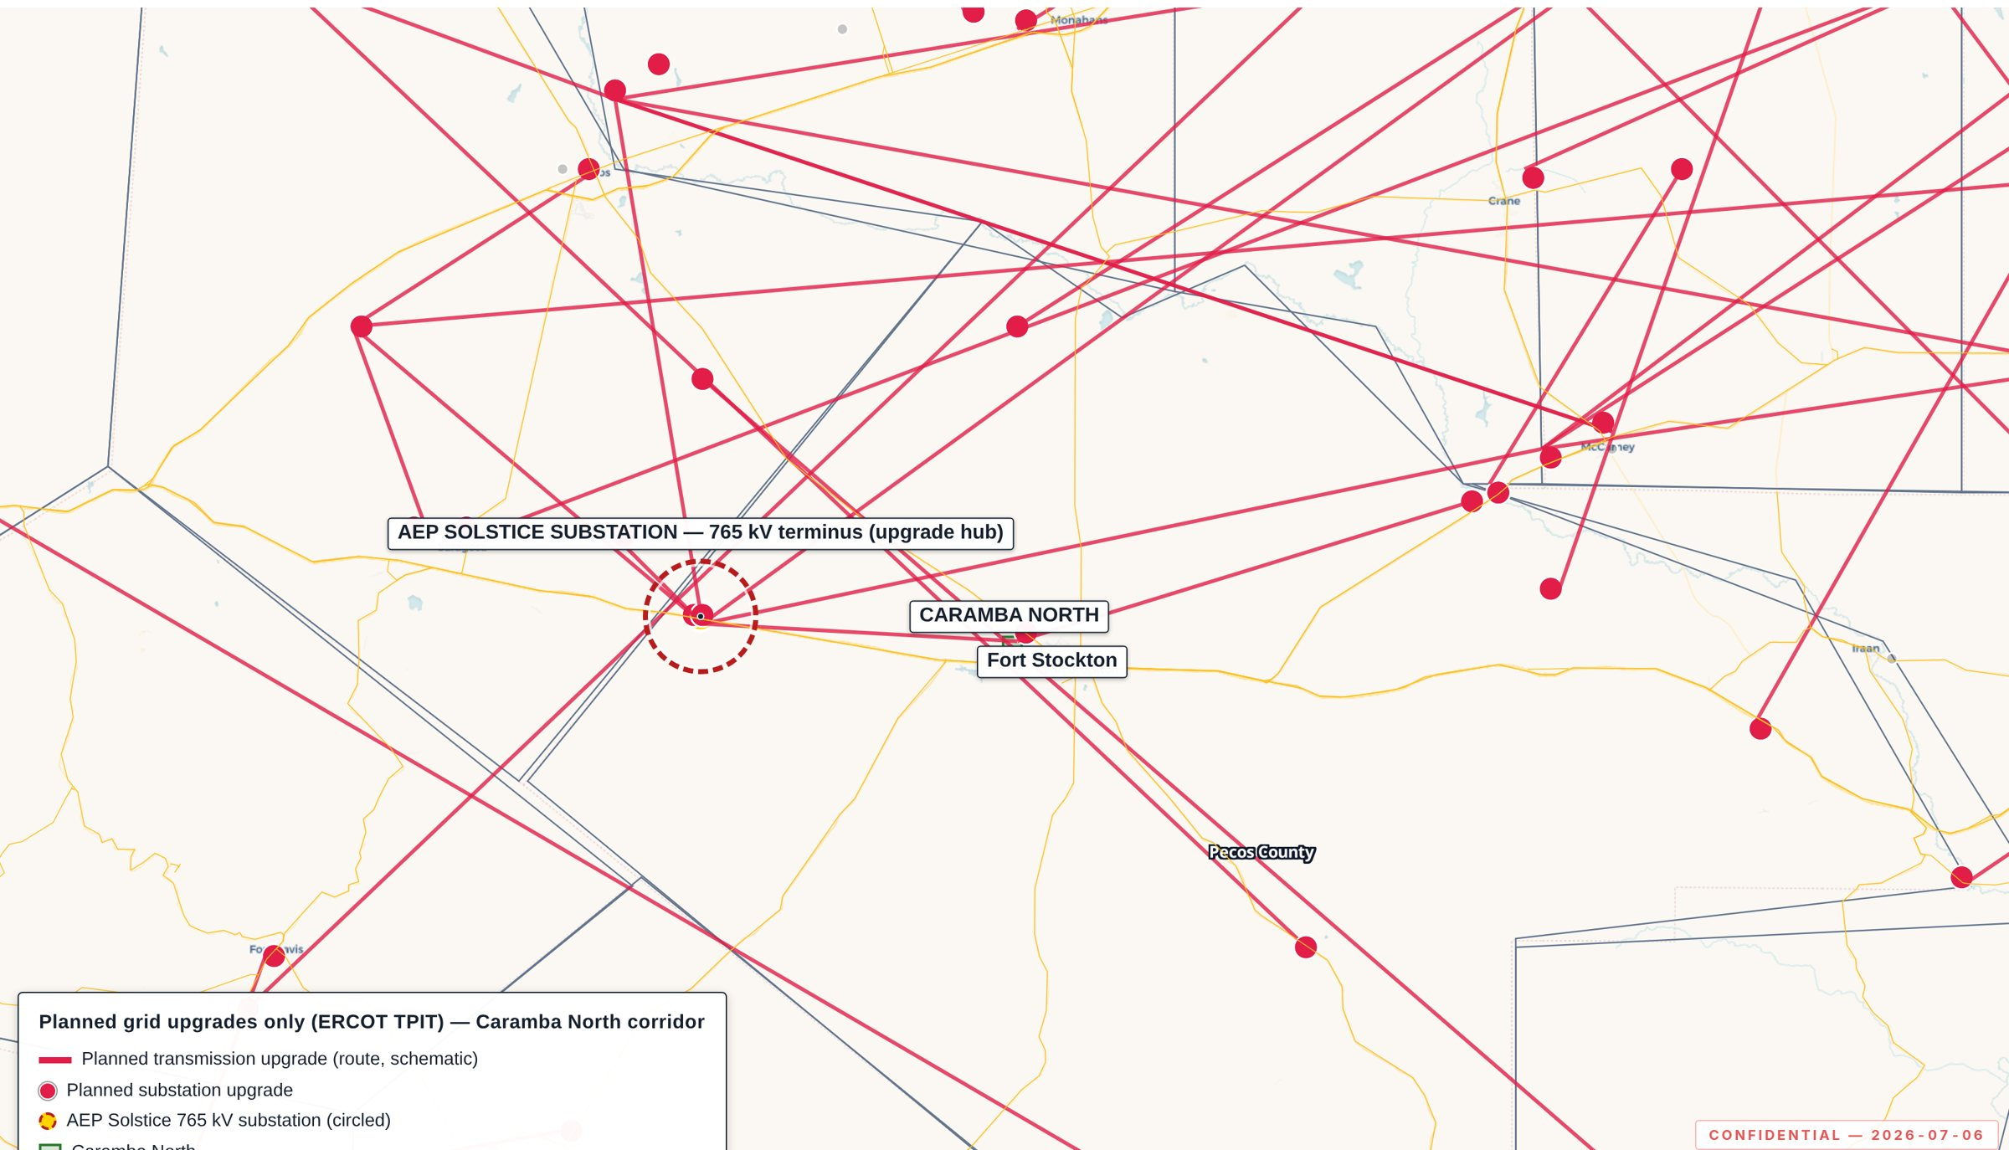
TRANSMISSION
Fifteen miles from the delivery point of all three approved 765 kV Permian import lines — the transmission decision is already made, upstream of this site.
15 mi
3
TO SOLSTICE SUBSTATION
APPROVED 765 KV IMPORT PATHS
Exhibit 3.1 — planned grid upgrades only (ERCOT TPIT); Solstice terminus circled.
AEP/CPS Energy's Solstice Substation — western terminus of the three PUCT-approved paths (Apr 24, 2025, PBRP Docket No. 55718). 141 substation and 133 line upgrades are tracked ERCOT-wide under TPIT — the pipeline of planned upgrades, not built yet.
CARAMBA NORTH — STRICTLY CONFIDENTIAL, POST-NDA
4

Slide 5

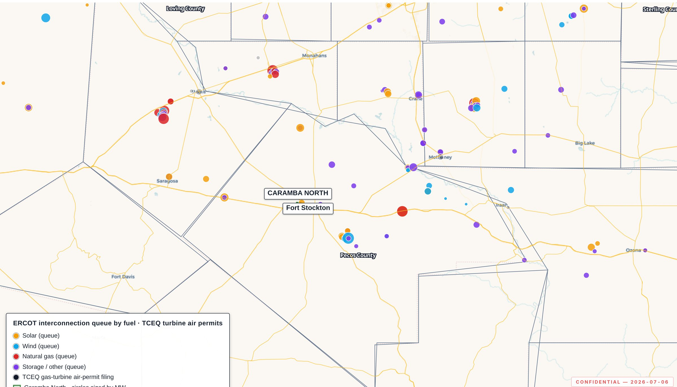
REGIONAL POWER CLUSTER
12 GW already queued in this county alone — before counting the two hyperscale campuses that follow.
12,039
3,226
MW QUEUED, PECOS CO. (39 PROJECTS)
MW OPERATING, PECOS CO.
Exhibit 4.1 — operating fleet and ERCOT interconnection queue over one footprint.
Within 20 miles specifically: 13 queued projects, 3,973 MW — before counting the adjacent six counties' 7,022 MW operating and 24,585 MW queued.
CARAMBA NORTH — STRICTLY CONFIDENTIAL, POST-NDA
5

Slide 6

WATER
Two-thirds of the district's industrial water rights are already permitted to this position — the water conversation is closed, not open.
47,418
42.3
~2/3
AF/YR PERMITTED, ADJACENT AFFILIATED LANDS
MGD EQUIVALENT
OF MIDDLE PECOS GCD INDUSTRIAL RIGHTS
Source: Edwards-Trinity (Plateau) aquifer; recharge held through the 1950s drought of record. Groundwater district: Middle Pecos GCD; permitted use: industrial (cooling, hyperscale loads).
CARAMBA NORTH — STRICTLY CONFIDENTIAL, POST-NDA
6

Slide 7

NATURAL GAS
A signable 15-year gas quote at Waha basis — the same structural discount now drawing behind-the-meter generation to this corridor.
20 mi
200,000
15-yr
TO WAHA HUB
MMBTU/DAY, INDICATIVE SUPPLY QUOTE
TERM, WAHA-INDEX PRICING
CIAC $15–25M; lead time 9–15 months (counterparty-supplied terms). Basis context: structural discount to Henry Hub; negative Waha prints in 2024-2025 as Matterhorn, Blackcomb, Hugh Brinson, and GCX pipelines rebalance Permian egress.
CARAMBA NORTH — STRICTLY CONFIDENTIAL, POST-NDA
7

Slide 8
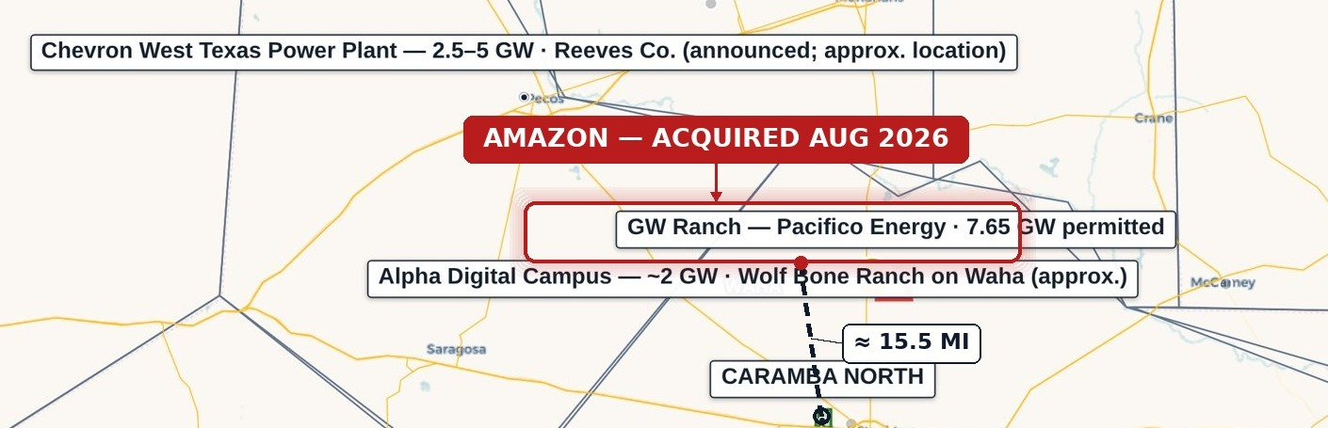
FEATURE · GW RANCH
The largest air permit issued in the US this year sits fifteen miles up the same highway corridor — under construction, not announced.
8,000-acre site, Pecos County. Amazon disclosed ownership Aug 2026 (previously Pacifico Energy Group, which remains power-plant developer/operator). 35 gas turbines plus 1.8 GW battery storage and up to 750 MW solar; three 189,000 sq ft data-center buildings (Gensler design, ~$300M each), targeted completion Dec 2026.
15.5 mi
FROM CARAMBA NORTH
7.65 GW
TCEQ AIR PERMIT — LARGEST IN THE US
Clarification: the 7.65 GW figure is a TCEQ generation air permit, not an ERCOT interconnection queue position — the project is off-grid initially and Amazon has not disclosed an ERCOT filing. Source: public reporting, Aug 2026.
~$12B
EST. TOTAL PROJECT INVESTMENT
CARAMBA NORTH — STRICTLY CONFIDENTIAL, POST-NDA
8

Slide 9
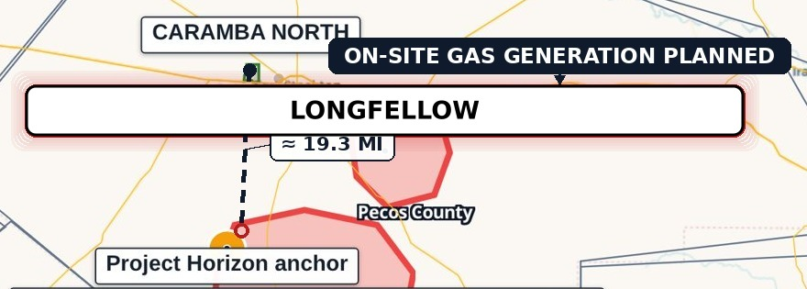
FEATURE · LONGFELLOW
A second phased gas-generation campus twenty miles south — the corridor's demand for on-site power isn't one project deep.
19.3 mi
On-site natural-gas generation planned: aero-derivative turbines with SCR and carbon-capture capability; closed-loop cooling on permitted non-potable groundwater. Originally announced Oct 2025 as a 2 GW campus. Status: phase-1 site work underway; on-site generation build planned in phases. No confirmed ERCOT queue position or TCEQ air-permit record found for this site as of Aug 2026.
FROM CARAMBA NORTH
568 ac
SITE, PECOS COUNTY
8 phases
Distances are measured edge-to-edge, tract boundary to disclosed site location, not centroid-to-centroid. Longfellow's own public materials describe the location as more than 25 miles outside Fort Stockton, consistent with the longer figure here — this distance is not represented as shorter.
250 MW EACH, ORIGINALLY ANNOUNCED
CARAMBA NORTH — STRICTLY CONFIDENTIAL, POST-NDA
9

Slide 10

THE CORRIDOR IS ALREADY BUILT
79.3% of the two profiled anchors' combined announced capacity is already under construction — the regional pipeline is majority-built, not majority-speculative.
79.3%
20.7%
GW RANCH — UNDER CONSTRUCTION
LONGFELLOW — PLANNED / PHASE-1
Basis: GW Ranch's 7.65 GW TCEQ-permitted capacity is under construction; Longfellow's originally announced 2 GW campus is in planned/phase-1 status. Figures reflect announced capacity among the two profiled anchors, not the full regional pipeline.
CARAMBA NORTH — STRICTLY CONFIDENTIAL, POST-NDA
10

Slide 11

WHY THIS MATTERS NOW
The region around Caramba North sits inside a state-level interconnection queue so large it triggered a regulatory pause — the demand signal is real enough to have created a policy problem.
474 GW
226 GW
63 GW
END OF 2024
NOV 2025 — NEARLY QUADRUPLED IN A YEAR
AUG 2026 — STATEWIDE BACKLOG, ~90% DATA-CENTER-DRIVEN
Sources: Latitude Media, “ERCOT's large load queue has nearly quadrupled in a single year” (Dec 3, 2025); Utility Dive, “Facing an estimated 474 GW of interconnection requests, Texas hits pause on data centers” (Aug 2026). Aug 3, 2026 gubernatorial directive ordered an audit of all ERCOT-queue data centers and paused the “Batch Zero” large-load review process pending that audit.
CARAMBA NORTH — STRICTLY CONFIDENTIAL, POST-NDA
11

Slide 12

THE DILIGENCE PLATFORM
Every figure in this document is independently re-derivable from a cited public source — this isn't a broker's summary.
11
Weekly
Monthly
CITED PUBLIC SOURCE DATASETS
RRC REFRESH CADENCE
ERCOT QUEUE / TPIT REFRESH
Every point, line, and boundary traces to a cited public dataset (ERCOT GIS Report/TPIT, PUCT, EIA-860, TCEQ, RRC dbf900/production/W-1, FracFocus, Middle Pecos GCD, HIFLD, USGS, BTS, Census TIGER), with per-feature source popups. EIA/USGS/OSM layers refresh annually. Static, versioned build; deployed bundle byte-verified on release; access logged.
lrp-tx-gis.netlify.app — access credentials issued to the deal team separately.
CARAMBA NORTH — STRICTLY CONFIDENTIAL, POST-NDA
12

Slide 13

SUBSURFACE & DRILLING ACTIVITY
Pecos County has the lowest new-drilling count of seven comparable Permian counties since 2020 — a 90%-below-peer-average level of activity, not merely “quiet.”
115
1,181
0
NEW-DRILL WELLS, PECOS CO. SINCE 2020
PEER AVERAGE, SIX COMPARABLE COUNTIES
NEW-DRILL WELLS WITHIN 5 MI OF THE TRACT
Zero new-drill wells within 2 miles of the tract since 2020; zero within 5 miles; one within 10 miles (9.37 mi away). Within 10 miles, 83% of non-plugged wellbores are marginal/end-of-life production, versus 60% at ≤ 2 mi and 62% at ≤ 5 mi — the closer ring is even quieter than the wider one.
CARAMBA NORTH — STRICTLY CONFIDENTIAL, POST-NDA
13

Slide 14

NOTICES
Not a speculative land bet — a parcel positioned to benefit from a buildout already underway, without carrying the exposure of being the marginal, unproven project in the queue.
This Confidential Offering Memorandum has been prepared solely for the use of a limited number of prospective counterparties, under executed non-disclosure agreement, in connection with the potential acquisition of, or investment in, the Caramba North property. It is delivered on a strictly confidential basis and may not be reproduced or distributed without consent.
This document does not constitute an offer to sell or a solicitation of an offer to buy any security or interest. Information is preliminary and indicative, compiled from sources believed reliable, and subject to revision without notice.
Public data is drawn from ERCOT, PUCT, EIA, TCEQ, RRC, FracFocus, Middle Pecos GCD, HIFLD, USGS, BTS, and U.S. Census TIGER. Third-party transaction and market news is drawn from public reporting cited inline or in the companion source register. Recipients should conduct their own independent investigation, including consultation with their own legal, tax, accounting, and engineering advisors.
CARAMBA NORTH — STRICTLY CONFIDENTIAL, POST-NDA
14

