Slide 1
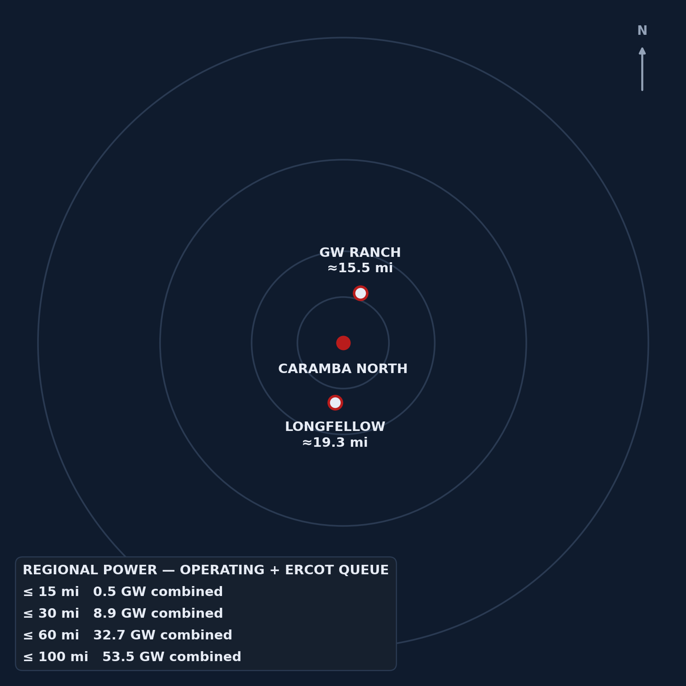
STRICTLY CONFIDENTIAL · OFFERING MEMORANDUM
CARAMBA NORTH
A 1,300-acre powered land position on the same north–south line as two hyperscale-scale power campuses — 15.5 and 19.3 miles out — inside a 32.7 GW regional cluster already forming around it.
PECOS COUNTY, TEXAS · FAR WEST ERCOT · PERMIAN BASIN · I-10 CORRIDOR
1,300
47,418
15 mi
20 mi
32.7 GW
CONTIGUOUS ACRES
AF/YR WATER RIGHTS
TO 765 KV SOLSTICE SUB
TO WAHA GAS HUB
OPERATING + QUEUE, ≤60 MI
Prepared by Land Resource Partners · lrp-tx-gis.netlify.app
2026-08-24 · Institutional deck
Exhibit — regional power-gravity, radius rings from the tract.
CARAMBA NORTH · CONFIDENTIAL OFFERING MEMORANDUM
1

Slide 2

















CONTENTS
Eighteen sections, property through appendix
Every stat in this deck traces to the source register in the closing appendix — this is a data-room summary, not a broker narrative.
03 Investment Thesis
11 Feature — Longfellow
04 Executive Summary
12 Water
05 The Property
13 Natural Gas
06 Transmission
14 Macro Context — ERCOT Backlog
07 Regional Power Cluster
15 The Diligence Platform
08 Ring Analysis / Power-Gravity
16 Subsurface & Drilling Activity
09 Regional Data-Center Pipeline
17 Appendix — Distances & Sources
10 Feature — GW Ranch (Amazon)
18 Important Notices
CARAMBA NORTH · CONFIDENTIAL OFFERING MEMORANDUM
2

Slide 3
03 · INVESTMENT THESIS
Inside the corridor, not adjacent to it
Two hyperscale-scale projects — 7.65 GW and 2 GW — sit on the same north–south line through the property at 15.5 and 19.3 miles; the region's own numbers do the selling, not the site's.
Caramba North is not a speculative land bet — it is a 1,300-acre parcel sitting inside an already-forming power and data-center corridor. The region's own numbers do the selling: 32.7 GW of operating and queued power capacity within 60 miles, in a state where the interconnection backlog just got large enough to trigger a gubernatorial audit and a queue-processing pause. Caramba North is positioned to benefit from the same infrastructure buildout without carrying the exposure of being the marginal, unproven project in that queue — it already has water and gas under contract-ready terms, not just an application.
1,300
15.5 mi
19.3 mi
32.7 GW
47,418
79.3%
MAX CONTIGUOUS ACRES
TO GW RANCH, EDGE-TO-EDGE
TO LONGFELLOW, EDGE-TO-EDGE
OPERATING + QUEUE, ≤60 MI
AF/YR WATER, CONTRACT-READY
OF ANNOUNCED LOCAL MW UNDER CONSTRUCTION
CARAMBA NORTH · CONFIDENTIAL OFFERING MEMORANDUM
3

Slide 4
04 · EXECUTIVE SUMMARY
The numbers across every diligence track, on one page
Ten figures spanning land, transmission, power, water, and gas — each sourced to the underlying data model, none of them estimated.
1,300
47,418
15 mi
20 mi
12.0 GW
CONTIGUOUS ACRES, NORTH OF I-10
AF/YR WATER PERMITTED
TO 765 KV SOLSTICE SUBSTATION
TO WAHA GAS HUB
ERCOT QUEUE, PECOS CO. ALONE
32.7 GW
15.5 mi
19.3 mi
79.3%
474 GW
OPERATING + QUEUE, ≤60 MI RADIUS
TO GW RANCH (7.65 GW PERMIT)
TO LONGFELLOW (2 GW PLANNED)
OF LOCAL ANNOUNCED MW UNDER CONSTRUCTION
STATEWIDE ERCOT BACKLOG, AUG 2026
CARAMBA NORTH · CONFIDENTIAL OFFERING MEMORANDUM
4

Slide 5
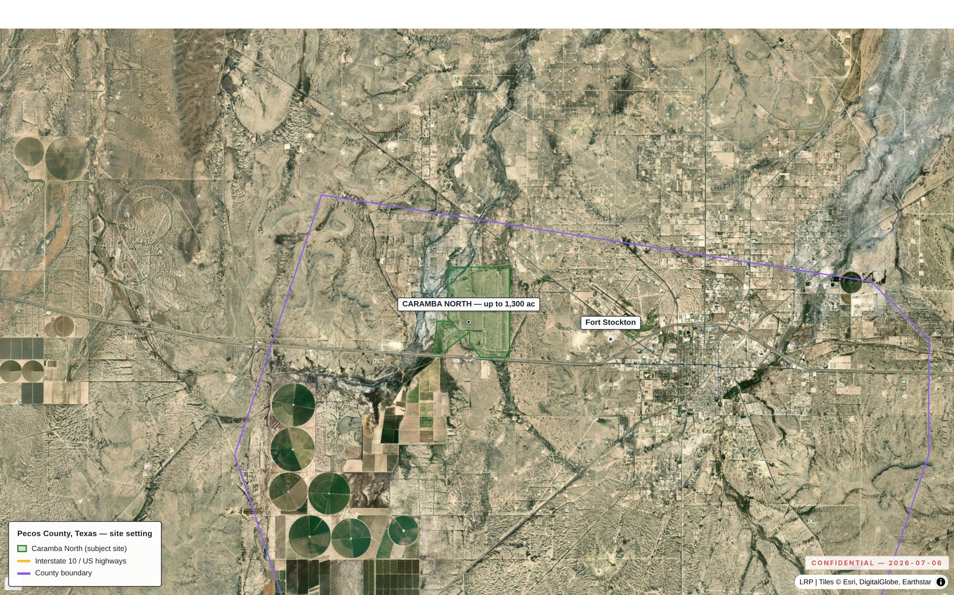
05 · THE PROPERTY
As-of-right industrial land, five miles from Fort Stockton
No zoning ordinance inside ERCOT's fastest-growing large-load pocket — a permitting-timeline story, not a rezoning story.
ATTRIBUTE | DETAIL
Size / configuration | Up to 1,300 contiguous acres, north side of I-10
Access | Direct I-10 frontage; long-haul fiber and rail proximate
Municipal services | Fort Stockton, ~5 mi — services and regional airport
Land-use regime | No zoning ordinance; industrial/energy uses as of right
ERCOT weather zone | Far West — ERCOT's highest-growth large-load pocket
County | Pecos County, Texas
Exhibit 2.1 — the Caramba North tract on the north side of I-10, five miles from Fort Stockton.
CARAMBA NORTH · CONFIDENTIAL OFFERING MEMORANDUM
5

Slide 6
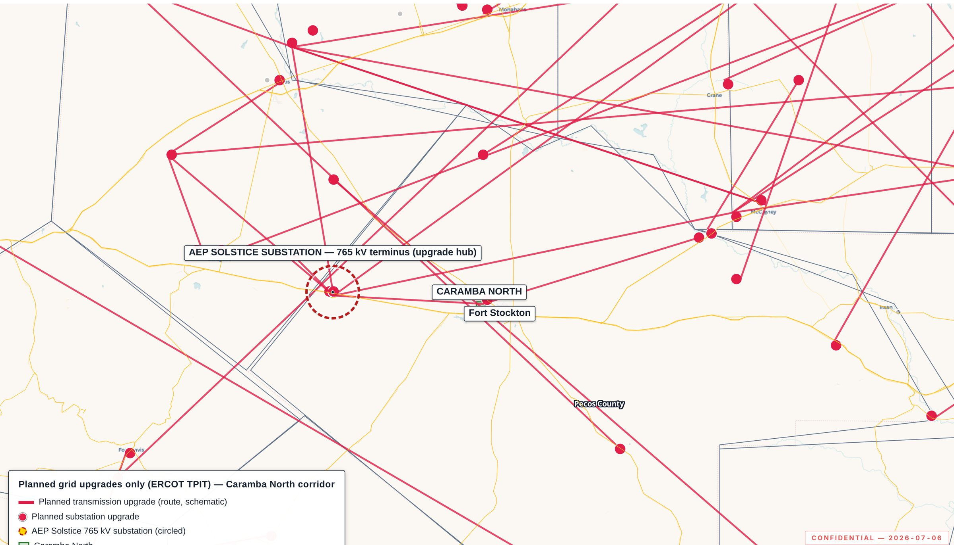
06 · TRANSMISSION
Fifteen miles from the delivery point of all three approved 765 kV lines
The transmission decision is already made, upstream of this site — six local substations sit within ten miles.
ELEMENT | DISTANCE | DETAIL
Solstice Substation (AEP/CPS Energy) | 15 mi | Terminus of 3 PUCT-approved 765 kV Permian import paths (No. 55718, Apr 24 2025)
Fort Stockton Plant | 2 mi | 138 kV/69 kV
Airport | 3.3 mi | 138 kV
Fort Stockton | 5.4 mi | 69 kV
16th Street | 6 mi | 138 kV/69 kV
Northern Natural | 7 mi | 69 kV/4 kV
Gomez | 9.7 mi | 69 kV/25 kV
TPIT pipeline, ERCOT-wide | — | 141 substation + 133 line upgrades tracked (planned, not yet built)
Exhibit 3.1 — planned grid upgrades only (ERCOT TPIT); Solstice terminus circled.
CARAMBA NORTH · CONFIDENTIAL OFFERING MEMORANDUM
6

Slide 7
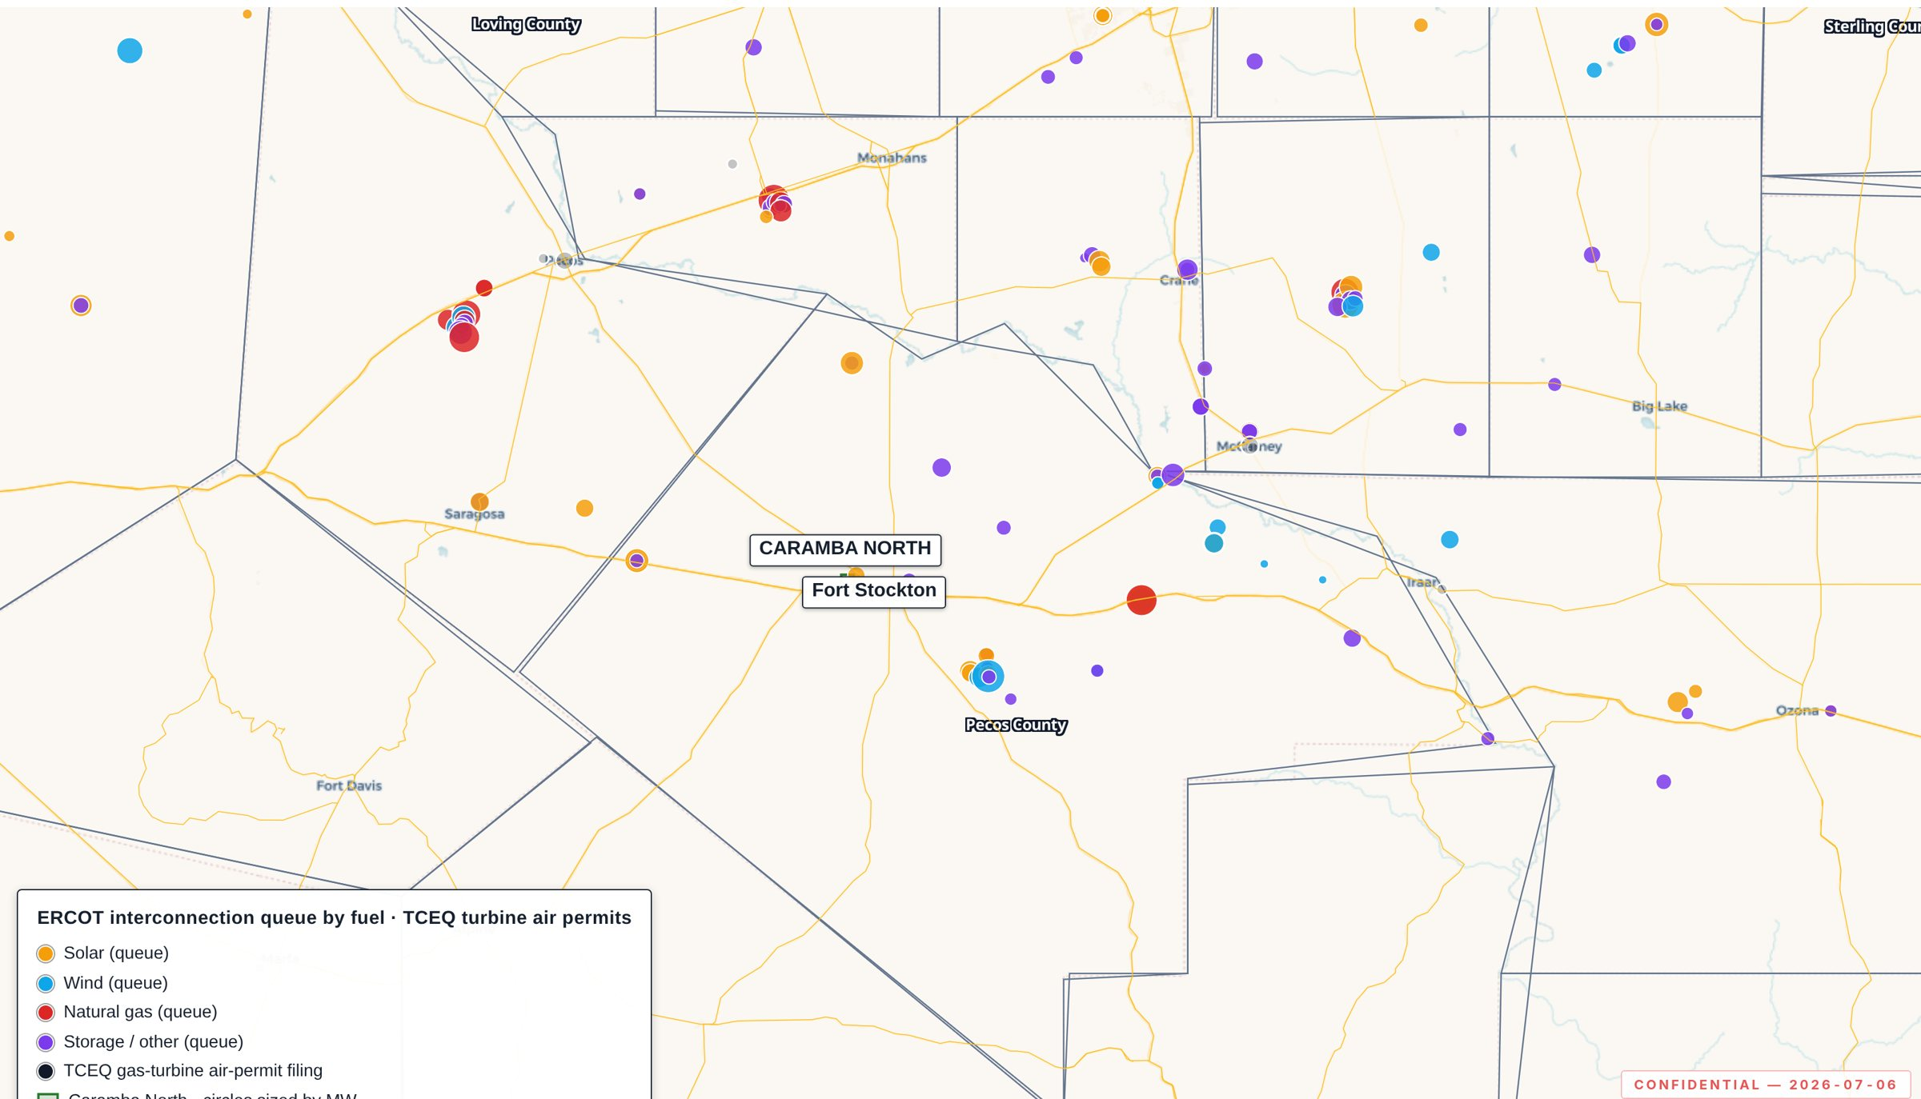
07 · REGIONAL POWER CLUSTER
12.0 GW already queued in Pecos County alone
Before counting the two hyperscale campuses profiled in the ring-analysis and feature pages — adjacent counties add 24,585 MW more.
TECHNOLOGY | OPERATING | ERCOT QUEUE
Solar | 13 · 2.2 GW | 16 · 6.3 GW
Wind | 5 · 542 MW | 10 · 3.0 GW
BESS | 6 · 505 MW | 11 · 1.4 GW
Gas | 1 · 1 MW | 2 · 1.4 GW
Total, Pecos County | 3.2 GW | 12.0 GW
RING | OPERATING | ERCOT QUEUE
Adjacent 6 counties* | 7.0 GW | 24.6 GW
Within 20 mi (queue only) | — | 13 proj · 3,973 MW
Exhibit 4.1 — operating fleet and ERCOT interconnection queue over one footprint.
*Reeves, Crane, Ward, Upton, Ector, Crockett. Nearest operating storage: St. Gall Energy Storage I, 1.9 mi (103 MW BESS).
CARAMBA NORTH · CONFIDENTIAL OFFERING MEMORANDUM
7

Slide 8
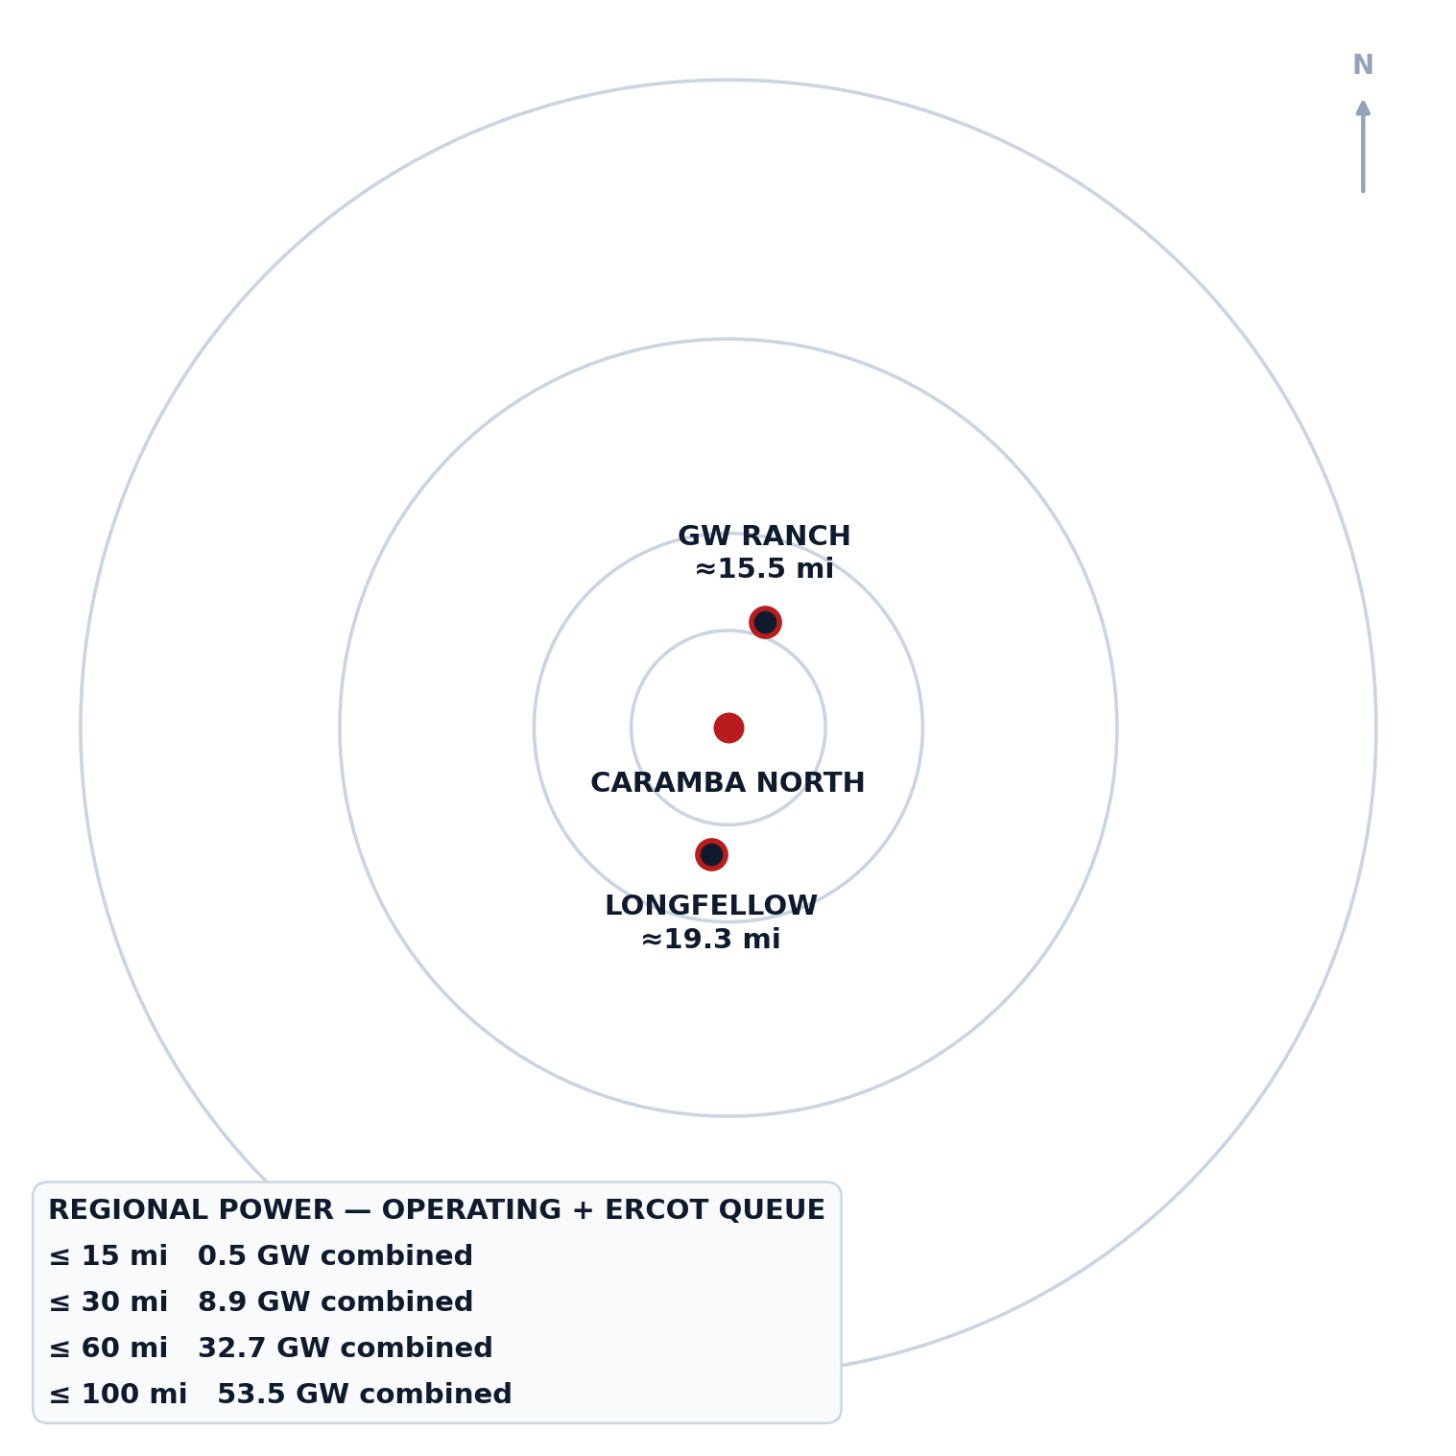
08 · RING ANALYSIS / POWER-GRAVITY
32.7 GW inside 60 miles — measured by radius, not by county line
Region-wide operating + ERCOT-queue capacity, computed from the same EIA-860 and ERCOT-queue layers used throughout — not county-bounded.
RADIUS | OPERATING | ERCOT QUEUE | COMBINED
≤ 15 mi | 0.1 GW | 0.4 GW | 0.5 GW
≤ 30 mi | 1.2 GW | 7.7 GW | 8.9 GW
≤ 60 mi | 6.3 GW | 26.4 GW | 32.7 GW
≤ 100 mi | 11.8 GW | 41.7 GW | 53.5 GW
Bearing: GW Ranch sits almost due north (~19°) and Longfellow almost due south (~188°) of Caramba North — the property sits on the north–south line between them, not off to one side.
Maturity: 79.3% of the two anchors' combined announced MW is already under construction (GW Ranch); 20.7% is planned / phase-1 (Longfellow) — the regional pipeline is majority-built, not majority-speculative.
Exhibit — power-gravity diagram: radius rings from Caramba North; GW Ranch and Longfellow at true bearing/distance.
CARAMBA NORTH · CONFIDENTIAL OFFERING MEMORANDUM
8

Slide 9
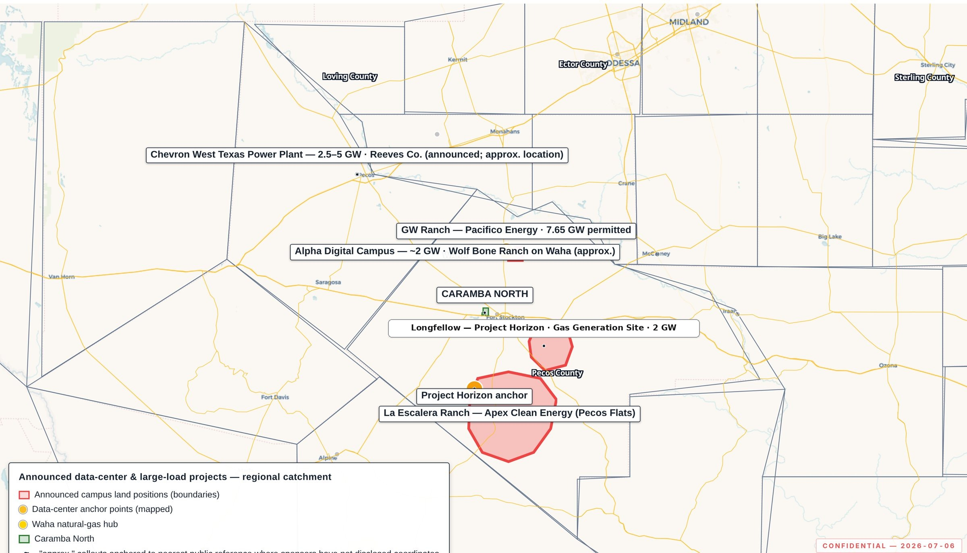
09 · REGIONAL DATA-CENTER PIPELINE
Two anchors, one corridor: 9.7 GW of announced capacity within 60 miles
79.3% of that combined capacity is already under construction — the regional pipeline is majority-built, not majority-speculative.
PROJECT | SITE | CAPACITY | STATUS | DISTANCE
GW Ranch | 8,000-ac site, Pecos Co. | 7.65 GW (TCEQ air permit) | Under construction | 15.5 mi
Longfellow | 568-ac site, Pecos Co. | 2 GW planned (8-phase) | Phase-1 site work underway | 19.3 mi
79.3%
20.7%
UNDER CONSTRUCTION (GW RANCH)
PLANNED / PHASE-1 (LONGFELLOW)
Exhibit 7.1 — announced data-center and large-load projects surrounding the site.
Distances are corrected edge-to-edge (tract boundary to disclosed site location) — see the Appendix methodology note.
CARAMBA NORTH · CONFIDENTIAL OFFERING MEMORANDUM
9

Slide 10
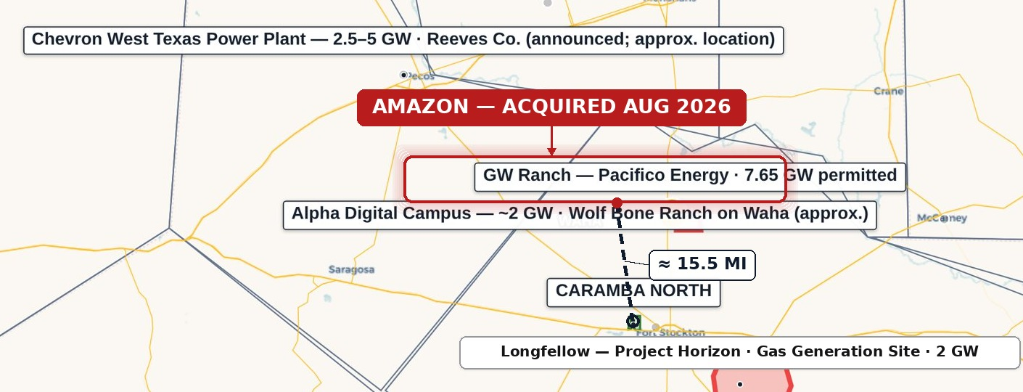
10 · FEATURE — GW RANCH (AMAZON)
The largest air permit issued in the US this year — 15.5 miles up the same corridor
Under construction, not announced: three data-center buildings targeted for completion December 2026.
8,000-acre site, Pecos County
≈ 15.5 miles from Caramba North, edge-to-edge (TCEQ record: "~17 mi north of Fort Stockton on Highway 18").
Amazon disclosed ownership Aug 2026
Pacifico Energy Group remains the power-plant developer/operator.
35 gas turbines · 7.65 GW TCEQ air permit
Largest air permit issued in the US (Jan/Feb 2026), plus 1.8 GW battery storage and up to 750 MW solar.
Exhibit — GW Ranch (highlighted), dashed distance line to Caramba North, ≈ 15.5 mi edge-to-edge. Base map: Exhibit 7.1.
Three 189,000 sq ft data-center buildings
Gensler design, ≈ $300M each; targeted completion Dec 2026; ≈ $12B estimated total project investment.
Clarification — the 7.65 GW figure is a TCEQ generation air permit, not an ERCOT interconnection queue position; Amazon has not disclosed an ERCOT filing and the project is off-grid initially — this sits inside the state-level audit context (slide 14).
CARAMBA NORTH · CONFIDENTIAL OFFERING MEMORANDUM
10

Slide 11
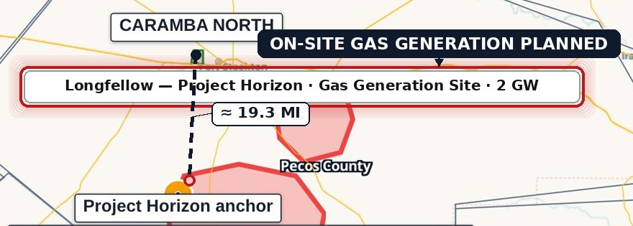
11 · FEATURE — LONGFELLOW
A second phased gas-generation campus, 19.3 miles south
The corridor's demand for on-site power isn't one project deep.
568-acre site, Pecos County
≈ 19.3 miles from Caramba North, edge-to-edge. Longfellow's own public materials describe the location as "more than 25 miles outside of Fort Stockton."
On-site natural-gas generation planned
Aero-derivative turbines with SCR and carbon-capture capability; closed-loop cooling on permitted non-potable groundwater.
Originally announced Oct 2025
Exhibit — Longfellow (highlighted), dashed distance line to Caramba North, ≈ 19.3 mi edge-to-edge. Base map: Exhibit 7.1.
A 2 GW, 8-phase campus (250 MW/phase).
Status: phase-1 site work underway
On-site generation build planned in phases.
Permitting status — no confirmed ERCOT queue position or TCEQ air-permit record was found for this site as of Aug 2026 — stated here as a fact about permitting status, not as commentary on the project's viability.
CARAMBA NORTH · CONFIDENTIAL OFFERING MEMORANDUM
11

Slide 12
12 · WATER
Already permitted: two-thirds of the district's industrial water rights
47,418 AF/yr on adjacent affiliated lands — the water conversation is closed, not open.
ATTRIBUTE | DETAIL
Permitted volume | 47,418 AF/yr (≈ 42.3 MGD)
Position | Adjacent affiliated lands — ≈ two-thirds of all Middle Pecos GCD industrial rights
Source aquifer | Edwards-Trinity (Plateau)
Recharge history | Recharge held through the 1950s drought of record
Groundwater district | Middle Pecos GCD
Permitted use | Industrial — cooling and hyperscale loads
47,418
AF/YR PERMITTED, ADJACENT AFFILIATED LANDS
≈ 2/3
OF ALL MIDDLE PECOS GCD INDUSTRIAL RIGHTS
CARAMBA NORTH · CONFIDENTIAL OFFERING MEMORANDUM
12

Slide 13
13 · NATURAL GAS
A signable 15-year gas quote at Waha basis, twenty miles from the hub
The same structural discount now drawing behind-the-meter generation to this corridor, at GW Ranch and Longfellow alike.
ATTRIBUTE | DETAIL
Distance to hub | 20 mi to Waha
Indicative volume | 200,000 MMBtu/day
Term / pricing | 15-year term, Waha-index pricing (counterparty-supplied)
CIAC | $15–25M
Lead time | 9–15 months
Basis context | Structural discount to Henry Hub; negative Waha prints 2024–2025 as Matterhorn, Blackcomb, Hugh Brinson, and GCX pipelines rebalance Permian egress
20 mi
TO WAHA HUB
15 yr
SIGNABLE INDICATIVE TERM, WAHA-INDEX
CARAMBA NORTH · CONFIDENTIAL OFFERING MEMORANDUM
13

Slide 14
14 · MACRO CONTEXT — ERCOT BACKLOG
The state-level queue got large enough to trigger a regulatory pause
63 GW to 474 GW in under two years — a demand signal real enough to have created a policy problem, a different claim than "this area is growing."
DATE | STATEWIDE QUEUE | DETAIL
End of 2024 | 63 GW | Large-load interconnection queue, statewide
Nov 2025 | 226 GW | ≈ 77% of that load is data centers targeting 2030 interconnection
Aug 2026 | ≈ 474 GW | ≈ 90% data-center-driven; "more than five times Texas' record peak" demand, per Gov. Abbott
Aug 3, 2026: a gubernatorial directive to audit all ERCOT-queue data centers, and a pause of the "Batch Zero" large-load review process pending that audit. The region around Caramba North (32.7 GW within 60 mi) sits inside a state-level queue so large it triggered a regulatory pause.
Source: public reporting, Aug 2026 — Latitude Media, "ERCOT's large load queue has nearly quadrupled in a single year" (Dec 3, 2025); Utility Dive, "Facing an estimated 474 GW of interconnection requests, Texas hits pause on data centers" (Aug 2026).
CARAMBA NORTH · CONFIDENTIAL OFFERING MEMORANDUM
14

Slide 15
15 · THE DILIGENCE PLATFORM
Every figure in this document is independently re-derivable from a cited public source
Not a broker's summary — per-feature source popups, versioned builds, and a logged access record.
PLATFORM PROPERTY | WHY IT MATTERS FOR DILIGENCE
Source-cited features | Every point/line/boundary traces to a cited public dataset; per-feature source popups
Refresh discipline | RRC weekly; ERCOT queue/TPIT monthly; EIA/USGS/OSM annually
Analytical tooling | Filters by county/depth/spud year/fuel/status; time scrubber; measure/share/print tools
Reproducibility | Static, versioned build; deployed bundle byte-verified on release; access logged
lrp-tx-gis.netlify.app · access credentials issued to the deal team separately
CARAMBA NORTH · CONFIDENTIAL OFFERING MEMORANDUM
15

Slide 16
16 · SUBSURFACE & DRILLING ACTIVITY
Pecos: the lowest new-drilling count of seven comparable Permian counties
115 new-drill events since 2020 vs. a 1,181 peer average — roughly 90% below peer average.
0
0
1
83%
NEW-DRILL WELLS ≤ 2 MI SINCE 2020
NEW-DRILL WELLS ≤ 5 MI SINCE 2020
NEW-DRILL WELLS ≤ 10 MI SINCE 2020
NON-PLUGGED WELLBORES ≤10 MI MARGINAL/EOL
BOTTOM LINE
Shallow drilling, hydraulic fracturing, or new drilling of any kind — three independent public records point the same way: it is not happening at or near this site.
Within 10 mi, 83% of non-plugged wellbores are marginal/end-of-life production (vs. 60% at ≤2 mi, 62% at ≤5 mi) — the closer ring is even quieter than the wider one.
CARAMBA NORTH · CONFIDENTIAL OFFERING MEMORANDUM
16

Slide 17
17 · APPENDIX — DISTANCES & SOURCES
Distances are measured edge-to-edge, and every source is named
Boundary-to-site, not centroid-to-centroid — the methodology and the full source register, stated once.
Distance methodology — distances to GW Ranch and Longfellow are measured edge-to-edge — from the nearest point on the Caramba North tract boundary to each site's disclosed location, rather than centroid-to-centroid, which runs measurably longer since the tract itself has spatial extent. GW Ranch: 15.5 mi (vs. 17.3 mi centroid). Longfellow: 19.3 mi (vs. 19.7 mi centroid) — Longfellow's own public site describes its location as more than 25 miles outside Fort Stockton, consistent with the longer figure; this distance is not represented as shorter.
ELEMENT | DETAIL
URL | https://lrp-tx-gis.netlify.app
Login | Business email + access password (issued to deal team separately)
Primary sources | ERCOT (GIS Report, TPIT), PUCT, EIA-860, TCEQ, RRC (dbf900, production, W-1), FracFocus, Middle Pecos GCD, HIFLD, USGS, BTS, U.S. Census TIGER
Refresh cadence | RRC weekly; ERCOT queue/TPIT monthly; EIA/USGS/OSM annually
CARAMBA NORTH · CONFIDENTIAL OFFERING MEMORANDUM
17

Slide 18
IMPORTANT NOTICES
Confidential — prepared for a limited number of counterparties under NDA.
This Confidential Offering Memorandum has been prepared solely for the use of a limited number of prospective counterparties, under executed non-disclosure agreement, in connection with the potential acquisition of, or investment in, the Caramba North property. It is delivered on a strictly confidential basis and may not be reproduced or distributed without consent.
This document does not constitute an offer to sell or a solicitation of an offer to buy any security or interest. Information is preliminary and indicative, compiled from sources believed reliable, and subject to revision without notice. No representation or warranty, express or implied, is made as to accuracy or completeness.
Public data is drawn from ERCOT, PUCT, EIA, TCEQ, RRC, FracFocus, Middle Pecos GCD, HIFLD, USGS, BTS, and U.S. Census TIGER, supplemented by project-level GIS analysis and counterparty-supplied indicative terms. Third-party ownership and permitting disclosures referenced in this deck (e.g., GW Ranch) are drawn from public reporting cited in the companion source register. Recipients should conduct their own independent investigation, including consultation with their own legal, tax, accounting, and engineering advisors.
CARAMBA NORTH · CONFIDENTIAL OFFERING MEMORANDUM
18

