Slide 1
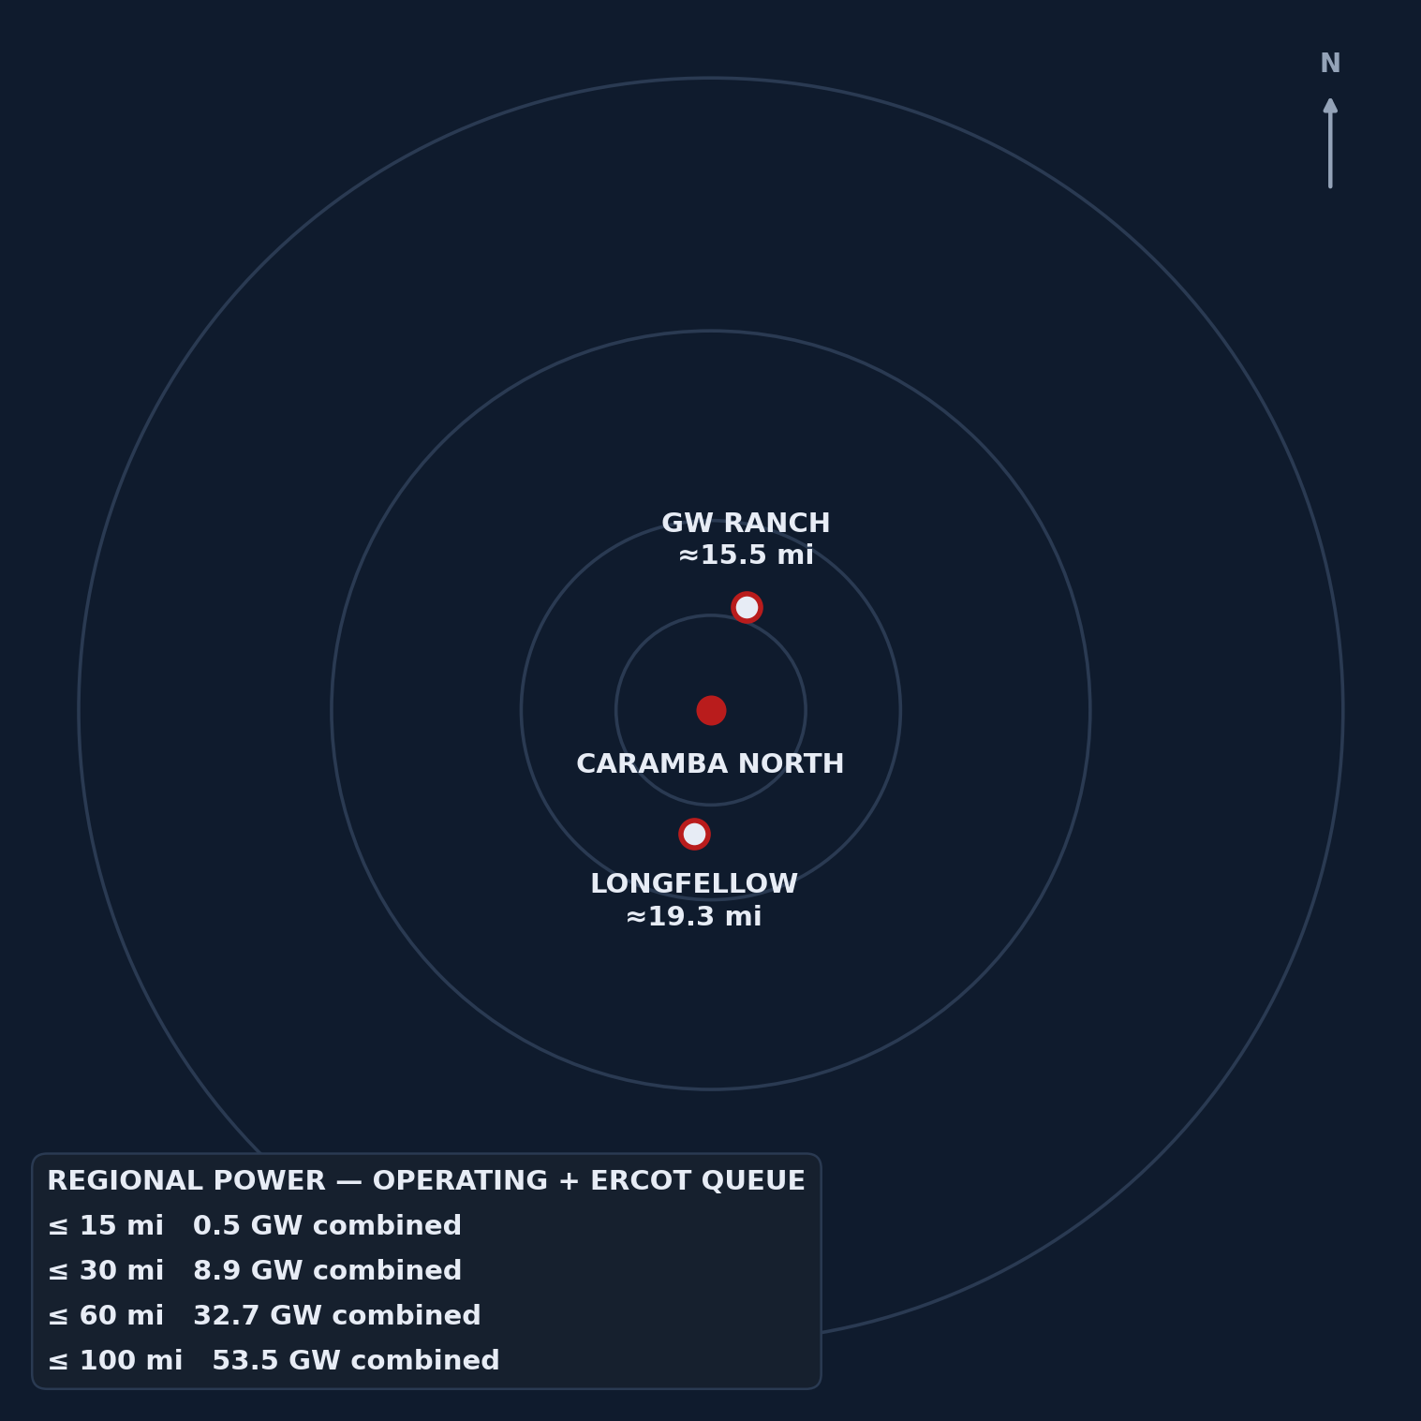
STRICTLY CONFIDENTIAL · OFFERING MEMORANDUM
CARAMBA NORTH
Map-and-Infographic-Led Summary
A 1,300-acre parcel inside an already-forming power and data-center corridor — two hyperscale-scale projects sit on the same north–south line through the property, backed by transmission, water, and gas positions already permitted, not proposed.
1,300
ACRES — THE SITE
≈15.5 MI
GW RANCH — 7.65 GW, UNDER CONSTRUCTION
≈19.3 MI
LONGFELLOW — PHASE-1 SITE WORK UNDERWAY
32.72 GW
OPERATING + QUEUED WITHIN 60 MILES
Prepared by Land Resource Partners · lrp-tx-gis.netlify.app
2026-08-24 · Pecos County, Texas · Far West ERCOT

Slide 2

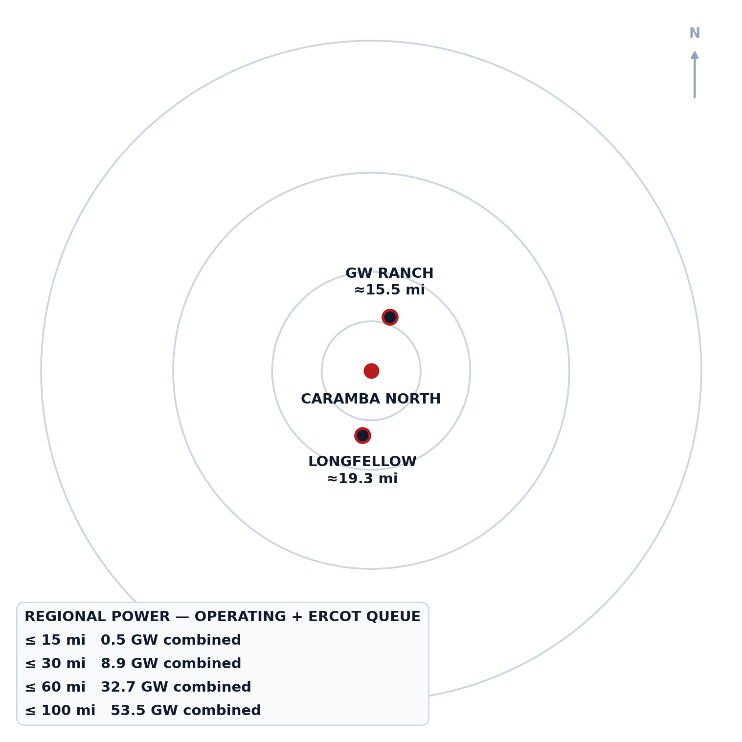
REGIONAL POWER GRAVITY
Caramba North sits inside the gravity well, not outside it
32.72 GW of operating + queued capacity sits within 60 miles — GW Ranch and Longfellow anchor the same north–south line as the tract, at 15.5 and 19.3 miles.
8.9 GW
COMBINED CAPACITY ≤ 30 MI
53.5 GW
0.48 GW
COMBINED CAPACITY ≤ 100 MI
COMBINED CAPACITY ≤ 15 MI
32.72 GW
COMBINED CAPACITY ≤ 60 MI
Bearing from Caramba North: GW Ranch ≈ 19° (near-due north); Longfellow ≈ 188° (near-due south) — the tract sits on the line between them, not off to one side.
CARAMBA NORTH — MAP-LED SUMMARY, CONFIDENTIAL
2

Slide 3

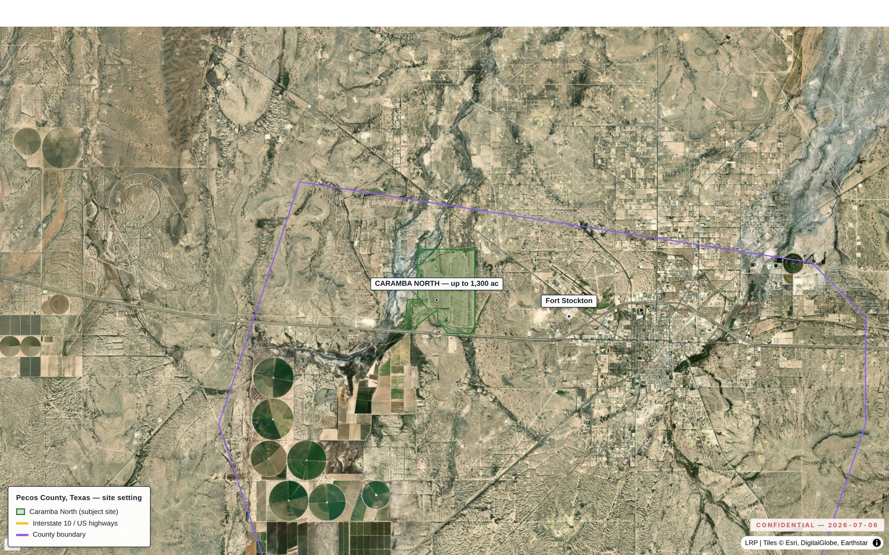
02.1 · THE PROPERTY
As-of-right industrial land, five miles from Fort Stockton
No zoning ordinance and a Far West ERCOT position — this is a use-as-of-right story, not a rezoning story.
1,300
≈5 mi
MAX CONTIGUOUS ACRES
TO FORT STOCKTON (SERVICES, AIRPORT)
No zoning
Far West
INDUSTRIAL / ENERGY USE AS OF RIGHT
HIGHEST-GROWTH LARGE-LOAD POCKET, ERCOT
CARAMBA NORTH — MAP-LED SUMMARY, CONFIDENTIAL
3

Slide 4

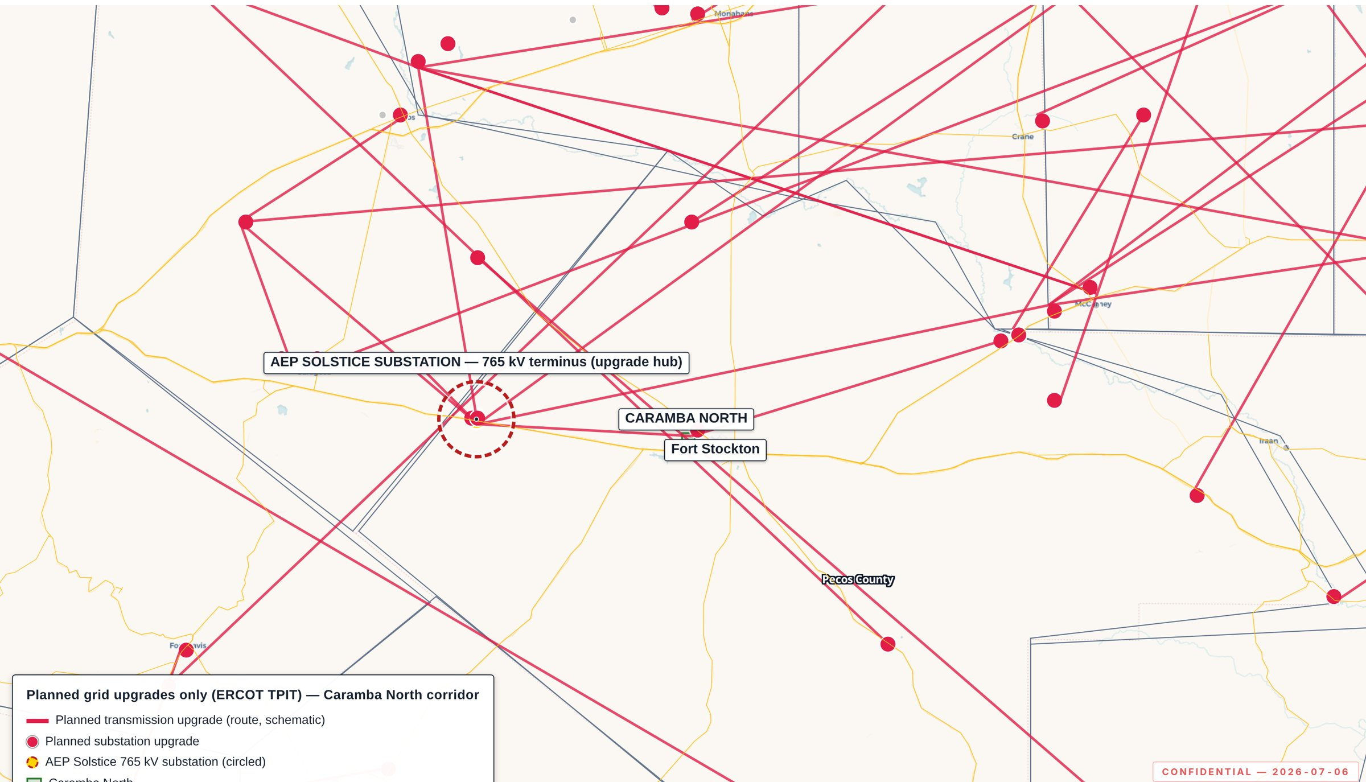
02.2 · TRANSMISSION
Fifteen miles from the western terminus of ERCOT’s 765 kV backbone
The transmission decision is already made, upstream of this site — not a future contingency.
15 mi
6
TO AEP SOLSTICE — WESTERN TERMINUS OF ALL 3 APPROVED 765 KV PERMIAN IMPORT PATHS (PBRP NO. 55718, APR 2025)
LOCAL SUBSTATIONS WITHIN 10 MILES
141 + 133
SUBSTATION + LINE UPGRADES TRACKED ERCOT-WIDE (TPIT PIPELINE)
CARAMBA NORTH — MAP-LED SUMMARY, CONFIDENTIAL
4

Slide 5

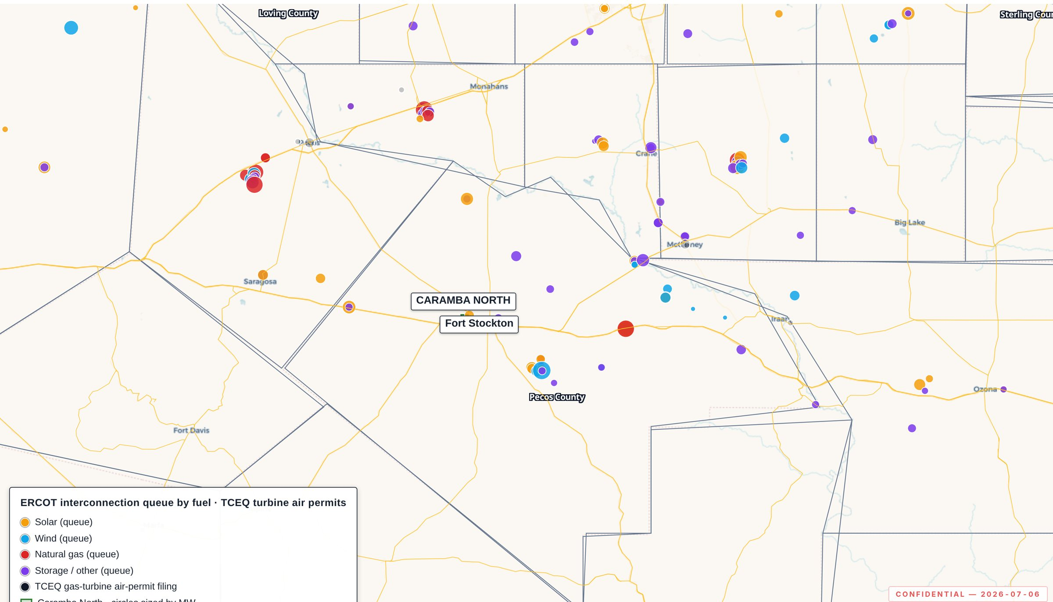
02.3 · REGIONAL POWER CLUSTER
12 GW already queued in Pecos County alone
Before counting the two hyperscale campuses profiled ahead — this is the densest renewable + storage cluster in ERCOT.
3,226 MW
13 · 3,973 MW
OPERATING, PECOS COUNTY
QUEUED PROJECTS WITHIN 20 MILES
12,039 MW
ERCOT QUEUE, PECOS COUNTY
1.9 mi · 103 MW
NEAREST OPERATING STORAGE — ST. GALL ENERGY STORAGE I
CARAMBA NORTH — MAP-LED SUMMARY, CONFIDENTIAL
5

Slide 6


02.4 / 02.5 · WATER & NATURAL GAS
Water and gas positions that are already closed, not open
Two-thirds of the district’s industrial water rights, and a signable 15-year Waha-basis gas quote, sit on this position today.
200,000 MMBtu/d
47,418 AF/yr
15-YR TERM · WAHA-INDEX PRICING
≈ 42.3 MGD — EDWARDS-TRINITY (PLATEAU) AQUIFER
20 MI
WAHA HUB
CARAMBA NORTH
MIDDLE PECOS GCD
$15–25M CIAC
≈ 2/3
LEAD TIME 9–15 MONTHS · COUNTERPARTY-SUPPLIED TERMS
OF ALL MIDDLE PECOS GCD INDUSTRIAL WATER RIGHTS
Basis context: structural discount to Henry Hub, with negative Waha prints in 2024–2025 as Matterhorn, Blackcomb, Hugh Brinson, and GCX rebalance Permian egress.
CARAMBA NORTH — MAP-LED SUMMARY, CONFIDENTIAL
6

Slide 7

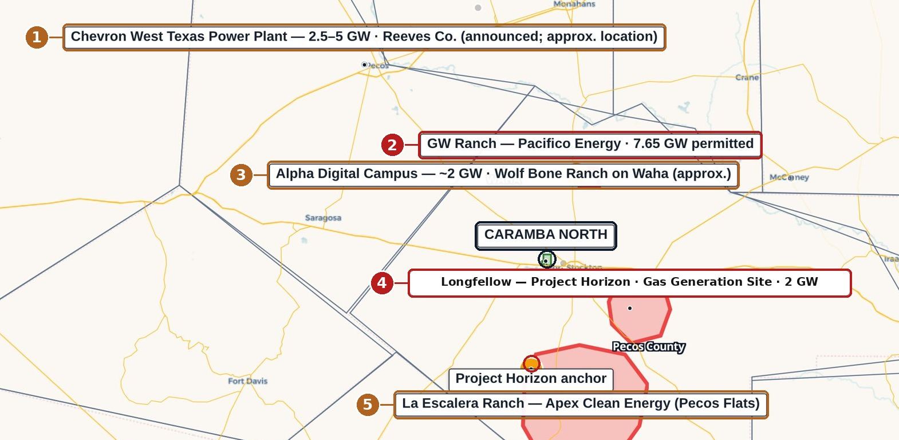
02.6 · REGIONAL DATA-CENTER / POWER PIPELINE
Five projects on one map — the corridor is not a two-project story
The two feature anchors ahead (GW Ranch, Longfellow) sit alongside three more announced positions on the same catchment.
≈ 2 GW
2.5–5 GW
3 · ALPHA DIGITAL CAMPUS (WOLF BONE RANCH)
1 · CHEVRON WEST TEXAS POWER PLANT (ANNOUNCED)
7.65 GW
2 · GW RANCH — UNDER CONSTRUCTION
Pecos Flats
≈19.3 mi
5 · LA ESCALERA RANCH — APEX CLEAN ENERGY
4 · LONGFELLOW — PHASE-1 SITE WORK UNDERWAY
CARAMBA NORTH — MAP-LED SUMMARY, CONFIDENTIAL
7

Slide 8

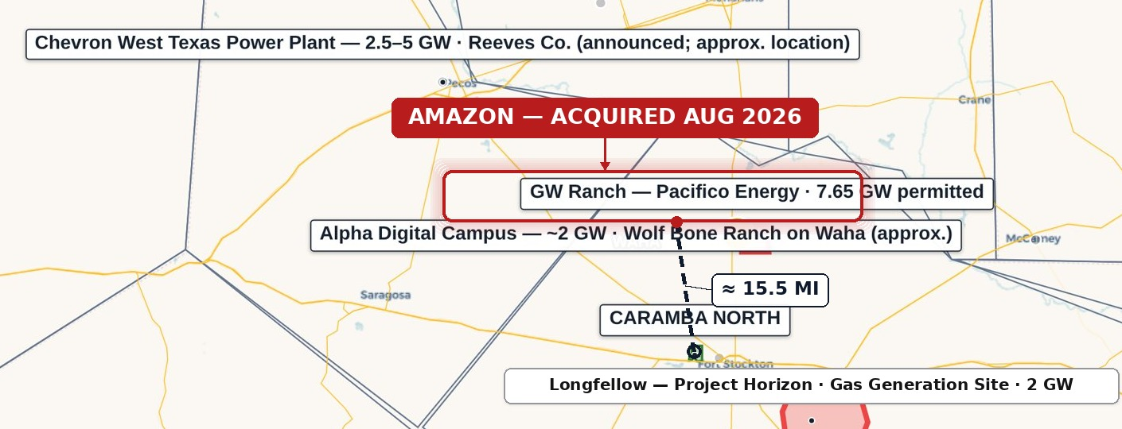
FEATURE · AMAZON / GW RANCH
GW Ranch — ≈ 15.5 miles from Caramba North
The largest air permit issued in the US this year sits up the same highway corridor — under construction, not announced.
7.65 GW
1.8 GW + 750 MW
3 buildings
≈ $12B
TCEQ AIR PERMIT — LARGEST ISSUED IN THE US (JAN/FEB 2026)
BATTERY STORAGE · SOLAR, ALONGSIDE 35 GAS TURBINES
189,000 SQ FT EACH (GENSLER) — TARGETED DEC 2026
ESTIMATED TOTAL PROJECT INVESTMENT
Under construction — 79.3% of the two profiled anchors’ combined announced MW. Clarification: the 7.65 GW figure is a TCEQ generation air permit, not an ERCOT interconnection queue position; the site is off-grid initially and subject to the Aug 3, 2026 state data-center permitting pause pending audit.
CARAMBA NORTH — MAP-LED SUMMARY, CONFIDENTIAL
8

Slide 9

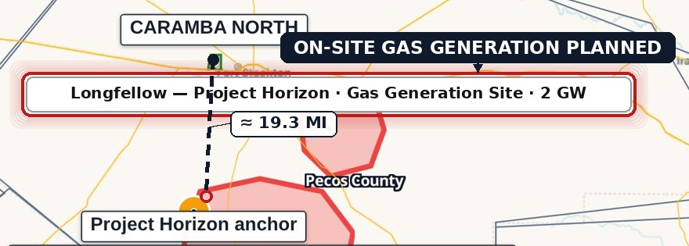
FEATURE · LONGFELLOW
Longfellow — ≈ 19.3 miles from Caramba North
A second phased gas-generation campus twenty miles south — the corridor’s demand for on-site power isn’t one project deep.
568 acres
≈ 19.3 mi
On-site gas
Phase-1 underway
PECOS COUNTY SITE (LONGFELLOW RANCH)
FROM CARAMBA NORTH, EDGE-TO-EDGE
AERO-DERIVATIVE TURBINES PLANNED, SCR + CARBON-CAPTURE CAPABILITY
SITE WORK UNDERWAY; GENERATION BUILD PLANNED IN PHASES
Closed-loop cooling on permitted non-potable groundwater. No confirmed ERCOT interconnection queue position or TCEQ air-permit record found for this site as of Aug 2026 — a fact about permitting status, not commentary on viability.
CARAMBA NORTH — MAP-LED SUMMARY, CONFIDENTIAL
9

Slide 10

02.6 · PROJECT-MATURITY FRAMING
The regional pipeline is majority-built, not majority-speculative
Of the two profiled anchors’ combined announced capacity, four-fifths is already under construction.
79.3% · 7.65 GW
GW RANCH — UNDER CONSTRUCTION, FIRST POWER TARGETED H1 2027
20.7%
79.3%
LONGFELLOW — PLANNED / PHASE-1 SITE WORK UNDERWAY, OF COMBINED ANNOUNCED CAPACITY
under construction
2 of 2
PROFILED ANCHORS WITHIN 60 MILES — THE PIPELINE IS NOT ONE PROJECT DEEP, AND MOST OF IT IS ALREADY POURED CONCRETE, NOT A RENDERING
CARAMBA NORTH — MAP-LED SUMMARY, CONFIDENTIAL
10

Slide 11

STATE-LEVEL CONTEXT
A queue large enough to trigger a state audit
The demand signal is real enough to have created a policy problem — a different claim than “this area is growing.”
474 GW
226 GW
63 GW
ERCOT large-load queue, end of 2024
ERCOT large-load queue, Nov 2025 — ~77% data centers targeting 2030
Statewide backlog, Aug 2026 (~90% data-center-driven)
The region around Caramba North (32.72 GW within 60 mi) sits inside a queue so large it triggered an Aug 3, 2026 directive to audit all ERCOT-queue data centers and pause the “Batch Zero” large-load review process.
Source class: public reporting, Aug 2026 — Latitude Media (Dec 3, 2025); Utility Dive (Aug 2026). Full citations in the source register.
CARAMBA NORTH — MAP-LED SUMMARY, CONFIDENTIAL
11

Slide 12

02.8 · SUBSURFACE & DRILLING ACTIVITY
No new drilling is occurring at or near the site
Pecos County has the lowest new-drill count of seven comparable Permian counties since 2020 — ~90% below the peer average.
115
NEW-DRILL WELLS, PECOS, SINCE 2020 — VS. PEER AVG 1,181
0
NEW-DRILL WELLS ≤ 5 MILES OF THE TRACT SINCE 2020
83%
OF NON-PLUGGED WELLBORES ≤ 10 MI ARE MARGINAL / END-OF-LIFE
1 of 7
COUNTIES THIS QUIET — PECOS IS THE LOWEST OF ALL SEVEN COMPARABLE PERMIAN COUNTIES BY A WIDE MARGIN
CARAMBA NORTH — MAP-LED SUMMARY, CONFIDENTIAL
12

Slide 13

02.7 · THE DILIGENCE PLATFORM
Every figure is independently re-derivable from a cited source
This isn’t a broker’s summary — every point, line, and boundary traces to a public dataset with a per-feature source popup.
Weekly
ERCOT
RRC REFRESH CADENCE
HIFLD
PUCT
Monthly
ERCOT QUEUE / TPIT REFRESH
Mid. Pecos GCD
EIA-860
Annually
EIA / USGS / OSM REFRESH
GIS PLATFORM
Byte-verified
FracFocus
TCEQ
STATIC, VERSIONED BUILD — ACCESS LOGGED
RRC
lrp-tx-gis.netlify.app · access credentials issued to the deal team separately
CARAMBA NORTH — MAP-LED SUMMARY, CONFIDENTIAL
13

Slide 14
IMPORTANT NOTICES
This Confidential Offering Memorandum has been prepared solely for the use of a limited number of prospective counterparties, under executed non-disclosure agreement, in connection with the potential acquisition of, or investment in, the Caramba North property. It is delivered on a strictly confidential basis and may not be reproduced or distributed without consent.
This document does not constitute an offer to sell or a solicitation of an offer to buy any security or interest. Information is preliminary and indicative, compiled from sources believed reliable, and subject to revision without notice. No representation or warranty, express or implied, is made as to accuracy or completeness.
Public data is drawn from ERCOT (GIS Report, TPIT), PUCT, EIA-860, TCEQ, RRC (dbf900, production, W-1), FracFocus, Middle Pecos GCD, HIFLD, USGS, BTS, and U.S. Census TIGER, supplemented by project-level GIS analysis and counterparty-supplied indicative terms. Distances to GW Ranch and Longfellow are measured edge-to-edge — tract boundary to disclosed site location — not centroid-to-centroid; see the companion source register for the full methodology note. Third-party transaction items are drawn from public reporting cited in the companion source register. Recipients should conduct their own independent investigation, including consultation with their own legal, tax, accounting, and engineering advisors.
CARAMBA NORTH — MAP-LED SUMMARY, CONFIDENTIAL
14

