Slide 1
CONFIDENTIAL OFFERING MEMORANDUM
CARAMBA NORTH
A 1,300-acre parcel inside an already-forming power and data-center corridor — two hyperscale-scale projects sit on the same north-south line through the property, backed by transmission, water, and gas positions that are already permitted, not proposed.
PECOS COUNTY, TEXAS · FAR WEST ERCOT · I-10 CORRIDOR
2026-08-24 · Executive read — five minutes

Slide 2
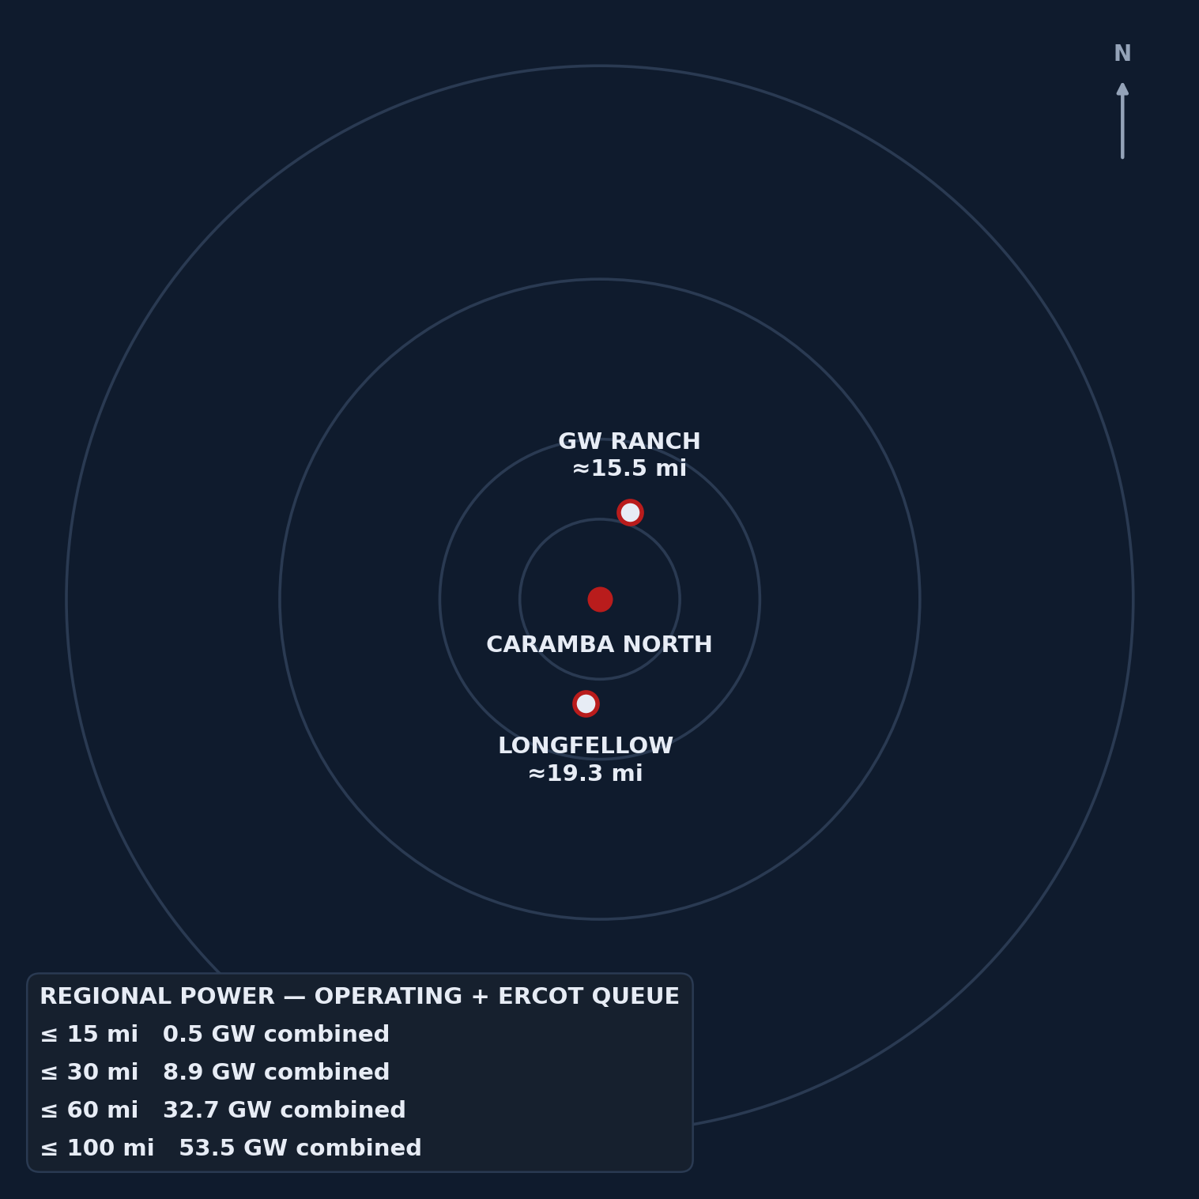
02 / THE REGIONAL SIGNAL
32.7 GW sits within 60 miles.
Caramba North is inside that radius, not adjacent to it — and the two feature anchors on the following pages sit on the same north-south line through the property.
By Aug 2026 ERCOT's statewide interconnection backlog reached ≈474 GW (≈90% data-center-driven) — large enough to trigger a gubernatorial audit and a pause of large-load queue review (public reporting, Aug 2026).
CARAMBA NORTH — CONFIDENTIAL
2

Slide 3
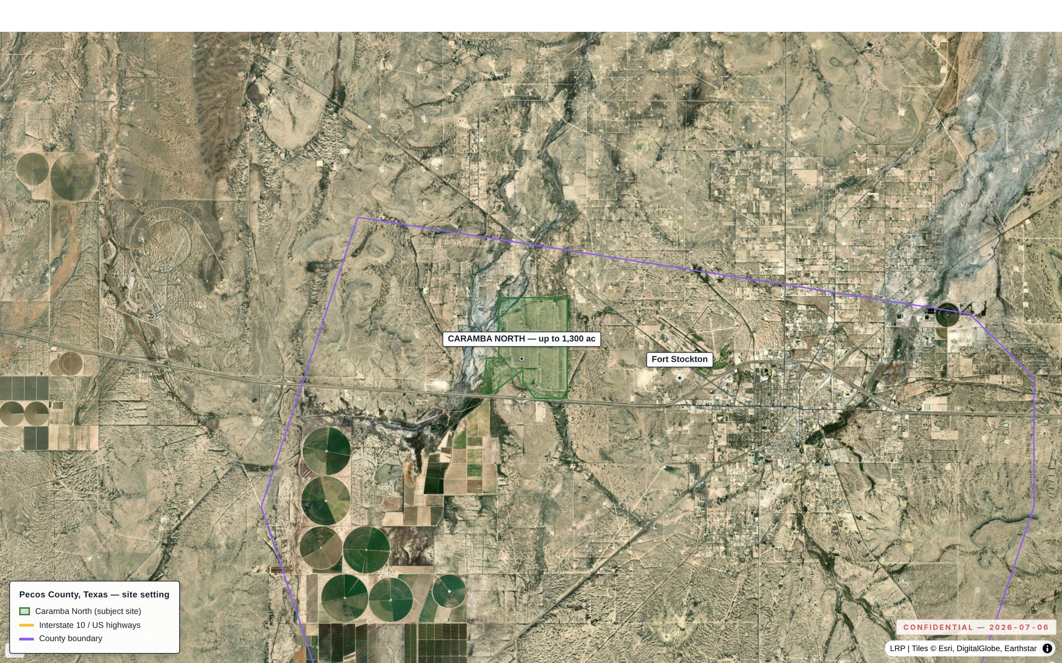
03 / THE PROPERTY
As-of-right industrial land, not a rezoning story.
1,300 contiguous acres on I-10, five miles from Fort Stockton, in ERCOT's fastest-growing large-load pocket — with no zoning ordinance standing between this site and use.
Site setting, I-10 corridor
1,300
0
~5 mi
CONTIGUOUS ACRES
ZONING ORDINANCES
TO FORT STOCKTON
CARAMBA NORTH — CONFIDENTIAL
3

Slide 4
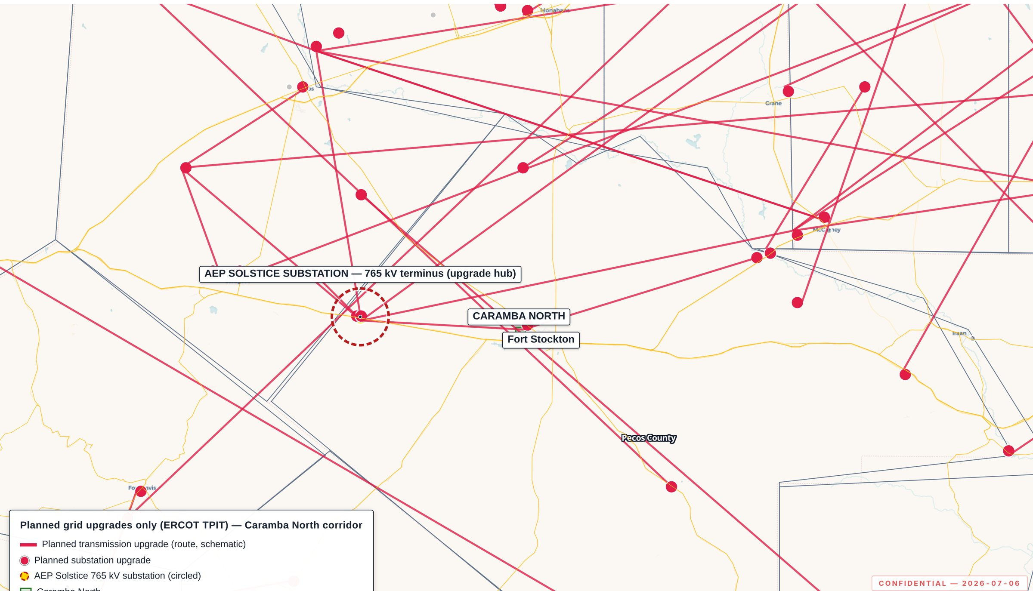
04 / TRANSMISSION
The transmission decision is already made.
Fifteen miles from the delivery point of all three PUCT-approved 765 kV Permian import paths — this site sits downstream of a decision, not upstream of a proposal.
Planned grid upgrades (ERCOT TPIT)
15 mi
3
141
TO SOLSTICE SUBSTATION
APPROVED 765 KV IMPORT PATHS
SUBSTATION UPGRADES, ERCOT TPIT
CARAMBA NORTH — CONFIDENTIAL
4

Slide 5
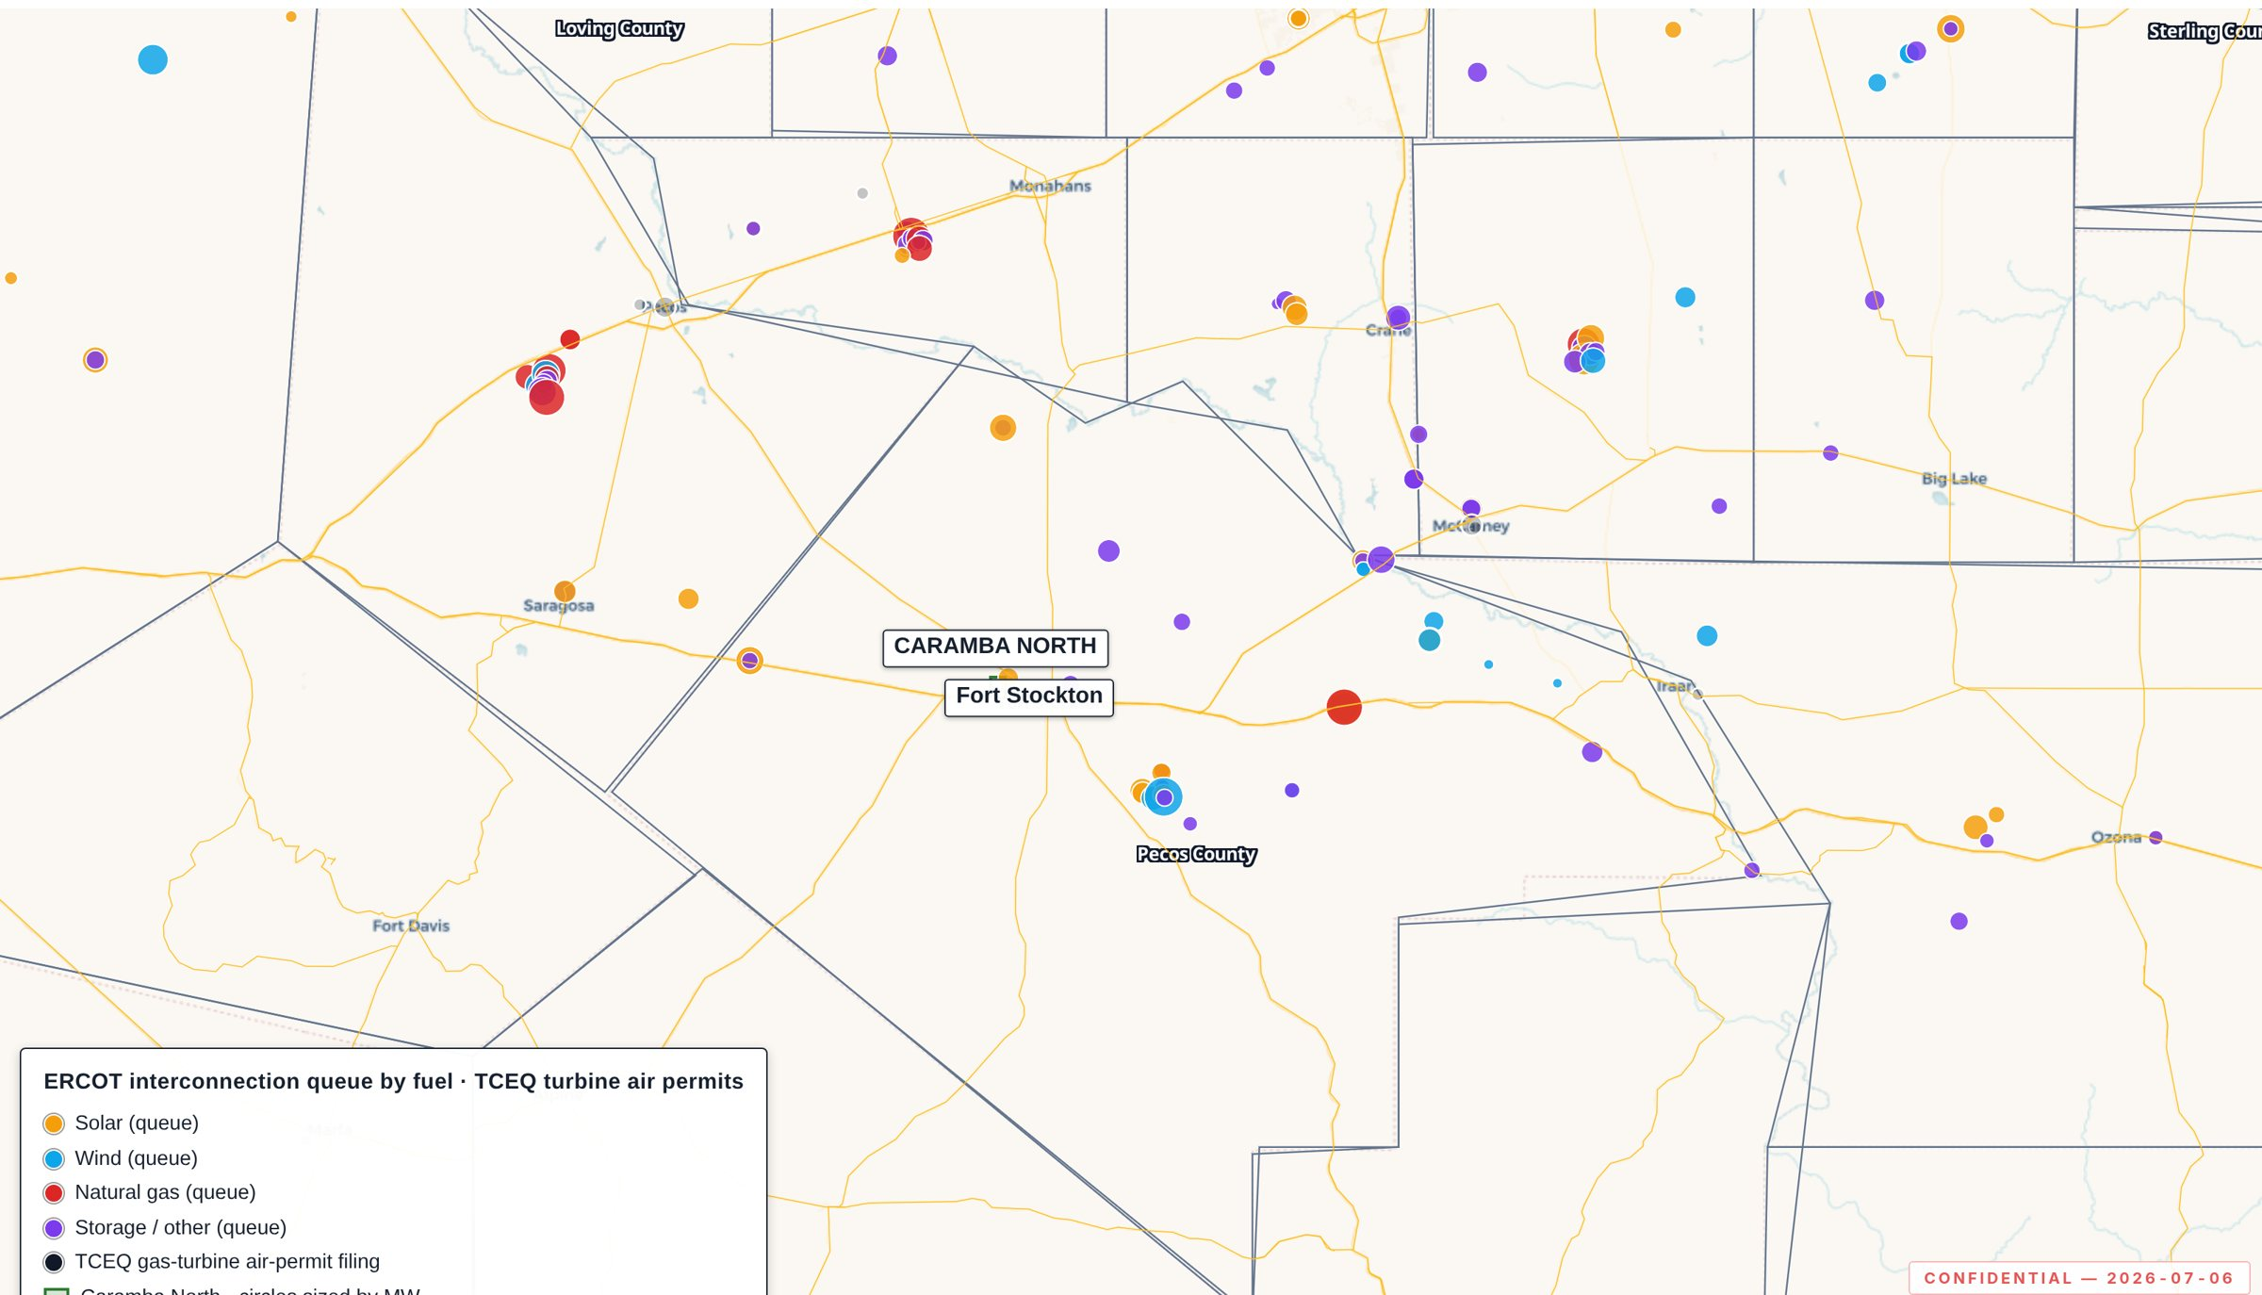
05 / REGIONAL POWER CLUSTER
12,039 MW is already queued in Pecos County alone.
That's before counting the two hyperscale campuses profiled next — the cluster is county-deep before it is corridor-wide.
Operating fleet + ERCOT queue
3.2 GW
12.0 GW
24.6 GW
OPERATING, PECOS CO.
ERCOT QUEUE, PECOS CO.
QUEUED, 6 ADJACENT COUNTIES
CARAMBA NORTH — CONFIDENTIAL
5

Slide 6

06 / WATER
The water conversation is closed, not open.
47,418 AF/yr — roughly two-thirds of all Middle Pecos GCD industrial water rights — is already permitted on adjacent affiliated lands, drawn from Edwards-Trinity (Plateau) aquifer recharge held through the 1950s drought of record.
47,418
≈ 2/3
AF/YR PERMITTED (≈42.3 MGD)
OF DISTRICT INDUSTRIAL RIGHTS
CARAMBA NORTH — CONFIDENTIAL
6

Slide 7

07 / NATURAL GAS
A signable gas quote, at a structural discount.
Twenty miles to Waha, with an indicative 200,000 MMBtu/day, 15-year, Waha-index supply quote already in hand — the same basis discount now drawing behind-the-meter generation to this corridor.
20 mi
200,000
15 yr
TO WAHA HUB
MMBTU/DAY, QUOTED
INDICATIVE TERM
CARAMBA NORTH — CONFIDENTIAL
7

Slide 8
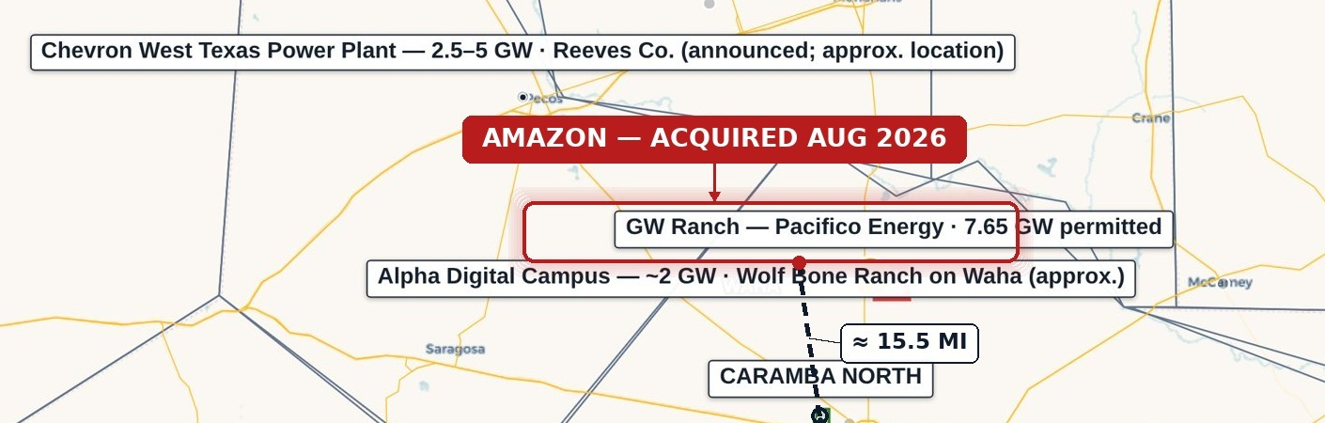
08 / FEATURE — GW RANCH (AMAZON)
The largest air permit issued in the US this year — fifteen miles up the same highway.
Under construction, not announced: 7.65 GW of TCEQ-permitted gas generation on an 8,000-acre site, disclosed as Amazon-owned in August 2026.
15.5 mi
7.65 GW
79.3%
FROM CARAMBA NORTH
TCEQ AIR PERMIT
OF ANCHOR MW U/C
CARAMBA NORTH — CONFIDENTIAL
8

Slide 9
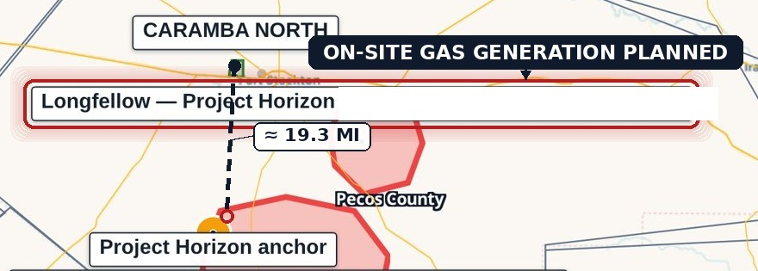
09 / FEATURE — LONGFELLOW
A second phased gas-generation campus, twenty miles south.
On-site natural-gas generation planned — aero-derivative turbines with SCR and carbon-capture capability, closed-loop cooling on permitted non-potable groundwater. Phase-1 site work is underway; the corridor's demand for on-site power is not one project deep.
19.3 mi
2 GW
20.7%
FROM CARAMBA NORTH
ORIGINAL 8-PHASE DESIGN
OF ANCHOR MW, PHASE-1
CARAMBA NORTH — CONFIDENTIAL
9

Slide 10

10 / SUBSURFACE & DRILLING
The lowest new-drilling count of seven comparable Permian counties.
Pecos County: 115 new-drill wells since 2020, against a peer average of 1,181 — roughly 90% below peer average, with zero new-drill wells within five miles of the tract.
115
1,181
≈ 90%
NEW-DRILL WELLS, PECOS, SINCE 2020
PEER-COUNTY AVERAGE
BELOW PEER AVERAGE
CARAMBA NORTH — CONFIDENTIAL
10

Slide 11

11 / THE DILIGENCE PLATFORM
Every figure here is independently re-derivable.
This isn't a broker's summary — every point, line, and boundary in the underlying GIS platform traces to a cited public dataset (ERCOT, PUCT, EIA-860, TCEQ, RRC, FracFocus, Middle Pecos GCD, HIFLD, USGS, BTS, Census TIGER), refreshed on a fixed cadence and access-logged.
Weekly
Monthly
10+
RRC REFRESH
ERCOT QUEUE / TPIT REFRESH
CITED PUBLIC SOURCE CLASSES
CARAMBA NORTH — CONFIDENTIAL
11

Slide 12
12 / CLOSE
The region does the selling.
32.7 GW within 60 miles, a transmission position already downstream of an approved 765 kV decision, water and gas positions already contracted-ready — Caramba North is positioned to benefit from this buildout without carrying the exposure of being the marginal, unproven project in the queue.
Confidential Offering Memorandum prepared for a limited number of prospective counterparties under NDA. Not an offer to sell or a solicitation of an offer to buy any security. Information is preliminary and indicative, from sources believed reliable; subject to revision. Public data drawn from ERCOT, PUCT, EIA, TCEQ, RRC, FracFocus, Middle Pecos GCD, HIFLD, USGS, BTS, and U.S. Census TIGER; third-party transaction items sourced to public reporting cited in the companion source register.
Prepared by Land Resource Partners · lrp-tx-gis.netlify.app
2026-08-24

