Slide 1


TWG – April 26 2021
Davide Schiavone

Slide 2
CV-X-IF Project Concept
This project is the creation of the specification of the CV-X-IF interface between RISC-V cores and co-processors
Lead within the OpenHW Group Cores TG
CV-X-IF is the specification of a microprocessor-co-processor interface applicable to RISC-V cores (not only CV cores)
Leverages RISC-V ISA encoding
Accelerator-agnostic instruction offloading
Draft v0.1 driven so far by ETH Zurich available on GitHub
https://github.com/pulp-platform/riscv-extension-interface
Now ready to move to OpenHW Group and looking for a Project Manager among members

Slide 3
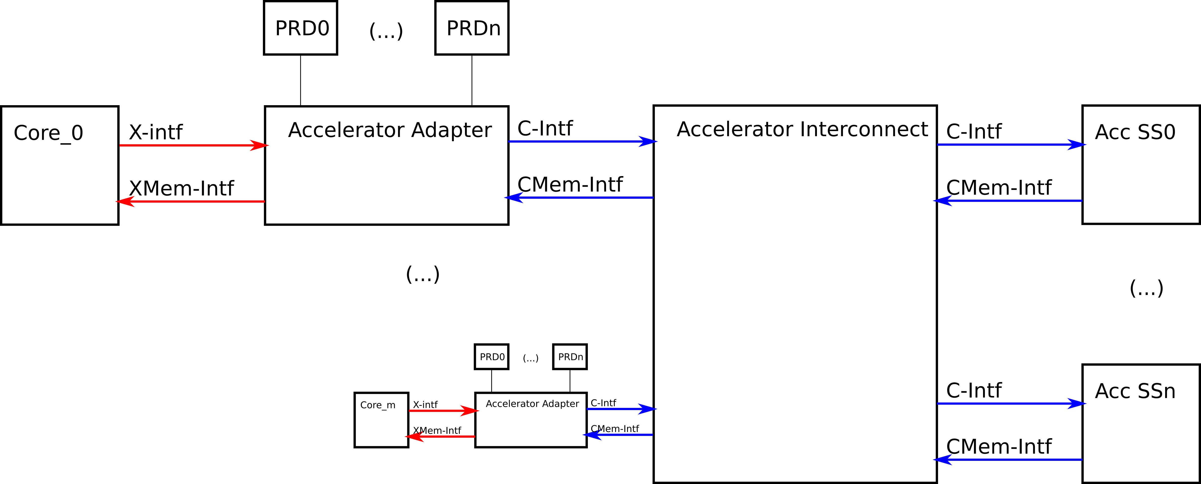
CV-X-IF Spec
Objectives
Provide a unified accelerator interface.
Decouple development of accelerators and CPU cores
Re-use extension accelerators with different cores
Share expensive accelerator units across multiple cores in a cluster

Slide 4






CV-X-IF Project Components: Phase 0
0
Spec definition driven by ETH with inputs from
SiLabs, YosysHQ, and lowRISC
11.2020
0.1
ETH releases v0.1
04.2021

Slide 5

CV-X-IF Project Components: Phase 1
0.1
04.2021
HW implementation feedback
CV32E40P RV32F ext
Ibex for RV32B ext
CV32E40P PULP NN ext
CVA6 RVFD ext
0.9
10.2021

Slide 6

CV-X-IF Project Components: Phase 2
0.9
10.2021
finalization feedback
CV32E40X
Formal Spec
Compilers
1.0
OpenHW Group releases v1.0
06.2022

Slide 7
Join the CV-X-IF Project
Wide technical contribution from members like:
ETH Zurich, SiLabs, YosysHQ, UniBo, Embecosm, [Thales]
Many challenges
agnostic decoding, memory ordering, exceptions, compressed extensions, compilers
Looking for a Manager to direct the project towards its goals among OpenHW Group’s members

